Slide 1
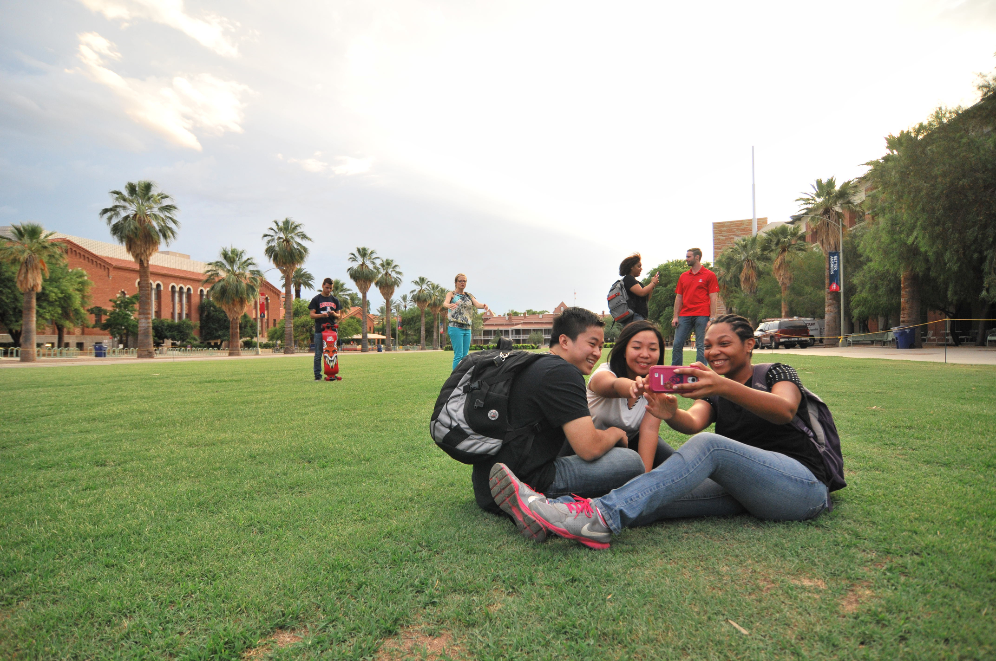
creating kind communities

Slide 2
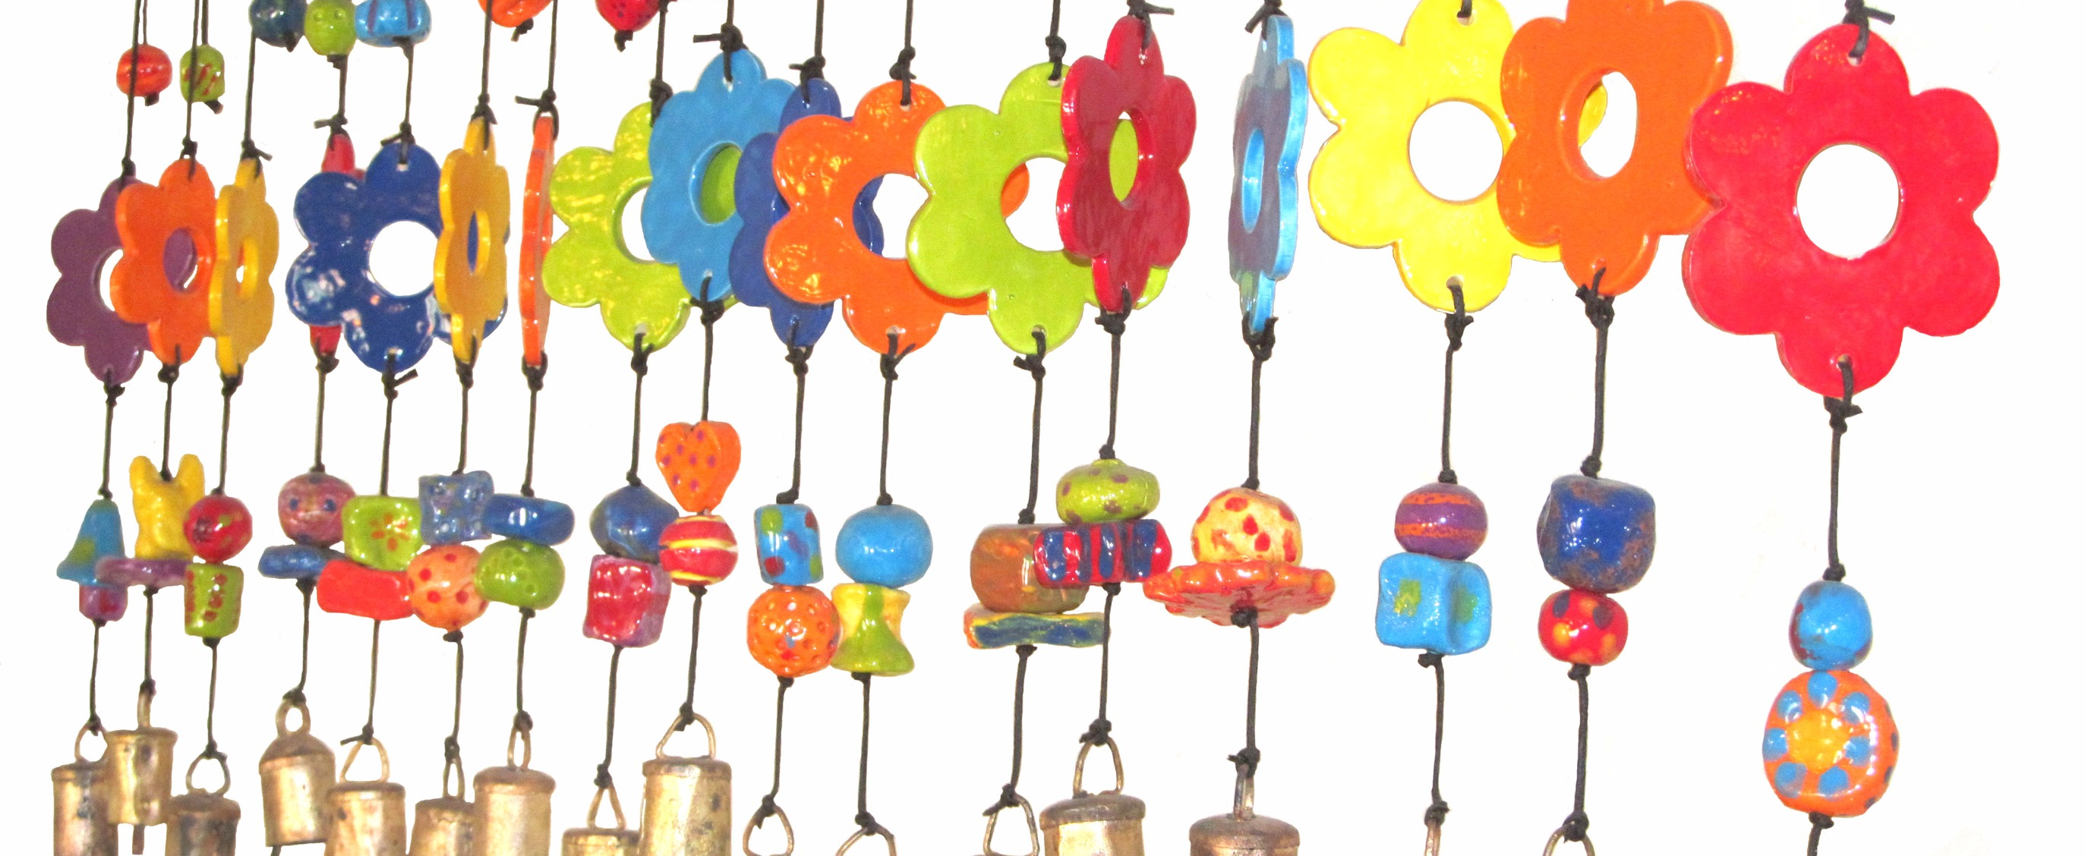

Slide 3
be
KIND
(not nice)

Slide 4
Think about a kindness you’ve experienced.

Slide 5
Think about a kindness you’ve experienced.
How did you know it was kind?

Slide 6
Think about a kindness you’ve experienced.
How did you know it was kind?
What was the outcome of the kindness (or outcomes)?

Slide 7


Slide 8


Slide 9
When you leave here today, you will be able to…

Slide 10
When you leave here today, you will be able to…
Explain the difference between “nice” and “kind”.

Slide 11
When you leave here today, you will be able to…
Explain the difference between “nice” and “kind”.
Explain why kindness is a health behavior.

Slide 12
When you leave here today, you will be able to…
Explain the difference between “nice” and “kind”.
Explain why kindness is a health behavior.
Identify four key determinants (predictors) of kind behavior.

Slide 13
When you leave here today, you will be able to…
Explain the difference between “nice” and “kind”.
Explain why kindness is a health behavior.
Identify four key determinants (predictors) of kind behavior.
Describe individual and community barriers to enacting kind behaviors.

Slide 14
When you leave here today, you will be able to…
Explain the difference between “nice” and “kind”.
Explain why kindness is a health behavior.
Identify four key determinants (predictors) of kind behavior.
Describe individual and community barriers to enacting kind behaviors.
Lead a conversation with your colleagues about increasing kind behavior at work.

Slide 15
Belongingness entails an unwavering commitment to not simply tolerating and respecting difference, but to ensuring that all people are welcome and feel that they belong.
        –John A. Powell, Director of the Othering & Belonging Institute, UC Berkeley

Slide 16
why kindness?

Slide 17
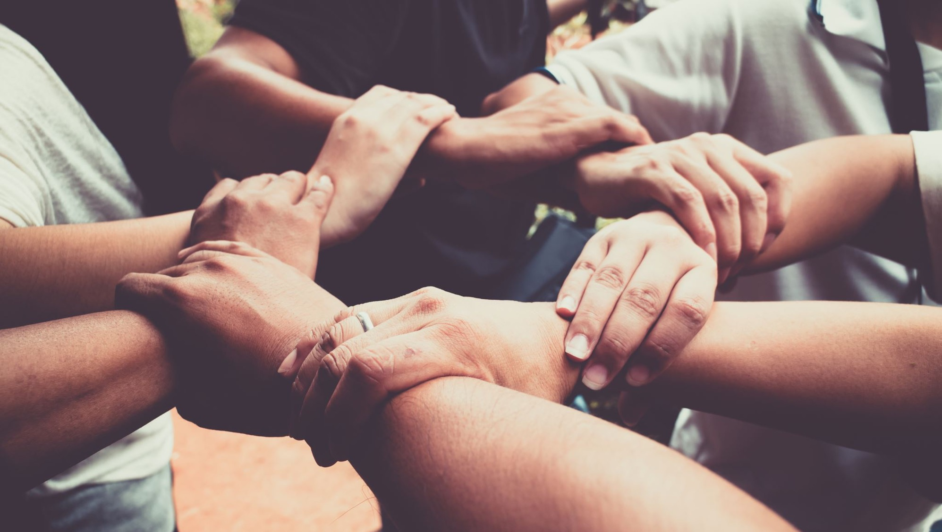
kindness → health & well-being

Slide 18
How did (does) our species survive?

Slide 19
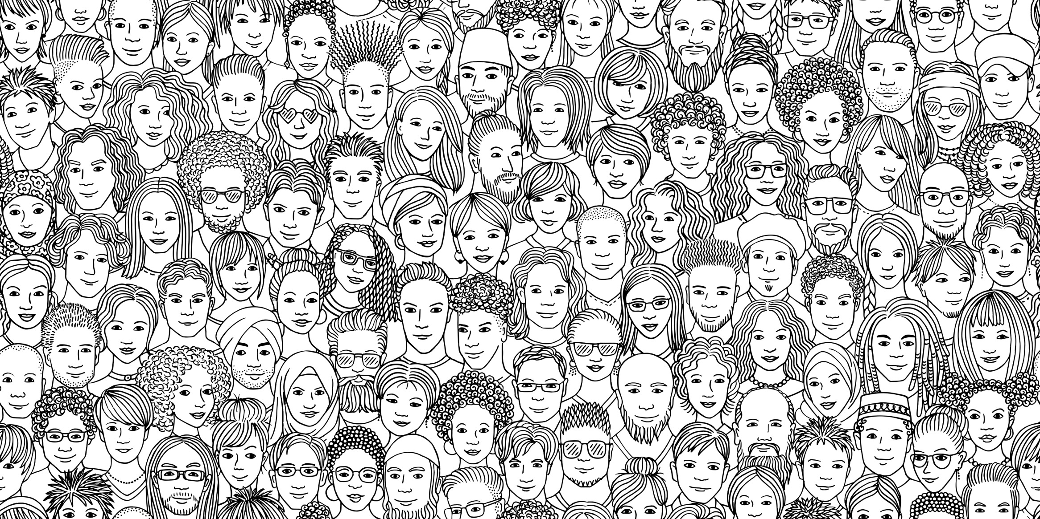
we need
each other!

Slide 21
kindness
communicates
safety

Slide 22
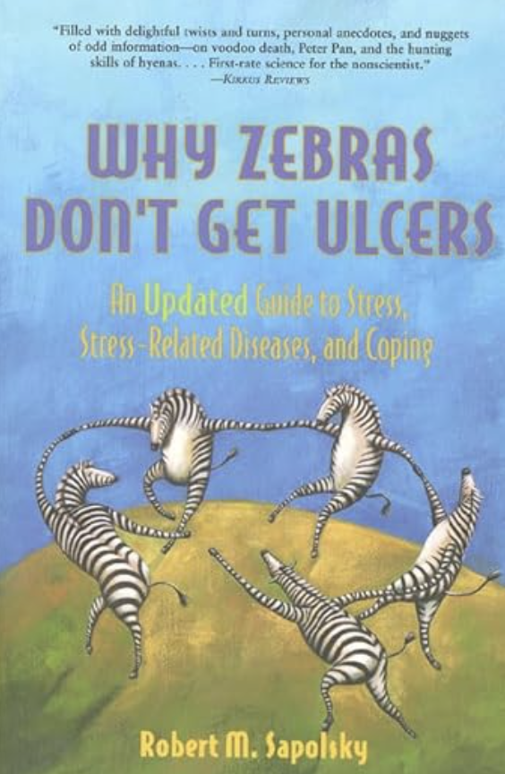

Slide 23
GUTS
generalized unsafety theory of stress

Slide 24
social vigilance

Slide 25
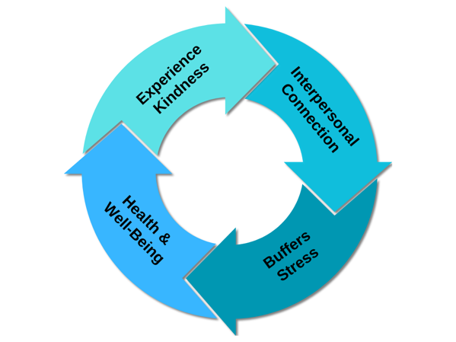

Slide 26
kindness as a
health behavior

Slide 28
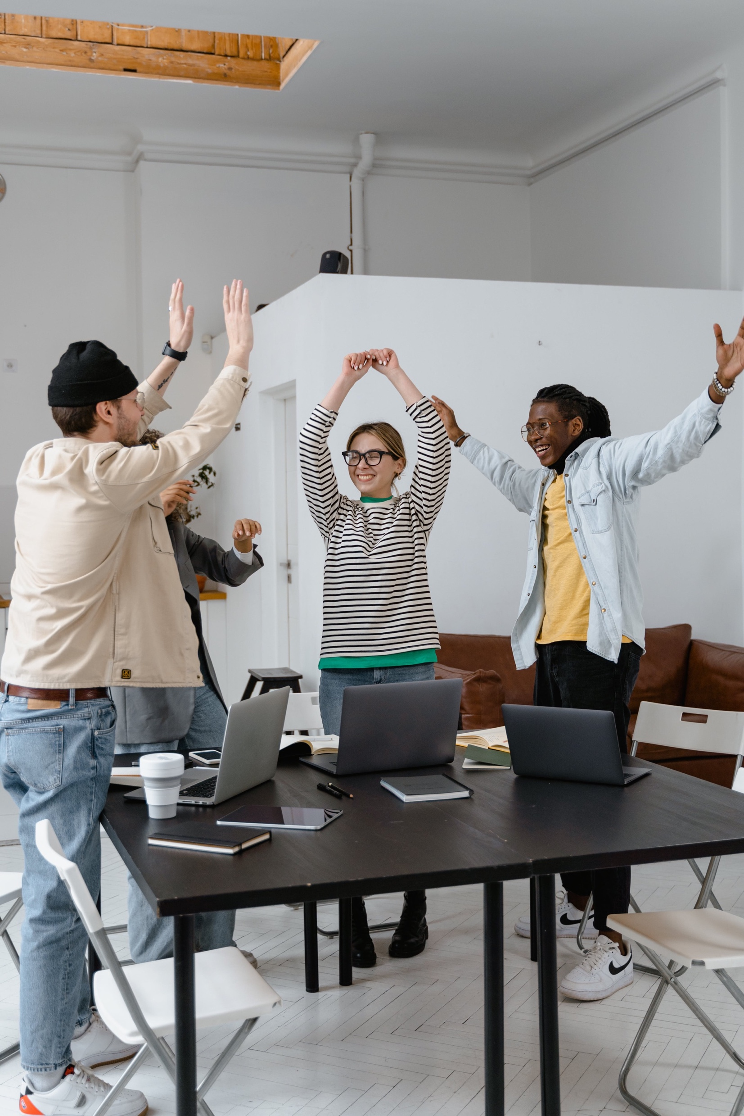
yaaaaaay, kindness!!

Slide 29
practicing kindness: the need

Slide 30
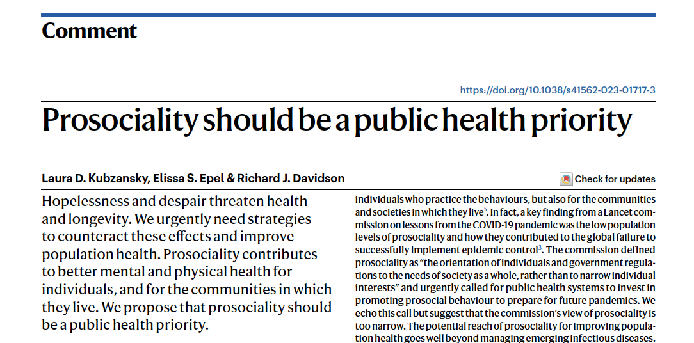

Slide 31
kindness as a
health behavior

Slide 32
kindness as a
health behavior
kindness as a
health equity issue

Slide 33
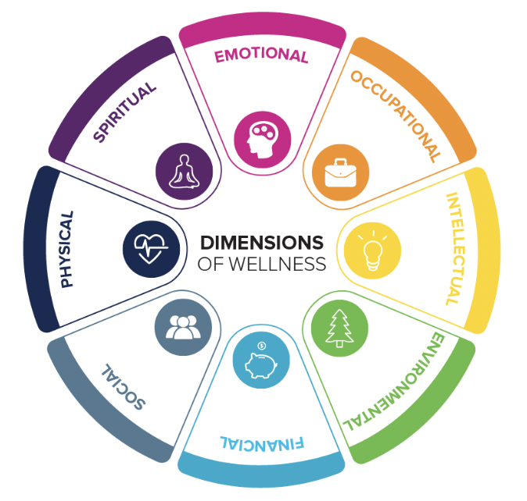

Slide 34
social

Slide 35
practicing kindness: the how

Slide 36


Slide 37




social-
ecological model:
laws
policy
regulations
Community
leaders
systems
culture
environment
Relationships
&
interaction
Individual knowledge, attitudes, skills

Slide 38
context

Slide 39
community of
practice

Slide 40
what determines kind behavior?

Slide 41
what behaviors?

Slide 42
friendly behaviors
communication
effort
inclusive & fair behaviors
helping behaviors
social support behaviors
self-kindness behaviors

Slide 43
what determines kind behavior?

Slide 44
Predictor #1:
attitude

Slide 45
what are some ATTITUDES
about doing kind behavior?

Slide 46
Predictor #2:
norms (context)

Slide 47
who are the
INFLUENCERS
in our community?

Slide 48
attitude toward the behavior?
kind intention
kind behavior
norms?

Slide 49
what can happen between
intention and behavior?
kind intention
kind behavior

Slide 50
intent vs. impact

Slide 51
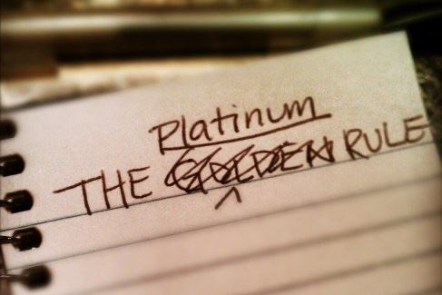
Notes:
We need to up our game from the golden rule – Instead of “treat others the way you want to be treated” work on “treat others the way they want to be treated”.

Slide 52
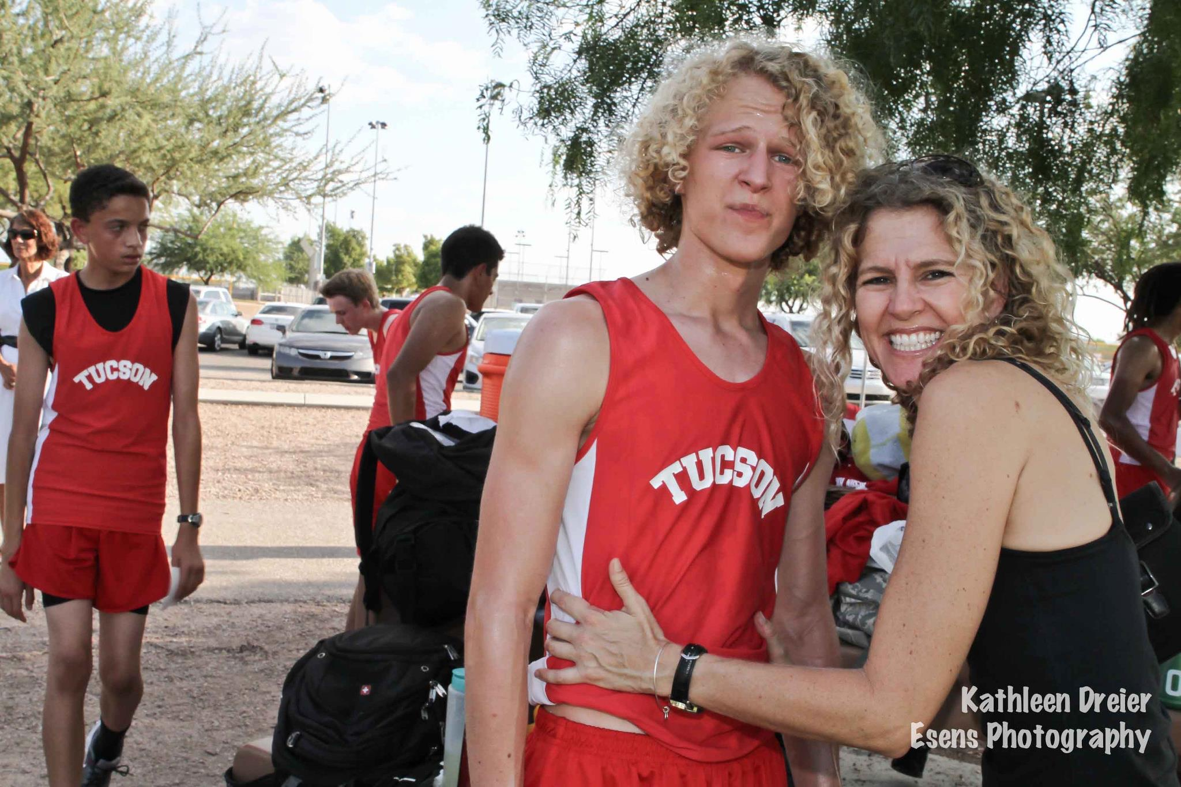

Slide 53
kind intention
kind behavior
positive outcome/
impact

Slide 54
kind intention
unkind behavior
negative outcome/
impact

Slide 55
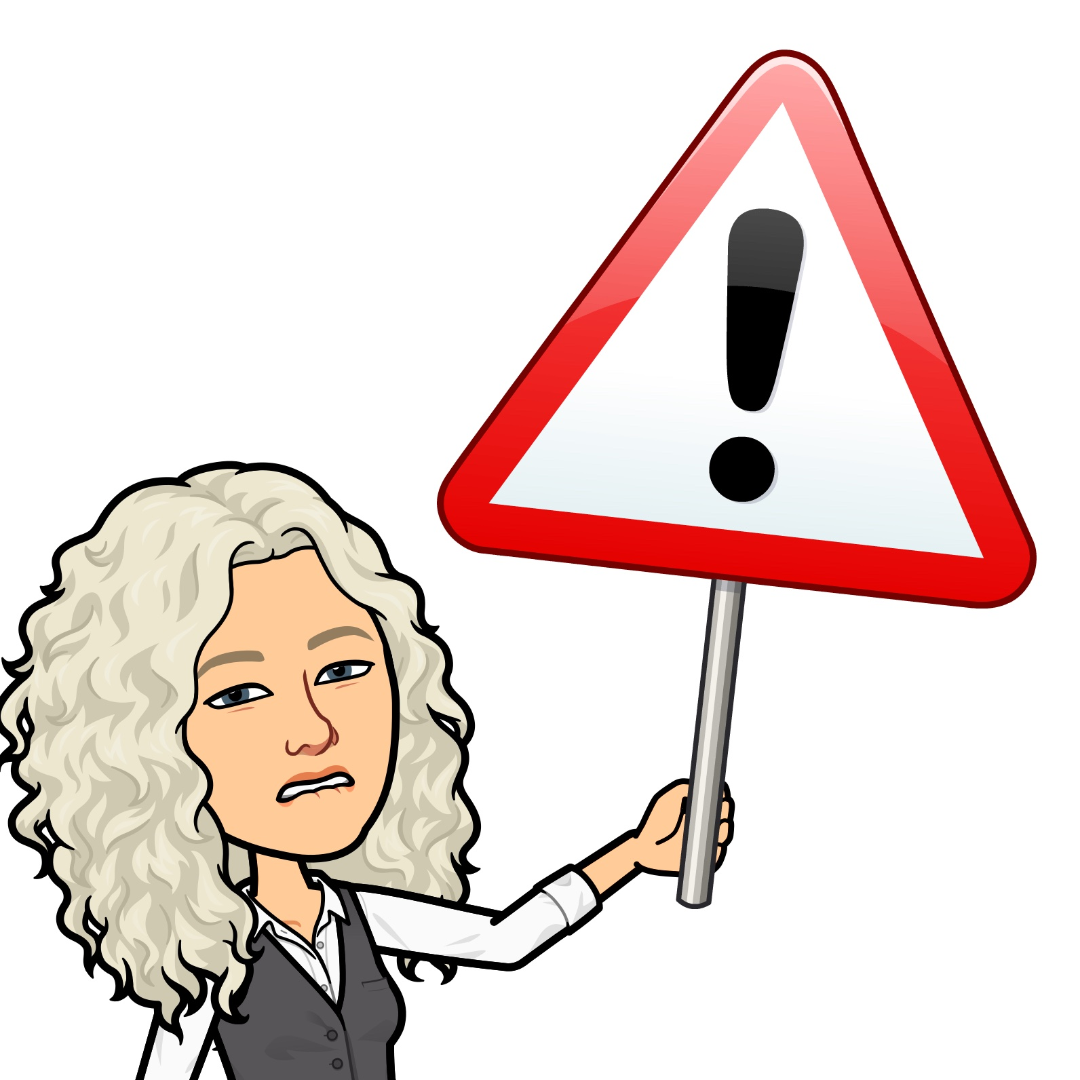
kind intention
unkind behavior
negative outcome/
impact

Slide 56
microaggressions

Slide 57
microaggressions
subtle acts of exclusion

Slide 58
Subtle Acts of Exclusion (Jana & Baran, 2020):
    You (and your struggles) are invisible.
    You are inadequate.
    You are not an individual.
    You don’t belong.
    You are not normal.
    You are a curiosity.
    You are a threat.
    You are a burden.

Slide 59
microaggressions
subtle acts of exclusion
unintentional unkindness

Slide 60
skills
kind intention
kind behavior

Slide 61
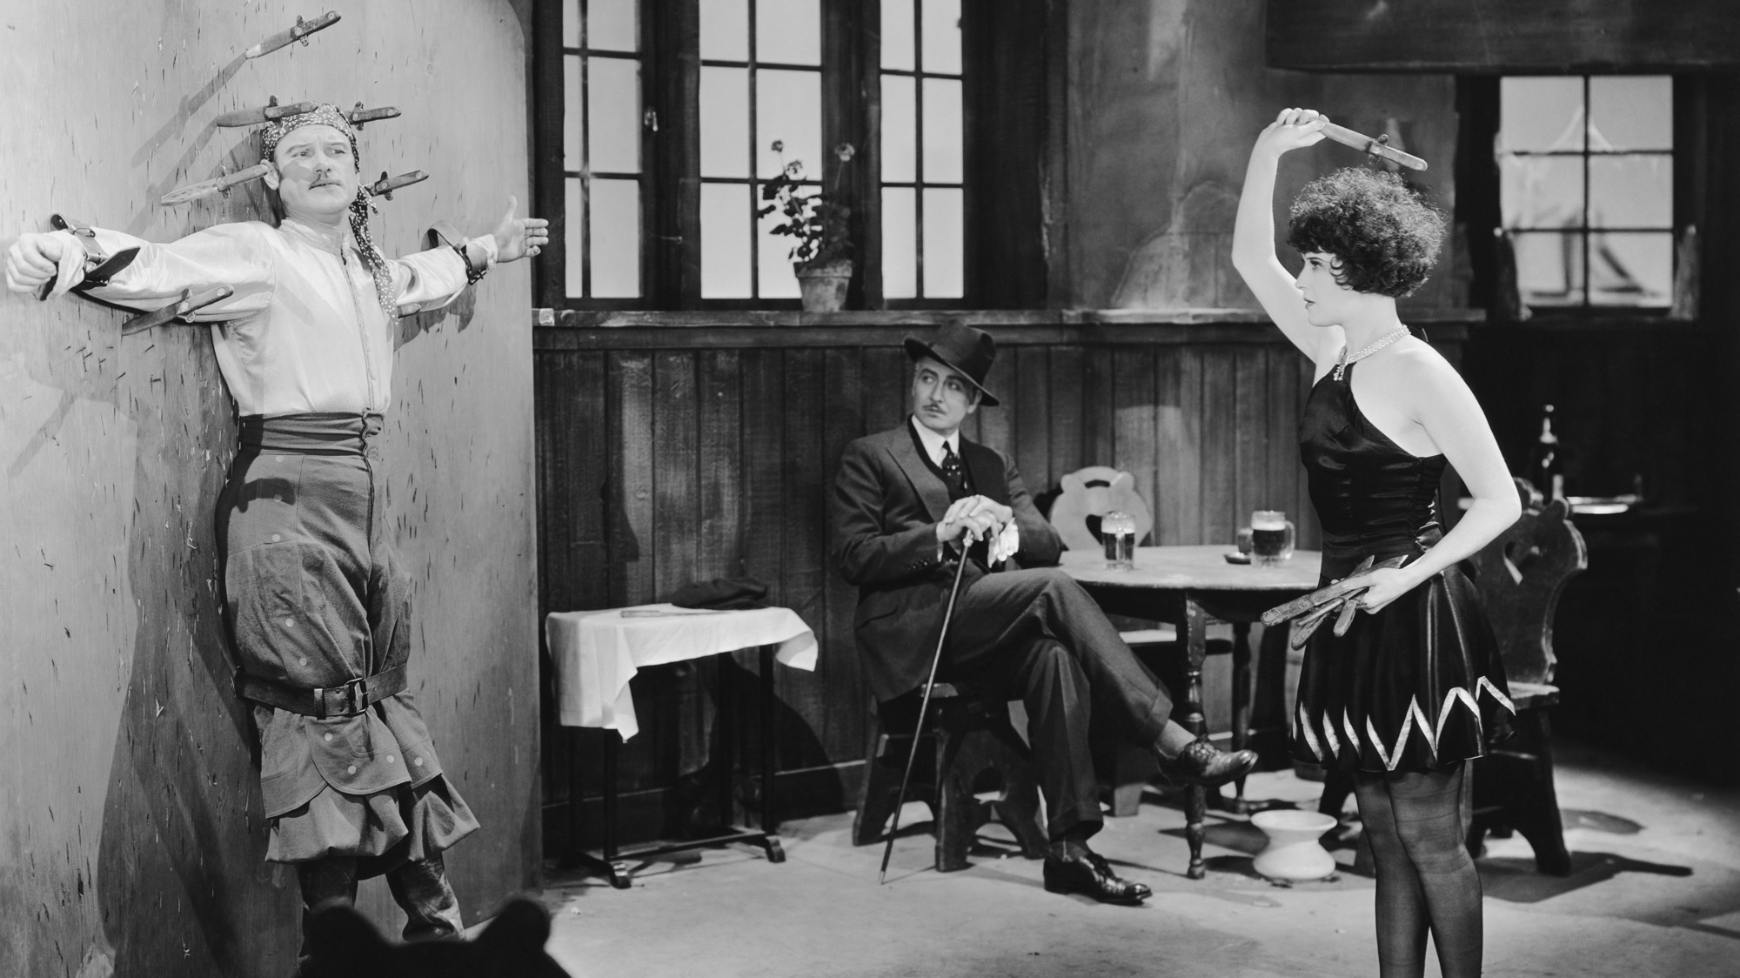

Slide 62
Predictor #3:
skills (confidence & actual skills)

Slide 63
what SKILLS
do people
need to learn?

Slide 64
empathy

Slide 65
empathy
empathy bias

Slide 66
empathy
empathy bias
empathic accuracy

Slide 67
skills
kind intention
kind behavior
environment/ systems

Slide 69
Predictor #4:
supportive
systems (more context)

Slide 70
what SYSTEMS
are supportive? need to change?

Slide 71
leadership?

Slide 72
Reasoned Action Theory
(Fishbein & Ajzen; aka Theory of Reasoned Action, Theory of Planned Behavior)
attitude toward the behavior?
skills
behavioral
intention
norms?
behavior
can I do the behavior?
environment
systems

Slide 73
4 key predictors of kind behavior:
attitude
norms (context)
confidence & skills
supportive systems (more context)

Slide 74
confident humility

Slide 75
Increasing kind behavior in your world:

Slide 76
Increasing kind behavior in your world:
Make kindness salient. Message about the benefits of kindness (emphasizing kindness as a health behavior).

Slide 77
Increasing kind behavior in your world:
Make kindness salient. Message about the benefits of kindness (emphasizing kindness as a health behavior).
As a community, identify and remove systemic barriers to kind behavior.

Slide 78
Increasing kind behavior in your world:
Make kindness salient. Message about the benefits of kindness (emphasizing kindness as a health behavior).
As a community, identify and remove systemic barriers to kind behavior.
Leaders are kindness influencers. Nurture their ability to model and encourage kind behavior.

Slide 79
Increasing kind behavior in your world:
Make kindness salient. Message about the benefits of kindness (emphasizing kindness as a health behavior).
As a community, identify and remove systemic barriers to kind behavior.
Leaders are kindness influencers. Nurture their ability to model and encourage kind behavior.
Identify skills that are necessary to do kindness well. Provide the opportunity for people to learn and practice the skills.

Slide 80
Increasing kind behavior in your world:
Make kindness salient. Message about the benefits of kindness (emphasizing kindness as a health behavior).
As a community, identify and remove systemic barriers to kind behavior.
Leaders are kindness influencers. Nurture their ability to model and encourage kind behavior.
Identify skills that are necessary to do kindness well. Provide the opportunity for people to learn and practice the skills.
Continue learning and practicing!

Slide 81
Increasing kind behavior in your world:
Make kindness salient. Message about the benefits of kindness (emphasizing kindness as a health behavior).
As a community, identify and remove systemic barriers to kind behavior.
Leaders are kindness influencers. Nurture their ability to model and encourage kind behavior.
Identify skills that are necessary to do kindness well. Provide the opportunity for people to learn and practice the skills.
Continue learning and practicing!

Slide 83
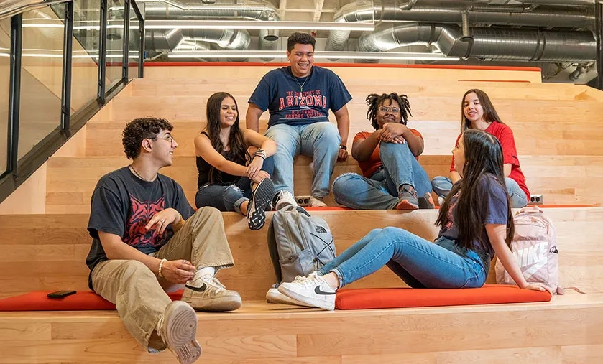
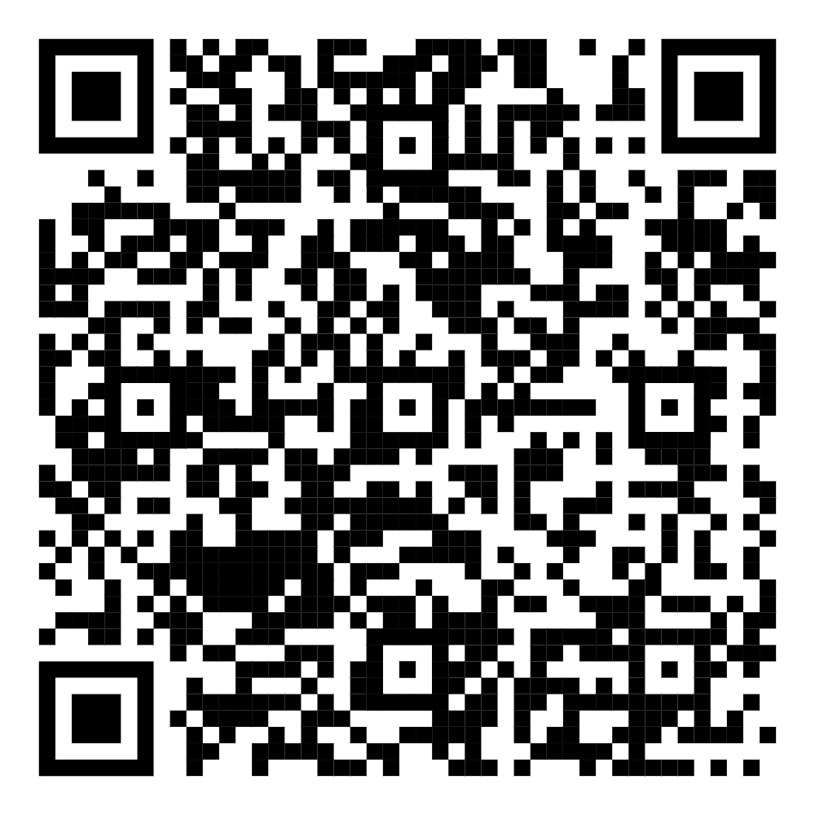

Become a KIND CAT!
KIND CATS are UA students committed to building a more connected, supportive campus community—for everyone’s benefit!
Join KIND CATS and get ready to:
Grow your leadership skills & teamwork abilities
Dive into hands-on community research with real impact
Make meaningful connections & build a sense of belonging
Level up your resume with standout experiences
Be part of building a campus that’s more connected, inclusive—and a lot more fun!
Scan the QR code and fill out the KIND CATS club interest form!
We can’t wait to meet you!

Slide 84
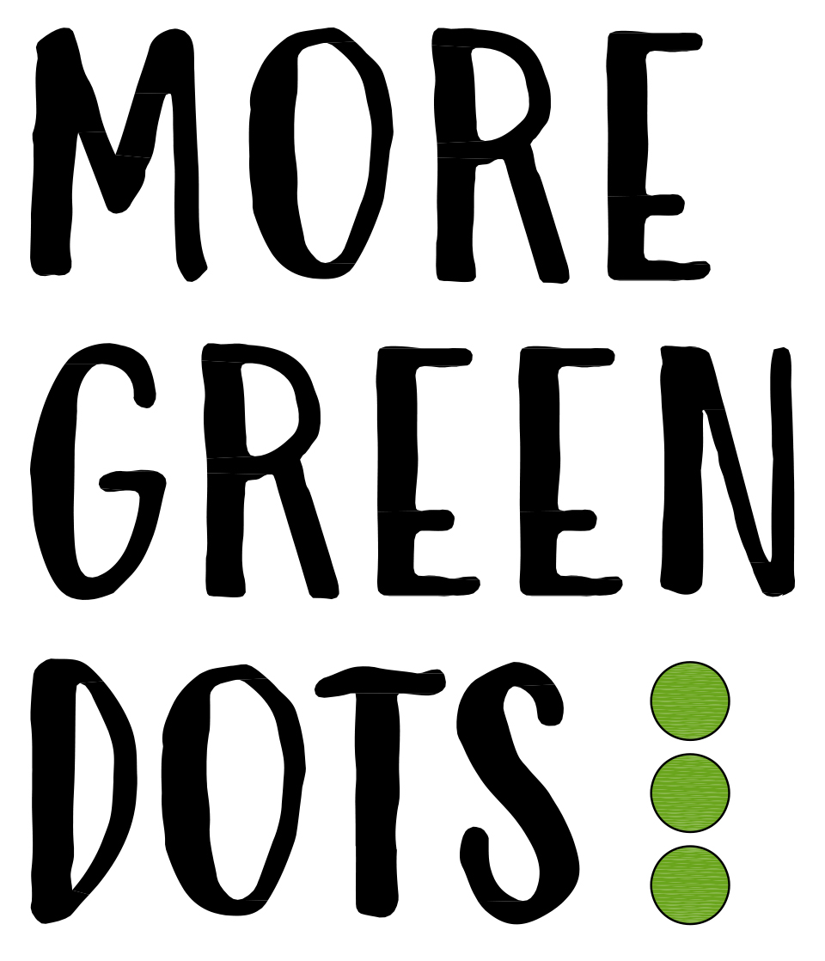

Slide 85


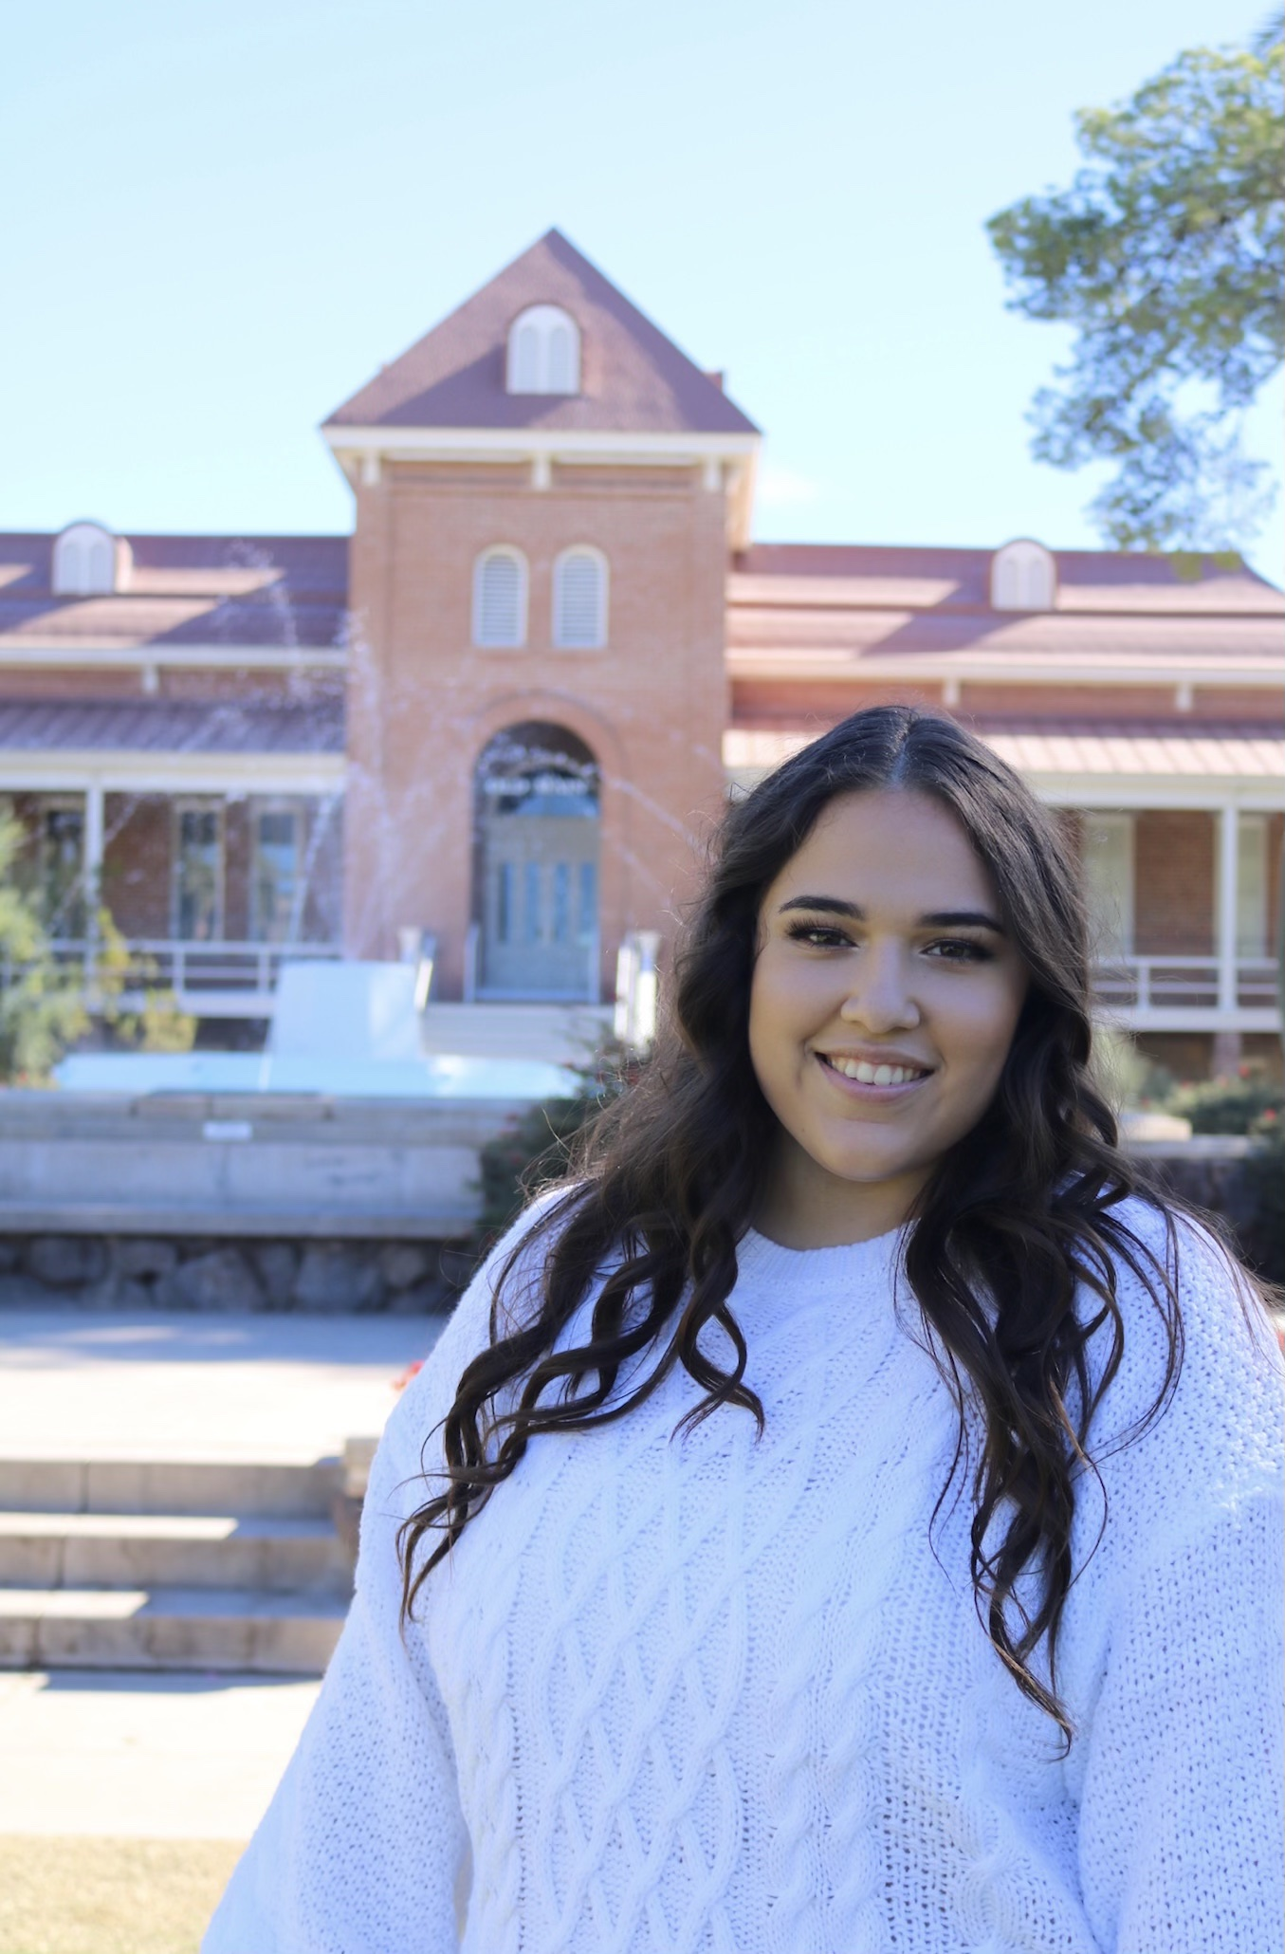
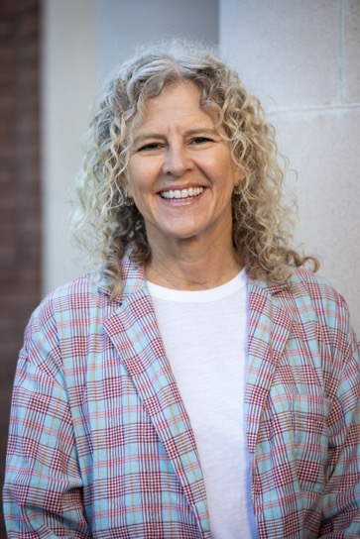
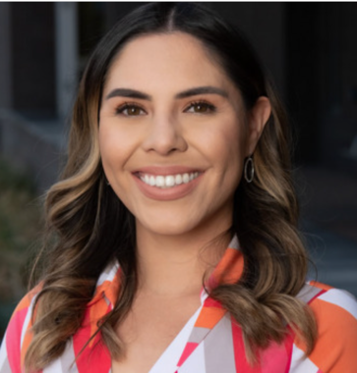
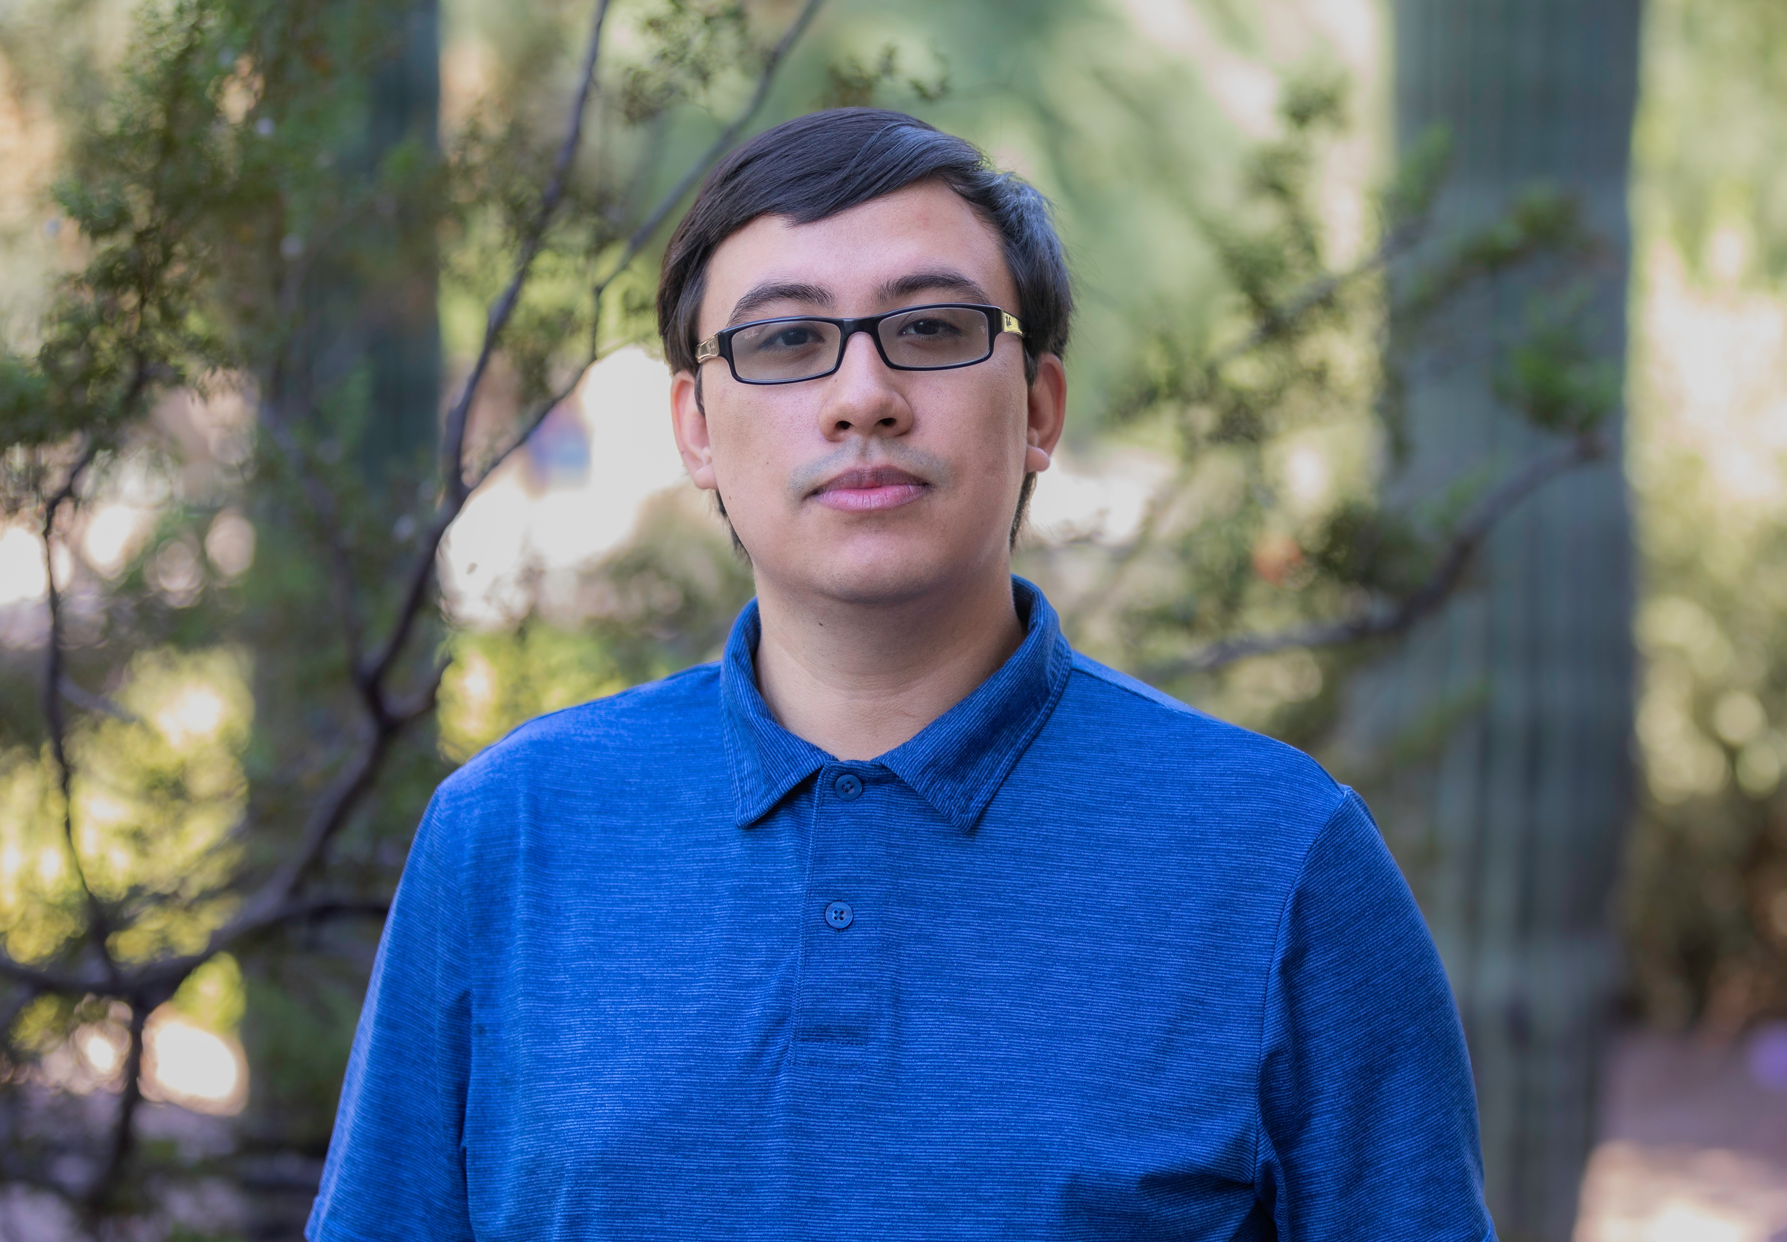
Engaging community to develop and implement a theory-based,
empirically driven model for the collective practice of kindness
Bianca Levario, MA
Program Manager
basolis2@arizona.edu
she/her/hers
Alessandro Gonzalez, MA
Research Assistant
alessandrog@arizona.edu
he/him/his
Grace Aroz-Moscoso
Graduate Research Assistant
gracearoz@arizona.edu
she/her/hers
Jeannette Maré, PhD, MA
Director, Research Professor
jmare@arizona.edu
she/her/hers

