Slide 1
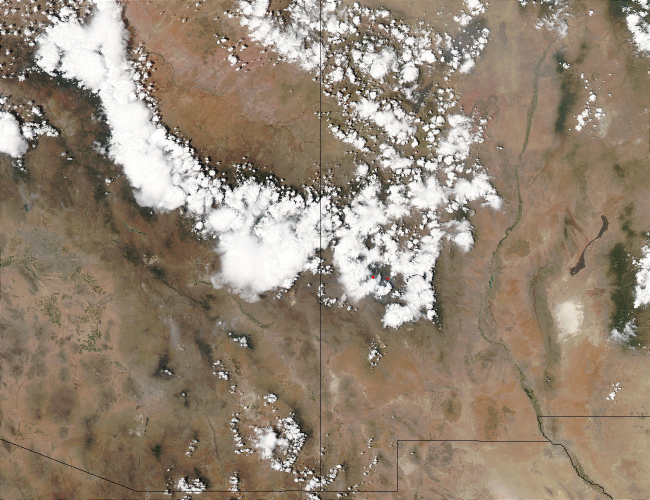
An intro to Arizona weather and climate
Mike Crimmins
Extension Specialist – Climate Science
Dept. of Soil, Water, & Env. Science & Arizona Cooperative Extension
The University of Arizona

Slide 2
Presentation Overview
The global climate system
Meteorology 101
Controls on Arizona climate
Climate variability and Change
Notes:
What is going on?
Why and what extension is…
Who am I working with
What am I doing…

Slide 3
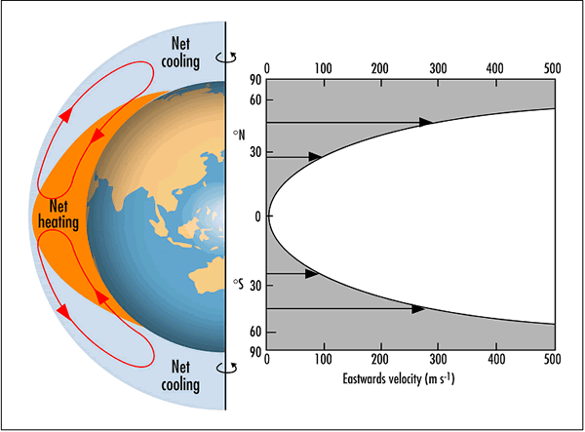
Global Energy Balance
From http://www.bom.gov.au

Slide 4
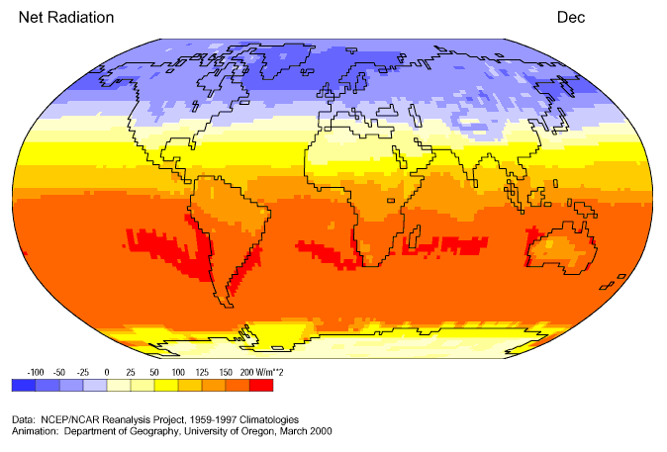
Annual Cycle

Slide 5
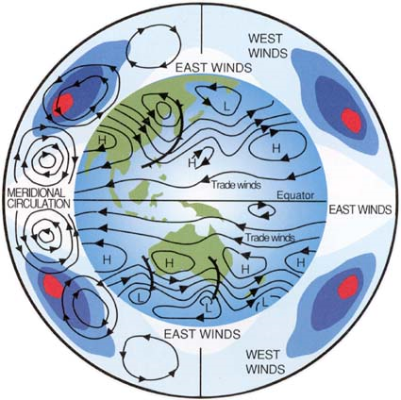
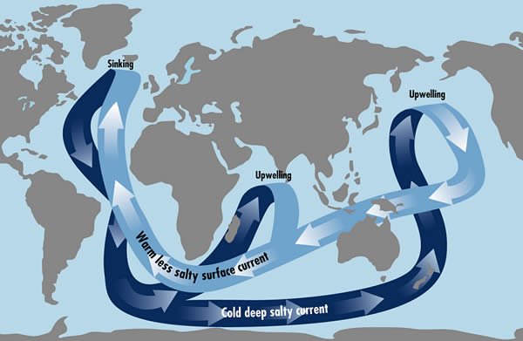
Global Circulations
Atmosphere
Ocean
From http://www.bom.gov.au

Slide 6
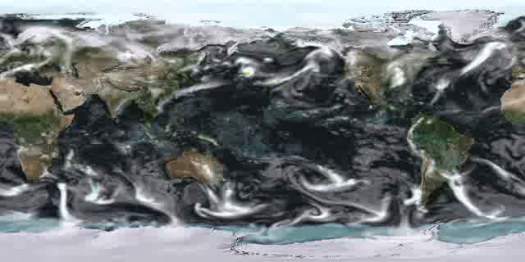
Global Circulations

Slide 7
Meteorology 101

Slide 8
Weather Circulation Features
Low Pressure System
  Rising air
  Counter-clockwise circulation
  Can produce precipitation if moisture is available
Jet Stream
  High winds at ~30,000 ft between cold/warm air
  Provides energy for low pressure systems; helps steer storms (storm track)
High Pressure System
  Sinking air
  Clockwise circulation
  Typically associated with dry conditions
L
H

Slide 9
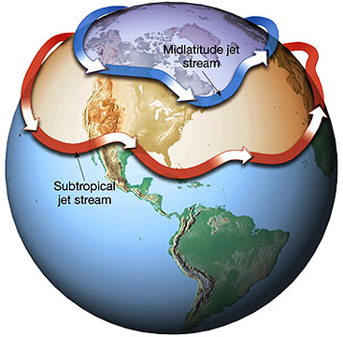
Jet Streams
L
H
http://rst.gsfc.nasa.gov

Slide 10
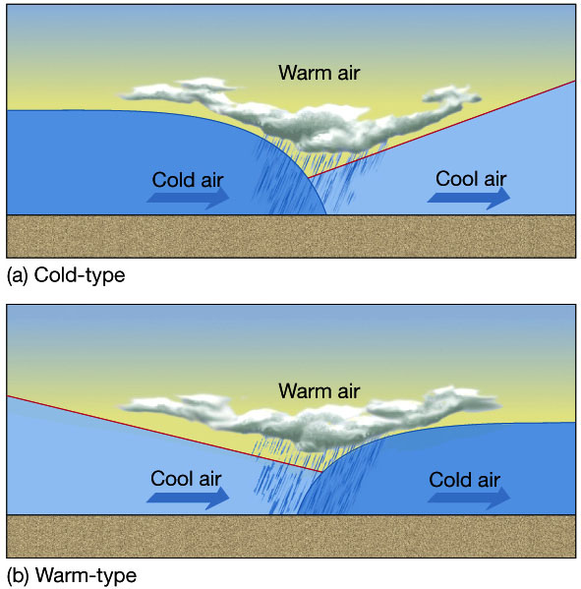
Fronts
http://www.ux1.eiu.edu/~cfjps/1400/fronts.html

Slide 11
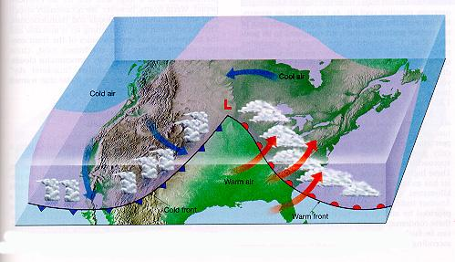
Fronts
http://earth.usc.edu/~stott/Catalina/images/weatherimages.jpg/ninefour.jpg

Slide 12
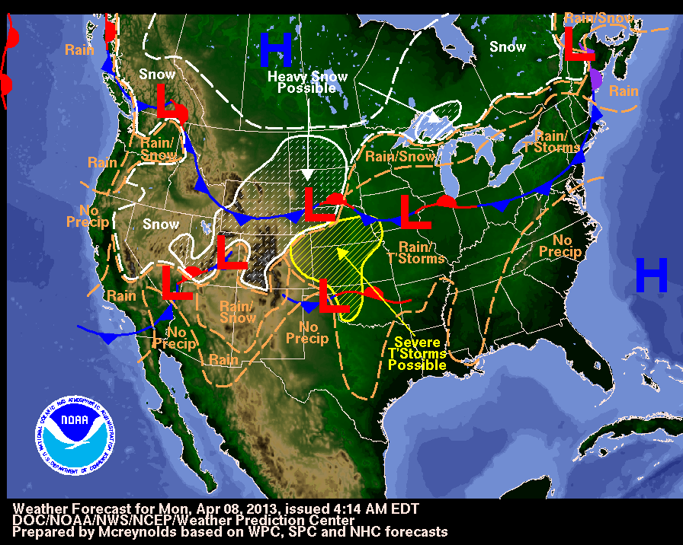

Slide 13
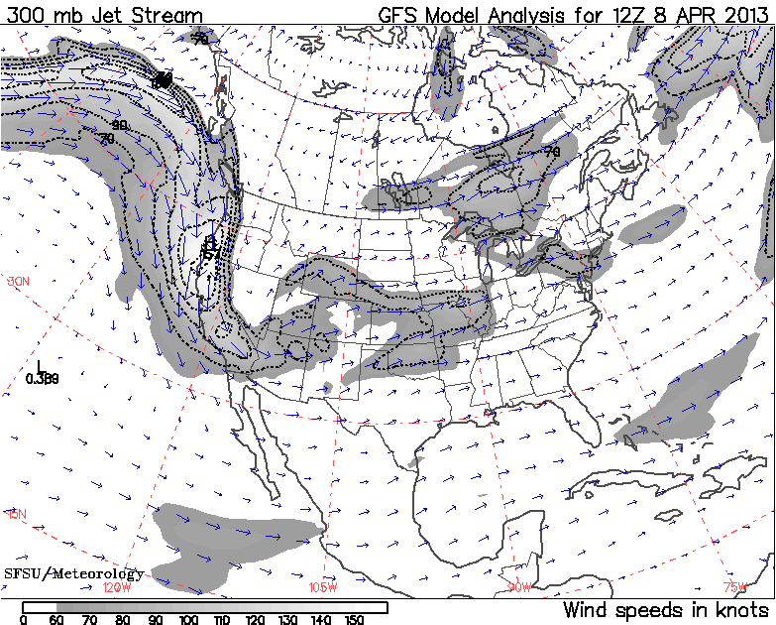
http://virga.sfsu.edu/gif/jetstream_init_00.gif

Slide 14
What does it take to produce precipitation?
Vertical Atmospheric
Motion
Atmospheric Moisture
(water vapor)
Precipitation

Slide 15
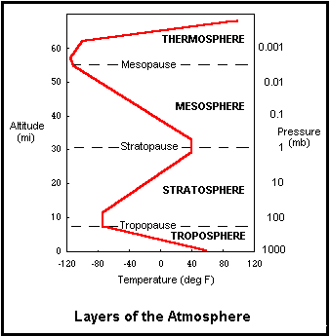
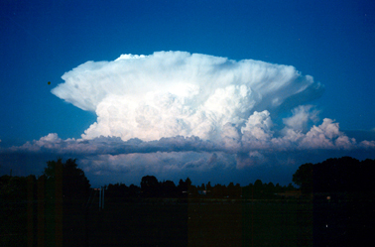
Temperature decrease with height
All weather occurs in troposphere
Temperature decreases with height on average ~3.5 °F/1000 ft. (mean environmental lapse rate)
Can you spot the tropopause in the photo?

Slide 16
Where does atmospheric moisture come from?
Moisture Advection: Water evaporates into atmosphere over ocean areas and moves over continental areas
Moisture Recycling: Precipitation initially from advection re-enters atmosphere from evapotranspiration
Maritime
Airmass
Continental
Airmass
Wet soil/active vegetation = ET

Slide 17
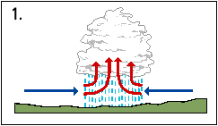
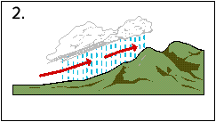
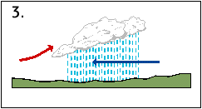
Lifting Mechanisms
Convection: Intense heating at surface cause buoyancy
Orographic Lifting: Air is forced up and over physical barrier
Frontal Lifting: Air masses of different temperature/moisture levels force vertical motion
http://www.angliacampus.com/public/pri/geog/rivers/page04a.htm

Slide 18
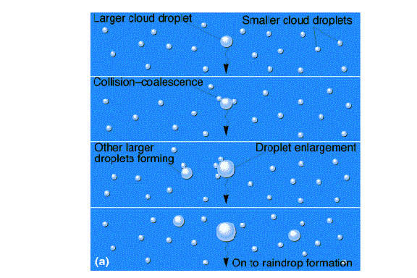
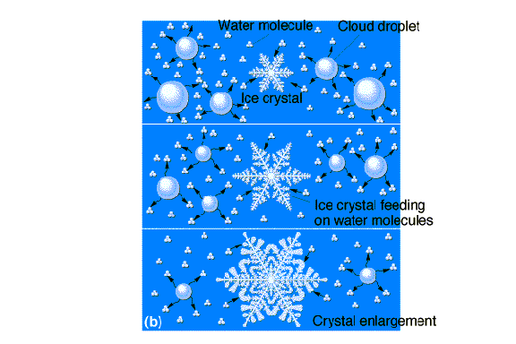
Last step…precipitation processes
Warm Clouds
(tropical areas)
Cold Clouds
(everywhere else)

Slide 19
Background on AZ Climate

Slide 20
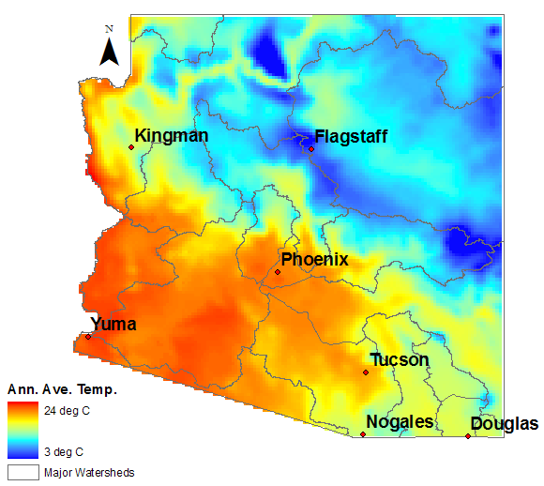
Annual Average Arizona Temperatures

Slide 21
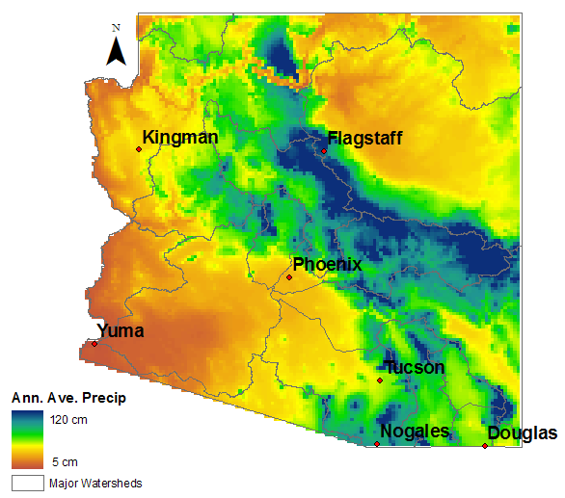
Annual Average Arizona Precipitation
Notes:
Precipitation is strongly related to elevation.
Higher elevations can intercept mid and upper level moisture and force precipitation.
‘Sky Island’ ranges of southeastern Arizona can receive three times as much precipitation as the surrounding low desert areas.

Slide 22
Arizona Climograph
Notes:
Monsoon more important east and south
Winter precip effective recharge (high summer evap,

Slide 23
Climate Quiz
A
San Francisco,CA
B
Minneapolis, MN
C
Globe, AZ
D
Atlanta, GA

Slide 24
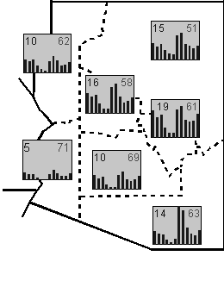
Seasonal Distribution of Precipitation
3 in.
Jan
Dec
More winter precip in northern AZ
Stronger monsoon signal in southeast AZ (more summer precip)
(graphic from Sheppard, et al. 2000)
Mean Annual
Precip (in.)
Annual Avg.
Temp (F)
Notes:
Brand new…maybe only in the country?
Similar to a state climatologist but much more time in field and access to resources abroad
Extension specialists have responsibilities with knowledge transfer, liaisons, leadership roles for statewide programs
Bridge the ‘valley of death’ between university research and potential user groups
Work with Gregg to coordinate Extension resources into RISA projects

Slide 25
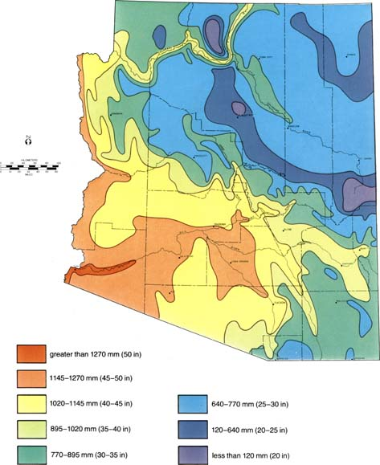
Annual Average Arizona Potential Evapotranspiration
http://southwest.library.arizona.edu/
Notes:
Precipitation is strongly related to elevation.
Higher elevations can intercept mid and upper level moisture and force precipitation.
‘Sky Island’ ranges of southeastern Arizona can receive three times as much precipitation as the surrounding low desert areas.

Slide 26
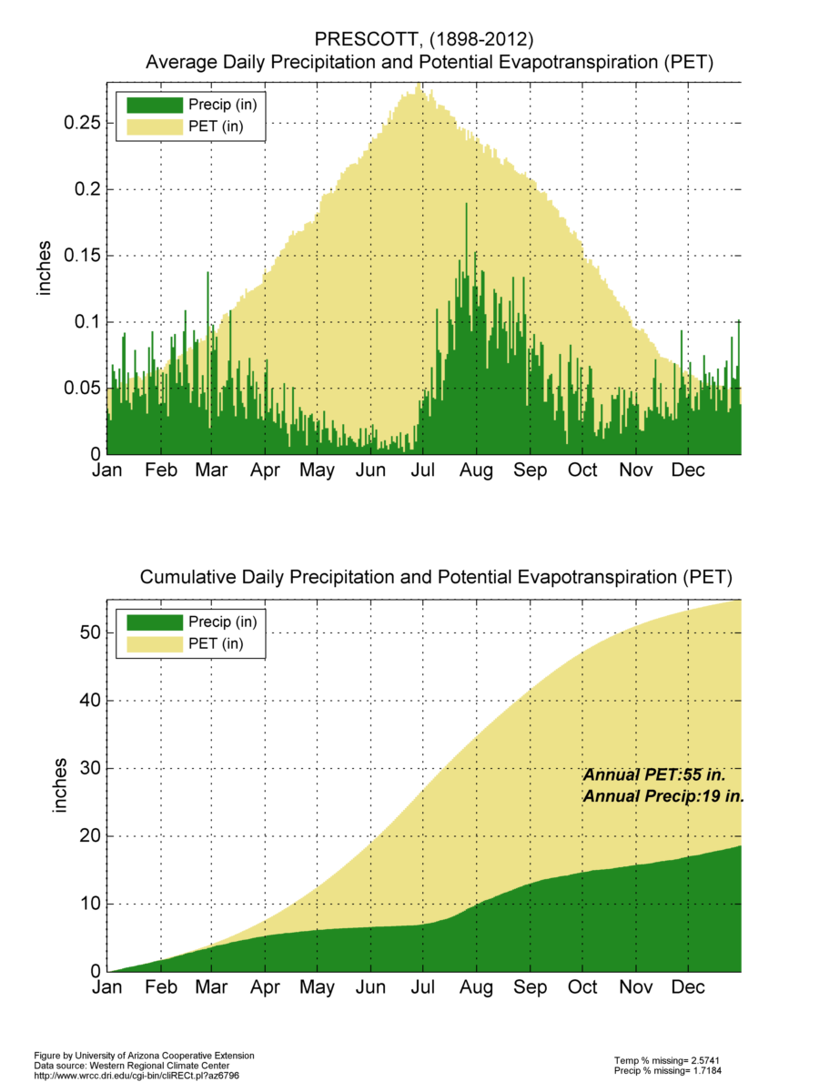
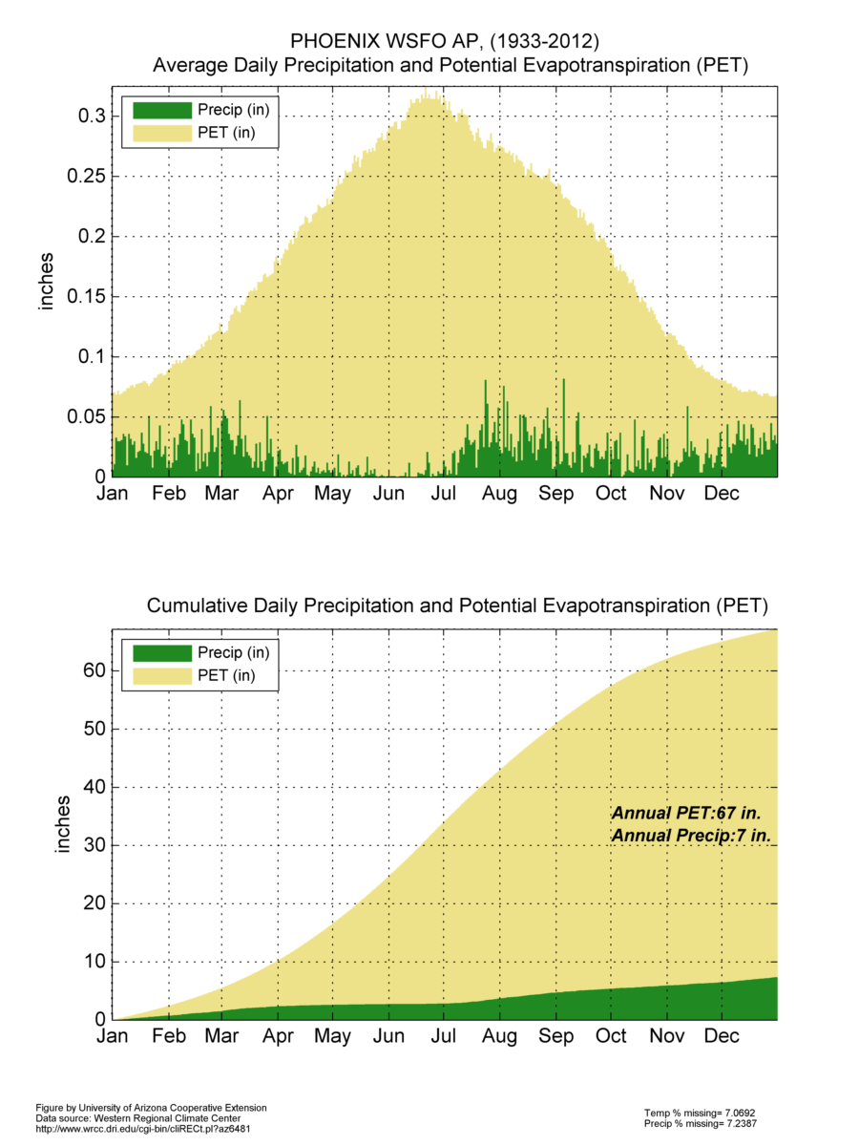
Arid-zona: Seasonality and aridity

Slide 27
How has Maricopa County climate varied over time?

Slide 28
Annual Precipitation and Temperature (departures from average)

Slide 29
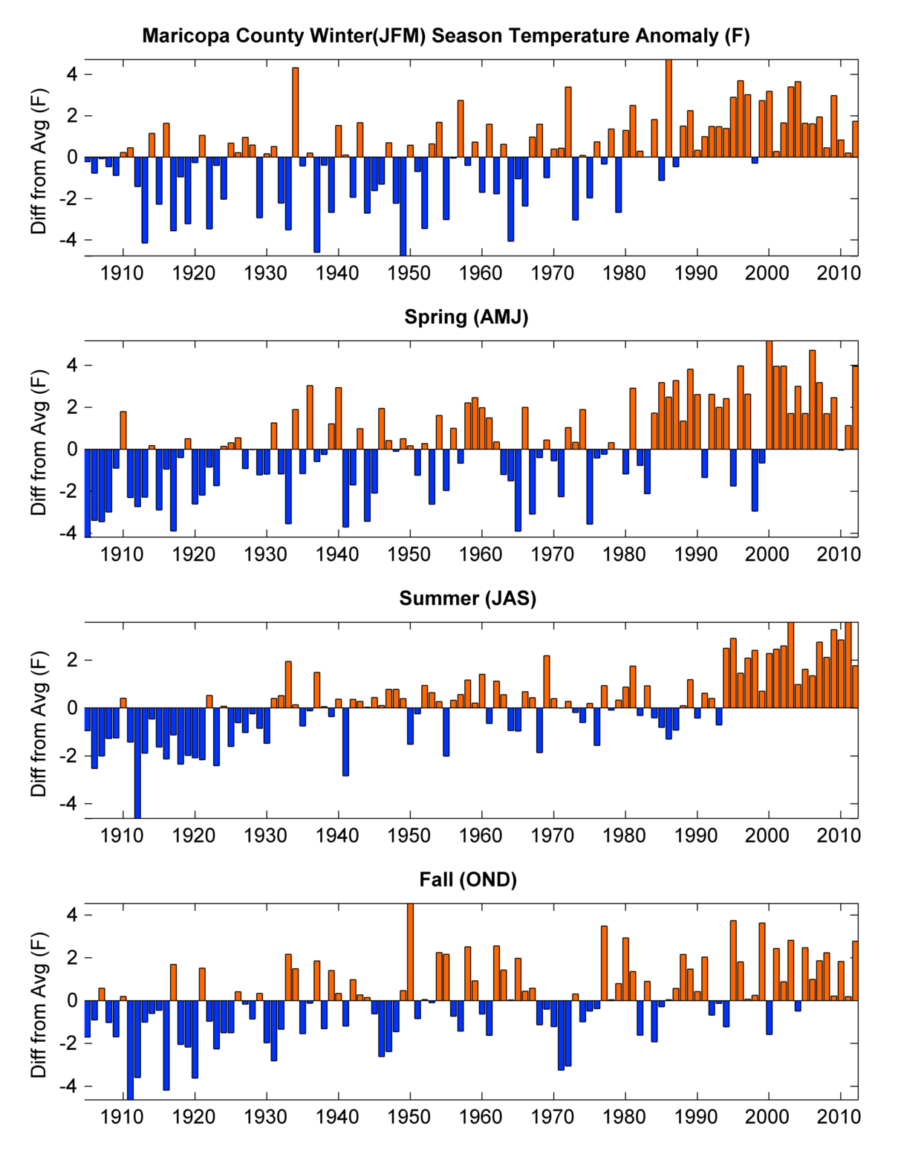
Seasonal Temperatures (departure from average)

Slide 30
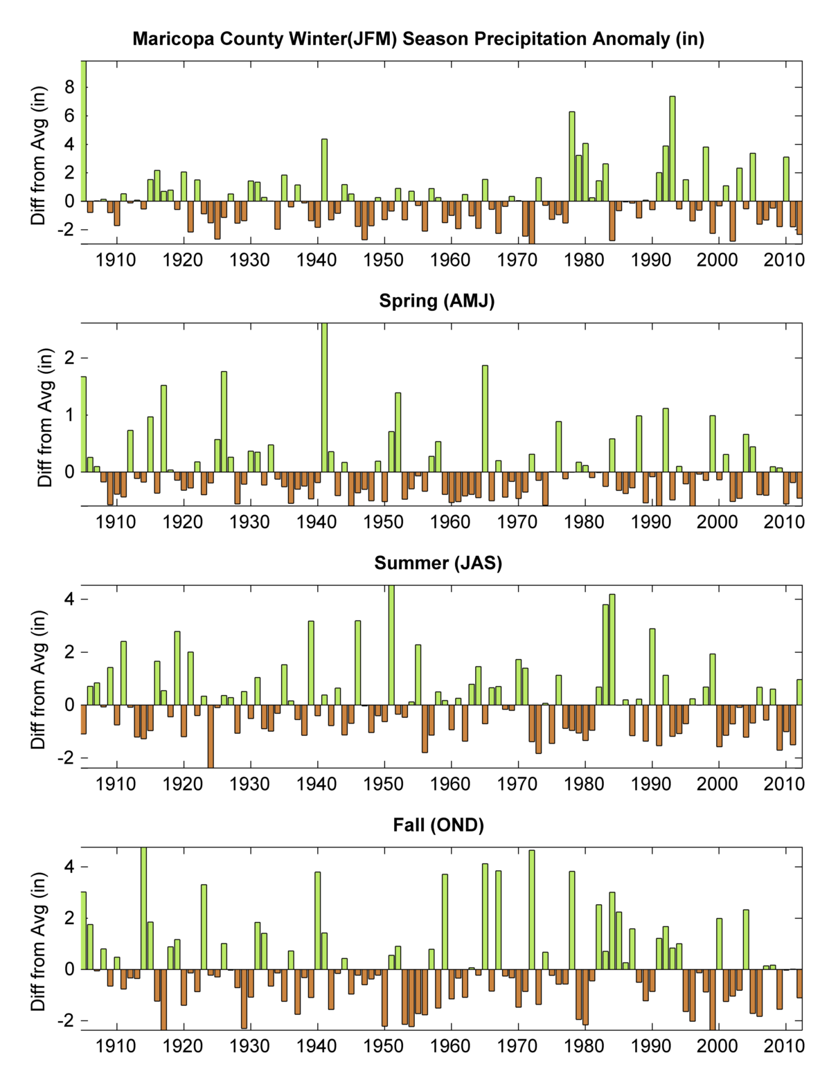
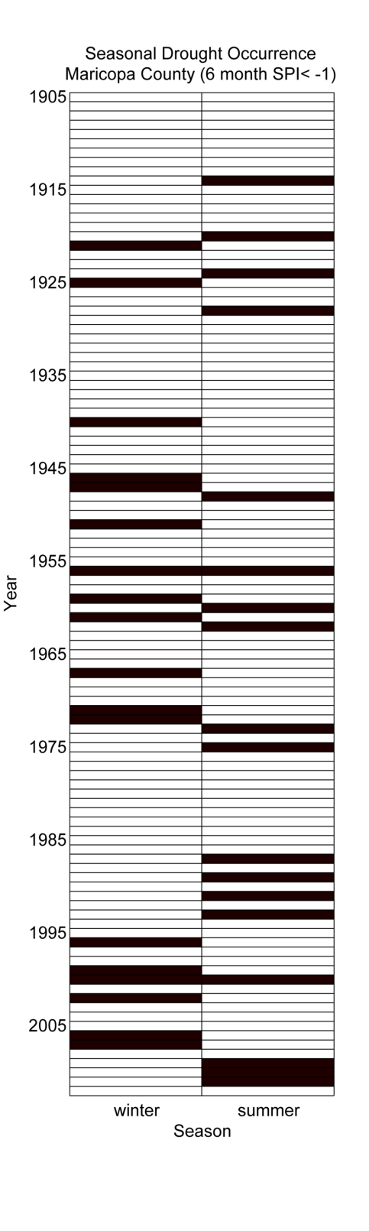
Seasonal Precipitation →
Drought

Slide 31
Atmospheric Controls on Arizona Climate

Slide 32
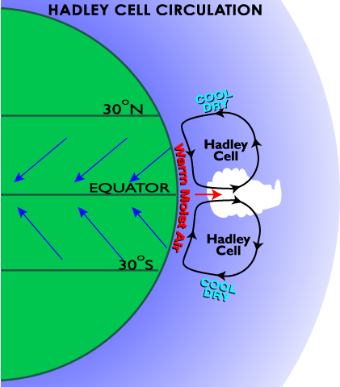
Atmospheric Circulation and Arizona Climate
Large-scale circulation patterns are an important determinant of local climate
Arizona has a unique geographic position in northern hemisphere
Circulation patterns are tied to global ocean sea surface temperatures
Patterns can persist for years and even decades
http://www.geography.hunter.cuny.edu/~tbw/wc.notes/7.circ.atm/animations/GlobalWind.html

Slide 33
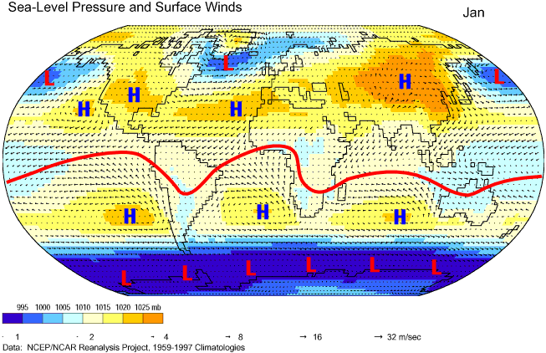
Seasonality of Circulation Patterns

Slide 34
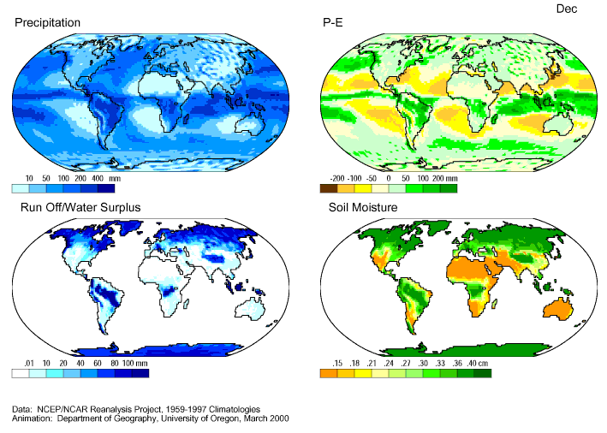
Global Hydroclimate

Slide 35
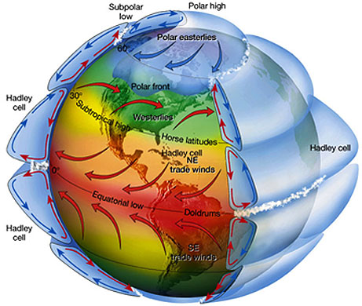
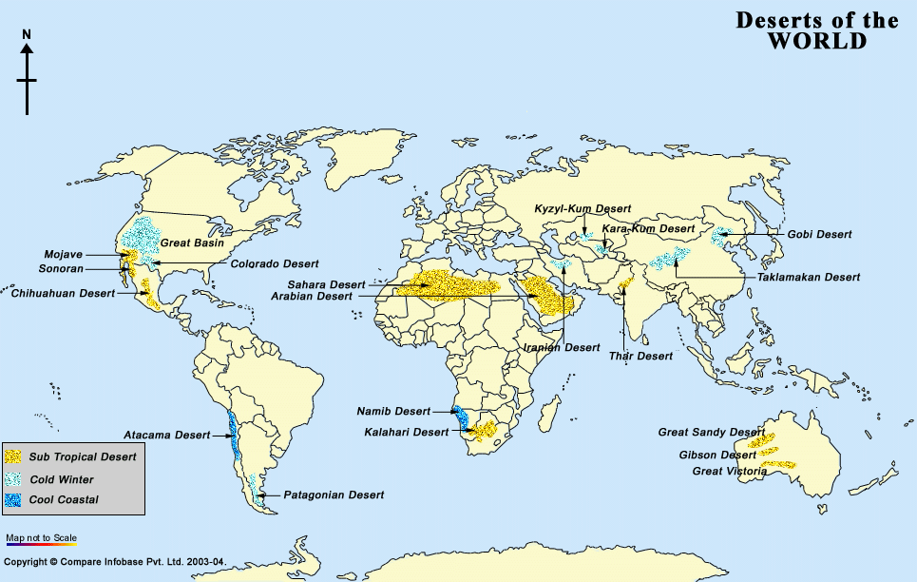
Global Circulations and Aridity

Slide 36
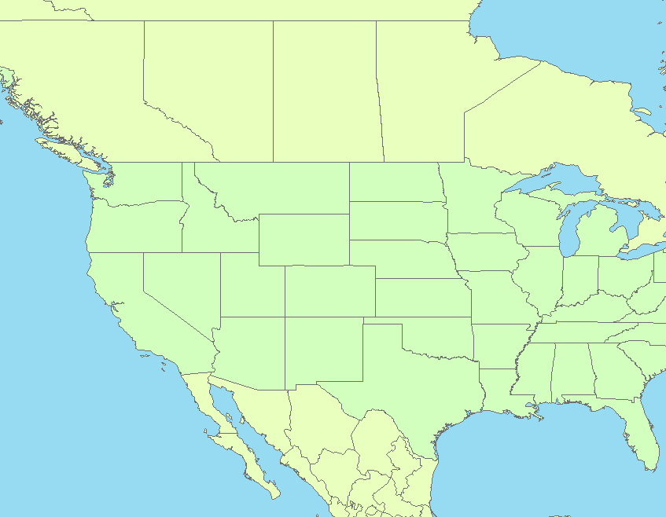
Winter Circulation Pattern
MOIST AIR
Average Wintertime Mid-latitude Jet Stream Track
L
Shift of jet stream track towards Arizona
DRY AIR
H

Slide 37
Summer Circulation Pattern
Average summertime mid-latitude jet stream track
DRY AIR
Weak flow around expanded Bermuda sub-tropical
high-pressure system
H
H
H
MOIST AIR
Monsoon
circulation

Slide 38
Interannual Climate Variability

Slide 39
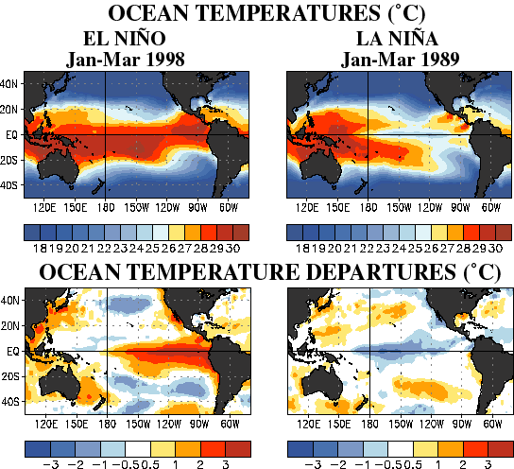
What are El Niño and La Niña?
Notes:
Anomalously warm equatorial sea surface temperatures (SST) off of the South American coast are El Nino events. Anomalously cold SSTs are La Nina events.
El Nino and La Nina episodes develop every 2-5 years.

Slide 40
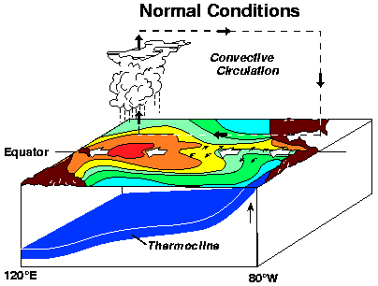
Atmosphere-Ocean Coupling

Slide 41
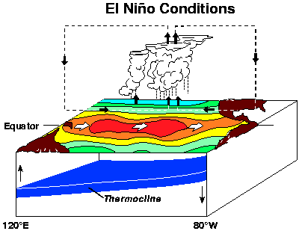
Atmosphere-Ocean Coupling

Slide 42
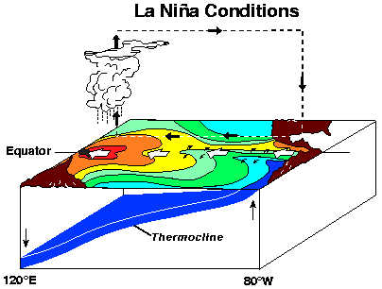
Atmosphere-Ocean Coupling

Slide 43
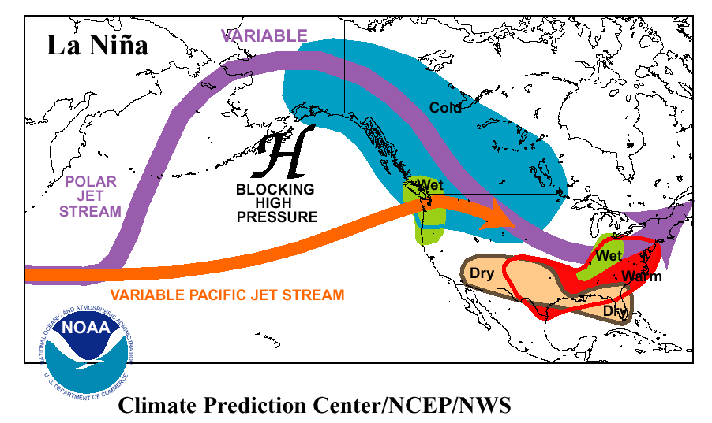
Dominant Circulation Pattern: La Niña Winter
Notes:
Cold, equatorial sea surface temperatures displace active Pacific jet stream further north, away from southwest U.S.
This limits storm systems and precipitation over the southwest during the winter months.

Slide 44
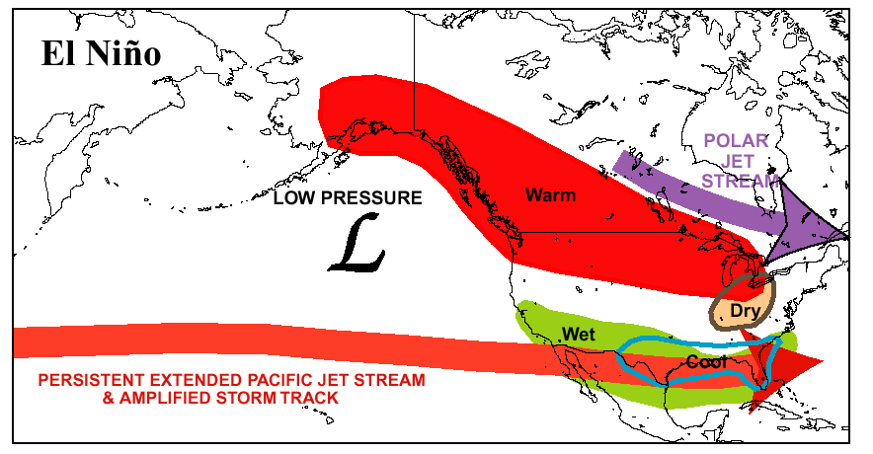
Dominant Circulation Pattern: El Niño Winter
Notes:
Warm, equatorial sea surface temperatures enhance the Pacific jet stream over the southwest U.S.
This increases storm system passages and precipitation over the southwest during the winter months.

Slide 45
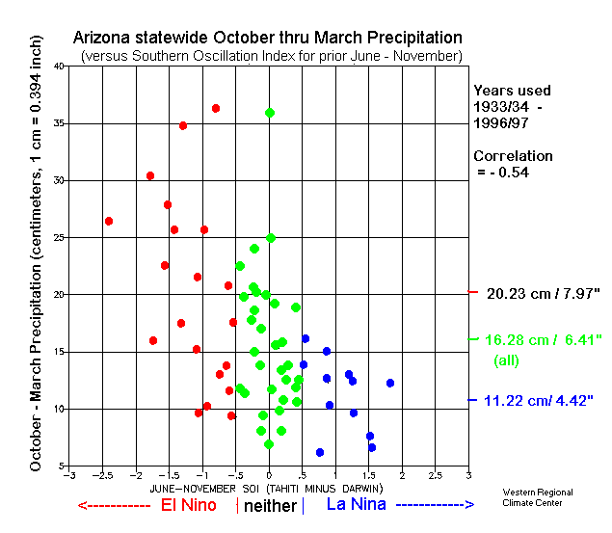
Arizona ENSO Connection
2005
2001
2003
2004
2007
2006
2000
1999
2002
Notes:
La Nina episodes are almost consistently associated with lower winter precipitation amounts. Higher confidence in La Nina/Dry Winter forecast.
Much more spread in precipitation amounts associated with El Nino episodes. Less confidence in El Nino/Wet Winter forecast.

Slide 46
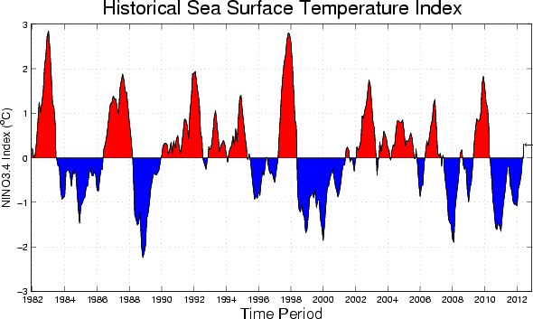
ENSO: 1982-2012
http://iri.columbia.edu/climate/ENSO

Slide 47
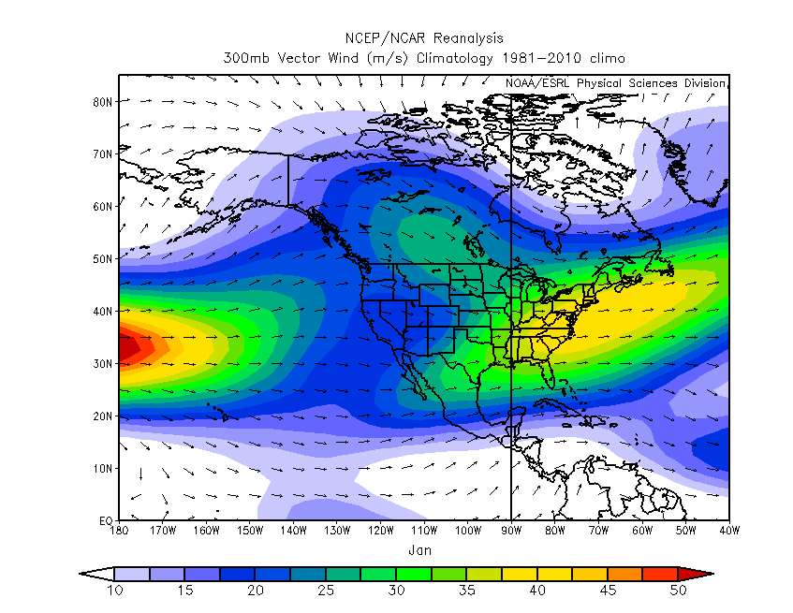
Average Jet stream winds (~30,000 ft) - January
L
H
http://www.esrl.noaa.gov/psd

Slide 48
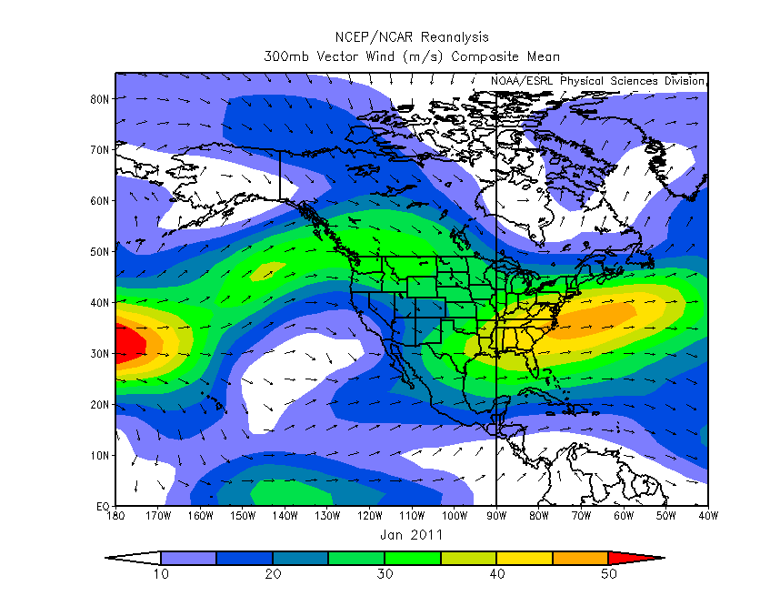
Jet stream winds (~30,000 ft) – January 2011
L
H
http://www.esrl.noaa.gov/psd

Slide 49
North American Monsoon

Slide 50
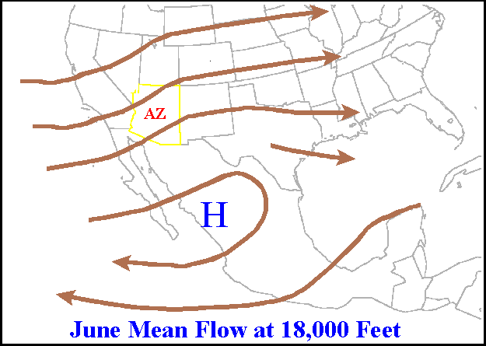
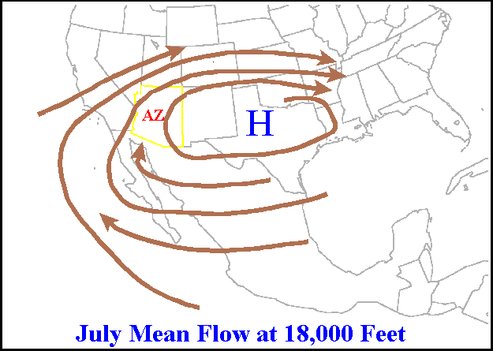
Monsoon
Monsoon start dates for Tucson
Average start July 3rd
Earliest start June 17 2000
Latest start July 25 1987
Monsoon season rainfall (June 15th to September 30th)
Average monsoon season rainfall 6.06”
Driest monsoon season 1.59” in 1924
Wettest monsoon season 13.84” in 1964

Slide 51
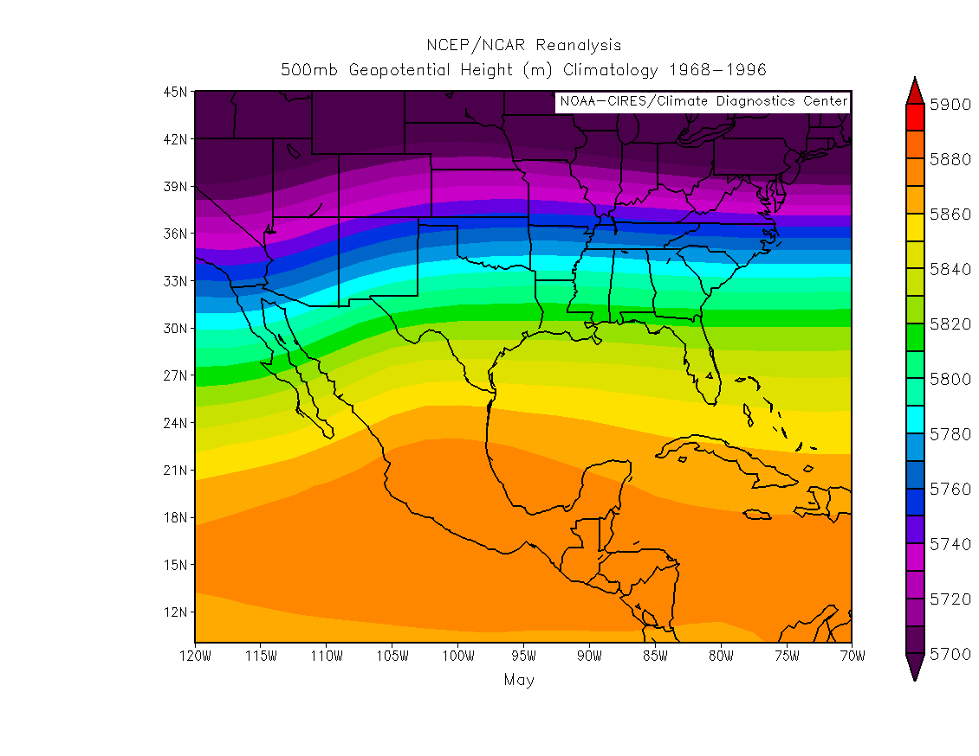
Upper Level Flow - May
H
H

Slide 52
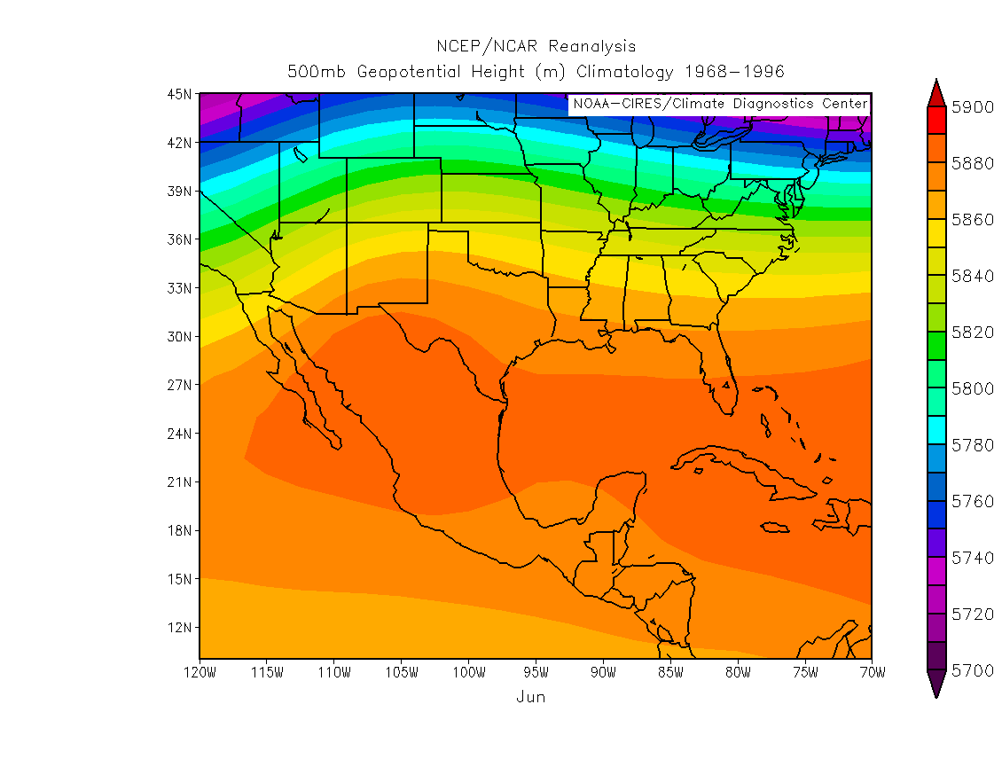
Upper Level Flow - June
H
H

Slide 53
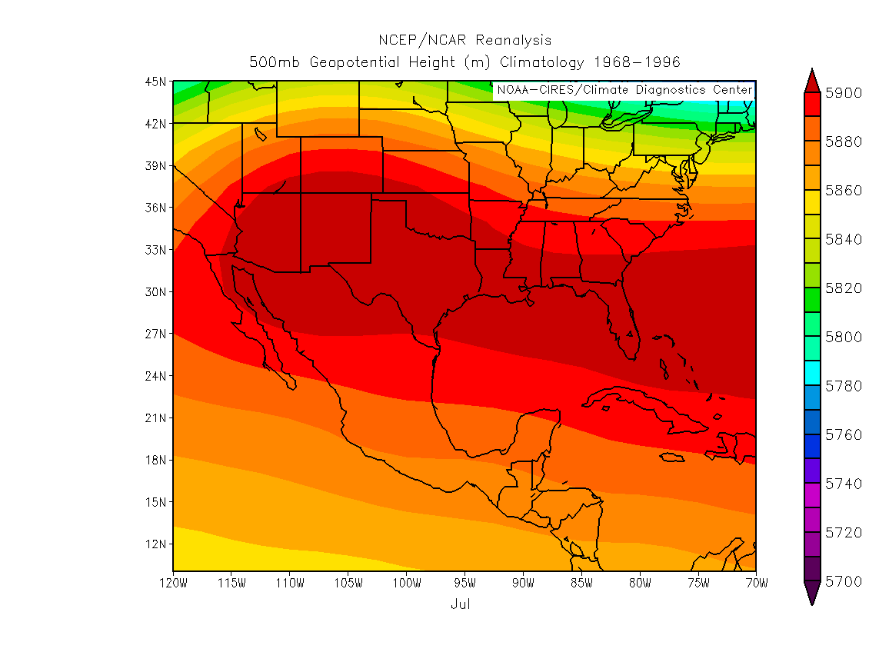
Upper Level Flow - July
H
H

Slide 54
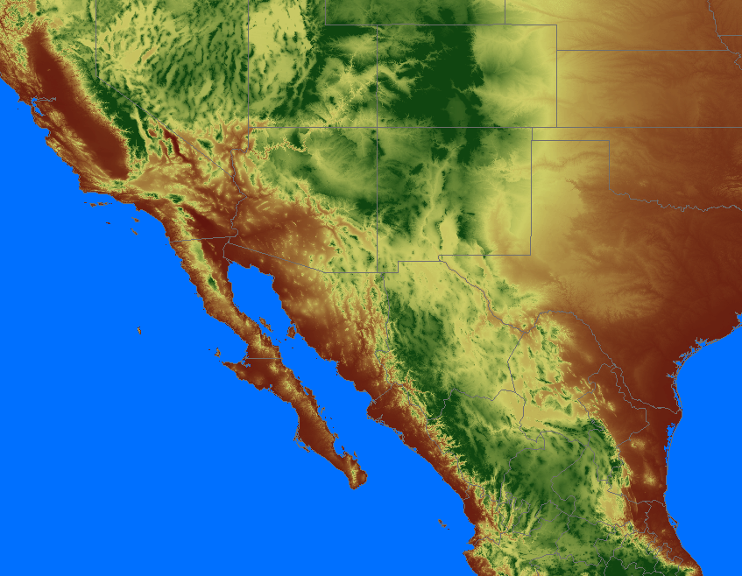
westerly wind
NE
NV
UT
CO
Four Corners
High Pressure
KS
CA
H
TX
CO. River Valley
Thermal Low
AZ
NM
L
Mid-level moisture
from Gulf of Mexico
TX
Low-level moisture
from Gulf of California
Core Monsoon Area
(abundant tropical moisture, frequent
thunderstorm activity)
GULF OF
MEXICO
PACIFIC OCEAN
Conceptual diagram of key circulation features of the North American Monsoon System
easterly wind
Mexico

Slide 55
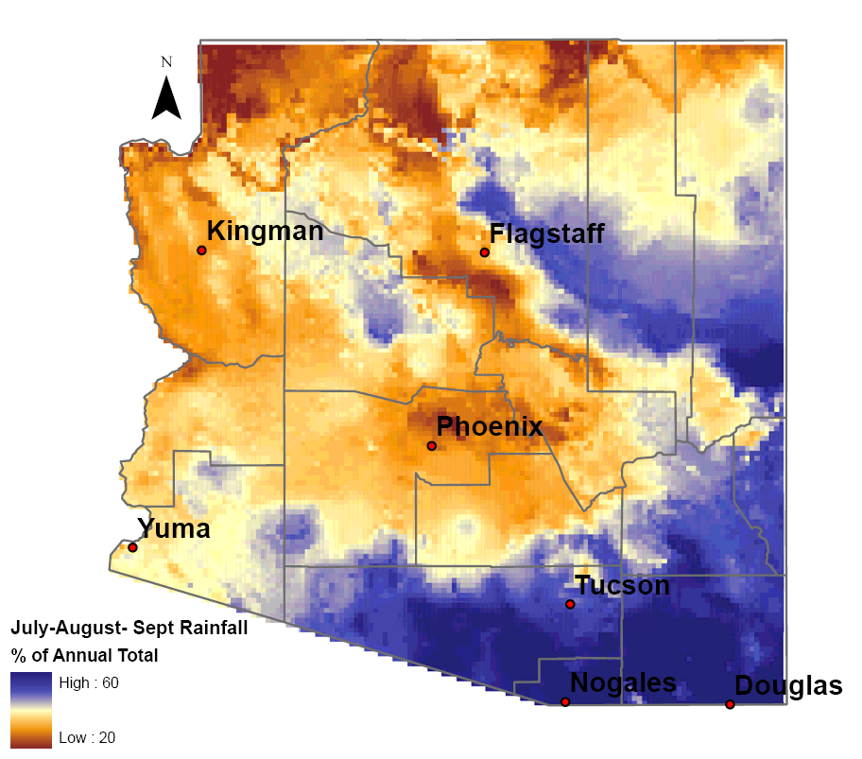
Monsoon Precipitation across AZ
Total Monsoon Rainfall
JAS Percent of Annual
Rainfall

Slide 56

Triggers of Thunderstorm Events
Gulf Surge
Adams and Comrie 1997

Slide 57

Triggers of Thunderstorm Events
Upper level waves/vortices

Slide 58

Triggers of Thunderstorm Events
Thunderstorm Outflows
http://www.wrh.noaa.gov/psr/pns/2011/July/DustStorm.php
AZ DOT

Slide 59

Triggers of Thunderstorm Events
Thunderstorm Outflows
Adams and Comrie 1997

Slide 60
Triggers of Thunderstorm Events
Frontal Storms
NWS Flagstaff

Slide 61

Triggers of Thunderstorm Events
Frontal Storms
NWS Flagstaff

Slide 62




Summer Severe Thunderstorm Patterns in Arizona
From National Weather Service – Tucson
http://www.wrh.noaa.gov/twc/monsoon/monsoon_patterns.php

Slide 63
Monsoon Day in Tucson
UofA Cloud Convection Experiment

Slide 64
Flash floods
Flash Flood Watch: Conditions are favorable for flash flooding over large or multiple areas of the region. These are usually issued only when an especially active day is expected. Watch weather reports and conditions closely.
Urban and Small Stream Flood Advisory: Minor flooding is expected or underway in low lying and flood prone areas. While it may not be life threatening, extreme caution is advised, particularly for motorists.
Flash Flood Warning: Life-threatening, rapid flooding is about to occur, or is already underway. Move to higher ground now! It is particularly dangerous to be in a low lying area or near a wash.
From National Weather Service – Phoenix
http://www.wrh.noaa.gov/psr/general/safety/index.php

Slide 65

Flash Floods:
Never drive into a flooded roadway!
FEMA

Slide 66

Fighting a Losing Battle
Width: 5.5 feet
Length: 14 feet
Ground Clearance: 10 inches
Weight: 3,400 pounds
However, 1 foot of water displaced by this vehicle weighs:
(5.5’ x 14’ x 1’ x 62.4 lbs./cu.ft.) = 4,805 pounds
From Steve Waters, Maricopa County Flood Control District

Slide 67
Severe Thunderstorms
Severe Thunderstorm Watch: Conditions are favorable for widespread thunderstorms with damaging winds and even large hail to develop. These are usually issued only when an especially active day is expected. Watch weather reports and conditions closely.
Severe Thunderstorm Warning: A thunderstorm with damaging winds of 60 mph or greater is about to occur, or is already underway. These winds could also produce a dust storm with visibilities below 1/4 mile. Hail 1" in diameter or larger is also possible.
Dust Storm Warning: A dust storm, with visibilities of 1/4 mile or less, is about to strike, or has already developed. Pull off the road now! Wind gusts between 40 and 60 mph are also likely.
From National Weather Service – Phoenix
http://www.wrh.noaa.gov/psr/general/safety/index.php

Slide 68

Lightning
http://www.jason.org/digital_library/110.aspx

Slide 69

Lightning Safety
Flash-to-bang of five seconds = 1 mile
Immediately get off elevated areas such as hills, mountain ridges or peaks
SEEK: Seek clumps of shrubs or trees of uniform height. Seek ditches, trenches or the low ground. Seek a low, crouching position with feet together with hands on ears to minimize acoustic shock from thunder.
Immediately get out and away from ponds, lakes and other bodies of water
Stay away from objects that conduct electricity (barbed wire fences, power lines, windmills, etc.)
A safe vehicle is any fully enclosed metal topped vehicle such as a hard topped car, minivan, bus, truck, etc
Bolt from the blue
http://www.lightningsafety.noaa.gov/outdoors.htm

Slide 70
Climate Change

Slide 71

What is causing climate change?
Carbon Dioxide, Methane, and Nitrous Oxide are major GHGs
From http://www.climatechange.gc.ca
Notes:
Recent changes in the global climate system are primarily caused by human-caused disruptions to the atmospheric chemistry and radiation balance of the planet
The ‘greenhouse effect’ describes the mechanism that warms the planet by trapping some of the sun’s energy in the lowest levels of the Earth’s atmosphere
Greenhouse gases trap some of the sun’s energy, keeping the planet much warmer than it would be without an atmosphere.
The greenhouse effect is an important part of the Earth’s thermostat; recent increases in the greenhouse gases due to human activities like burning oil and coal for energy over the past 100 years have increased the amount of greenhouse gases in the atmosphere. Increasing levels of greenhouse gases trap more energy, raising the temperature of the planet.

Slide 72

Global Temperature and Carbon Dioxide
USGCRP 2009
Notes:
The amount of carbon dioxide has risen steadily over the past 100 years in concert with increasing global temperatures.
Note how the increase in global temperatures is very similar to temperature changes on the Navajo Nation

Slide 73

Natural vs. Anthropogenic Forcings
Observed
Natural Only
Stott et al. (2000)

Slide 74

Temperature Projections
USGCRP 2009
Notes:
- Computer models that project potential changes in the global climate system well into the future show that temperatures will most likely continue to warm to very high levels by the end of this century.

Slide 75

Precipitation Projections
USGCRP 2009
Notes:
- Computer models of potential changes in precipitation note that winter and spring precipitation may decline in the coming decades

Slide 76
Interactions between temperature and precipitation
Confidence in continuation of increasing temperatures
Projections on precipitation variability are less clear
Increasing temperatures alone will increase aridity
Hoerling & Eischeid 2007
Notes:
- The combined impact of less precipitation and warmer temperatures produces increasing aridity across much of the western U.S. in coming decades

Slide 77
Closing Points
Elevation, latitude, and ocean sea-surface temperatures create a complex Arizona climate
Different mechanisms create summer versus winter precipitation
Lots of opportunity for variability (spatially and temporally)
Climate change is real and a reason for concern in Arizona

Slide 78
Thanks! crimmins@email.arizona.edu http://cals.arizona.edu/climate

