Slide 1
Climate Change and Arizona: A brief overview
Mike Crimmins
Assoc. Professor/Extension Specialist
Dept. of Soil, Water, & Environmental Science & Arizona Cooperative Extension
The University of Arizona

Slide 2
Presentation Overview
Climatic Context
Greenhouse Effect and Climate Change
Scenarios and Projections
Potential Implications for Arizona
Notes:
What is going on?
Why and what extension is…
Who am I working with
What am I doing…

Slide 3
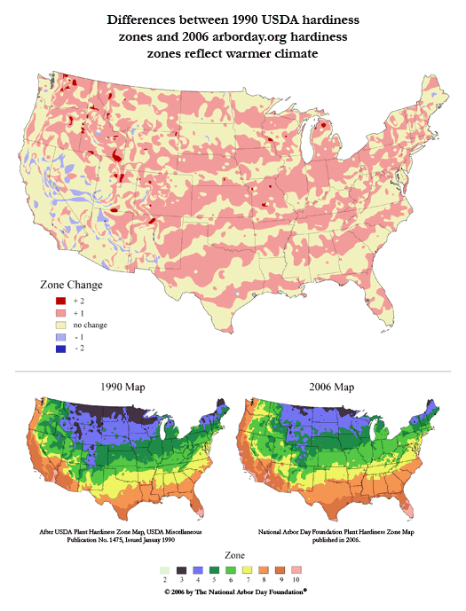
Climate change and my garden…why should I care?
Water
Choosing what and when to plant each season
Long-term commitments to trees and shrubs
Pests and crud

Slide 4
Climatic Context

Slide 5
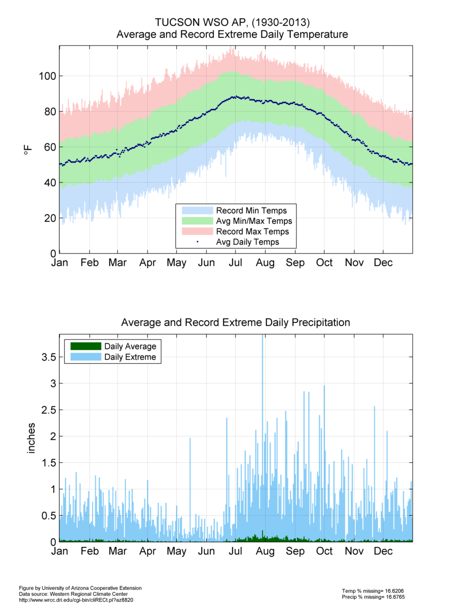
Climate of Tucson
100F
32F

Slide 6
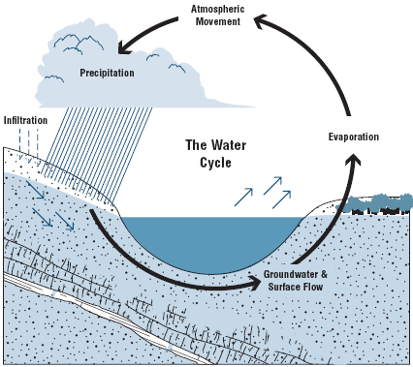
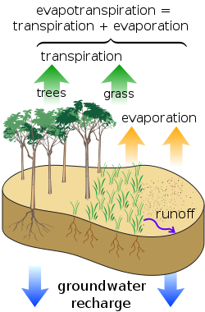
Hydrologic Cycle and Aridity

Slide 7
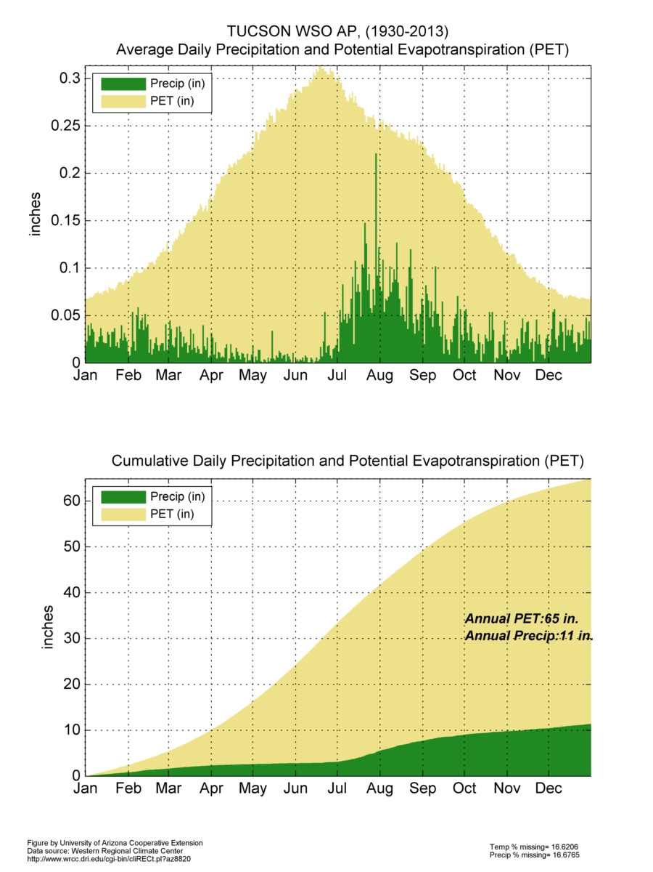
Climate of Tucson

Slide 8
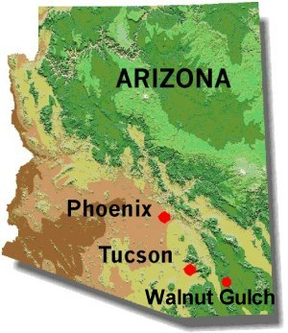
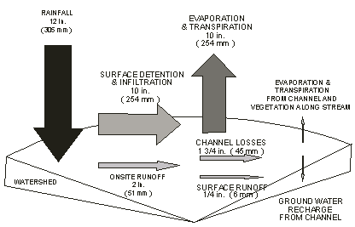
Example Water Balance: Walnut Gulch, Arizona
http://www.tucson.ars.ag.gov/dap/field_sites.htm

Slide 9
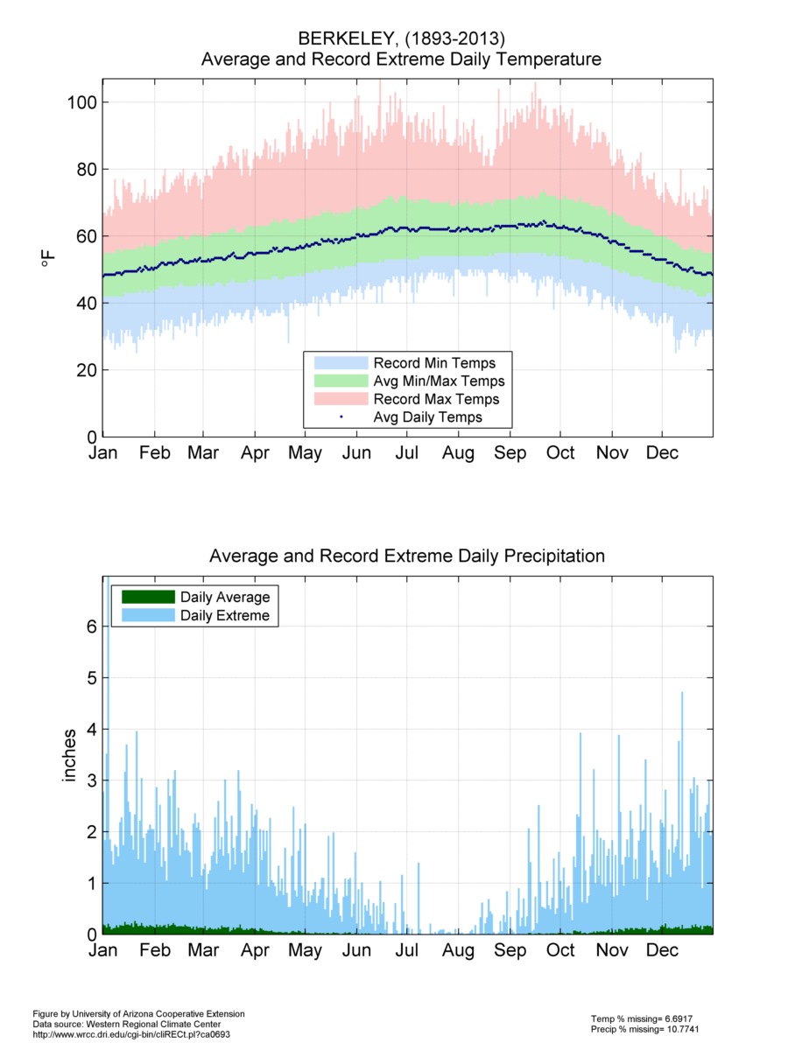
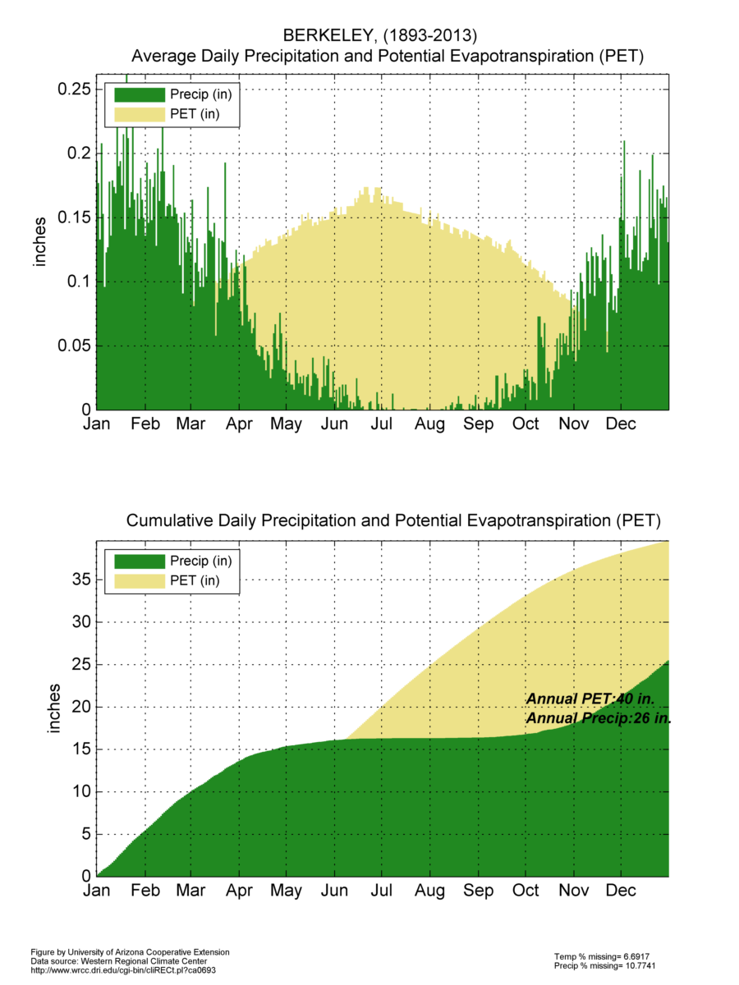

Slide 10
Observed changes

Slide 11
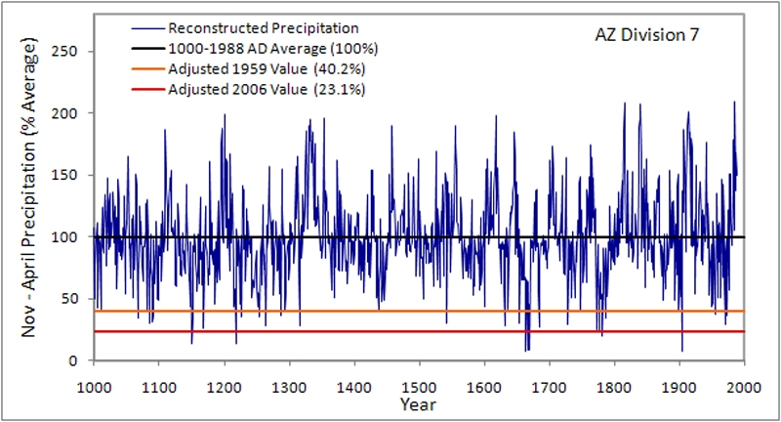
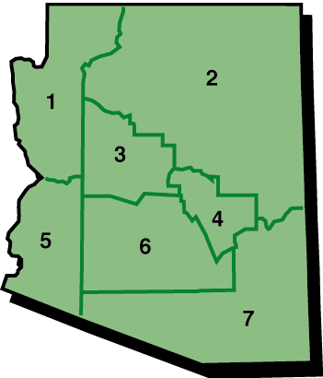
Precipitation: 1000-1988
1980’s pluvial
2002 drought
http://www.climas.arizona.edu/tools/paleoclimate

Slide 12
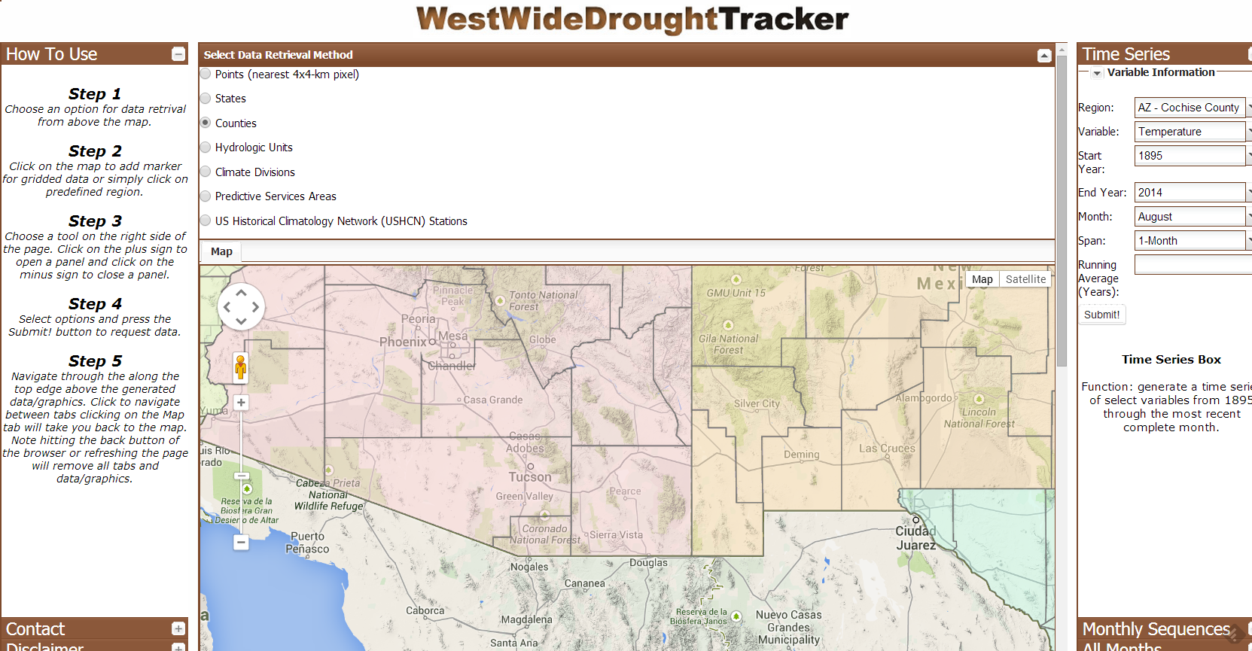
Climate Data Time Series
Western Regional Climate Center
http://www.wrcc.dri.edu/wwdt/

Slide 13
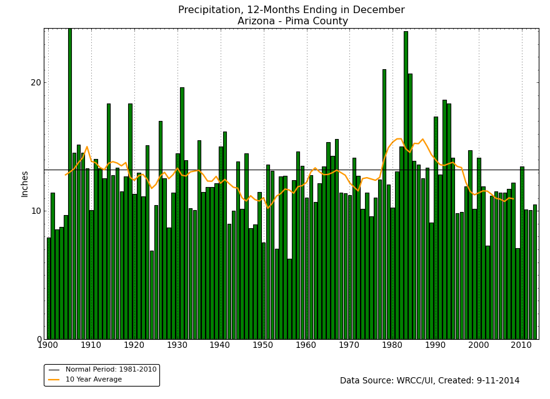
1900-2013
http://www.wrcc.dri.edu/wwdt/time/

Slide 14
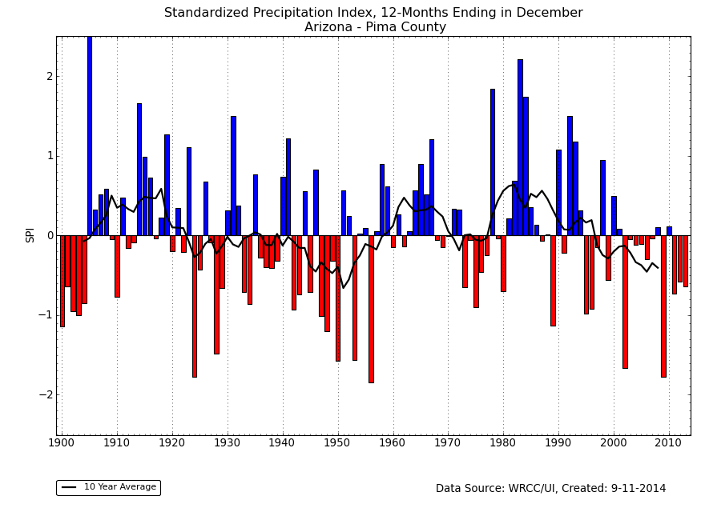
1900-2013
10 of 14 years since 2000
below average precip
Wet
Dry
SPI Drought Index: Annual Precipitation
http://www.wrcc.dri.edu/wwdt/time/

Slide 15
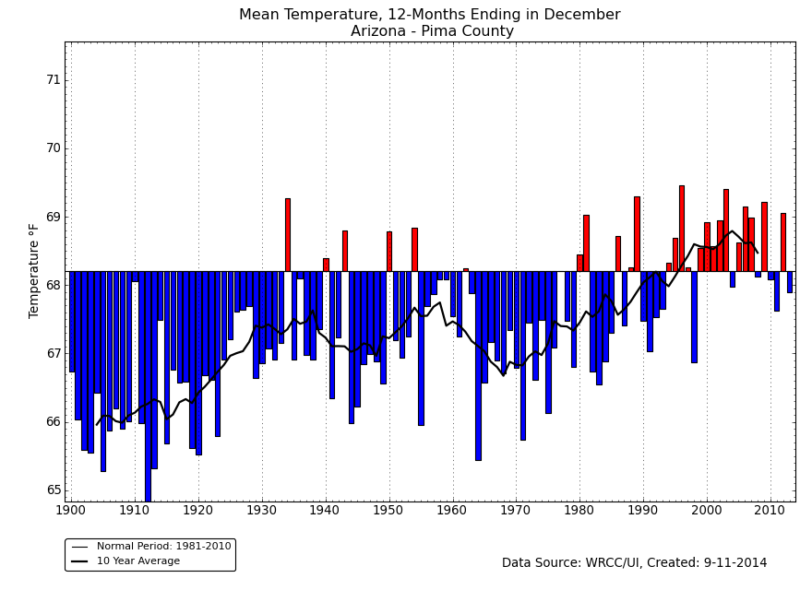
1900-2013
9 of 14 years since 2000
above average temps
Warm
Cool
http://www.wrcc.dri.edu/wwdt/time/

Slide 16
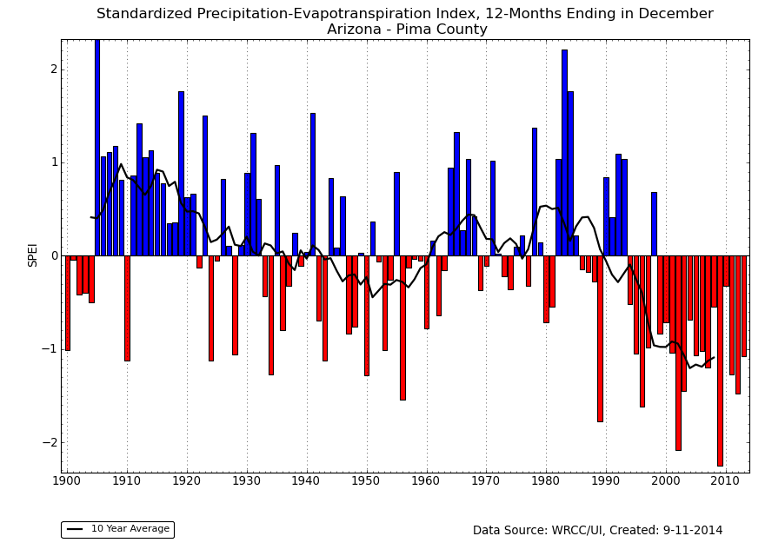
1900-2013
14 of 14 years since 2000
Warm/drier than average
Wet
Dry
SPI Drought Index: Annual Precipitation and Annual Avg. Temps.
http://www.wrcc.dri.edu/wwdt/time/

Slide 17
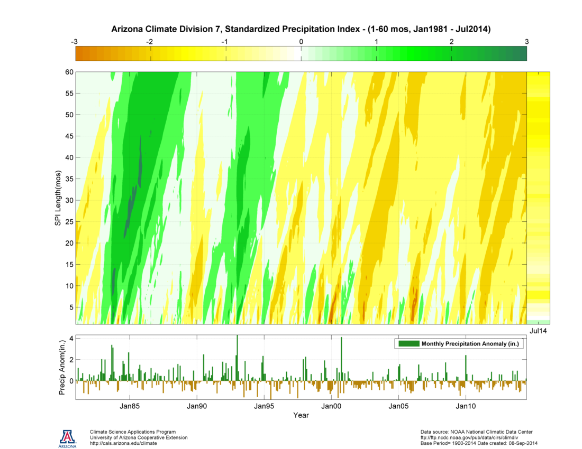
DRY
Average
WET
Long-term
Drought
Short-term
Drought
http://cals.arizona.edu/climate/misc/spi/spi_contour.html

Slide 18
Climate Change Science

Slide 19
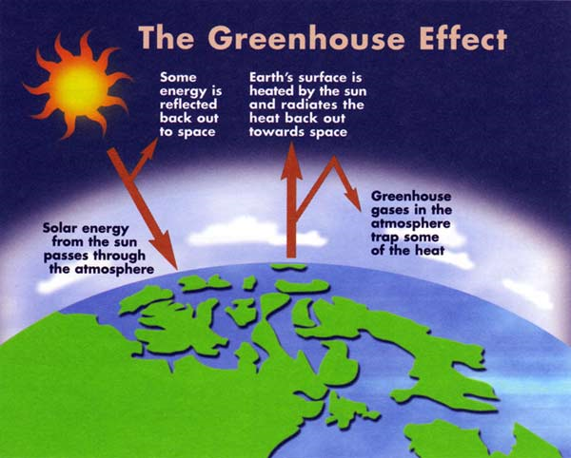
Carbon Dioxide, Methane, and Nitrous Oxide are major GHGs
From http://www.climatechange.gc.ca

Slide 20
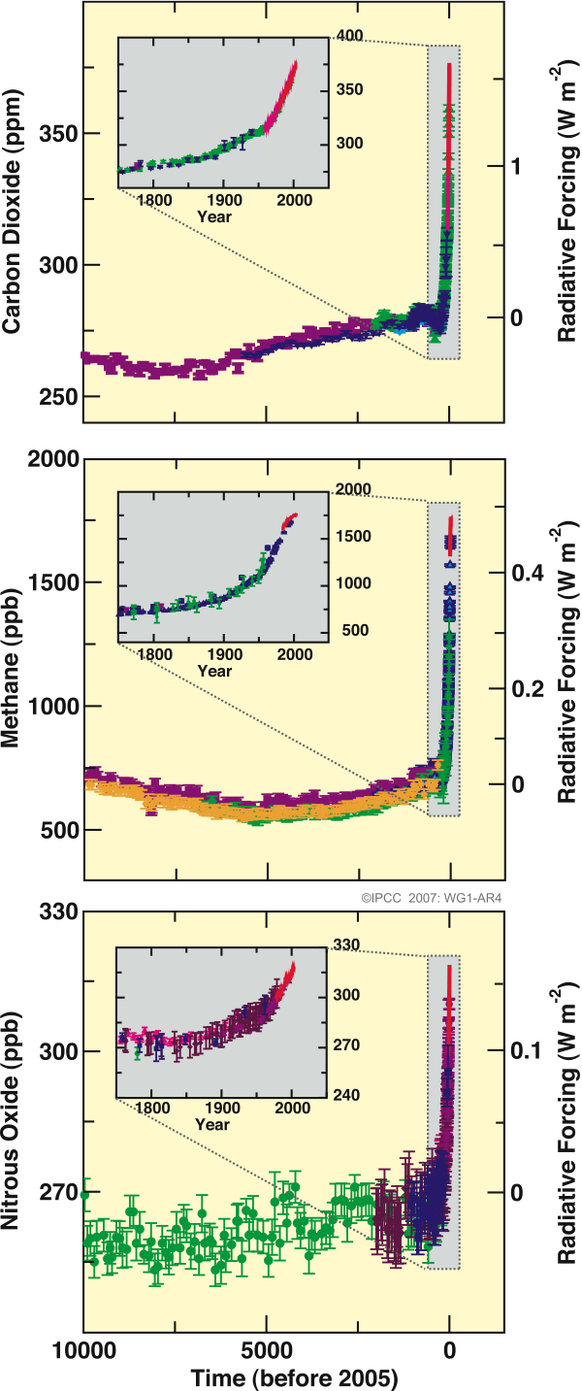
Changes in greenhouse gases over the past 10,000 years
IPCC 2007

Slide 21
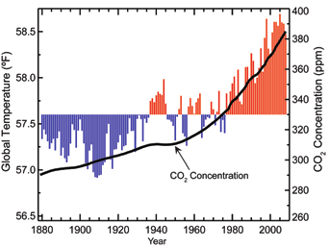
Global Temperature and Carbon Dioxide
USGCRP 2009

Slide 22
Climate Change Modeling and Projections
“…all models are wrong, but some are useful.”
--G.E. Box

Slide 23
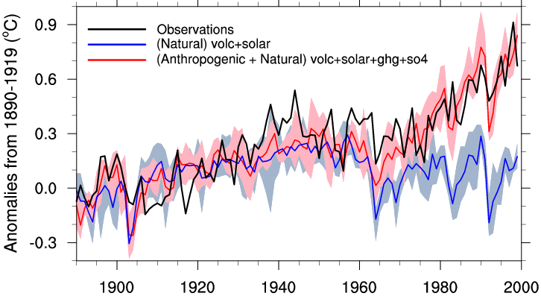
Natural vs. Anthropogenic Forcings
Observed
Natural Only
Stott et al. (2000)

Slide 24
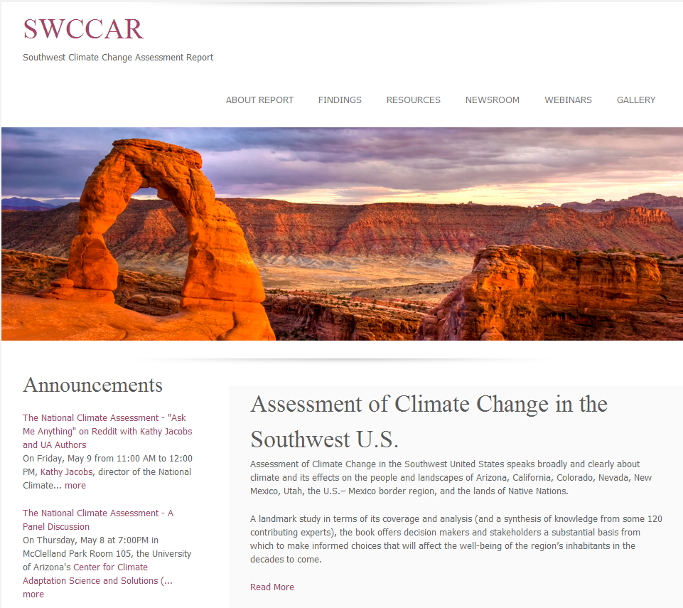
http://www.swcarr.arizona.edu/

Slide 25
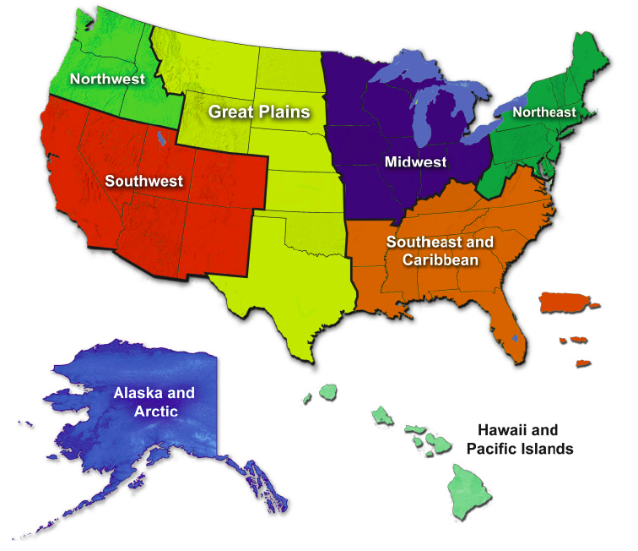
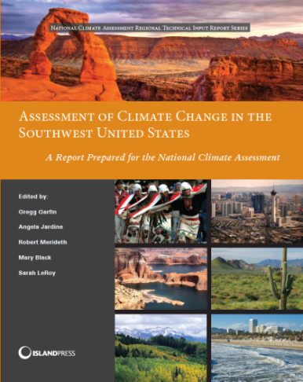
Climate Projections
Slide courtesy of G. Garfin
http://www.swcarr.arizona.edu
Notes:
Diverse 6-state region
Climate changes superimposed on:
Rapid population increase (56 million people in 2010; 94 million in 2050)
Infrastructure degradation (ASCE estimates $3.6 trillion needed by 2020, just to maintain infrastructure across U.S. – incl. airports, highways, reservoirs, etc.)
Variations in National and state economies
U.S.-Mexico border region and associated complicated issues

Slide 26
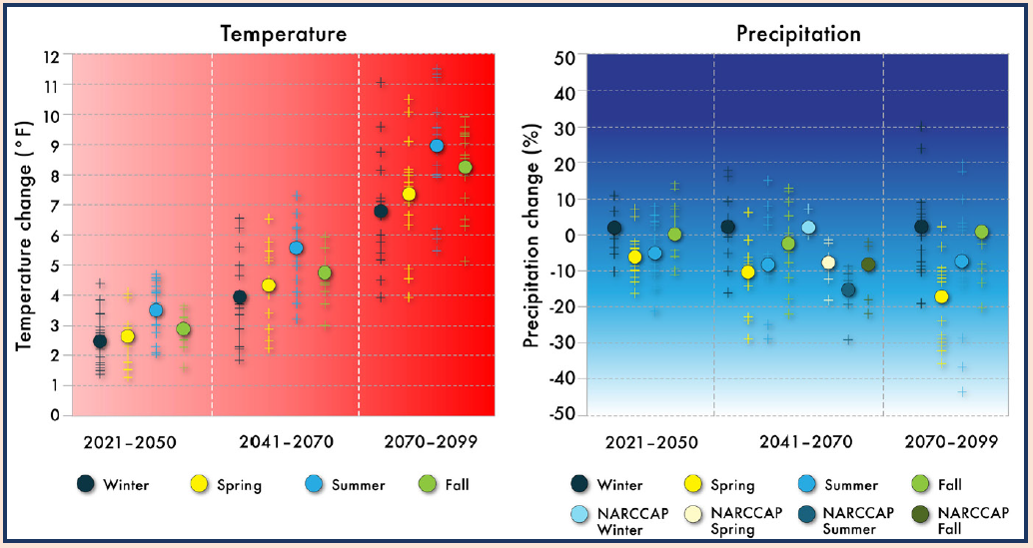
Temperature and Precipitation Projections for SW US
A2 Emissions Scenario
(NCA-SW 2013)

Slide 27
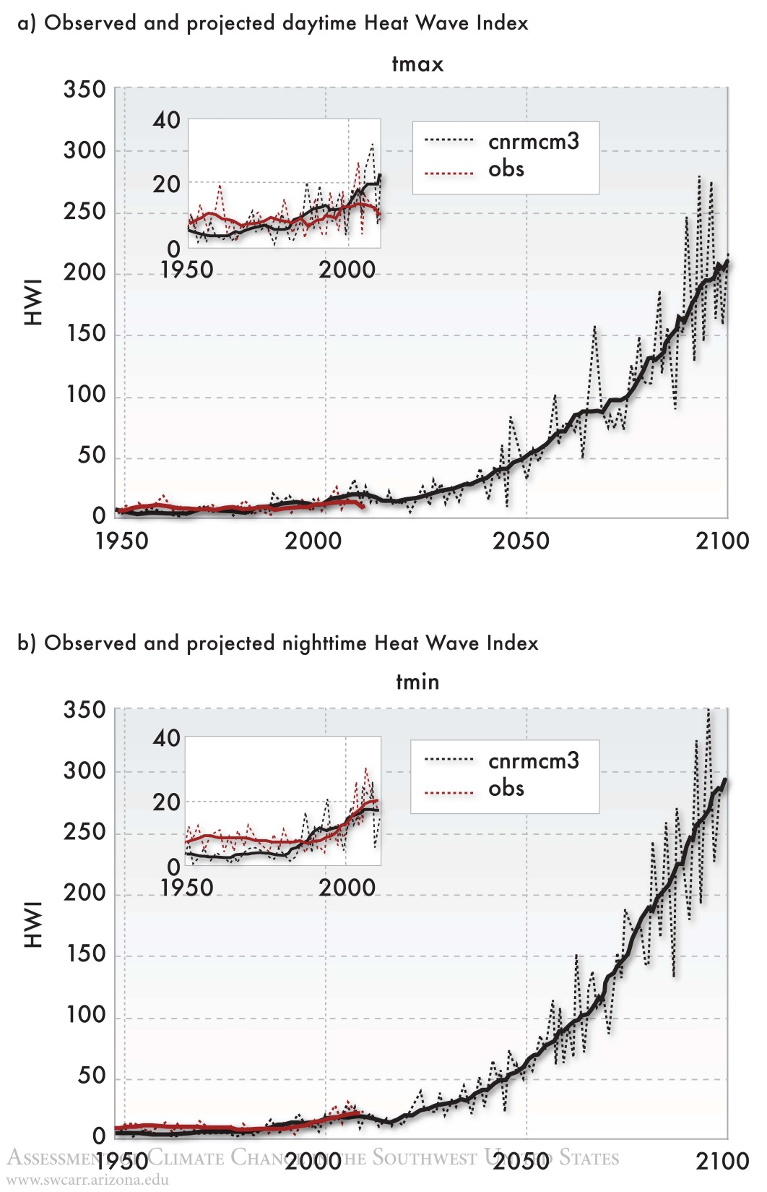
Heat Waves
More frequent
Longer
More intense
(NCA-SW 2013)
Notes:
SOUTHWEST REPORT – CHAPTER 7
In other words, a local heat wave is registered when temperature rises to
the level of the hottest 5% of summer days or nights. The local magnitude of the heat
wave (the heat wave index, or HWI) is the difference between the actual Tmax or Tmin
and its corresponding 95th percentile threshold, summed over the consecutive days of
the heat wave, or over the entire season if a measure of summertime heat wave activity
is desired. This measure is similar to the familiar degree days, except that the threshold
temperature is defined relative to local climatology, as opposed to an absolute threshold,
making the HWI consistent and comparable for all locations representing a region.
The regional HWI is then constructed by taking the regional average of the local values.
HWI includes the frequency, intensity, duration, and spatial extent of heat waves across
the Southwest.
NOTE: Results are confirmed by NCA – which used a different method, and averaged many more statistically downscaled models – see slide 21

Slide 28
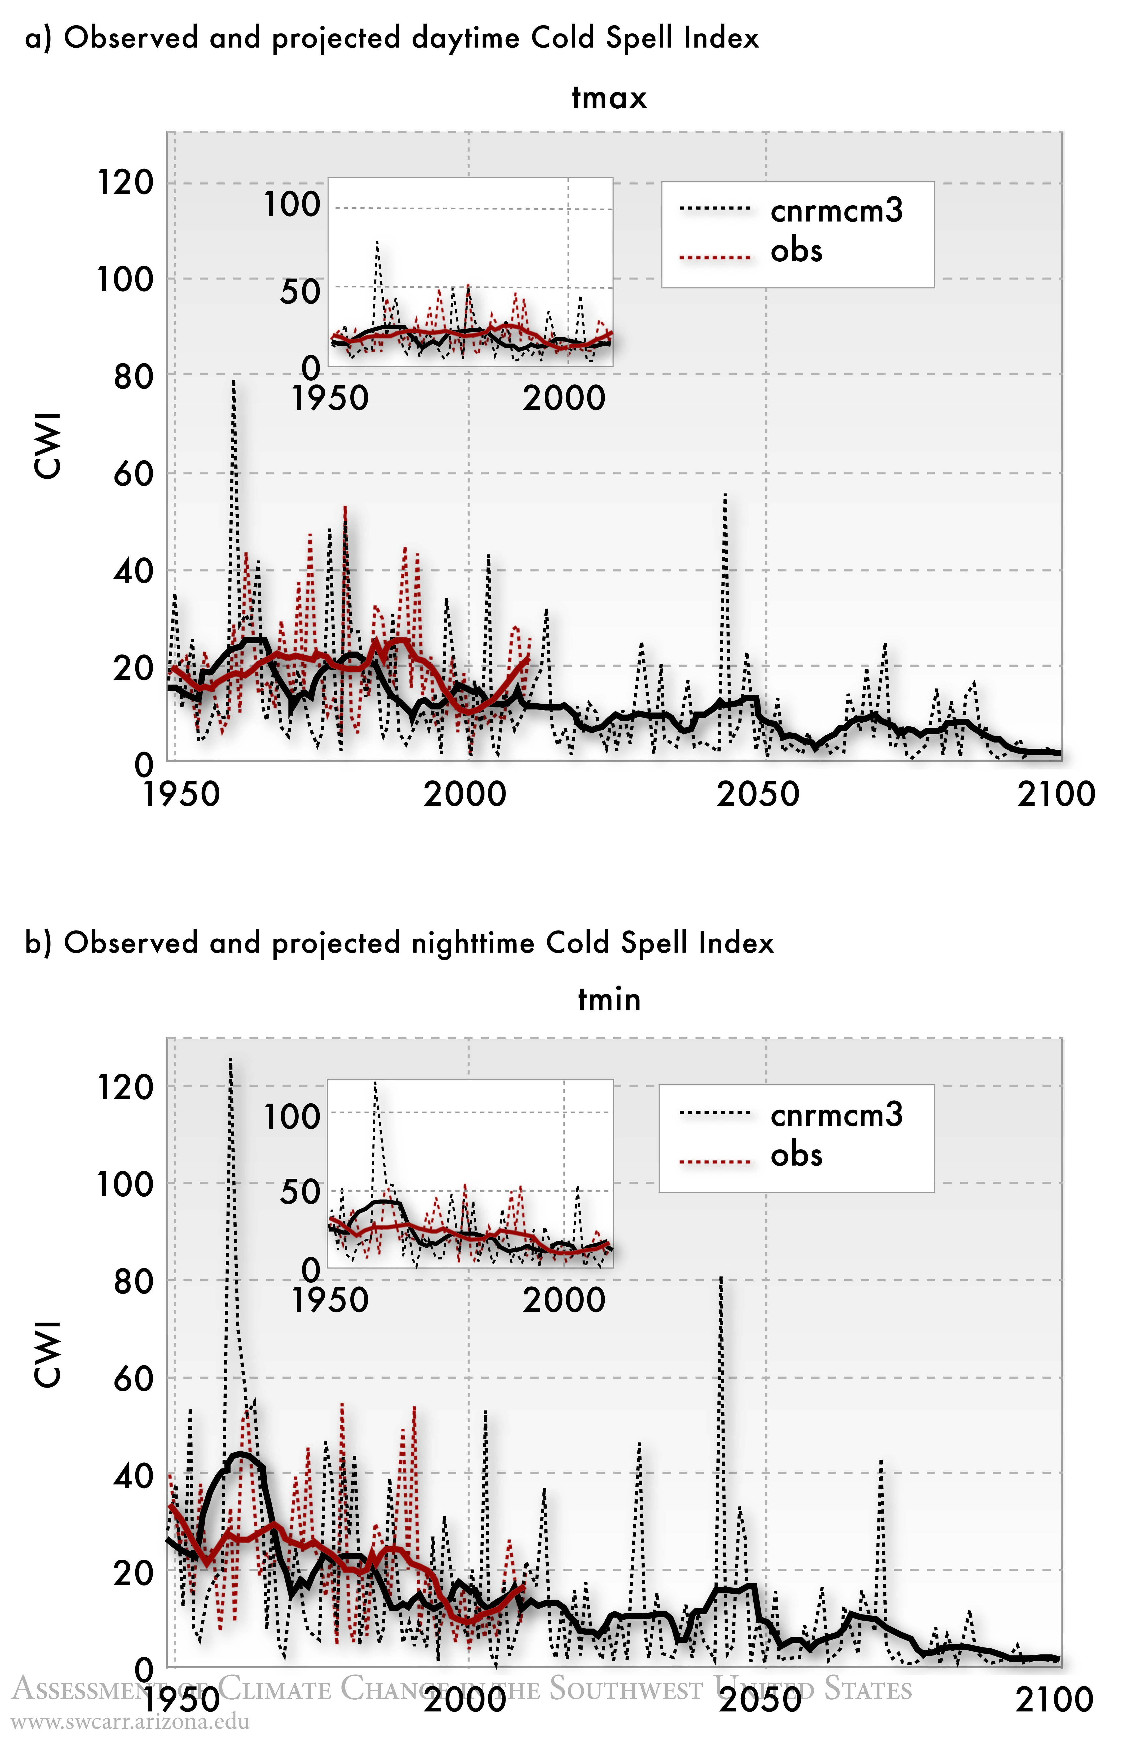
Cold Spells
Less frequent
Just as cold
(NCA-SW 2013)
Notes:
SOUTHWEST REPORT – CHAPTER 7
NOVEMBER-MARCH is the season measured
In other words, cold outbreaks occur when temperature drops below the local levels defining the coldest 5% of winter days or nights, and are measured by how far they drop below those levels over the entire region
Again, confirmed using different methods – see next slide

Slide 29
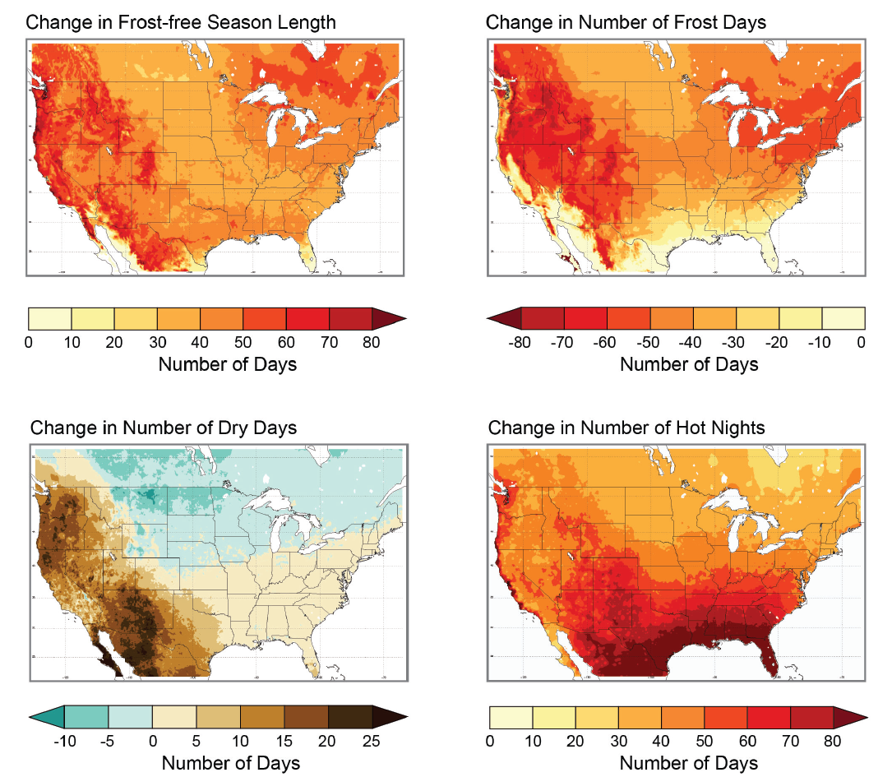
Frost-free Season
Freeze Days
High
emissions
A2
Draft 2013 National Climate Assessment – Chapter 6: Agriculture
Dry Days
Hot Nights
(NCA-SW 2013)
Notes:
Maps are from draft NCA, but THESE CONCLUSIONS ARE FROM SOUTHWEST REPORT
Heat waves, as defined relative to current climate, are projected to increase in
frequency, intensity, duration, and spatial extent. (high confidence)
• Heat waves are projected to become more humid and therefore expressed relatively
more strongly in nighttime rather than daytime temperatures, with associated
stronger impacts on public health, agriculture, ecosystems, and the energy
sector. (medium-low confidence)
• Wintertime cold snaps are projected to diminish in their frequency, but not
necessarily in their intensity, into the late twenty-first century. (medium-high
confidence)
The following is from draft NCA report
FROST = 32 Upshot for cereal grains = rapid growth, less time to mature, lower productivity
HOT NIGHTS = Top 10% of Tmin 1971-1990
Figure 6.5
Caption: Many climate variables affect agriculture. Changes in climate parameters critical to agriculture show lengthening of the growing season and reductions in the number of frost days (days with minimum temperatures below freezing) for 2100, under an emissions scenario that assumes continued increases in heat-trapping gases (A2). Changes in these two variables are not identical, with the length of the growing season increasing across most of the U.S. and more variation in the change in the number of frost days. Warmer-season crops, such as melons, would grow better in warmer areas, while other crops, such as cereals, would grow more quickly, meaning less time for the grain itself to mature, reducing productivity (Hatfield et al. 2011). Taking advantage of the increasing length of the growing season and changing planting dates could allow planting of more diverse crop rotations, which can be an effective adaptation strategy. In the lower, right graph, hot nights are defined as nights with a minimum temperature warmer than 90% of the minimum temperatures between 1971 and 1990 (Source: Walthall et al. 2012).

Slide 30
Statistically downscaled precipitation changes (%) for high emission scenario
A2 High Emissions Scenario
(NCA-SW 2013)
Notes:
SOUTHWEST REPORT – CHAPTER 6
Why does this pattern occur?
Hadley cell intensification
Jet stream migration, due to changing temperature gradient between tropics/poles
The pattern gives us *some* confidence in precip projections
Most of the drying is winter & spring
Annual precipitation change (in inches) from the historical simulation for the low-emissions scenario (left), the high-emissions scenario (middle), and percentage of historical simulation compared to the high-emissions scenario (right). Early- (2021–2050), mid- (2041–2070) and late- (2070–2099) twenty-first century periods shown in top, middle and bottom panels. Values shown are the median of sixteen simulations downscaled via BCSD. Source: Bias Corrected and Downscaled World Climate Research Programme's CMIP3 Climate Projections archive at http://gdo-dcp.ucllnl.org/downscaled_cmip3_projections/#Projections:%20Complete%20Archives.

Slide 31
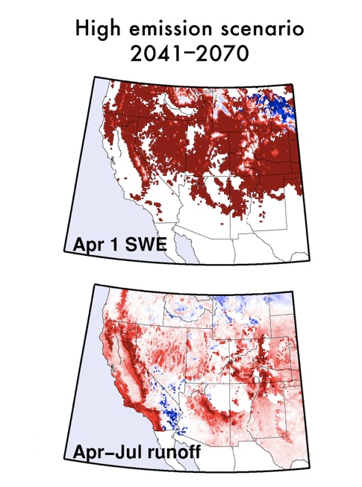
Less Snow
Less Runoff
Less Soil Moisture
A2 High Emissions Scenario
(NCA-SW 2013)
Notes:
SOUTHWEST REPORT – CHAPTER 6
Drought is generally expected to intensify in a warming climate, but some variation
across basins can be expected, although few basins have been analyzed.
• Drought, as expressed in Colorado River flow, is projected to become more frequent,
more intense, and longer-lasting, resulting in water deficits not seen during
the instrumental record. (high confidence)
• Northern Sierra Nevada watersheds may become wetter, and in terms of flow,
somewhat less drought-prone with climate change. (medium-low confidence)
• In terms of soil moisture, drought is expected to generally intensify in the dry
season due to warming. (high confidence)

Slide 32
Implications for Arizona
Higher temperatures
Higher evaporation and transpiration rates (increased water loss in reservoirs, faster drying of soils following precip events, more stress on vegetation)
Less snow/more rain in winter; less snowpack for spring runoff, earlier pulse of precip/less water available in summer
Longer growing seasons; more extreme heat events, but freezes will still be possible
Precipitation
Projections are lower confidence
Higher temperatures on same precipitation variability: more intense drought periods
Increasing variability → more flooding with intervening drought periods

Slide 33
Thanks!
crimmins@u.arizona.edu
http://cals.arizona.edu/climate

