Slide 1
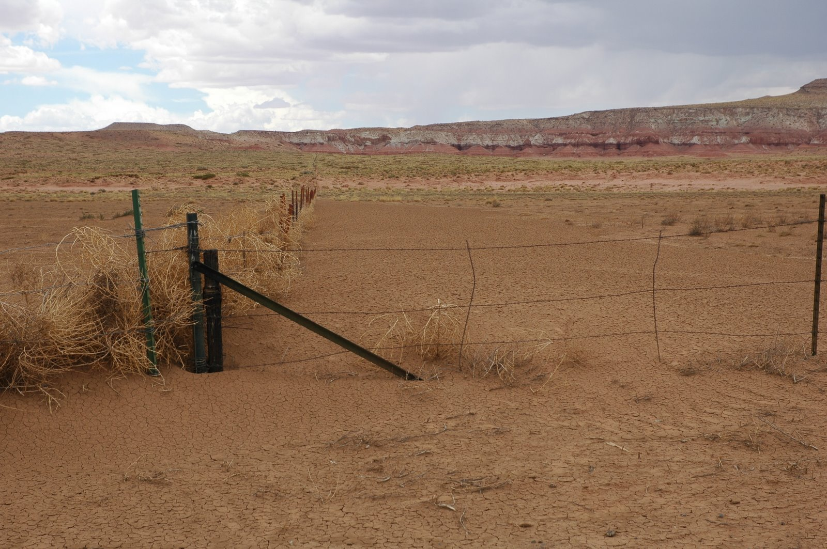
Assessing and Supporting Drought Monitoring Needs on the Hopi and Navajo Nations
Mike Crimmins
Dept. of Soil, Water & Environmental Science
University of Arizona

Slide 2
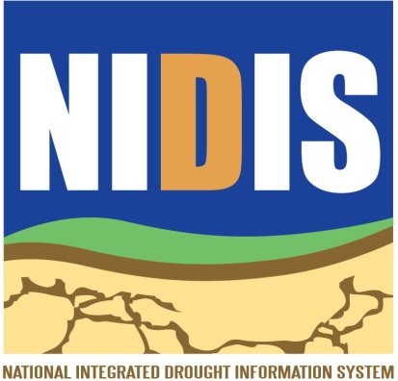


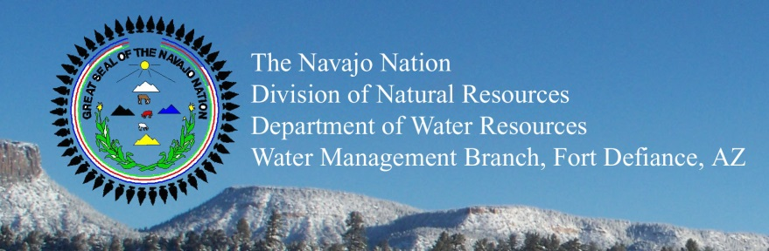
Acknowledgements
Dan Ferguson
University of Arizona
CLIMAS/Institute of the Environment
Clayton Honyumptewa
Manager, Hopi Tribe Department of Natural Resources
Priscilla Pavatea
Director Office of Range Management, Hopi Tribe Department of Natural Resources
Alison Meadow
University of Arizona
SW Climate Science Center/ Institute of the Environment
and many others from UA, Hopi DNR, Navajo WMB

Slide 3
Overview
NOAA-SARP/NIDIS funding (2010) to support drought monitoring and planning efforts for Hopi Tribe and Navajo Nation
  Lingering impacts from 2002 drought and hard hitting ‘flash drought’ 2009
  Concerns over drought detection and response as well as planning at both Hopi and Navajo
2010-2013: Interviews, focus groups, field visits, working meetings, and presentations
  Need for synthesis and interpretation of existing climate information and monitoring products
  Focus on existing capacity…local drought impact monitoring

Slide 4
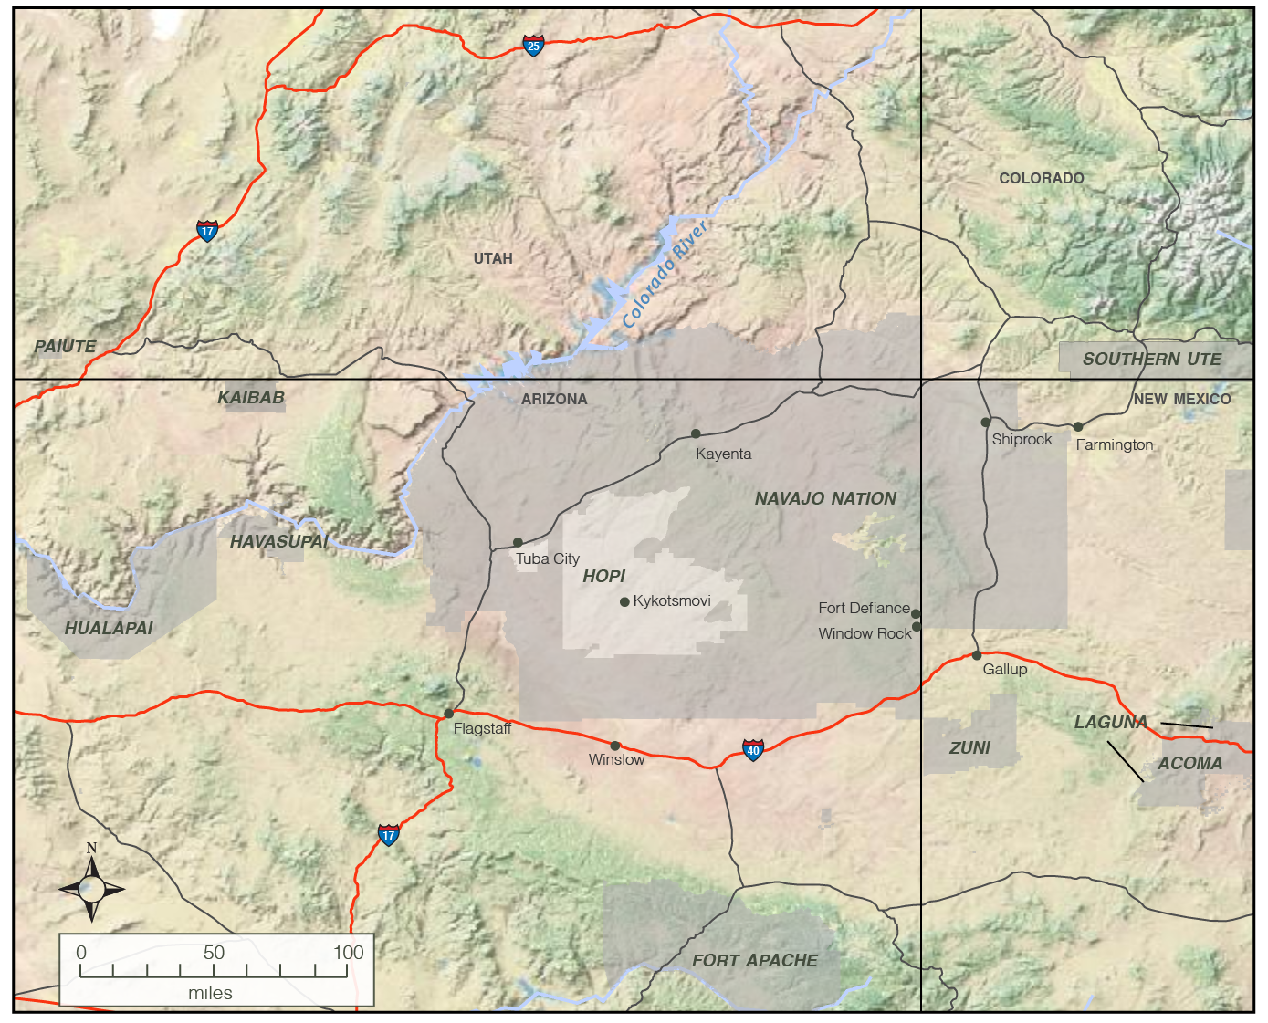
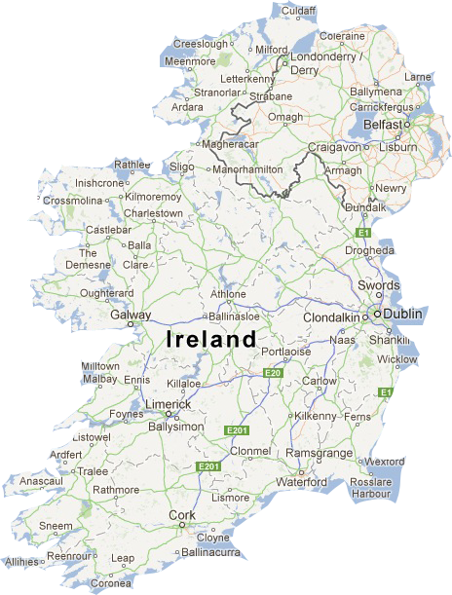
combined area of Hopi and Navajo reservations is
~ 32,000sq. mi or ~83,000 sq km
It’s a really big place…

Slide 5
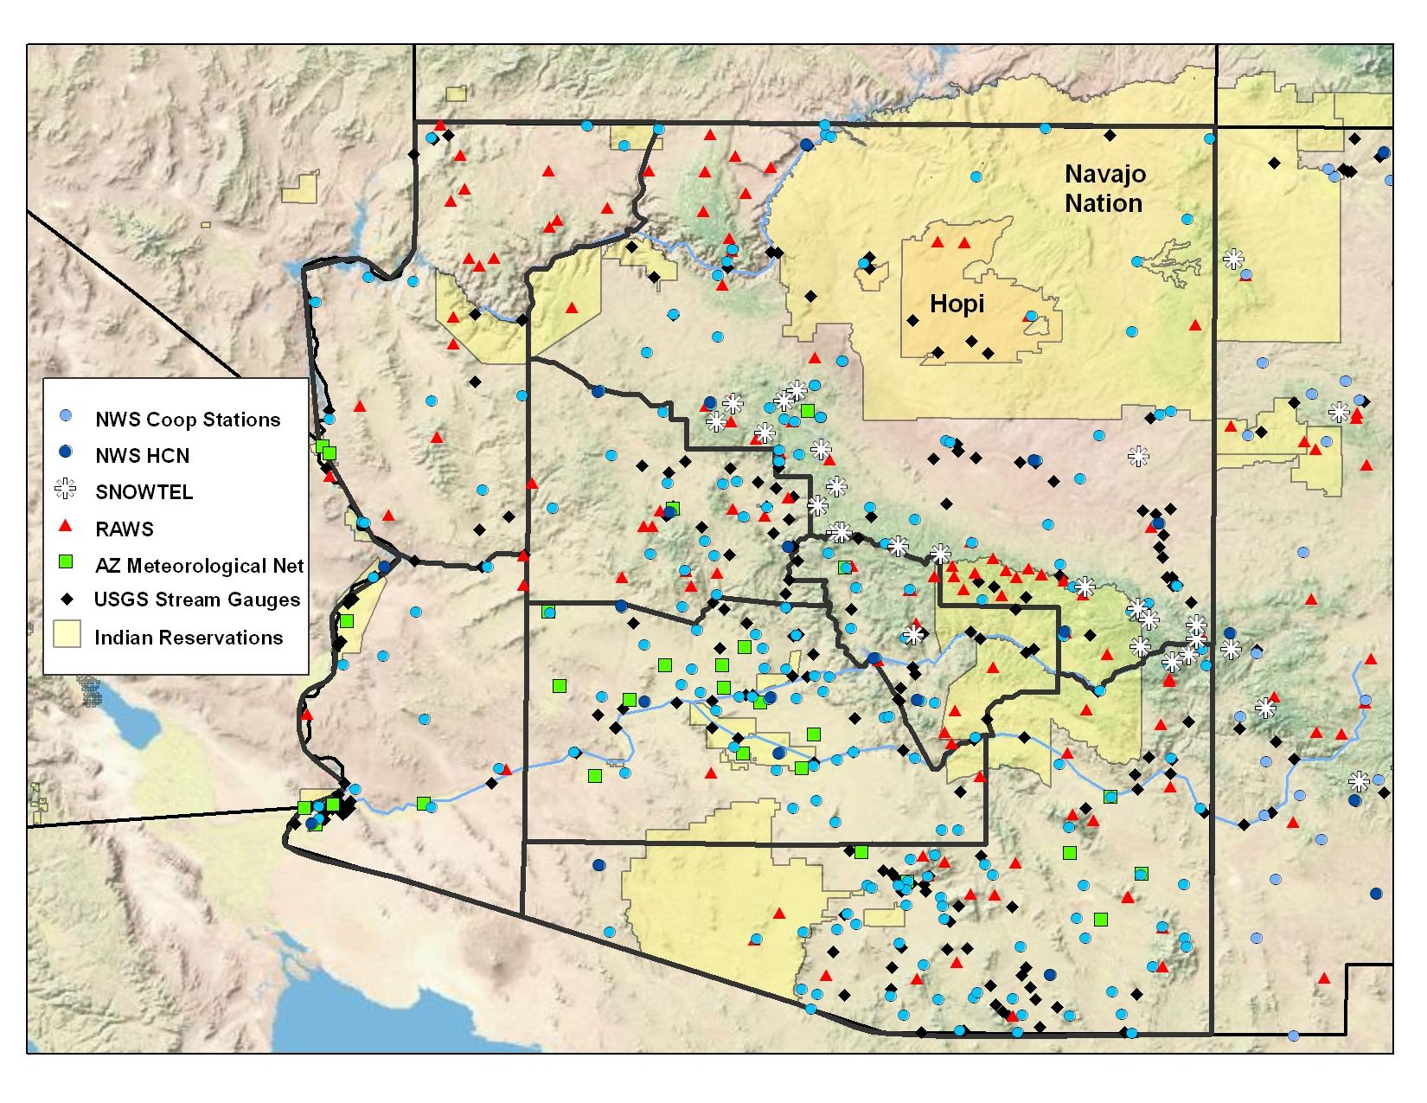
without much data…
map courtesy of Zack Guido, University of Arizona

Slide 6
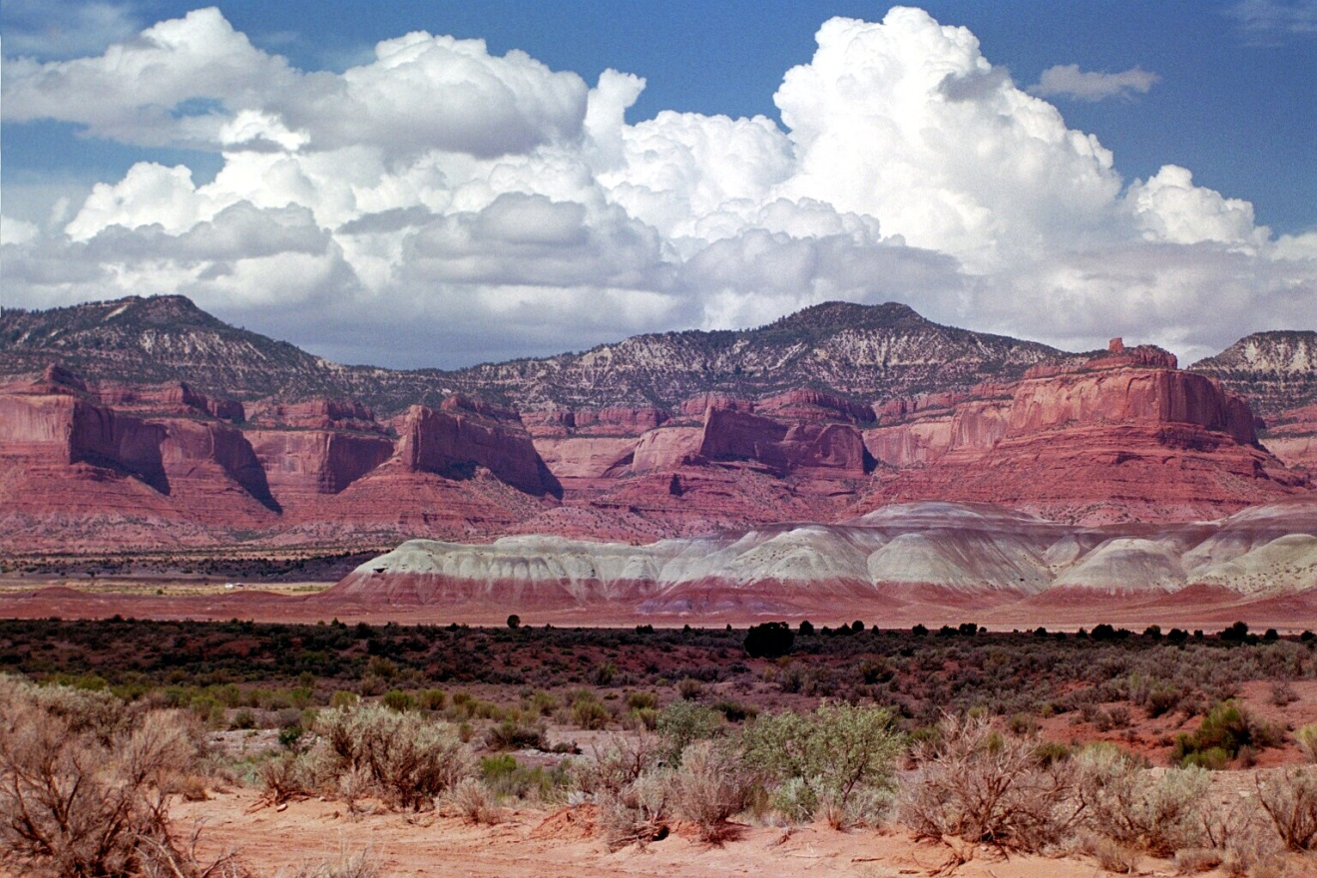
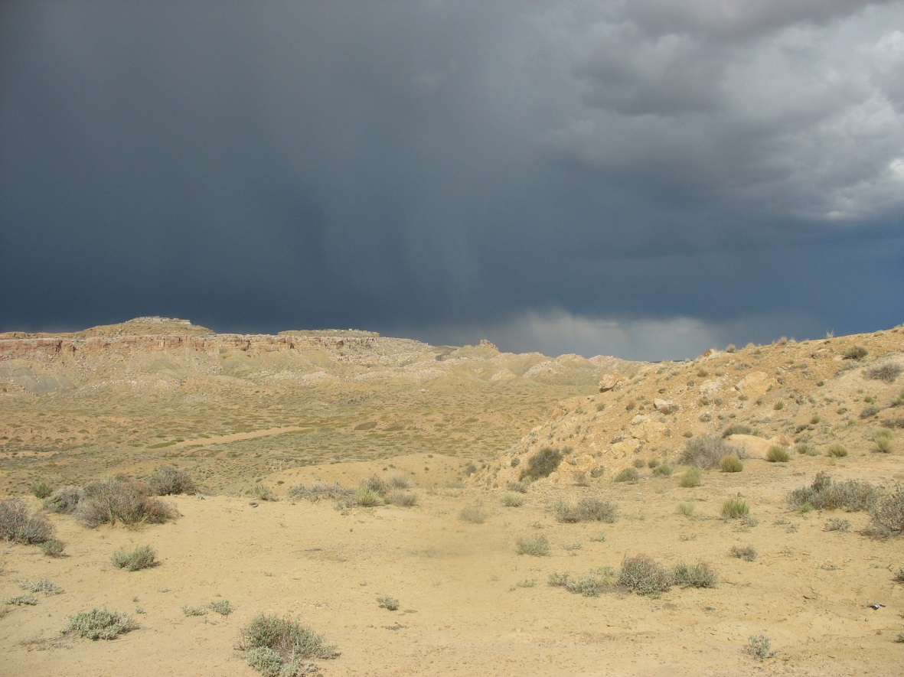
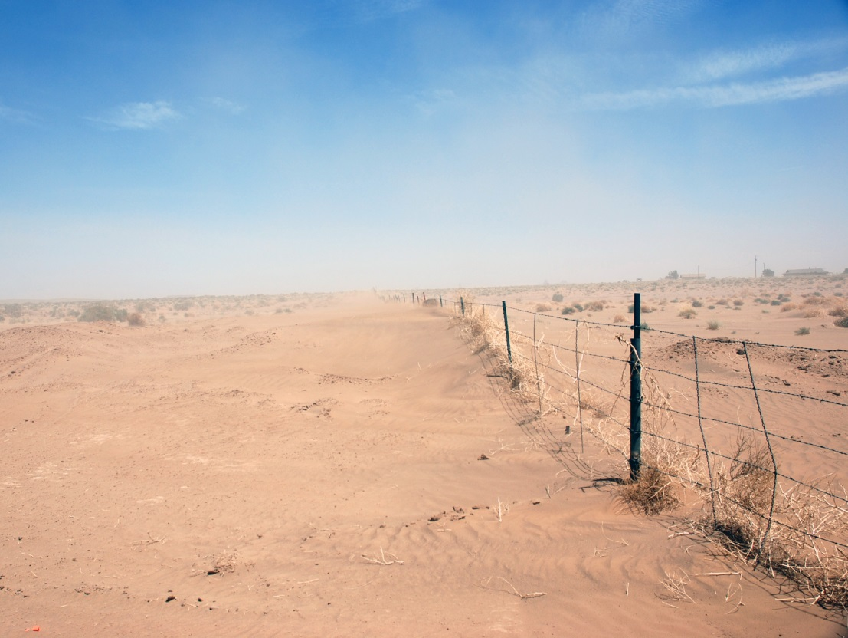
complex topography,

Slide 7
Rapid reversal -
wet/dry years
80’s wet
period
Extended drought
period
highly variable climate,

Slide 8
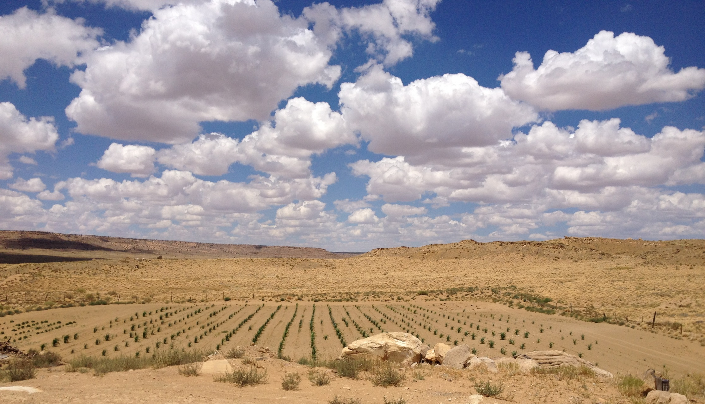
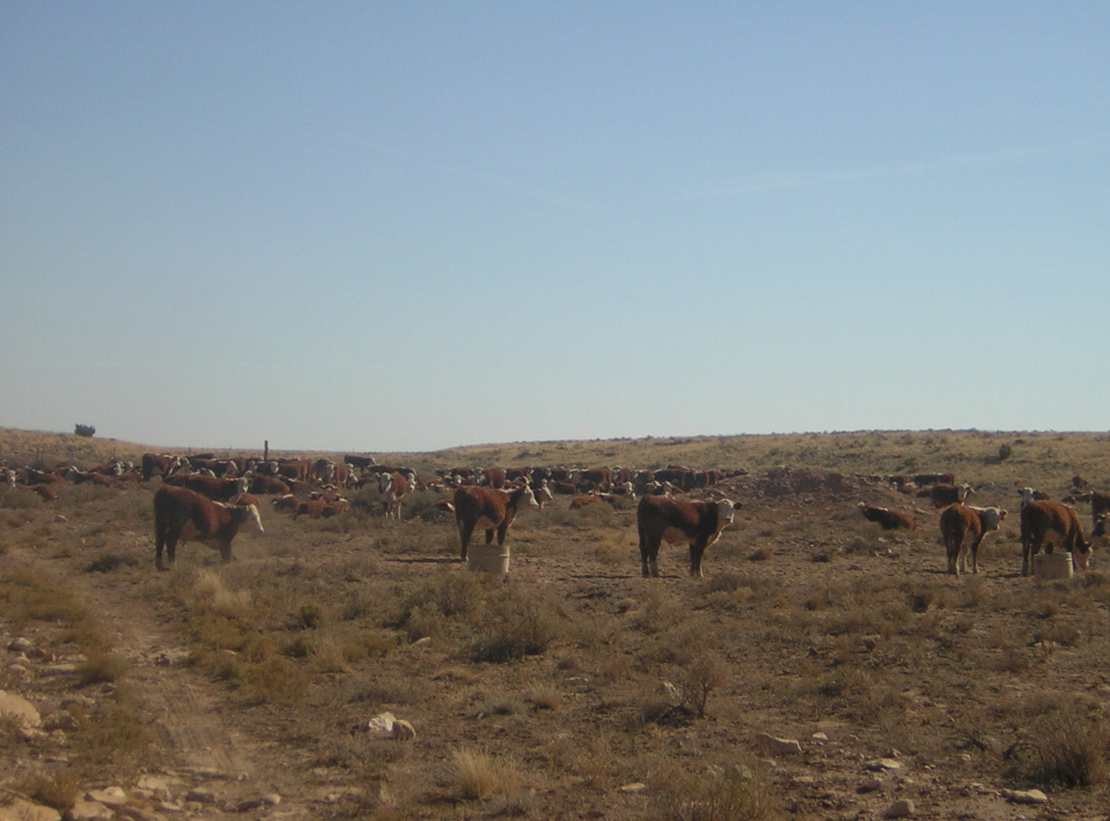
Photo courtesy Hopi Dept. of Natural Resources
Photo: Daniel Ferguson, U of AZ
and livelihoods/land uses that are vulnerable to variability.

Slide 9
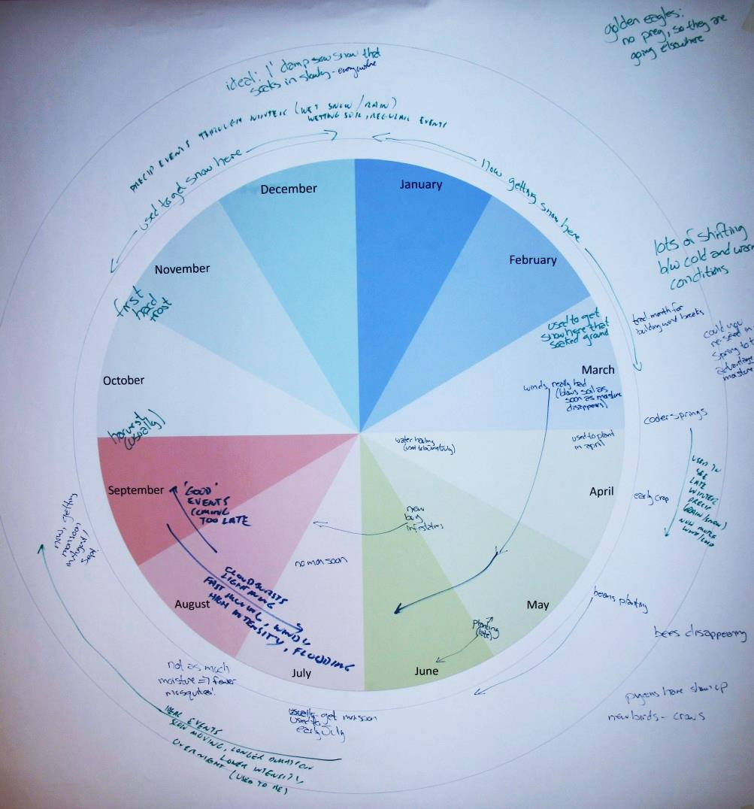
Climate/drought concerns
Impact of recent droughts on unique cultural and natural resources → range conditions, water resources, dryland agriculture, ecosystems
Shifts in seasonality; snow vs. rain and impact on soil moisture status
Shifts in timing and intensity of precipitation events within seasons; dry spells
Warming temperatures
Decision calendar from
Hopi DNR Workshop

Slide 10
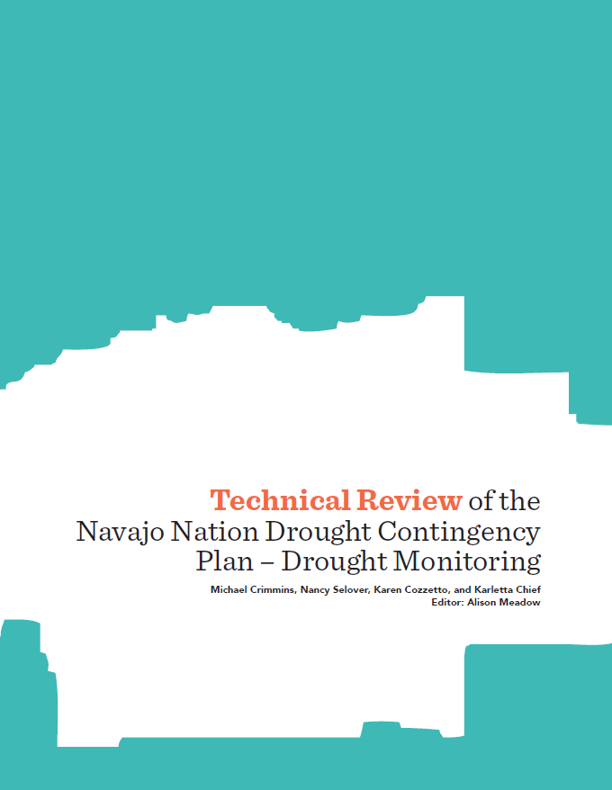
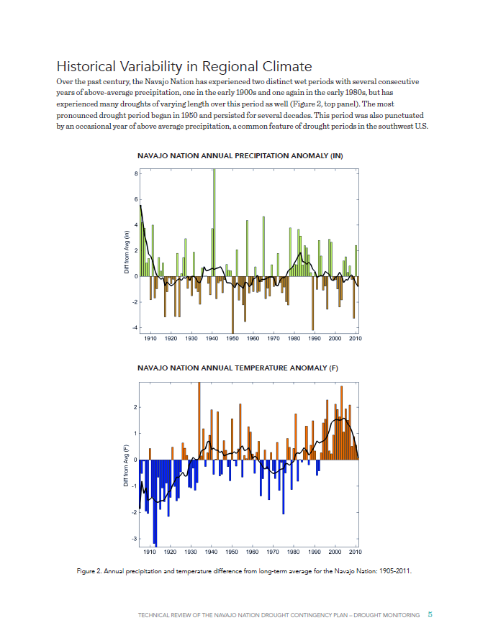
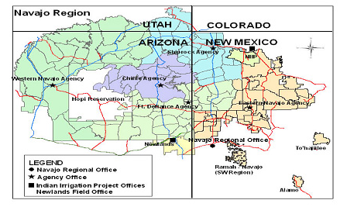
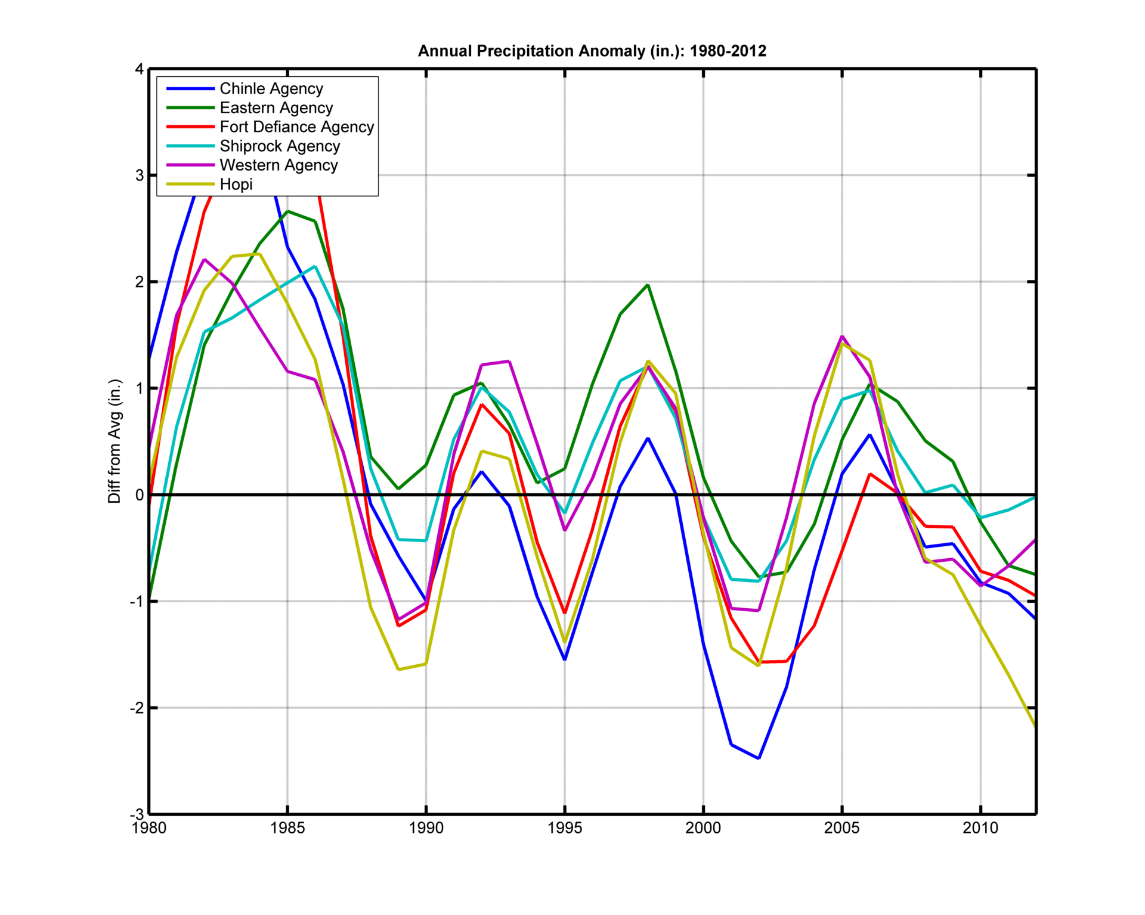
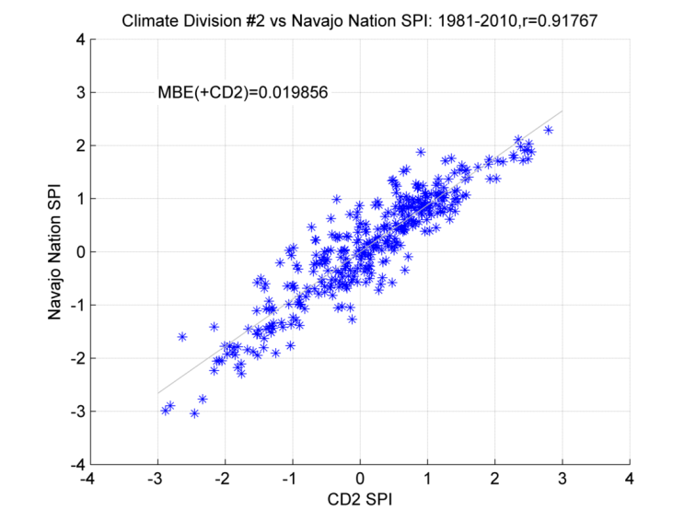
Reviewing, assessing, and synthesizing regional climate information
Notes:
Drought plan review for Navajo WMB
Focus on performance of existing SPI
Use of gridded data in sub-regional historical analyses

Slide 11
Regional Composite Daily Cumulative Precip
Snow/water res
Snow/water res
wildfires
soil moisture recharge
dryland agriculture (growing seas)
rangeland forage
Regionally and sectorally specific drought monitoring strategies
Winter storm season
Spring dry season
Summer monsoon season
Fall transition season

Slide 12
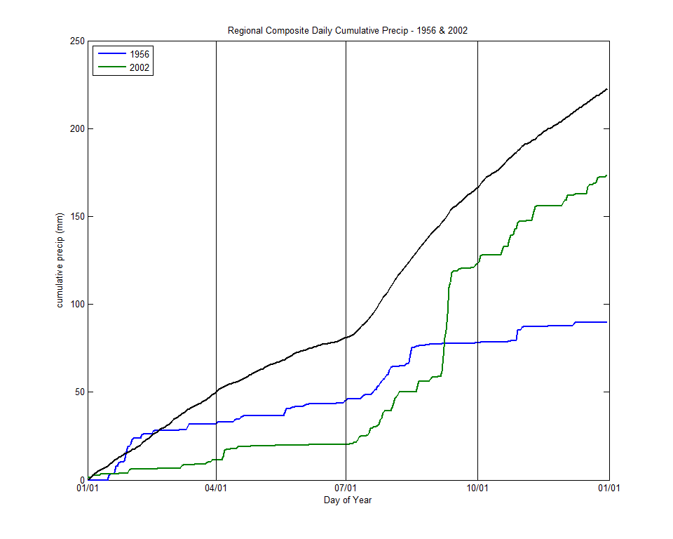
Regional Composite Daily Cumulative Precip – 1956 vs. 2002
2002
Different ‘flavors’ of drought require new monitoring metrics
Cut-off low event
Sept 10-13th
1956
Long-term mean
Record spring
dry spell

Slide 13
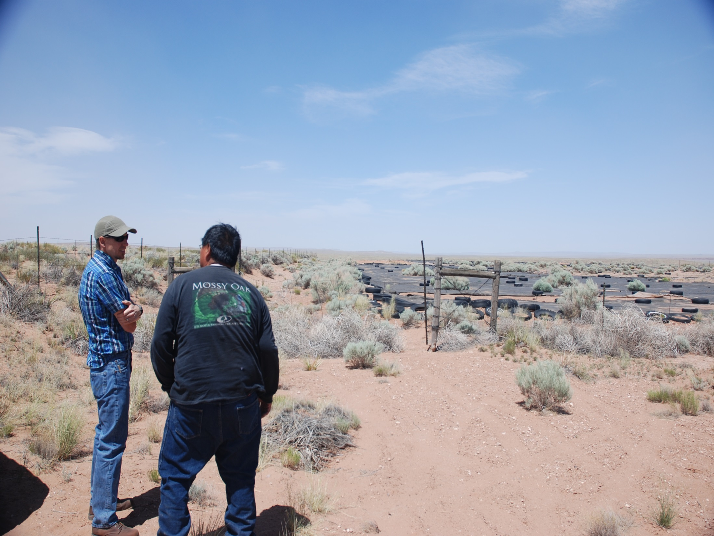
Local Drought Impact Monitoring
large, complex landscape
not much quality hydro-meteorological data
highly variable climate
Most important: the people who live here know how they are exposed to drought and know what drought looks like in this place.

Slide 14
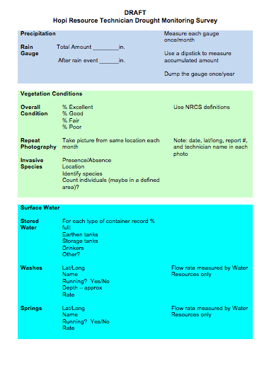
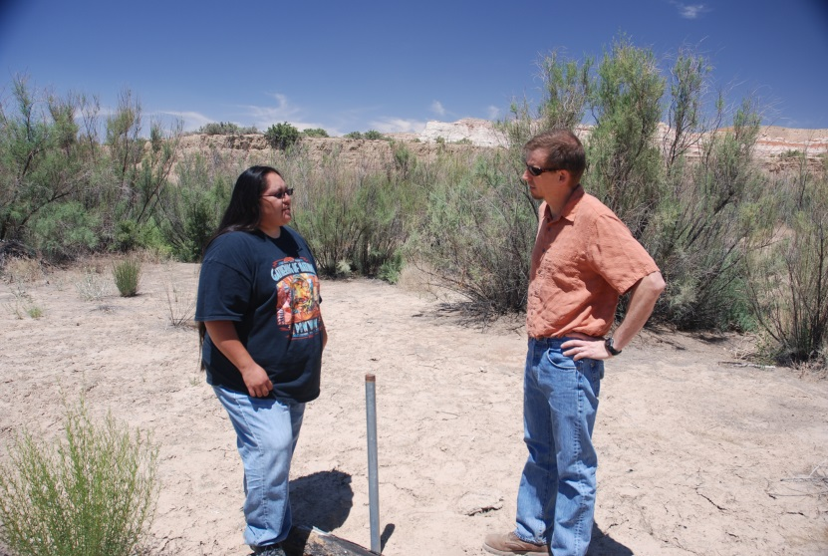
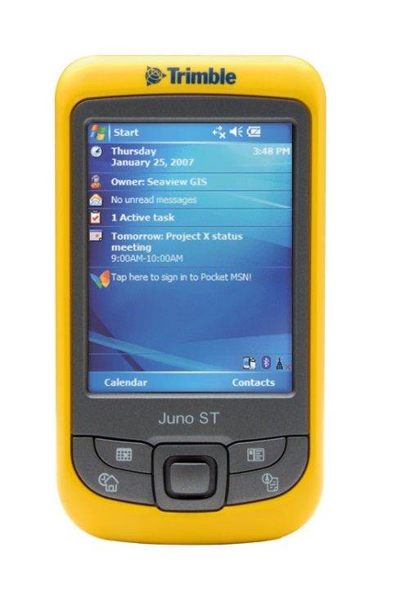
Existing workforce regularly collecting environmental monitoring data
Working to streamline monitoring to inform drought status reporting

Slide 15
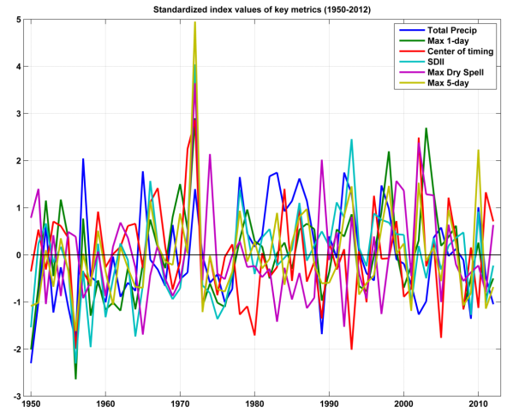
available data with new metrics
drought impacts obs
+
Better local characterization of drought

Slide 16
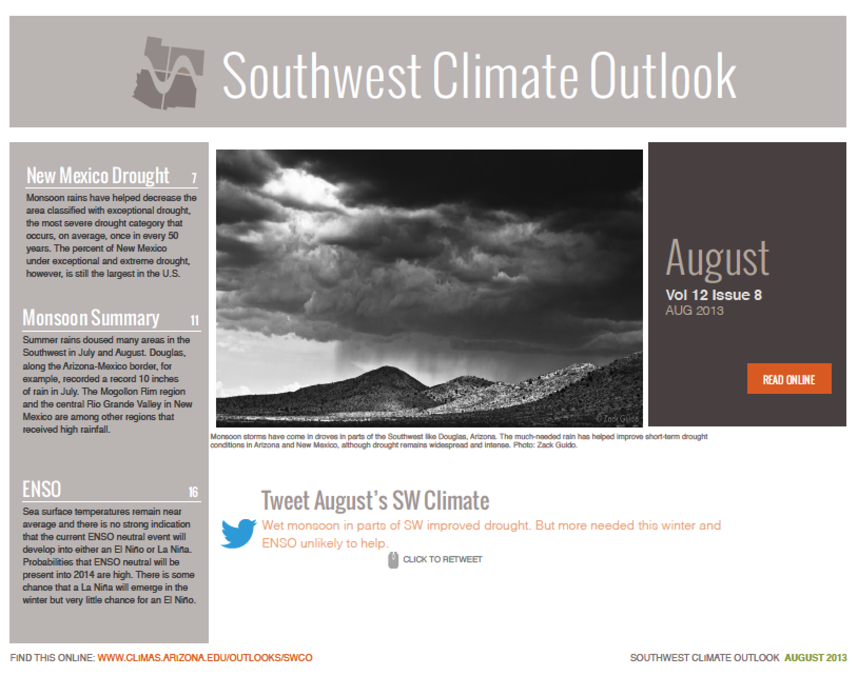
first cut at turning all this data into useful knowledge:
Quarterly Four Corners Drought Update modeled on SWCO?

Slide 17
Next Steps
Assess community vulnerabilities to drought
Use results of vulnerability assessment to develop set of drought indicators
Identify data and info that can be used to monitor those indicators

Slide 18
Thanks!
crimmins@email.arizona.edu
http://cals.arizona.edu/climate

