Slide 1
Drought in Arizona: Where are we now and where are we headed?
Mike Crimmins
Assoc. Professor/Extension Specialist
Dept. of Soil, Water, & Environmental Science & Arizona Cooperative Extension
The University of Arizona

Slide 2
Presentation Overview
Where are we now?
Climatic Context
Interannual Climate Variability
Where are we headed?
Notes:
What is going on?
Why and what extension is…
Who am I working with
What am I doing…

Slide 3
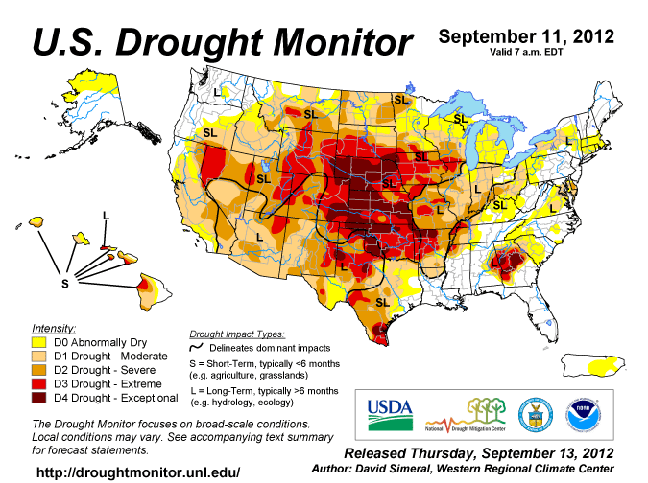

Slide 4
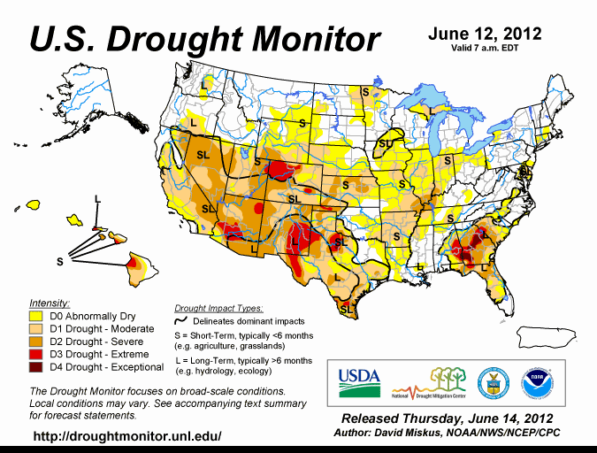

Slide 5
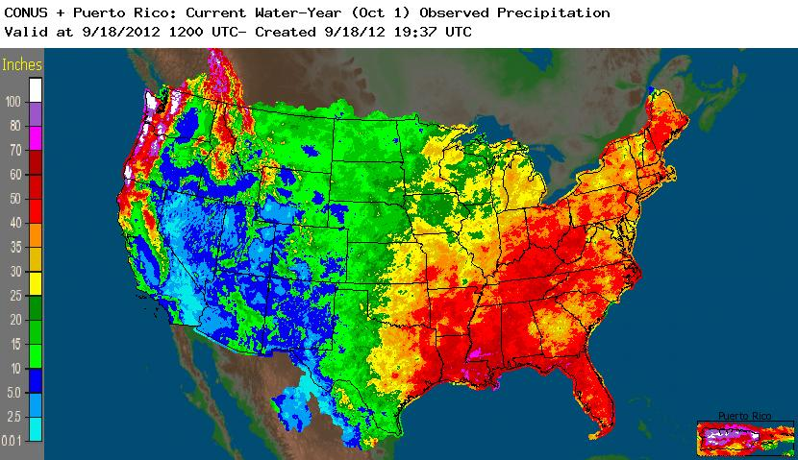
Water-year Precipitation

Slide 6
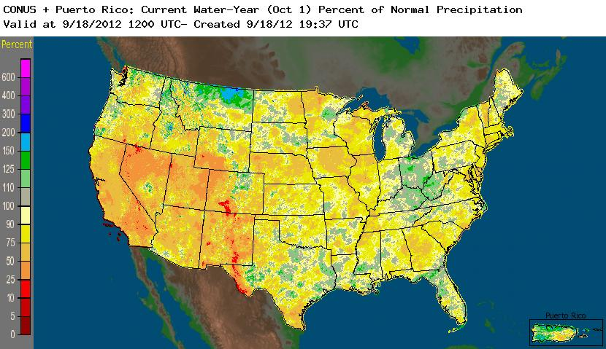
Water-year Precipitation

Slide 7
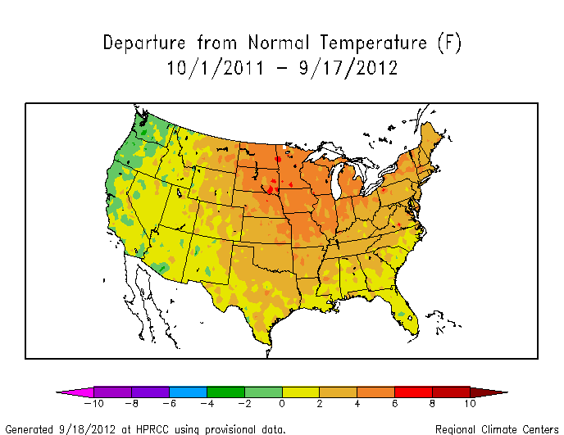
Water-year Temperature

Slide 8
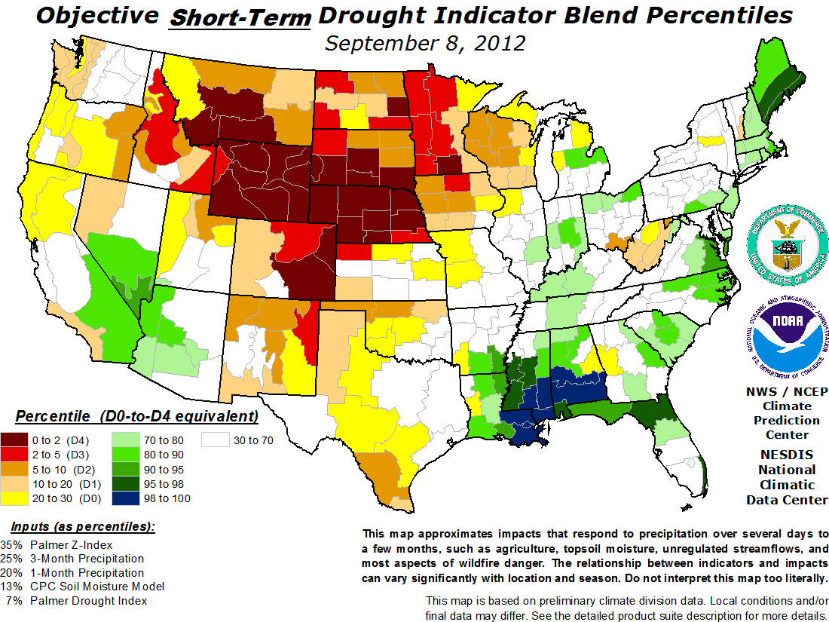
Short-term Drought Conditions

Slide 9
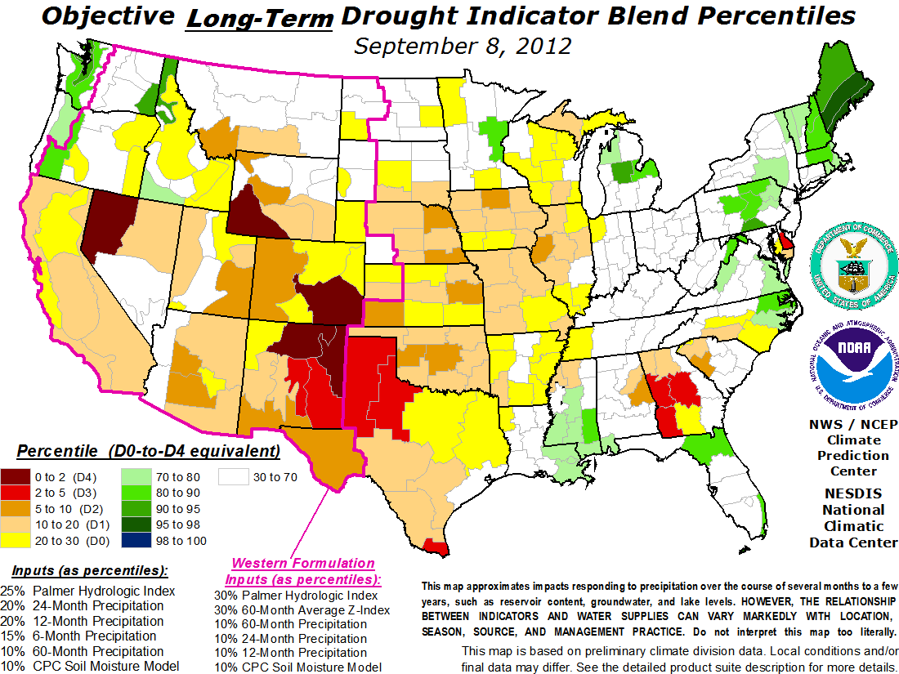
Long-term Drought Conditions

Slide 10
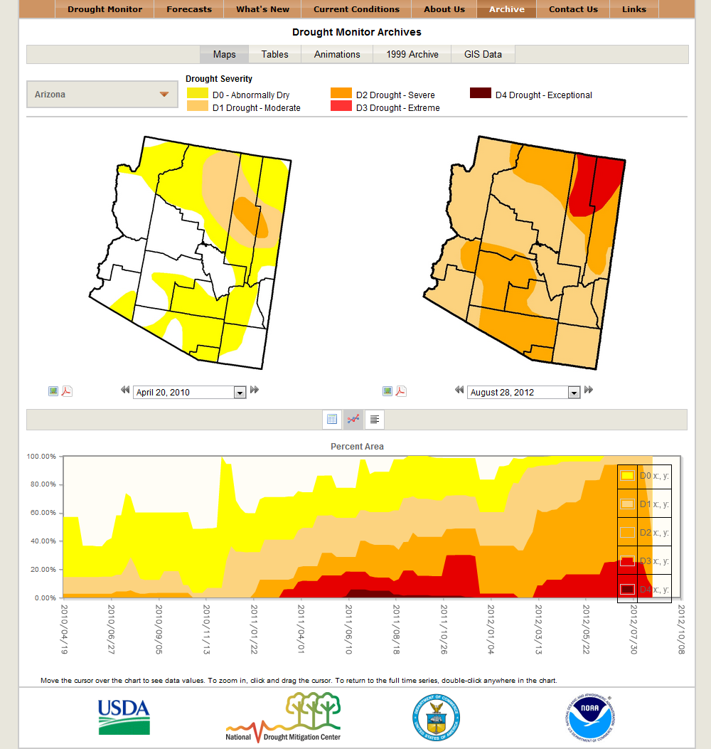
AZ Drought

Slide 11
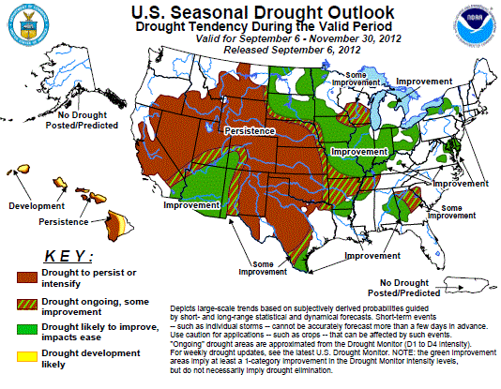

Slide 12
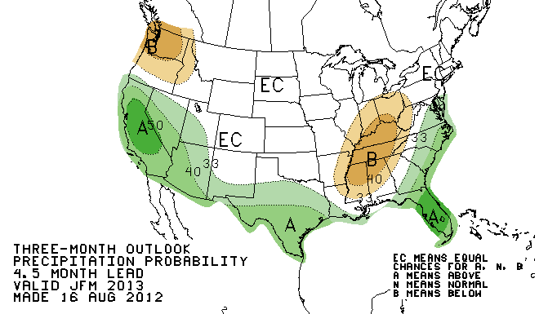
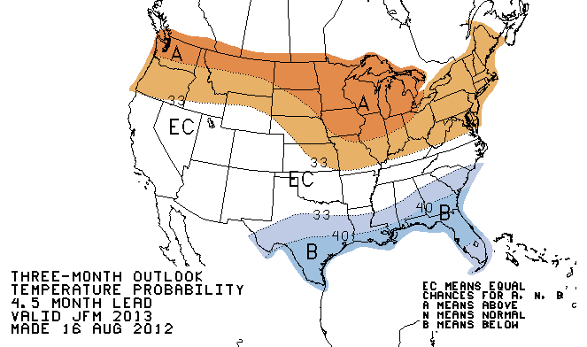
Seasonal Forecasts
http://www.cpc.ncep.noaa.gov/products/predictions/90day/

Slide 13
Climatic Context

Slide 14
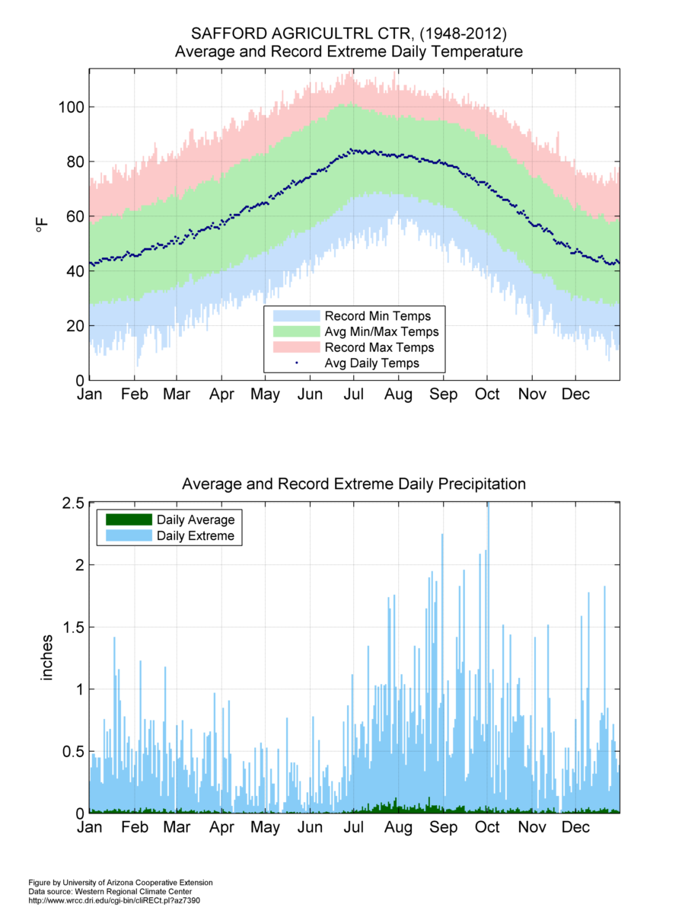
Climate of Safford

Slide 15
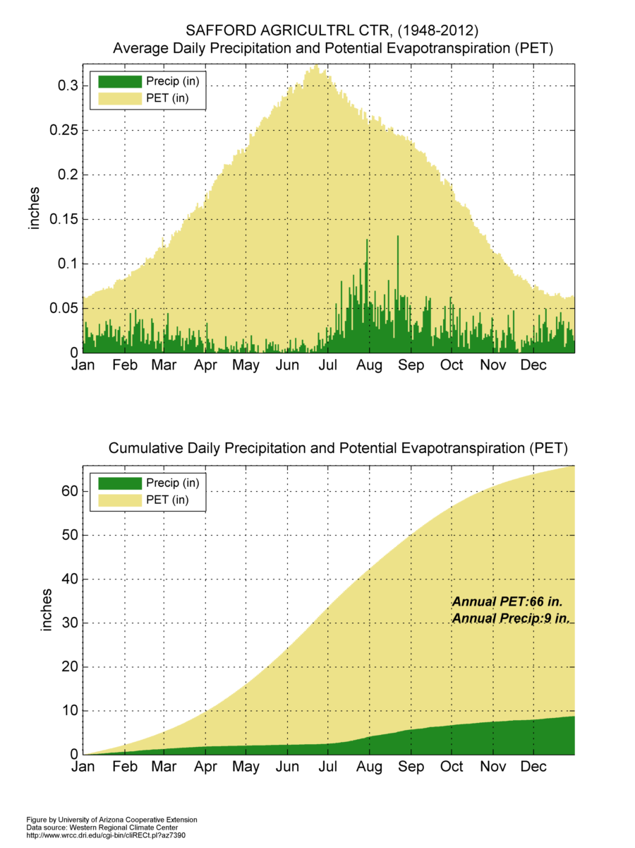
Climate of Safford

Slide 16
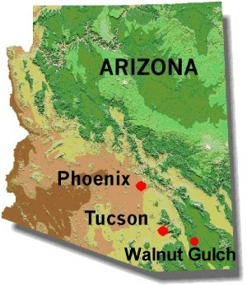
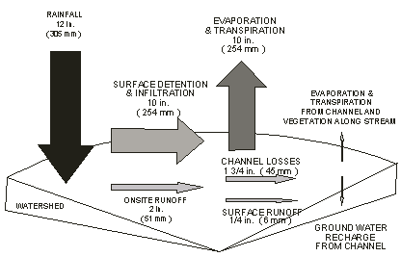
Example Water Balance: Walnut Gulch, Arizona
http://www.tucson.ars.ag.gov/dap/field_sites.htm

Slide 17
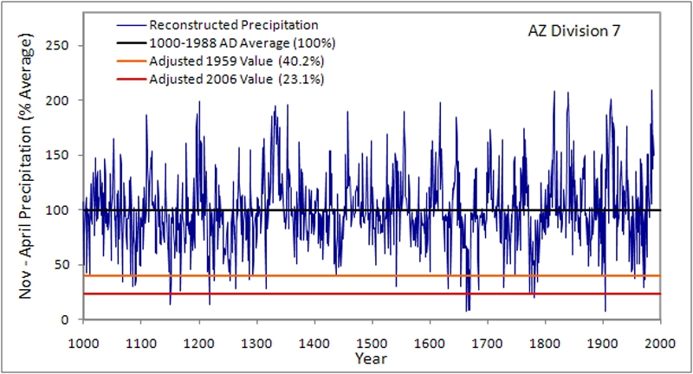
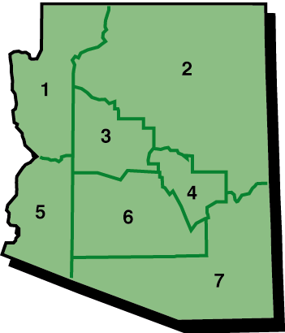
Precipitation: 1000-1988
http://www.climas.arizona.edu/research/paleoclimate/product.html

Slide 18
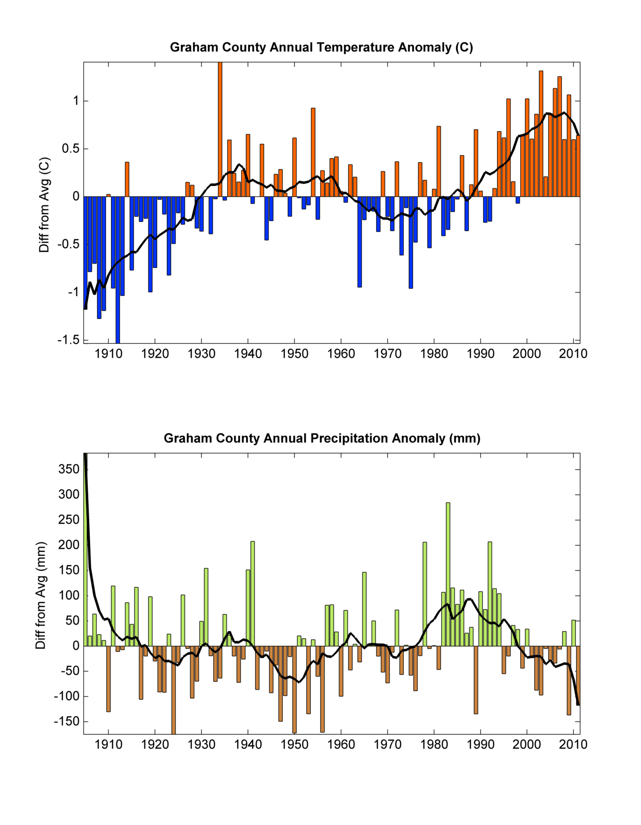
Precipitation: 1905-2011

Slide 19
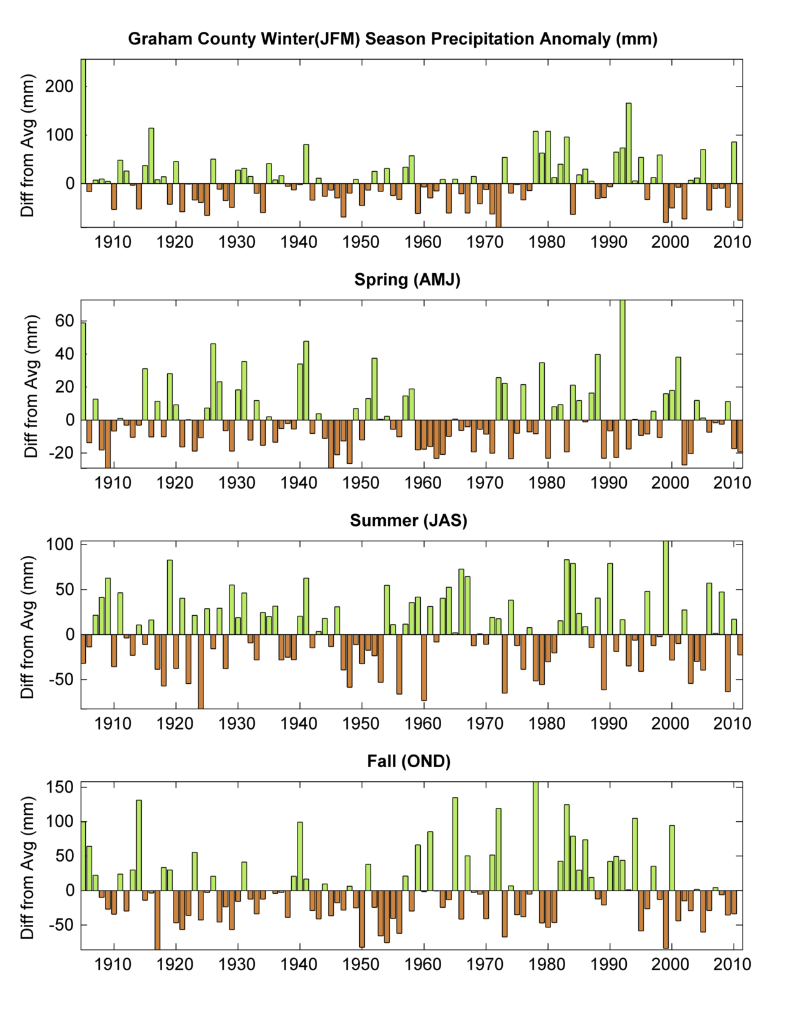
Seasonal Precipitation: 1905-2011

Slide 20
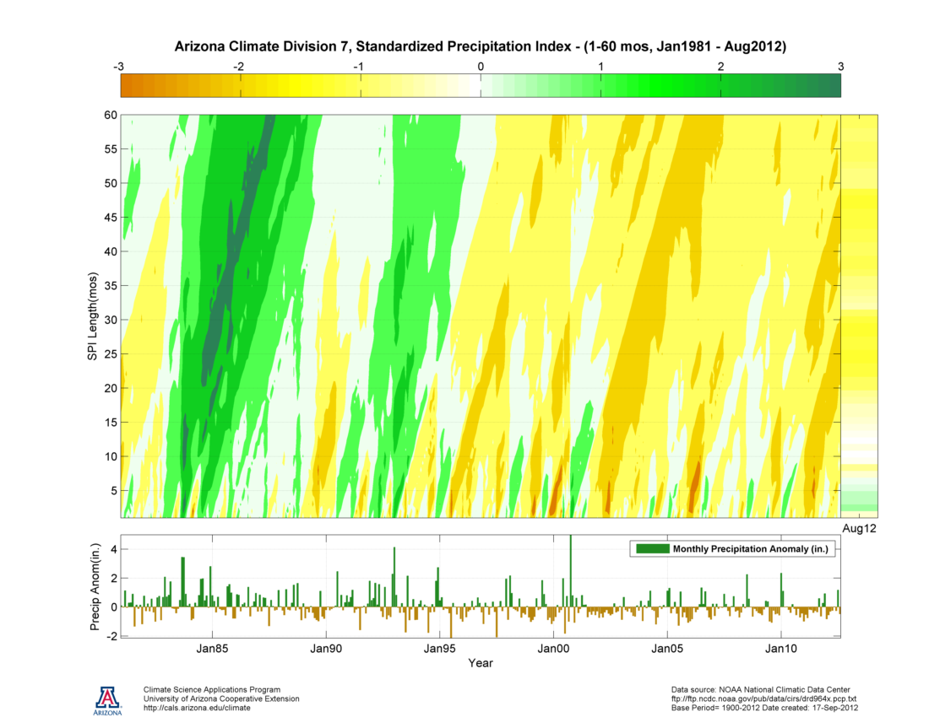
DRY
Average
WET
Long-term
Drought
Short-term
Drought
http://cals.arizona.edu/climate/misc/spi/spi_contour.html

Slide 21
Temperature: 1905-2011

Slide 22
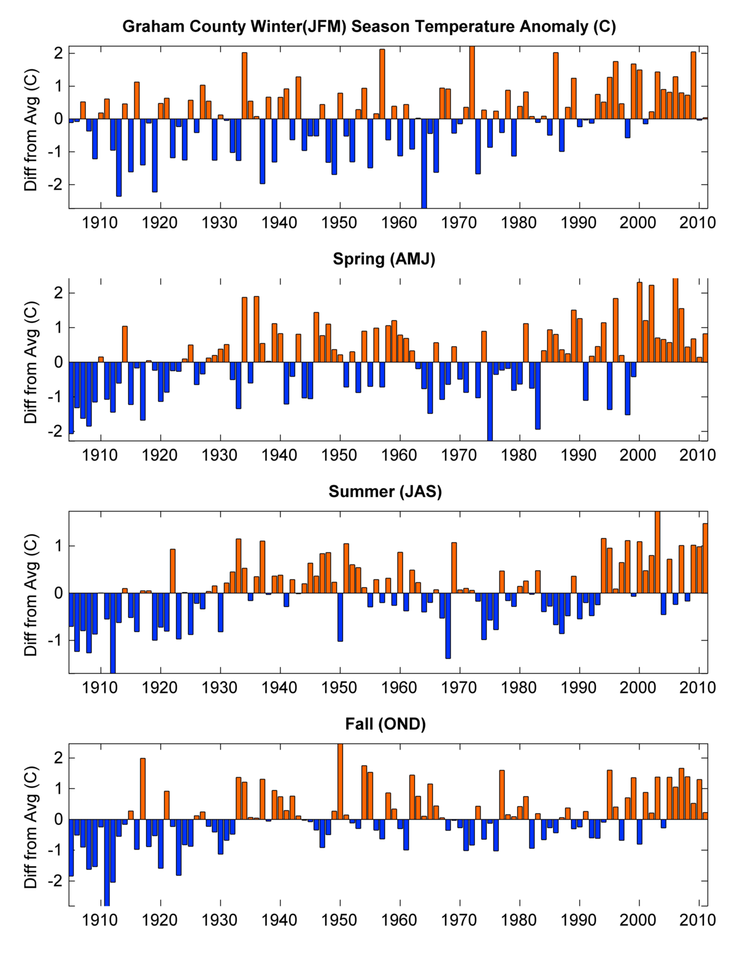
Seasonal Temperature: 1905-2011

Slide 23
Atmospheric Controls on Arizona Climate

Slide 24
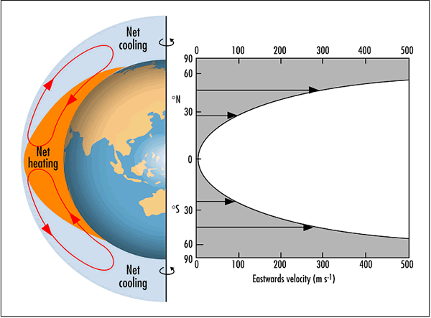
Global Energy Balance
From http://www.bom.gov.au

Slide 25
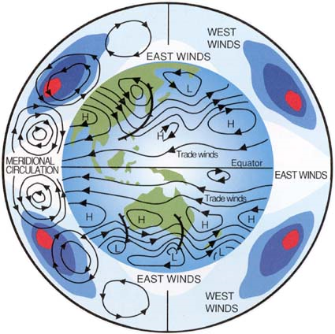
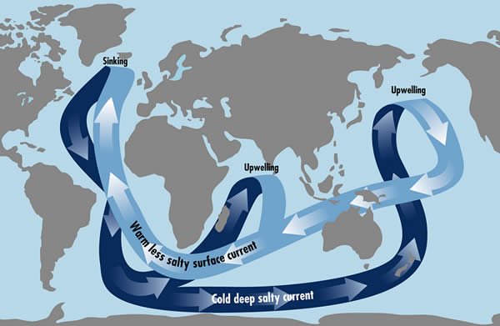
Global Circulations: Flows of Mass & Energy
Atmosphere
Ocean
From http://www.bom.gov.au

Slide 26
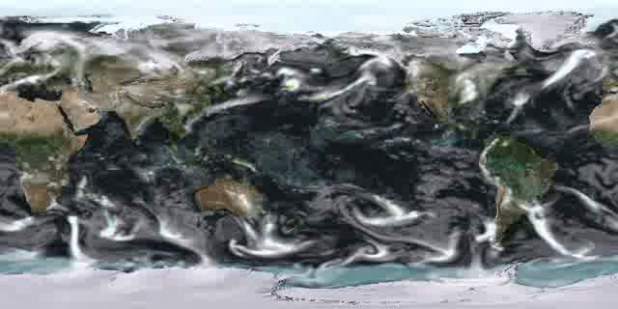
Global Circulation
http://www.cmmap.org/learn/climate/gencirc.html

Slide 27
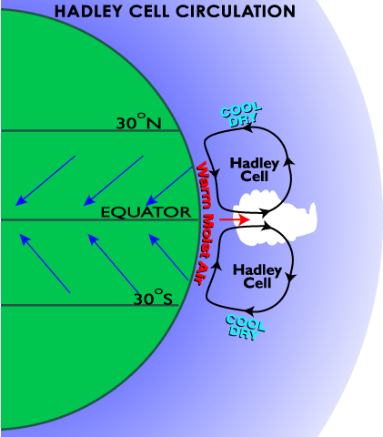
Atmospheric Circulation and Arizona Climate
Large-scale circulation patterns are an important determinant of local climate
Arizona has a unique geographic position in northern hemisphere
Circulation patterns are tied to global ocean sea surface temperatures
Patterns can persist for years and even decades
http://www.geography.hunter.cuny.edu/~tbw/wc.notes/7.circ.atm/animations/GlobalWind.html

Slide 28
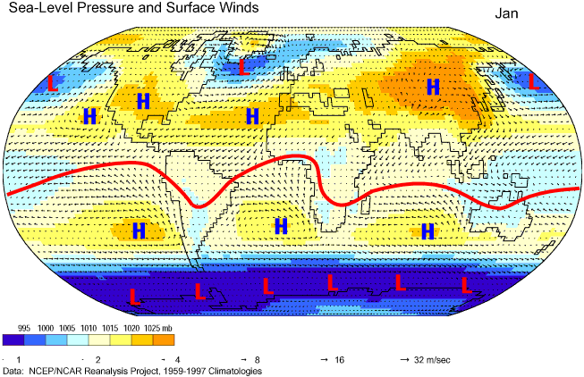
Seasonality of Circulation Patterns

Slide 29
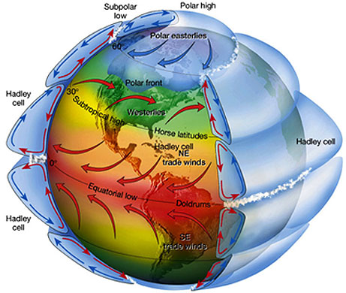
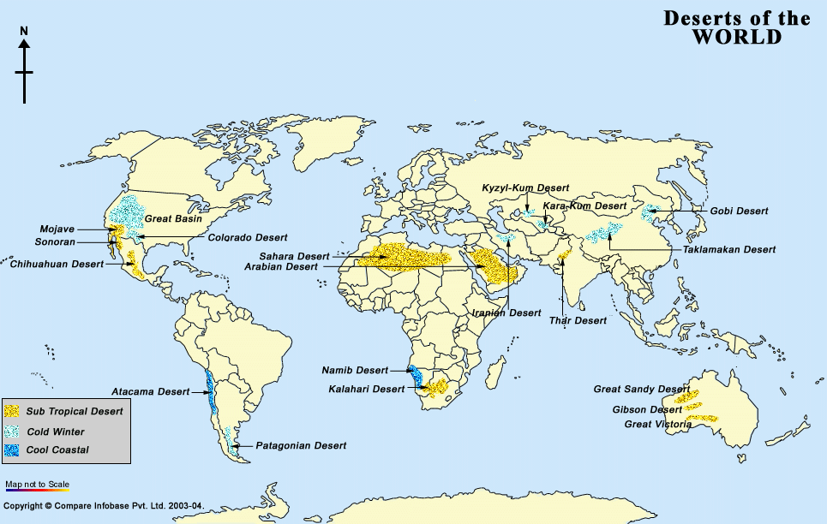
Global Circulations and Aridity

Slide 30
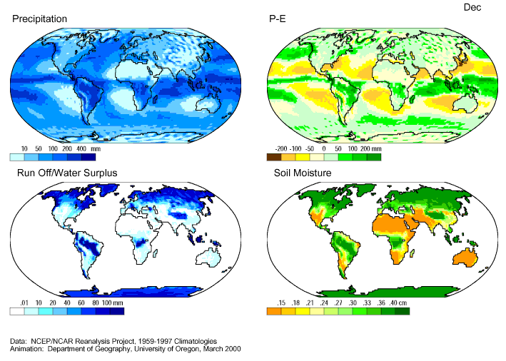
Global Hydroclimate

Slide 31
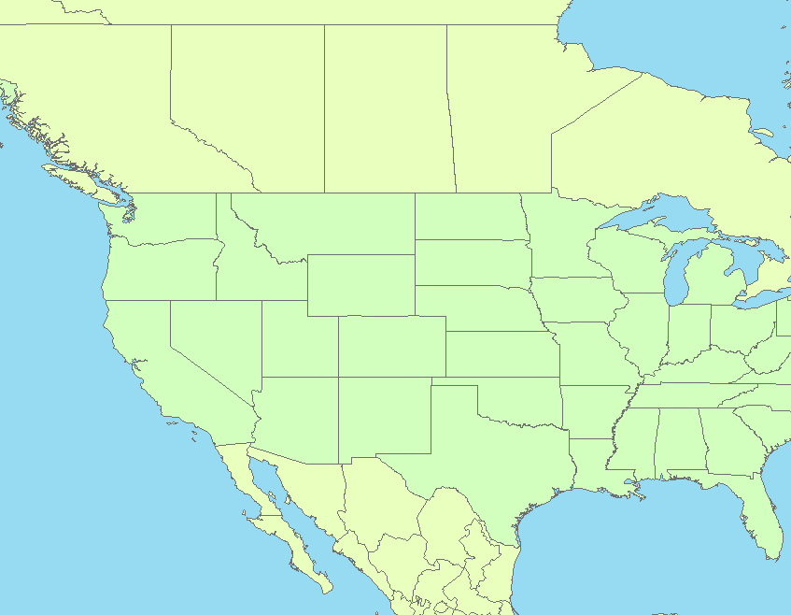
Winter Circulation Pattern
MOIST AIR
Average Wintertime Mid-latitude Jet Stream Track
L
Shift of jet stream track towards Arizona
DRY AIR
H

Slide 32
Summer Circulation Pattern
Average summertime mid-latitude jet stream track
DRY AIR
Weak flow around expanded Bermuda sub-tropical
high-pressure system
H
H
H
MOIST AIR
Monsoon
circulation

Slide 33
Interannual Climate Variability

Slide 34
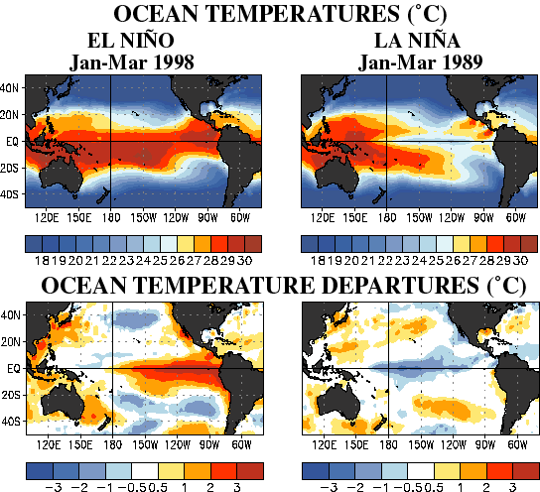
What are El Niño and La Niña?
Notes:
Anomalously warm equatorial sea surface temperatures (SST) off of the South American coast are El Nino events. Anomalously cold SSTs are La Nina events.
El Nino and La Nina episodes develop every 2-5 years.

Slide 35
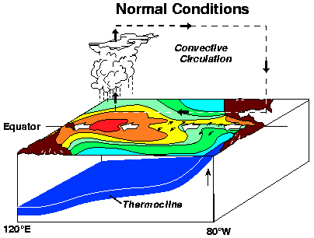
Atmosphere-Ocean Coupling

Slide 36
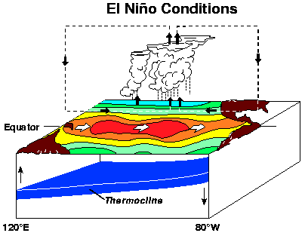
Atmosphere-Ocean Coupling

Slide 37
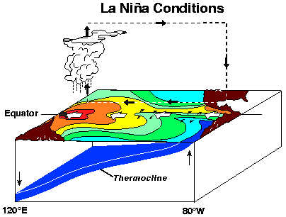
Atmosphere-Ocean Coupling

Slide 38
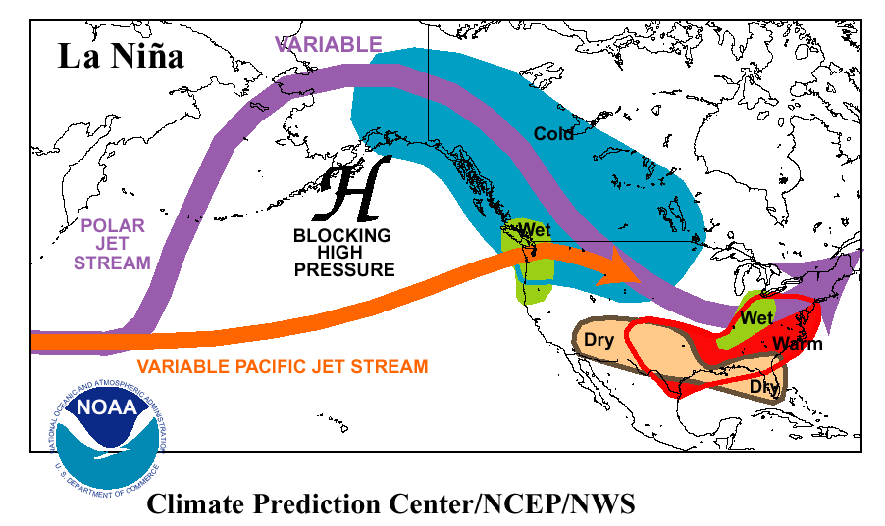
Dominant Circulation Pattern: La Niña Winter
Notes:
Cold, equatorial sea surface temperatures displace active Pacific jet stream further north, away from southwest U.S.
This limits storm systems and precipitation over the southwest during the winter months.

Slide 39
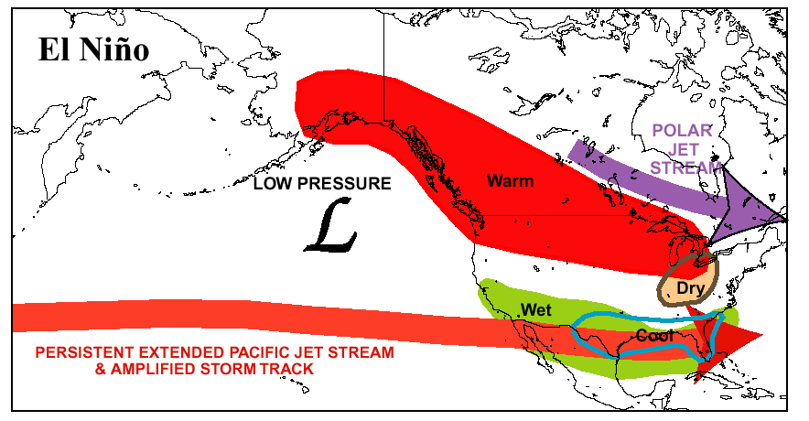
Dominant Circulation Pattern: El Niño Winter
Notes:
Warm, equatorial sea surface temperatures enhance the Pacific jet stream over the southwest U.S.
This increases storm system passages and precipitation over the southwest during the winter months.

Slide 40
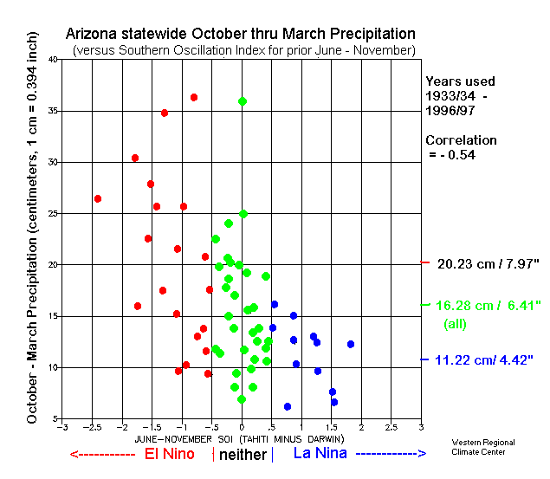
Arizona ENSO Connection
2005
2001
2003
2004
2007
2006
2000
1999
2002
Notes:
La Nina episodes are almost consistently associated with lower winter precipitation amounts. Higher confidence in La Nina/Dry Winter forecast.
Much more spread in precipitation amounts associated with El Nino episodes. Less confidence in El Nino/Wet Winter forecast.

Slide 41
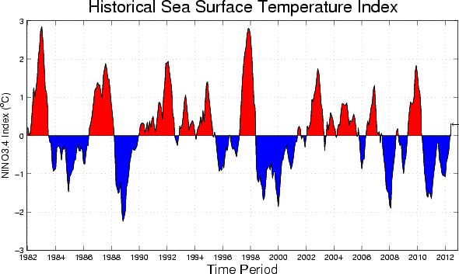
ENSO: 1982-2012
http://iri.columbia.edu/climate/ENSO

Slide 42
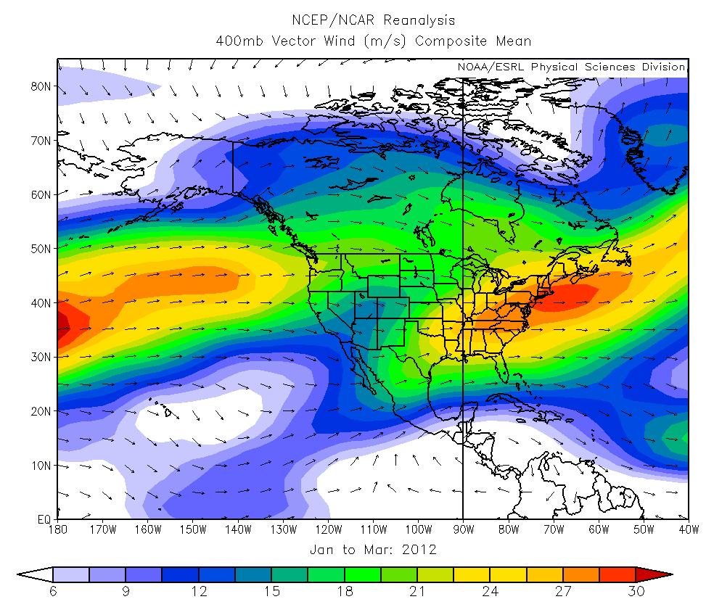

Slide 43
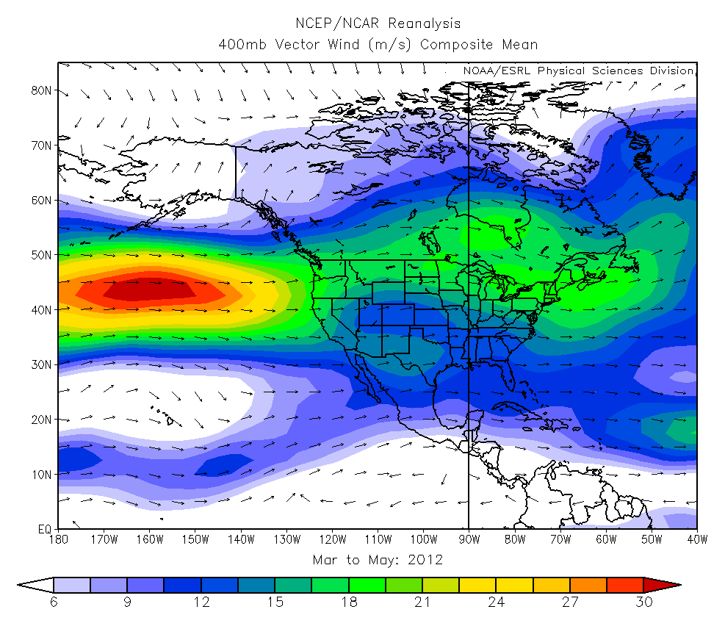

Slide 44
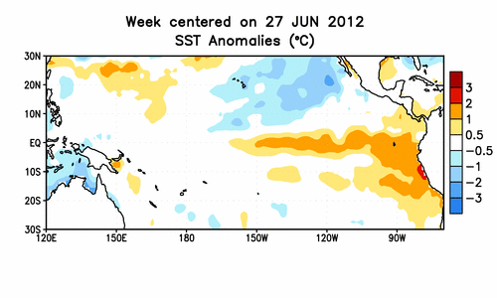
Current Conditions

Slide 45
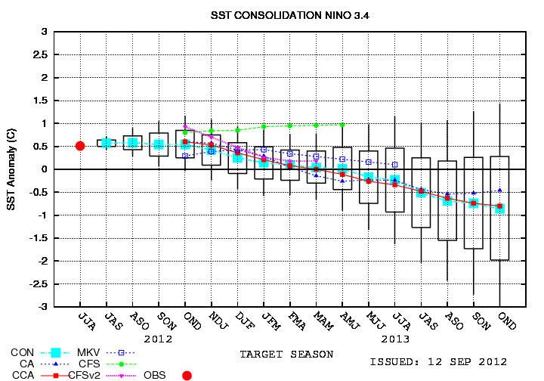
Seasonal Forecasts

Slide 46
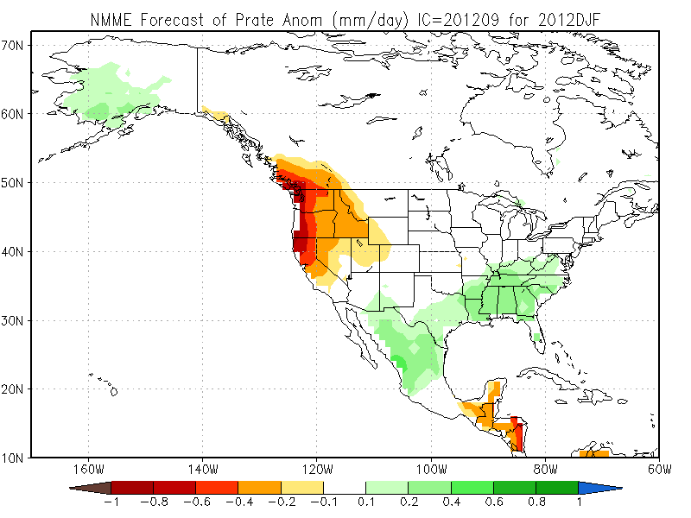
Seasonal Forecasts
http://www.cpc.ncep.noaa.gov/products/predictions/90day/tools/briefing/

Slide 47
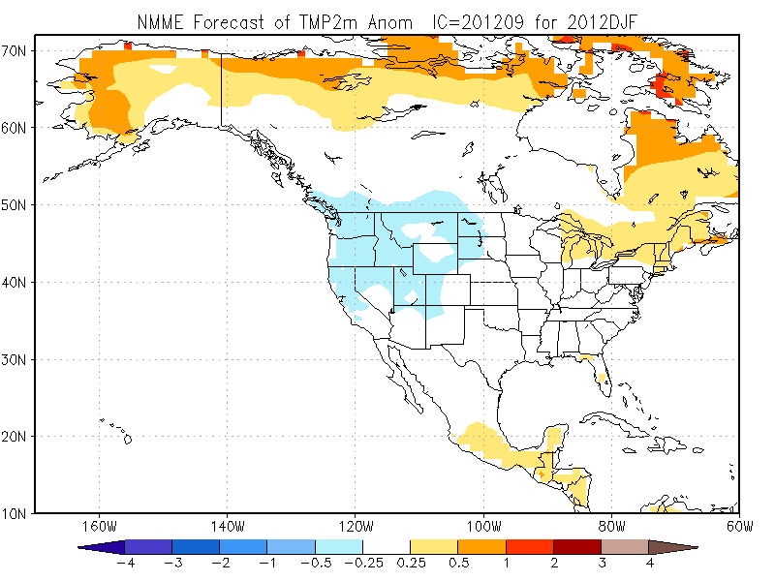
Seasonal Forecasts
http://www.cpc.ncep.noaa.gov/products/predictions/90day/tools/briefing/

Slide 48
Where are we headed in the long-term?: Climate Change Projections

Slide 49
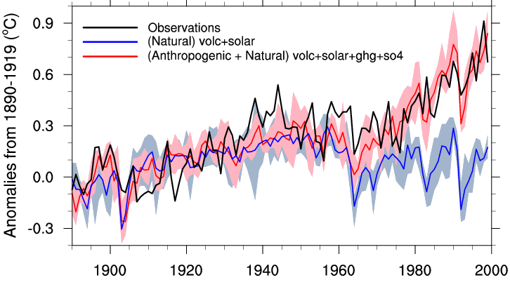
Natural vs. Anthropogenic Forcings
Observed
Natural Only
Stott et al. (2000)

Slide 50
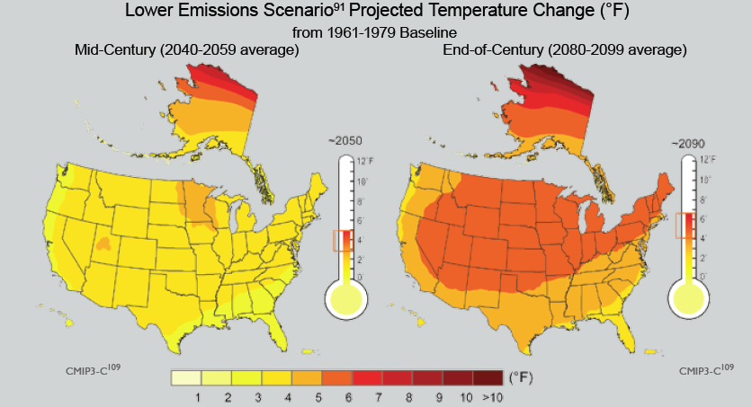
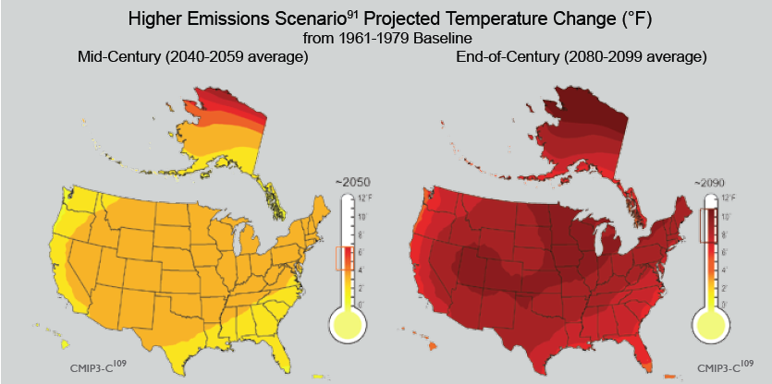
Temperature Projections
USGCRP 2009

Slide 51
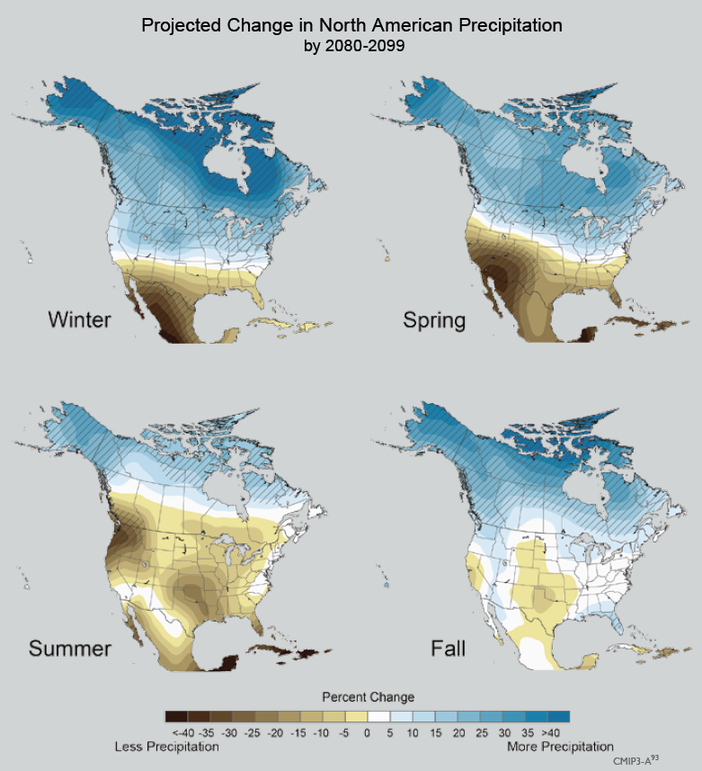
Precipitation Projections
USGCRP 2009

Slide 52
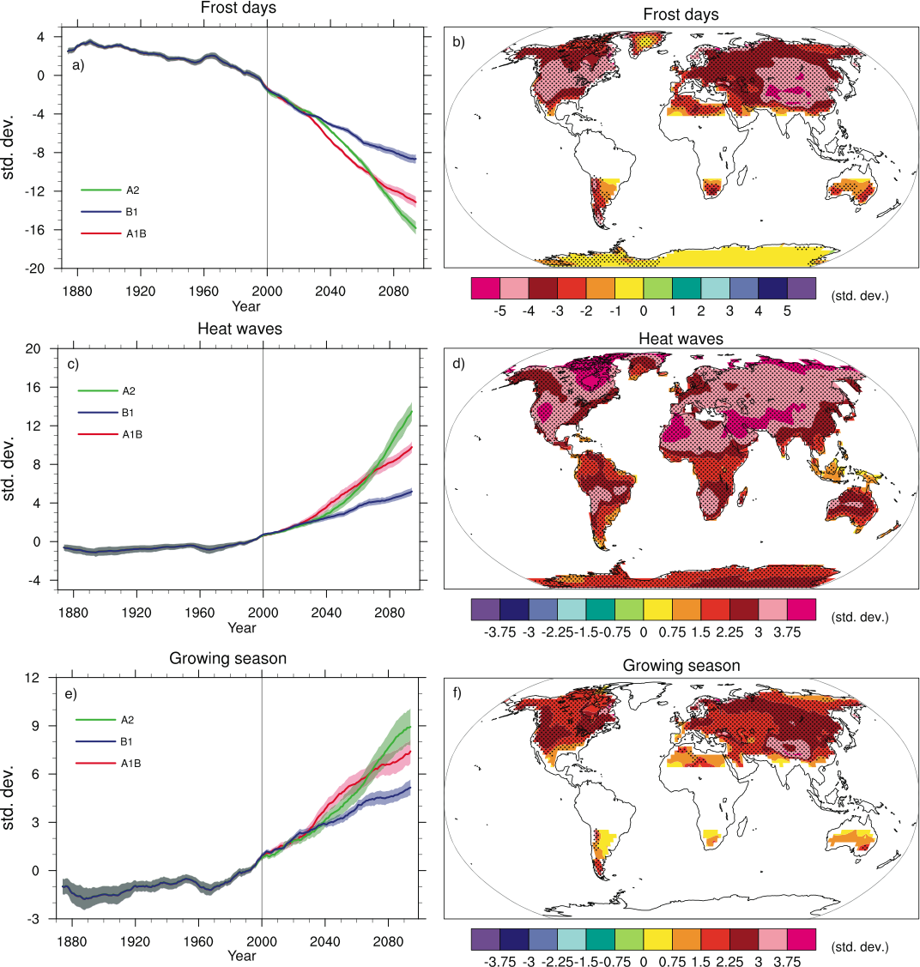
Potential changes in temperature extremes
IPCC 2007
IPCC 2007

Slide 53

Potential changes in precipitation
IPCC 2007
Notes:
Figure 10.18. Changes in extremes based on multi-model simulations from nine global coupled climate models, adapted from Tebaldi et al. (2006). (a) Globally averaged changes in precipitation intensity (defined as the annual total precipitation divided by the number of wet days) for a low (SRES B1), middle (SRES A1B) and high (SRES A2) scenario. (b) Changes in spatial patterns of simulated precipitation intensity between two 20-year means (2080–2099 minus 1980–1999) for the A1B scenario. (c) Globally averaged changes in dry days (defined as the annual maximum number of consecutive dry days). (d) Changes in spatial patterns of simulated dry days between two 20-year means (2080–2099 minus 1980–1999) for the A1B scenario. Solid lines in (a) and (c) are the 10-year smoothed multi-model ensemble means; the envelope indicates the ensemble mean standard deviation. Stippling in (b) and (d) denotes areas where at least five of the nine models concur in determining that the change is statistically significant. Extreme indices are calculated only over land following Frich et al. (2002). Each model’s time series was centred on its 1980 to 1999 average and normalised (rescaled) by its standard deviation computed (after de-trending) over the period 1960 to 2099. The models were then aggregated into an ensemble average, both at the global and at the grid-box level. Thus, changes are given in units of standard deviations.

Slide 54
Interactions between temperature and precipitation
Confidence in continuation of increasing temperatures
Projections on precipitation variability are less clear
Increasing temperatures alone will increase aridity
Hoerling & Eischeid 2007

Slide 55
Implications for Arizona
Higher temperatures
  Higher evaporation and transpiration rates (increased water loss in reservoirs, faster drying of soils following precip events, more stress on vegetation)
  Less snow/more rain in winter; less snowpack for spring runoff, earlier pulse of precip/less water available in summer
  Longer growing seasons; more extreme heat events, but freezes will still be possible
Precipitation
  Projections are lower confidence
  Higher temperatures on same precipitation variability: more intense drought periods
  Increasing variability → more flooding with intervening drought periods

Slide 56
Closing Points
Elevation, latitude, and ocean sea-surface temperatures create a complex Arizona climate
Different mechanisms create summer versus winter precipitation
Lots of opportunity for variability (spatially and temporally)
Climate change is real and a reason for concern in Arizona

Slide 57
Thanks!
crimmins@u.arizona.edu
http://cals.arizona.edu/climate

Slide 58
Backup slides

Slide 59
North American Monsoon

Slide 60


Monsoon
Monsoon start dates for Tucson
Average start July 3rd
Earliest start June 17 2000
Latest start July 25 1987
Monsoon season rainfall (June 15th to September 30th)
Average monsoon season rainfall 6.06”
Driest monsoon season 1.59” in 1924
Wettest monsoon season 13.84” in 1964

Slide 61

Upper Level Flow - May
H
H

Slide 62

Upper Level Flow - June
H
H

Slide 63

Upper Level Flow - July
H
H

Slide 64

westerly wind
NE
NV
UT
CO
Four Corners
High Pressure
KS
CA
H
TX
CO. River Valley
Thermal Low
AZ
NM
L
Mid-level moisture
from Gulf of Mexico
TX
Low-level moisture
from Gulf of California
Core Monsoon Area
(abundant tropical moisture, frequent
thunderstorm activity)
GULF OF
MEXICO
PACIFIC OCEAN
Conceptual diagram of key circulation features of the North American Monsoon System
easterly wind
Mexico

Slide 65


Annual Average Arizona Climate
Data from PRISM Group, Oregon State University, http://www.prismclimate.org
Data from PRISM Group, Oregon State University, http://www.prismclimate.org
Notes:
Orient people not in AZ to dramatic variability

Slide 66

The Greenhouse Effect is a good thing, so what’s the problem?

Slide 67
Sensitivity of the Earth’s Climate
Earth is now radiating 0.85 W/m² less energy than it is receiving
Imbalance and associated warming are consistent with GHG forcings
Components of natural variability (e.g. solar irradiance and volcanic aerosols) are small
More warming “in the pipeline”
Hansen et al. 2005

Slide 68

http://www.princeton.edu/~cmi/resources/stabwedge.htm

Slide 69

http://www.nasa.gov/topics/earth/features/arctic_thinice.html
http://www.noaanews.noaa.gov/stories2009/20090402_seaice.html

Slide 70


http://www.nasa.gov/topics/earth/features/arctic_thinice.html

Slide 71

Atmospheric CO₂ Changes
http://www.globalwarmingart.com/

Slide 72


Slide 73


Slide 74

Emission Scenarios and Temperature Projections
IPCC 2007

Slide 75

Range of projections
Better
Worse
IPCC 2007

Slide 76


Slide 77


Temp Projections for Arizona
IPCC-AR4 18 model ensemble output
Courtesy of Jon Eischeid and Marty Hoerling, NOAA

Slide 78

Global Temperature Trend
Updated through Jan-Aug 2008
http://www.ncdc.noaa.gov/

Slide 79


Slide 80
Solomon et al. 2009, Proceedings of the National Academy of Sciences

Slide 81

Solomon et al. 2009, Proceedings of the National Academy of Sciences

Slide 82
Emission and climate change scenarios
(UK Met Office 2008)

Slide 83

Trends in CO₂
Pre-industrial Amount: 280 ppm
Present Amount: 385 ppm
450 ppm = ~2°C warming
Current trend: 2 ppm/yr
(J. Hansen 2007)
http://www.esrl.noaa.gov/gmd/ccgg/trends/

Slide 84

Major warming and cooling influences on climate: 1750-2005
USGCRP 2009

Slide 85

Long-term Precipitation Variability
Annual Avg. Total Precip: 7.4 in.
Annual Avg. Total ET: 77.6 in
Daily averages based on 1987-2007 period

Slide 86


Resources
http://www.southwestclimatechange.org/
http://www.extension.org/climate%20forests%20woodlands

