Slide 1


School IPM FOR Teachers
In-Person Education Module
Lesson 1 of 2

Slide 2
Learning Objectives
Explain the importance of communicating to parents about health and safety issues associated with pests and pesticides
Explain the importance of removing or eliminating clutter in the classroom
Give examples of proper food storage procedures
Describe proper sanitation methods for pets in the classroom

Slide 3

Learning Objectives
Explain how to manage communicable pests, including those that transmit diseases
Describe students’ roles and responsibilities in
implementing IPM in the classroom
Explain the importance of annual notification/ special notification to parents and students
when pesticide applications are scheduled/made

Slide 4

1.
Teachers and IPM
Teachers and students share the same environment - are exposed to the same risks
Teachers are very
important links in
a school IPM
program
Notes:
Teachers have a chance to influence how future generations manage pests in their homes and places of work.
Everything a teacher learns about school IPM will help them manage pests in their own homes.

Slide 5

Teachers and IPM
Teacher involvement in a school IPM program is important because:
Teacher/student relationship
First-hand information on student sensitivities
and behaviors
Influence
Notes:
Teachers influence students, who influence parents, who change social norms.

Slide 6

1.
IPM is Not an Additional Item on Your to-do List
IPM does not add to your responsibilities
IPM will make your life and your teaching
environment healthier
IPM is not your job alone, it is everyone’s job
Notes:
Teachers have one of the most demanding jobs, with little spare time, and considerable personal investment.

Slide 7
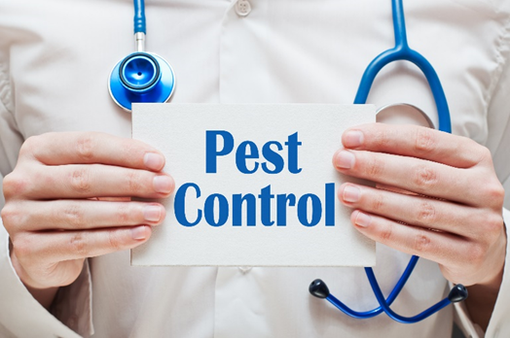
Parents and IPM
As a teacher you:
Help parents realize their role in keeping their children safe from pests and pesticides
Inform parents about IPM practices implemented at school and how it benefits their children
Notes:
Teachers connect the school community to the parents of students.

Slide 8
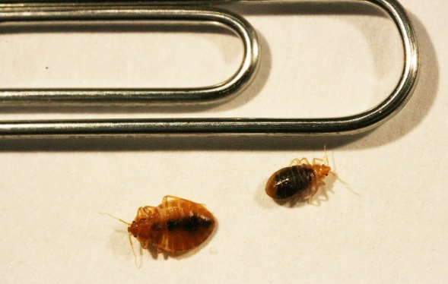
Parents and IPM
Inform parents:
How pests can be introduced to the classroom
About the importance of preventing the spread of pests
Make sure “panic” pests are correctly identified, many parents have not seen bed bugs and may confuse them with other pests – Dawn H. Gouge, University of Arizona
Notes:
Pests can be introduced into the classroom from student belongings such as backpacks and clothes.
It is important to note that some pests can cause a panic, such as bed bugs. If pests are found hitchhiking into school on students, deal with them discreetly to avoid embarrassment to parents and students.

Slide 9

Parents and IPM
Separating student belongings reduces the risk of classroom
transition of
pests such as
head lice and
bed bugs

Slide 10
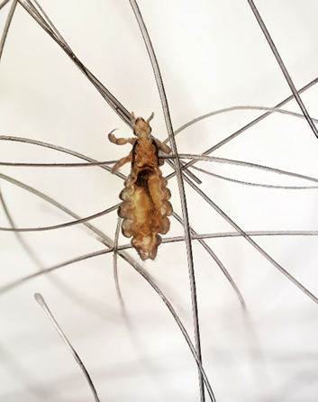
Parents and IPM
Schools are rarely transition locations for head lice
Most children obtain head lice during sleepover parties
There is absolutely no need to
send students home if they have
head lice nits – nits do not
transfer
Adult head louse
Notes:
Parents and teachers be knowledgeable in the subject of head lice and encourage corrective action (e.g., using nit combs).

Slide 11

Parents and IPM
5.
Parents should use IPM practices in their
homes to extend the benefits of IPM
Parent support can motivate and reinforce your efforts to implement IPM in your classroom

Slide 12
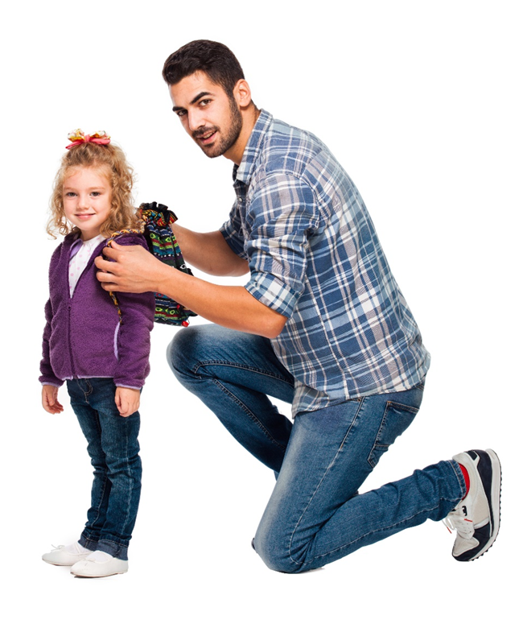
Parents and IPM
5.
Inform parents:
About the risks associated with pests and pesticides
That they should not volunteer to use pesticides on the campus
About the rules for pesticide applications in school
Notes:
About the rules for pesticide applications in school, including who can apply them and how notifications are communicated.

Slide 13

Example Notification Policies
  Facility management staff will make sure all parents and staff are notified prior to any pesticide applications in buildings or on grounds
  With the exception of exempt or emergency applications
In some states, notifications must be issued and notifications posted at least three business days prior to applications
Notes:
In some states, notifications must be posted at least three business days prior to application.
Parents may be notified each time a non-exempt pesticide is applied, or given guidance documents when students are enrolled.

Slide 14
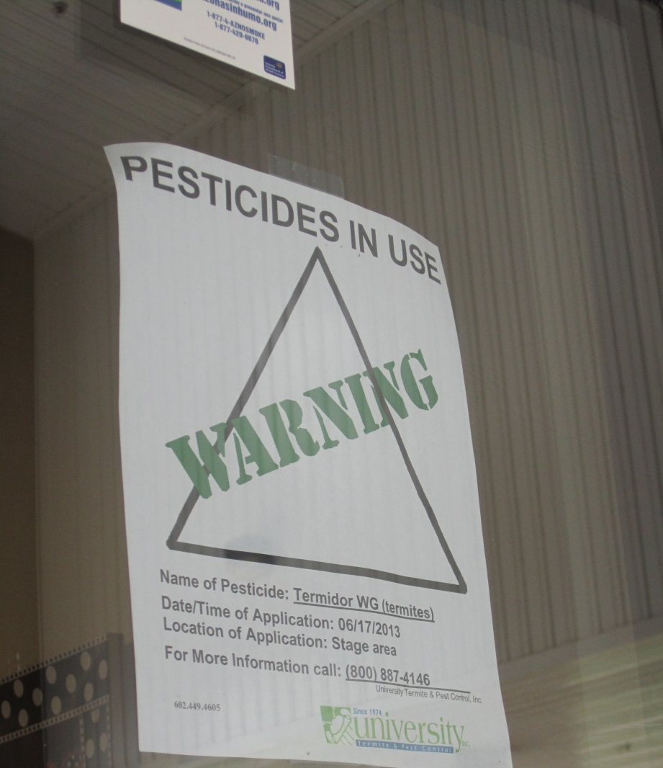
Posting
Notification signs
Outdoor application areas may be cordoned off and flagged
Pesticide application posting
– Dawn H. Gouge, University of Arizona
Notes:
Notification signs will be posted at the building entrance and near the site of planned applications in advance of pesticide use, or at the time of application if it’s an emergency application.

Slide 15
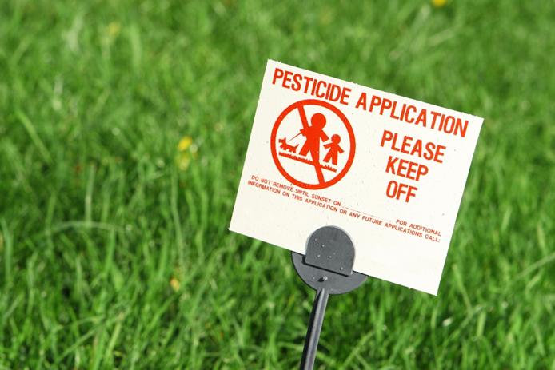
Posting
Signs shall remain in place for the legally specified time (which varies by state) after a pesticide application
Notes:
Teachers should be aware of the postings.

Slide 16
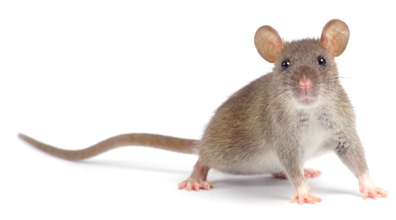
1.
Practicing IPM in Your Classroom
Reduce classroom clutter!
Make sure that class supplies are neatly stored and organized
Encourage your students to be good custodians of their classroom environment
Notes:
Clutter provides pests with ample shelter and makes cleaning, monitoring and control very difficult.
Please not that some pests can get into zip-lock bags.

Slide 17
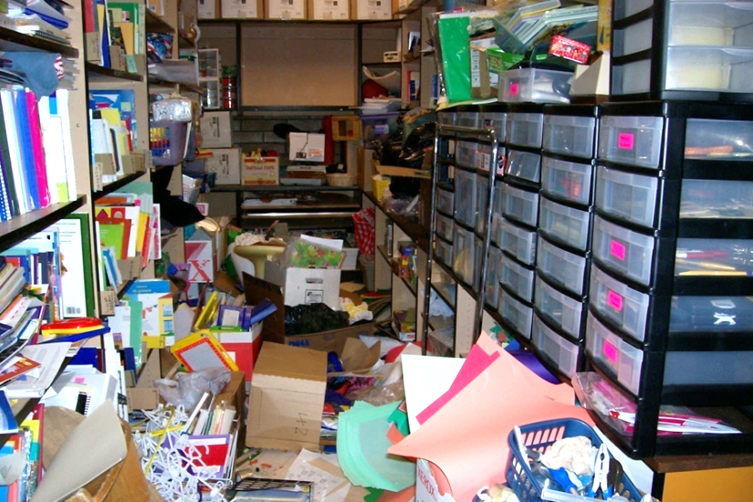
1.
Practicing IPM in Your Classroom
Clutter makes cleaning difficult
Clutter can also affect fire safety, allergen reduction and
pest prevention
efforts
Cluttered store room
– Jerry Jochim, Monroe County Community School Corporation

Slide 18
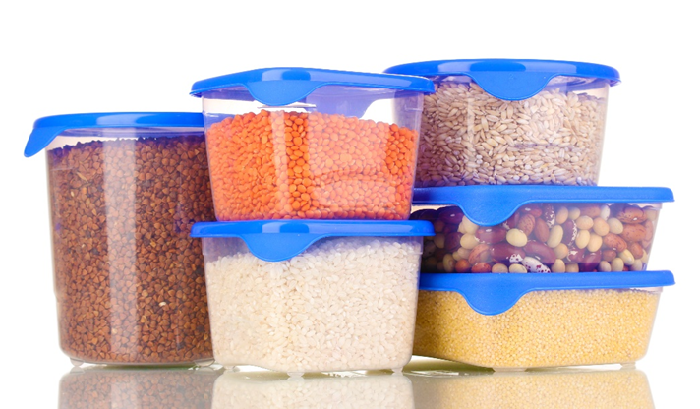
1.
Practicing IPM in Your Classroom
Proper storage
Keep food and all edible supplies
used for class activities in closed air-tight containers

Slide 19
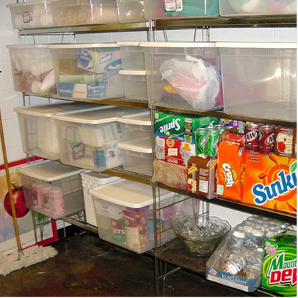
Practicing IPM in Your Classroom
See-through storage totes can reduce and prevent ant and cockroach problems
Supplies organized in see-through totes
– Jerry Jochim, Monroe County Community School Corporation
Notes:
Some food items come with pests within the packaging. Storing in airtight containers prevents those pests getting out!

Slide 20
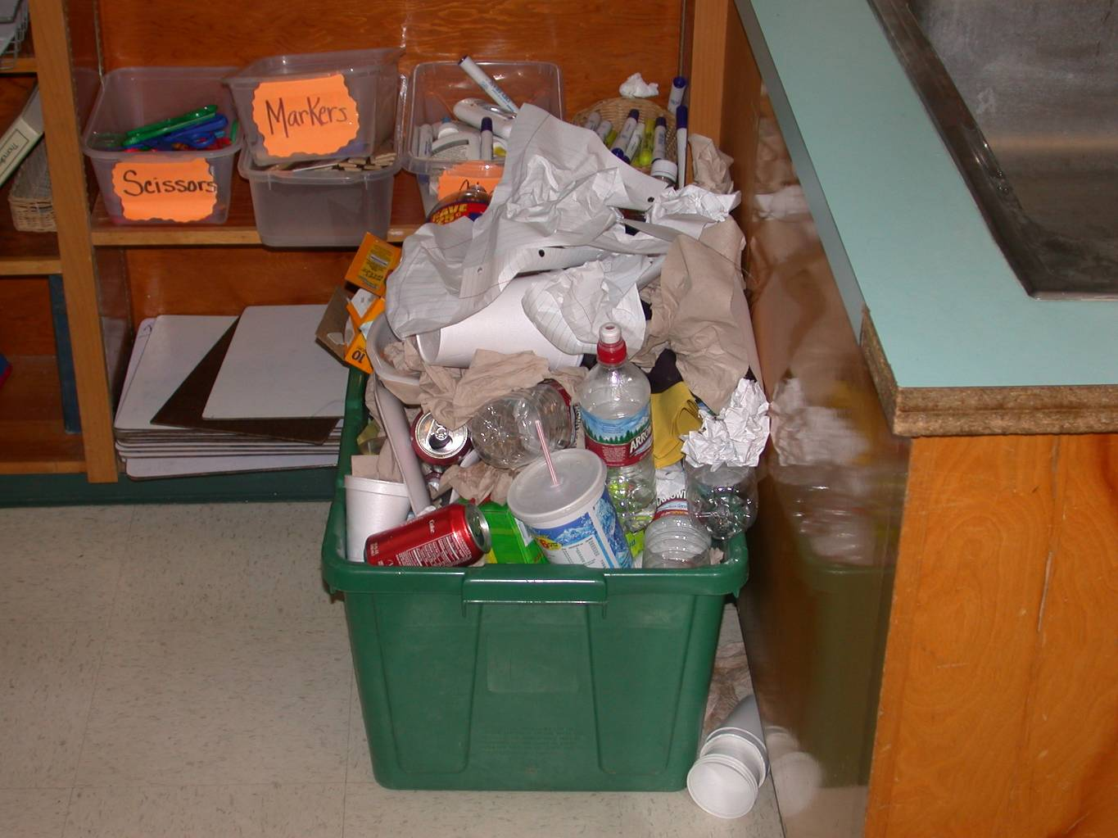
1.
Practicing IPM in Your Classroom
Sanitation
Clean up after class activities
Anything with food remains should be placed in
trash cans, bagged, and taken to outside dumpsters
before the day ends
Recycling is great, but not if left to fester in a classroom over a 2-week break
– Dawn H. Gouge, University of Arizona

Slide 21
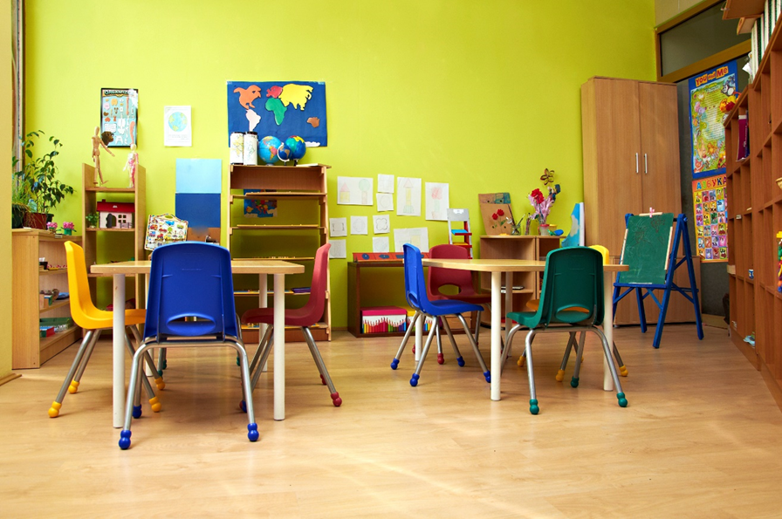
1.
Practicing IPM in Your Classroom
Remember: Cleanliness discourages pests to enter
No food, water, or shelter = No pests

Slide 22
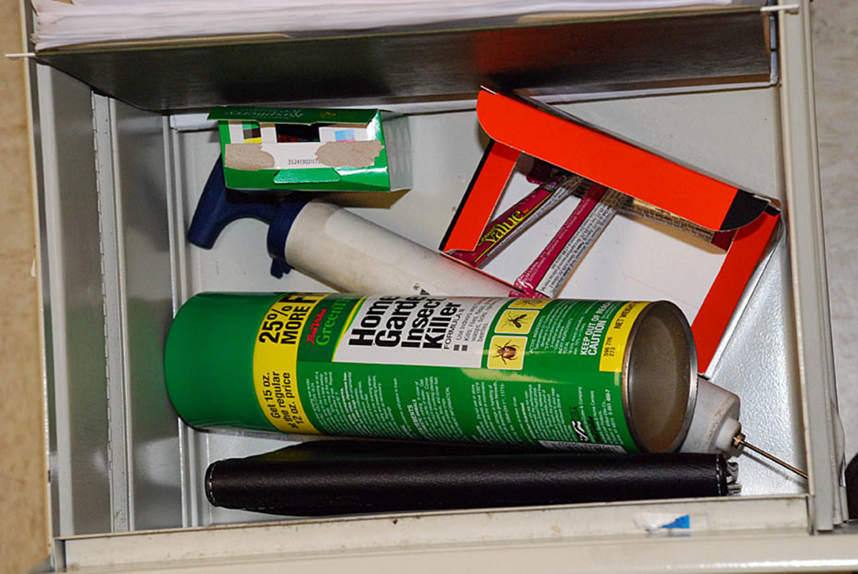
1.
Practicing IPM in Your Classroom
Never bring over-the-counter pesticides or homemade remedies to your classroom
Pesticide aerosol in teacher’s desk
– Marc Lame, Indiana University

Slide 23
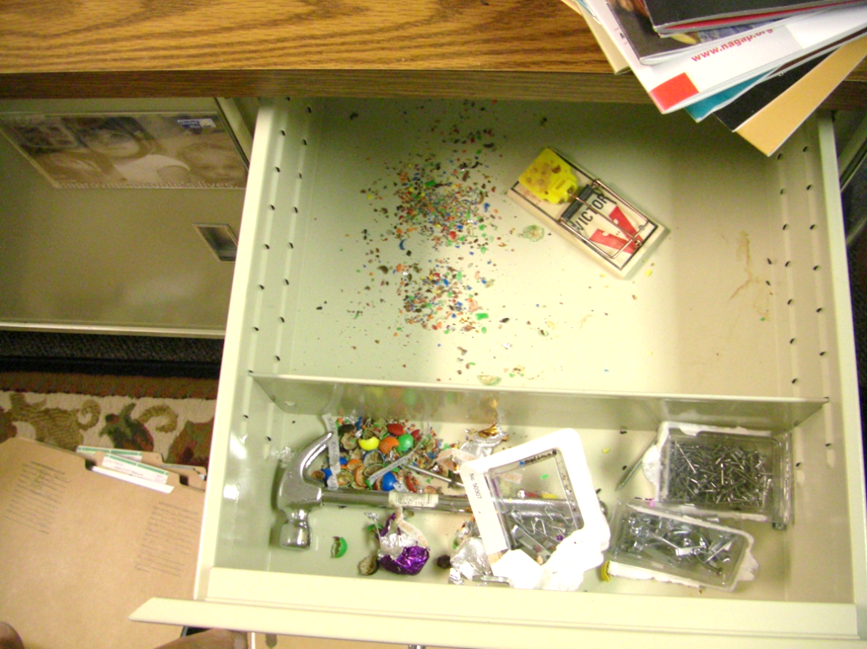
Practicing IPM in Your Classroom
Always keep personal food and drink items in sealed containers
Mouse trap in teachers desk drawer (putting students at risk of injury) – Marc Lame, Indiana University

Slide 24
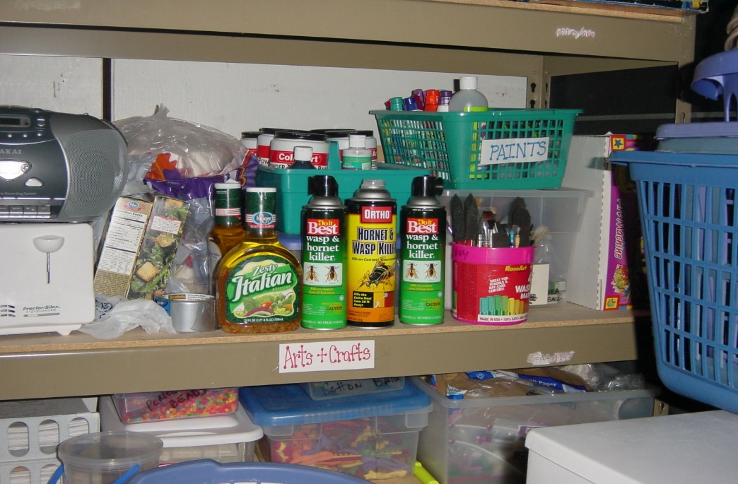
Practicing IPM in Your Classroom
Never leave cleaning materials or supplies unattended or in open, child-accessible places
Pesticide aerosols on arts and crafts storage shelving – Jerry Jochim, Monroe County Community School Corporation

Slide 25
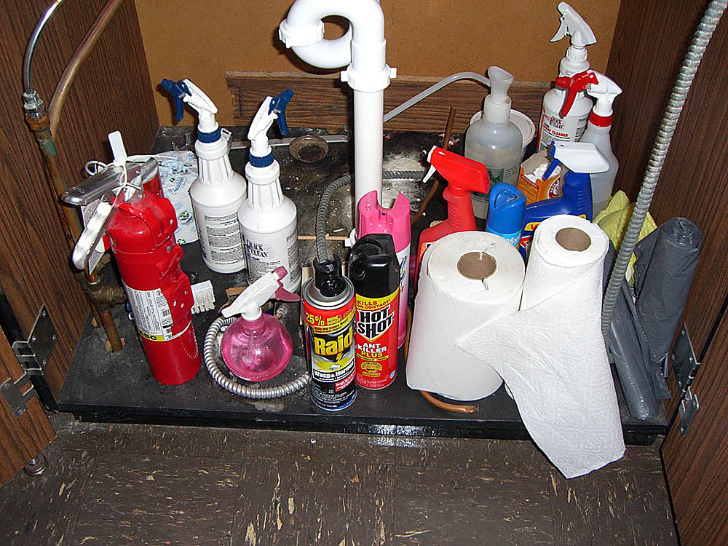
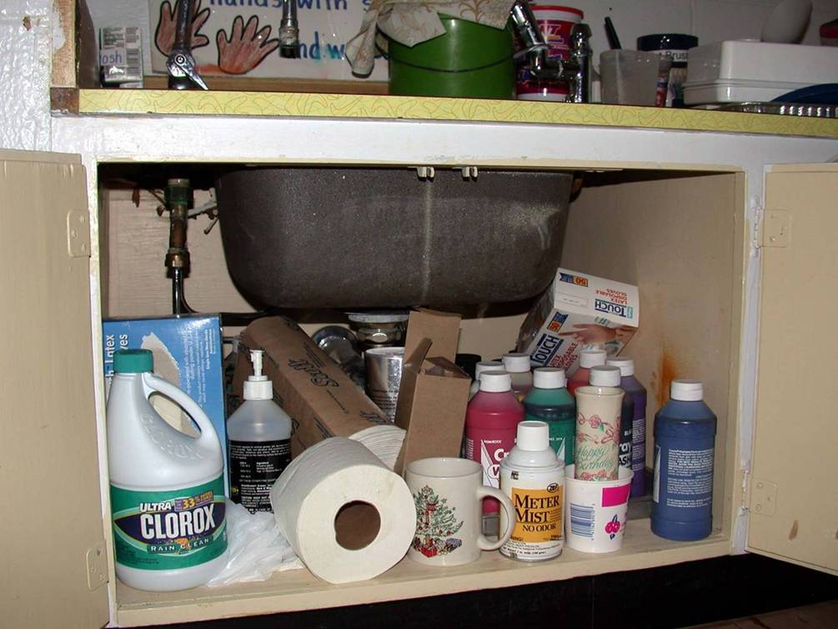
1.
Practicing IPM in Your Classroom
Improperly stored cleaning products and pesticides in sink cupboard in classrooms –
Dawn H. Gouge, University of Arizona

Slide 26
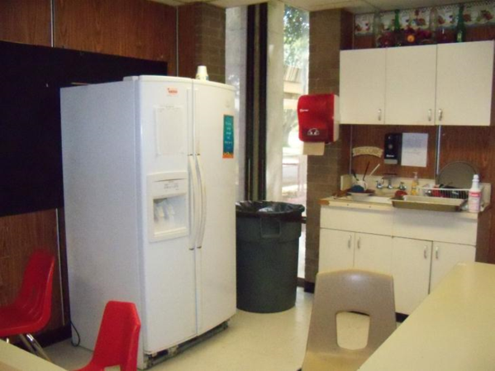
1.
Practicing IPM in the Teachers Lounge
The teacher’s lounge is your place to rest and recover
Keep it clean and welcoming
Clean and tidy teachers lounge - Jerry Jochim, Monroe
County Community School Corporation

Slide 27
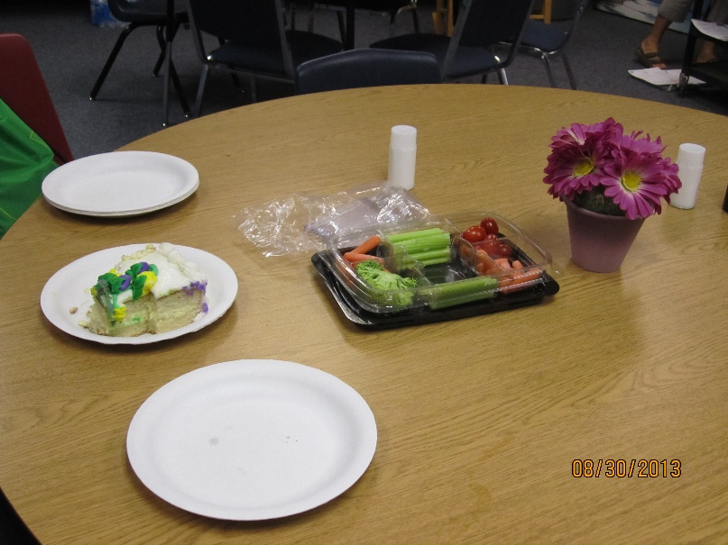
1.
Practicing IPM in the Teachers Lounge
Anything with food remains should be placed in trash cans, bagged and taken to outside dumpsters before the day ends
Food left out in a teachers lounge – Shujuan Li, University of Arizona

Slide 28
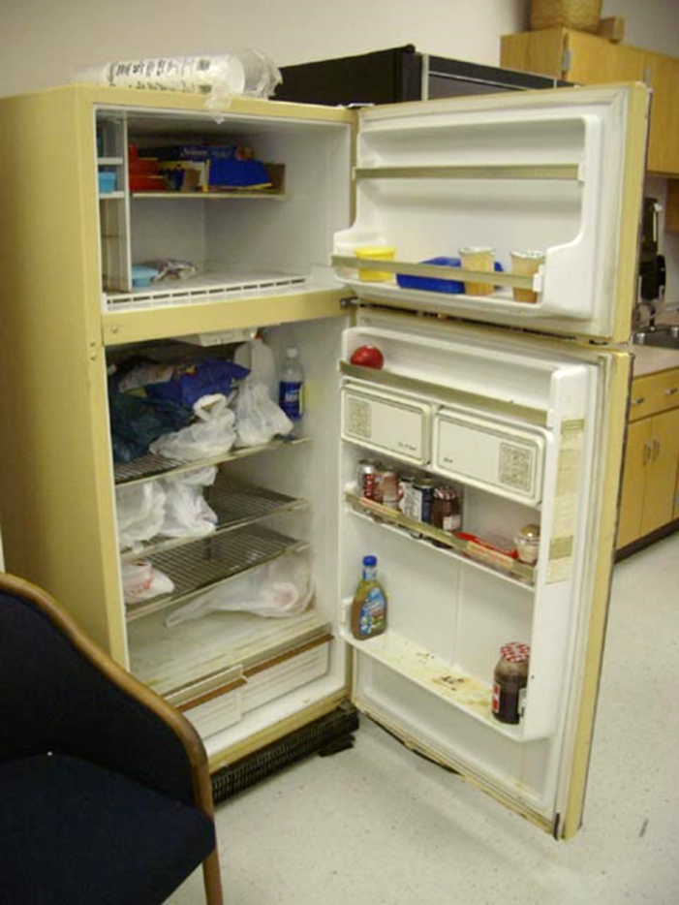
1.
Practicing IPM in the Teachers Lounge
Clear out unused food items from refrigerators and cabinets
Clean up after a spill
Teacher’s lounge fridge with food debris and spills - Jerry Jochim, Monroe
County Community School Corporation

Slide 29
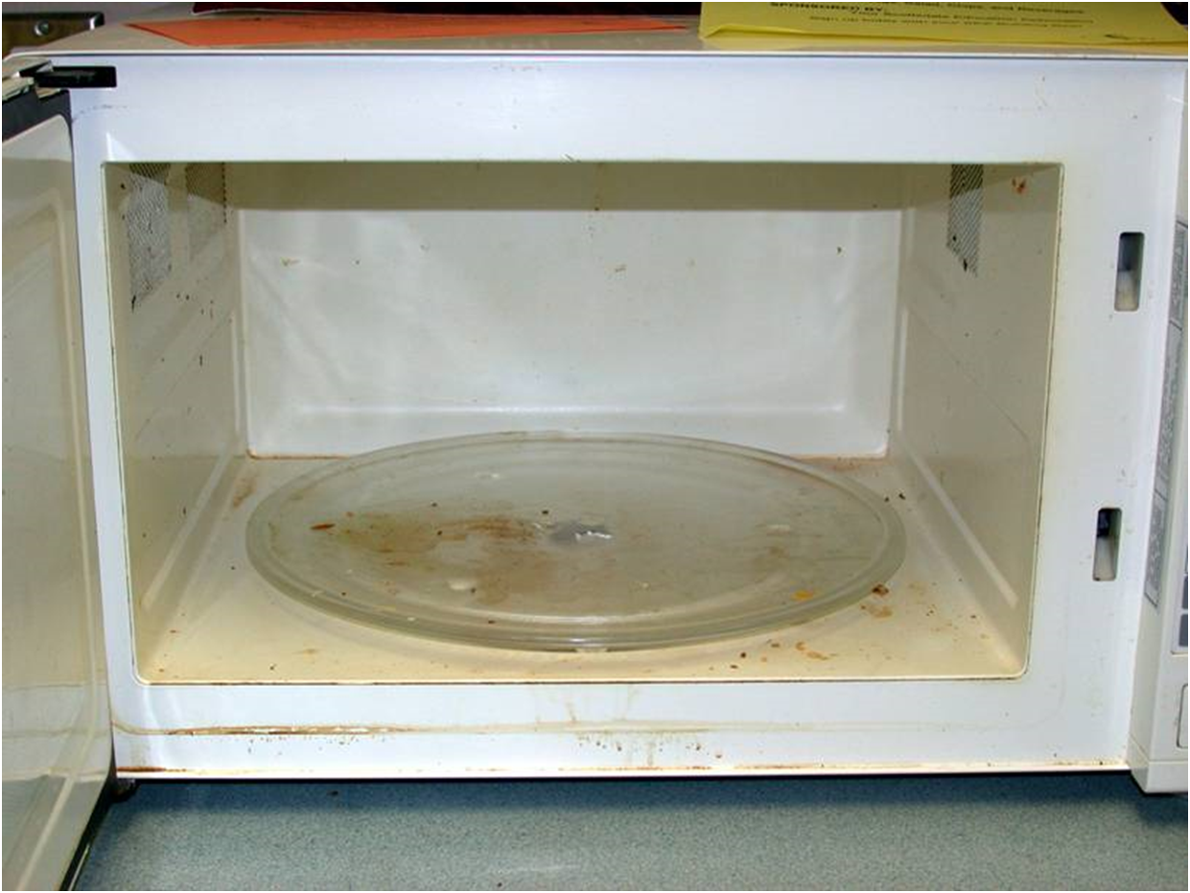
1.
Practicing IPM in the Teachers Lounge
Clean up after use
Microwave with food debris in teacher’s lounge – Dawn H. Gouge, University of Arizona

Slide 30
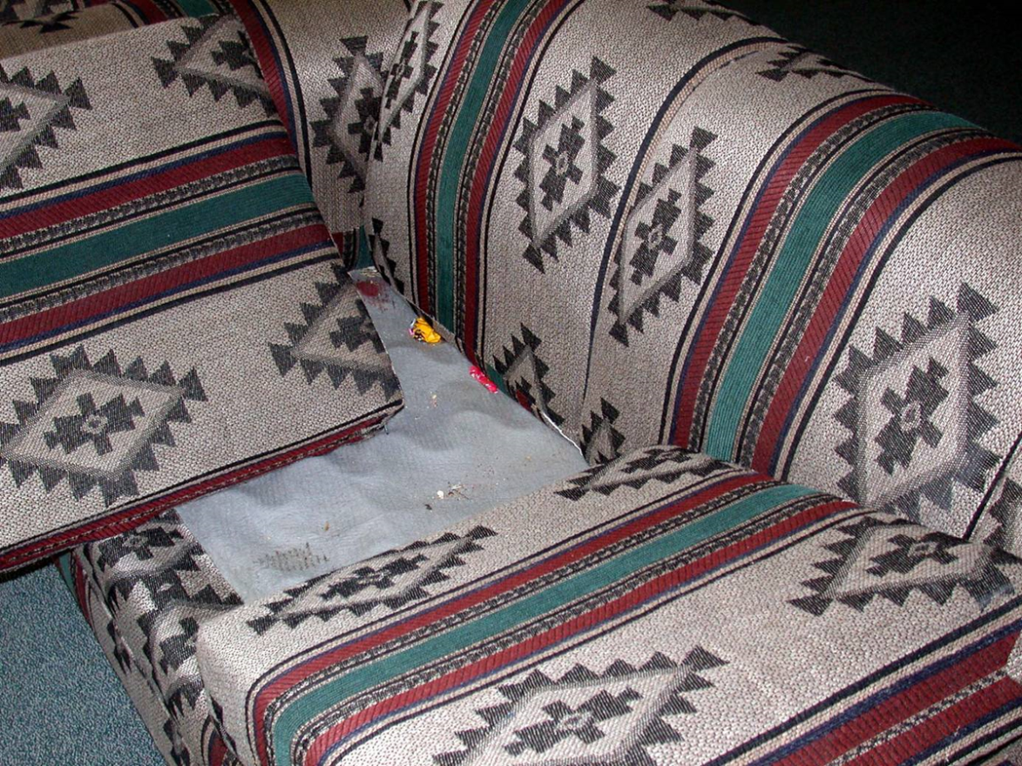
1.
Practicing IPM in the Teachers Lounge
Furniture food
“Furniture food” in couch in teacher’s lounge – Dawn H. Gouge, University of Arizona

Slide 31
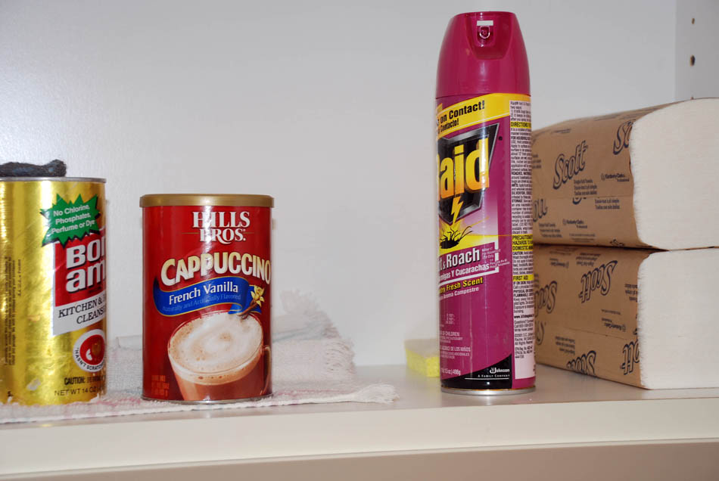
Practicing IPM in the Teachers Lounge
Never bring or apply pesticides in your lounge
Keep cleaning supplies in locked cabinets separate from food
Improper storage of cleaning product next to cappuccino product, with
contraband pesticide in a teachers lounge cabinet – Dawn H. Gouge, University of Arizona
Notes:
These products can worsen pest problems by interfering with or reducing the effectiveness of treatments made by pest management professionals.

Slide 32
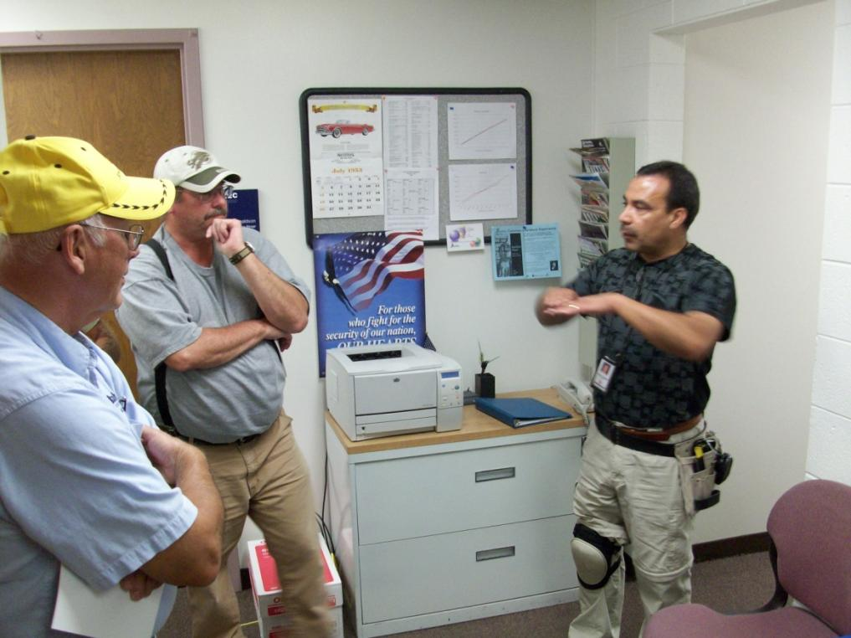
Be Aware, Get Involved!
Ready to step outside your class and teachers lounge?
Know your school IPM coordinator or pest-management personnel
Ask questions
Report pests you see
Follow their
recommendations
IPM coordinator teaching custodial crew – Marc Lame, Indiana University

Slide 33
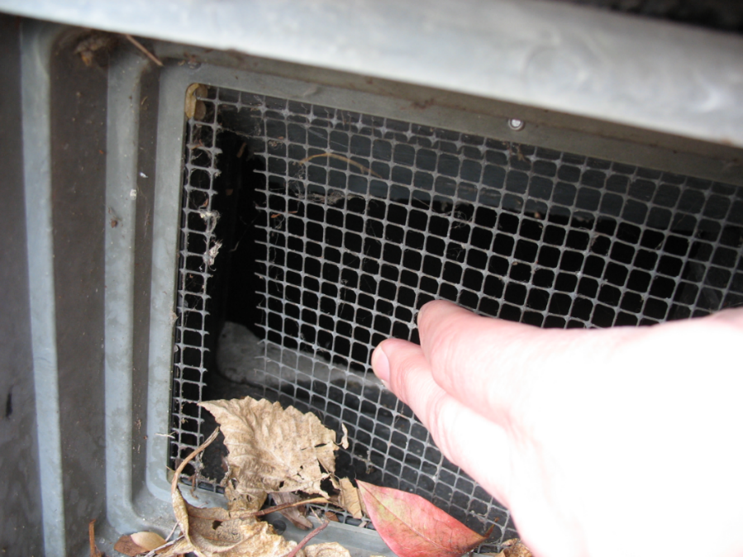
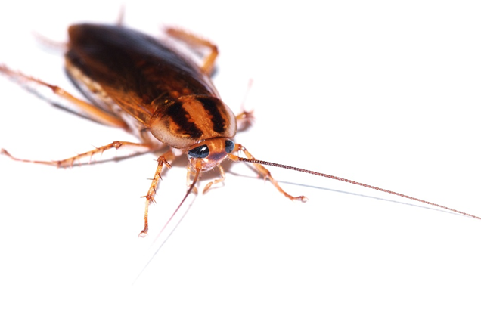
3.
Be Aware, Get Involved!
Observe and report pest occurrences and pest entryways
Torn mesh on wall void opening that must be reported – Marc Lame, Indiana University
The German cockroach is a high-priority
a pest to be reported

Slide 34
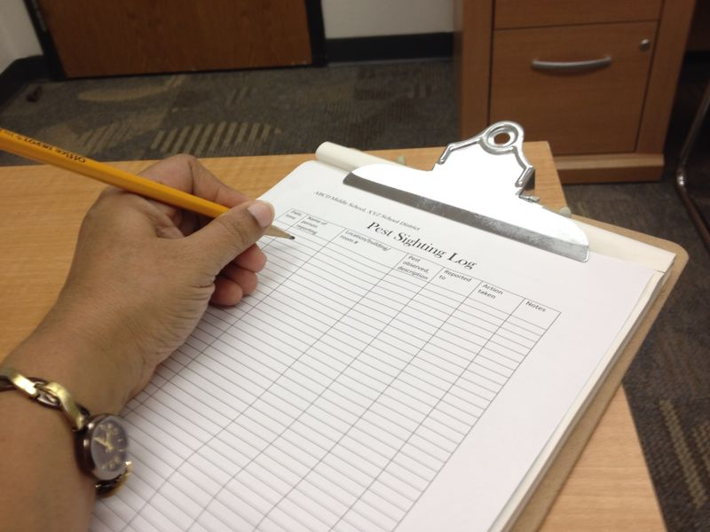
3.
Be Aware, Get Involved!
Pest-sighting logs
Work-order
reporting system
Pest sighting log – Shaku Nair, University of Arizona

Slide 35
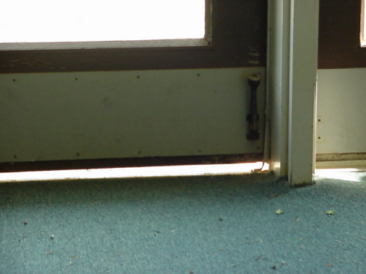
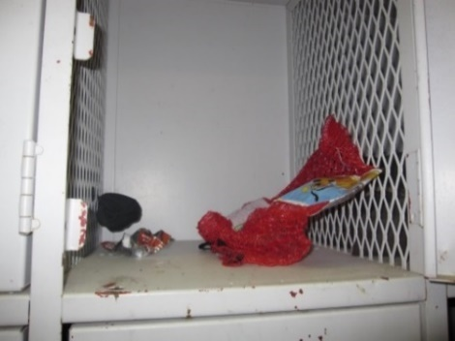
2.
Be Aware, Get Involved!
Know what to look for and report:
Pests
Signs of pests
Pest entry points
Pest conducive
conditions
Gap under doorway large enough for a rat to enter – Dawn H. Gouge, University of Arizona
Decomposing food and trash in athletic locker – Dawn H. Gouge, University of Arizona

Slide 36
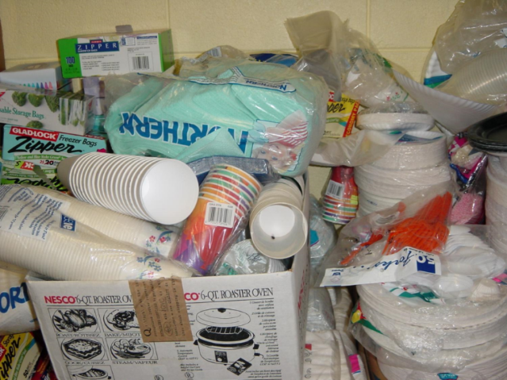
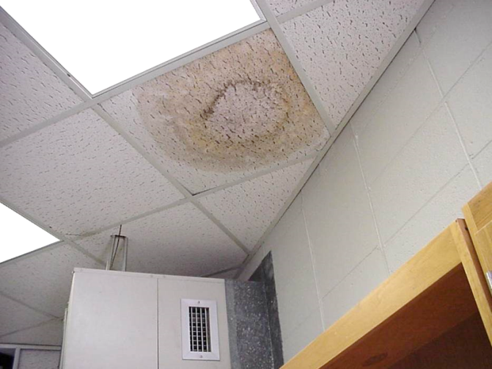
2.
Be Aware, Get Involved!
Mouse infested booster club storage – Dawn H. Gouge, University of Arizona
What to look for:
Clutter
Cardboard boxes
Open food items
Unsealed plumbing and
electrical wall penetrations
Unsealed floors and
floor to wall junctures
Undisturbed containers
Moisture
Water marks and mold on ceiling tile – Shaku Nair, University of Arizona

Slide 37

2.
Be Aware, Get Involved!
Discussing IPM and its advantages with your school community members
Get involved with environmental health
activities
Notes:
Set an example. Demonstrate your success with IPM.

Slide 38
2.
“I panicked when I saw mouse droppings on the floor.
I knew about IPM from an in‐service training, so the IPM Coordinator and I looked for a reason why the mouse might be coming to my room.
I found chips I use as rewards open inside my cabinet. The bag had been chewed through!
Now, I put all of my food and snacks in containers with tight-fitting lids. The mouse has not been back!
I was proud to tell the other teachers about my mouse and how I handled it.”
Success Story
Source: IPM for Texas Schools and Teachers, Texas A&M AgriLife Extension

Slide 39
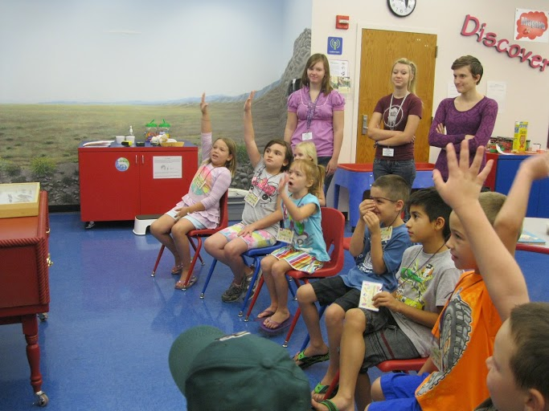
Involve Students in IPM
Students’ role
Lessons learned at a young age will remain with children for life
Emphasize the importance of:
  Clutter control
  Good sanitation
  Proper storage of food
Shujuan Li, University of Arizona
Notes:
Emphasize that IPM is everyone’s job, not the teacher’s alone.

Slide 40

Involve students in IPM
Engage your students in reducing clutter and organizing the classroom
Notes:
If there is too much going on in a class, some students find it difficult to focus.

Slide 41
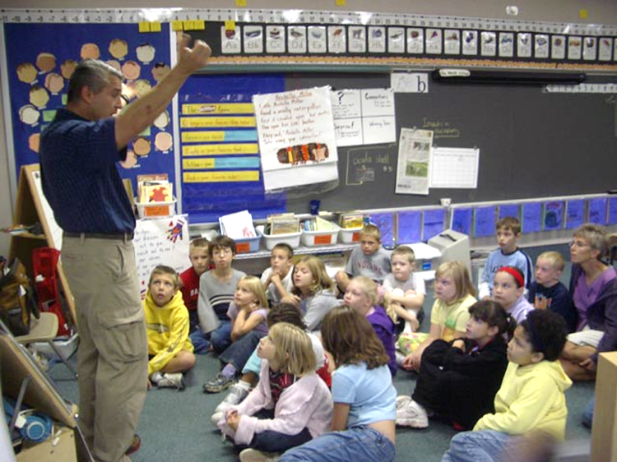
Involve Students in IPM
Have students
  Clean up
  Learn about commonly found pests
  Recognize and report pests, evidence of pests, and pest-conducive
  conditions
Jerry Jochim, Monroe
County Community School Corporation
Notes:
Having kids help clean up after class activities helps them realize the importance and skills needed to maintain good sanitation and organization.

Slide 42

Involve Students in IPM
Make sure that students:
  Do not leave food in lockers, classrooms or common areas
  Eat and drink in
  designated areas
  Dispose of trash
  appropriately

Slide 43

Managing Classroom Pets
Make sure that pet food and bedding is cleaned and stored properly
Some animals, bedding, or feed may be
asthma triggers
Notes:
Animals are effective and valuable teaching aids, but safeguards are required to reduce the risk of supporting pests so that ants, roaches and mice don’t become class pets!

Slide 44
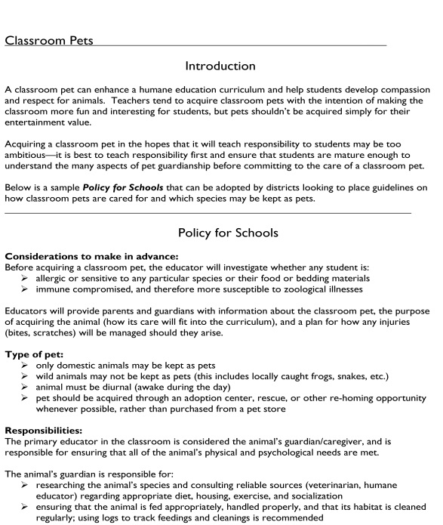
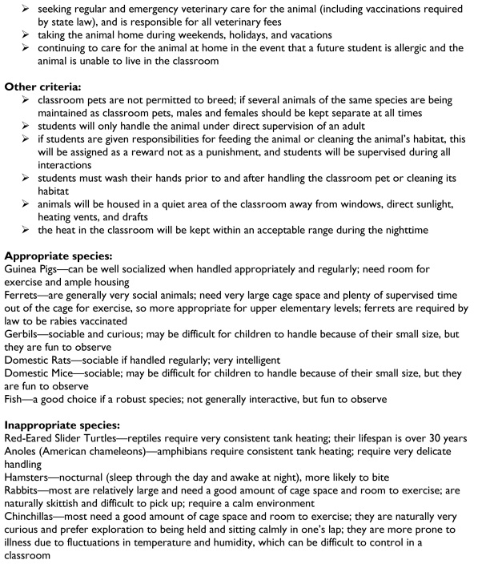

Classroom Pet Policy
District classroom pet rules may stipulate that teachers be responsible for clean out duties
Notes:
Additionally, the school nurse should be consulted prior to housing an animal in a classroom, to confirm that no students using the classroom have allergy problems.

Slide 45

Communicable/Parasitic Pests
Communicable pests of concern are head lice and bed bugs
Head lice rarely transfer between students in school
Head-to-head
contact has to occur
to transfer lice
Notes:
Transfer of lice on inanimate objects such as hats, helmets or headphones is very unlikely!
More information on these pests is included in the school nurse materials.

Slide 46

Communicable/parasitic pests
Transfer of lice on inanimate objects is unlikely
More information on these pests is included in the school nurse materials
There is no advantage
or justification for
“no-nit” policies

Slide 47
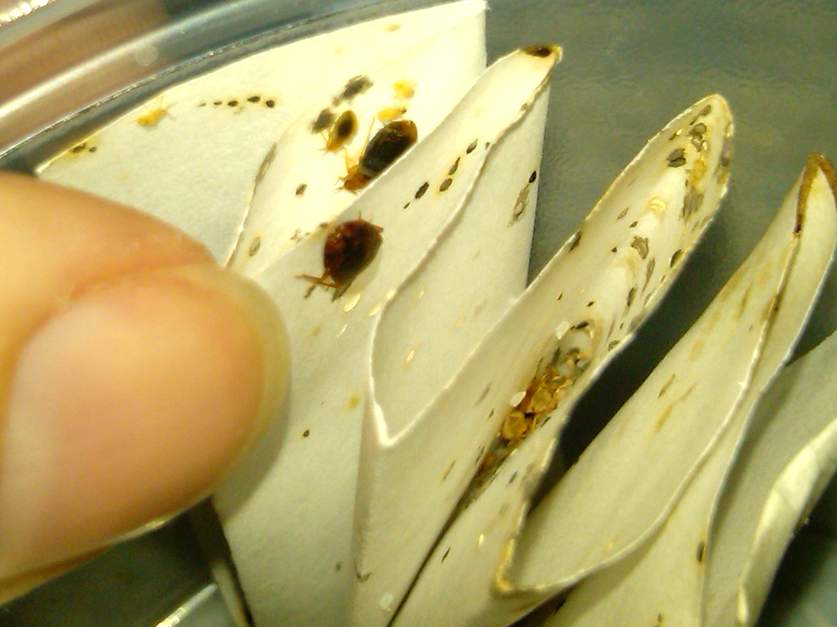
Communicable/Parasitic Pests
Bed bugs are excellent hitchhikers
Bed bugs in paper –
Dawn H. Gouge, University of Arizona
Notes:
With parental help, it is quite possible for students who live in infested homes to attend school normally, without bringing the pests into school.
More information on these pests and others is included in the school nurse materials.

Slide 48
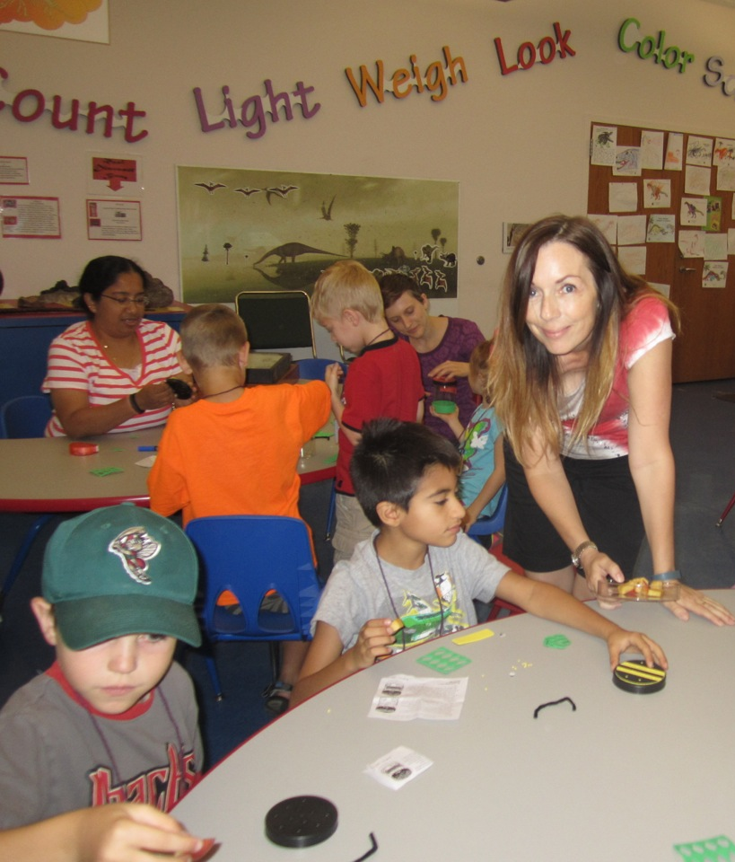
Teachers Show the Way!
“I want my classroom to be a welcome, safe, and comfortable learning environment, free of pests”
Alison Stoltman
Shaku Nair,
University of Arizona

Slide 49

Check In!
Communicating with parents
about pest and pesticide risks
Importance of observing
pesticide application notifications
Importance of clutter control
Proper storage of food and supplies
Proper sanitation methods
Students’ roles and responsibilities in IPM
Congratulations
Lesson 2 covers incorporation of IPM in your teaching curriculum

Slide 50

Resources
National School IPM Information Source: IPM for School Faculty and Staff http://schoolipm.ifas.ufl.edu/Florida/faculty.htm
Texas AgriLife Extension Southwest Technical Resource Center for IPM Schools and Child Care Facilities and Texas Integrated Pest Management Affiliate for Public Schools - IPM for Teachers
http://schoolipm.tamu.edu/files/2010/11/Teacher_IPMSmall.pdf
eXtension (2014) School Integrated
Pest Management for Teachers
http://www.extension.org/pages/
21012/school-integrated-pest-
management-for-teachers#.
U9h98rHLNeo

