Slide 1
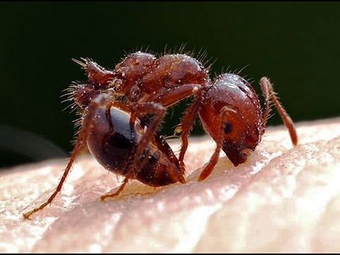
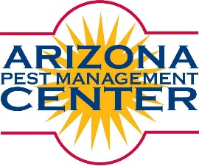

Biting, Stinging and Venomous Arthropods
Shaku Nair
University of Arizona
Maricopa Ag. Center
37860 W. Smith-Enke Road
Maricopa, AZ 85138
Notes:
1

Slide 2
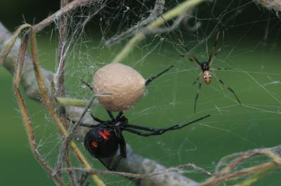
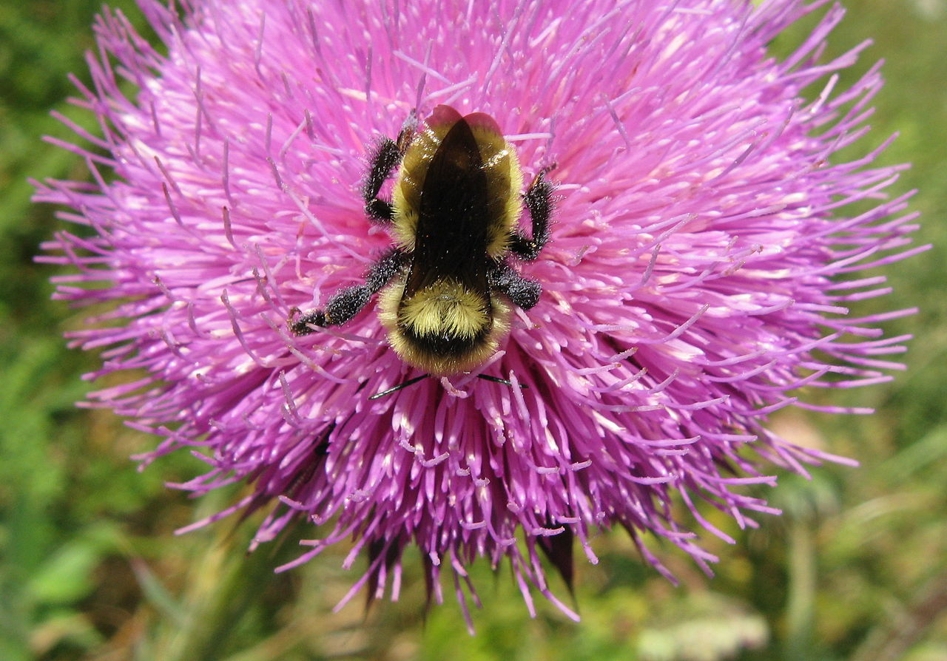
Overview
Modes of Action
Venomous Ants, Wasps, & Bees
Venomous Arachnids
Other Dangerous Insects

Slide 3
Modes of Action
Bites – spiders, centipedes, assassin bugs, ants
Stings – scorpions, ants, wasps, bees
Allergies – it’s personal
Dermatitis – caterpillars, blister beetles

Slide 4
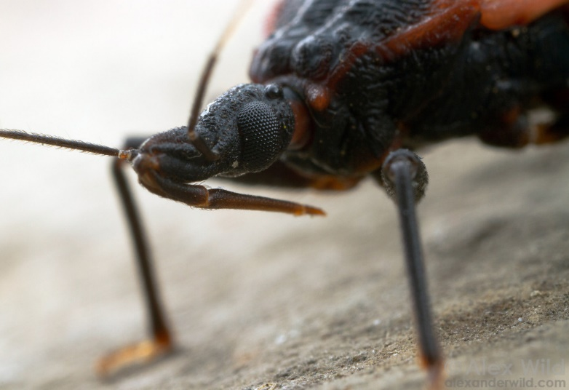
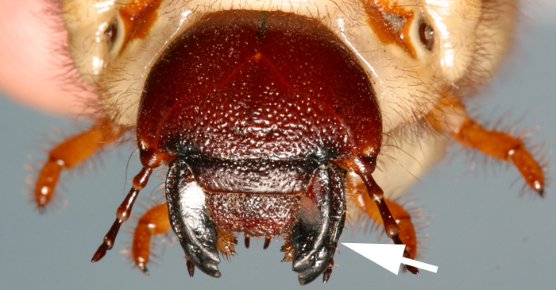
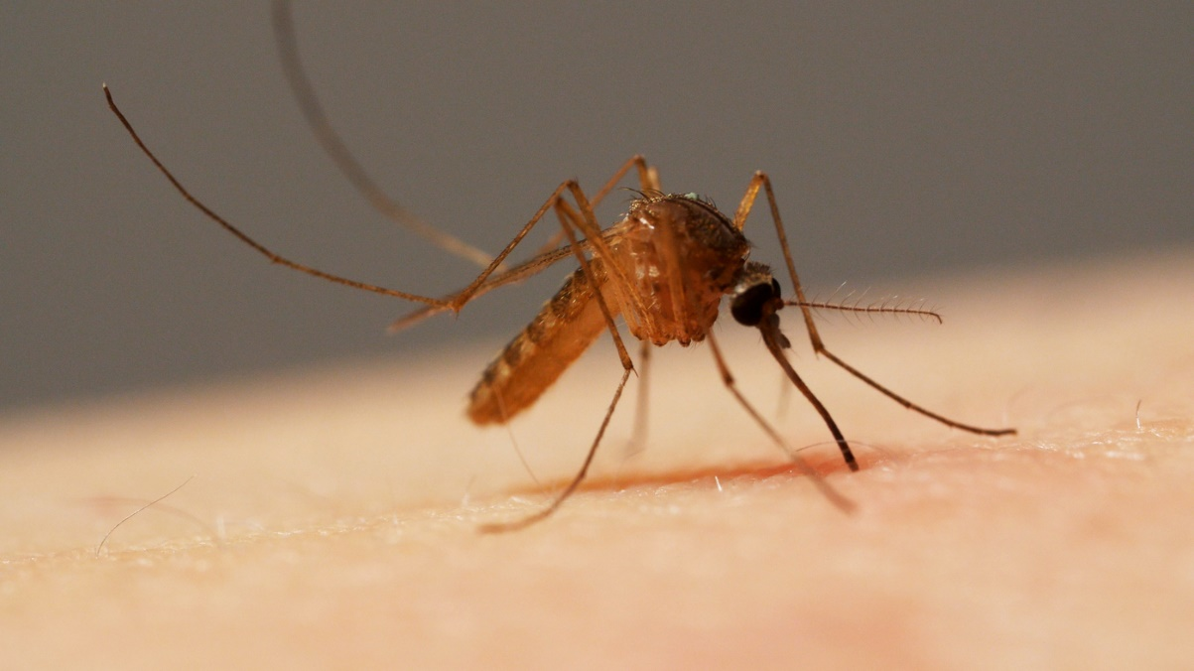
Biting vs. stinging

Slide 5
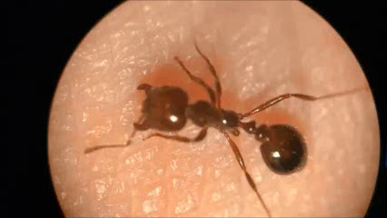
Biting vs. stinging
Video: HelloScience! https://www.youtube.com/watch?v=DtbjV-Sfayc

Slide 6
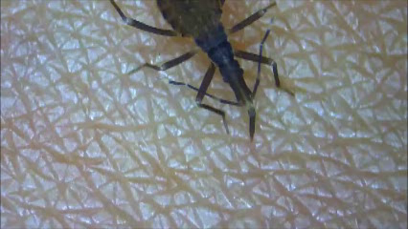
Biting vs. stinging
Video: BugBrotherBrazil, https://www.youtube.com/watch?v=i5iAMs-2uQI

Slide 7
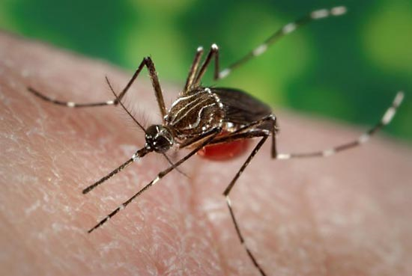
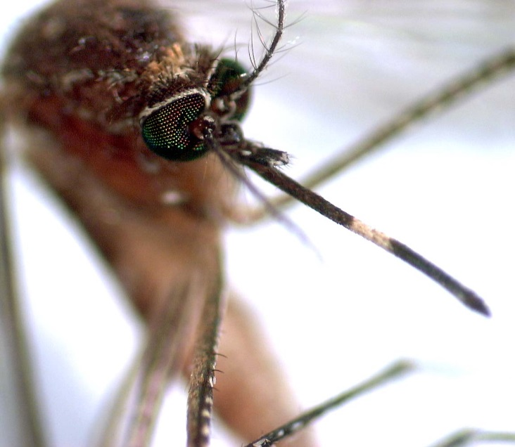
Mosquitoes – pay special attention!
Notes:
Schools and child care facilities should be safe environments.

Slide 8
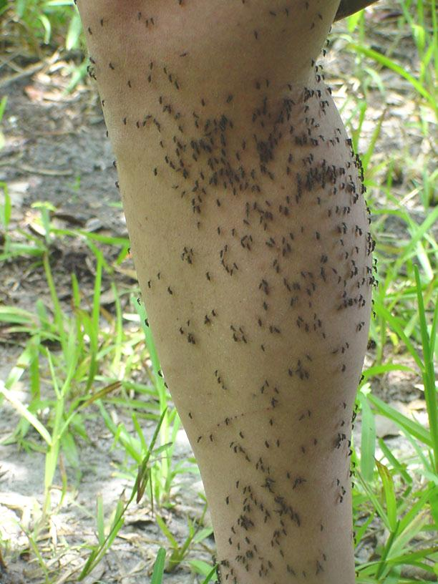
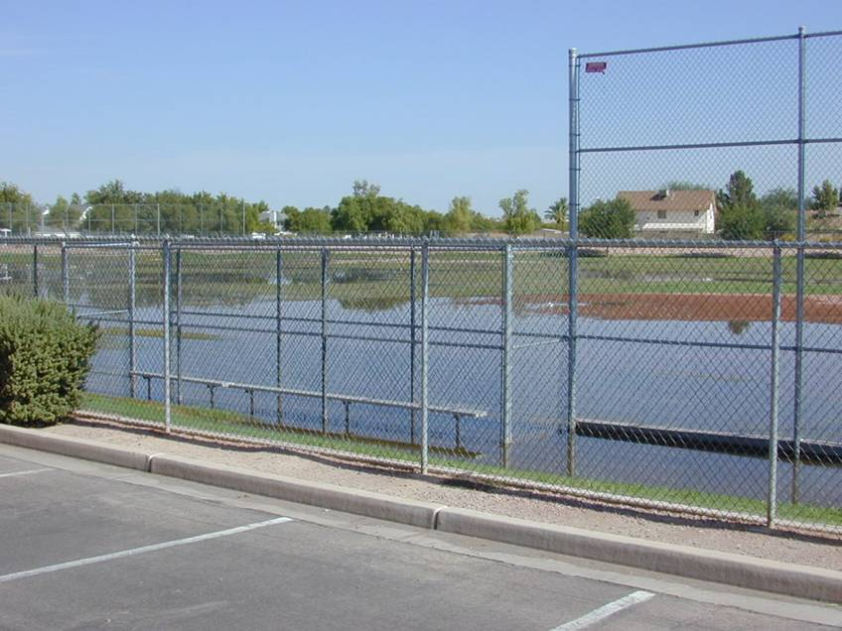
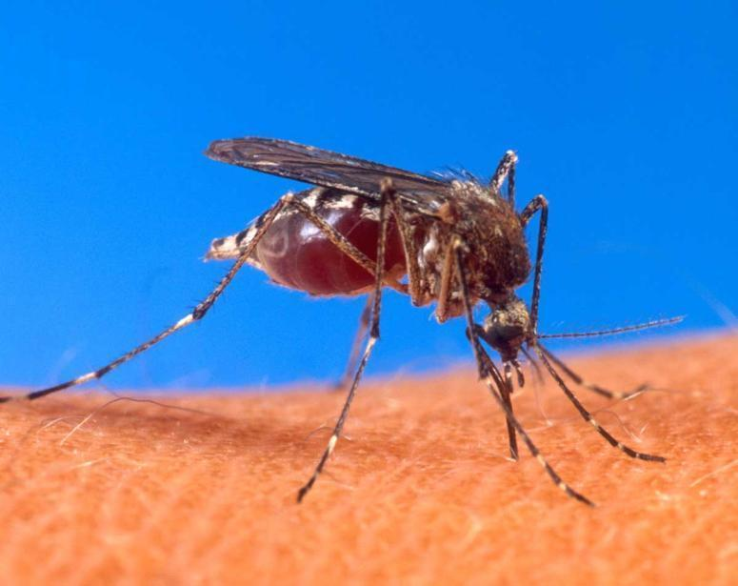
School Playing
Field
Notes:
Enabling pests

Slide 9
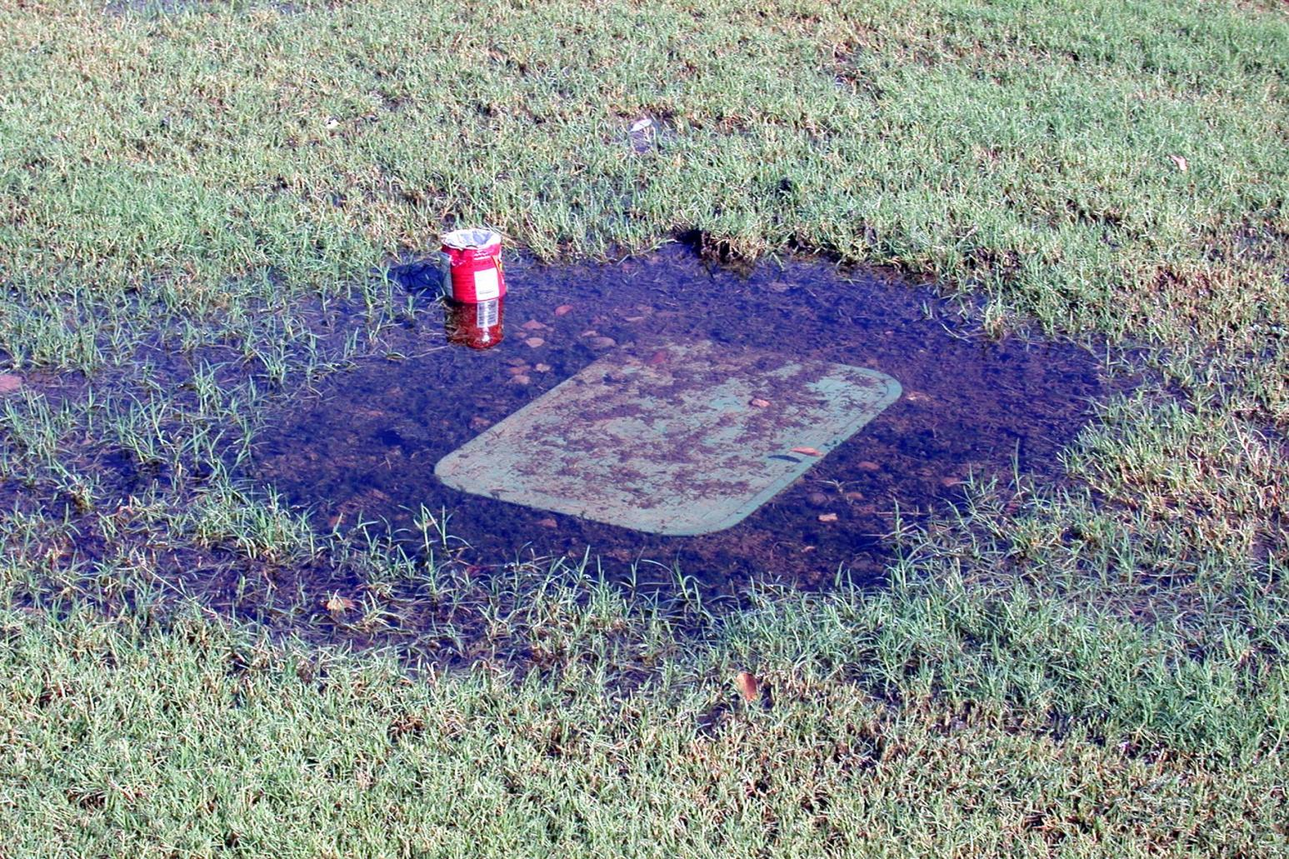
Thousands from 1 gallon of water
¼ inch of water is enough

Slide 10
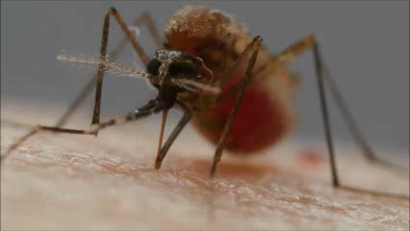
Biting or stinging?
Video: PBS Digital Studios, https://www.youtube.com/watch?v=rD8SmacBUcU&t=2s

Slide 11
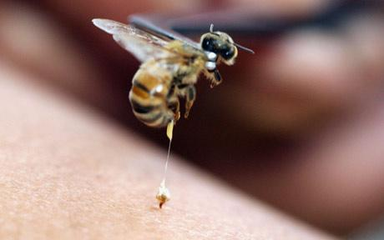
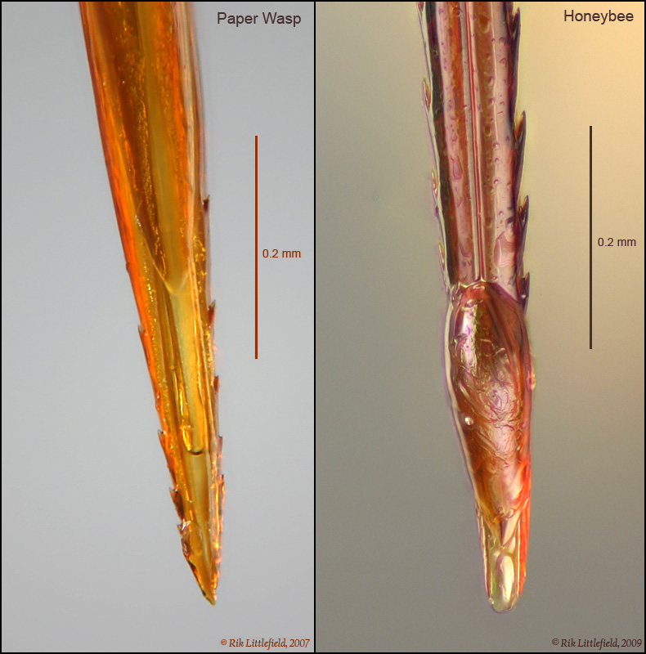
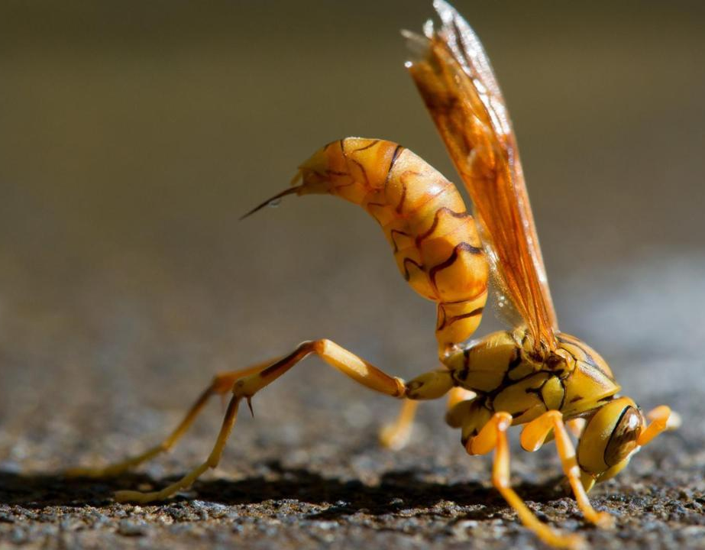
Biting vs. stinging

Slide 12
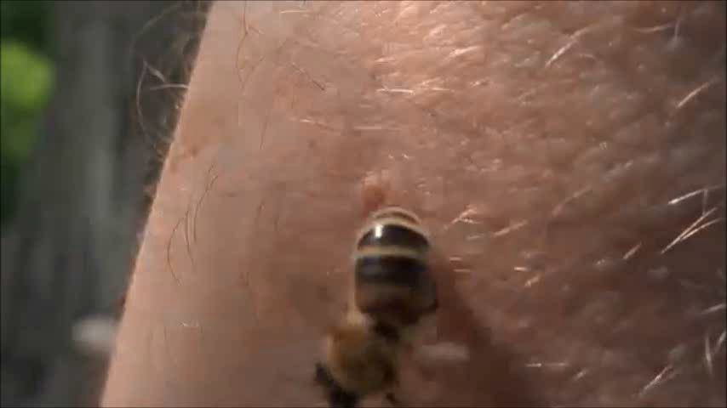
Biting vs. stinging
Video: Arvin Pierce, https://www.youtube.com/watch?v=G-C77ujnLZo&t=110s

Slide 13
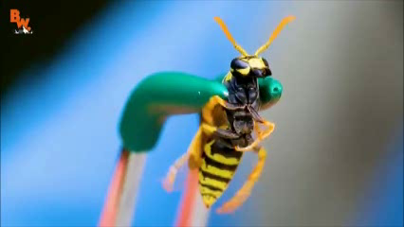
Biting vs. stinging
Video: Coyote Peterson, Brave Wilderness,
https://www.youtube.com/watch?v=EHJNGdFll4o&t=1078s

Slide 14
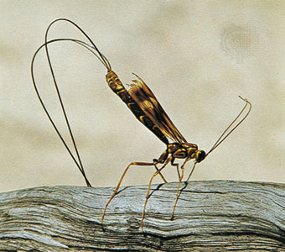
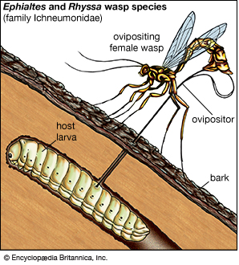
Ovipositor

Slide 15
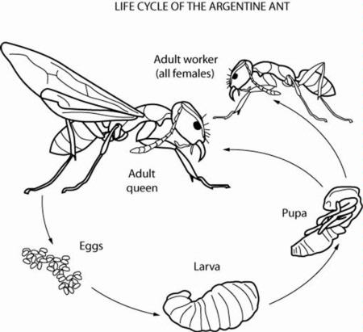
Venomous Insects
Ants, Wasps, and Bees
Order Hymenoptera
Life Cycle
  Larvae maggot-like mostly, some resemble caterpillars
  Go through complete metamorphosis
  Adults hard-bodied and mostlywinged
Thin and transparent wings
  Hind wings smaller than front wings
  Tiny hooks (hamuli) join wings
Mostly beneficial
  Pollinators, predators, parasites
  Provide honey and wax
Females usually have ovipositor modified for defense

Slide 16
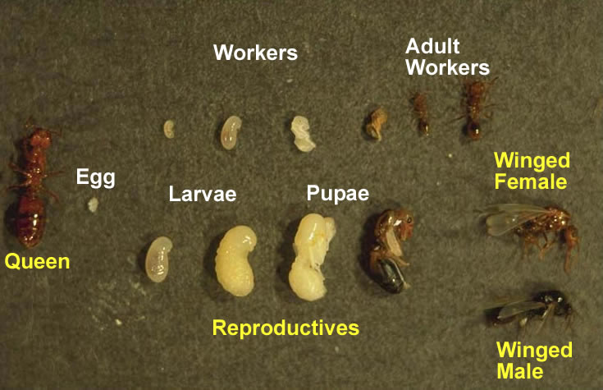
Ants
More than 12,000 species of ants all over the world
Social insects
  Workers
  Males
  Queen

Slide 17
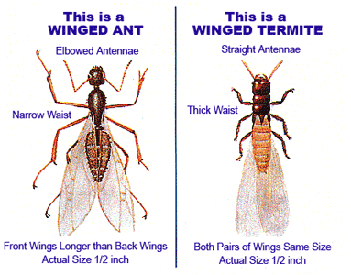
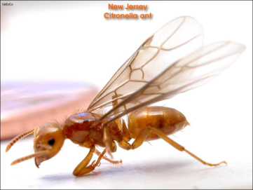
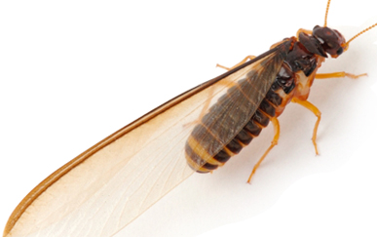
Ant vs Termite
Ants
  Elbowed antenna
  Skinny waist
Termites
  Straight antenna
  Thick waist

Slide 18
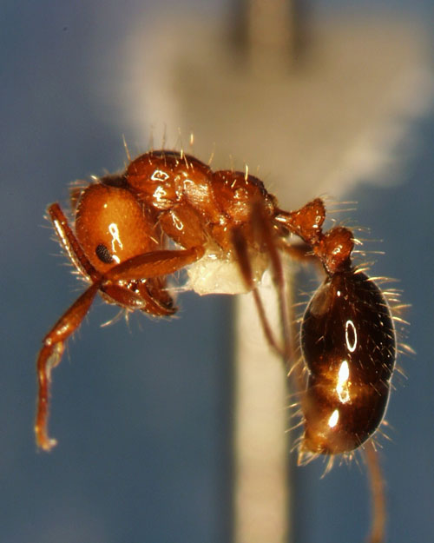
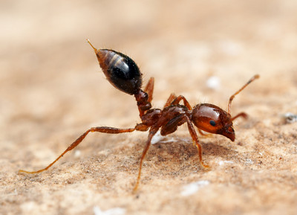
Stinging Ants
Can be very painful
In response to danger

Slide 19

Bees and Wasps
Primary concern about the group is their defensive behavior - they sting
As many as 10 - 15% of residents will be stung in any given year

Slide 20
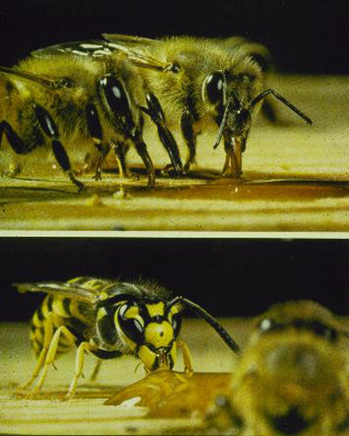
Wasp or Bee?
Most people cannot distinguish between the two
Most stings are caused by wasps
Proper control depends on identification

Slide 21
Major Differences Between
Bees and Wasps
1. Wasps are predatory; bees feed on plant products
2. Bees are hairy and have plumose or branched hairs

Slide 22
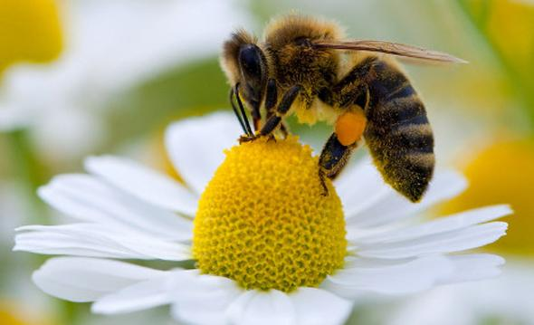
What is a Bee?
Many types of bees present in AZ
Flying insects that collect nectar and pollen
20,000 species, many differences between them
Some make honey and some don’t
Some sting, while others can’t

Slide 23
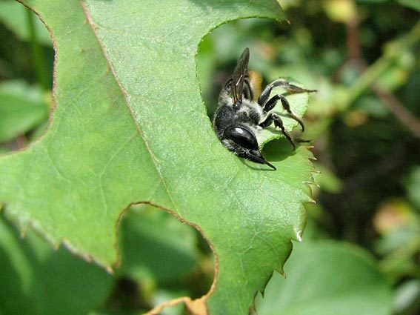
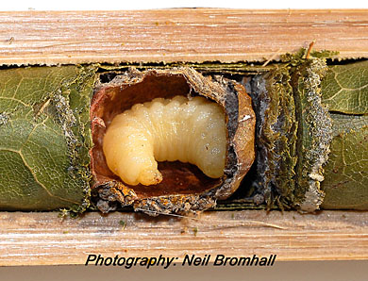
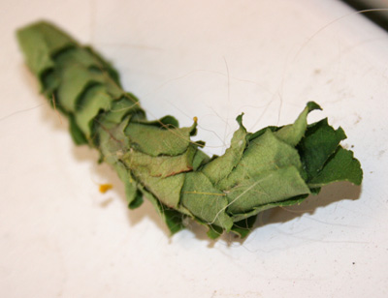
Leafcutter Bee
Beneficial Insect
Pollinators
Not aggressive

Slide 24
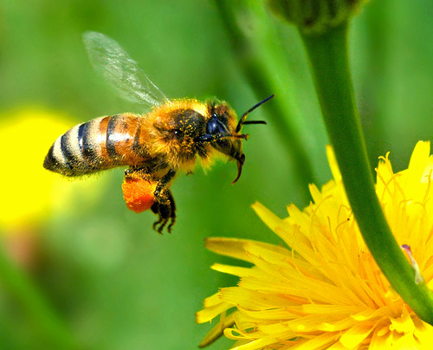
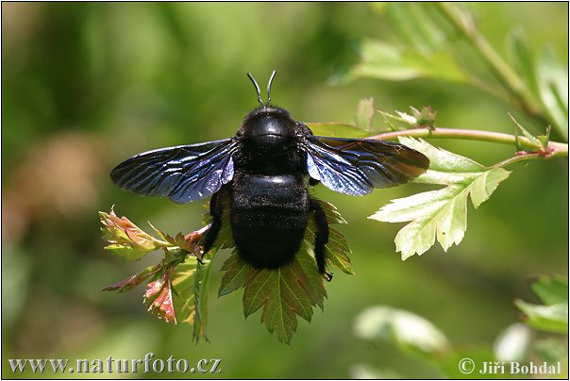
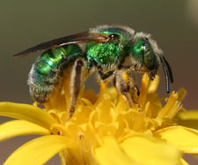
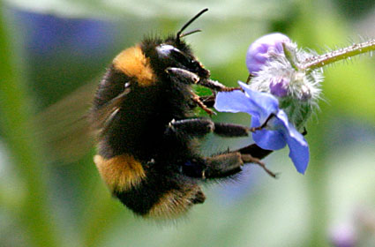
Arizona Bees
Honeybee
Carpenter
bee
Sting
Sting under extreme circumstance
Sweat bee
Bumble
bee
Small Sting
Sting

Slide 25
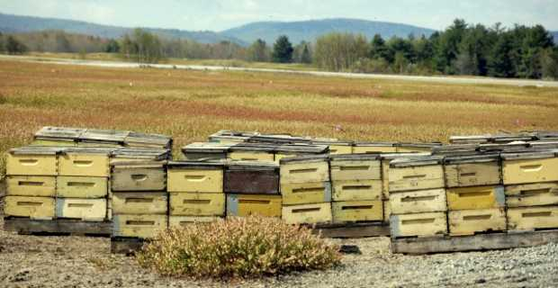
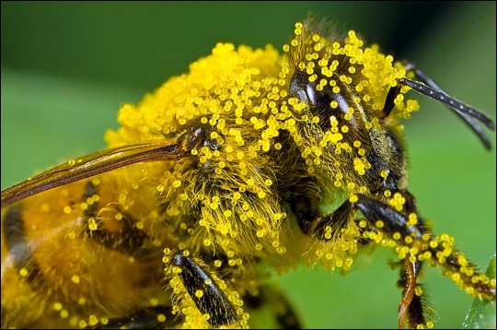
Bee Pollination
Honeybees provide 80% of the pollination needed by agricultural crops.
US harvest more than $20 billions annually in pollinated crops.
Bees are important!

Slide 26
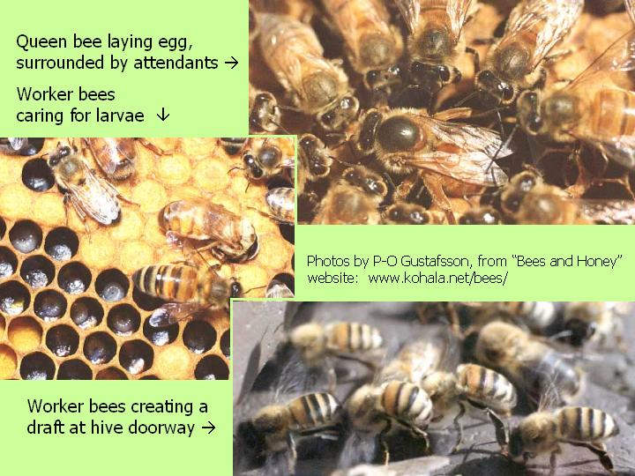
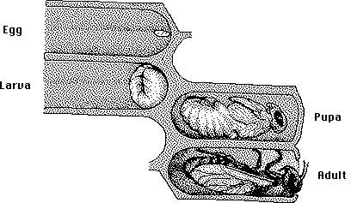
Worker bees fanning hive with wings

Slide 27
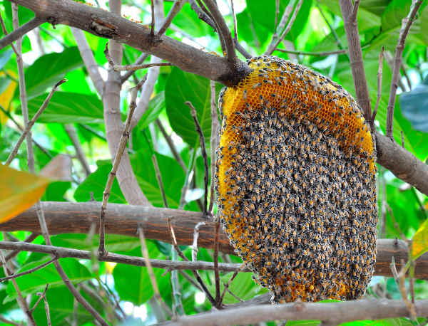
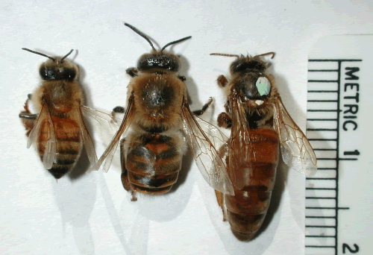
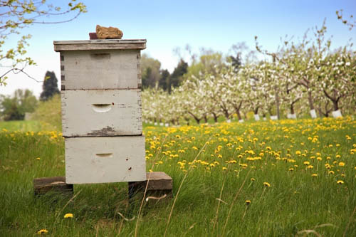
Honey Bee Biology
Bees are social insects and live in colonies
Caste system
  Queen
  Worker
  Drone

Slide 28
Swarm vs Hive
Hives
Permanent: weeks +
Usually in holes, walls, trees
Most bees not visible
Usually much flight activity
If exposed, comb seen
Often defensive
Bees with yellow/orange
pollen on legs arriving
Swarms
Temporary: present 1-4days
Always exposed & open
Visible cluster of bees
Usually quiet, little flight
Comb not present
Very rarely defensive
Pollen-laden bees not seen
Usually occurs in spring

Slide 29
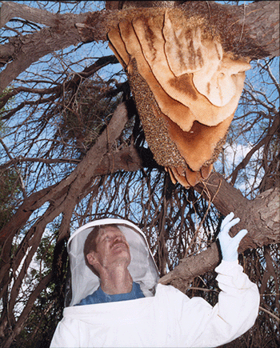
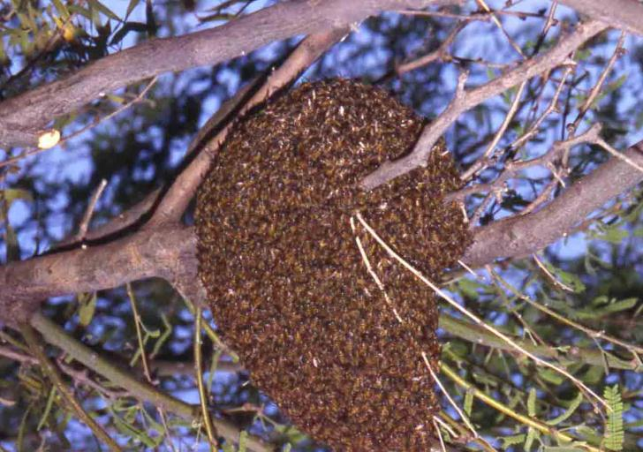
Swarm vs Hive

Slide 30
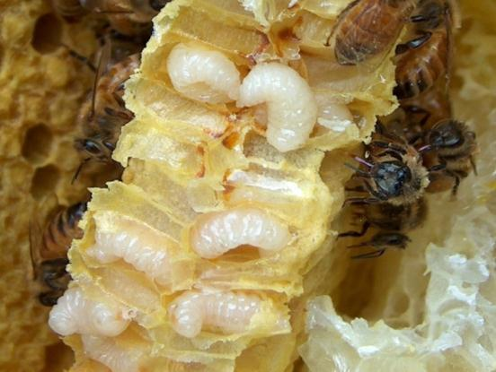
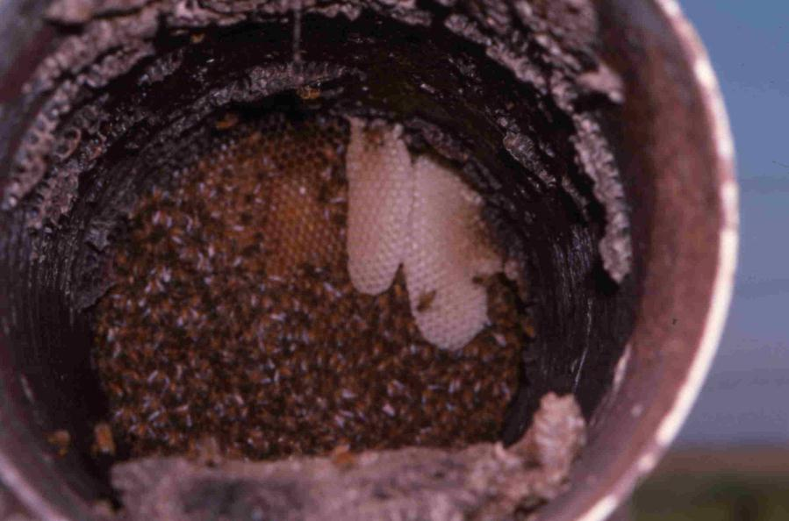
Hives
Usually made in openings

Slide 31

Hives

Slide 32

Managing Bee Problems
Bees are beneficial and should not be killed unless they are causing a problem
Bumble bee nests are small and can be killed with an insecticidal spray or a dust placed in the entrance
Carpenter bees only cause problems in early spring and also can be killed with insecticides
Honey bee nests are difficult to capture or destroy and should be done by a professional

Slide 33


Hive and Swarm Removal
  Local bee keepers may be available for removal of bees

Slide 34




Venom Sac

Slide 35

Bumble Bee Biology
Bumble bees have a biology and life cycle similar to Vespid wasps
Nests are started by queens in the spring and die out at the end of the season
Bumble bees nest in the ground, old mouse nests, old hay or similar locations
Bumble bee colonies are generally small
Bumble bee nest

Slide 36

Carpenter Bees
Carpenter bees resemble bumble bees
Carpenter bees are solitary and nest in wood
They are not aggressive, but male bees will defend territories by buzzing (but males cannot sting!)
They can be common around structures where wood is exposed to nesting

Slide 37




What’s Not a Bee
Tarantula
Wasp
Yellow
Jacket
Paper
Wasp
Baldfaced
Hornet
All can sting multiple times

Slide 38





Sawfly Family: Tenthredinidae
Often brightly colored
Body shape is somewhat roundish and robust, fly like in appearance
Larvae are caterpillar-like, but no crochets and more than five pairs of prolegs
Many adults are predaceous
Larvae are herbivore pests

Slide 39





Family: Ichneumonidae
Long antennae
Females have a long ovipositor, sometimes longer than body
Parasitoids, larvae feed on a single insect host

Slide 40






Slide 41



Slide 42





Slide 43


Problems with Paper Wasps
Most problems occur in late summer and fall when nest are large
Wasps are more defensive when nests are large
Yellowjackets readily scavenge food, bringing them into contact with people
Good sanitation will help reduce problems

Slide 44


Wasp and Hornet Nests

Slide 45



Removing Nests
This is a dangerous job!
  Large nests should be removed by pest control operator
Small nests (can be handled by others)
  Cover face/neck, wear long sleeves, long pants, hat and eye protection
  Spray at night when wasps are quiet

Slide 46



Stay Safe
Remain calm
Never wave your arms when approached by a stinging insect!
Cover face with hands and look through fingers
Run directly to a building or car
If in the open run 2 football field lengths

Slide 47

Other biting insects
Conenose Bugs
Also called kissing bugs or Hualapai tigers
Common residents in woodrat or packrat nests
Adults disperse during the summer rainy season and are often attracted to porch lights
Feed at night on a variety of animals
  May feed on reptiles and mammals, including us
  People are generally bitten while resting or asleep and do not usually awake while being fed upon
  Feed by inserting a proboscis beneath the skin and sucking blood
  Bites may become painful and swollen, but are typically not serious

Slide 48

Blister Beetles
Blister beetles are active during the spring, summer, and fall
  Especially after wet winters or good summer rains
  They feed on succulent vegetation and flowers
They possess a chemical defense called cantharidin
  Excreted from the joints
  Typically when the animal is restrained
  Absorbed through the skin and causes blistering
  Symptoms are very similar to poison ivy
  Ingestion by livestock is a problem

Slide 49

Caterpillars
Many species of larval butterflies and moths possess urticating hairs
  Small defensive spines with a venom gland
  Administered when handled or brushed against
  Generally these hairs produce an unpleasant burning or stinging sensation much like a bee sting or worse
  Some species have powerful venom and may cause nausea, headache, respiratory distress, and may require medical attention
  The sting site may remain irritated for several days.
Puss caterpillar

Slide 50
Venomous Arthropods
Spiders
All spiders are venomous
  Spiders bite to deliver their venom
  Spiders are primarily predators on other invertebrates
  Larger species or those with very strong webs occasionally take small vertebrates
Are spiders dangerous to humans?
  Are its jaws strong enough to penetrate human skin?
  Is the venom virulent enough to cause any serious effects on humans?
  Only two varieties in Arizona are generally considered dangerous to humans

Slide 51



Spiders
Black Widow (Latrodectus species)
  One species in AZ
  Severe pain, respiratory distress, cramping
  There is a very effective antivenin available
Brown spiders (Loxoceles species)
  Five species in AZ
  Bites may go undetected for long periods of time (in excess of 8 hours)
  The perpetrator is seldom seen
  Local pain and swelling, potential necrotic ulcer
Daddy long legs (Opiliones species)
  Not spiders and not venomous, contrary to popular belief

Slide 52


More Arachnids
Scorpions
  56 species in AZ
  All venomous but only one considered dangerous
    Bark scorpion (Centruroides exilicauda)
    Potentially life threatening to children under 4 years old
Ticks
  Brown dog tick (Rhipicephalus sangiuneus)
  Not venomous but able to spread disease by biting
  Rocky Mountain Spotted Fever bacteria found in some

Slide 53

Biting vs. stinging

Slide 54

Biting vs. stinging
Video: Coyote Peterson, Brave Wilderness,
https://www.youtube.com/watch?v=XFw_HRG8PvY

Slide 55
Other Venomous Arthropods
Centipedes, conenose bugs, blister beetles, and some caterpillars have nasty bites or stings
Some can be very painful and cause medical complications
The bites or stings of these animals are seldom considered life threatening
Medical problems result when a person is allergic or hypersensitive to the sting or bite

Slide 56

Centipedes
Arizona centipedes are generally small in size and present little threat to people
  Centipedes deliver venom via a modified pair of legs beneath the head called gnathopods
  Centipedes are most active when conditions are warm and moist
  They are found in a wide variety of habitats
  They prey on other invertebrates, but larger species can take small vertebrate prey
Common or Tiger Centipede

Slide 57

Giant desert centipede
Giant desert centipede (Scolopendra heros)
  May obtain lengths of 8 inches or more
  The bite is very painful but does not generally require medical attention
  The area of the bite has been known to remain hypersensitive for weeks

Slide 58

Thank you!
Contact:
Shaku Nair, nairs@email.arizona.edu
University of Arizona Community IPM

