Slide 1
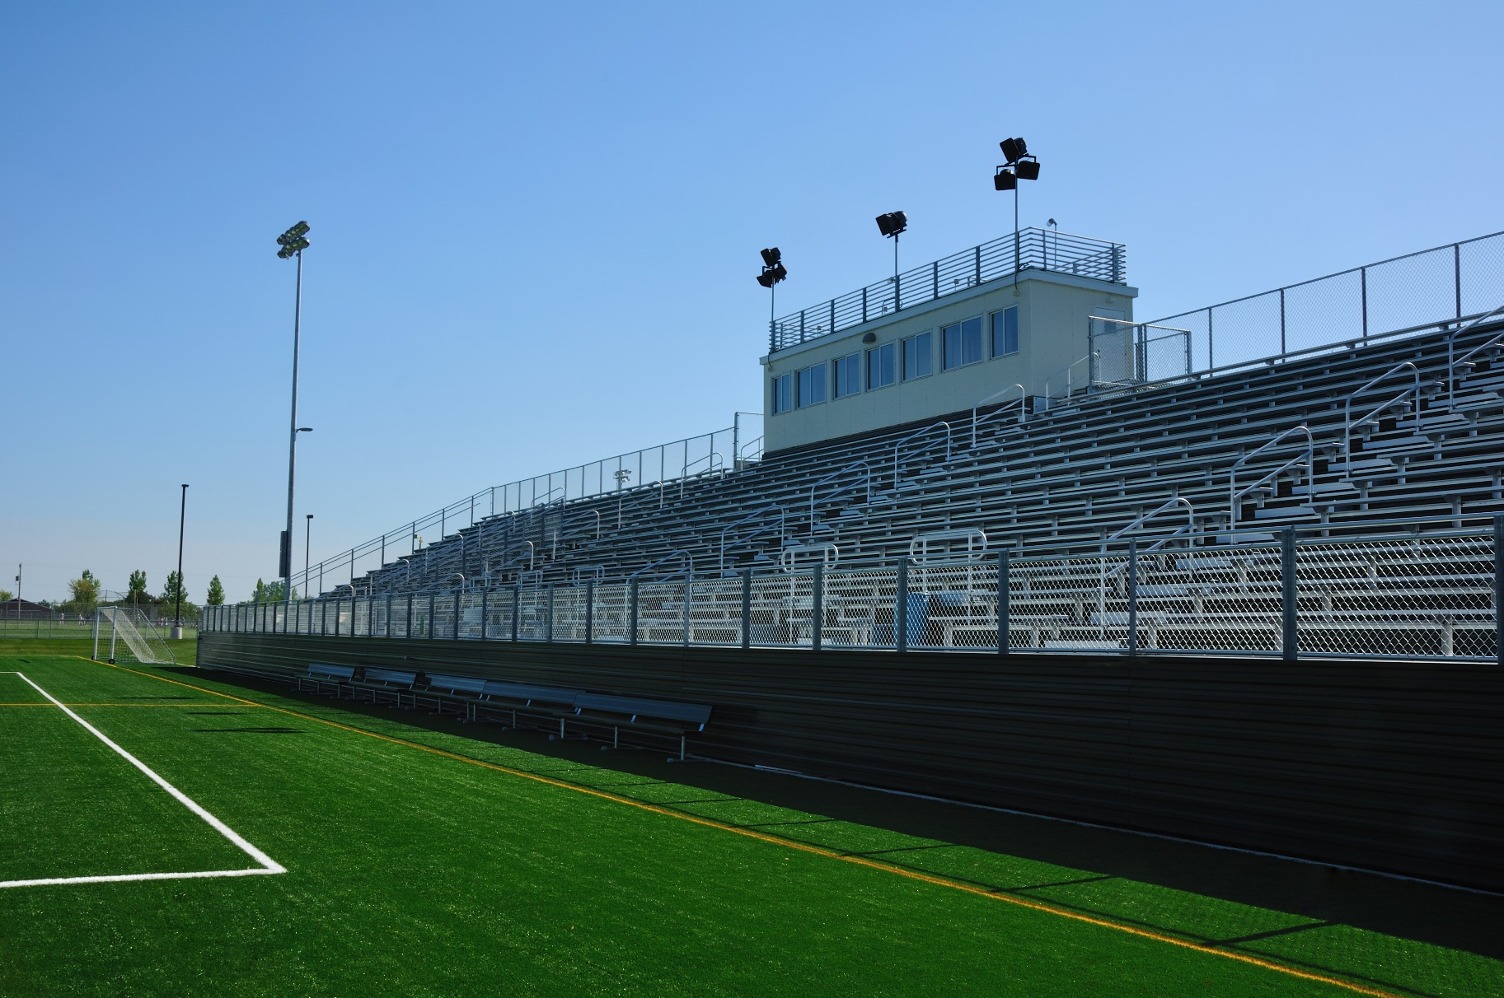
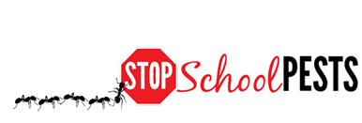
Common Turfgrass diseases
Lesson 4 of 4
In-Person Educational Module

Slide 2
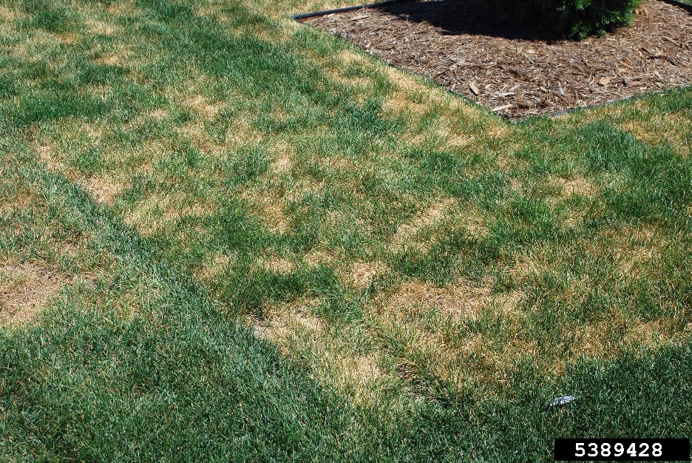
Learning Objectives
Identify and describe how to manage common turfgrass diseases
Describe how to avoid and reduce stresses on turfgrass
Spring dead spot - Howard F. Schwartz, Colorado State University, IPMImages.org

Slide 3
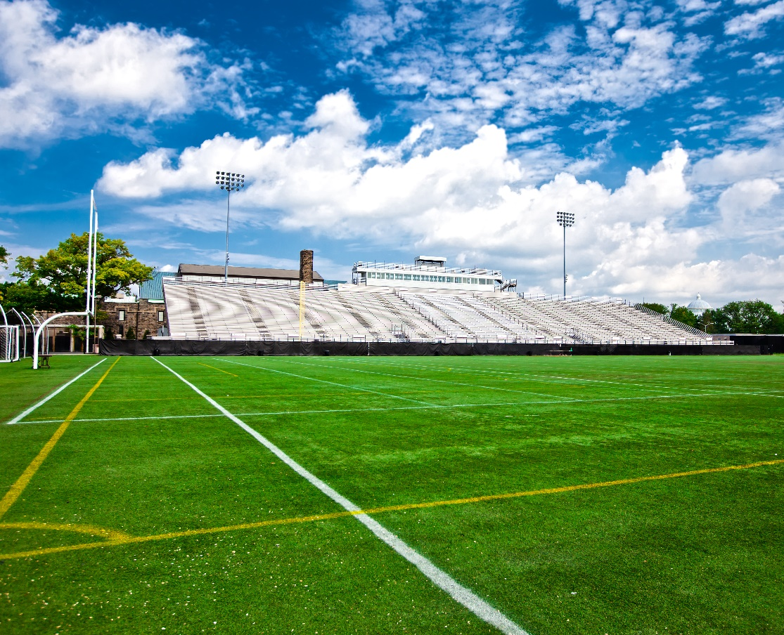
Regions
Weather and climate greatly impact turfgrass disease
Most disease issues can be managed with cultural techniques
Variety selection
Irrigation
Mowing practices

Slide 4
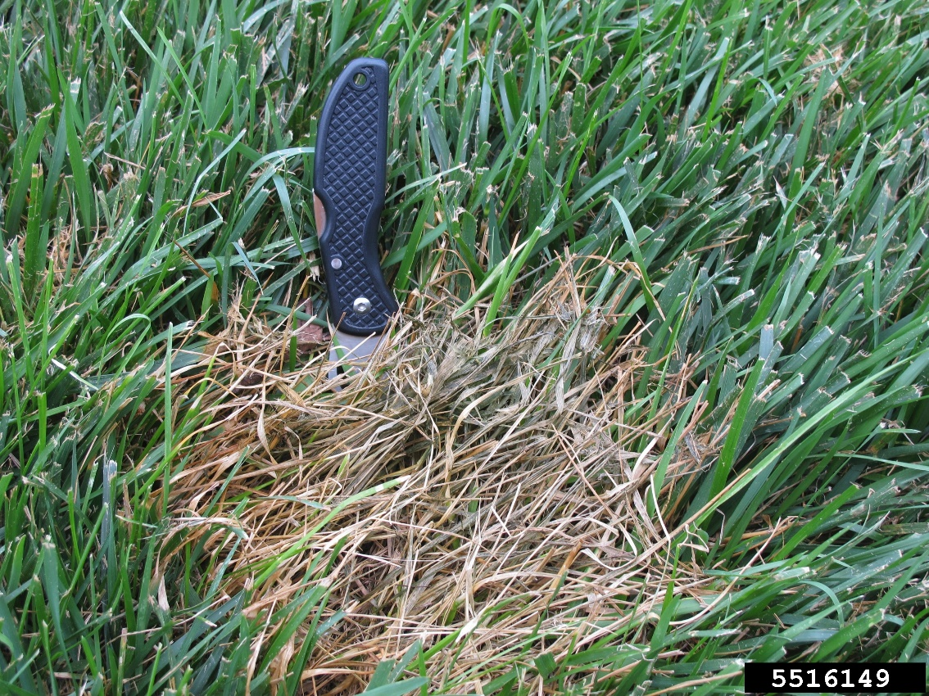
Identifying, Monitoring and Management of Turfgrass Disease
Fairy ring
Spring dead spot
Pythium blight
Dollar spot
Rusts
Leaf spot
Red thread
Pythium root and stem
rot - Lee Miller, University of Missouri, Bugwood.org

Slide 5
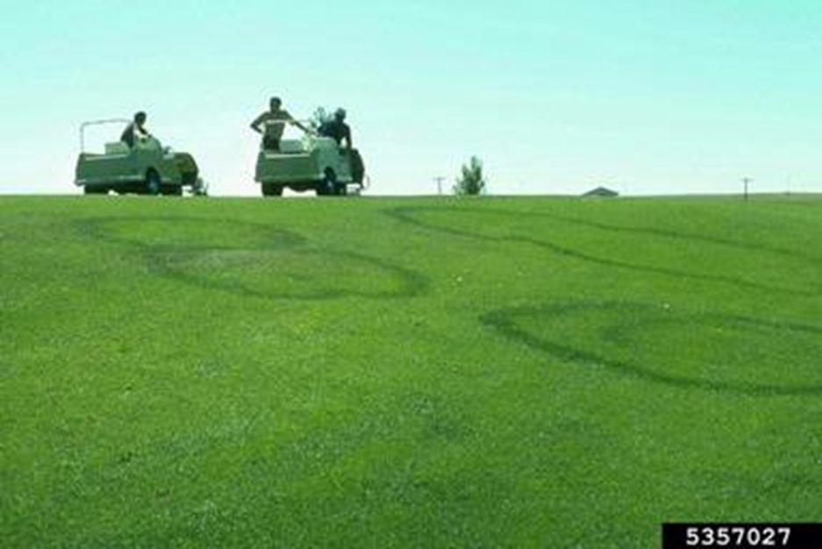
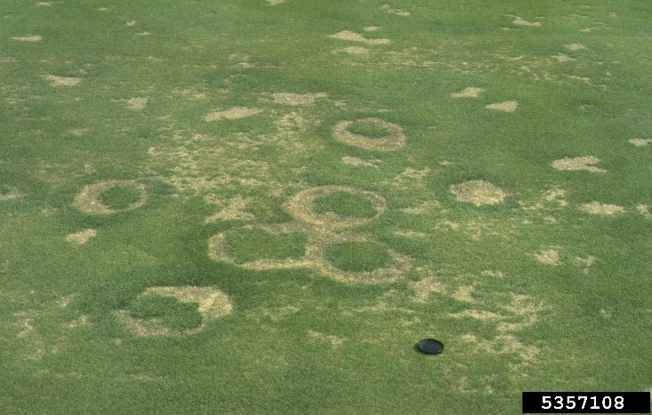
Fairy Rings
Circular, centimeters to meters in diameter
Large dark green rings, a thin ring of dying/dead turf, or rings of mushrooms without loss of turfgrass
Green rings, also fairy rings -William M. Brown Jr., Bugwood.org

Slide 6
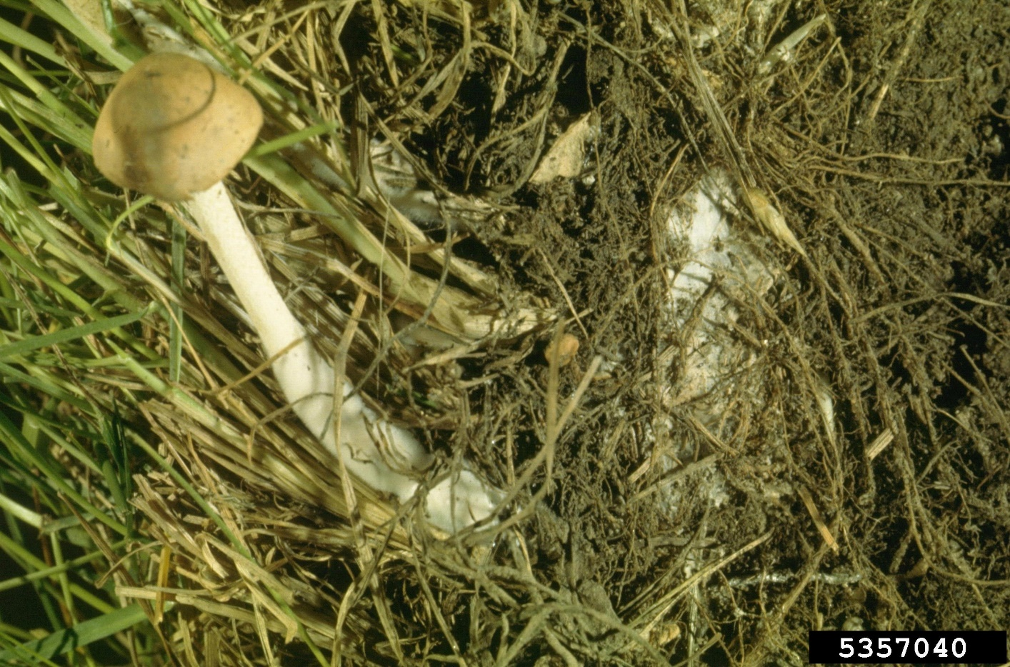
Fairy Rings
Correct fertilization, irrigation and regular dethatching will reduce symptoms
Fairy ring fruiting bodies - Lester E. Dickens, Bugwood.org

Slide 7
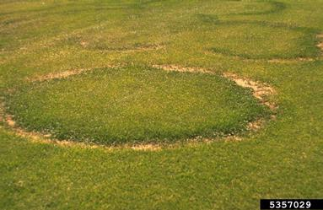
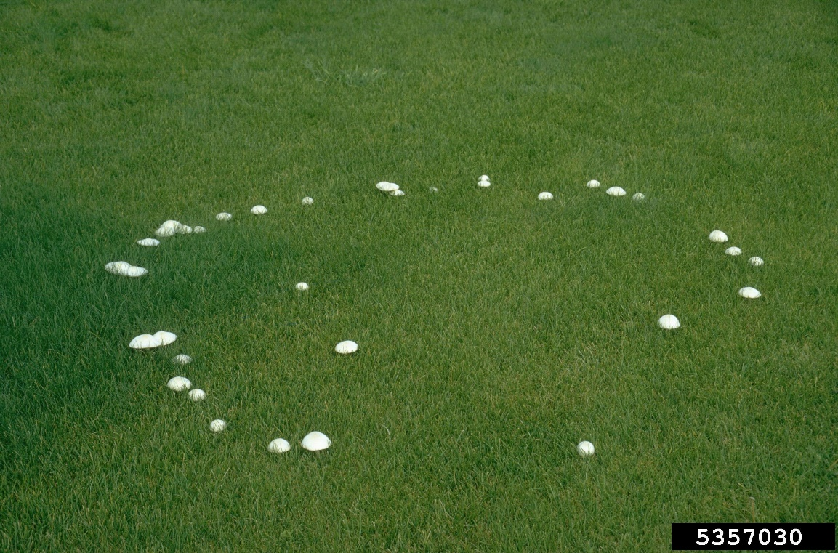
Fairy Ring
Dead rings
Live rings
William M. Brown Jr., bugwood.org
Notes:
Dr. Alec Kowaleski (Oregon State University turfgrass agronomist

Slide 8
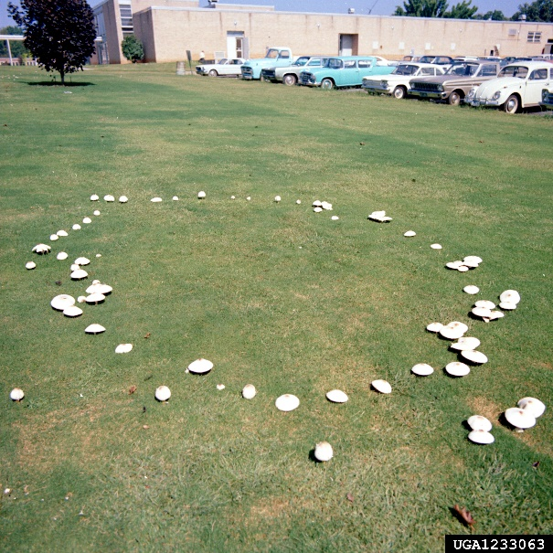
Spring Dead Spot
Circular areas of dead grass, 6 to 12 inches in diameter
Appears when warm-season turf emerges after winter
Dark, sunken areas may become black and breakable
Spread of the pathogen in old debris and roots
Remove infected areas, reduce organic matter accumulation, avoid later fall fertilization, maintain proper pH
Fruiting fairy ring - Clemson University - USDA Cooperative Extension Slide Series, Bugwood.org

Slide 9
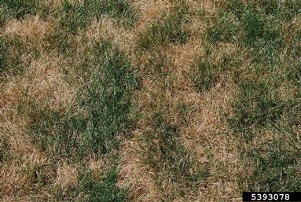
Spring Dead Spot
Problematic on bermudagrass used in transition zones, were deep winter dormancy is present
Spring dead spot - Howard F. Schwartz, Colorado State University, Bugwood.org

Slide 10
Pythium Blight
Cotton-like strands (mycelia) and small, circular spots of dead grass that run together
Leaf blades blacken, wither, and turn reddish-brown Leaves lie flat, stick together, and appear greasy
Fungus develops in low spots that remain wet during periods of high humidity
Indicator of over-fertilization, overwatering and/or poor drainage
Cultivation may improve drainage

Slide 11
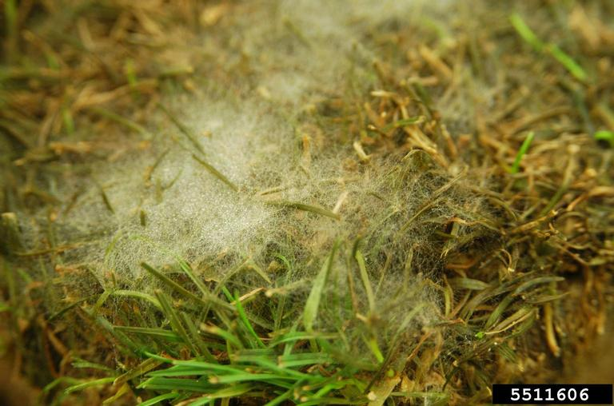
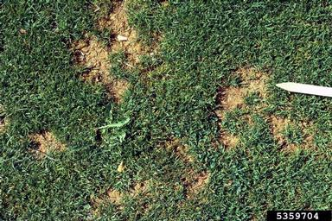
Pythium blight
Cottony white mycelium observed early in the morning during periods of high heat and humidity
Pythium blight - Ward Upham, Kansas State University, bugwood.org
Pythium blight - William M. Brown Jr., Bugwood.org

Slide 12
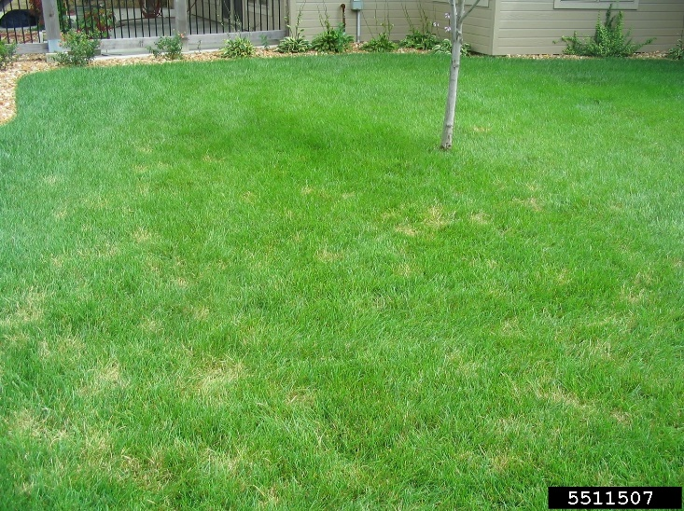
Dollar Spot
Spots the size of a silver dollar that merge to form large, irregular areas
Leaves appear water-soaked initially, then brown - A reddish band extending across the leaf appears
Excessive leaf wetness, water stress, excess thatch, and poor nutrition all contribute to the problem
An indicator of low fertility
Dollar spot - Ward Upham, Kansas State University, Bugwood.org

Slide 13
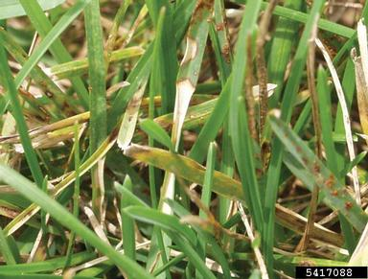
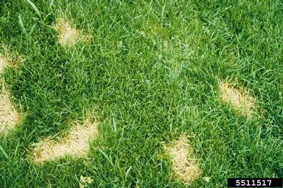
Dollar spot
Begin as quarter-size spots and increase to silver dollar-size spots that multiply
Dollar spot - Barb Corwin, Turfgrass Diagnostics, Bugwood.org
Dollar spot - Ward Upham, Kansas State University, bugwood.org

Slide 14
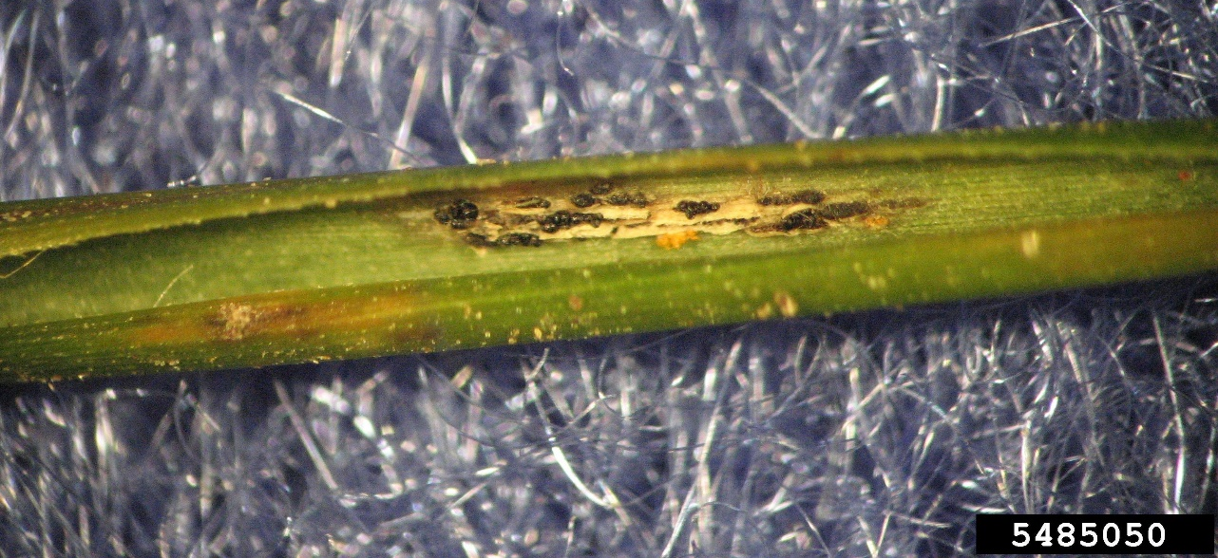
Rusts
Bumps appear as powdery masses of yellow, orange, purple, black or brown spores on leaves and sometimes on stems
During periods of warm days and cool nights, especially in turf with low fertility
Fertilization
Rust - Clarissa Balbalian, Mississippi State University, Bugwood.org

Slide 15
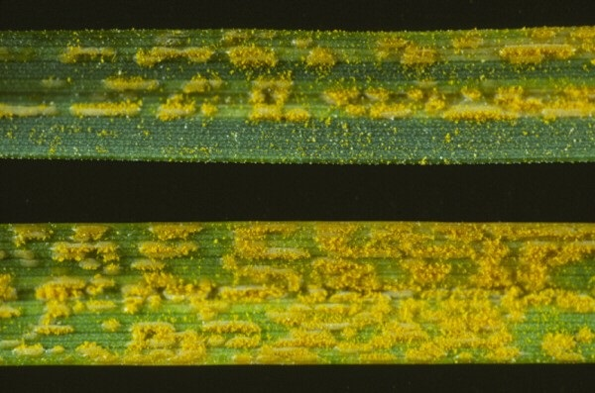
Rusts
In low fertility cause
Rust - R.S. Byther, Washington State University

Slide 16
Leaf Spot
Spots may vary from small discrete dots and raised areas to irregular yellow or brownish patches that cover the leaf surface
Leaves with obvious lesions
Multiple fungal pathogens associated with excess organic matter, poor drainage and excessive fertilization
Core cultivation and vertical mowing will decrease organic matter, and improve surface drainage

Slide 17
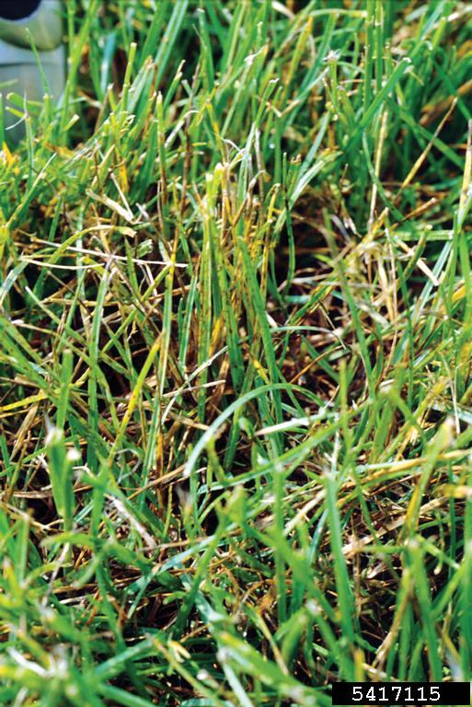
Leaf Spot
Can kill turf and result in bare spots
With low light levels, leaf spot is more severe
Leaf spot on Kentucky bluegrass - Ned Tisserat, Colorado State University, Bugwood.org

Slide 18
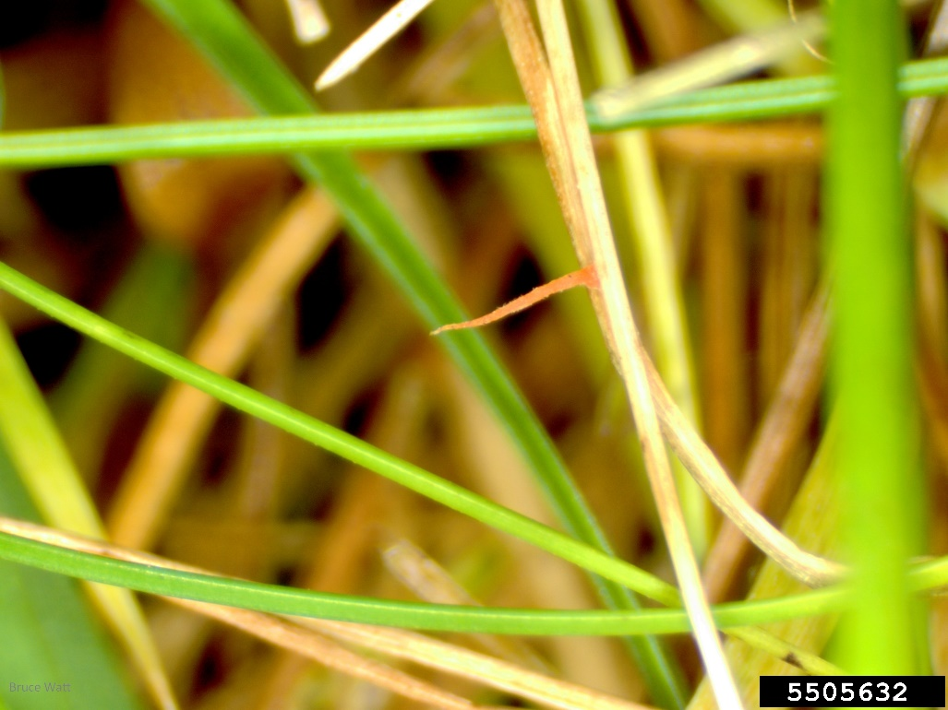
Red Thread
Pink, gelatinous fungal crusts projecting from leaves
Disease may kill turfgrass in patches 2 to 8 inches in diameter
Proper irrigation and fertilization
Red thread - Bruce Watt, University of
Maine, Bugwood.org

Slide 19
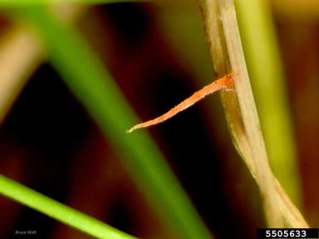
Red Thread
Adequate nitrogen can usually prevent this disease
Red thread - Bruce Watt, University of Maine, bugwood.org

Slide 20
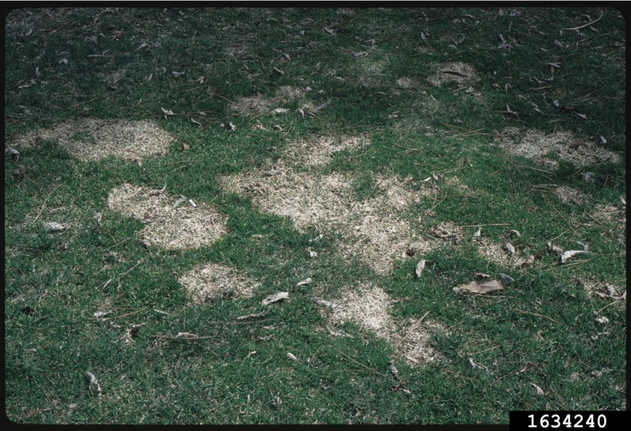
Managing Disease in Turfgrass
Disease development can be a sign of excessive organic matter
Reduce organic matter through frequent cultivation
Snow mold - Penn State Department of Plant Pathology & Environmental Microbiology Archives, Penn State University, Bugwood.org

Slide 21
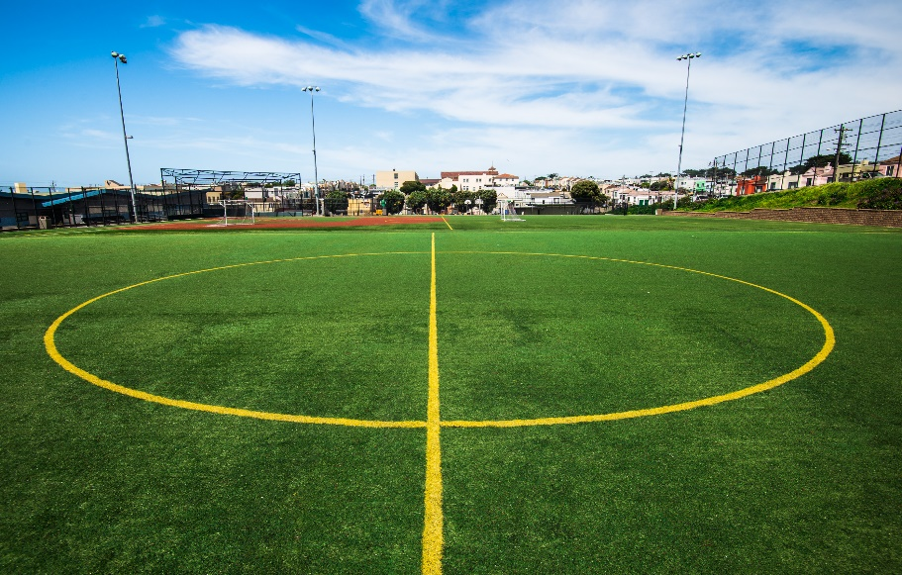
Managing Disease in Turfgrass
Overwatering is a frequent cause
Irrigate in the early morning
Try to avoid late afternoon or nighttime irrigation
Apply water only as fast as the turf accepts it

Slide 22
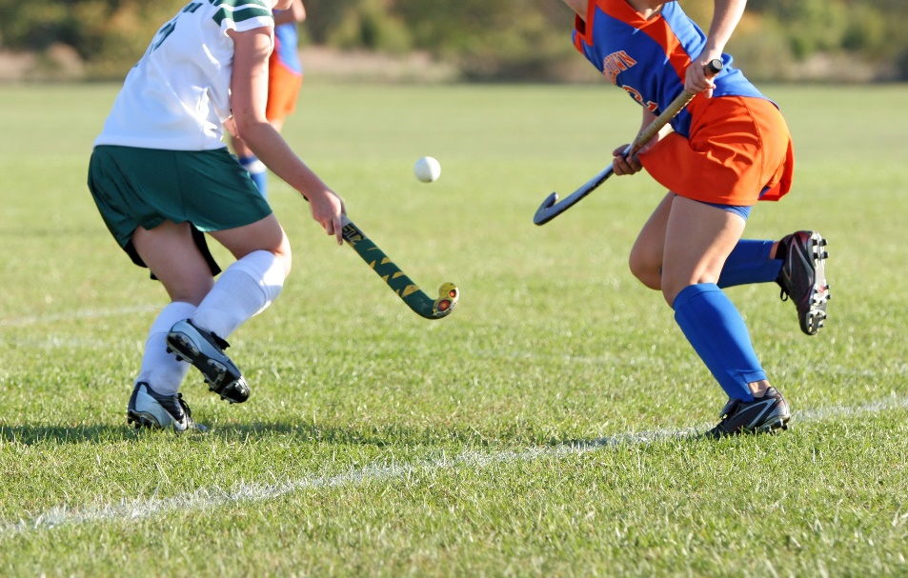
Managing Disease in Turfgrass
Good turf management is the first step in turf disease management
Proper mowing
Proper fertilization
Irrigate appropriately
Annual cultivation
Dethatch sod forming grasses and aerate
Fungicides should be used only if cultural measures do not provide adequate control

Slide 23
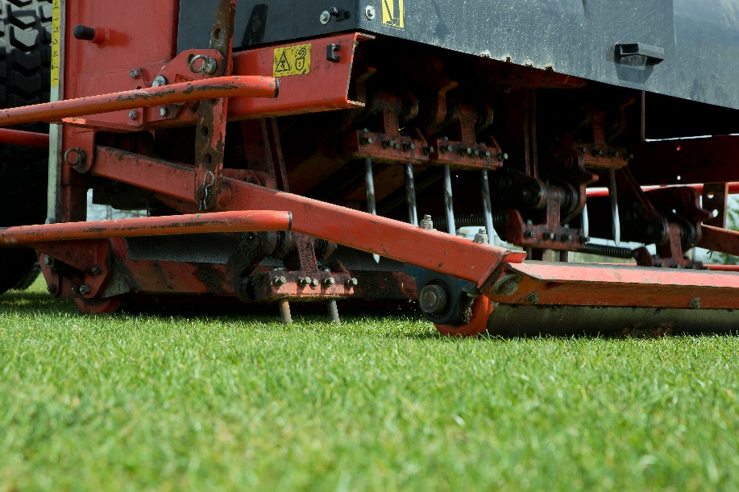
Managing Turf Stress
Aerate to:
Relieve soil compaction
Encourage drainage
Prevent thatch buildup
Limit field access under wet soil conditions
Promote a resilient, deeply rooted turf in the off-season
Raise mowing heights during summer stress, especially if rainfall is the only source of water

Slide 24
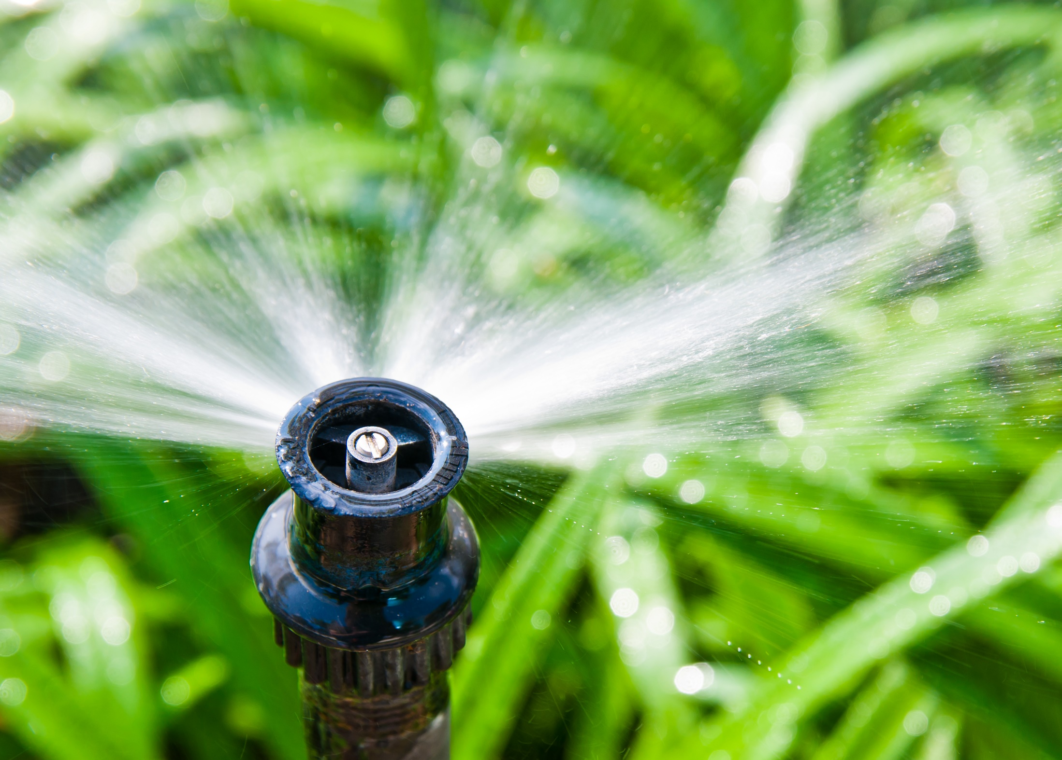
Managing Turf Stress
Water deeply and infrequently
Overwatering reduces root growth, turf resilience, and encourages weeds and diseases
Evaluate irrigation system
Eliminate areas with standing water and/or “missed” areas
Water in the early morning

Slide 25
Managing Turf Stress
Consider drought-tolerant turf varieties
When setting up an irrigation program start with 0.2 inches per event applied 2 or 3 times a week

Slide 26
Check In!
In this lesson you learned:
How to identify and manage common turfgrass diseases
How to avoid and reduce stresses on turfgrass
Congratulations, you have completed the School Grounds IPM learning module!

Slide 27
Resources
Iowa State University. (2010). Plant and Insect Diagnostic Clinic. http://www.ipm.iastate.edu/ipm/info/plant-diseases/turf-grass-rust
Maine Department of Agriculture, Conservation and Forestry. School IPM. http://www.maine.gov/dacf/php/integrated_pest_management/school/index.shtml
Michigan State University http://www.msuturfdiseases.net/details/_/necrotic_ring_spot_13/
Rutgers Cooperative Extension. IPM Report Card for School Grounds: General Requirements. http://entomology.osu.edu/schoolipm/IPMfiles/ReportCardGeneral.pdf
Texas A&M Agrilife Extension. Landscape IPM Module 6. http://schoolipm.tamu.edu/videodvd/
Umass Extension Center for Agriculture. Best Management Practices For Lawn and Landscape Turf. http://extension.umass.edu/turf/sites/turf/files/pdf-doc-ppt/lawn_landscape_BMP_2013_opt.pdf
University of California Agricultural and Natural Resources. (2009). How to Manage Pests. http://www.ipm.ucdavis.edu/PMG/r785100411.html

