Slide 1
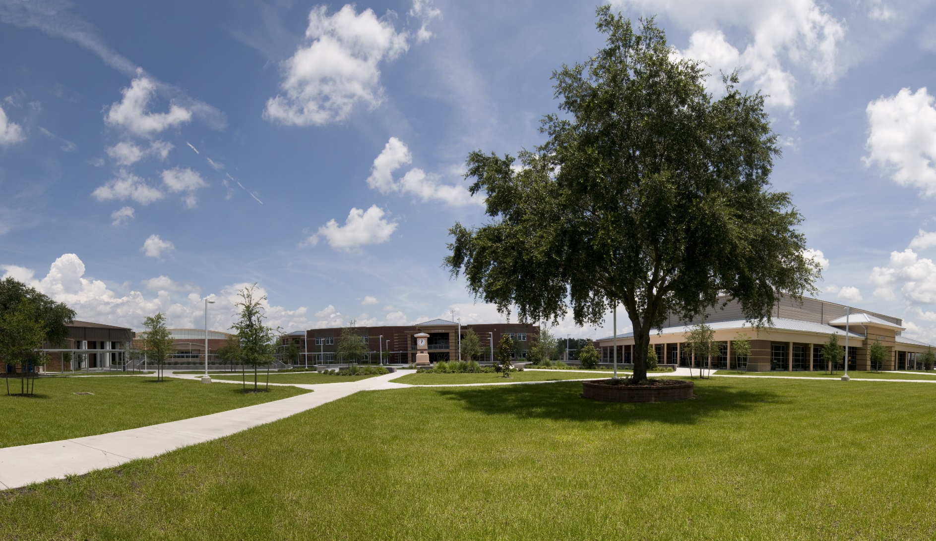

Practices to maintain healthy Landscapes
Lesson 1 of 4
In-Person Educational Module

Slide 2
Learning Objectives
Describe the zone management approach
The principles behind sustainable landscapes
    Cultural controls
    Physical controls
    Biological controls
Explain the importance of landscaping practices specific to pest exclusion
Explain sound pruning practices

Slide 3
Zone Management Approach
Classifying landscape sites:
Using a map of your school grounds, divide it into zones - high, medium and low maintenance
Exclude high-
maintenance plants

Slide 4

Zone Management Approach
Brainstorm the best plants for each zone
Planning reduces plant replacement and landscape
management
Tami Proffitt Photography

Slide 5

Landscape IPM
Landscape IPM includes:
Structural pests
Plant pests

Slide 6
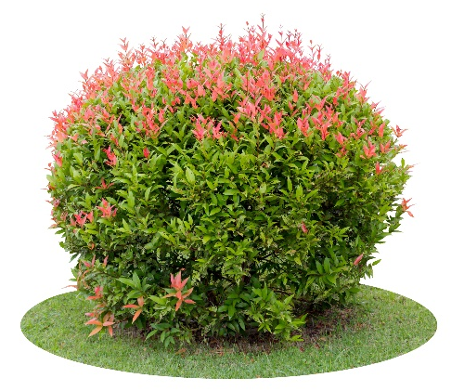
Selecting Plants
Plant selection based on suitability for the site and function
Select plants that are tolerant to insects, diseases and wildlife pests
Native plants may:
  Require less water
  Require less maintenance
  Benefit from native pollinators
Some native plants require more maintenance

Slide 7

Plant Selection
Use a list of plants that are pest, heat and drought-resistant for your region
Consider maintenance zones
Gradually phase out
high-maintenance/
pest-prone plants

Slide 8
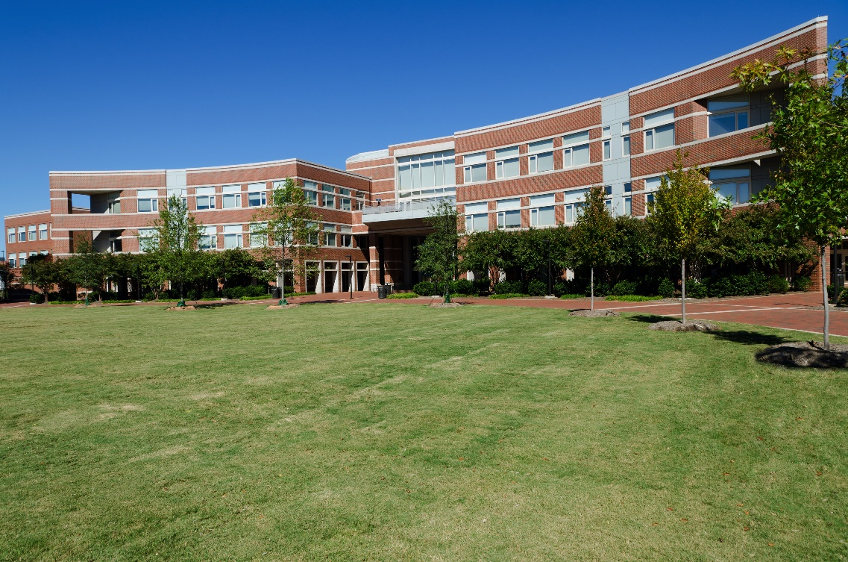
Principles Behind Sustainable Landscapes
Cultural controls
Physical controls
Biological controls

Slide 9
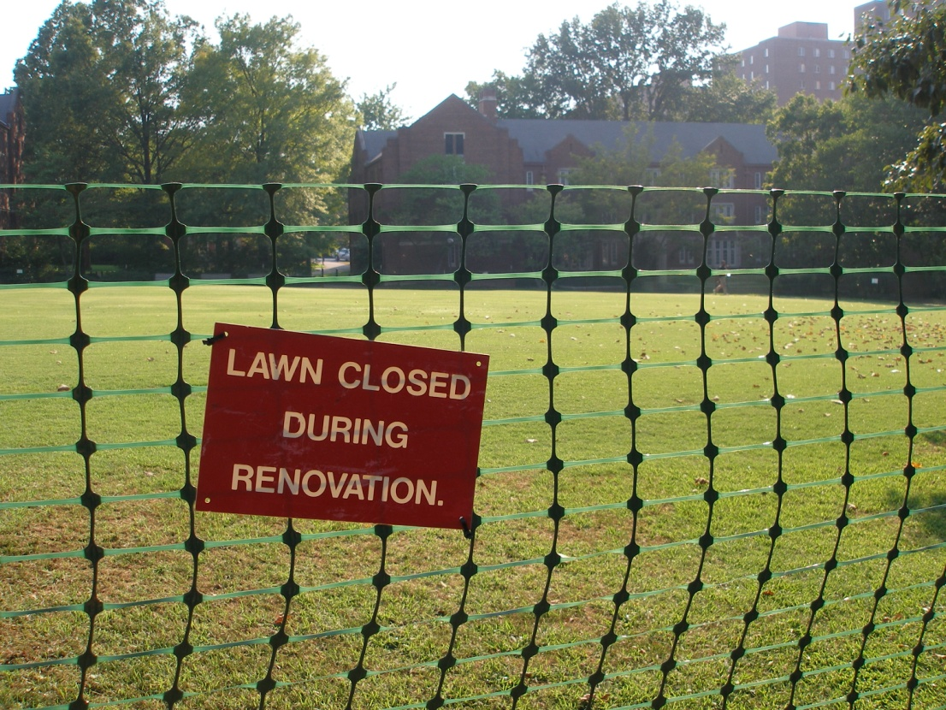
Cultural Controls
Cultural Controls
Practices that improve plant health and reduce plant problems
  Monitor
  condition
  Sanitation
  Horticultural
  techniques
Notes:
Monitoring for what?

Slide 10
Cultural Controls
4.
Sanitation
Good sanitation practices can reduce or eliminate food for pests
Avoid plants that
  Drop seeds or fruit
  Become weedy
  Attract insects, rodents and undesirable birds
Remove diseased or pest-infested leaves or branches

Slide 11
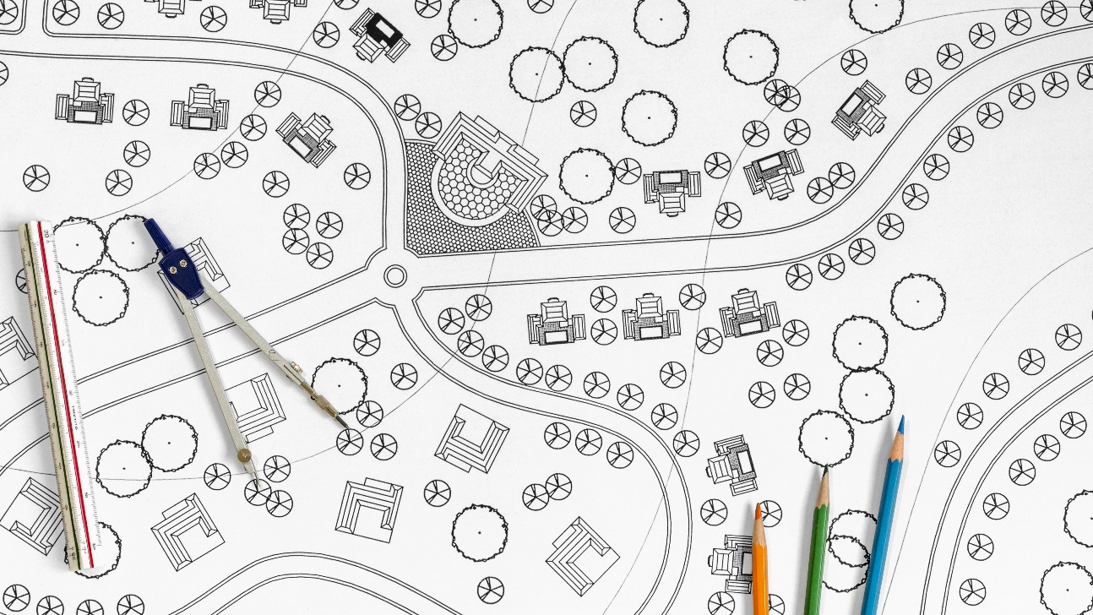
Cultural Controls
Design/redesign landscape plantings to avoid or eliminate problem-prone plants
Horticultural techniques include:
  Proper planting techniques
  Irrigation
  Soil testing
  Fertilizing
  Pruning
  Mowing

Slide 12

Physical Controls
Physical controls include:
Manipulating water, humidity, temperature and physical condition
  Habitat modification
  Use of barriers
  such as mulch
  Removing pests
  by hand
  Trapping pests

Slide 13
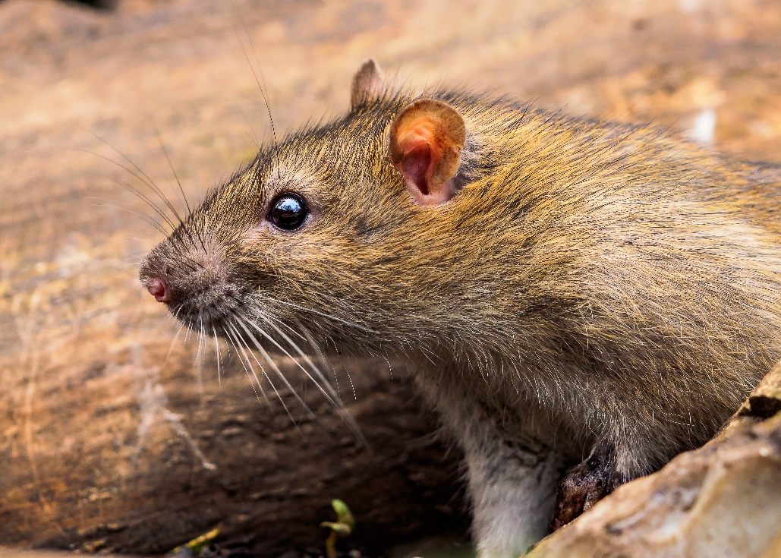
Physical Controls
4.
Habitat modification:
To survive, pests need:
  Food
  Water
  Supportive environment
Removing vegetation near buildings decreases rodent habitat; eliminating standing water reduces mosquito breeding sites; thinning branches improves air circulation and reduces disease problems

Slide 14
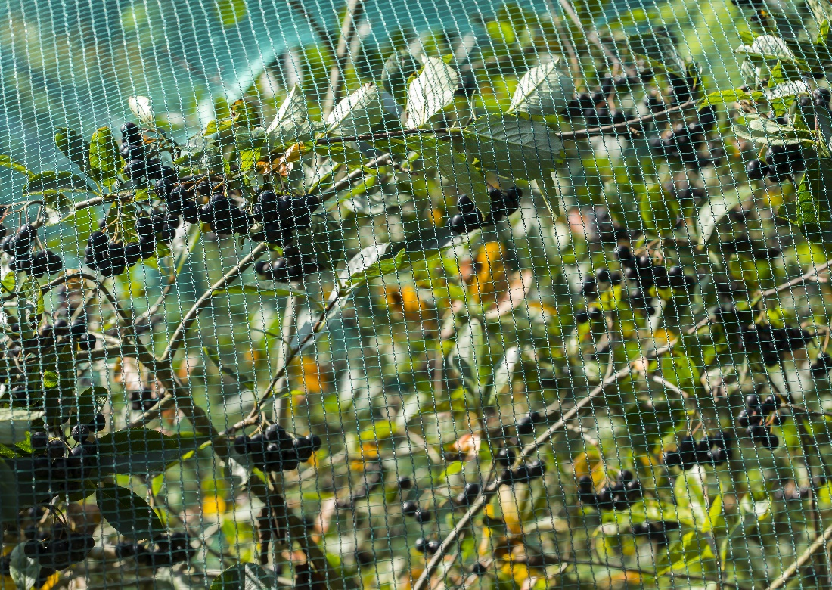
Physical Controls
Barriers
Landscape fabric
Degradable cardboard
or newspaper
Monitor mulch as it can be a good habitat for some pests
Netting can prevent wildlife from feeding plants, and can be invisible from a distance

Slide 15
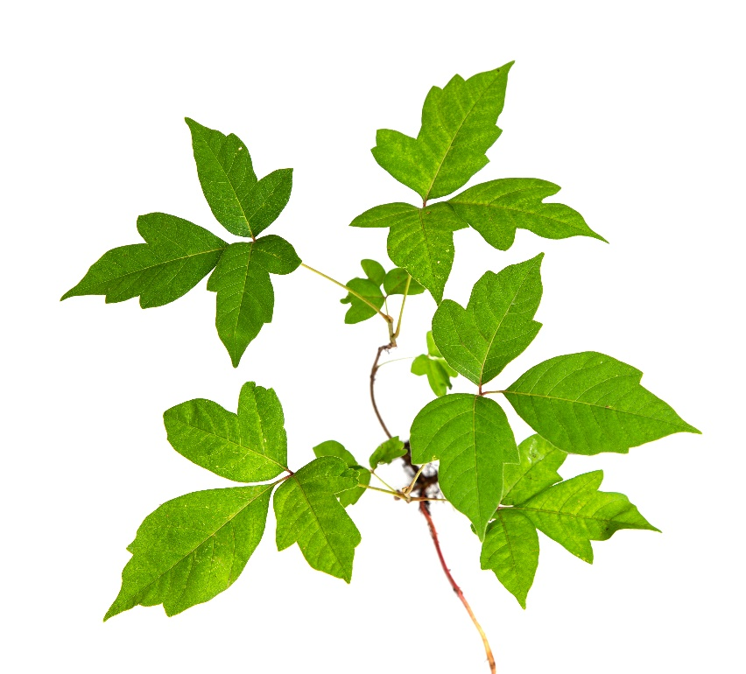
Physical Controls
Poison ivy
Removing pests by hand
May be the safest
and most economical
Use care and protective
gloves with poisonous species
Trapping
Many traps are available
Note that some traps can attract more insects to the areas, e.g., Japanese beetle traps

Slide 16
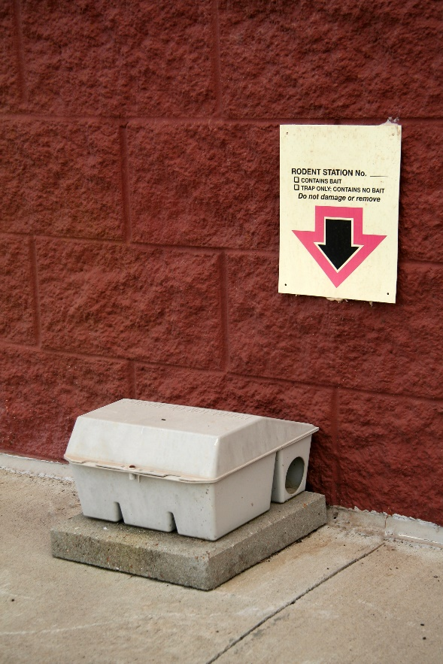
Physical Controls
4.
  Place traps in inaccessible areas
  Use tamper-resistant stations
  Involve students in the IPM
  program, get them invested
  Trap placement is crucial
Tamper-resistant station

Slide 17
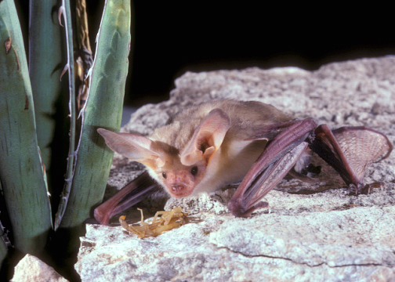
Biological Controls
Using living organisms to naturally suppress pest populations
Biological controls usually target specific pests
Pallid bat with scorpion - Bat Conservation International

Slide 18
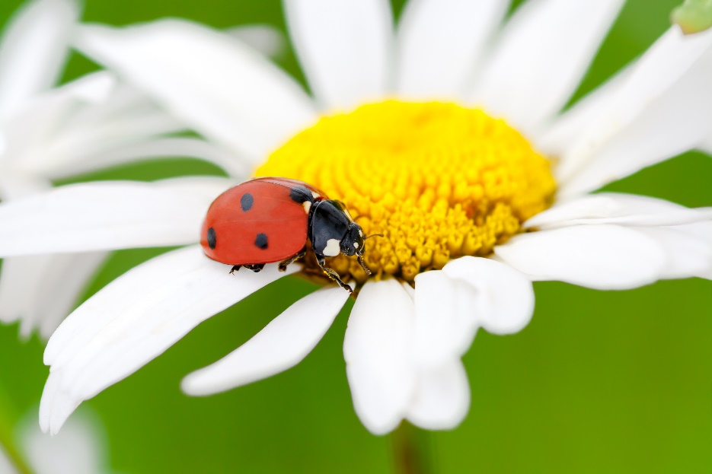
Biological Control
Many species of birds, bats and insects act as biological control agents
Beneficial
organisms
Lady beetles are familiar beneficial insects, they feed almost exclusively on soft-bodied insects and insect eggs

Slide 19
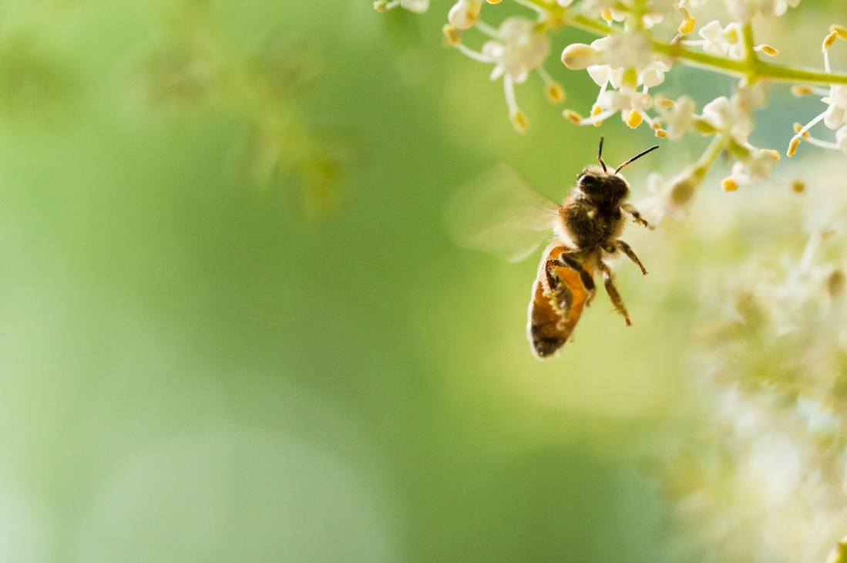
Biological Control
Maintaining or increasing the number of beneficial organisms
Flowering plants in the landscape can attract and support beneficial organisms
Avoid placing
plants that attract
stinging insects
along walkways
or near entryways

Slide 20
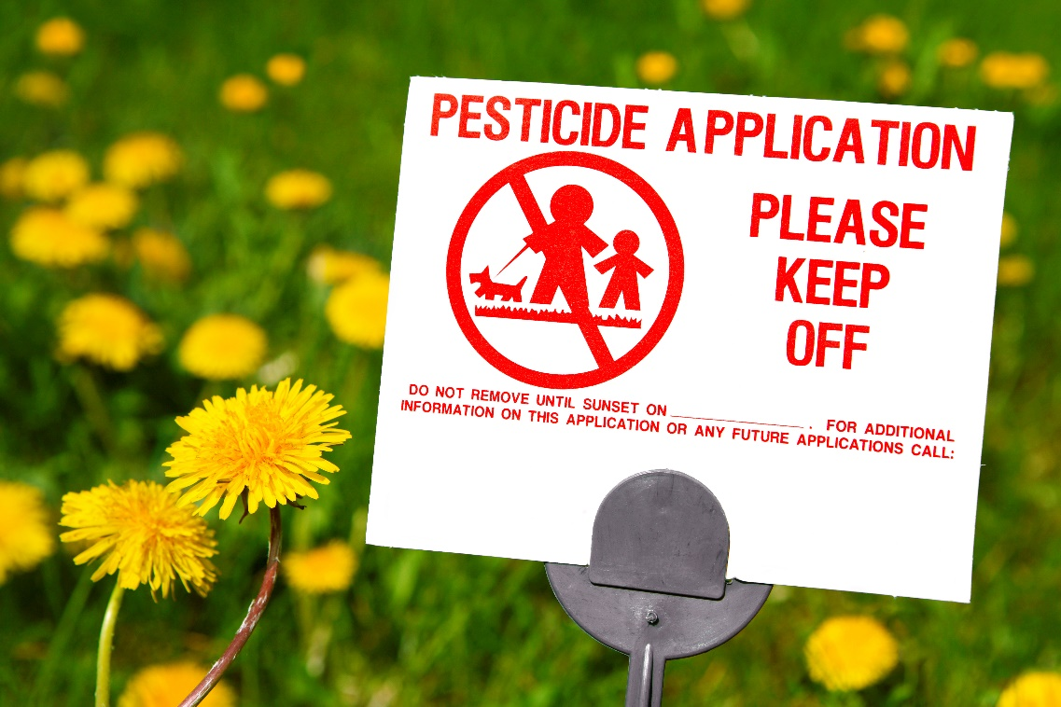
Pesticides
Pesticides
May be used in specific situations when other methods do not provide adequate control
Post signs

Slide 21
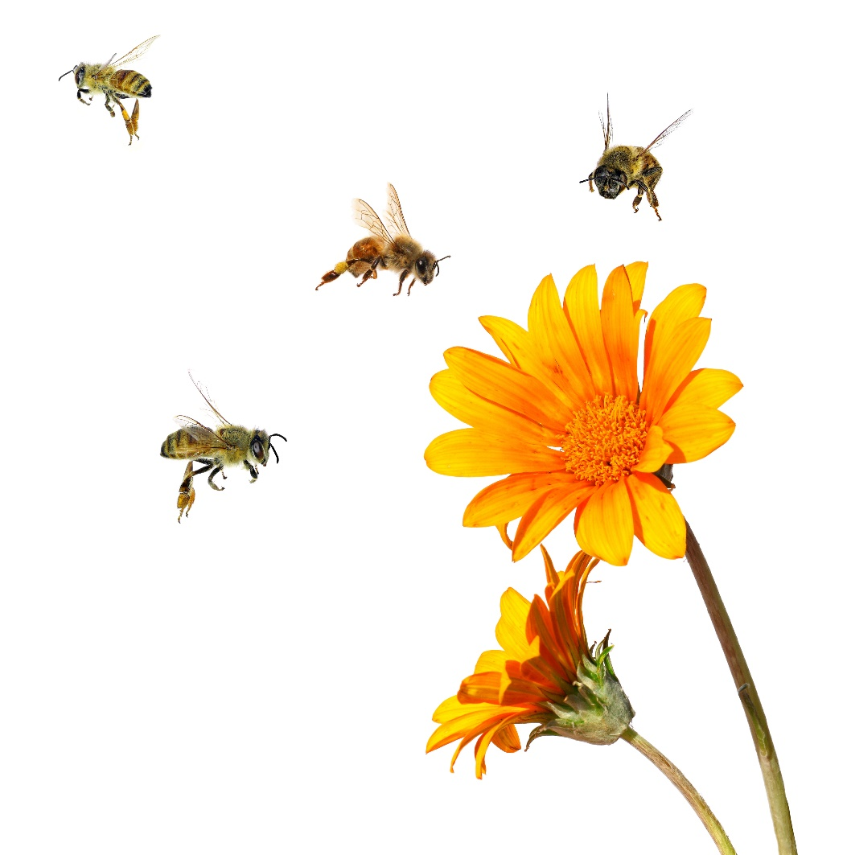
Pesticides
Some pesticides are lethal to biological controls
  Treat when populations reach action thresholds
  Time treatments to be
  least disruptive to beneficials
  Avoid broad-spectrum insecticides
  Select targeted, least-risk
  pesticides formulated
  for the target pest

Slide 22

When Using Pesticides
A pesticide applicator license may be required
Be in compliance with local, state and federal laws (which change over time)
Follow guidelines in your school
district IPM policy
and plan

Slide 23

Landscape Management Tips
4.
Know your plants
Tolerance level for
common problems
Landscape preparation
Mulch
Pruning
Fertilizer
Irrigation

Slide 24

Landscaping Practices to Avoid Problems
4.
Plants should be adapted to existing environmental conditions
Use USDA hardiness zones as a plant selection aid http://planthardiness.ars.usda.gov/
phzmweb/interactivemap.aspx
Select plants that are resistant to
common local pest problems and
environmental stresses

Slide 25
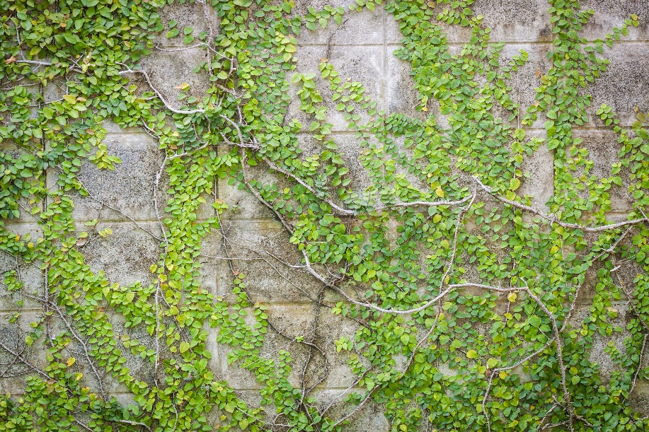
4.
Landscaping Practices to Avoid Problems
Shrubs should be pruned away from buildings
Shape so they do not create places for rodents to hide
Keep tree limbs pruned at least six feet away from buildings
Remove vines climbing
on buildings or growing
low to the ground next
to buildings

Slide 26
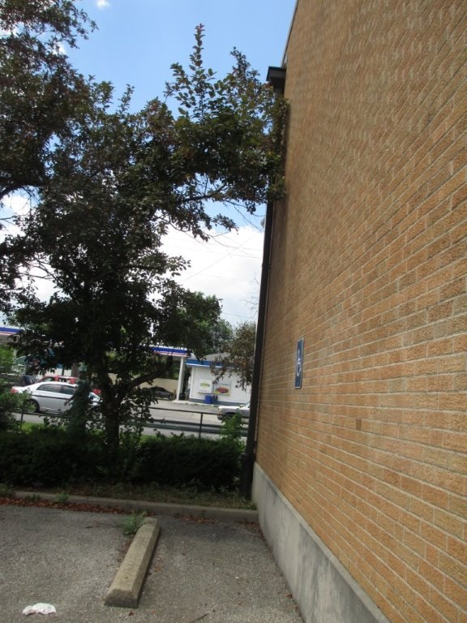
Landscape Management Tips
Pruning
Use certified arborists to prune trees and shrubs or trained staff
Generally, no more than 25% of tree canopy per year should be removed
Overgrown trees allow easy access to buildings for pests – Shaku Nair, University of Arizona

Slide 27
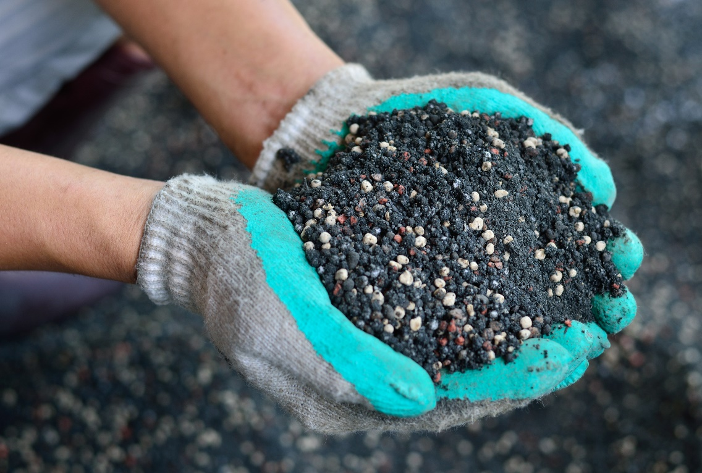
Landscape Management Tips
Fertilizing
Fertilize plants only as necessary
Use slow-release
or time-release
nitrogen
fertilizers

Slide 28
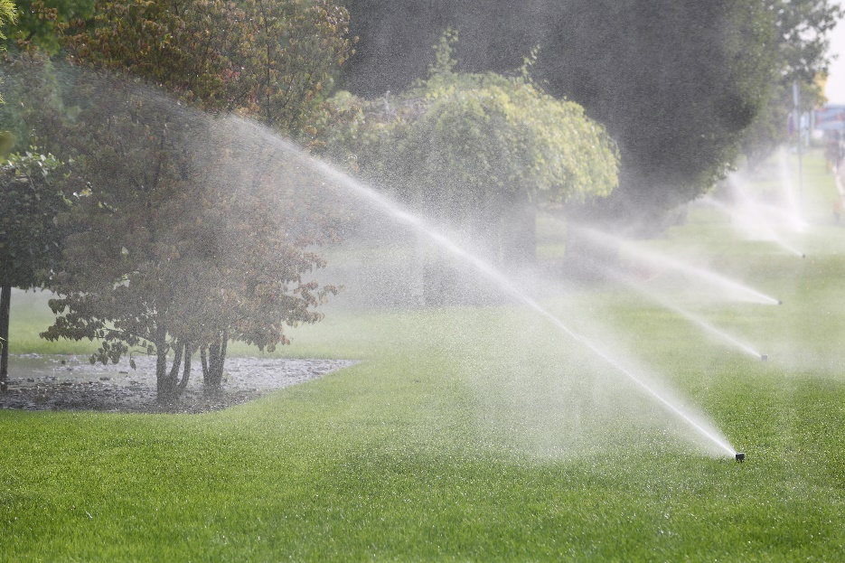
Landscape Management Tips
Irrigating
Soils differ from school to school and within a site
Soils ability to accept/hold and move water is variable and alters irrigation needs
Irrigate early in the
morning, infrequently
and with longer
durations

Slide 29
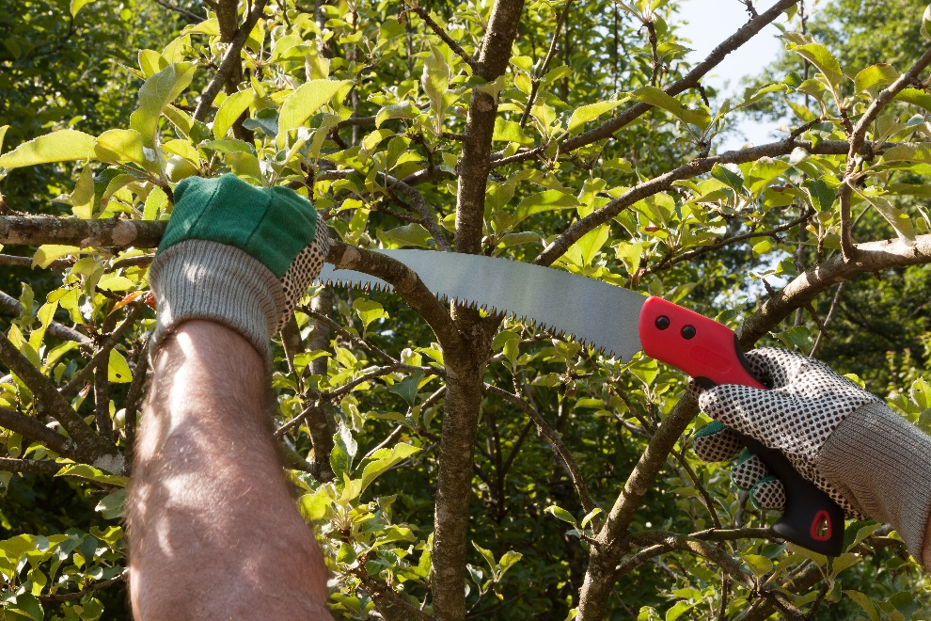
Sound Pruning Practices
Why prune:
  Maintaining plant health
  Safety
  Renovating or rejuvenating
  Formal hedges require
  continuous pruning to
  maintain their size and
  shape
Notes:
http://extension.arizona.edu/sites/extension.arizona.edu/files/pubs/az1499.pdf
http://extension.oregonstate.edu/linn/sites/default/files/pruning_pub_handout2012.pdf

Slide 30
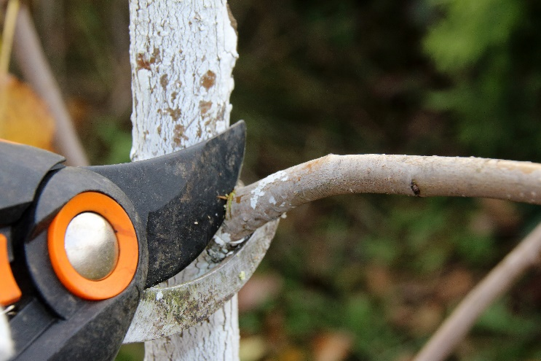
Sound Pruning Practices - Trees
Maintain health of tree:
  a) Remove all dead, dying, and diseased limbs
  b) Remove crossovers, which can rub together and damage limbs and harbor disease
  c) Remove hazardous branches before they fall
  d) Rorrect and repair damage
Raise the canopy
Rejuvenate the tree (remove
no more than 1/3
of the wood in one year)
Notes:
http://extension.oregonstate.edu/linn/sites/default/files/pruning_pub_handout2012.pdf

Slide 31
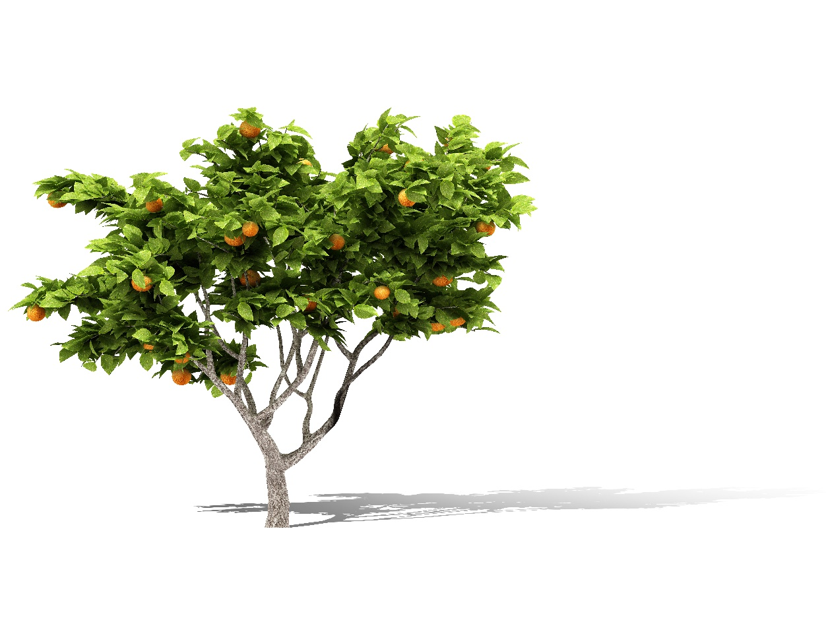
Sound Pruning Practices - Trees
Improve the aesthetic quality of the tree
Slow the tree’s growth
Fruit trees:
  Increase fruit production
  Develop strong 45-degree
  angles to support fruit load
  Remove limbs that grow
  down or straight up
  Maintain tree size
  Maintain fruit spurs

Slide 32
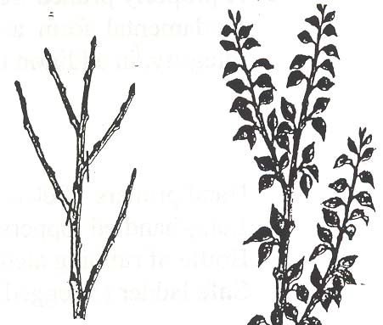
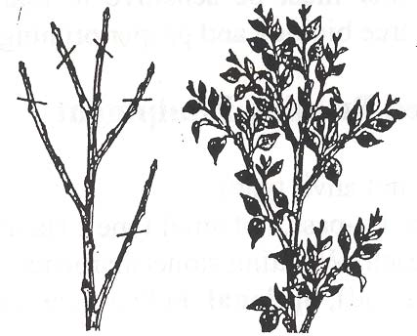
Types of Pruning Cuts
Oregon State University Extension
Heading Cuts: Several buds left on the cut branch grow, making denser, more compact foliage on more branches
Thinning Cuts: Branches are removed entirely, leaving no buds to grow
Energy is diverted into remaining branches, which grow more vigorously

Slide 33
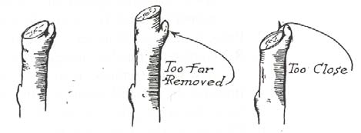
Angle of Cuts
Oregon State University Extension
Always make cuts close to a node
Branches grow only at these nodes
correct
Notes:
http://extension.oregonstate.edu/linn/sites/default/files/pruning_pub_handout2012.pdf

Slide 34
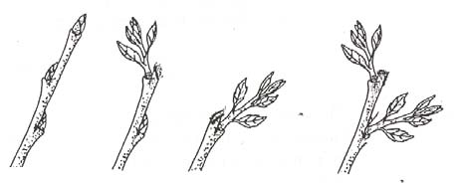
Placement of Cuts
Oregon State University Extension
Prune to the lateral bud that will produce the branch you want
An outside bud, pruned with a slanting cut just above the bud, will usually produce an outside branch
A flat cut above the bud allows two lower buds to release and grow shoots

Slide 35
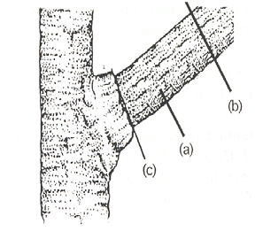
Pruning Thick, Heavy Branches
Oregon State University Extension
1. Undercut the bottom of the branch about 1/3 of the way through, 6-12 inches out from the trunk (a)
2. Make a second cut from the top, about 2-inches farther out from the under-cut, until the branch falls away (b)
3. Cut back the resulting stub to the branch collar (c) (not flush with the trunk)

Slide 36
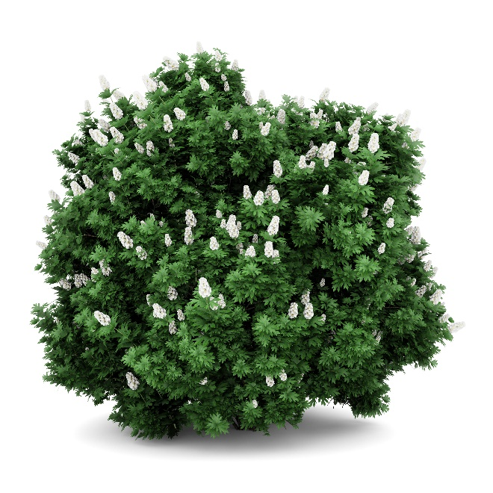
When to Prune Trees
Generally, the best time to prune trees is during the dormant period
Remove dead or diseased branches any time
Pruning done during the dormant season tends to invigorate tree growth
Pruning done during peak growth
tends to slow growth
Generally, berries and tree fruits are
pruned November until bloom
Prune blooming ornamentals during
and immediately after bloom

Slide 37
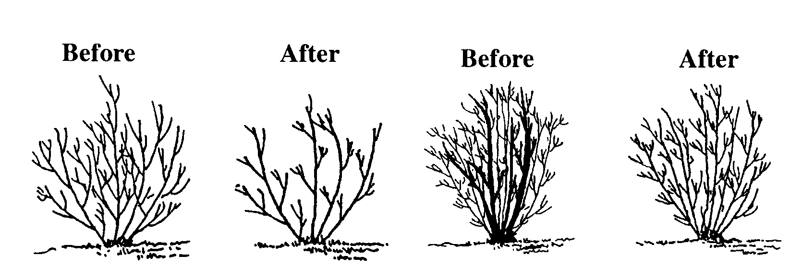
How to Prune a Shrub
Oregon State University Extension
Selective thinning: removing branches back to the point of attachment to another branch (left), or to the base of the plant (right)
This is the most desirable method
Notes:
http://extension.arizona.edu/sites/extension.arizona.edu/files/pubs/az1499.pdf

Slide 38
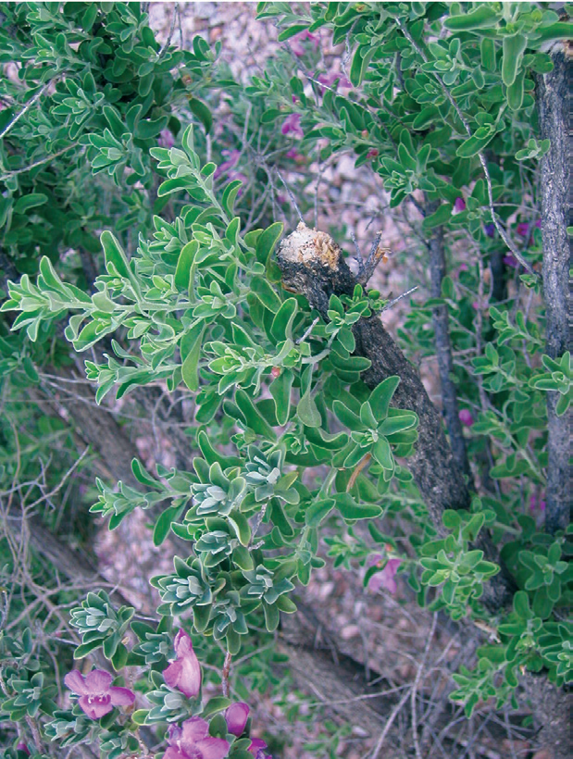
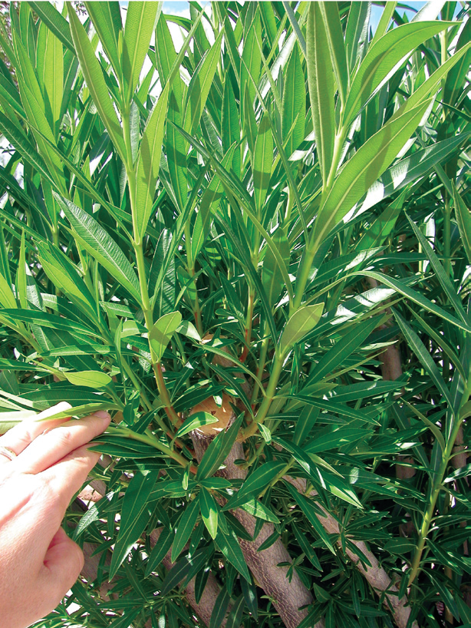
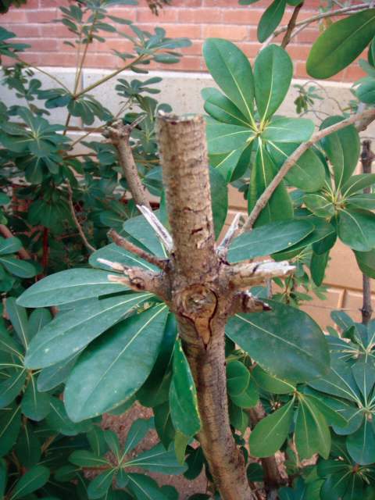
Heading Cuts
Heading cuts: remove parts of a branch resulting in multiple new shoots below the cut (left and middle)
Leaving stubs should be avoided (far right) as they will usually die back
Shujuan Li, University of Arizona

Slide 39
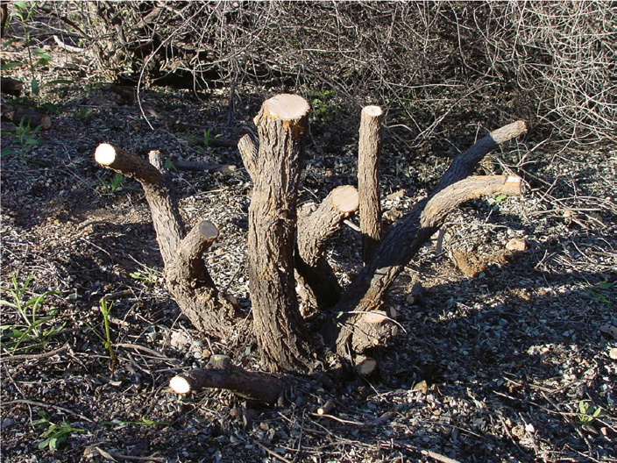
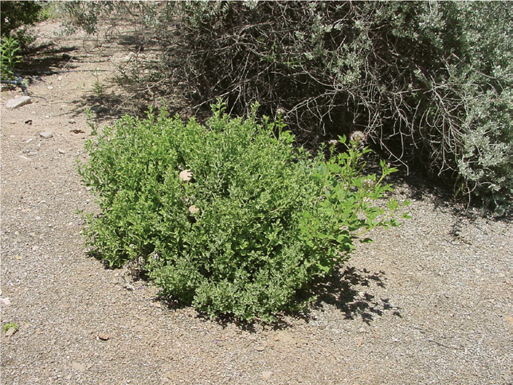
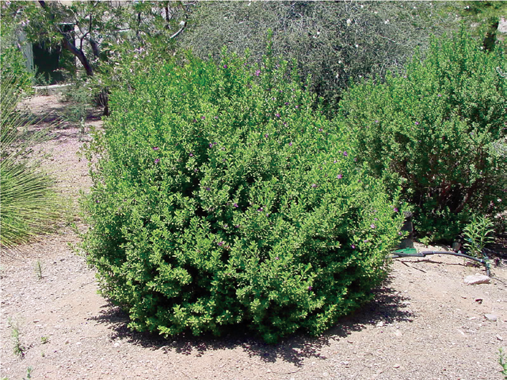
Renovating or Rejuvenating
Renovating or rejuvenating: Cut at 12-18 inches above the ground in late winter or early spring
By fall the shrub has grown a full new canopy
Shujuan Li, University of Arizona

Slide 40
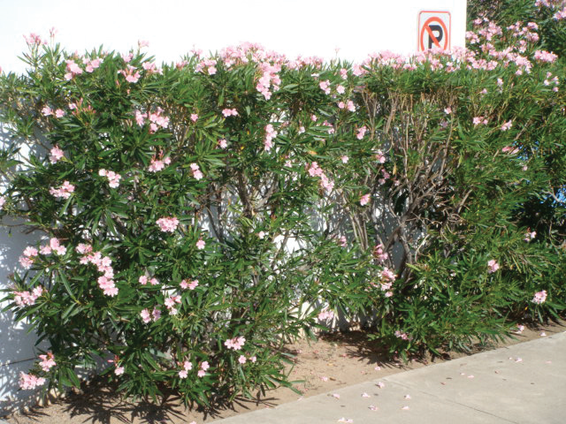
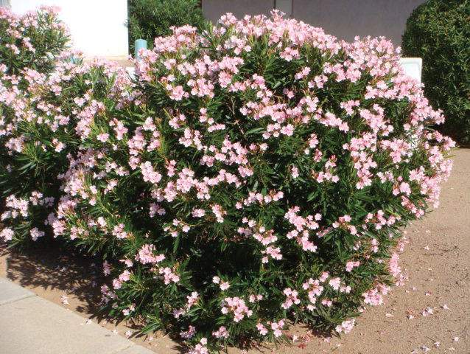
Shearing is not a good practice
Shearing shrubs entails cutting back branches to a uniform surface
This is only suitable for formal hedges or special topiaries
Regular shearing of shrubs removes flower buds, flowers, and reduces their beauty – it is bad practice
Oleander is not well suited for shearing (left), kept in its natural shape an oleander shrub will flower from spring to fall (right) – Shujuan Li, University of Arizona

Slide 41
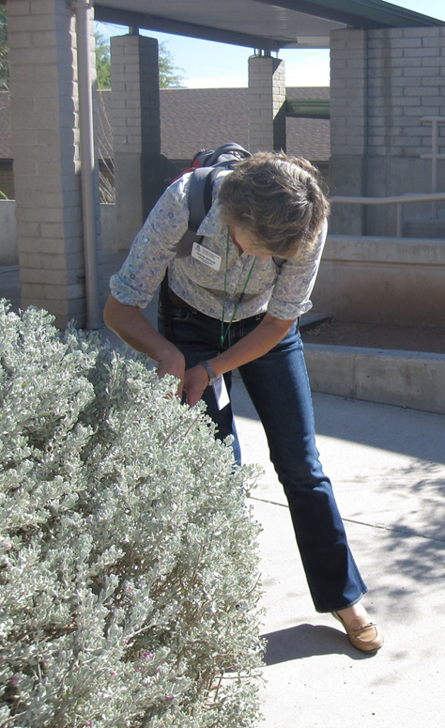
When to Prune Shrubs
Generally, pruning takes place after flowering
Spring flowering shrubs should
be pruned in late spring
Summer or fall flowering shrubs
should be pruned in late winter
to early spring
Selective pruning of a few
branches can be done
throughout the year
Selectively pruning to thin the shrub – Shaku Nair, University of Arizona

Slide 42
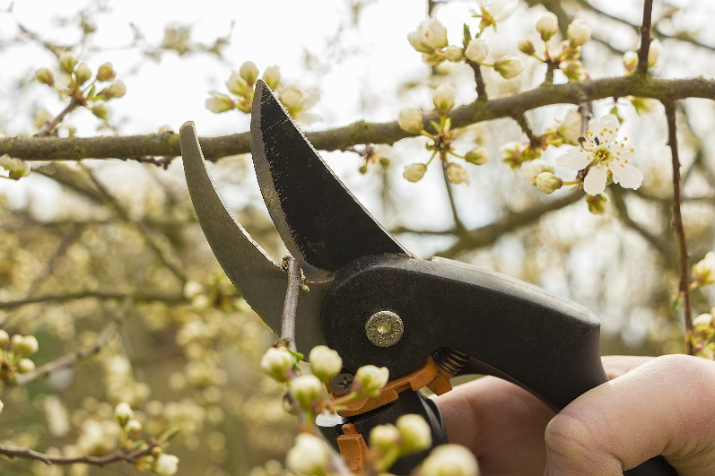
Shrub Pruning Summary
Don’t prune unless it is really necessary
Pruning just to demonstrate work is bad practice
Use appropriate, sharp, clean tools
Prune at the right time
Use the natural growth form
as a guide
Shear only formal hedges

Slide 43
Check In!
This lesson you learned:
The zone management approach
The principles behind sustainable landscapes
The importance of landscaping practices specific to pest exclusion
Sound plant pruning practices
Next you will learn more about cultural turf management!

Slide 44
Resource List
Iowa State University. (2010). Plant and Insect Diagnostic Clinic. http://www.ipm.iastate.edu/ipm/info/plant-diseases/turf-grass-rust
Maine Department of Agriculture, Conservation and Forestry. School IPM. http://www.maine.gov/dacf/php/integrated_pest_management/school/index.shtml
Rutgers Cooperative Extension. IPM Report Card for School Grounds: General Requirements. http://entomology.osu.edu/schoolipm/IPMfiles/ReportCardGeneral.pdf
Texas A&M Agrilife Extension. Landscape IPM Module 6. http://schoolipm.tamu.edu/videodvd/
Umass Extension Center for Agriculture. Best Management Practices For Lawn and Landscape Turf. http://extension.umass.edu/turf/sites/turf/files/pdf-doc-ppt/lawn_landscape_BMP_2013_opt.pdf
University of California Agricultural and Natural Resources. (2009). How to Manage Pests. http://www.ipm.ucdavis.edu/PMG/r785100411.html

