Slide 1



IPM Philosophy,
Roles and Responsibilities –
Why should we choose to use IPM
Shaku Nair
University of Arizona
Maricopa Ag. Center
37860 W. Smith-Enke Road
Maricopa, AZ 85138

Slide 2
Phi·los·o·phy fəˈläsəfē/
A particular system of thought

Slide 3

Possible thoughts about pests…

Slide 4
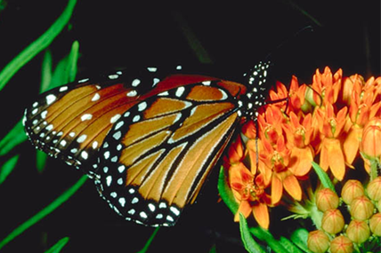
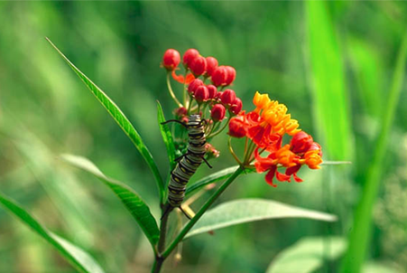
What is a pest?

Slide 5
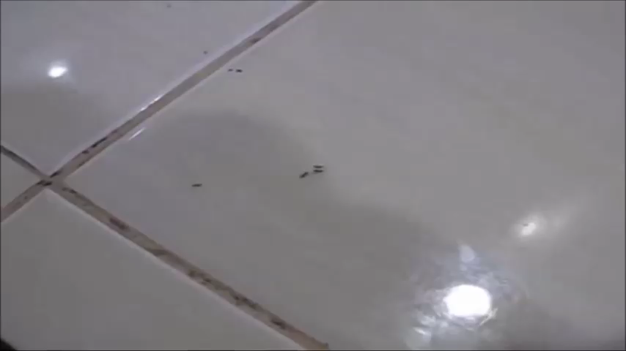
Pest situation

Slide 6

Pest situation

Slide 7
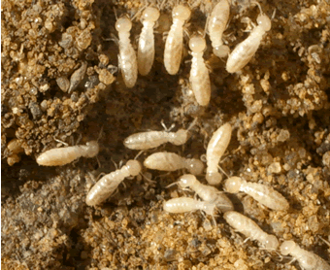
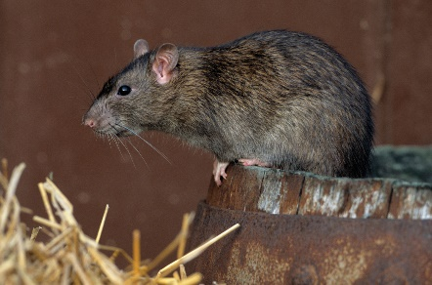
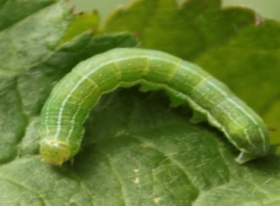
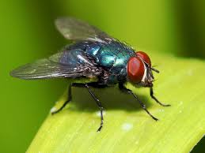
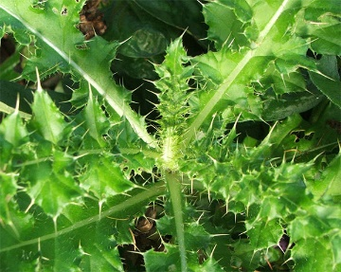
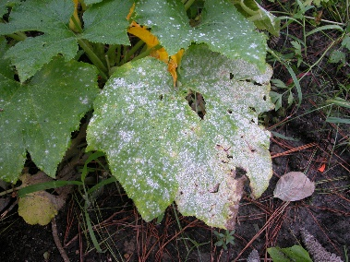
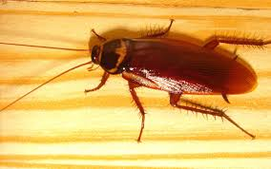
A Pest, Defined
Any organism that is detrimental to humans or their interests
  destroys crops & structures
  poses threats to human health and livestock
  reduces aesthetic and recreational value
Any organism that is out of place!
Pests include insects, mites, plant pathogens, weeds, mollusks, fish, birds, and mammals
Notes:
What is a PEST? A pest is any organism that is unwanted by humans. Pests may be unwanted due to their destructive nature, the health concerns they pose, or because they’re plain annoying. Insects are not the only kind of pest. Mites, plant pathogens, weeds, mollusks, fish, birds, and even some mammals can be pests. They can be found in waterways, agriculture, landscapes, roadsides, natural areas, stored food, schools, hospitals and even swimming pools.

Slide 8
Problems due to pests
Can cause structural damage/crop damage
Can bite / sting
Can damage food by entering and feeding
Can contaminate food and surfaces with microorganisms they carry
Nuisance when they invade buildings
Can cause allergies, asthma and other hypersensitive reactions
Can vector disease microbes

Slide 9
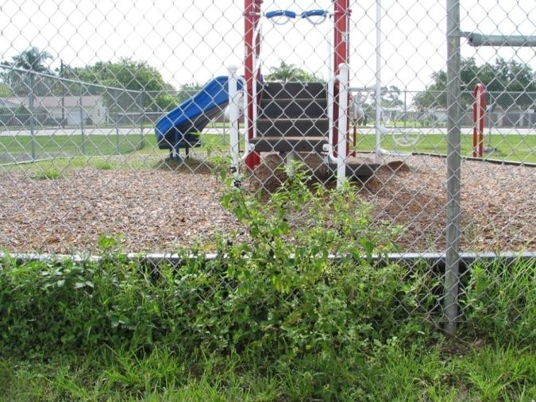
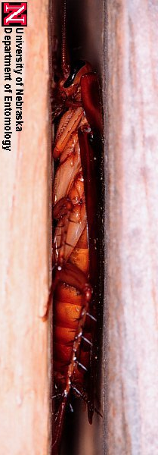
Why Pests?
Biological entities
Seek food, shelter, and water!

Slide 10
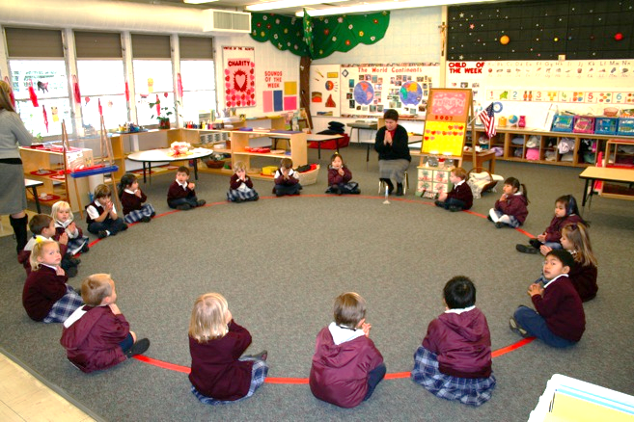
Community (“Sensitive”) Environment ??
Schools, child care centers, homes, hospitals, retirement/ nursing facilities, restaurants, hotels
Challenging places for pest management
Host diverse people, confined spaces, different lengths of time
Have health problems such as asthma, allergies, or immune system compromising diseases
Include diverse physical spaces, indoors and out, that provide ideal entry points and harborages for pests, and require customized solutions to pest problems
Diminishing budgets and deferred maintenance worsen these problems
http://www.canyonheightsacademy.com/academics/pk_environment_files/page39_2.jpg

Slide 11
Pests in community environments
Bats
Ticks
Cockroaches
Flies
Spiders
Wasps
Ants
Weeds
Snakes
Head lice
Bed bugs
Wild animals
Rodents
Mites
Bees
Scorpions
Birds

Slide 12
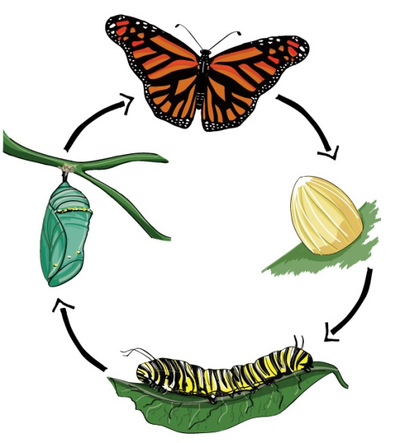
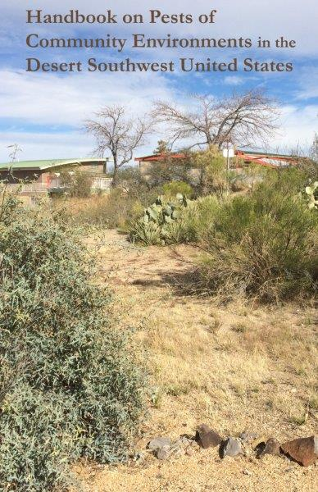
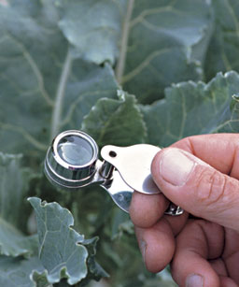
‘Pest’ Identification is Critical!
All stages of a pest may not look the same or cause the same damage.
Know the host of the pest or where it was found.
Use good resources.
Have pests examined by specialists.
Handle samples carefully.

Slide 13
Take good pictures
Don’t zoom too much on your phone.
Hold your camera with both hands and as steady as possible.
Get as many pictures as possible.
Click, check, click again.
Get pictures of damage, or other useful background.

Slide 14
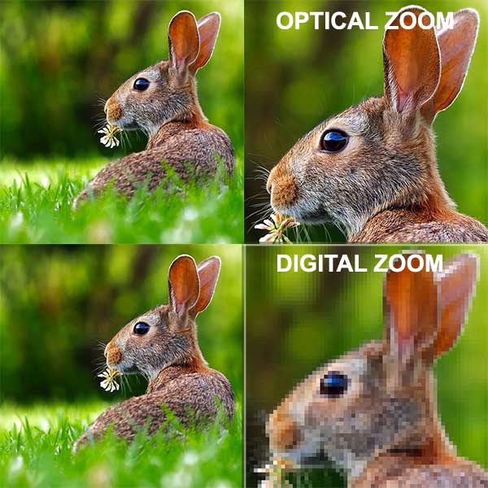
Take good pictures
Smartphone photo tip: Zoom in with your hands or feet, not your phone!

Slide 15
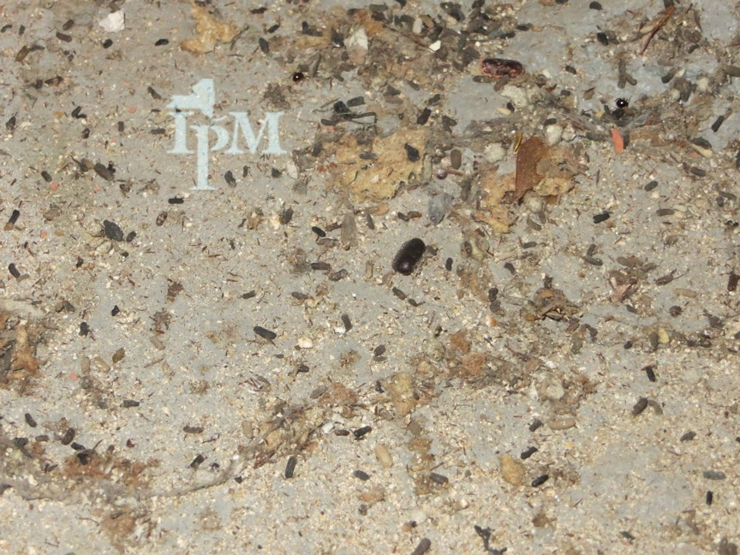
What pest might be present?

Slide 16
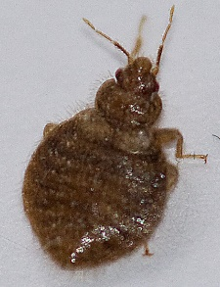
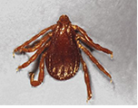
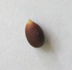
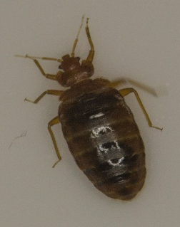
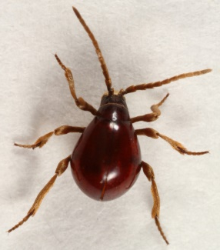
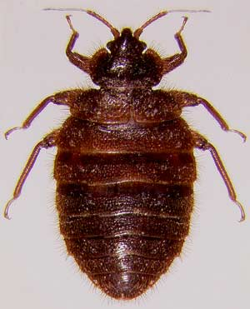
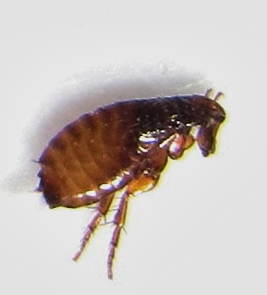
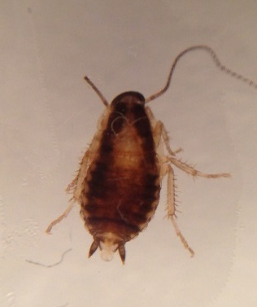
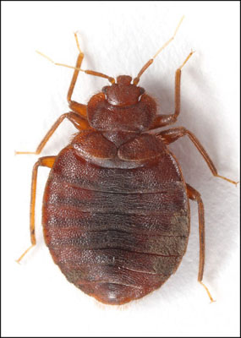
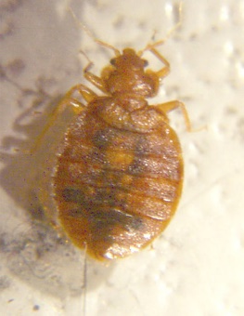
Find the bed bug
1
2
3
4
5
Brown dog tick
Swallow bug
Brown dog tick
Swallow bug
Apple seed
✓
Shiny spider beetle
7
10
6
8
9
Bat bug
Cat flea
German cockroach
nymph
✓
Mexican poultry bug

Slide 17
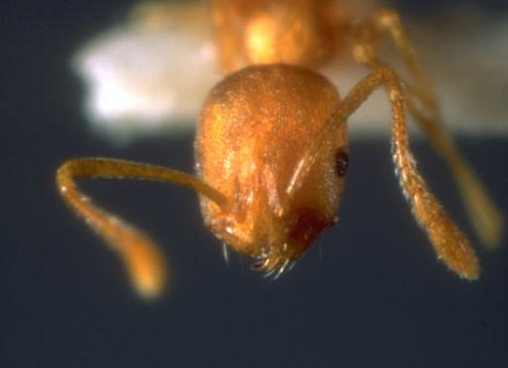
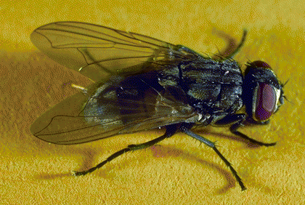
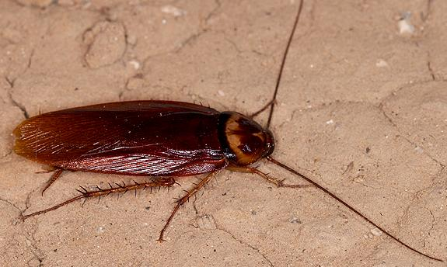
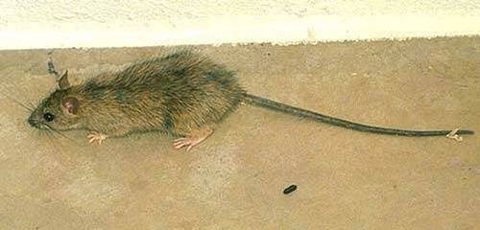
The Unacceptable 4
Cockroaches
Flies
Ants
Rodents
Notes:
VECTOR PATHOGENS ON OUTSIDE OF BODY VERY WELL DUE TO THEIR PREFERRED HABITAT AND BIOLOGY
Roaches – cross-contamination, visit a wide variety of “food” items
Flies – mobility and external digestion
Mice and rats – Urination, fecal deposits, transmission of disease organisms
Ants – vecore pathogens on outside of body

Slide 18
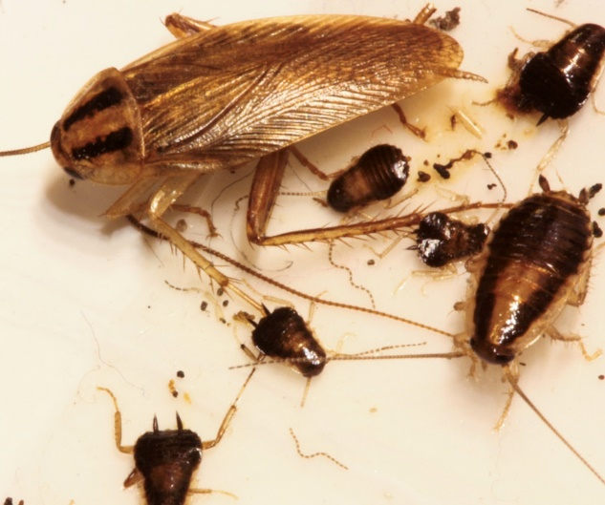
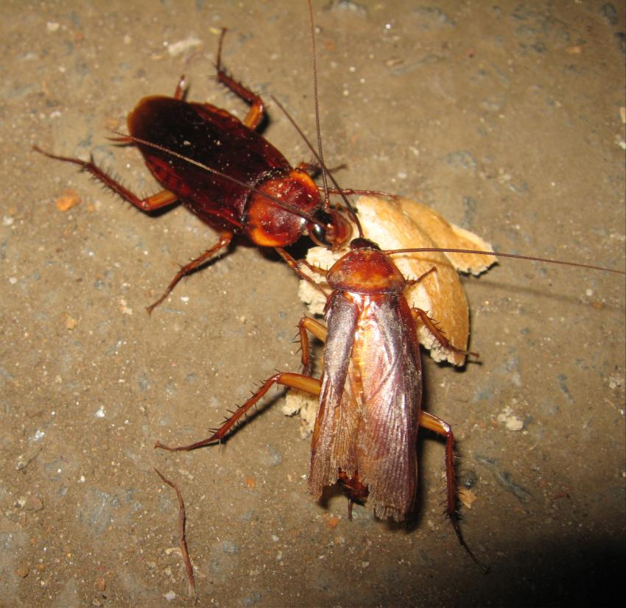
cockroaches
German
American
Oriental
Turkestan
Can contaminate food and other surfaces, disease vectors – carry and spread pathogens
  Cause allergies and asthma
  Nuisance and unwelcome!

Slide 19
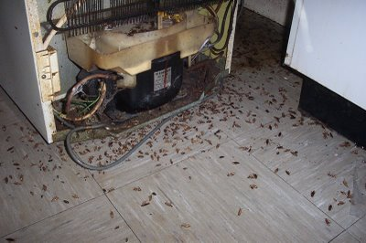

Allergies & asthma
Cockroaches are a leading cause of childhood asthma!
http://www.epa.gov/ncer/images/inhaler.jpg
Allergens: Substances produced in cockroaches bodies
Spread into the environment through their feces, shed skins and other body parts, and dead bodies
The longer these materials persist in the environment, the higher the chances of them getting spread through the air and reaching sensitive people
Notes:
19

Slide 20
Cockroach allergens
For sensitive people, eight units of cockroach allergen per gram of dust can trigger a reaction. ONE female cockroach will produce 1500 units per day!
Even one cockroach and its frass can be an asthma trigger
Getting rid of cockroaches helps, but does not remove the remains. Clean using simple soap to remove allergens
Helps to see when new evidence shows up

Slide 21
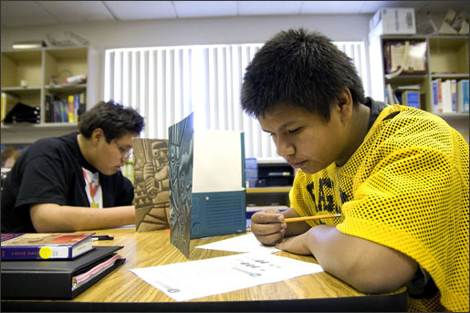
Asthma costs the US ~ $20 billion –
annually
56% of the overall cost of asthma comes in lost work time
Asthma adds about 50 cents to every health care dollar spent on children
12.8 million school days per year
Asthma reduces
student
achievement

Slide 22
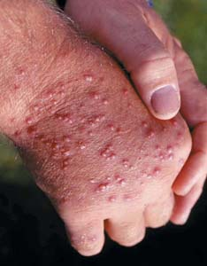

Ants
Argentine ant
Southern fire ant
Pharaoh ant
Carpenter ant
Can cause painful stings and bites
Can destroy structures by burrowing and nesting
Can contaminate food and other surfaces
  disease vectors – carry and spread pathogens

Slide 23

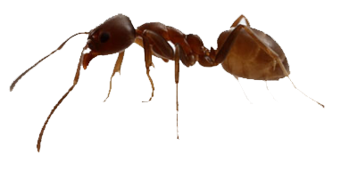
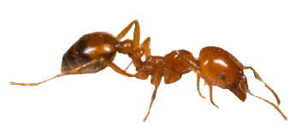
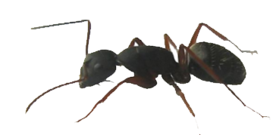
Ant sizes
Pharaoh ant
Argentine ant
Southern fire ant
Carpenter ant

Slide 24
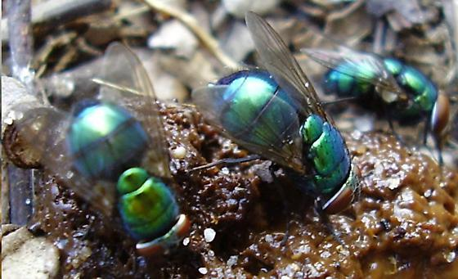
Filth Flies
http://bugguide.net/images/cache/TK5KAK4K6KAQ108QC08QC0EQ9KGKOK7KVK7KY0GKCK4KTK9Q304Q6KKKUKGQ2KLKA0SKCKIKBKBQAKUQ1KVQ1KXK.jpg
Breed in filthy matter (manure, garbage, cadavers, etc.)
Considered pests because
  nuisance insects
  contaminate food and other surfaces
  disease vectors – carry and spread pathogens
House flies
Blow flies
Flesh flies
Drain flies
Lots of
other flies

Slide 25
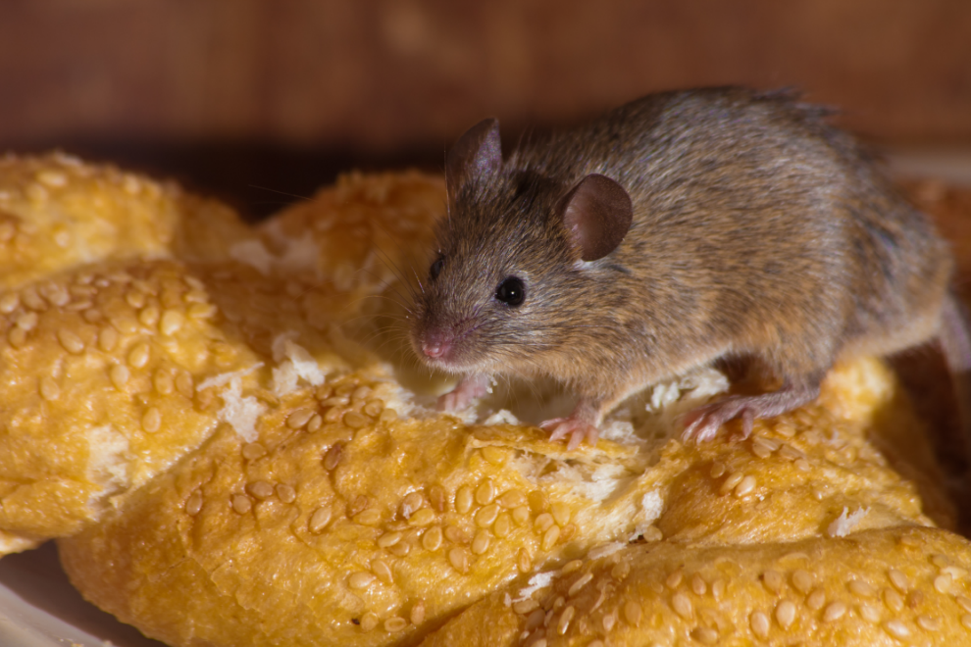
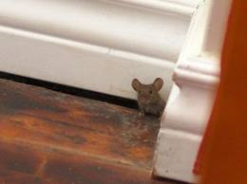
Mice & rats
Destroy food and structures
Can spread allergies and asthma
Can lead to school closures
Students can eat rodent baits leading to hospitalization
Can contaminate food and other surfaces

Slide 26
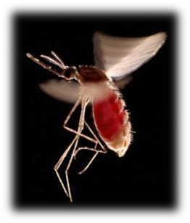
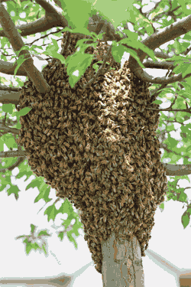
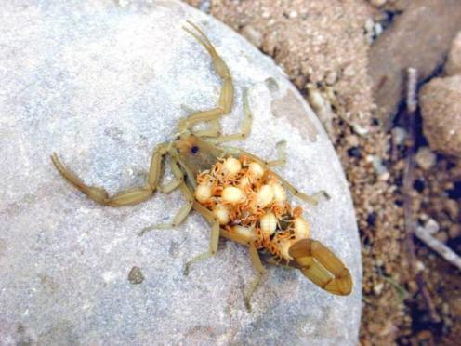
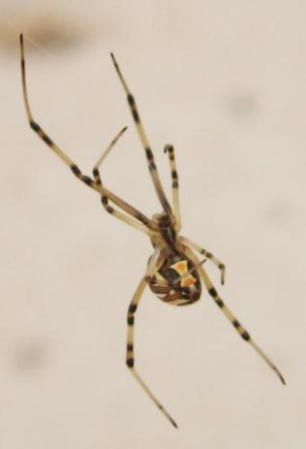
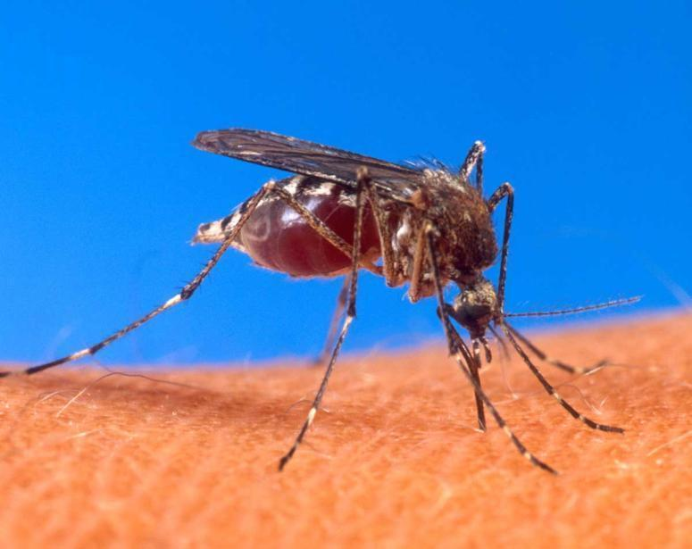
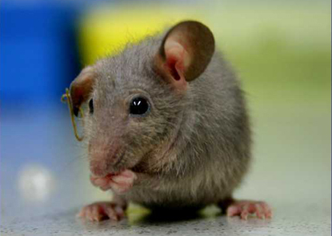
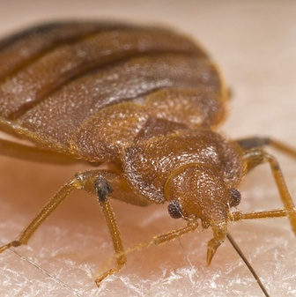
Many other pests

Slide 27


Panic pest number 1
Notes:
Make sure that the district does not feel defensive. We are not the pesticide police, facilitate compliance, don’t slap folk around. To become accepted community members we need to foster trust.
Mid-term and 1 year evals. You can take a tougher line but not on the initial inspection.
Suggest a pesticide amnesty opportunity, sending memos out for any and all pesticides to be turned in for appropriate disposal.

Slide 28




Panic pest
number 2
Notes:
Schools and child care facilities should be safe environments.

Slide 29

Pest control /management
http://www.midwesthiphopsummit.com/wp-content/uploads/2013/07/kill-cockroach.jpg
Notes:
29

Slide 30


Slide 31


Slide 32


Pests
can generate
risks
- as can pest management
practices

Slide 33

What is IPM?
Focuses on the fundamental reason why pests are a problem in the first place
Proactive – monitoring and inspecting is constant
Pesticides are used only when necessary and not as a band aid

Slide 34


IPM = Intelligent
Pest Management
Promotes environmental
health
Works indoors and outdoors
Notes:
Pest conducive conditions allow pests to thrive in our schools and homes

Slide 35

What IPM is NOT
An “out of sight, out of mind” contractual function
A no chemical pesticide option
A chemical pesticide program
A job description added to an unwilling or unqualified individual
A “low bid” process

Slide 36

IPM components
Each environment/situation is different!
But IPM components are similar:
Proper identification
Regular monitoring
Plan of action
Education and communication
Being proactive
Multiple tactics

Slide 37


IPM components
Proper identification
  What is normal? What is acceptable?
  Are you sure it is a pest?
  Many problems are a result of abiotic factors
  (environment, cultural
  methods, pest-proofing)

Slide 38


IPM components
Understanding the problem is key
Regular monitoring is the most economical and simple strategy to manage pests
Don’t look. Observe!

Slide 39

IPM components
Be proactive and discriminate between
options
Communicate, collaborate with experts

Slide 40

Common Problems
No monitoring in PVAs.
No PMP hours with staff.
Excess pesticide use e.g. 143 applications for 3 schools in one year.
No ID e.g. “red ants” or “sugar ants”.
Poor knowledge e.g. mice have no bones.
OTC pesticides.
No communication with
or education of faculty
and staff.
Poor partnerships.
IPM costs more….

Slide 41
IPM must be compatible with current operations
Doing what you do now---just think pests!!!
  Security = monitoring
  Energy conservation = exclusion
  Sanitation = nothing to eat
  Clutter control = no place to live
Food Water Shelter
Notes:
Pests need the same things we need to survive, food, water and shelter.

Slide 42

Have a policy for each pest
IPM components
  Response plan
  Thresholds
  Management protocols
  Communication protocols
Notes:
Pest vulnerable areas (PVAs)

Slide 43

When transitioning from a traditional monthly treatment service to an IPM program, costs usually decreased in the long-term.
Notes:
Which of the following statements is true?
Response
Pre test
Post test
Practicing good IPM standards typically increases liability issues for schools but the offset in pesticide use may ultimately reduce costs.
Training faculty and staff regarding IPM practices is the least important part of a school IPM program
Involving students and communicating IPM information to parents is not a benefit to the community because of the cost and time involved.
When transitioning from a traditional monthly treatment service to an IPM program, costs nearly always decrease
Which statement is true?
Response
Pre test
Post test
Practicing good IPM standards typically increases liability issues for schools but the offset in pesticide use may ultimately reduce costs.
Training faculty and staff regarding IPM practices is the least important part of a school IPM program
Involving students and communicating IPM information to parents is not a benefit to the community because of the cost and time involved.
When transitioning from a traditional monthly treatment service to an IPM program, costs nearly always decrease

Slide 44
Multiple tactics
IPM components
Physical
Mechanical
Natural
Cultural
Regulatory
Biological
Genetic
Chemical
Notes:
As mentioned earlier, it’s important to correctly identify the pest in order to develop an effective management plan. Determining the cause of the problem or identifying the pest may be difficult. Immature stages of weeds and insects may not look at all like the mature stages.
Once you have properly identified the pest, learn about its biology. Resources that can help you identify and learn more about pests and host plants include books, extension bulletins, and field guides that contain pictures and biological information. Search the Internet. Illustrations of immature pest stages are helpful. Remember, weed seedlings and rosettes often don’t resemble mature plants, and caterpillars don’t resemble adult moths. If you can’t identify the pest, take it to a specialist. When collecting specimens for identification, make sure you collect several specimens and store them in suitable containers. Don’t forget to record important specimen information like the host plant and location where the specimen was collected.

Slide 45

Natural Controls
Many species of birds, bats and insects can suppress pest populations.
Because they control pests, they are often
known as beneficial organisms, beneficials, or natural enemies.

Slide 46

Physical/Mechanical Controls
Barriers are used to keep pests from plants in the same way window screens keep out flying and crawling insects.
Traps are effective to manage various pests indoors and outdoors. Trap placement is crucial to effectiveness.

Slide 47


Pest-Proofing!
This door is open to pests!

Slide 48

Physical/Mechanical Controls
Removing pests by hand
In some situations, this may be the safest and most economical strategy. Use care and protective wear with poisonous or irritating species.

Slide 49
Cultural controls
4.
Good sanitation practices can reduce or eliminate food for pests.
Outdoors- removing fallen, diseased or pest-infested leaves, branches and fruit to reduce pathogen and insect populations
Indoors- cleaning floors and work surfaces, proper disposal of trash, storing food in sealed containers

Slide 50

Biological Controls
Many natural enemies can be encouraged to act as biological control agents.
Some biocontrol agents are produced commercially and can be purchased.
Lady beetles are familiar beneficial insects. They feed almost exclusively on soft-bodied insects and insect eggs.

Slide 51


Biological Controls
Maintaining or increasing the number of beneficial organisms can be an effective way to manage pests.
Including flowering plants in the landscape can attract and support beneficial organisms that are natural enemies of pests.

Slide 52

pesticides
Thresholds
Spray timing
Chemical Selection
Resistance
Mode of Action
Selective chemistry

Slide 53

What are thresholds?
Can be based on:
  Aesthetics
  Number of pests
  Damage to plants
  Food Loss
  Comfort level

Slide 54
pesticides
  Understand pest mode of feeding/habitat for effective reach.
  Treat only when populations reach action thresholds.
  Time treatments to be least disruptive to beneficials.
  Avoid broad-spectrum insecticides, toxic to many species of insects.
  Select targeted, low-risk pesticides, such as Bacillus thuringiensis, insect growth regulators, and baits formulated to attract only the target pest.
  Read the label – the label is the LAW!

Slide 55
pesticides
“Traditional,” broad-spectrum pesticides
  long residual
  may cause outbreaks of non-target pests
  negatively affects beneficial organisms
  usually higher toxicity
  can control multiple pests at once

Slide 56

Introduction
Importance/
Resistance
MoA
Group 1
MoA
Group 2
MoA
Group 3
MoA
Group 4
MoA
Group 5
MoA
Group 7
Quiz
Finally
Done!
How Resistance Works

Slide 57

Introduction
Importance/
Resistance
MoA
Group 1
MoA
Group 2
MoA
Group 3
MoA
Group 4
MoA
Group 5
MoA
Group 7
Quiz
Finally
Done!

Slide 58

Introduction
Importance/
Resistance
MoA
Group 1
MoA
Group 2
MoA
Group 3
MoA
Group 4
MoA
Group 5
MoA
Group 7
Quiz
Finally
Done!

Slide 59

Introduction
Importance/
Resistance
MoA
Group 1
MoA
Group 2
MoA
Group 3
MoA
Group 4
MoA
Group 5
MoA
Group 7
Quiz
Finally
Done!

Slide 60

When using pesticides…
Use least hazardous options first
  Select least toxic materials
  Attempt to
  preserve natural
  enemies
  Use broad-spectrum
  insecticides as an
  absolute last resort

Slide 61

Pest scenario 1

Slide 62

Solution

Slide 63

Pest scenario 2

Slide 64


Solution

Slide 65

Pest scenario 3

Slide 66




Solution

Slide 67
Take-home message:
IPM in community environments
Regular monitoring
Proper identification
Have a plan of action
Keep records

Slide 68
Take-home message:
IPM in community environments
Keep pests away
Use least-risk and least-disruptive methods
Spot treatments or localized treatments (as opposed to routine, calendar-based sprays covering large areas)

Slide 69

Take-home message:
IPM in community environments
IPM is the best way to manage pests in your environment!

Slide 70

Pest prevention is everyone’s job

Slide 71

Questions?
Contact us:
University of Arizona
Maricopa Ag. Center
37860 W. Smith-Enke Road
Maricopa, AZ 85138
Phone: 520-374-6299
Email: nairs@email.arizona.edu

