Slide 1

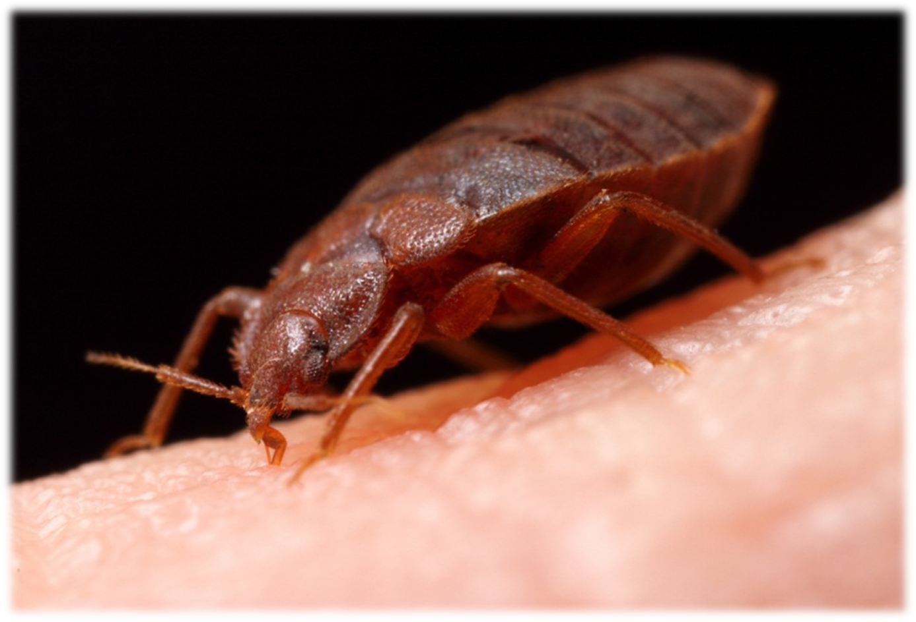
Love at first bite

Slide 2
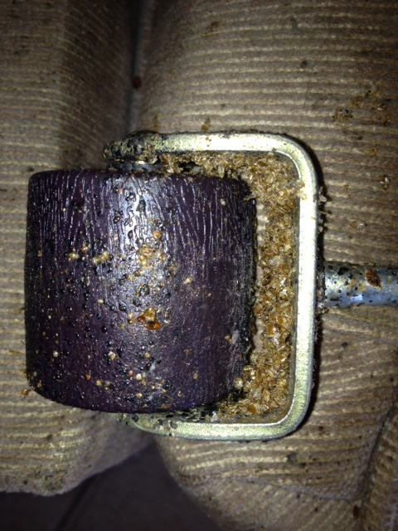
What are we going to cover?
What are bed bugs
History
Resurgence
Biology
Signs
Control
Detection
Disposal
School
Social
impacts
Chemical disasters

Slide 3
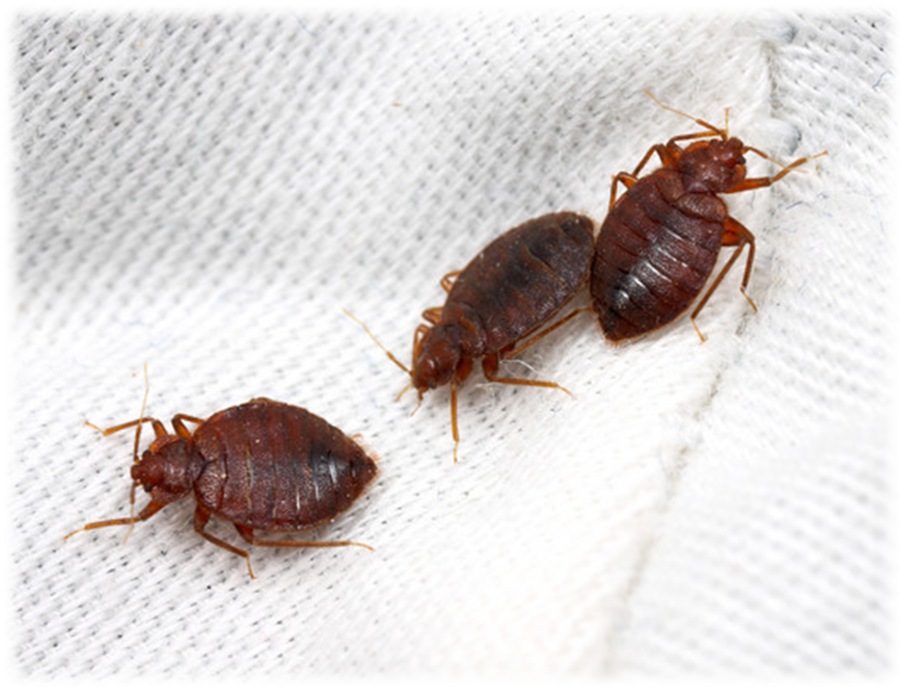
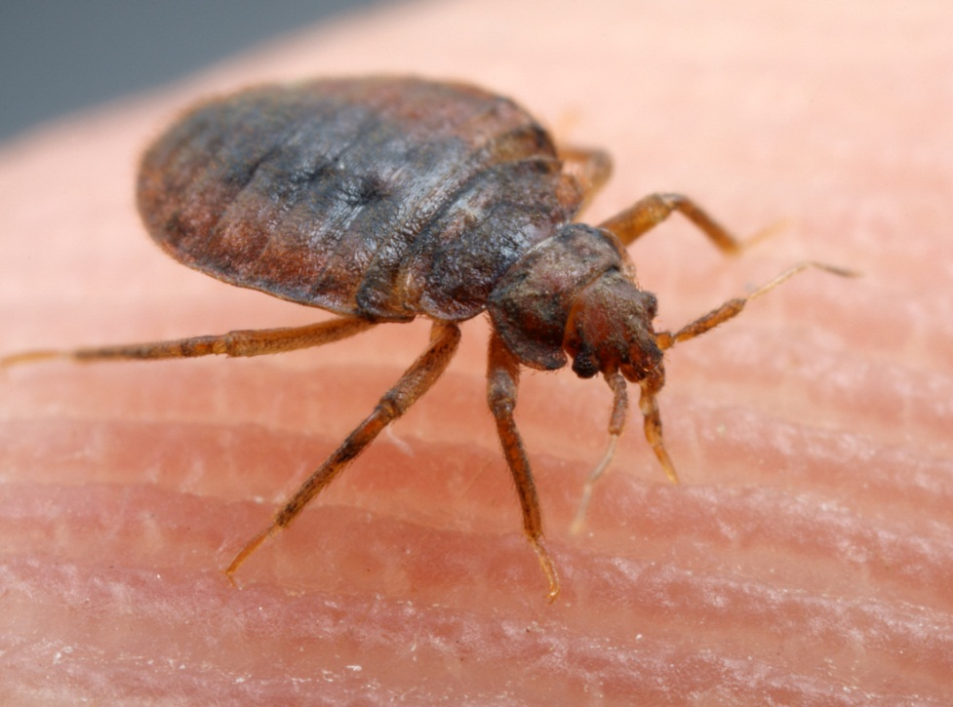
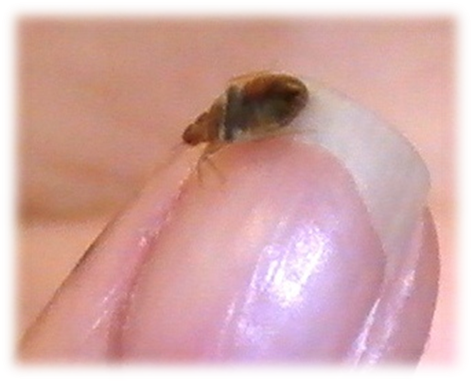
Anyone
can accidently
acquire bed
bugs

Slide 4
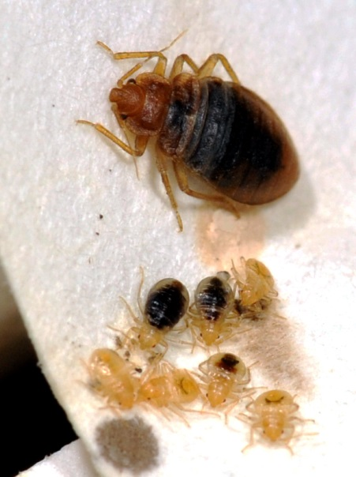
What are bed bugs?
Blood feeding true bugs - order Hemiptera
Eggs hatch and immatures
go through
5 nymph stages
before
becoming
adults
Notes:
Bed bugs are blood-feeding insects in the order Hemiptera (also called true bugs) they go through incomplete metamorphosis (gradual) and the life stages are best described as?
Baby bed bug, young immature bed bug, adult bed bug
Egg, five immature nymph stages, and a final sexually mature adult stage
Larva, adult
Egg, larva, pupa, adult

Slide 5
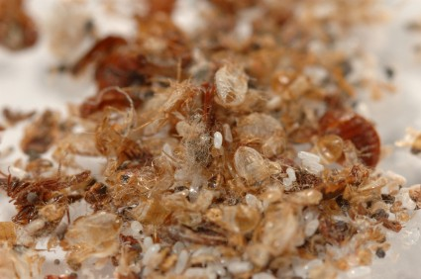
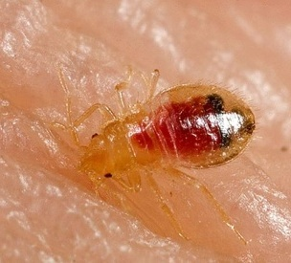
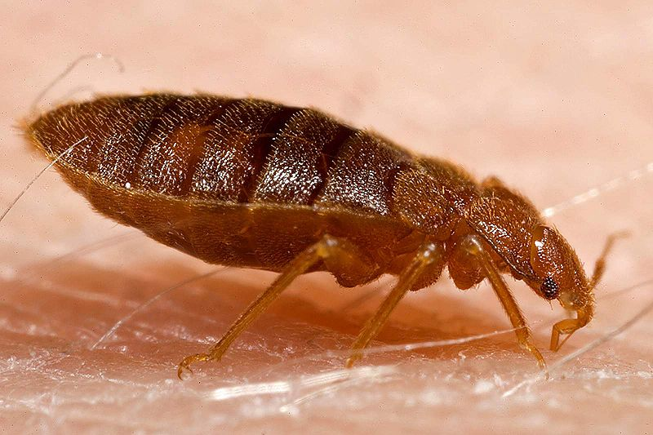
Adults are about the size of an apple seed

Slide 6
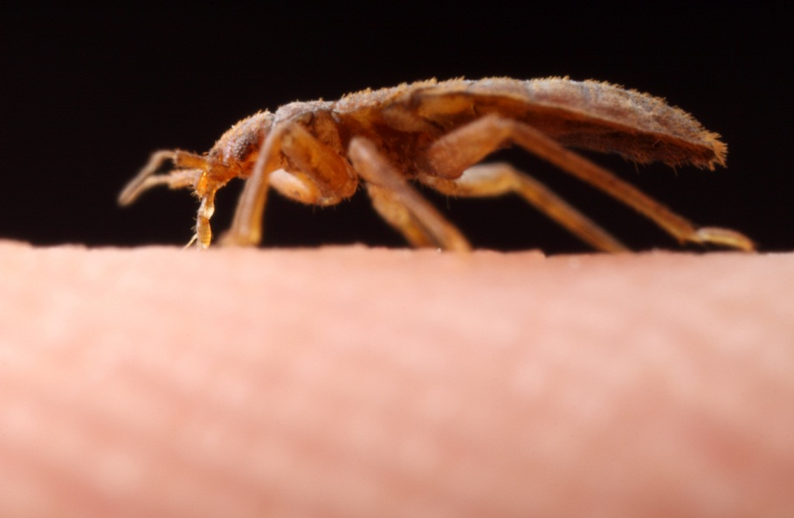

Slide 7
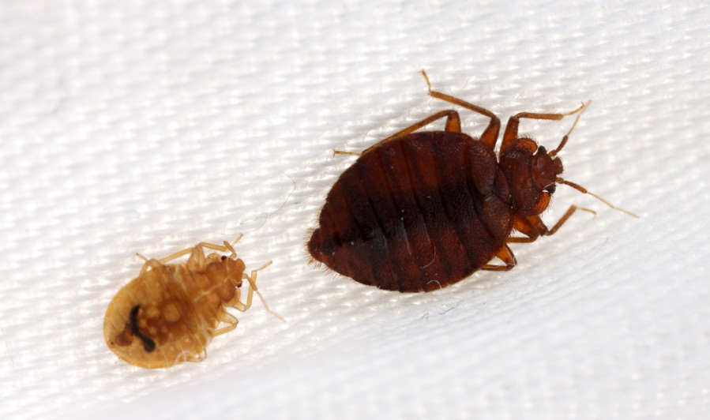
Bed bugs are not known to transmit disease organisms

Slide 8
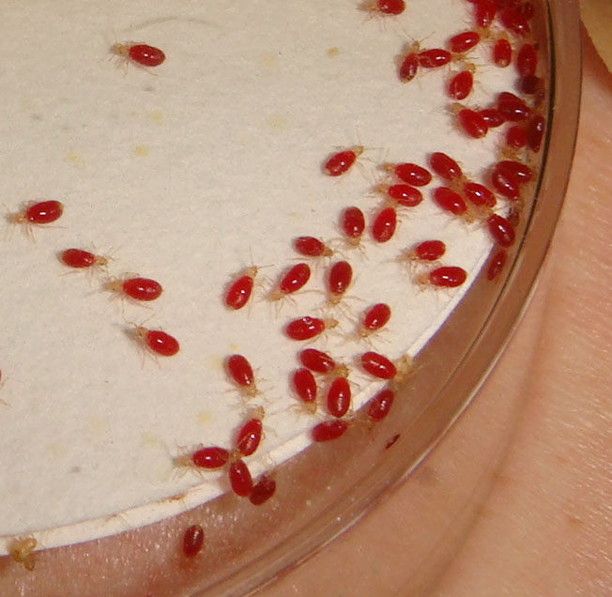
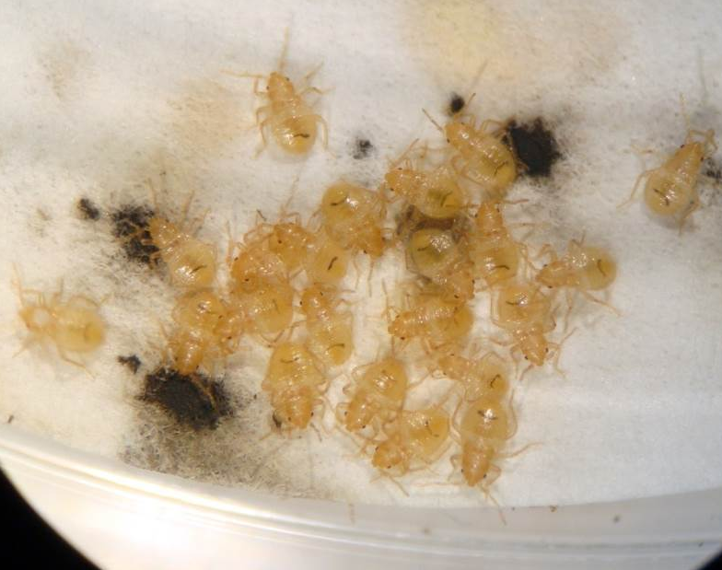
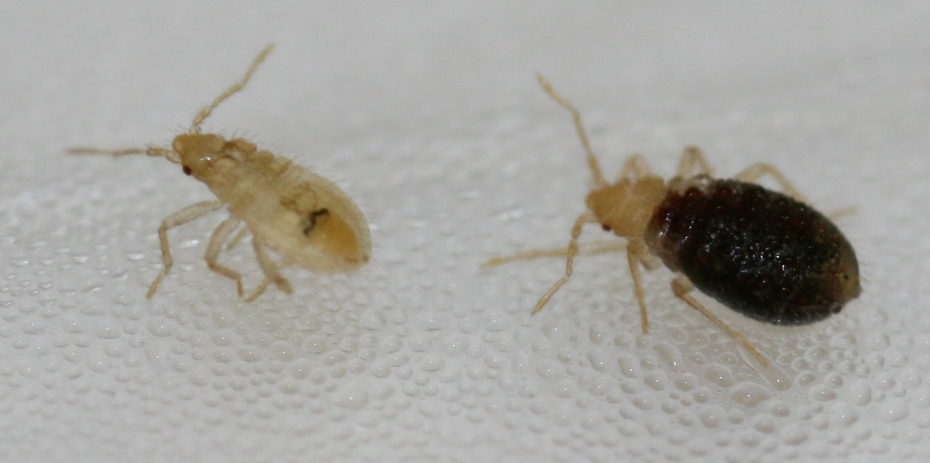
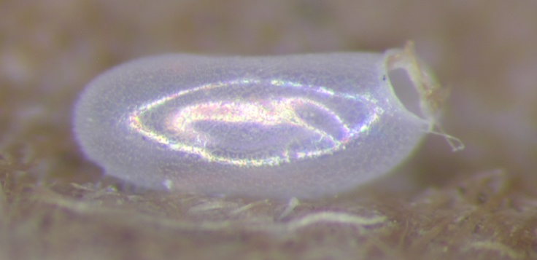

Slide 9
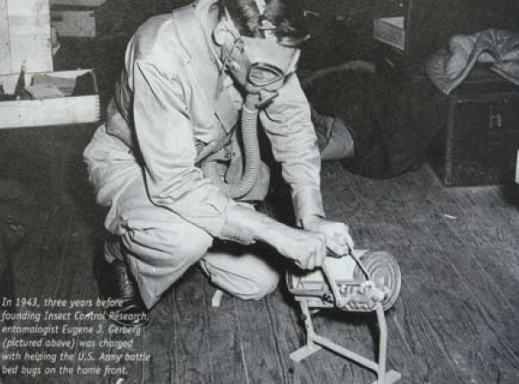
History
1910 -1940 bed bugs became a community-wide problem in US
Infestations were worse in poorer, overcrowded
communities,
although
wealthy
households
had problems
as well
Fumigation with hydrogen cyanide

Slide 10
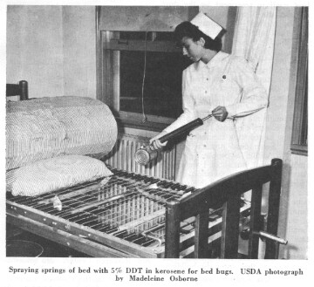
Common pest in the US at the turn of the century
Almost eradicated in 1940-50 due to DDT
Resistance
documented
to DDT,
malathion,
carbamates
and
pyrethroids

Slide 11
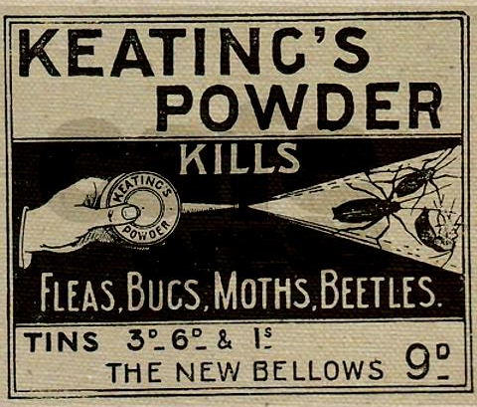
Pull beds away from walls
Place bed legs in pans of oil
Application of pyrethrum powder (dried chrysanthemum flowers) dusted between the sheets of a bed
Vigorous housecleaning, washing
bedding/beds
Dousing slats, springs,
and crevices with
boiling water or grease
from salt pork or bacon

Slide 12
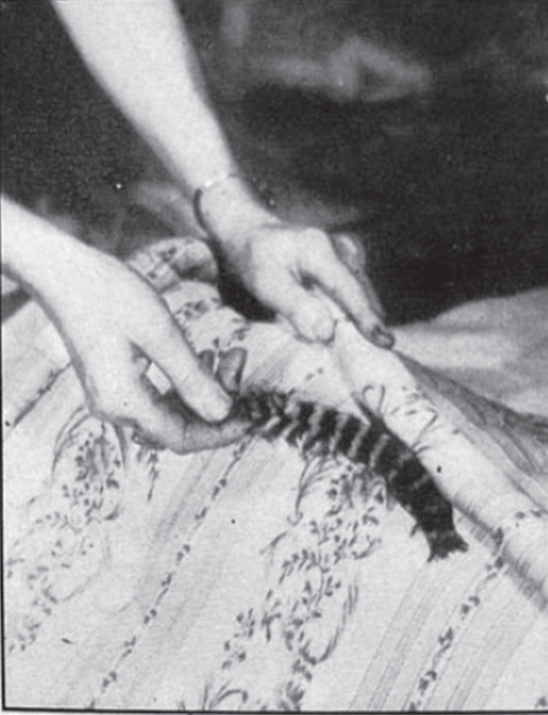
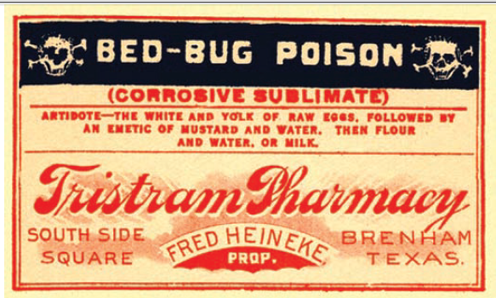
People resorted to extremely dangerous practices
Mercury chloride applied to the mattress using a feather
“Sometimes it is possible to destroy a light infestation by thorough soaking of the bed and other places with high-test gasoline”
Doner and Thomssen 1943

Slide 13
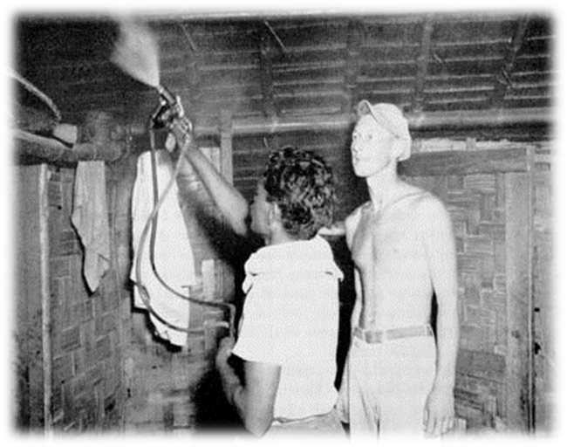
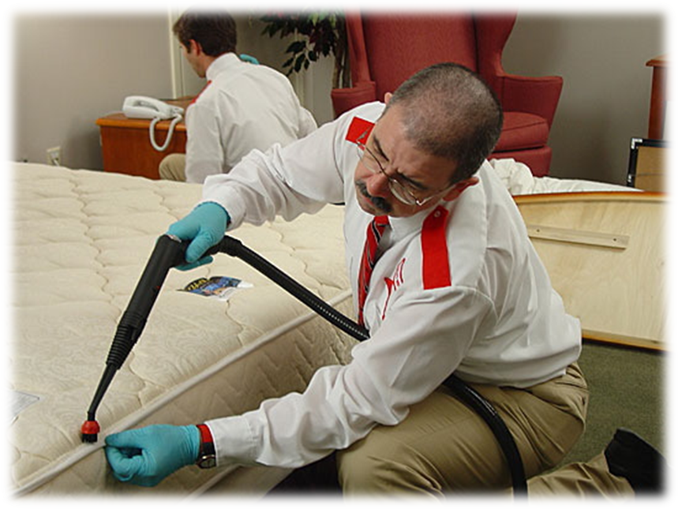
Management relied upon
Labor intensive
Detailed work
Constant monitoring
This is just as true today as it was then, despite technological advances

Slide 14
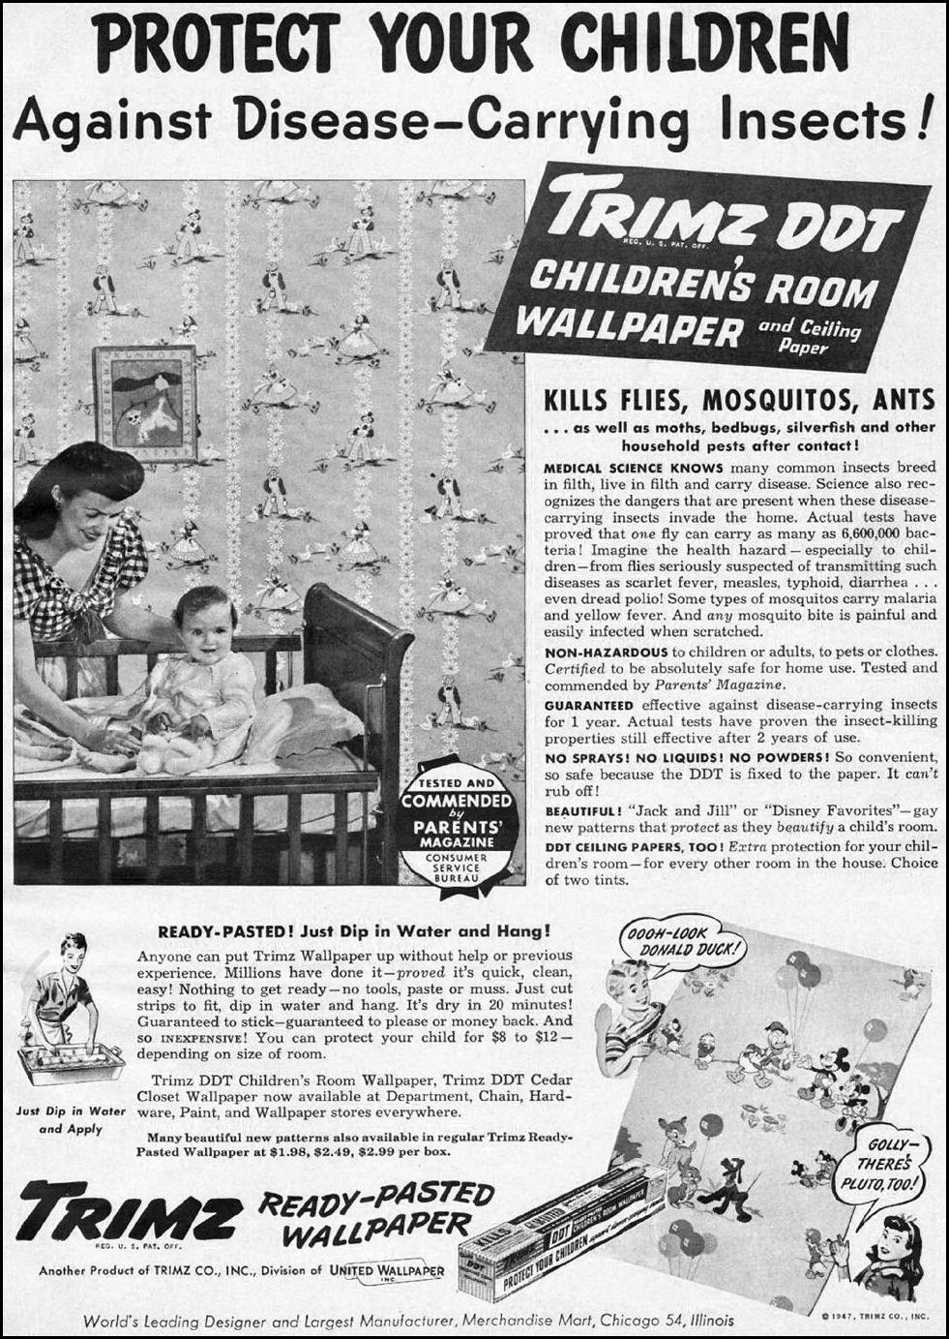
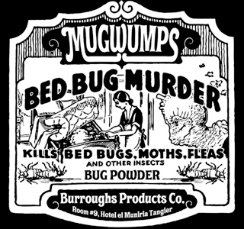
1947
There was little understanding of chemical exposure risks
DDT impregnated wall paper

Slide 15
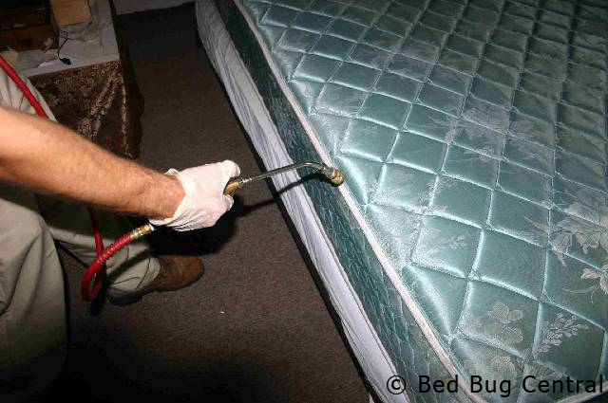
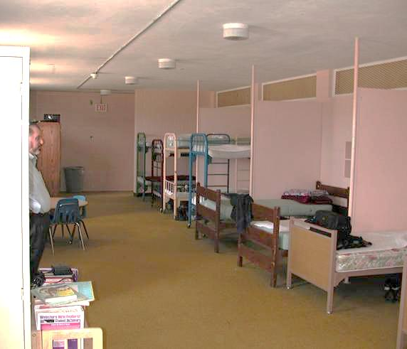
Resurgence
Beds in school dorms were sprayed with diazinon weekly
Diazinon registration for in-home use withdrawn by manufacturer in 2004
2001 Arizona
Some communities remain unaware of chemical exposure risks
Notes:
Diazinon is derived from a World War II nerve gas developed by Nazi Germany

Slide 16
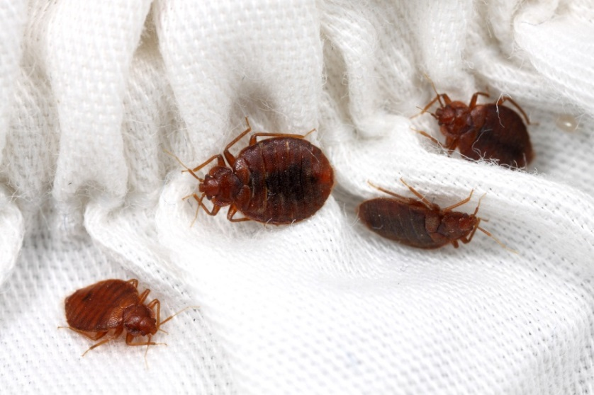

Bedbugapocalypse! Overall increase of 20% between 2012 and 2013
1. Chicago
2. Los Angeles (+1)
3. Columbus, Ohio (+3)
4. Detroit (-2)
5. Cincinnati
6. Cleveland/Akron/Canton (+2)
7. Dayton (+4)
8. Washington D.C. (-1)
9. Denver (-5)
10. Indianapolis (+6)
11. Richmond/Petersburg, Va. (+1)
12. Raleigh/Durham/Fayetteville, N.C. (+3)
13. Dallas/Ft. Worth (-4)

Slide 17
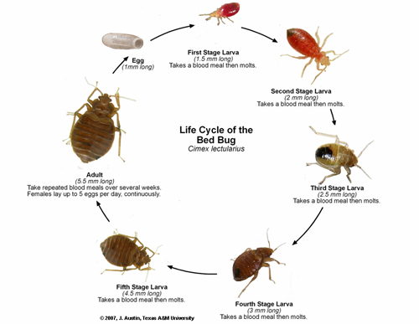
40 bed bugs are in a 70°F room on May 2. By Nov 2 how many are there?
First Stage
(1.5 mm long)
Egg
(1 mm)
Second Stage
(2 mm long)
Cimex
lectularius
Adult (5.5 mm long)
Third Stage
(2.5 mm long)
5,905!
Fifth Stage
(4.5 mm long)
Fourth Stage (3 mm long)

Slide 18
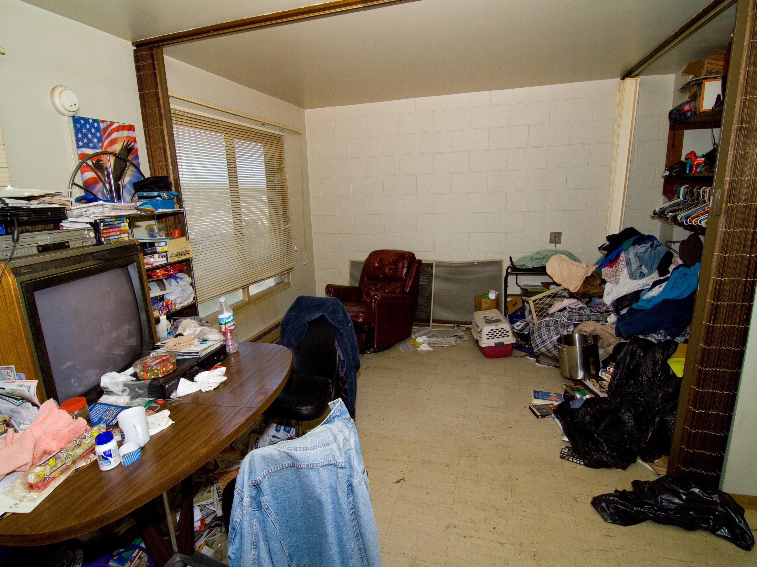

Slide 19
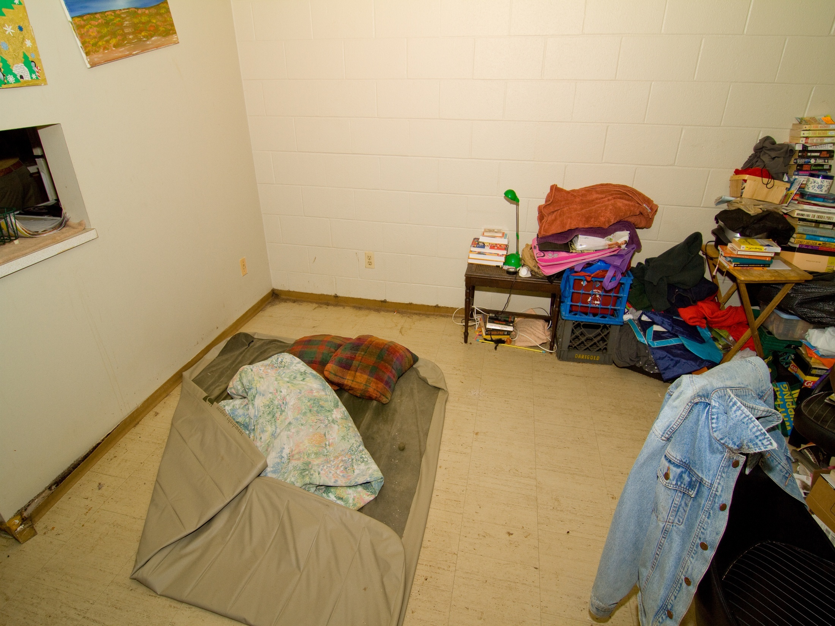
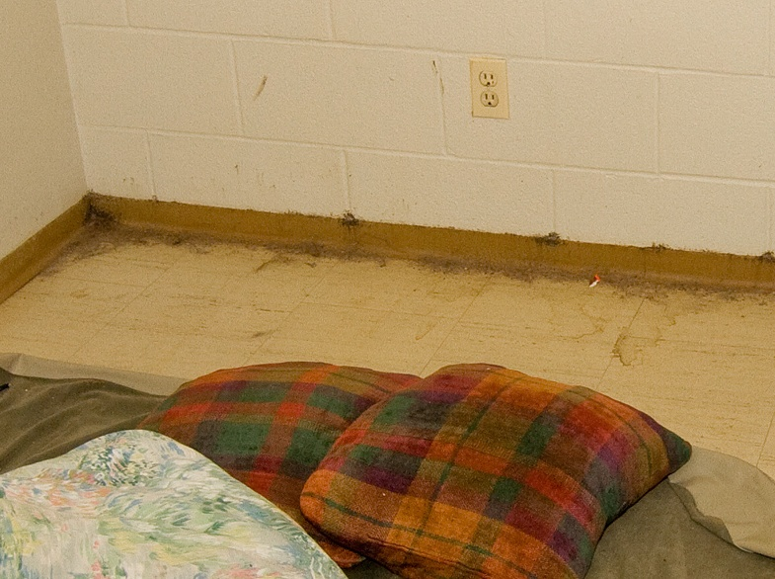

Slide 20
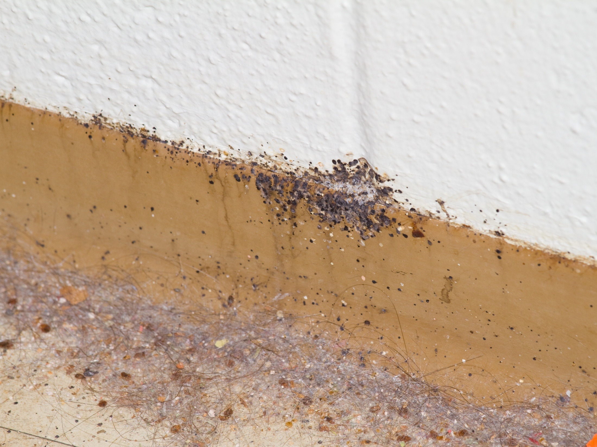

Slide 21
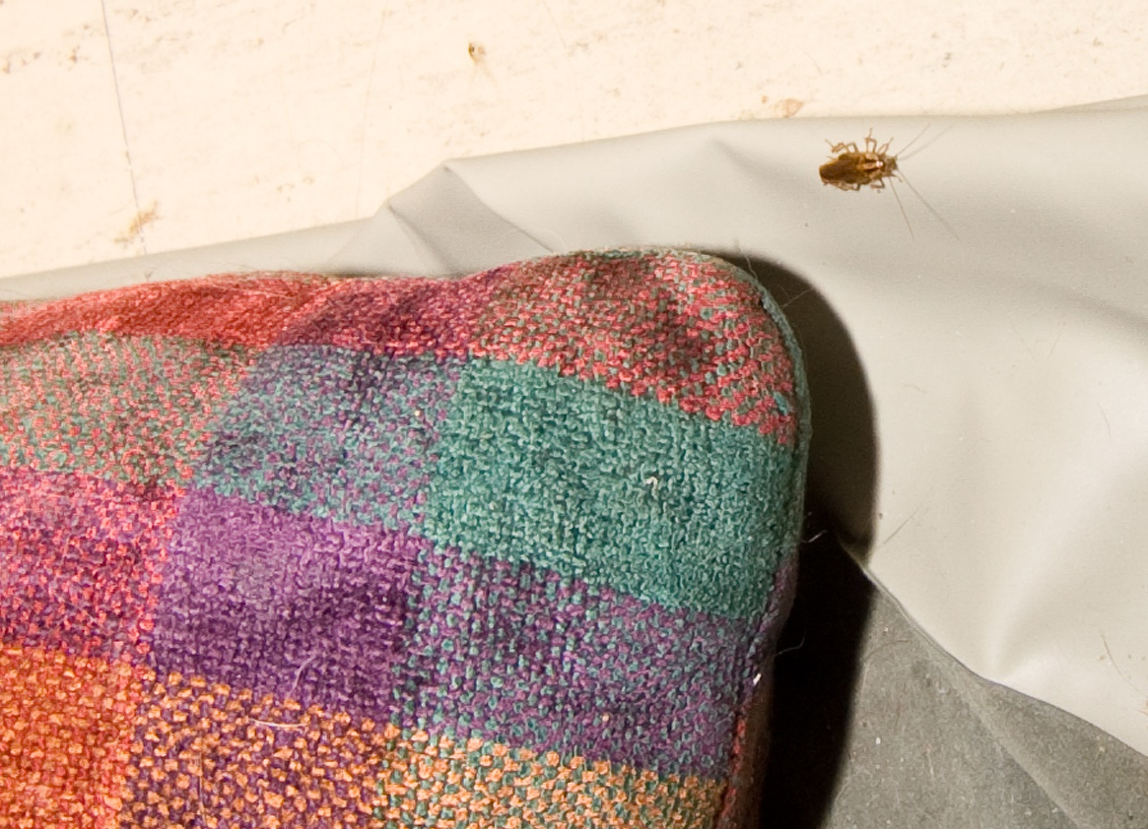

Slide 22
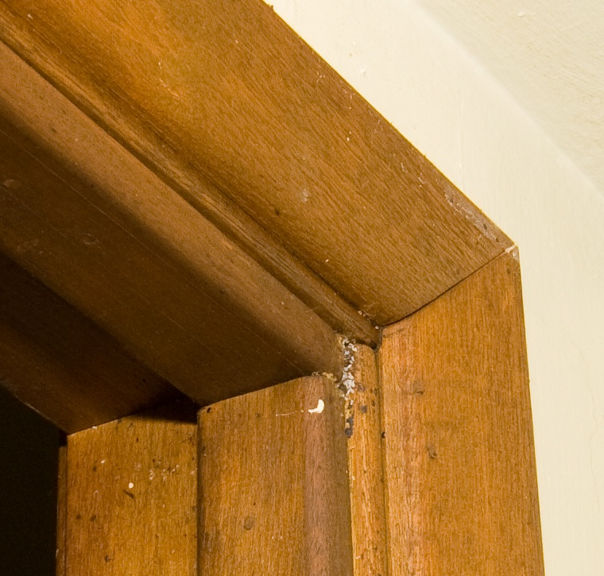
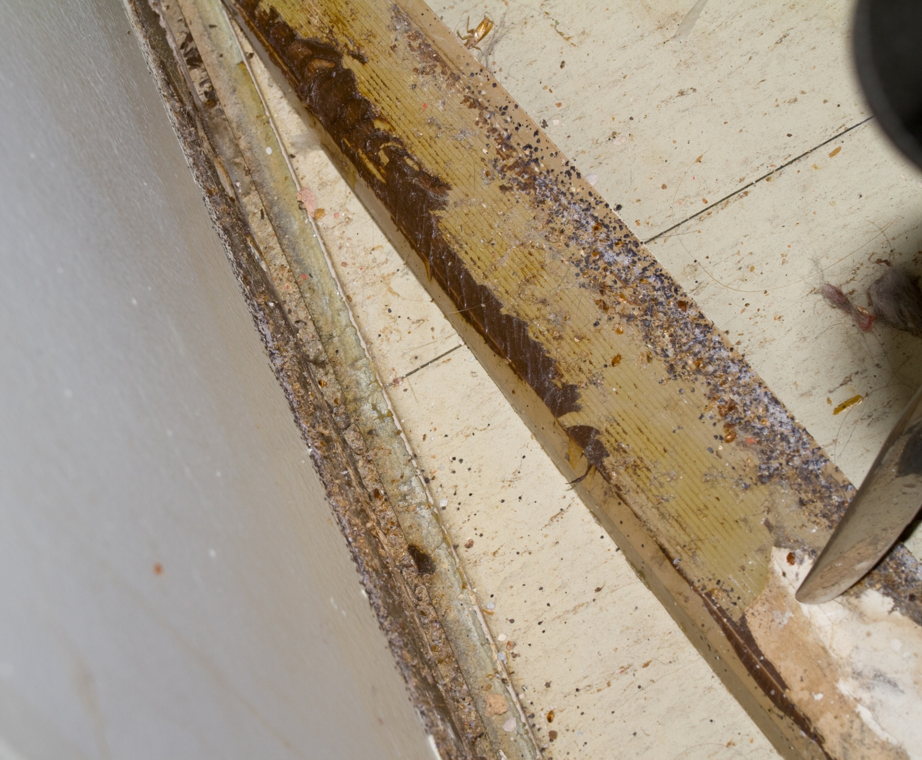
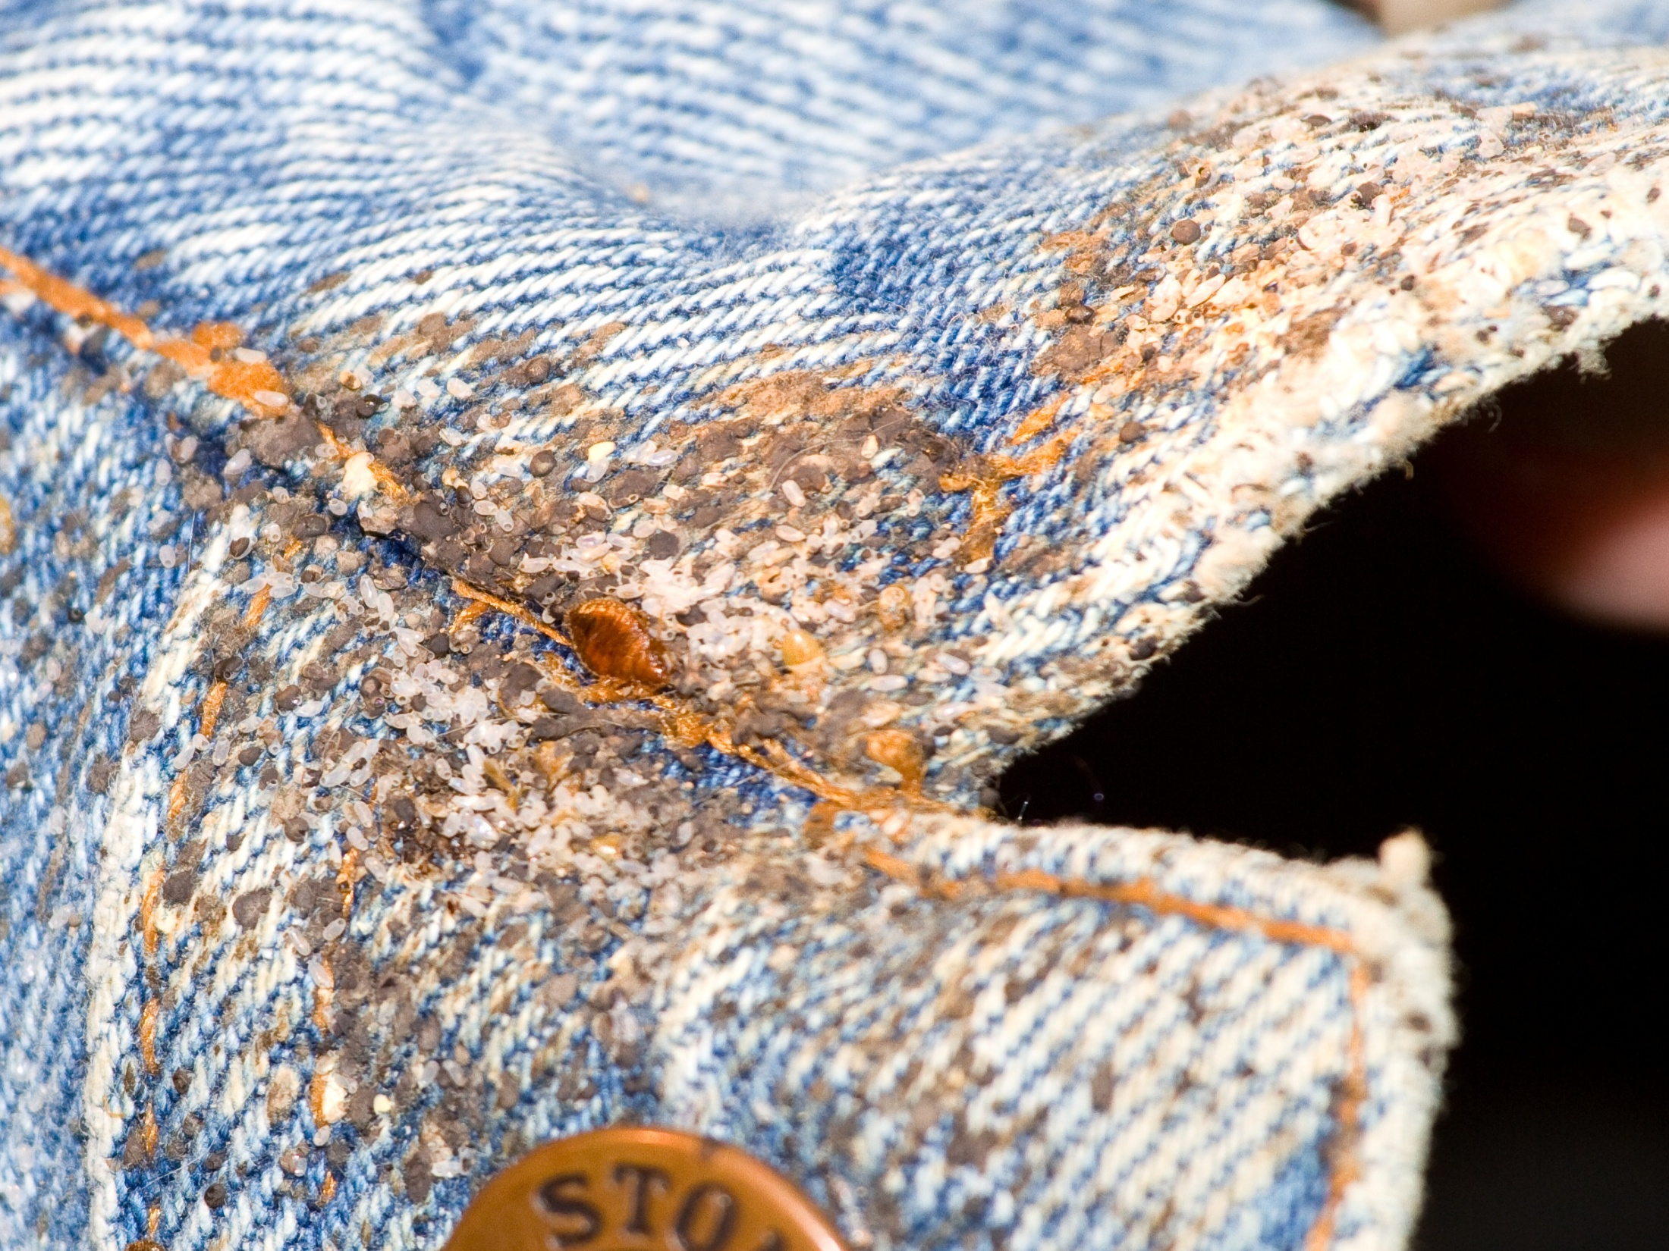
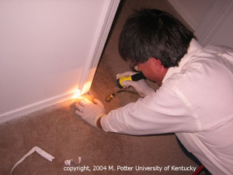
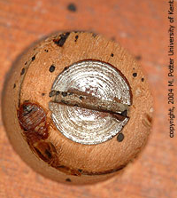
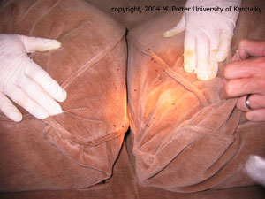
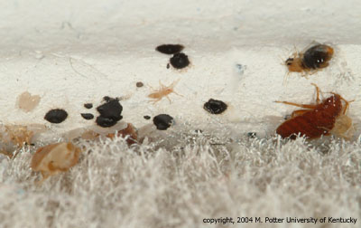
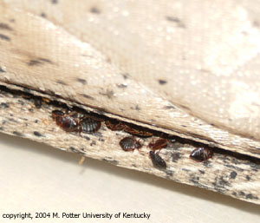
Combine inspection with vacuum cleaning
Use a brush, flash-light, canister vacuum
with a crevice
attachment

Slide 23
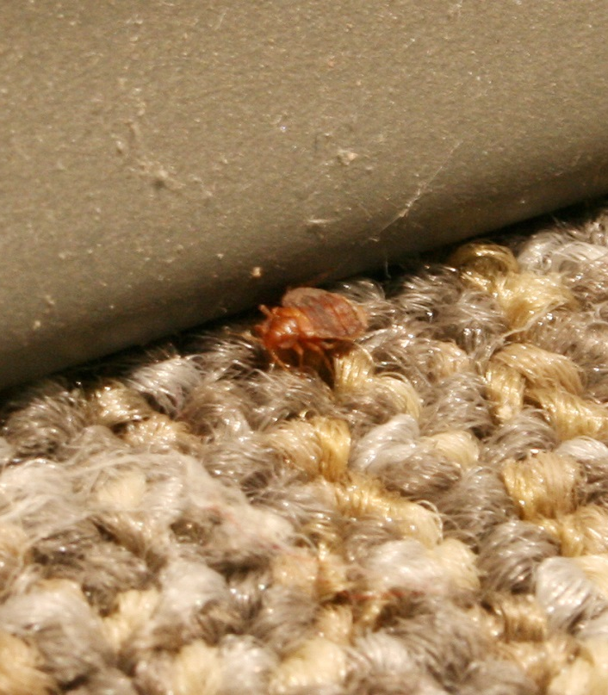
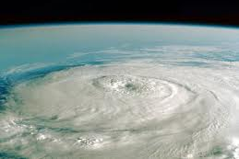
Why have bed bug infestations re-emerged in the developed world?
To a lesser extent:
Immigration from third world countries
Transient homeless during economic downturn
Home transitions increased
Loss of DDT? – Not likely!

Slide 24
Why Bed Bugs Have Returned
More significantly:
Changes in pest management strategies
  Reduction in pesticide use indoors
  Introduction and use of pest specific baits instead of liquid pesticides
  Bed bugs don’t eat baits!
Notes:
Adoption of IPM strategies e.g. less liquid insecticides sprayed around the home to target cockroach and ants

Slide 25
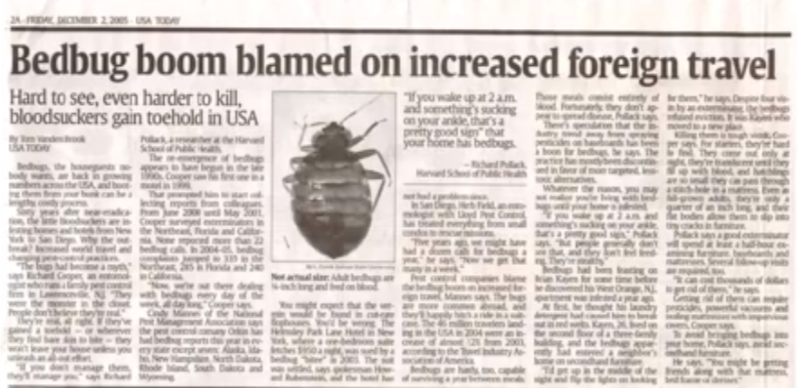

Why Bed Bugs Have Returned
  Increase in global and domestic travel
  Introduction of bed bugs into U.S. by foreign travelers, and re-infestation by native bugs previously restricted
  Mobile society that can carry bed bugs to all corners of the U.S.
Notes:
Increase in global travel that can carry the bugs to all corners of the U.S.

Slide 26

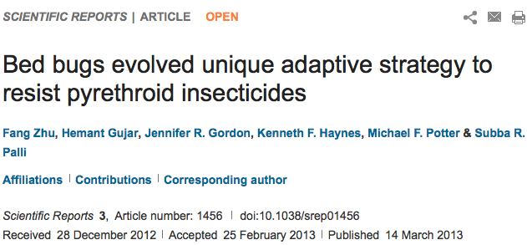
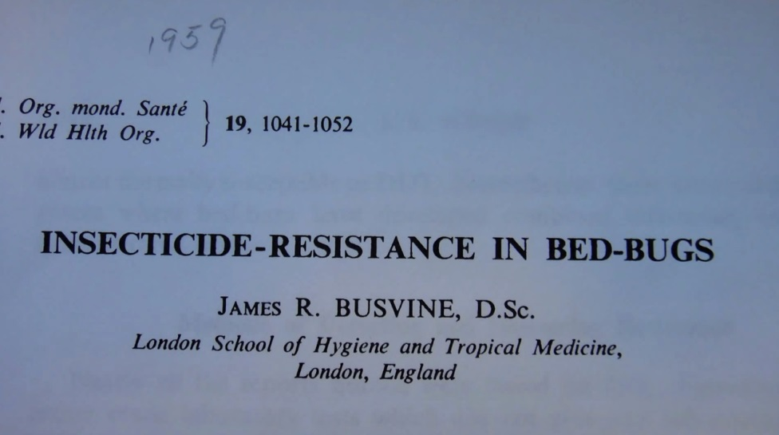
Why Bed Bugs Have Returned
  Bed bugs show increased resistance to insecticides that are widely used
  Metabolic enzymes
  Kdr mutations
  Cuticular proteins
  Abc transporters
Notes:
Pyrethroid insecticides are commonly used in bedbug control because of their relative safety for humans and pets, effectiveness, and low cost, but their use has also led to widespread development of resistance in the pests.

Slide 27
bed bugs arrive
Active
Bed bug moves by walking from an infested area:
From one room to another
From one apartment to another via pipes, telephone or cable wires
Down a hallway after dropping of an item being discarded
Passive
Bed bug is introduced hitchhiking on something:
Furniture
Mattress
Things we carry or wear (purse, coat, shoes, backpacks)

Slide 28
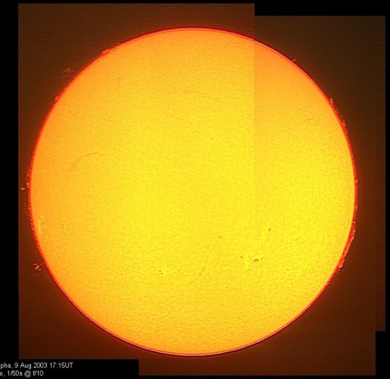
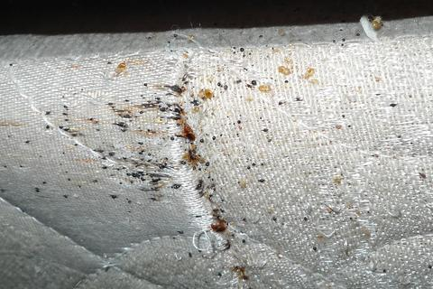
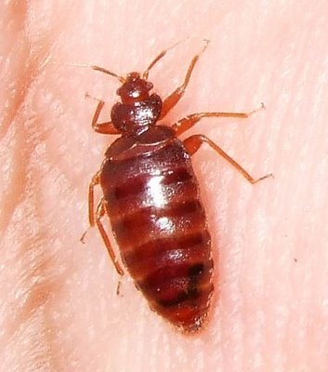
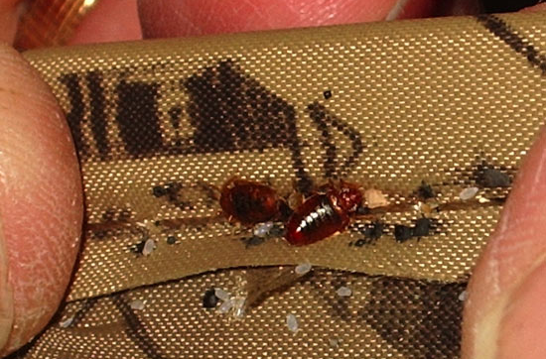



Biology
Feeding
Hiding

Slide 29
First Stage
(1.5 mm long)
Egg
(1 mm)
Second Stage
(2 mm long)
Bed bug
life cycle
Adult (5.5 mm long)
Third Stage
(2.5 mm long)
Fifth Stage
(4.5 mm long)
Fourth Stage (3 mm long)

Slide 30


Slide 31

Bed bugs feed on the blood of humans, birds and mice
Feed at night –
mainly
Saliva can cause a
person to itch
and cause swelling
Scratching can
lead to infected
sores

Slide 32


Bites may occur in lines
- usually on exposed skin

Slide 33


  One study found 30% had a reaction
  Another study indicated 96% (of refugees in Sierra Leone) had reactions
  Reactions vary depending on your immune system and number of bites
  Bites do not confirm bed bug infestations

Slide 34

Saliva causes a “sensitivity” to bites
5 stages: no reaction; delayed reaction; both immediate & delayed; immediate reaction only; & finally, no reaction.
True hypersensitivity can develop
Anemia
Asthma
Skin lesions
(multiple bites)

Slide 35

Probe the skin to find a capillary space that allows the blood to flow rapidly
May probe the skin several times before feeding
Feed for 5-10 min
After feeding, move
to aggregations
Bed bugs usually
feed every 3-7 days

Slide 36


After feeding adults become interested in mating
They engage in
traumatic
insemination
Females may be
mated by many
different males
Females leave
aggregations after
being mated several times

Slide 37

Females that mate only once will produce 25% more eggs than multi-mated females
A single mated female can cause an infestation
After taking a blood
meal females
produce 5-20 eggs
over ~12 days
Females produce
~143 eggs in a lifetime

Slide 38


Aggregate in cracks and crevices all day
If hungry they become active between midnight and 5:00 am
Stimulated by the
increase of CO₂ in
the room
Travel many yards
to get to host
Bed bugs detect
temperature, CO_{2,}
other chemicals

Slide 39


Signs
Excreted
digested blood
Looks like
cockroach
feces but feels
flat or smooth

Slide 40



Slide 41

Frass spots (bed bug poop)
  Mattress seams and on the tag
  Wood frame of the box springs
  Behind the head board
  Along the tops of
  baseboards / the edge
  of carpeting
  Ceiling / wall junctions
  behind pictures
  Electrical outlets
  In curtain seams

Slide 42


Fecal Crust

Slide 43


Blind resident in
disabled public
housing

Slide 44




Slide 45


Slide 46


Not all aggregations are obvious

Slide 47



Slide 48


Molted Skins

Slide 49


Less Obvious Unless You Know
Looks like mold
But are actually bed bug aggregations
What are we looking at?

Slide 50



Slide 51



Slide 52



Blood
Smash and
Drag

Slide 53



Slide 54



Slide 55





Slide 56



Slide 57

Most products will kill some bed bugs
Consumers do not realize that killing bed bugs we can see is not the problem
1 exterior
3 partial
16 internal

Slide 58


Control
Multiple applications of
insecticides
Crack and crevice applications
Resistance to pyrethroid
products is very high
Not all populations are
resistant to the same
products
Three general types of
resistance occurring
Notes:
There are several products labeled for bed bug treatments, and they are seeing widespread use because the pest control industry is using everything they can to combat bed bugs. And, researchers are making reccomenedations whether to use repellent or non repellent products in combination with Sanitation, matress treatments, mattress covers, and scorched earth policy. But as far as products are concerned, we currently have no data to tell us if these products actually work. So there is a great need to evaluate some of these products. So we can make better recommendations on how to control bed bugs. ***Repellency****

Slide 59

Resistance
Metabolic enzyme cytochrome p450, helps to break down toxins – one gene variant that confers resistance enables the bed bug to produce large quantities of the enzyme
Notes:
There are several products labeled for bed bug treatments, and they are seeing widespread use because the pest control industry is using everything they can to combat bed bugs. And, researchers are making reccomenedations whether to use repellent or non repellent products in combination with Sanitation, matress treatments, mattress covers, and scorched earth policy. But as far as products are concerned, we currently have no data to tell us if these products actually work. So there is a great need to evaluate some of these products. So we can make better recommendations on how to control bed bugs. ***Repellency****

Slide 60

Resistance
Commonly used insecticides target an ion channel and cause nerves to fire continuously, paralyzing and quickly killing the insects - resistant bed bugs may carry a mutation in the ion channel that prevents the pesticide from
binding
kdr-type
Notes:
There are several products labeled for bed bug treatments, and they are seeing widespread use because the pest control industry is using everything they can to combat bed bugs. And, researchers are making reccomenedations whether to use repellent or non repellent products in combination with Sanitation, matress treatments, mattress covers, and scorched earth policy. But as far as products are concerned, we currently have no data to tell us if these products actually work. So there is a great need to evaluate some of these products. So we can make better recommendations on how to control bed bugs. ***Repellency****

Slide 61

Resistance
Reduced cuticular penetration – thickening or remodeling of the bed bug cuticle may contribute to decreased insecticide penetration
Notes:
There are several products labeled for bed bug treatments, and they are seeing widespread use because the pest control industry is using everything they can to combat bed bugs. And, researchers are making reccomenedations whether to use repellent or non repellent products in combination with Sanitation, matress treatments, mattress covers, and scorched earth policy. But as far as products are concerned, we currently have no data to tell us if these products actually work. So there is a great need to evaluate some of these products. So we can make better recommendations on how to control bed bugs. ***Repellency****

Slide 62




Many Legitimate Products
Novel pesticide formulations
  Temprid (β-cyfluthrin & imidacloprid
  Transport (bifenthrin & acetamiprid)
  Tandam (ƛ-cyhalothrin & thiomethoxam
Chlorfenapyr
  pyrolle; “pro-insecticide”
Alpine Dust
  Dinotefuran and DE
CimeXa
  Amorphous silica gel

Slide 63

Non Chemical Methods
Becoming the primary methods used in combination with chemical methods
  Heat/Cold
  Vacuuming
  Mattress
  encasements
  Desiccant dusts
  Other
How do you treat libraries?

Slide 64


Treatment Preparations
Most PMPs provide preparation instructions
Instructions make treatments easier for PMP
Difficult for the resident: laundry bill
Top complaint is lack of tenant cooperation
New way of thinking!
Leave the infestation in place

Slide 65


Canine Detection
Excellent detectors
Can distinguish between live and dead bugs
Good for lawsuit defense
Expensive and require constant training
Are only as good as their handler
Notes:
65

Slide 66

Training varies
Verification differs
Few third party certifications

Slide 67






Active Monitors
NightWatch
CDC 3000
Verifi
BuggyBed
2 Bed Bug First Response
Bed Bug Beacon

Slide 68





Passive Monitors/Traps
4 Climb Up Interceptors
4 Bed Moat
4 CVT BB Trap
BB Alert
6 BB Detection System
Notes:
The top tow monitors use the human as bait and intercept hungry bed bugs on the way to the host.
The bottom two are probably most attractive to fed bed bugs who have left the host and are looking for a place to harbor.
68

Slide 69

Vacuuming
The value of
vacuuming is it
makes inspections
easier
Large infestations,
harborage areas are
filled with live bed
bugs, dead bed bugs,
molted skins, hatched
egg shells, and feces

Slide 70


Heat kills bed bugs Best of All!
Items can be placed in a hot dryer dry for 40 minutes after items
are dry
Washing only,
does not kill
bed bugs
Heat box

Slide 71


Showering removes bugs from your person
Notes:
Reinforce this point that was made earlier in the course.

Slide 72

Steam Cleaning
Steam
temperature
(at the bed bug)
must be 130º F (54º C) or greater
The steam head
must be large
Steam power
will kill bed bugs
and their eggs
Steaming is slow
and labor intensive

Slide 73


Heat
Chambers
Do it Yourself

Slide 74


Whole Home Heat
Propane or electric
Temperature ~140°F
Time 4 hours
Notes:
74

Slide 75


Cryonite®
Bed bugs exposed
to CO₂ snow at
-42º C
The snow is
pressurized
through a nozzle
that forms vapors
Snow freezes the
cells of the bugs
This system will
not eliminate a bed
bug infestation if used alone

Slide 76

Mattress Covers
Encasements for both mattress and box springs!
Improved version has a zipper protector sewn in
Traps bed bugs and eggs, bite proof and escape proof
Protected Zipper

Slide 77


Not all covers protect
Where the zipper closes and the zipper teeth
are vulnerable to bed bug escape

Slide 78


Desiccant Dusts
Desiccant dusts are
ultimately more effective
than sprays
Resistant strains died
in ~36 hours
Diatomaceous Earth
  insecticide grade 2-3 days
Silica dust
  2-3 days
Lasts unchanged in wall voids for years in low humidity
Notes:
78

Slide 79


Desiccant dusts
Best
So far
Notes:
79

Slide 80


Fumigation with Vikane
Fumigation is
generally considered
a last resort due
to price
Effective for multi-
unit housing
Residents moving to
and from different
units
Sharing of belongings
Large communal areas

Slide 81

DIY stores are not helping
Notes:
81

Slide 82




Disposal
Wrap and mark
items for disposal
Organize solid waste
pick-up

Slide 83






Slide 84

Why Bed bugs
IN School?
Bed bugs are excellent hitchhikers
  Clothing
  Backpacks
  Books
Bed bugs are good runners

Slide 85

Articles from home
Univ. Minnesota – Dr. S. Kells

Slide 86

Unhappy Bed Bugs
Schools
usually lack
a food source at night
Boarding schools are the exception
Backpacks, books, clothing, wheelchairs from home provide harborage and transport
Schools can be transitional locations

Slide 87

In-school transfer
can occur

Slide 88

Accurately identify all specimens
Provide basic information
Inspect room, monitor, careful cleaning and vacuuming
Reduce clutter
Isolate student
belongings in clear
plastic bags
Usually no need for
residual insecticides
Notes:
Take a piece of scotch tape and tape the bed bug between tape layers. Save for proper identification.

Slide 89

No good preventative solution until unmanaged reservoirs in homes or elsewhere are addressed

Slide 90
Results:
Children missing school
Faculty and staff losing their jobs
Affected
families
move homes
and schools
Extreme
chemical use
A. Wild

Slide 91






Paradichlorobenzene
Dichlorvos
Naphthalene
Notes:
Naphthalene or Paradichlorobenzene

Slide 92

parents
Inform parents how to send students to school free of bugs
  Launder clothes, dry heat for shoes, backpacks, etc.
  Clothing items
  stored separated
  from bed bug
  areas in
  airtight bags

Slide 93
If a bed bug is discovered in the school
Do not panic
or cause panic!
Often it’s a
stray, single bug
Collect it for proper ID
Do not evacuate the classroom or office
Thoroughly inspect the room

Slide 94

School protocol for “treatment”
Deep clean the affected
area thoroughly
Vacuum all floor and
corner areas
Wash desks and chairs
Wash floors
Temporarily remove rugs
Steam clean rugs and furniture

Slide 95




Shared articles can harbour bed bugs
Wheelchairs
Vacuums
Medical equipment
Electronics
Games
Clothing
Toys

Slide 96

Phoenix Union High School District – Bed Bug Policy
Policy 2012-2013 school year
2013-2014 >75% reduction in roving bed bug sightings
Cleaning and monitoring
not “spraying”

Slide 97



Parent and community education

Slide 98

Educate Students
Resource created by
Dr. Rebecca Baldwin
University of Florida
Notes:
http://entnemdept.ufl.edu/bug_club/BBBB%20Articulate%20Published%202012/Bed%20Bugs%20and%20Book%20Bags%20FINAL%202.28.12.pdf

Slide 99

Social Impacts
2007-2011 data from individuals calling by phone, sending written correspondence, or attending educational /
outreach events

Slide 100

Most commonly used pesticide choices for residents battling bed bugs was total release foggers,
& aerosol sprays
9% of residents had
applied gasoline on
their bed (one PHA
training)
19% of people had
attempted
non-chemical control
31% had used more
than two chemicals

Slide 101

42% people understand
what behaviors put
them at risk
89% indicated
extreme stress,
100% indicated
some anxiety
4.5% of residents
attempted to seal
cracks and crevices
8.9% had paid a company
to remediate the infestation

Slide 102

Few (>7%) people had no concerns when informed of average remediation costs
32% of specimens submitted as bed bugs or possible bed bugs were not bed bugs
$400-5000
Fumigation
Heat treatments
Pesticides

Slide 103



The poor are
at greatest risk
Increased number of people reporting long-term (beyond a year) bed bugs

Slide 104



Socioeconomic risk

Slide 105

Over the counter pesticides used in/on school backpacks
Children missing school for more than 6 months
Psychiatric patients refused admission to medical facilities
Isolation from friends and family
Bed bug detection dogs providing false positives

Slide 106

Other observations
Doctors and PA’s misdiagnose bed bugs based on bite
reactions

Slide 107


Loss of:
Home and/or belongings
Financial stability
Mental stability
Partner
Employment
Health
Children?

Slide 108


In 2012 we developed an on-line survey tool to methodically determine bed bug impacts and analyze the behavioral risk factors associated with bed bug infestations
2014 launch
Bed Bug survey in English: http://www.surveymonkey.com/s/DGLQS52
Bed Bug survey in Spanish: https://es.surveymonkey.com/s/F5NZXJK

Slide 109

Chemical disaster zones

Slide 110


Slide 111


Slide 112

Malathion
Lab results:
Malathion 581.09 ug

Slide 113

Misuse – Sevin Dust
Grandparents used Sevin Dust to treat bed bugs … “it worked for someone else”

Slide 114

Clean up procedures?

Slide 115




Unlabeled Mothballs
Chinese Chalk
Tres Pasitos
Products without a pesticide label are illegal !
Notes:
Examples of illegal pesticides are pictured.
The three pictures on the left are of unlabeled packages of mothballs.
The fourth photo is Chinese Chalk. People illegally use this unregistered pesticide to kill cockroaches. But the “chalk” could seriously harm people, especially children and pets.
The fifth photo is Tres Pasitos—“three little steps” in Spanish. The phrase refers to the number of steps mice take before they die.
Insecticide “chalk” (a.k.a. Miraculous or Chinese Chalk) and Tres Pasitos are two common illegal pesticides sold by street vendors or at ethnic markets.
Pesticides are illegal when they are not registered by the EPA or the state within which they are used or they are used against the label. Illegal pesticides should not be purchased or used.
Illegal pesticides may be stronger than ones that are legal for residential use. People may be tempted to purchase and use illegal pesticides because they are fast-acting. These products are illegal and harmful to people and pets.
In Boston, there has been success with pesticide buy-backs where residents are paid for the pesticides they have in their home.

Slide 116

Do not use foggers and “bombs”
Notes:
116
Refer back to previous discussion.

Slide 117




Slide 118


Bed bugs everywhere not just homes
Medical
Cinemas
Libraries
Elder/disabled care
Cinemas/theatres
Retail outlets
Transportation
Schools/childcare

Slide 119

Recap
Beds, sofas, bedside tables, recliners, picture frames…
= Hot Spot
Notes:
Bed bugs need blood to live, and blood is easiest to get when people are sleeping. So trainees need to look where people rest.
When bed bugs are suspected the locations in red should be inspected first.
The circles with dark red centers are the places within the unit where people are likely to rest: beds, sofas, and recliners. After feeding, bed bugs hide in nearby cracks. This increases the area one has to inspect to the lighter red ring. Note that the potential infestation area now contains tables, lamps, walls, and carpets. Encourage trainees to think in three dimensions: carpets, table drawers, hanging picture frames, peeling wallpaper, and box springs. The units above, below, and sharing walls with these infestation sites might have bed bugs.

Slide 120
In a home, where do bed bugs hide? (Choose the top 3)
  a.) box springs
  b.) couches / chairs
  c.) mattresses
  d.) night stand / dresser
  e.) baseboards and moldings
  f.) head boards and bed frames
  g.) walls / ceilings
  h.) TV remotes
  i.) curtains / drapes
  j.) toilets

Slide 121


Toilets
Even in the loo!
Notes:
Television and other remote controls, in the battery compartment
Telephones, cell and cordless phones
Lamps and alarm clock
Computers and other electronics
Cardboard boxes in closets and under the bed
Children’s toys and stuffed animals
Jewelry boxes
Brick walls and “popcorn” or other textured ceilings
Books, magazines, newspapers and files
Inside hollow doors
Ceiling light fixtures, smoke detectors
Heating units, air conditioners and ducts
Wheelchairs
Toilet seats

Slide 122

Resources
http://www2.epa.gov/bedbugs
http://www.epa.gov/oppfead1/cb/csb_page/updates/2013/fedstrat-bedbugs.html
http://extension.arizona.edu/sites/extension.arizona.edu/files/pubs/az1563.pdf
http://www.azdhs.gov/phs/oids/training/documents/2011/Bed-Bugs_Gouge.pdf
http://webdoc.agsci.colostate.edu/ipm/Bed%20bug%20photos.pdf

