Slide 1
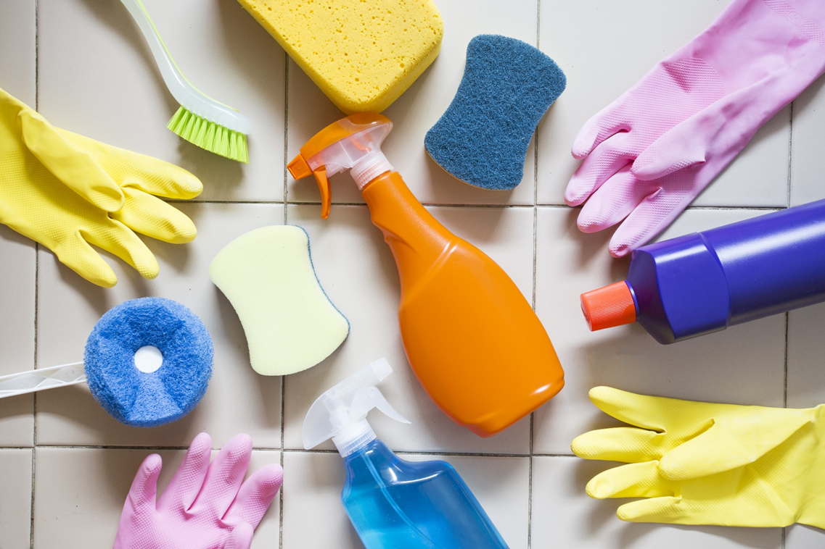
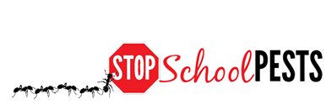
School IPM FOR CLEANING PROFESSIONALS
Self-Guided Education Module
Lesson 1 of 1

Slide 2
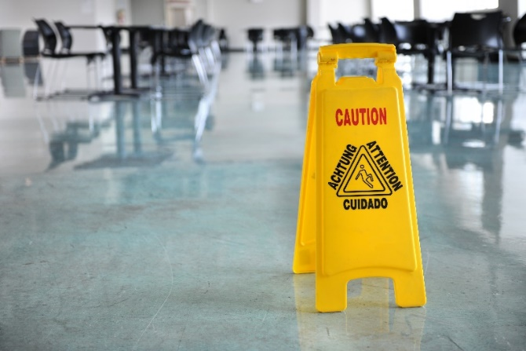
Learning Objectives
Describe common sanitation issues and problem areas
Describe key elements of sanitation and exclusion
Strategies
Tactics
Tools
Describe key elements of inspection and monitoring
What to look for
Where to look
Tools used
Frequency

Slide 3
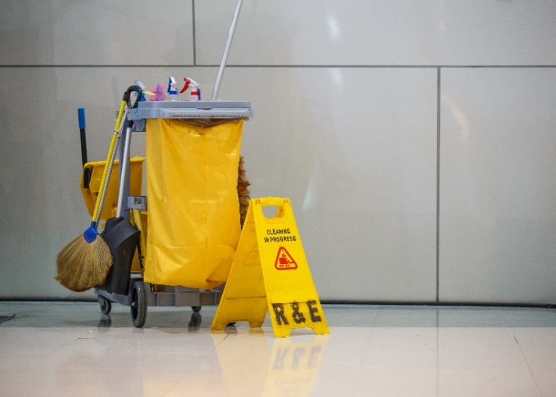
Learning Objectives
Describe key elements of data collection, recording and evaluation for:
Sanitation
Monitoring
Inspection
Describe proper and thorough cleaning procedures:
Drain areas
Floors
Corners
Beneath equipment
Floor joints

Slide 4
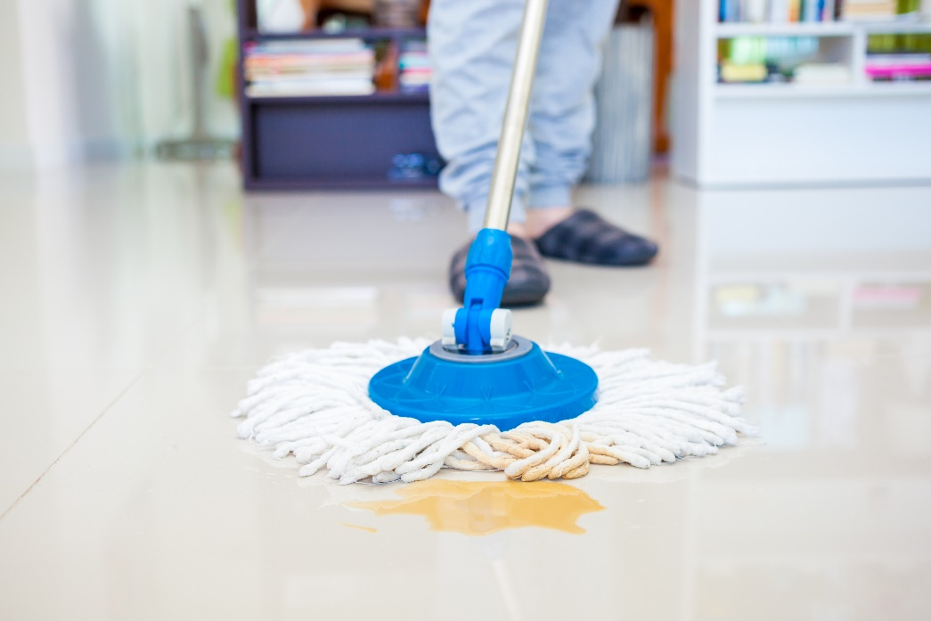
Learning Objectives
Provide examples of proper maintenance and storage practices of cleaning equipment
Provide examples of proper storage including inspection of deliveries for pest presence and good sanitation of storage areas to identify problems in early stages

Slide 5
Learning Objectives
Explain the importance of effective communication, education and cooperation between relevant parties:
Facility users
Contractors
Custodial
Food service
Landscape and grounds maintenance
Teachers
Administrators

Slide 6
1.
Do What You Already Do, Just Think Pest!
Custodians working in schools affect the quality of the learning environment and directly impact the quality of learning
Notes:
Custodians are among the most important people for IPM in any environment!
Custodians working in schools affect the quality of the learning environment and directly impact the quality of learning.

Slide 7
1.
Do What You Already Do, Just Think Pest!
Custodians are among the most important people for IPM in any environment!
“I am very proud to be the custodian of my school. I want the students here to enjoy how it feels to be in a clean and safe place”
- Robin Anderson,
Salt Lake City Schools
Robin Anderson - Ricardo Zubiate, Salt Lake City School District

Slide 8
1.
Do What You Already Do, Just Think Pest!
IPM Coordinators rely on custodians to inform them of pest sightings and correct or report conducive conditions
Custodians correct conducive conditions every day by denying pests access to food and moisture

Slide 9
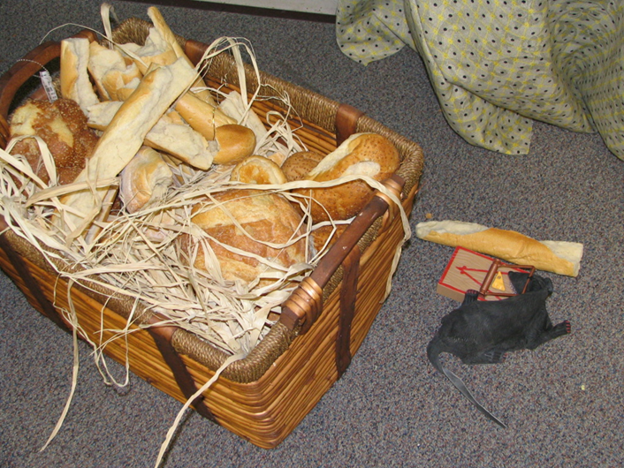
Do What You Already Do, Just Think Pest!
Custodians can play an important role educating principals, teachers, food service staff and others on how to avoid pest-conducive conditions
Basket of bread from school play left on stage over winter break, roof rats were delighted! - Jerry Jochim, Monroe County Community School Corporation

Slide 10
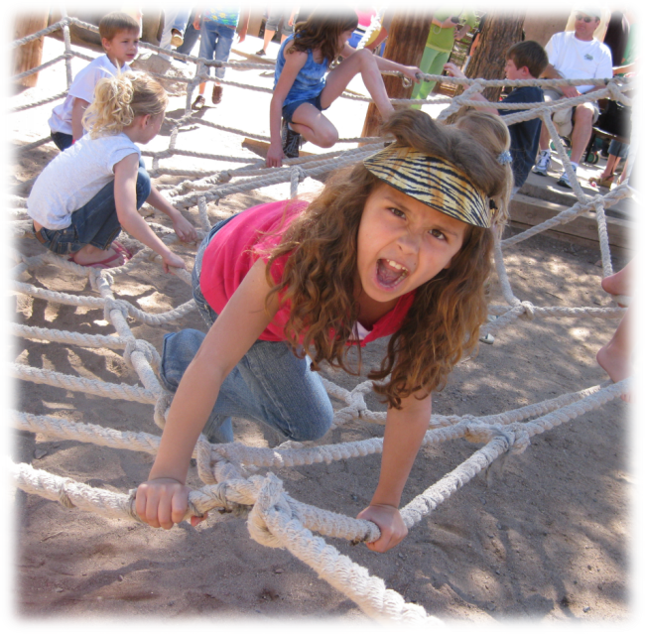
1.
Custodians Manage an Environment Affected by Students, Faculty, Staff and Parent volunteers.
Building occupant behavior should be well managed
Sensible rules go a long way to establishing a great program
The Head Custodian should be included on committees that develop policies for behavior
Example: School districts restricting drinks in outdoor areas to water or electrolyte drinks have dramatically reduced stinging insect problems around outdoor trashcans
Children can be unpredictable –
Dawn H. Gouge, University of Arizona

Slide 11
1.
Common Sanitation Issues and Problem Areas
Poor sanitation leads directly to pest problems by providing food, water and shelter
Good custodians are detail oriented with good technique
It takes time, effort and expertise to clean correctly
Some building occupants can have low standards and expectations for cleanliness and organization

Slide 12
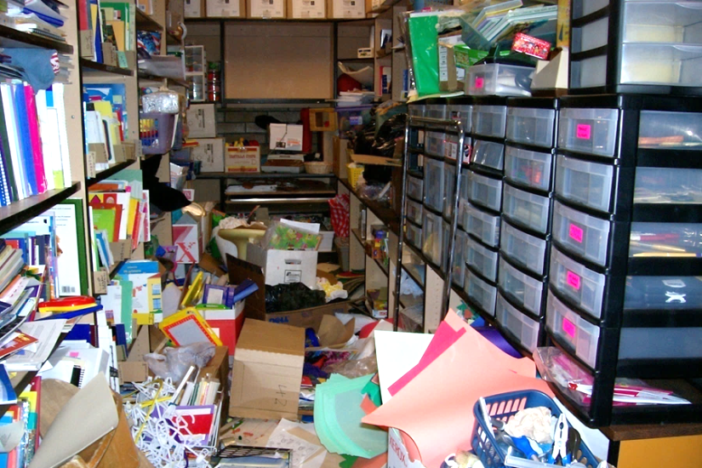
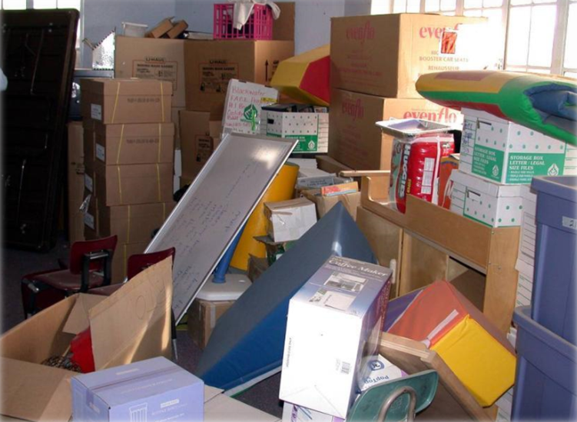
1.
Clutter Bugs - Most Schools Have One
How can any cleaning professional effectively remove dirt from these spaces? Impossible!
School policies should prohibit clutter for fire safety, allergen reduction and pest prevention reasons - Principal enforcement is critical
Cluttered storage - Dawn H. Gouge, University of Arizona

Slide 13
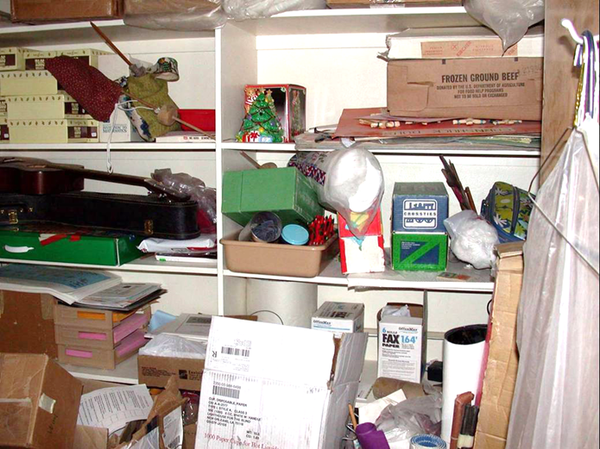
Administrative Support
Custodial staff should request support from school administration if teachers refuse to reduce clutter in their classrooms, making it more difficult to clean effectively and reduce pest allergens and harborage opportunities
Fire safety codes disallow clutter
Cluttered storage - Marc Lame, Indiana University

Slide 14
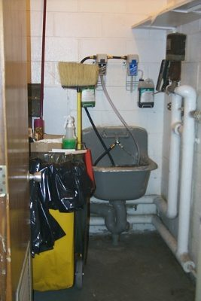
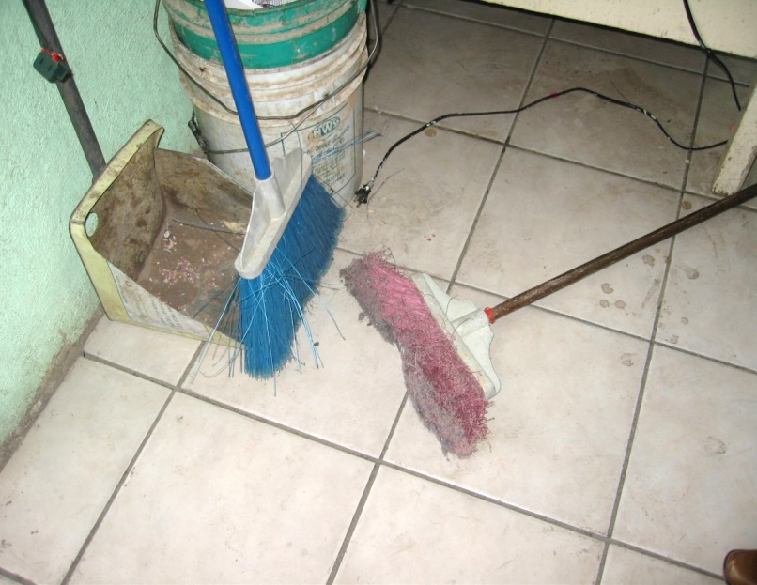
1.
Common Sanitation Issues and Problem Areas
Poor quality and/or poorly maintained cleaning supplies and tools are a problem
Dawn H. Gouge, University of Arizona
Nicely organized cleaning supply closet
Brooms should be stored upside down so they can dry properly

Slide 15
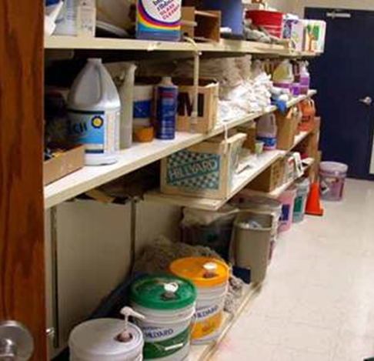
Cleaning Equipment Maintenance and Storage
Custodial closets can provide food, water, and shelter for pests if they are not well organized
Avoid storing items on the floor, which makes cleaning and inspection difficult – Dawn H. Gouge, University of Arizona

Slide 16
Cleaning Equipment Maintenance and Storage
Custodial Closet Tips
Inspect each custodial closet
Empty closets of no longer used items
Clean and paint
Evaluate the mechanicals
Check the lighting
Restock, organize and prioritize
Notes:
Meet with cleaning crew and inspect each custodial closet.
Empty closets of items no longer used or have not been used in months.
Clean and paint. Standards applied to the rest of the facilities, should be applied to custodial closets.
Evaluate the mechanicals (is there efferent storage space, shelving units, etc.)
Check the lighting. Often custodial closets do not have lights, making it more difficult to keep clean and organized.
Restock, organize and prioritize. Items should be organized by need and use.

Slide 17
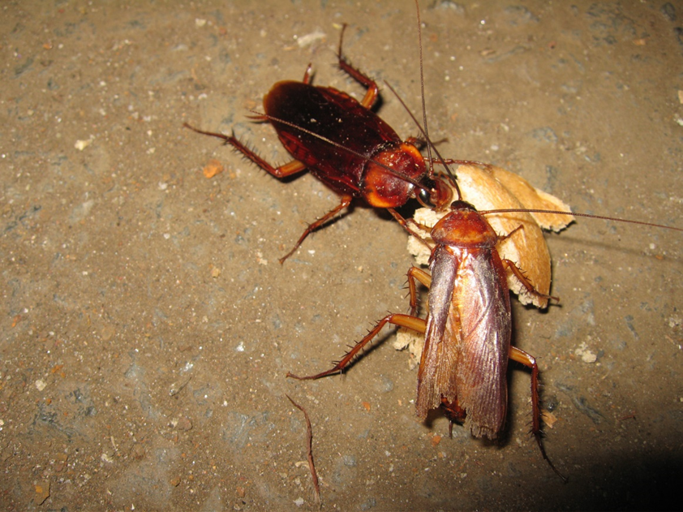
Common Sanitation Issues and Problem Areas
Sanitation standards may be compromised if too few custodians are staffing a school
National median maintained per full-time custodial worker: 32,100 square feet (American School and University Magazine, 2009)
American cockroaches eating food scraps – Dawn H. Gouge, University of Arizona

Slide 18
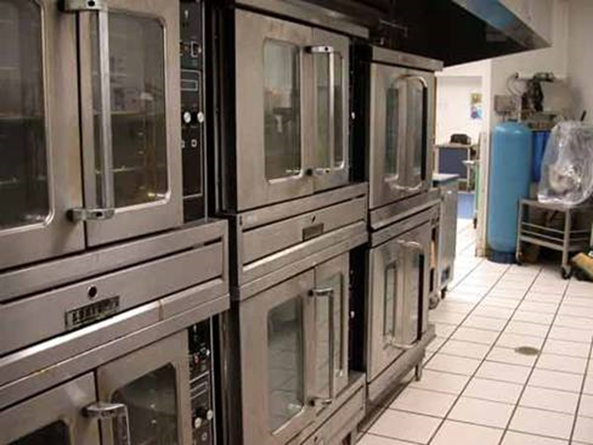
1.
Common Sanitation Issues and Problem Areas
Hard-to-reach places are dark and food and water can collect there, providing ideal habitat for cockroaches, fly maggots and other pests
Under and behind fixed equipment can be difficult to reach for cleaning or inspection – Dawn H. Gouge, University of Arizona

Slide 19
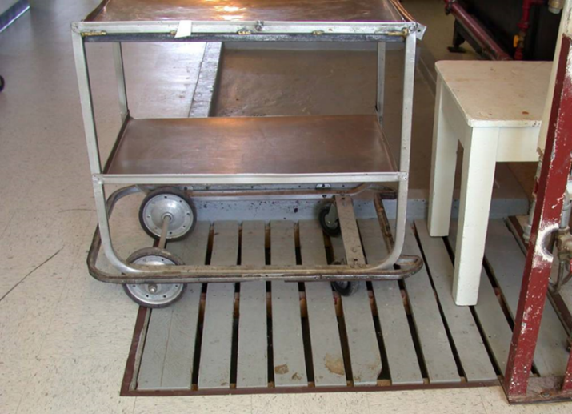
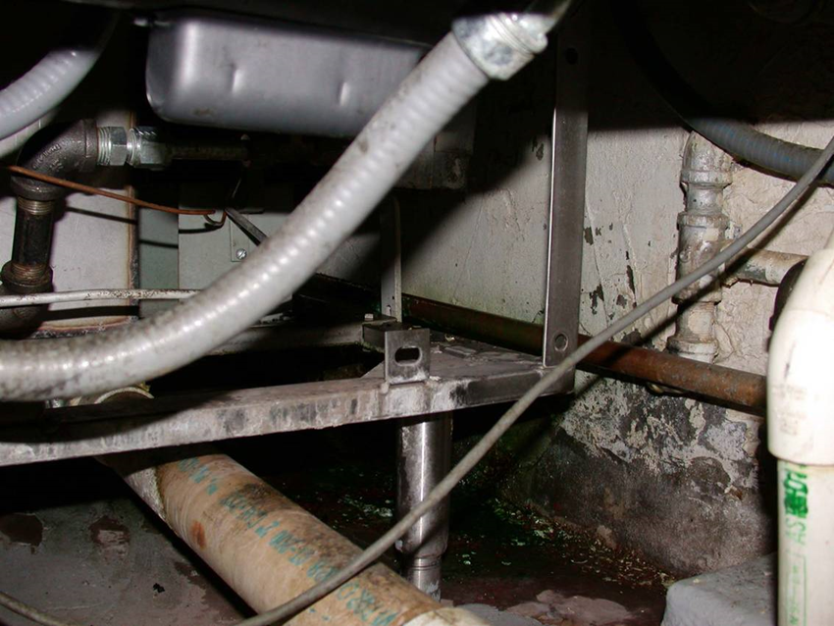
1.
More Hard-to-Reach Locations
Covered floor drains
Organic matter, grease feed pests
Jerry Jochim, Monroe County Community School Corporation
Under heating units

Slide 20
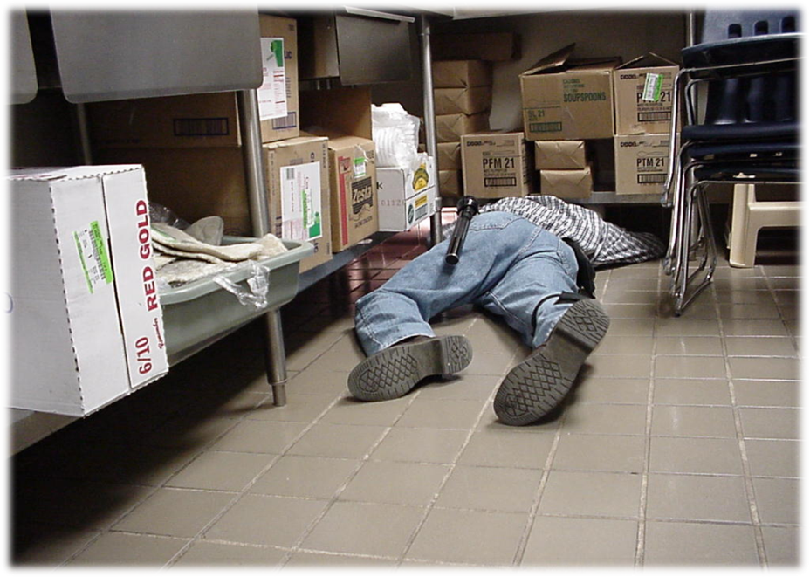
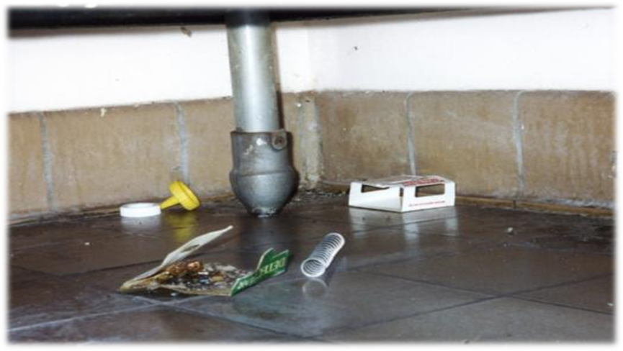
1.
Corner Cleaning
Debris collects in corners
Especially corners under furniture or behind equipment - one of the hardest places to clean is the “back-leg zone” of equipment and fixtures
Sweeping and mopping can push food debris into corners. That’s why pests love these areas!
Dawn H. Gouge, University of Arizona
The “back-leg zone”

Slide 21
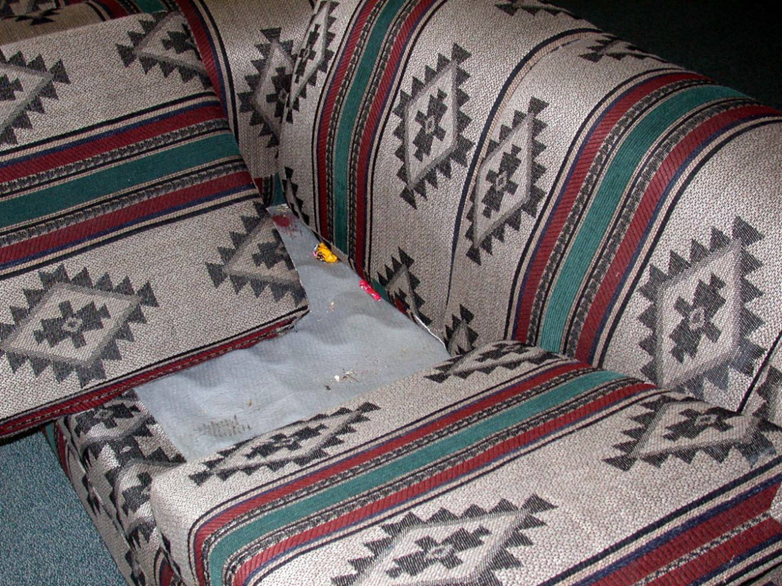
1.
Furniture food!
Crumbs collect under couch cushions and in chairs, attracting cockroaches, ants and mice
Upholstered furniture is difficult to keep clean, especially where food is consumed including teacher’s lounges, and coaches, maintenance or custodial offices – Dawn H. Gouge, University of Arizona

Slide 22
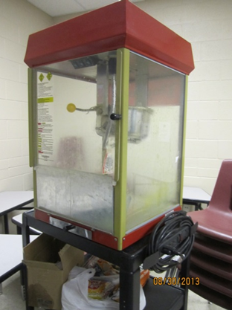
1.
Unmanaged Areas
Some areas in schools may not be managed by custodians - these areas can be especially vulnerable to pests including student stores, parent-run concession stands and booster storage areas
Head custodians and IPM Coordinators must be allowed to inspect all areas, and report sanitation and maintenance deficiencies for corrective action – Dawn H. Gouge, University of Arizona

Slide 23
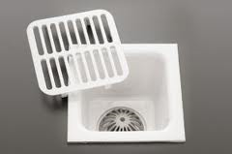
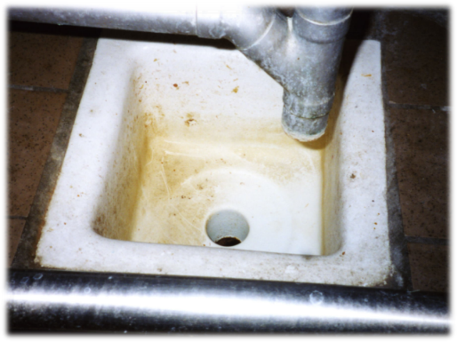
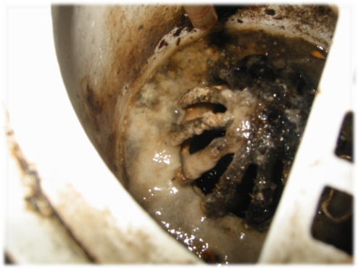
1.
Floor Drains and Floor Sinks
Organic matter builds up and drain fly maggots breed in the drain - often, food service staff clean from the floor up, and don’t have the tools or training to clean floor drains
Drains may be hidden or under or behind equipment
Dawn H. Gouge, University of Arizona
Clean!
Not good
Bad!

Slide 24
1.
Problem Zones
If problems zones are supporting pests, the custodians will need access to the areas
Principals are expected to give them the authority they need to keep all areas of the school clean

Slide 25
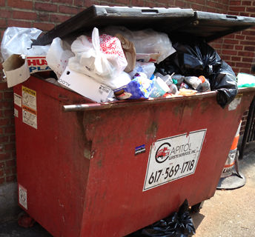
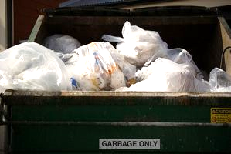
1.
Waste Management
Waste management is pest management:
Use good quality trash bags that do not tear!
Keep the insides and undersides of trash cans clean to avoid providing food for pests
Bag all waste going into dumpsters
Marc Lame, Indiana University
Left: Trash is haphazardly thrown into dumpster, some overflowing onto the ground
Right: All trash is secured in tied trash bags with no over flow

Slide 26
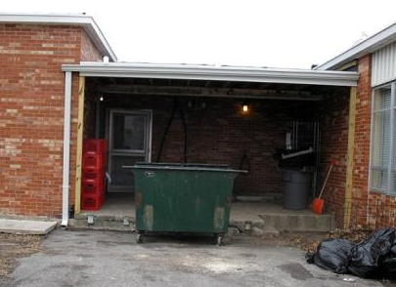
1.
Waste Management
Keep dumpsters clean, covered and well maintained
Place dumpsters on a concrete or asphalt surface 30-50 feet away from building entryways
Keep the area around the dumpster free of debris that can shelter pests
Don’t let dumpsters be a pest magnet!
This dumpster is way too close to the kitchen entryway – Dawn H. Gouge, University of Arizona

Slide 27
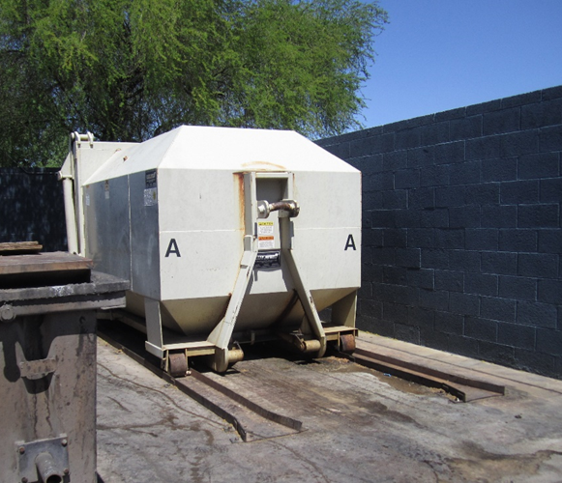
1.
More About Waste Management
Your service provider should rotate out dirty dumpsters for clean ones
Dumpster capacity should be sufficient to avoid overflow
Dumpsters should be emptied at least weekly
Consider sealed, leak-proof, self-contained compactors, available in many sizes – Shujuan Li, University of Arizona

Slide 28
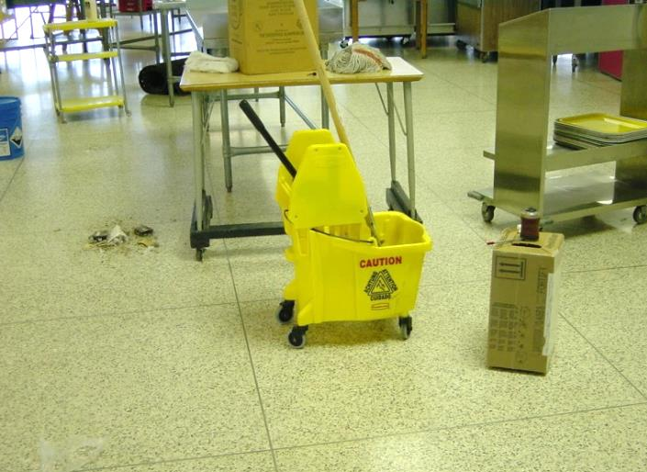
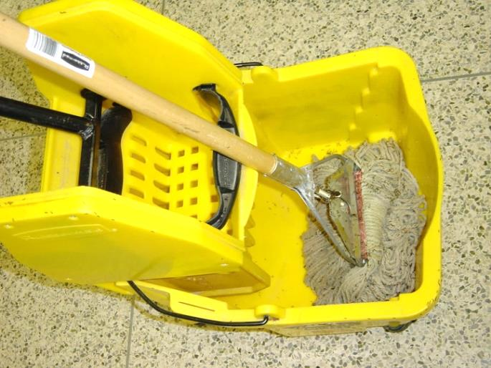
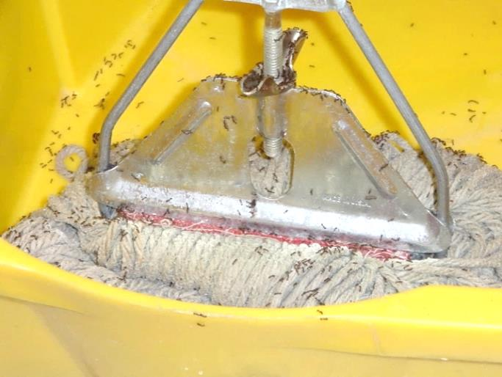
Key Strategies
Do what you do now, just think “pests”!
Here a custodian mopped up a pop spill and took a break - Just 20 minutes later fire ants had discovered the treat
If the custodian was “thinking pest”, he or she would have emptied the bucket and rinsed and hung the mop before taking a break, and avoided the ant invasion
Southern fire ants discover a mop used to clean up a soda pop spill - Jerry Jochim, Monroe County Community School Corporation

Slide 29
Key Strategies
Don’t attract pests
Some custodians take good care of the school, but forget that their custodial closets can provide food, water, and shelter for pests
Avoid storing items on the floor, which makes cleaning and inspection difficult – Dawn H. Gouge, University of Arizona

Slide 30
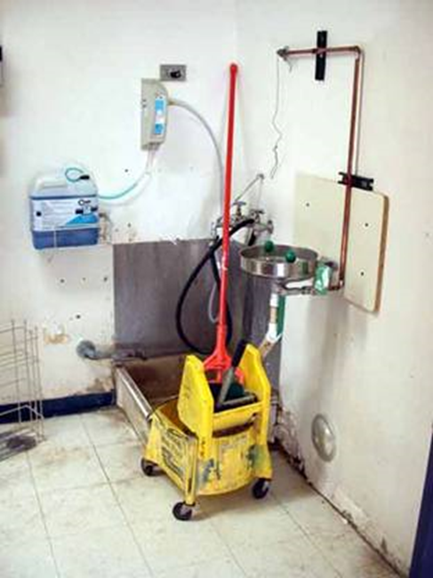
Key Strategies
Equipment used to clean will be full of food particles and moisture
Keeping cleaning equipment clean and dry is very important
Avoid leaving mops in dirty water– Dawn H. Gouge, University of Arizona

Slide 31
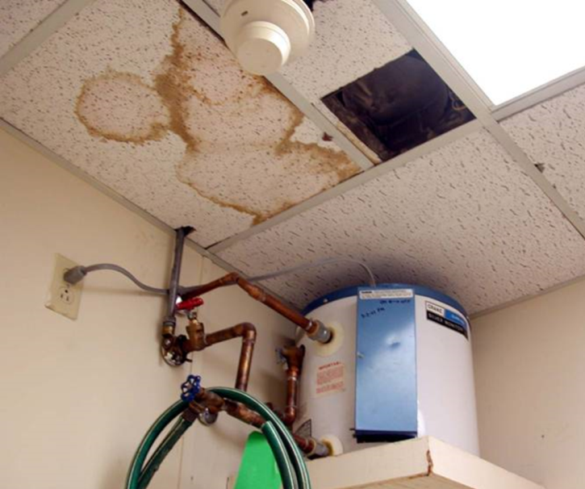
Key strategies
Report maintenance issues
Custodians know their building better than anyone else
It’s important for custodians to report pest-proofing needs to the IPM Coordinator or submit work orders for the building maintenance crew
Water leaks can lead to mold, carpenter ants, termites and flies. Report all leaks promptly – Dawn H. Gouge, University of Arizona

Slide 32
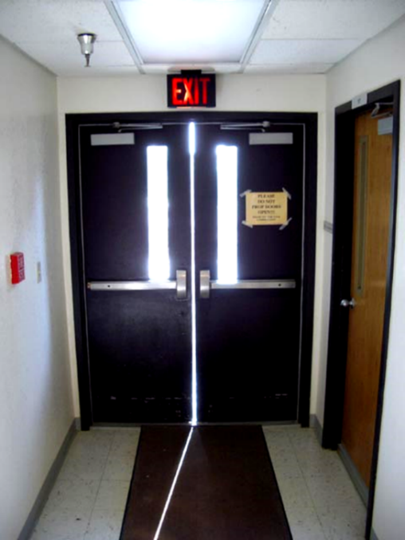
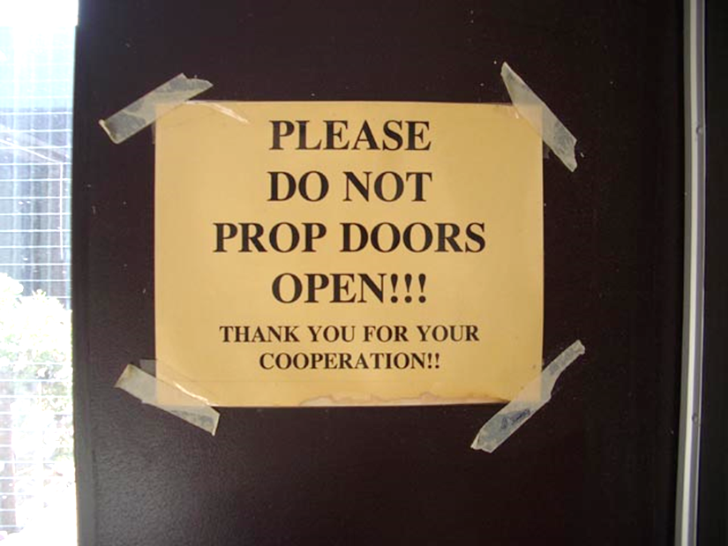
Reportable Conditions:
Missing or Damaged Door Sweeps and Seals
The vertical gap in the doorway below should be closed with brushes
Exterior doors should never be left propped open
Mice can enter through a ¼” gap
Effective door sweeps can cut pest complaints by 65%!
Dawn H. Gouge, University of Arizona
The horizontal door sweeps are present, but not the vertical

Slide 33
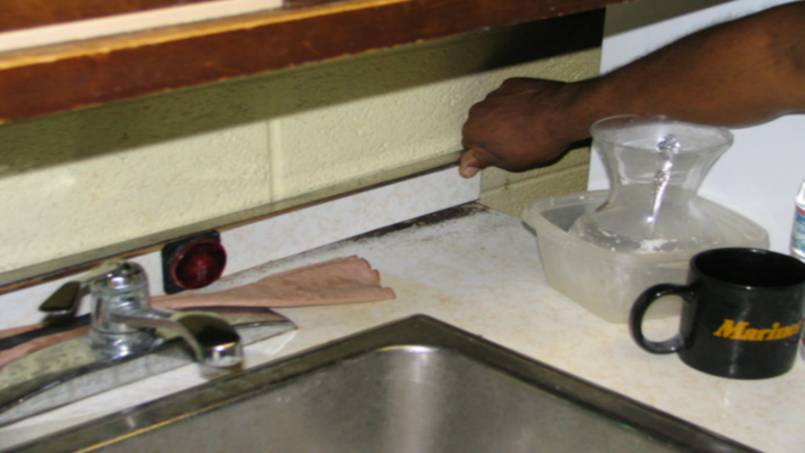
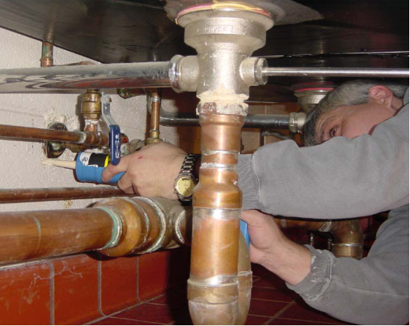
Reportable Conditions:
Gaps that Provide Cover For Pests
Cockroaches spend daytime hours harboring in cracks and crevices including open plumbing and electrical penetrations, and unsealed crevices
Report/submit work orders to correct these conducive conditions, especially in areas where food is stored, prepared or served
Custodians sealing around a pipe escutcheon plate and sealing a back-splash - Jerry Jochim, Monroe County Community School Corporation

Slide 34
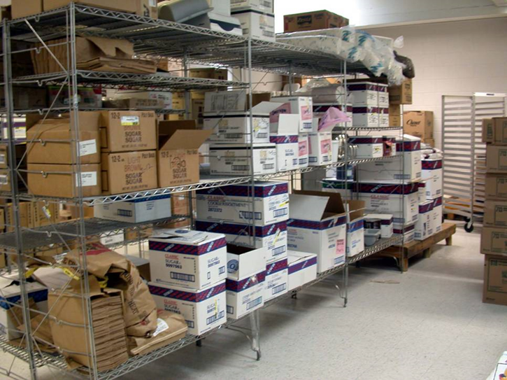
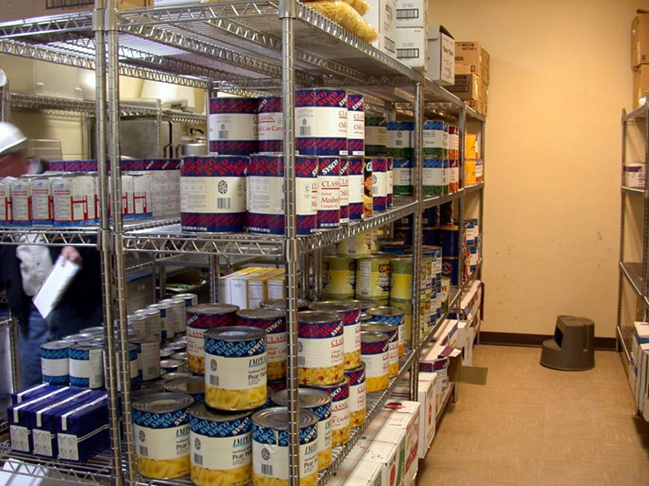
Cardboard
Corrugations in cardboard boxes provide excellent harborage for cockroaches, the glue in boxes is a food source, avoid storing things in cardboard boxes
Problematic
Excellent
Kitchen pantry, before and after cardboard removal -
Marc Lame, Indiana University

Slide 35
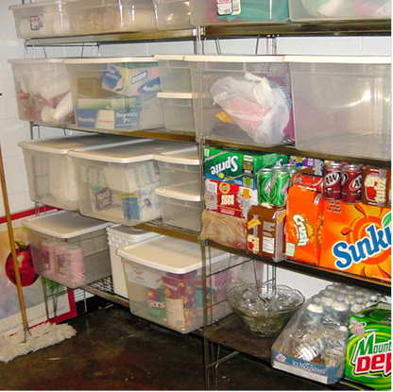
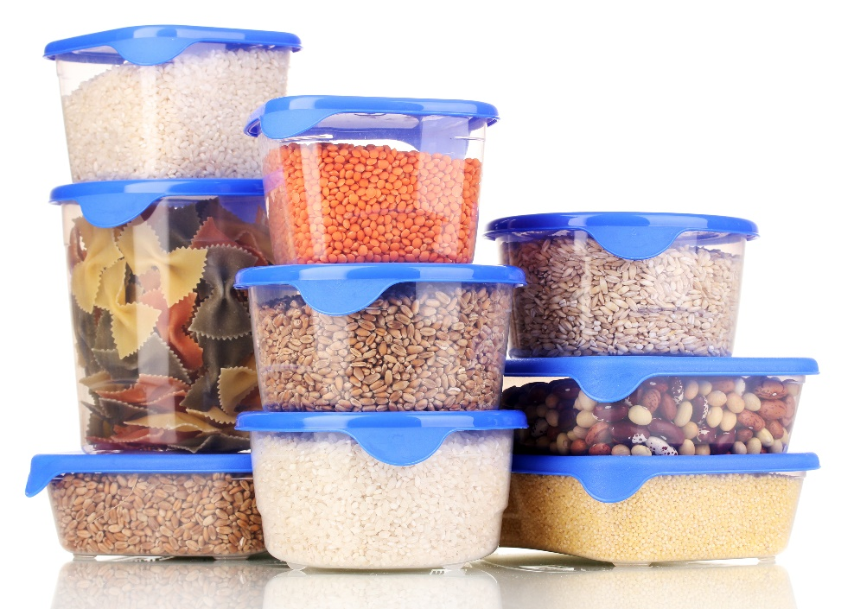
Reportable Conditions: Access to Food
Teachers should use airtight containers for storage of any edible classroom supplies
See-through storage totes can reduce and prevent ant and cockroach problems - Dawn H. Gouge, University of Arizona

Slide 36
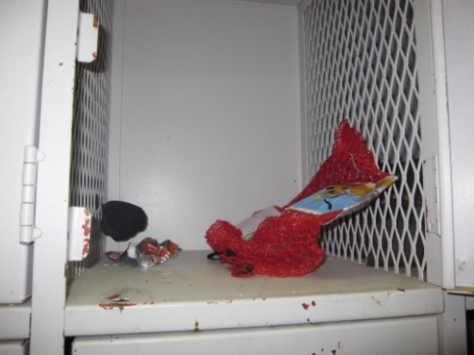
2.
Key Elements of Inspection and Monitoring
What to look for:
Pests
Signs of pests
Pest conducive conditions - pest opportunities providing access to food, water, and harborage
Mouse poop on a spoon
Dawn H. Gouge, University of Arizona
Wrappers and decomposing food in athletic locker

Slide 37
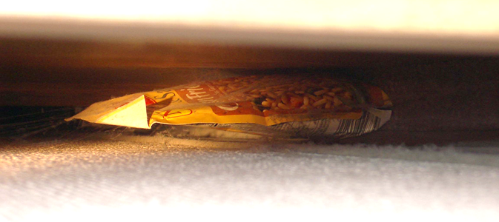
2.
Key Elements of Inspection and Monitoring
Where to look:
Dark shadowy corners
Hard to reach areas
Undisturbed places/ under and behind stationary items
Warm and/or wet places
Food storage and/or preparation areas
Waste collection containers and areas
Suspended ceilings
Food packet under refrigerator – Dawn H. Gouge, University of Arizona

Slide 38
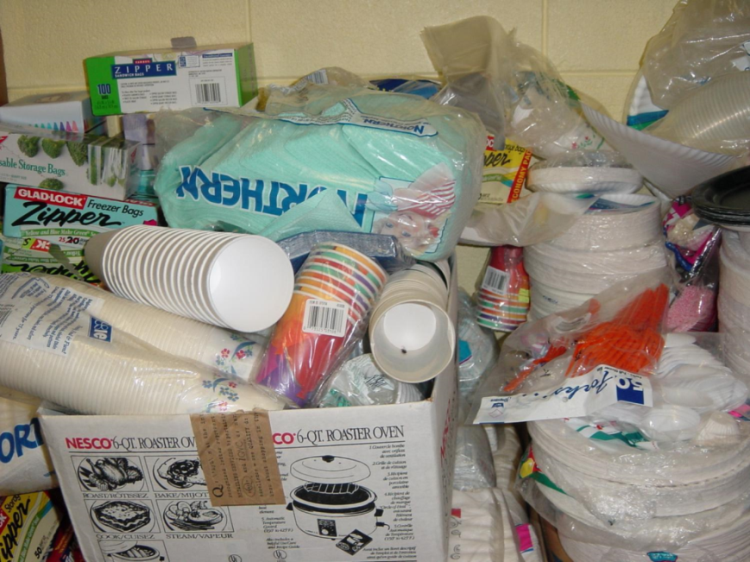
2.
Key Elements of Inspection and Monitoring
Where to look:
Warm walls with penetrations
Compressor motor voids in equipment
Unsealed floors and floor to wall junctures
Undisturbed containers
Cardboard boxes
Clutter
Locked PTO storage, off limits to custodial staff – Dawn H. Gouge, University of Arizona

Slide 39
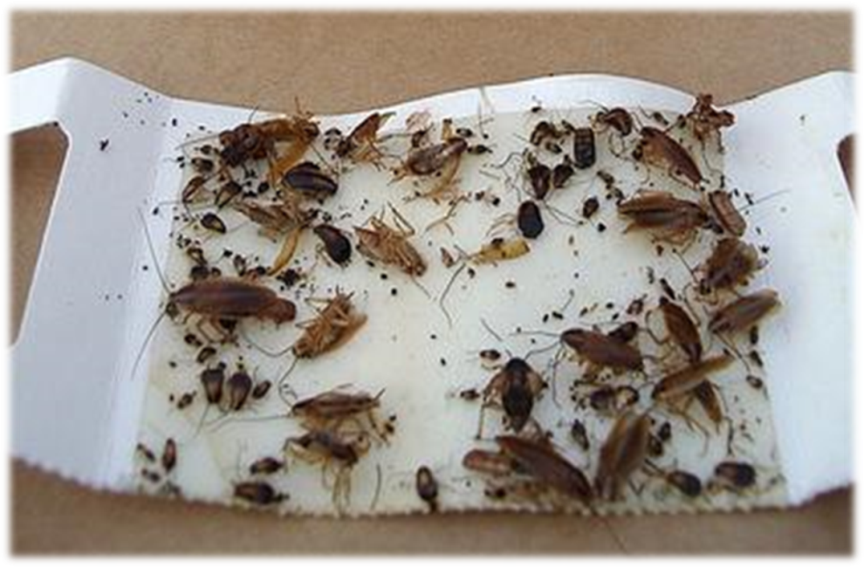
2.
Key Elements of Inspection and Monitoring
Tools:
Monitoring traps – trap crawling pests 24/7
Bright flashlight
Hand lens
Pest monitoring trap catching German cockroaches – Dawn H. Gouge, University of Arizona
Marc Lame identifying
an insect pest
Jerry Jochim, Monroe County Community School Corporation

Slide 40
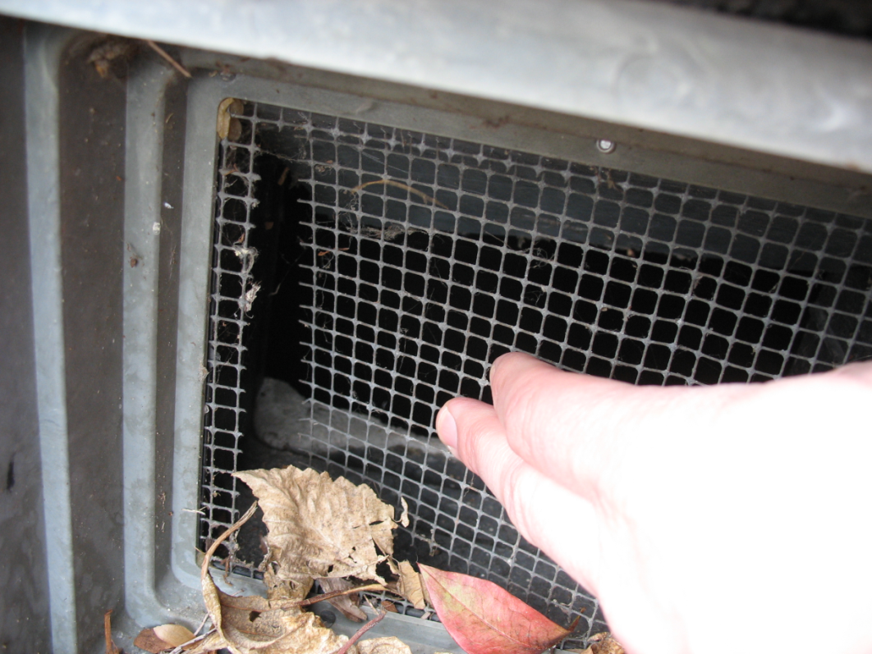
3.
Key Elements of Inspection and Monitoring
Communicating in writing to IPM Coordinators and others about pest issues documents your findings and actions Consider recording:
Pests
Signs of pests
Pest-conducive conditions
Broken exclusion mesh
Jerry Jochim, Monroe County Community School Corporation

Slide 41
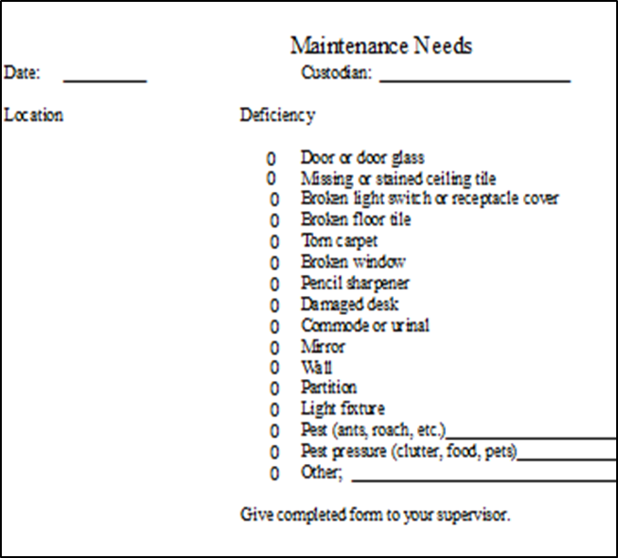
3.
Key Elements of Inspection and Monitoring
Some custodians carry a note pad on their equipment cart or develop their own checklists
Maintenance issues recording - Jerry Jochim, Monroe County Community School Corporation

Slide 42
Thorough Cleaning Procedures
3.
Drains
P-traps in drains prevent gases, odors and insects from entering buildings Keep them filled with water, dry p-traps can create access to your building from the sewer for American cockroaches
Dry icky drain which was giving access to American cockroaches – Dawn H. Gouge, University of Arizona

Slide 43
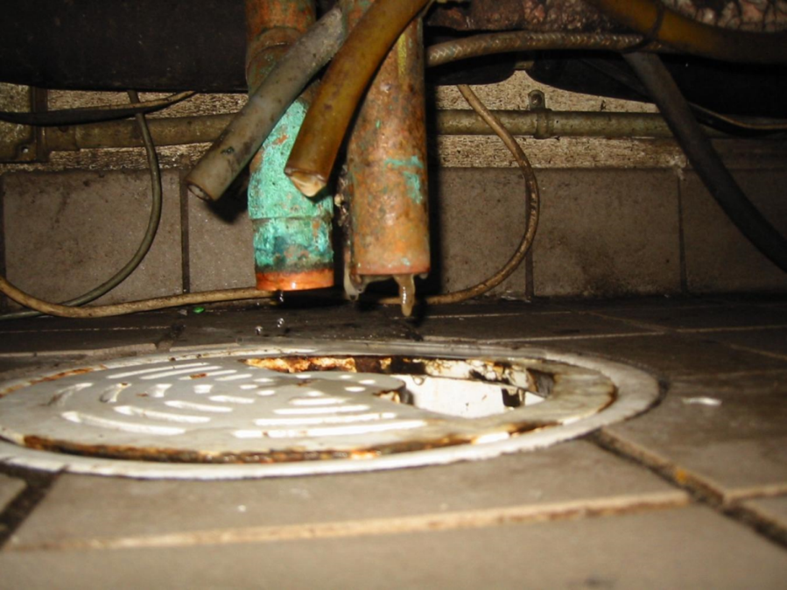
Thorough Cleaning Procedures
Drains under fixed equipment can be difficult to clean Drain fly maggots feed and grow in the organic matter that builds up in drains
Drain tucked under a fixed kitchen appliance in a difficult-to-reach place had not been cleaned in a long time – Dawn H. Gouge, University of Arizona

Slide 44
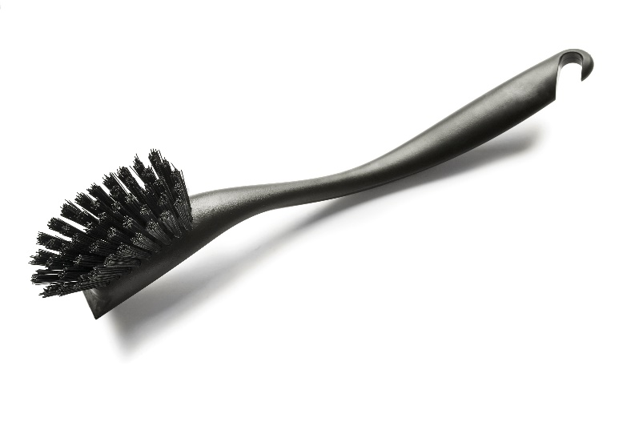
Thorough Cleaning Procedures
3.
Organic matter buildup in drains can be scraped out with a scraper or brushed out with a stiff brush Do this after food has been put away, and before food prep surfaces are cleaned to avoid contamination with listeria and other pathogens sometimes found in drains
Regular maintenance with an enzyme or biological cleaner can help keep drains in tip top shape
Drains should be cleaned with enzymatic cleaners monthly

Slide 45
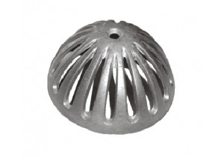
Thorough Cleaning Procedures
3.
Sink nets or floor dome strainers should also be cleaned regularly, some are dishwasher safe
Clean sink net
Clean floor sink dome strainer
Floor sink strainer catching food – Dawn H. Gouge, University of Arizona

Slide 46
Thorough Cleaning Procedures
3.
Floors
Remove debris, a long handled dustpan and brush are useful for solid items, paper and other trash
To avoid contamination, never dry sweep in areas where food is on display or people are eating
A damp mop may be used to contain spilled liquids
Place food residues in garbage containers lined with good quality plastic liners that don’t tear easily
Tie plastic bags shut prior to placing them in a dumpster for removal to avoid spillage and reduce pest access

Slide 47
Thorough Cleaning Procedures
3.
Floors
If you hose down floors with water, avoid spraying water directly on motors and other electrical equipment
Do not allow moisture to come in contact with stored dry goods; moisture promotes mold growth
If food debris is present, remember some proteins coagulate at 140° to 145°F, making them more difficult to clean - Excessive hot water or steam can bake proteins onto equipment much like an egg sticks to an ungreased frying pan

Slide 48
Thorough Cleaning Procedures
3.
Floors
Detergents are manufactured to do specific jobs Make your selection based on:
The type of dirt to be removed
The type of surface to be cleaned
Water quality (hard or soft)
Cleaning method (spray, foam, manual, etc.)
Cost

Slide 49
Thorough cleaning procedures
3.
Floors
After applying detergent, rinse with clean potable water It is important to remove all detergent residue
Pay special attention to corners, floor joints and under equipment – Dawn H. Gouge, University of Arizona

Slide 50
Cleaning Equipment Maintenance and Storage
To keep cleaning equipment in good working condition and avoid attracting pests, clean and store correctly after every use including:
Garbage receptacles
Pans
Brooms, dusters and brushes
Mops and buckets
Vacuum cleaners, polishers, scrubbers

Slide 51
Cleaning Equipment Maintenance and Storage
Emptying
Vacuum cleaners, floor scrubbers and other pieces of equipment need to be emptied of debris or chemicals before they are stored
Wiping Down, Washing and Rinsing
After use, each piece of equipment should be wiped down and, when appropriate, washed and rinsed to prevent build up of grit and grime

Slide 52
Cleaning Equipment Maintenance and Storage
Storage
Once brooms, mops and other tools are clean, store the items on off-the-floor racks
Clean and dry mop heads may be stored in transparent plastic totes or on wire shelving - Avoid heaping them on the floor or on solid shelving, they provide great harborage for spiders and cockroaches, and even nesting material for mice
Store equipment off the floor and in a manner that will allow it to dry rapidly – Dawn H. Gouge, University of Arizona

Slide 53
Cleaning Equipment Maintenance and Storage
Custodial Closets
A disorganized custodial closet can give the impression of apathy and negligence
A disordered closet can also lead to confusion in the cleaning processes, causing unnecessary stress and low productivity

Slide 54
Cleaning Equipment Maintenance and Storage
Custodial Cart and Closet Tips
Meet with cleaning crew and inspect custodial carts and closets
Empty carts and closets of items no longer used
Clean and paint closets - Standards applied to the rest of the facilities, should be applied to custodial closets
Evaluate the mechanicals (is there enough storage space, shelving units, etc.)
Check the lighting - Often custodial closets do not have lights, making it more difficult to keep clean and organized
Restock, organize and prioritize, according to need and use

Slide 55
Proper Storage Procedures for Consumables
4.
Inspect deliveries for pests or signs of pests - German cockroaches and mice can hitchhike in cardboard boxes
Good sanitation in storage areas prevents pest problems - Insect monitoring traps can help detect problems early
Think child safety, indoor air quality and pests
Easy access to bleach under this classroom sink is a hazard for children – Dawn H. Gouge, University of Arizona

Slide 56
Proper Storage Procedures for Consumables
4.
Store hazardous products in locked cabinets inaccessible to children
Store products together by type and in a place with good ventilation - If you can smell a product (cleaning product or pesticide) while it is in storage, the lid may be loose or ventilation may be insufficient to protect air quality and health
Routinely check storage areas to make sure that containers are closed tightly and that the sides of the containers are not bulging or leaking

Slide 57
Green Cleaning
4.
Informed Green Solutions, Inc. is a 501(c)(3) created to educate the general public on the benefits of environmentally preferable purchasing and the impacts our purchasing decisions have on human health and the environment http://www.informedgreensolutions.org/
The Ashkin Group, LLC is an internationally recognized consulting firm working to green the cleaning industry http://ashkingroup.com/news-2
Notes:
4

Slide 58
Check In!
In this lesson you learned:
Common sanitation issues and problem areas
Key elements of sanitation and exclusion
Elements of data collection, recording and evaluation
Proper and thorough cleaning procedures
Maintenance and storage practices of cleaning equipment
Congratulations, you have completed the Cleaning Professional Module!

Slide 59
Resources
North Carolina Cooperative Extension Service. Get Tough on Pests in School Facilities http://schoolipm.ncsu.edu/documents/Custodial_and_Maintenance_staff.pdf
North Carolina Cooperative Extension Service (2012) Implementing an IPM Program for Schools and Child Care Facilities http://schoolipm.ncsu.edu/documents/Manual-Chapter2.pdf
eXtension (2012) Indoor and Outdoor School IPM Strategies http://www.extension.org/pages/20416/indoor-and-outdoor-school-ipm-strategies#.Utf6rPugnro
38th Annual M&O Cost Study (2009) American School and University Magazine http://asumag.com/Maintenance/school-district-maintenance-operations-cost-study-200904/

