Slide 1
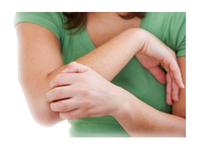


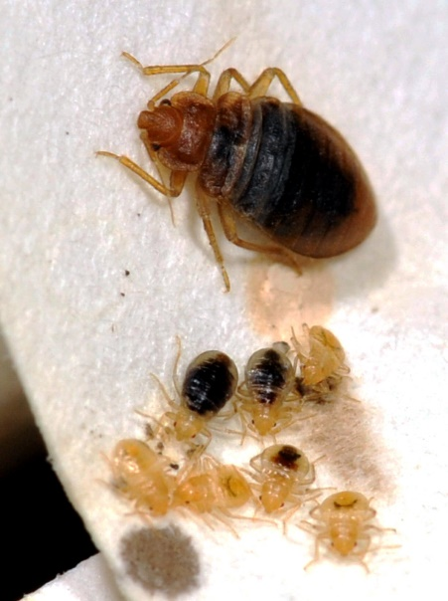
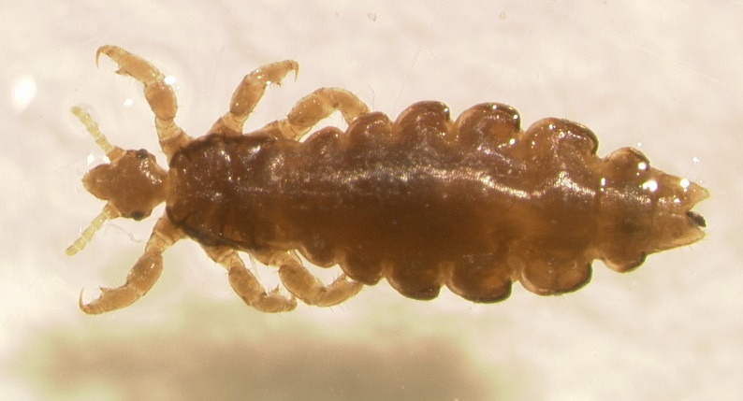
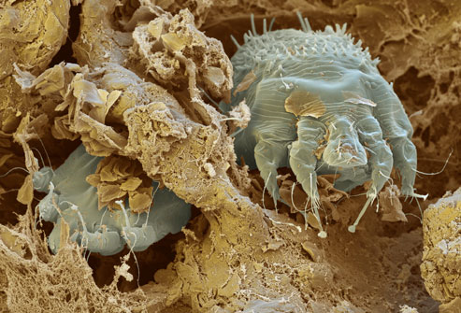
Itchy Bug Update - Bed bugs, lice, scabies
Dawn H. Gouge
Public Health Entomologist
Some images may be disturbing
2015 update
SarahCare & NADSA Conference

Slide 2
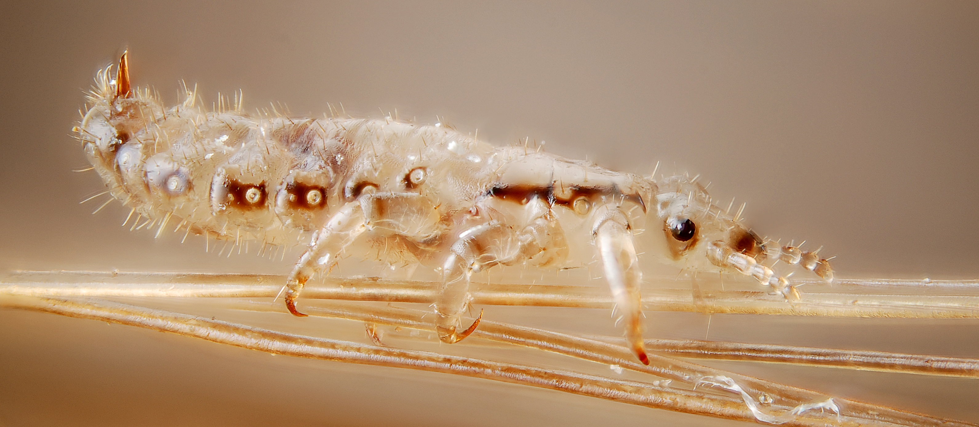
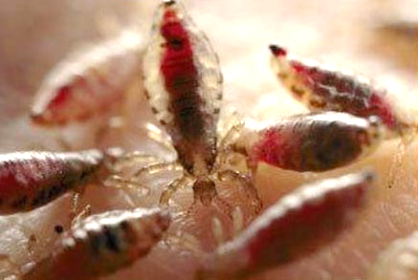
1. pediculosis capitisP
Head lice –
Pediculosis capitis
Blood feeding
ectoparasites associated with the scalp
More commonly found in school age students and girls
Seniors are vulnerable
Transfer can occur
due to
  Physical head-to-
  head contact
  Sharing beds
Notes:
Preschool and elementary age: (3-11 years old)

Slide 3
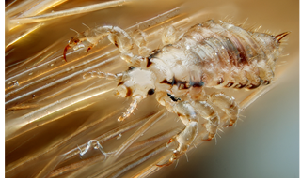



1.
Who was really behind the evolution of the “selfie”?
More than a million selfies are taken each day, according to research by TechInfographics.com
The Holy Father
Pope Francis
President Obama with
Malaysian Prime Minister Najib Razak
Notes:
Preschool and elementary age: (3-11 years old)

Slide 4
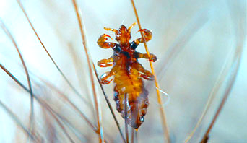
1.
Why are head lice cases increasing?
Immigrants from developing countries where incidence is much higher (up to 50%)
Hair extensions and wraps
Busier
parents
and
guardians
Notes:
Preschool and elementary age: (3-11 years old)

Slide 5
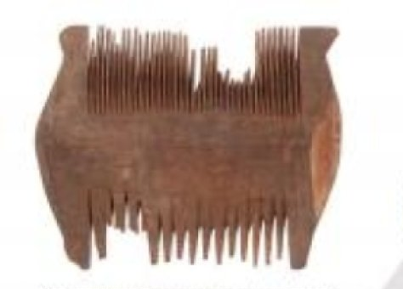
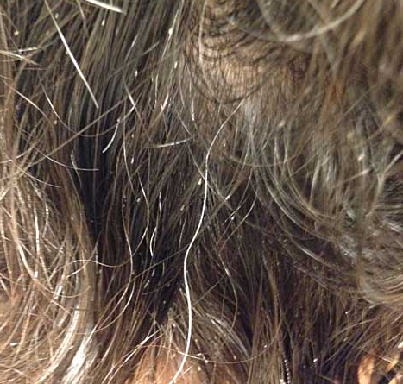
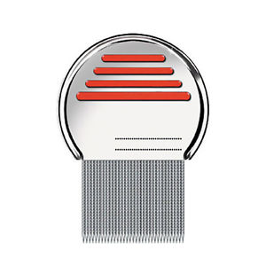
1.
Society reliant on quick-fix solutions
6th century nit comb from Egypt
21st century Terminator nit comb
Notes:
Preschool and elementary age: (3-11 years old)

Slide 6
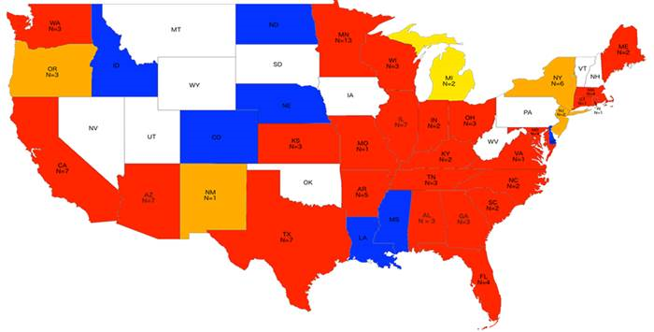
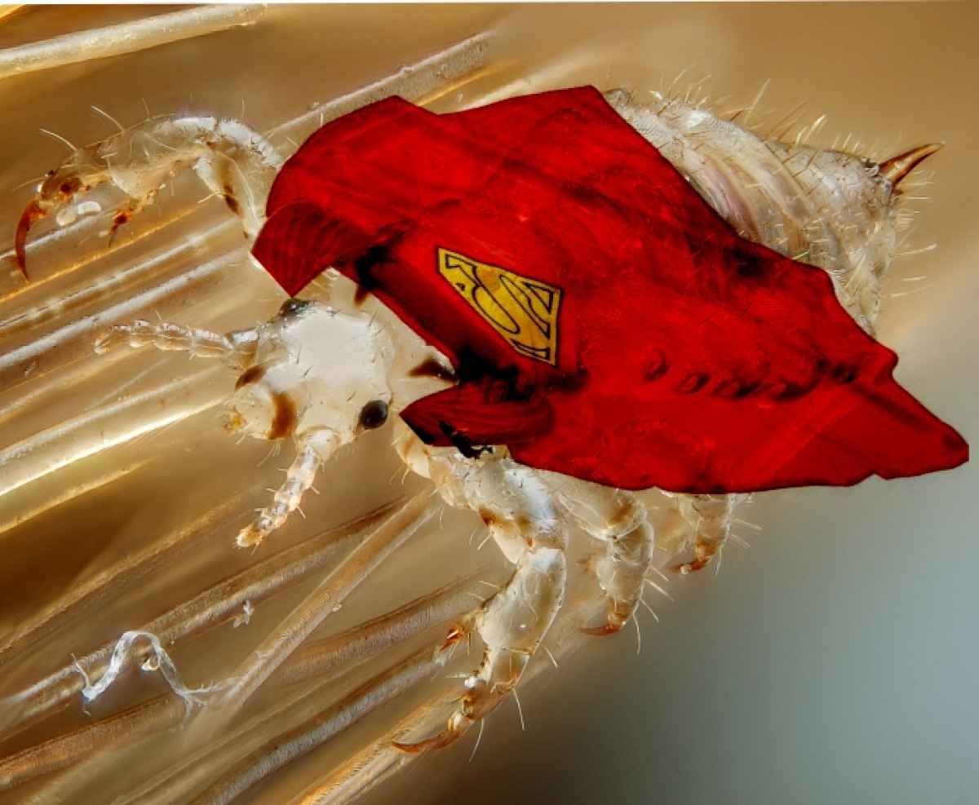
1.
Head lice are resistant
to OTC pediculicides
(Yoon et al. 2015)
100% Resistant
50-90% Resistant
1-49% Resistant
Data not analyzed
States not tested
Notes:
Preschool and elementary age: (3-11 years old)

Slide 7
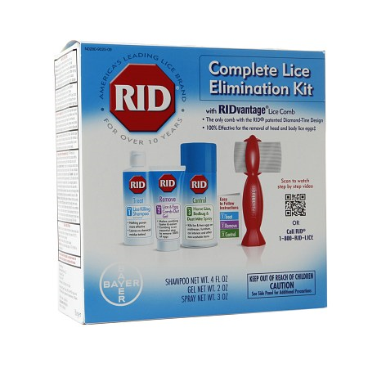
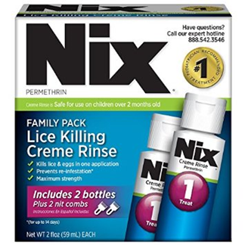
1.
In most of the U.S. head lice are highly resistant to OTC pediculicides (Yoon et al. 2015)
Notes:
Preschool and elementary age: (3-11 years old)

Slide 8
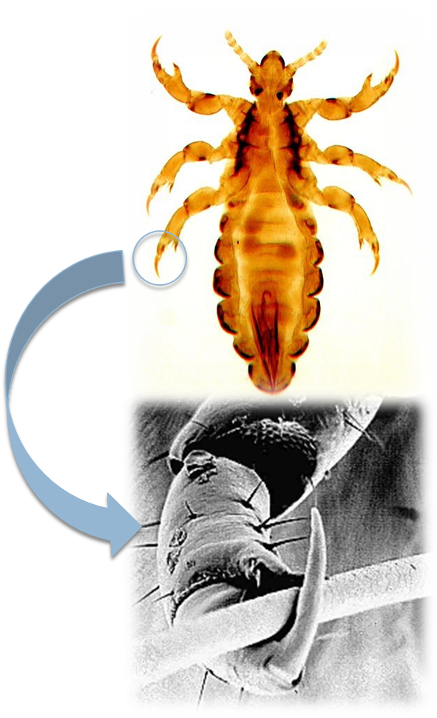
1.
Head lice facts
Size of a sesame seed
(2-3 mm long)
Tan in color
Crawl rapidly across the scalp
They do not and can not fly or jump
Care staff can acquire head lice if they have close contact with a heavily infested head

Slide 9
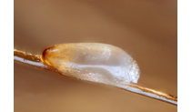
Head lice facts
Cannot survive away from the scalp,
and die within 2 days off the host
12 million cases annually, typically 1% of K-12 are affected no adult data
20-40% is a misdiagnosis
Common in schools and nursing home communities
Do not transmit disease causing pathogens
$1 billion US cost

Slide 10

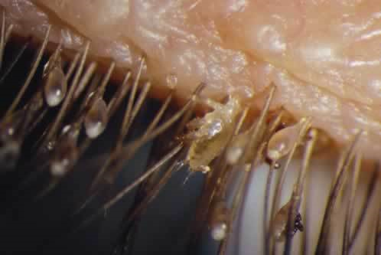
1.
Head lice facts
Finding nits alone is not a reason to treat, but nit removal is advisable
Only adult head lice transfer between heads
Lice in eyelashes
are likely to be
pubic lice

Slide 11
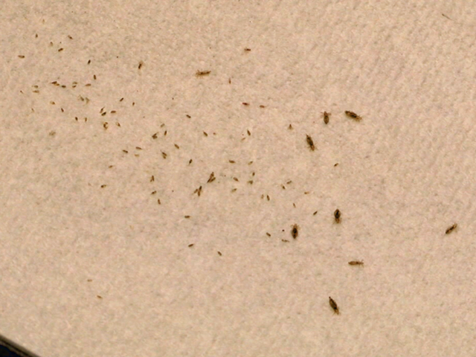
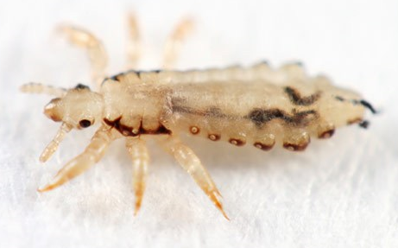
1.
Head lice facts
New generation every 3 weeks
Adult females lay 3-8 eggs/day

Slide 12
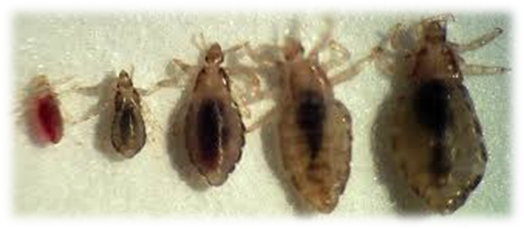
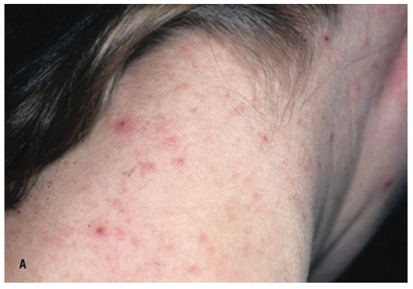
1.
Head lice symptoms
Itchy scalp often worse at night
Tickling or crawling sensation on the scalp
Red rash and tiny sores on the scalp, particularly behind ears and on neck
White to cream-colored nits
Insects seen crawling
on the hair

Slide 13

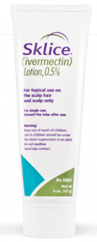
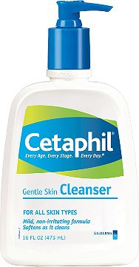
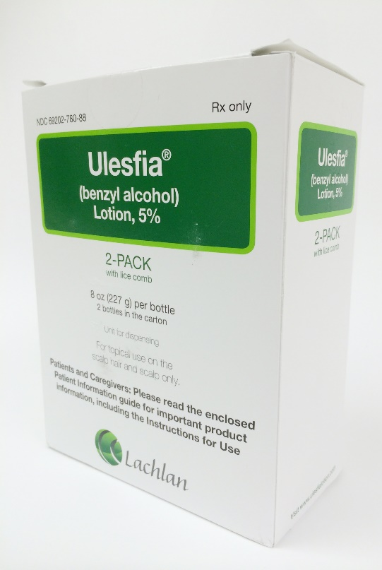
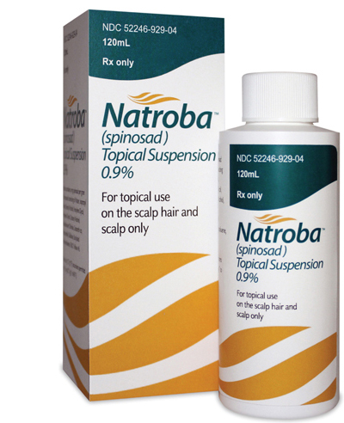
1.
Super
lice kryptonite
Resistance to OTC and
Rx products exists
Here is what we know works
  But you STILL have to
  use it correctly!
  Nit combing still increases
  the chances of rapid
  remediation

Slide 14
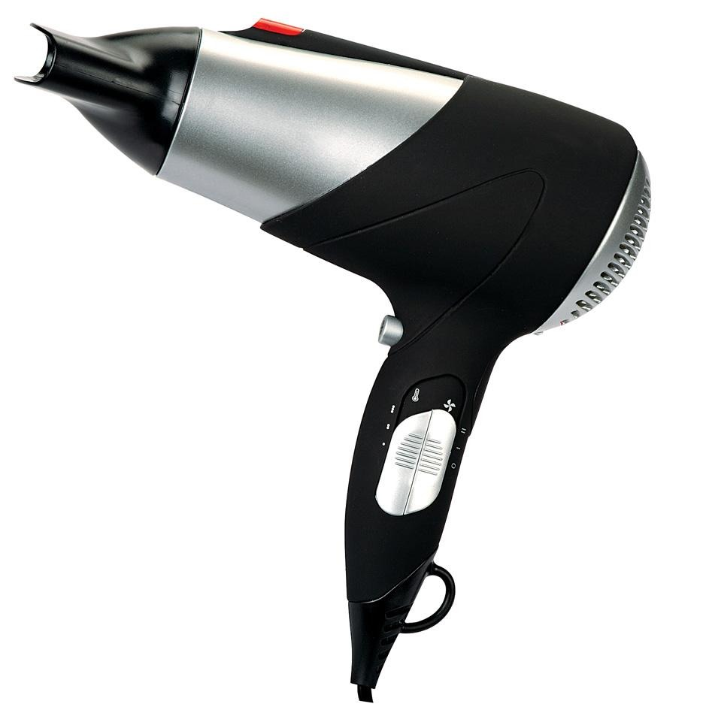
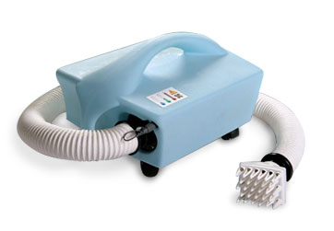
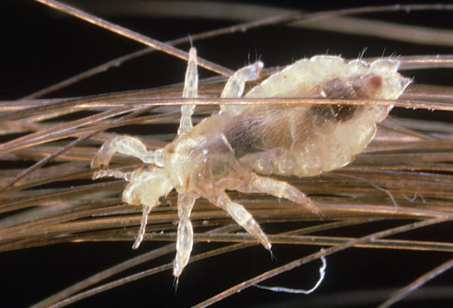
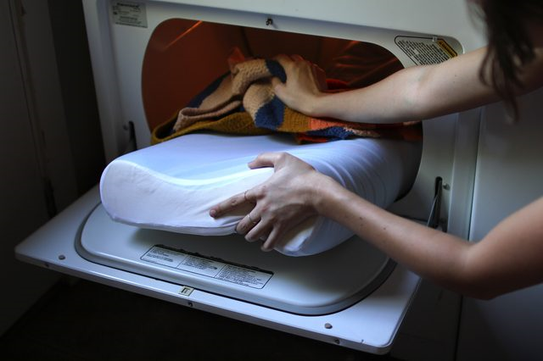
1.
Head lice kryptonite
Heat
AirAllé™

Slide 15
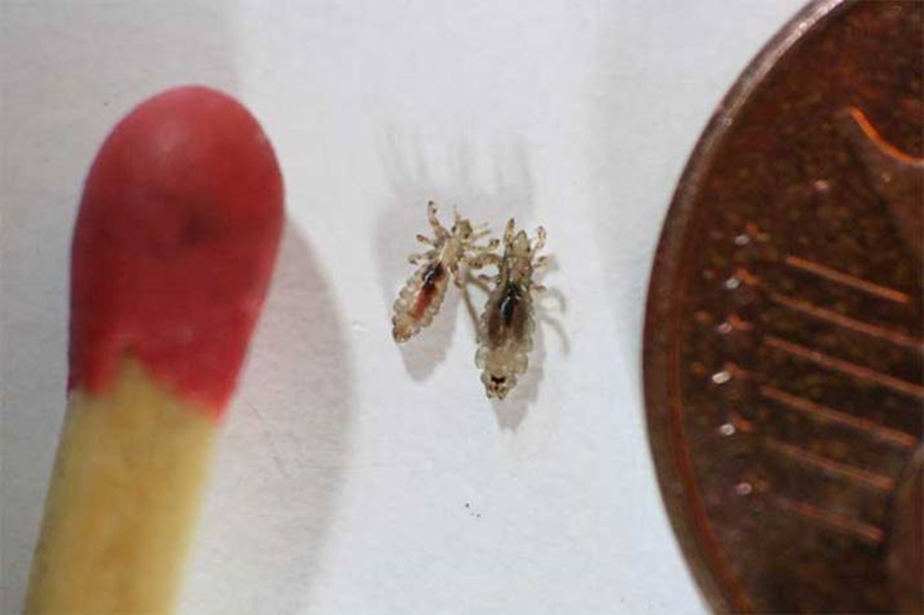
2-3 mm

Slide 16
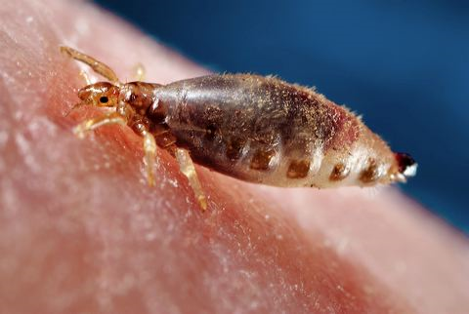
Body lice - Pediculus humanus corporis
Can (but don’t often) transmit pathogens causing typhus, trench fever, epidemic relapsing fever
Hygiene improvements and laundering are usually sufficient to resolve infestations
Transfer to care staff may occur if they have prolonged physical
contact with person,
clothing, or bedding
Larger than
head lice
(2.3-3.6 mm)

Slide 17
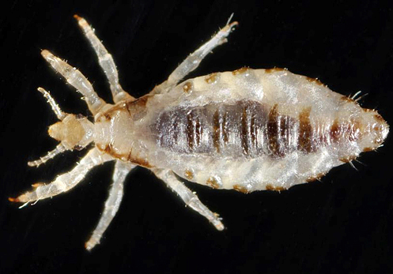
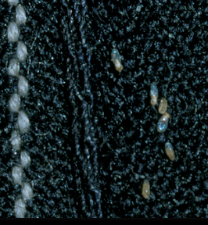
Body lice - Pediculus humanus corporis
If temperature/humidity is high, lice move to the outsides of clothing increasing transfer chance
Lice can survive several days off the host and nits can be viable for over a week

Slide 18
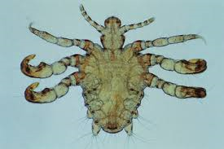
Symptoms of body lice
Severe itching of the skin particularly in the hip, groin and upper thigh areas
Scratch marks, open sores and healing wounds on the skin
Discolored, rough patches of the skin which may be thickened and hyperpigmented (Vagabond’s disease)
Insects crawling on skin or clothing
Nits on clothing
Pubic lice (Phthiriasis pubis) or “crabs”
(<2 mm)

Slide 19
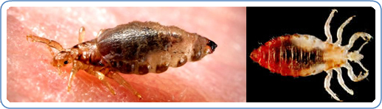
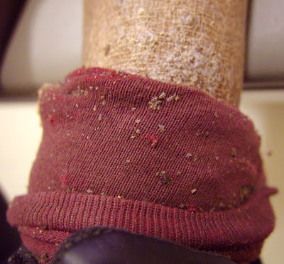
Trench fever and body lice
Bartonella quintana
B. quintana transmitted in the feces of body lice

Slide 20
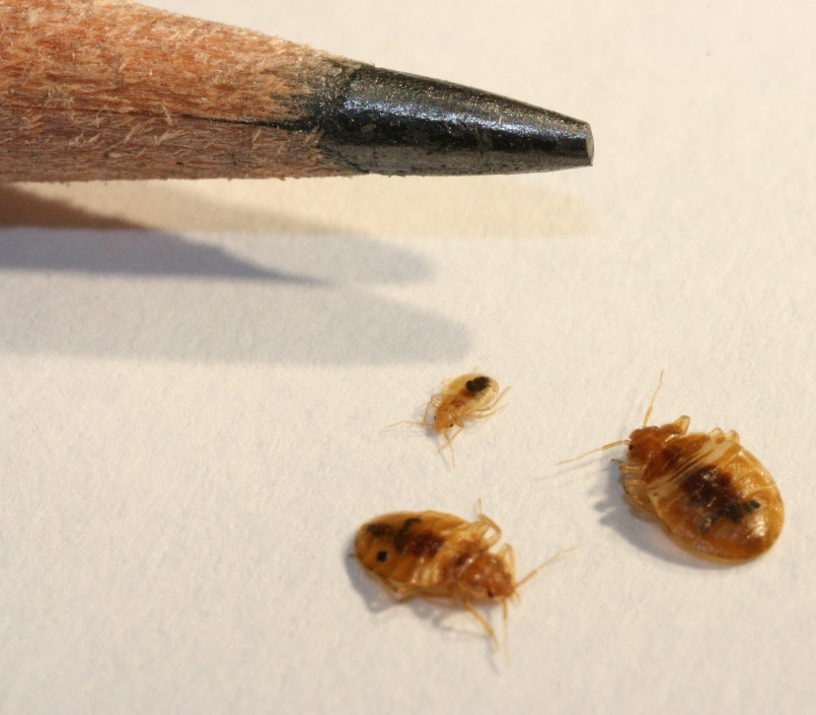
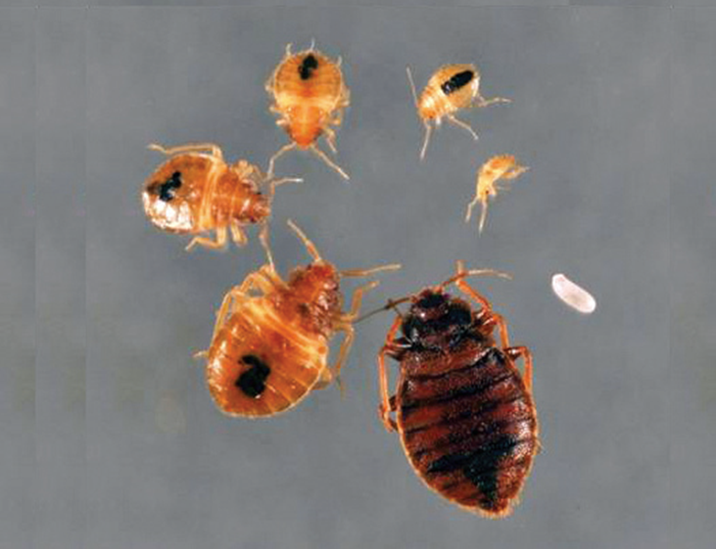
1.
Bed bugs – Cimex
lectularius
Blood feeding
ectoparasites
Hitch-hike in on
belongings that
come from
homes with
infestations
Size of an
apple seed

Slide 21
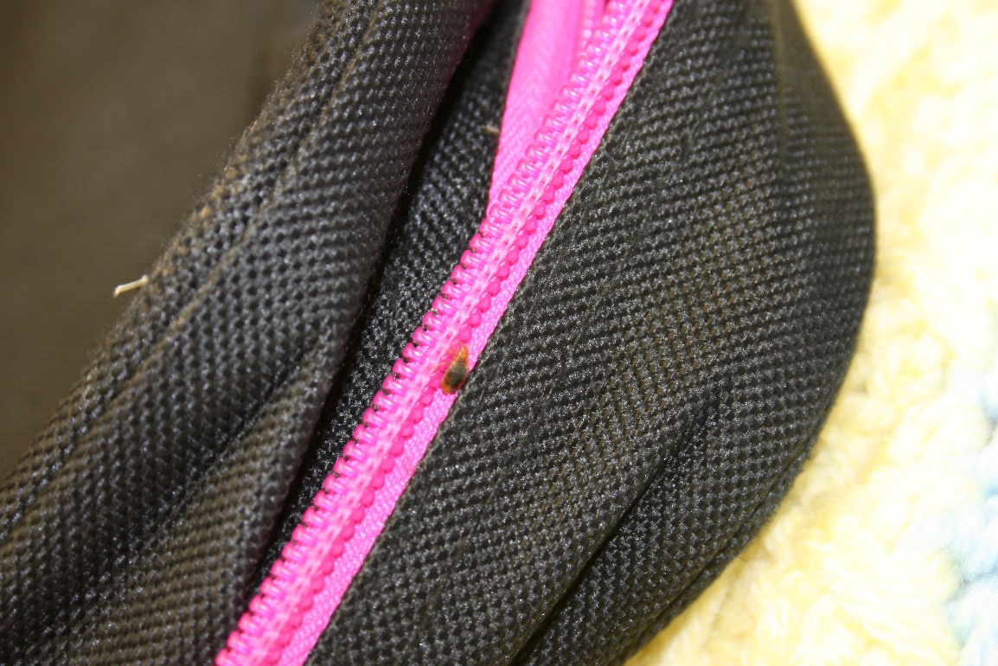
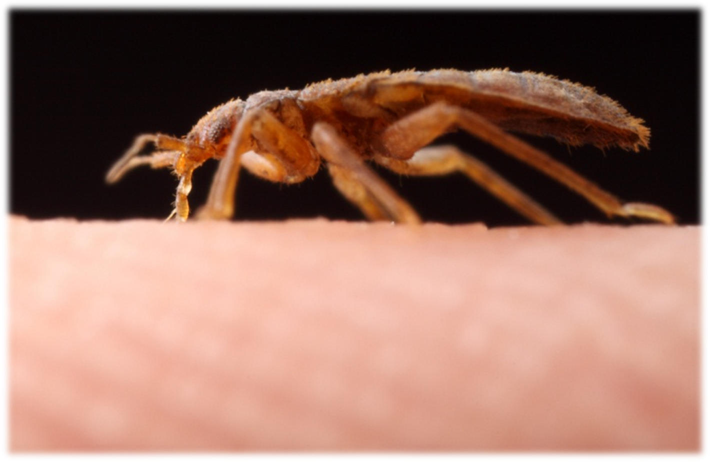
Bed bugs
Bugs fall off clothing or bags
and may be found roving
on surfaces
Transfer from one
person to another
is unlikely

Slide 22
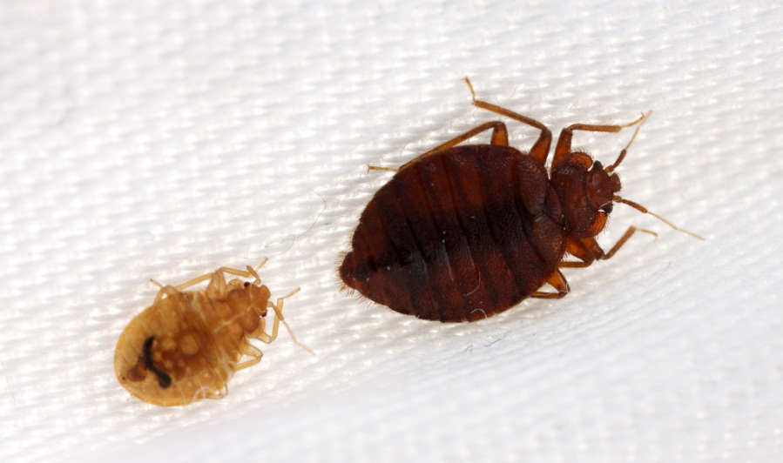
Bed bugs are not known to transmit disease organisms effectively

Slide 23
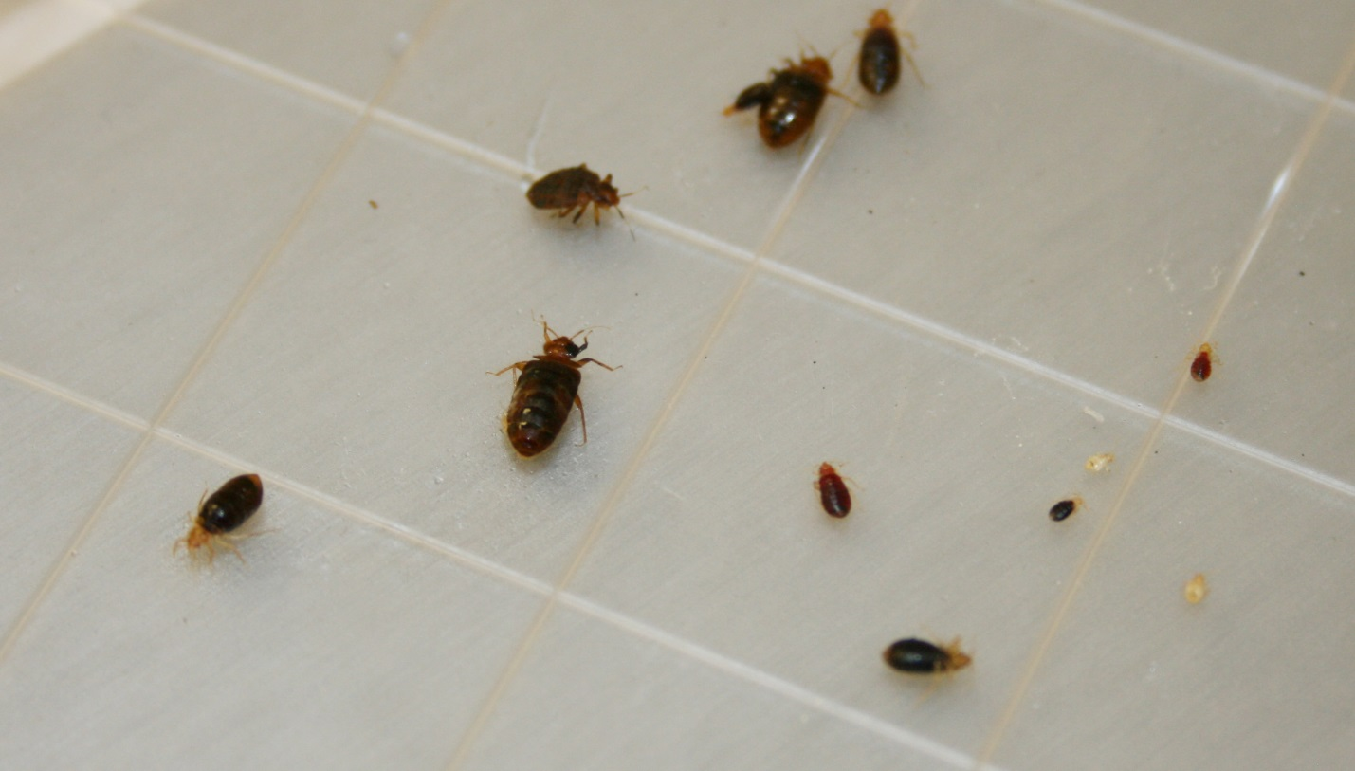
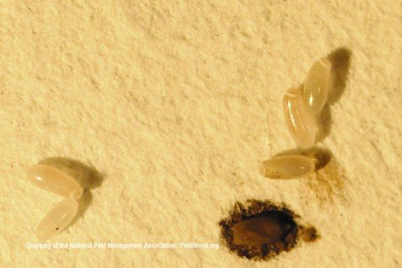
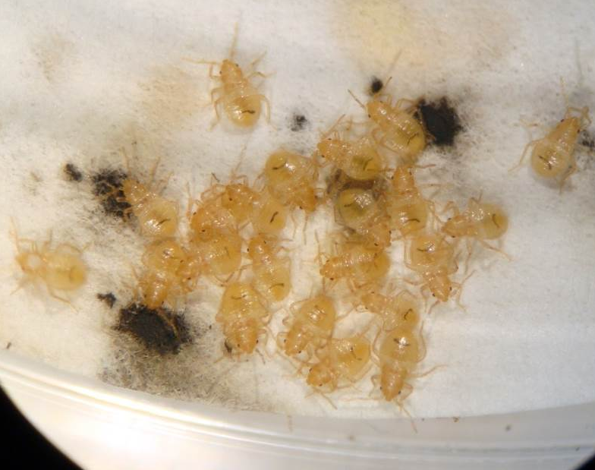
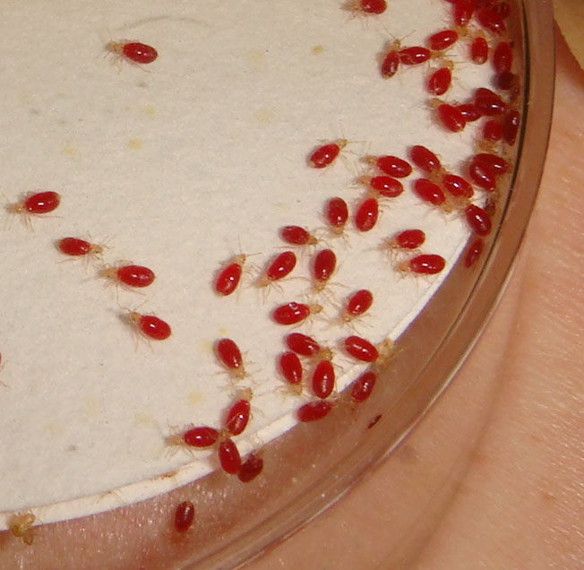

Slide 24
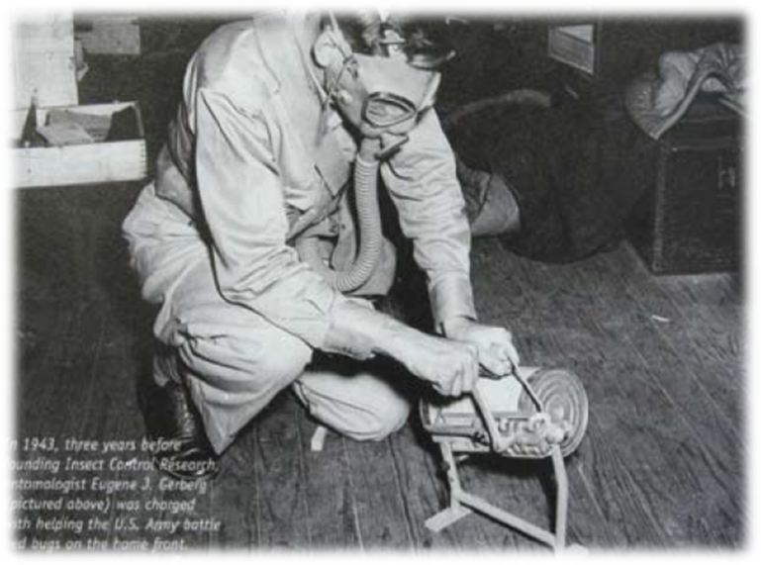
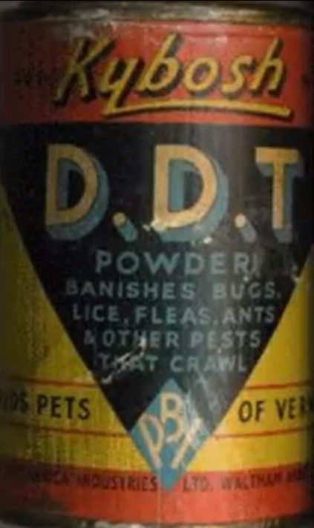
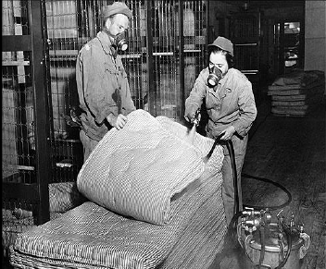
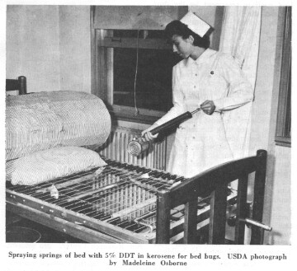

Bed bugs were almost eradicated from the U.S. in 1940-50

Slide 25

Limited mostly to hotels and remote communities in 1999, then quickly spread into residential sector
99.6% of nationwide surveyed pest management professionals have encountered a bed bug infestation in 2012 (2013 Bugs Without Borders)
Overall increase of 20% between 2012 and 2013

Slide 26





Changes in pest management strategies
  Increase in global and domestic travel
  Increased resistance to insecticides
  Changes in technology
Photography by Tim Flach, Getty Images.
Notes:
Reduction in pesticide use indoors.
Introduction and use of pest specific baits instead of liquid pesticides.
Introduction of bed bugs into U.S. on the luggage of foreign travelers, and re-infestation by native bugs.
Mobile society that can carry bed bugs to all corners of the U.S.
Pyrethroid insecticides are commonly used in bedbug control because of their relative safety for humans and pets, effectiveness, and low cost, but their use has also led to widespread development of resistance in the pests.

Slide 27


The poor are
at greatest risk
Increasing number of people reporting long-term (beyond a year) bed bug infestations

Slide 28
40 bed bugs are in a 70°F room on May 2. By Nov 2 how many are there?
5,905!

Slide 29


Slide 30



Slide 31


Slide 32








Combine inspection with vacuum cleaning
Use a brush, flash-light, canister vacuum
with a crevice
attachment

Slide 33


Blind resident in
disabled public
housing

Slide 34




Slide 35


Reactions to bites
Bites may occur in lines
- usually on exposed skin
Saliva can cause a
person to itch
and cause swelling
Scratching can
lead to secondary infections
Adults over 65 years of age tend to react less or not at all

Slide 36


  Emotional impact
    Loss of sleep
    Nightmares
    Stress/anxiety
    Feeling isolated
    Loss of self esteem
    Feelings of depression
    Cannot relax
    Loss of friends and family connections
    Etc., etc.
    http://cals.arizona.edu/apmc/public-health-IPM

Slide 37



Extra dead

Slide 38

Places where people rest for hours at a time
Beds, sofas, bedside tables, recliners, picture frames…
= Hot Spot

Slide 39

Most products will kill some bed bugs
Killing bed bugs we can see is never going to eradicate bed bugs from the home
1 exterior
3 partial
16 internal

Slide 40


Not all aggregations are obvious

Slide 41


Prevention
Care - Monitor – Clean repeat
Notes:
Avoid picking up discarded or second-hand items (especially beds & furniture) • Avoid sitting on furniture when in infested apartments & limit what you bring in with you • If itchy welts occur, immediately conduct a thorough inspection.

Slide 42



If a bed bug is discovered in a room
Do not panic
or cause panic!
Often it’s a
stray, single roving bug
Carefully collect it for identification
Do not evacuate the room
Thoroughly inspect,
clean and monitor the room

Slide 43






Passive monitors or traps
12 Volcano Trap
4 Climb Up Interceptors
4 Bed Moat
12 Blackout BB Detector
BB Alert
6 BB Detection System
Notes:
43

Slide 44


Canine detection
Excellent detectors
Can distinguish between live and dead bugs
Expensive and require constant training
Are only as good as their handler
Good defense in litigation cases – so is having a bed bug procedure protocol
Notes:
44

Slide 45




Resources
http://www2.epa.gov/bedbugs
http://cals.arizona.edu/apmc/public-health-IPM
http://www2.epa.gov/sites/production/files/2015-02/documents/fed-strategy-bedbug-2015.pdf
http://extension.arizona.edu/sites/extension.arizona.edu/files/pubs/az1563.pdf
http://extension.arizona.edu/sites/extension.arizona.edu/files/pubs/az1625-2014.pdf
https://extension.arizona.edu/sites/extension.arizona.edu/files/pubs/az1642-2014.pdf

Slide 46


Scabies mites
Human scabies - human itch mite Sarcoptes scabiei var. hominis
Female scabies mite burrows into the upper layer of the skin where it lives and lays its eggs
The scabies mite usually is spread by direct, prolonged skin-to-skin contact
Scabies mite burrow track
Notes:
The mites are small and may be below the skin surface, but burrow tracks may be visible, as depicted in the picture on this slide

Slide 47


Scabies mites
Optimal environments for the spread of scabies:
  Crowded living conditions
  Hospitals
  Childcare schools and adult daycare facilities
Mites can not survive longer than 3 days off the host
Mites can only be eliminated using prescription treatments – no resistance issues
Rx are different from head lice products
Notes:
As soon as a student has started a treatment plan, they are not infectious

Slide 48


Scabies is an intensely pruritic
Moderately contagious
Adults are 1/3 millimeter long
Mites are inactive below 20ºC (68ºF)
At 20ºC mites can persist for 2 weeks

Slide 49

SPREAD
The mite remains viable for 3 days on inanimate objects; transmission via articles such as clothing, towels, or bedding, is possible, but
not likely

Slide 50

Infection occurs due to the direct transfer of a single fertilized female
Notes:
Once bound to their host, 10-15 mites mate on the surface of the skin.

Slide 51

After mating, the male mite dies
The female mite burrows into the epidermis of the host (30 mins) using her jaws and front legs, then she lays up to 3
eggs per day
Life cycle
10-17
days

Slide 52



Burrows are often not seen but check in the webbing of fingers or on the inside of wrists
Notes:
The typical distribution is arm pits/breast area, waist line, and crotch/buttock area. It tends to avoid the face and neck.

Slide 53


An affected host harbors 10-15 adult mites during a typical infestation
Skin scrapes are the only
way to positively identify mites

Slide 54

A delayed type IV hypersensitivity reaction to the mites, molts, eggs, or scybala (packets of
feces) occurs
approximately
30 days after
initial
infestation

Slide 55

Scabies disproportionately affects women and children
Pruritus is most severe at night
Secondary bacterial infection is most commonly due to Staphylococcus aureus, group A β-hemolytic Streptococci, or Peptostreptococci

Slide 56

Scabies is unlikely to cause a long-term disease state in healthy individuals
Lesions and associated pruritus may last for weeks to months without adequate treatment
The immunocompromised are likely to develop crusted
scabies, which may
be impossible to
fully eradicate

Slide 57

In adults, lesions are usually confined below the neck and involve the web spaces between the fingers, flexor surfaces
of the arms, wrists,
axillae, and the
waistline
The umbilicus, nipples,
penis, and scrotum
may also be affected

Slide 58


Slide 59


Slide 60

Treatments
Permethrin (e.g. Elimite) is a neurotoxin that causes paralysis and death in ectoparasites
It is the most common treatment used today for scabies
The lotion should be applied over the entire body from neck down
It should be left on for
8-12 hours and then
rinsed off
Notes:
The following medications for the treatment of scabies are available only by prescription.
1.Permethrin cream 5%
Brand name product: Elimite*
Permethrin is approved by the US Food and Drug Administration (FDA) for the treatment of scabies in persons who are at least 2 months of age. Permethrin is a synthetic pyrethroid similar to naturally occurring pyrethrins which are extracts from the chrysanthemum flower. Permethrin is safe and effective when used as directed. Permethrin kills the scabies mite and eggs. Permethrin is the drug of choice for the treatment of scabies. Two (or more) applications, each about a week apart, may be necessary to eliminate all mites, particularly when treating crusted (Norwegian) scabies.
2.Crotamiton lotion 10% and Crotamiton cream 10%
Brand name products: Eurax*; Crotan*
Crotamiton is approved by the US Food and Drug Administration (FDA) for the treatment of scabies in adults; it is considered safe when used as directed. Crotamiton is not FDA-approved for use in children. Frequent treatment failure has been reported with crotamiton.
3.Lindane lotion 1%
Brand name products: None available
Lindane is an organochloride. Although FDA-approved for the treatment of scabies, lindane is not recommended as a first-line therapy. Overuse, misuse, or accidentally swallowing lindane can be toxic to the brain and other parts of the nervous system; its use should be restricted to patients who have failed treatment with or cannot tolerate other medications that pose less risk. Lindane should not be used to treat premature infants, persons with a seizure disorder, women who are pregnant or breast-feeding, persons who have very irritated skin or sores where the lindane will be applied, infants, children, the elderly, and persons who weigh less than 110 pounds.
4.Ivermectin
Brand name product: Stromectol*
Ivermectin is an oral antiparasitic agent approved for the treatment of worm infestations. Evidence suggests that oral ivermectin may be a safe and effective treatment for scabies; however, ivermectin is not FDA-approved for this use. Oral ivermectin has been reported effective in the treatment of crusted scabies; its use should be considered for patients who have failed treatment with or who cannot tolerate FDA-approved topical medications for the treatment of scabies. The dosage of ivermectin is 200 mcg/kg orally. It should be taken on an empty stomach with water. A total of two or more doses at least 7 days apart may be necessary to eliminate a scabies infestation. The safety of ivermectin in children weighing less than 15 kg and in pregnant women has not been established.

Slide 61

Reapplication of permethrin one week later is advised; however, no controlled studies exist that show that 2 applications are better than one
No cases of scabies resistants to permethrin have been documented

Slide 62

Crotamiton (e.g. Eurax; Crotan) frequent treatment failure has been reported with crotamiton
Lindane lotion is NOT recommended,
but not all
doctors are
aware of this

Slide 63

The antihistamine diphenhydramine (Benadryl), can be useful in helping provide relief from itching
Itching often becomes worse after the mites are killed, and can be intense for a few weeks
before abating
Notes:
Wash linens and bedclothes in hot water. Cut your nails, and clean under them thoroughly to remove any mites or eggs that may be present.
Thoroughly vacuum your rugs, furniture, bedding, and car interior and throw the vacuum-cleaner bag away when finished.
Try to avoid scratching. Keep any open sores clean.

Slide 64

Norwegian (crusted) scabies
In 1848, the Norwegians Danielssen and Boeck described a highly contagious variant of scabies that occurs in immunocompromised patients
Crusted or hyperkeratotic
scabies, is an overwhelming
scabies infestation that can
be difficult to control

Slide 65

Rare form of scabies occurs in the elderly or mentally incompetent patients
Because of an impaired antibody response, these individuals can be infested with thousands to millions of
mites

Slide 66

Inappropriate things
Pesticides applied to rooms
Pesticides applied to transportation buses
Sterilants and
high level
disinfectants
applied to room
surfaces
incorrectly

Slide 67


