Slide 1
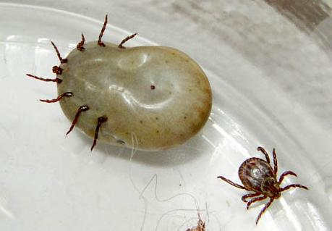
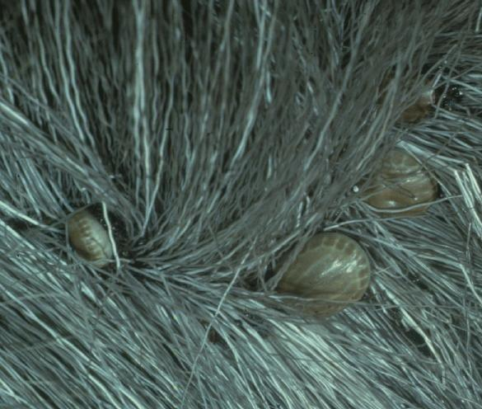
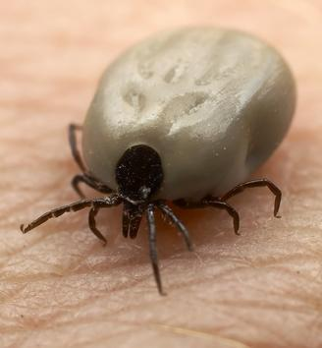
Tick Biology
and Control
Dawn H. Gouge
University of
Arizona
William L. Nicholson
CDC

Slide 2
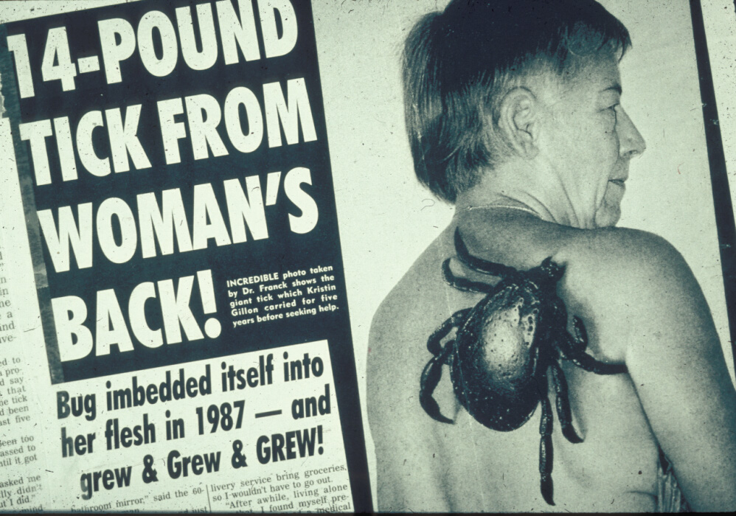

Slide 3
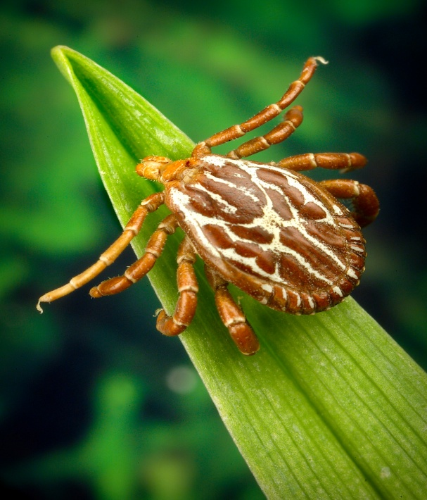
Ticks and Tick-Borne Diseases
Tick-borne diseases are increasing in the U.S.
Geographic ranges of vector ticks are expanding due to climate changes.
Notes:
Amblyomma maculatum

Slide 4
Trends in Tick-borne Diseases
Increasingly mobile society (and pets).
Increasingly “green” society.
Increasingly sophisticated diagnostics.
Decrease in medical awareness or suspicion for many TBD (it’s not all Lyme).
Decreasing expertise in vector biology and control.

Slide 5
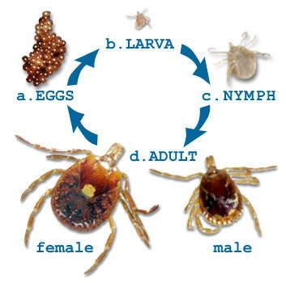
Ticks!
Not insects.
Four life stages
  Egg
  Larva (6 legs)
  Nymph (8 legs)
  Adult (8 legs)
Life cycle-may use several hosts.
Vector the widest variety of pathogens.

Slide 6
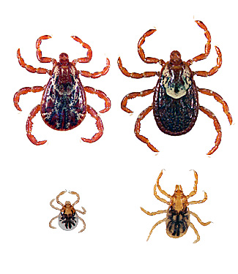

General Life Cycle of a Tick
Feed
Develop
Lay eggs
Ixodidae
Hatch
Egg
Female
Larva
Male
Feed
Develop
molt
Feed
Develop
molt
Adults
Nymph
Dermacentor
variabilis

Slide 7
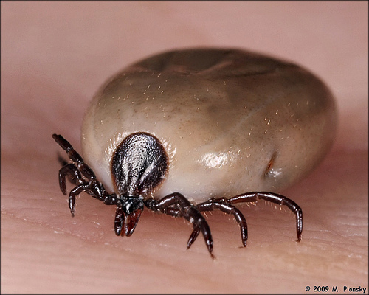
Factors for Tick Survival
Humidity
Temperature
Available hosts
Hiding spots
Predation
Natural disease
Pathogen-induced mortality

Slide 8
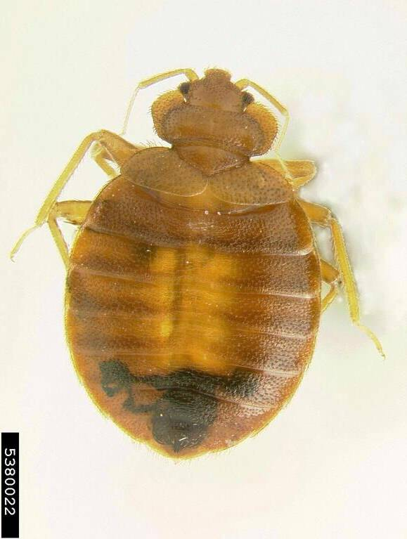
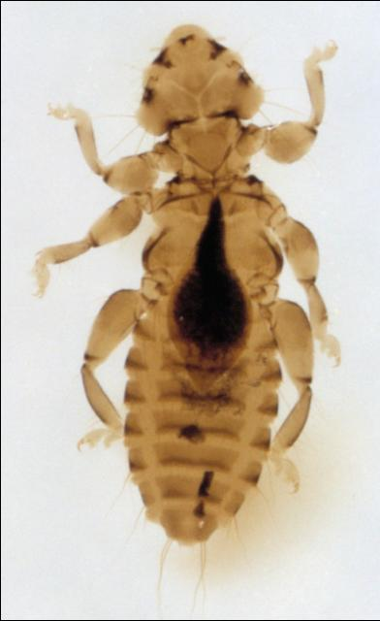
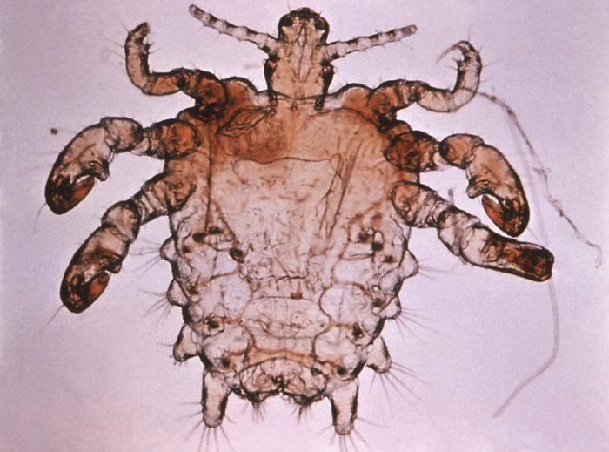
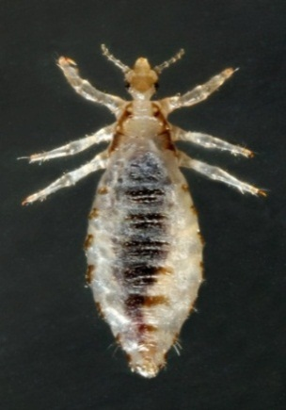
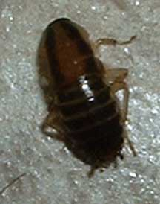
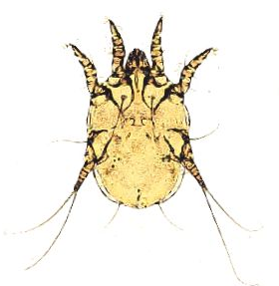
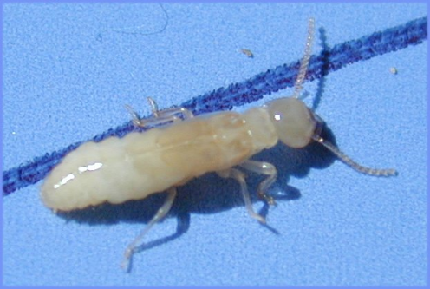
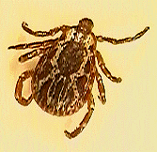
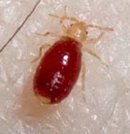
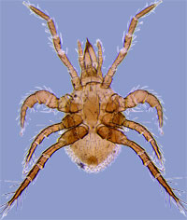
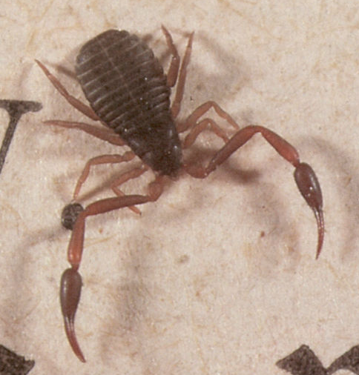
Find the tick

Slide 9
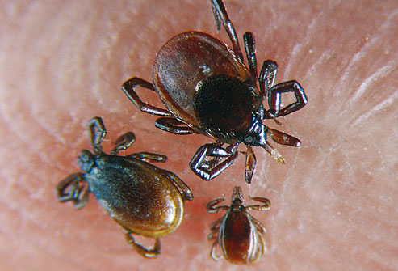
Effects of tick infestation
Worry
Blood loss
Salivary toxicant
Immune response
Wounding (secondary pathogen entry)
Pathogen transmission

Slide 10
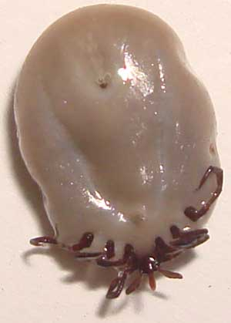
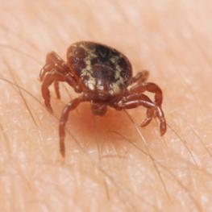
Tick Paralysis
Caused by toxin produced by Dermacentor ticks.
Progressive, ascending paralysis.
Reversed upon removal of tick.
May result in death if tick is not removed.
More frequent in young girls

Slide 11
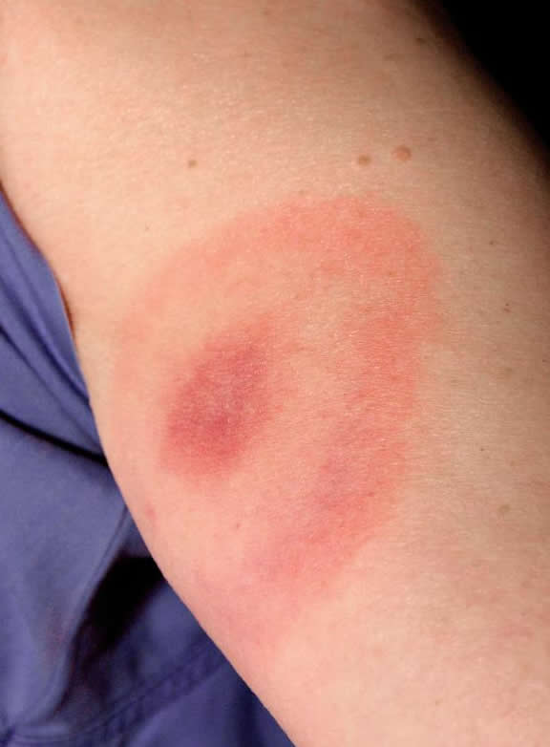
Tick Bite Allergies and Reactions
Wide range of
reactions.
Minor inflammatory
reactions locally.
Severe systemic
reactions (skin rash,
fever, nausea,
vomiting, diarrhea,
shock, and death).

Slide 12
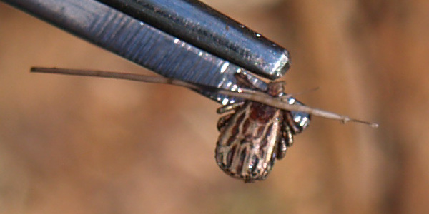
Severe allergic reactions (edema, pain, erythema, tissue necrosis, ulceration, prolonged healing).
Expanding erythematous lesions.
Anaphylactic shock.

Slide 13
Ticks and their associated diseases are seasonally distributed -BUT…….. AZ
Peak of disease activity corresponds with peak of tick activity (especially the life stage of tick most important for transmission).
J F M A M J J A S O N D

Slide 14
Ticks and their associated diseases are focally distributed (clustered).
Non-random
Clustered
Random
Pavlovsky, E.N. 1964. Natural nidality of transmissible diseases. University of Illinois Press: Urbana, Illinois. (English translation)

Slide 15
Disease Occurrence
Host
Pathogen
Vector
Suitable
environment

Slide 16
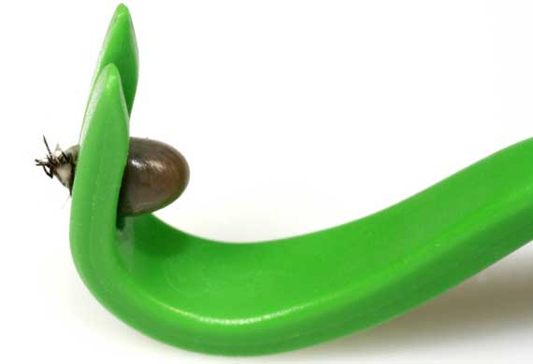
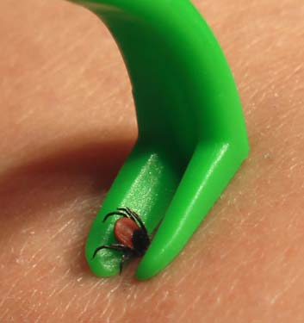
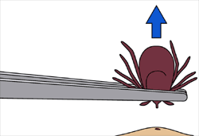
Proper Tick
Removal
Use fine-tipped tweezers to grasp tick close to skin
Pull tick’s body away from skin (avoid crushing head)
Clean skin with soap and water
Properly dispose of tick
DON’T: use petroleum jelly, a hot match, nail polish, or other products to remove a tick.

Slide 17
Tick Testing and Tick Bite Prophylaxis
Neither generally recommended following tick bites
  But RMSF transfers very quickly (<6 hours).
Tick bite prophylaxis: Single dose doxycycline (200 mg) within 72 hours of tick bite.
Always monitor site of tick bite and health closely following a tick bite.

Slide 18
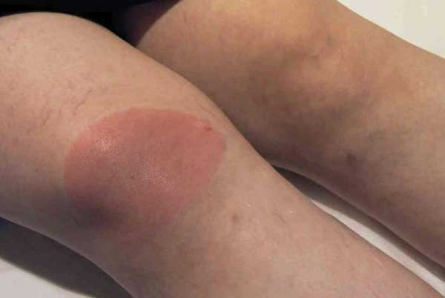
When to Suspect Tick-borne Illness
Acute febrile illness without apparent cause (fever, malaise, lethargy + other symptoms).
Onset during
May-September
(high tick
activity).

Slide 19
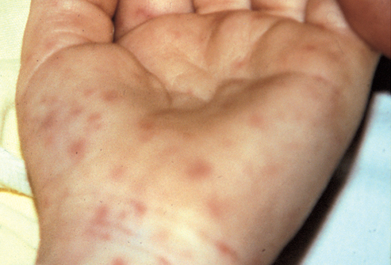
History of tick bite or exposure.
Persons at risk for tick bite.
History of travel to endemic areas (US and global travel).
Thrombocytopenia, elevated liver enzymes.
Rash not
always a
feature.

Slide 20
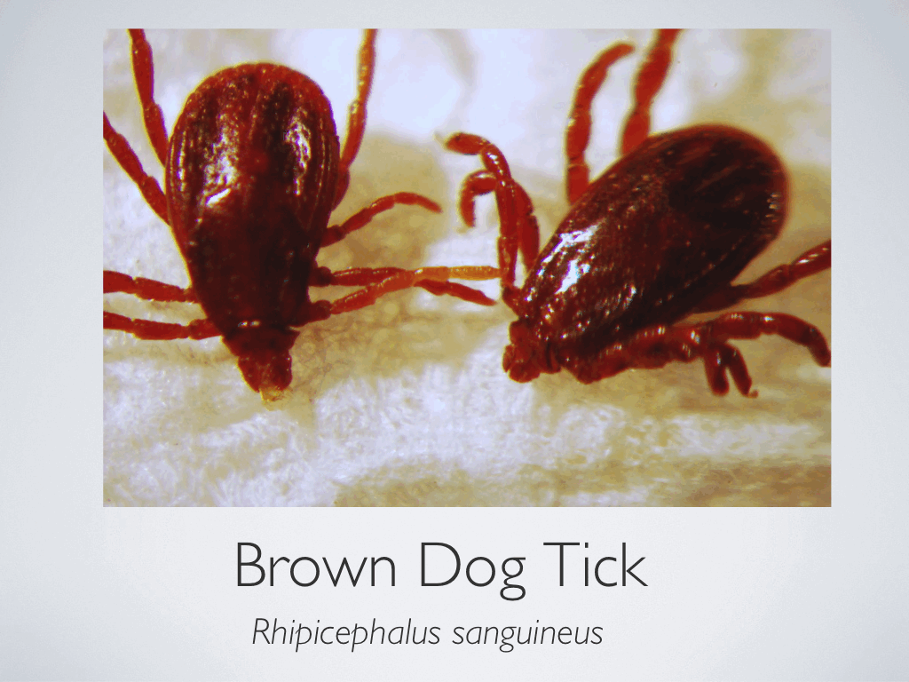
Brown dog tick -

Slide 21
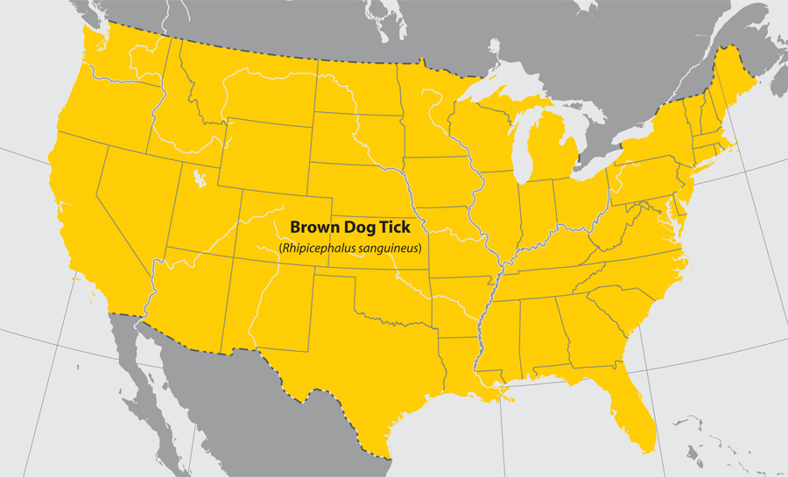
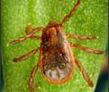
Bacteria Rickettsia rickettsii cause Rocky Mountain spotted fever.

Slide 22
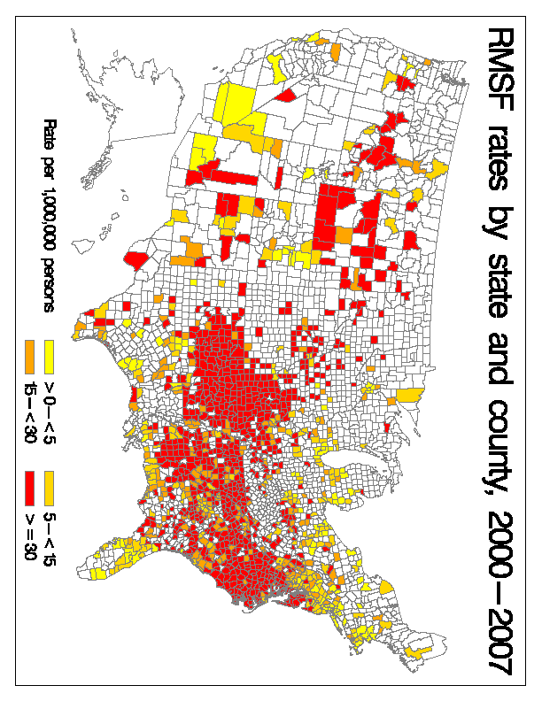

Slide 23
RMSF Cases and Incidence

Slide 24
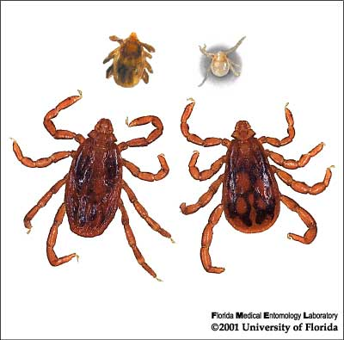
RMSF in Arizona
Identified in tribal
communities in eastern
Arizona (2003).
High infestations of
brown dog ticks,
Rhipicephalus sanguineus (all stages).
Many confirmed bites by nymphs on humans (behind ears / back of neck).
When first investigated in AZ, the annual incidence of RMSF in this area was 300x that of rest of country

Slide 25
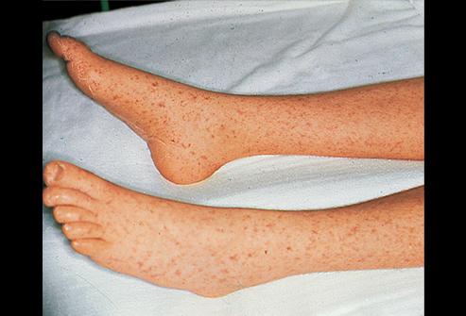
RMSF in Arizona
Now seen in six widely separated tribal lands (over 350,000 persons at risk).
From 2002-2013, 321 cases were identified.
Incidence: 136 cases per 100,000 persons/yr (~150x US average).
20 fatal Cases
  Case fatality rate = 7%.

Slide 26
RMSF in Arizona
Dog serosurveys.
1996 archived samples: 5.1% R. rickettsii, 3.6% R. rhipicephali, no crossreactive samples.
2004-2012, new surveys.
Prevalence ranged from 3-50% across six tribal lands (avg. 28.5%).
Arizona, non-tribal lands 5%.

Slide 27
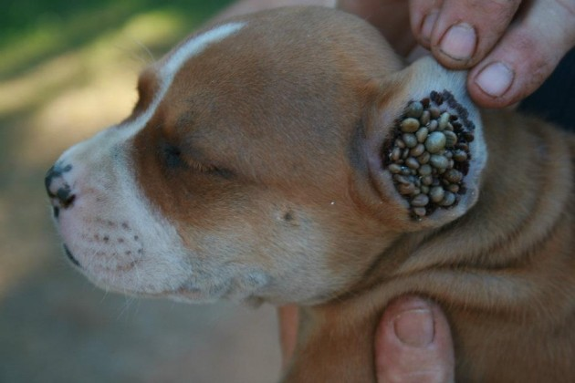

Slide 28
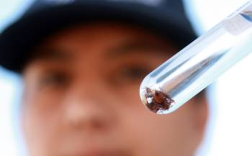
Mexicali Outbreak
Initial report: Sept. 2008 to Feb. 2009, eight deaths reported from Mexicali, Baja California, Mexico.
Additional 52 cases, 2 deaths in 2009.
CDC, local and federal health officials confirmed Rickettsia rickettsii.
Large numbers of ticks on dogs.
Earlier studies showed
50-79% of dogs infested
with a seroprevalence of
17% to R. rickettsii.

Slide 29
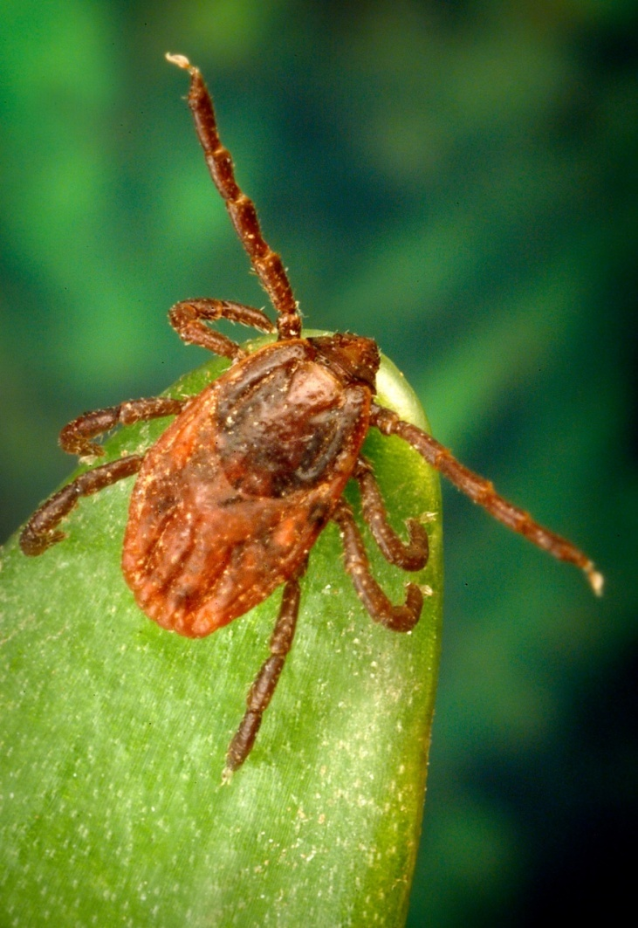
Rhipicephalus sanguineus
Brown dog tick
Found worldwide, primarily feeding on dogs as preferred host.
Larval and nymphal ticks occasionally feed on humans, especially when tick populations are high.
Transmit spotted fever rickettsiae in other parts of the world.

Slide 30
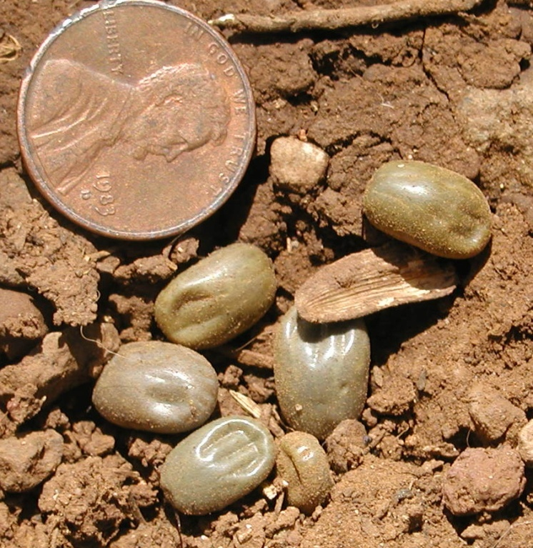
Incredible Reproductive Capacity
Brown dog ticks can complete their life cycle in as little as 63-93 days.
Each engorged female can lay 3000-4000 eggs.
Ticks can be transported to new locations as dogs move around from house-to-house.
Can complete life-cycle inside home.

Slide 31

Biological Features
Ticks move among hosts during high tick activity (interrupted feeding may shorten transmission time to second host).
Nocturnal detachment of nymphal and adult engorged
ticks concentrates
ticks and facilitates
host contact.

Slide 32

Biological Features
Increased height of questing and human biting rate with elevated temperature (Melendez et al. 1995; Parola et al. 2008).
Survives temperatures and humidities that other ticks cannot (Yoder et al. 2006a,b): 90% survival
at 40°C (104°F) and
33% survival at 50°C
(122°F).

Slide 33
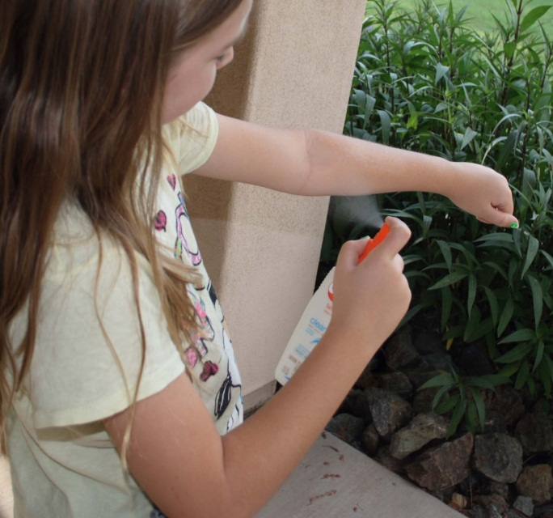
Prevention and Control:
Individual
Prevent tick bites: Use repellent, tick checks, and other simple measures to prevent tick bites.
Control ticks around your home.
Ask your doctor about
antibiotics if bitten
Learn the early signs
of tick-borne illness.

Slide 34
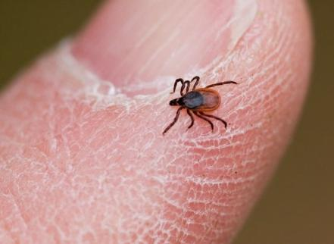
Prompt tick removal reduces risk
  Conduct tick checks after outdoor activities.
  Remove attached ticks early; use tweezers.

Slide 35
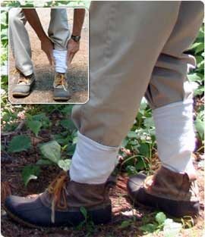
Avoid tick infested areas.
Wear light colored clothing to see ticks.
Tuck pants
into sock or
boots to keep
ticks on
exterior of
clothes.

Slide 36
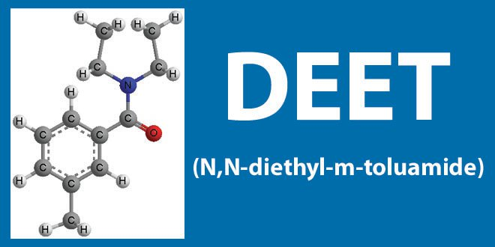
Personal Repellent Use
DEET (N, N-diethyl-3-methylbenzamide)
  Use for exposed skin and clothing
  Higher concentrations, longer duration of protection
    10% effective
    25-35% optimal
    >50% no more efficacious or longer lasting
  No greater than 15% for children

Slide 37
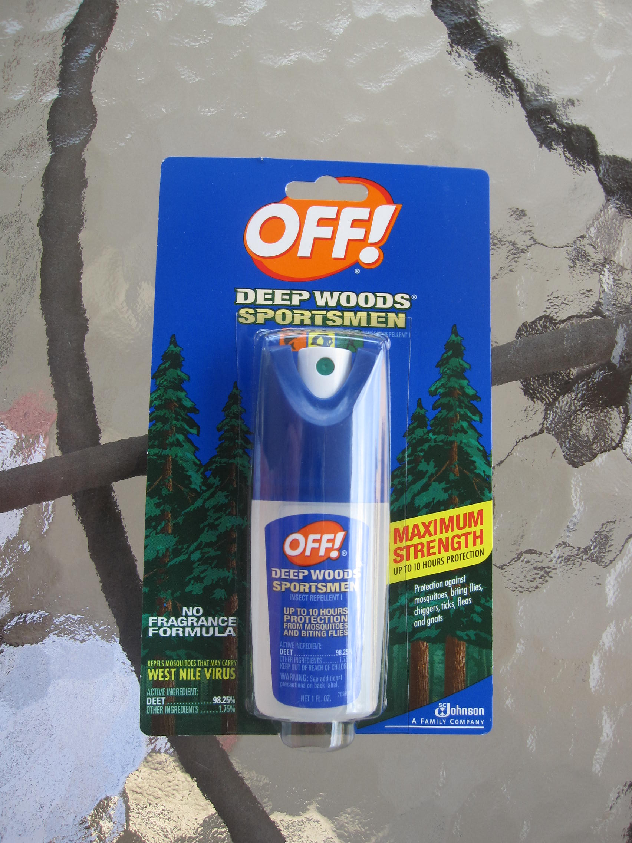
Permethrin
  Can only be used to treat clothing
Picaridin & botanical
products
  Less effective against
  ticks than mosquitoes

Slide 38
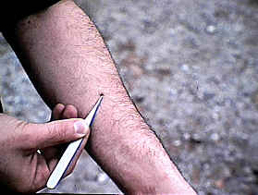
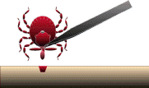

Prevention
Routine tick check and removal
  Transmission unlikely to occur if promptly removed (grace period varies).
  Use fine-tipped tweezers.
  Mirrors help.
  Record date/save tick.

Slide 39
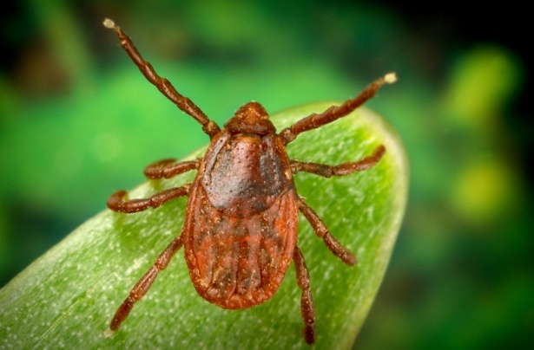
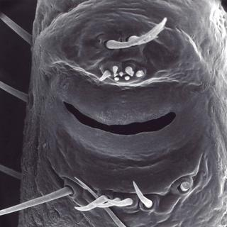
Carbon dioxide, heat
Ticks find a host by sensing light changes, temperature, and certain chemicals.
Their “noses” are sensory organs on the front legs.

Slide 40
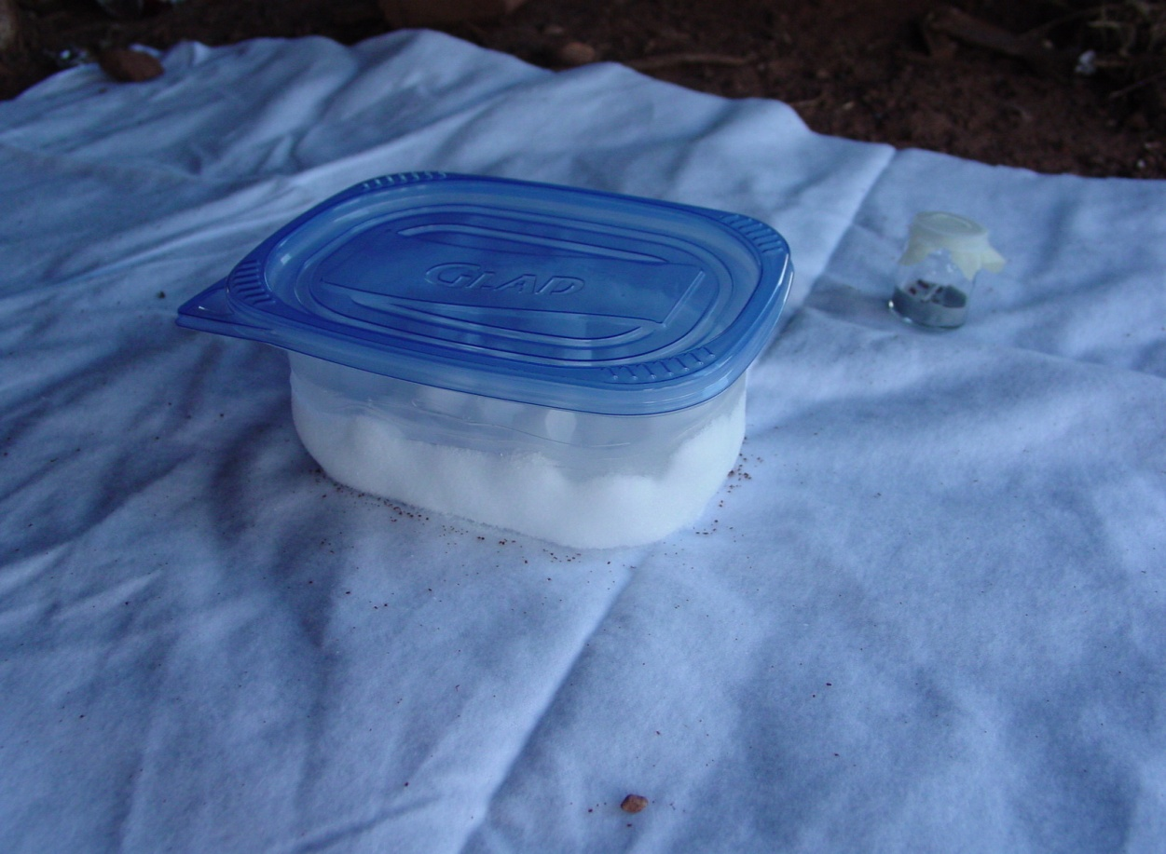
Surveillance for ticks
Carbon dioxide (dry ice) trap
Flagging
Dragging
Host exam
Limitations and bias to each method
CO_{2 is} 2.9 times heavier
than air

Slide 41
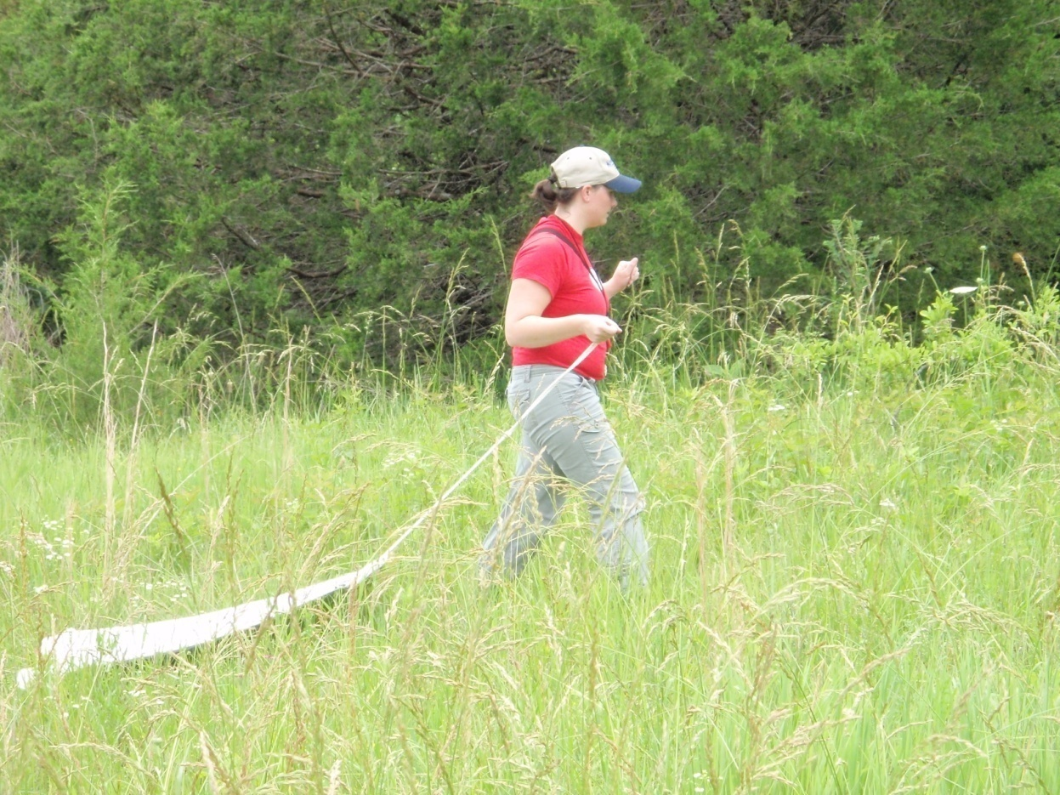
Tick Drag
Tick drag is pulled slowly through vegetation.
Ticks attach to fabric, which is checked periodically for tick attachment.

Slide 42

Tick flag is wiped slowly across and around vegetation.
Ticks attach to fabric, which is checked periodically for tick attachment.
Tick Flag

Slide 43

Fabric is checked and ticks removed

Slide 44


Species, life stage, distribution by location, season, infestation level, infection rate.
Rhipicephalus sanguineus

Slide 45
Home assessment
Examine for suitable microhabitats in the peridomestic environment.
Engorged ticks crawl into cracks and crevices (dark and tight) to develop and molt into the next life stage.
Various places have the appropriate microclimate needed for survival.

Slide 46

Rhipicephalus sanguineus Infestation
Vegetation in surrounding areas increased moisture levels under houses on piers.
“Shady places where dogs lie”

Slide 47
What are we looking for?
Are animals (dogs especially) present?
Is pet housing present?
Are there access points to the crawl space?
Is vegetation present and maintained?
Are there any wood piles, other debris?
Furniture and other outdoor storage?

Slide 48

Home assessment

Slide 49

Home assessment
Exterior:
  Examine cracks and crevices, along window and door openings, siding.
  Woodpiles, dog houses, outbuildings, under bushes, items stored outdoors.
Interior:
  Baseboards,
  along door and
  window trim,
  behind curtains,
  under furniture.

Slide 50

Rhipicephalus sanguineus Infestation
Voids in the concrete piers can contain ticks of all stages.
Larvae and nymphs can quest from the surface.

Slide 51


Rhipicephalus sanguineus Infestation
Mattresses discarded or stored under houses can provide dog resting sites and tick hiding spots. Stucco siding can harbor ticks.
Over 150 ticks were removed from a single mattress.

Slide 52
The situation
Brown dog ticks feed primarily on dogs.
Brown dog ticks feed rarely on people.
When dog populations rise, there is also a rise in tick numbers.
When tick numbers are high, even the occasional feeding on people is significant.
Close contact of humans with dogs and their ticks sets up the ideal situation for transmission.

Slide 53

Stopping the Cycle of RMSF
The most effective way to eliminate the tick problem (and thus the disease transmission) is by the use of several approaches:
Management of habitat
Management of tick
numbers
Management of dog
population
Avoidance of tick
contact

Slide 54
Management of Habitat
Decrease harborage of tick hosts
  Decrease outdoor storage, clean up debris, including illegal dump sites.
  Skirt houses to exclude animals.
Decrease harborage of molting ticks
  Caulk openings, cracks, crevices, trim.
Reduce moisture
  Reducing weeds and mowing grass allows wind and sun to dry the areas (which will reduce tick survival).

Slide 55

Management of free-living ticks
Constant new source of parasitic infestation.
Can repopulate area by ticks dropped off dogs.
Questing ticks are
risks to humans.

Slide 56

Targeted approach
Target areas where ticks are located.
Target timing of acaricide application to coincide with optimal numbers and life stage for best control.
Target repeat applications to maximize effectiveness and minimize waste.

Slide 57

Targeted Control: Ideal Situation
Environmentally-friendly: widespread pesticide application is not necessary.
Ticks are found mostly in specific locations (shady places where dogs rest: under decks, under porches, under houses).
Minimize pesticide use,
minimize exposure to
people.

Slide 58

Who does it?
Commercial applicators
Housing authorities
Municipal authorities
Public health authorities
Residents of
home using
pesticides
appropriately

Slide 59

Tools for management
Biological/Mechanical
  Soaps
  Desiccants
  Fungal pathogens
  Pheromone attractants
Chemical
  Many registered products in various formulations (spray, granules, dust).
  Topicals and impregnated collars for animals.

Slide 60
Management of Ticks: Chemical
Most effective and rapid way to reduce tick numbers.
Chemicals should be chosen for effectiveness against ticks, and for their relative safety to people and animals.
These products should give 3-4 weeks of protection, reducing frequency of follow-up applications.

Slide 61
Chemical Safety Plans
Education of control staff
  Knowledge of chemicals to be used
  Application rates
  Adverse reactions surveillance
  Personal protective equipment
Limit access to sprayed areas until dry
  Caution signs
  Clearing of area
Proper disposal of materials

Slide 62
Applications
Indoors
  Treatment of cracks and crevices, edges.
  Do not treat food preparation areas.
Outdoors
  Treatment of tick-infested areas.
  Treatment of animal sleeping areas.
  Do not treat ground water or areas where contaminated runoff could occur.

Slide 63

Treatment of premises
Indoor
  Dusts/powders
    Desiccants/scarification
    Desiccants + chemical
    pesticide
  Sprays
    Pyrethrins
    Pyrethroids
Use of trade names does not imply endorsement by CDC or other agencies.

Slide 64
Treatment of premises
Outdoor
  Sprays
    Pyrethrins, Bifenthrin, Permethrin, Lambda-Cyhalothrin, carbaryl
  Granules
    Carbaryl, Bifenthrin, Permethrin, Lambda-Cyhalothrin
  Dusts
    Carbaryl, Permethrin, Deltamethrin

Slide 65
Control of ticks around houses on piers
Area to treat (under house and 6-10 feet beyond edge of house).
Also treat under and around dog houses, porches, decks, or other shady places that dogs lay regularly.

Slide 66
Control of ticks around houses on slabs
Area to treat (band 6-10 feet beyond edge of house).
Also treat under and around dog houses, porches, decks, or other shady places that dogs lay regularly.

Slide 67

Granular formulations
Can be applied by homeowner
Can be purchased in shaker containers
Penetrates ground vegetation
Effectively used in early part of the RMSF response
Apply appropriate dosage!
Must be watered in to
release chemical

Slide 68

Application of pesticides
Re-apply if ticks return.
Many products will not kill eggs, so hatching ticks may appear after treatment.
New ticks may drop in the treated area.

Slide 69


The real problem

Slide 70

Dogs and RMSF
Dogs, like people, can become infected with RMSF.
Causes illness and
death in infected
dogs.
Recovered dogs are
immune to
reinfection.
Dogs can circulate
rickettsiae in their
bloodstream for 6-11
days upon infection.

Slide 71

Management of Ticks on Dogs
More difficult portion of the effort.
Household dogs will be easier to treat than free-roaming dogs.
Large number of dogs in area.
Many approaches
require direct
contact with the
dog.

Slide 72

Topicals
Pyrethrins
Permethrin,
Permethrin +
pyriproxyfen
Fipronil
Fipronil + methoprene
Fipronil + amitraz + methoprene
Metaflumizone + amitraz
Selamectin

Slide 73

Collars
Tetrachlorvinphos
(Hartz Ultraguard)
Tetrachlorvinphos +
(S)-methoprene (Hartz Ultraguard Plus)
Propoxur (Zodiac, Breakaway Plus)
Amitraz (Preventic)
Amitraz + pyriproxifen (Preventic Plus)
Deltamethrin (Adams Delta Force, Preventef-D, Scalibor)
Flumethrin + propoxur (Kiltix)
Flumethrin + imidacloprid (Seresto)
Mention of trade names does not imply endorsement by CDC or other agencies

Slide 74
Collars: Important reminders
Pay attention to the active ingredients in flea/tick collars. Pesticides effective for fleas may not be effective for ticks.
Dogs and cats are not the same. Some dog products are highly toxic to cats.
Never use collars on humans!!!
Replace collars on schedule (dated collars).
Company claims of duration are often based on lab studies, weathering and sunlight reduce the duration.

Slide 75

Reminder: Dog Population Control
Animal control efforts and tick management efforts go hand-in-hand.
Decrease in dog numbers will result in a reduction of tick numbers.
Spay/neuter programs can stabilize the situation.
Animal-directed efforts can
provide a long-term effect.

Slide 76

AZ: Challenges for control
Magnitude of the stray dog problem and lack of animal control
(one location:
est. 25,000 dogs with
2500 removals/year).
Limited political will and
sustained effort for
community-wide control.
Difficulty in treating
individual animals.
Retreatment,
identification, logistics.
Cost.

Slide 77




Slide 78



Useful Resources
  http://www.cdc.gov/rmsf/

