Slide 1
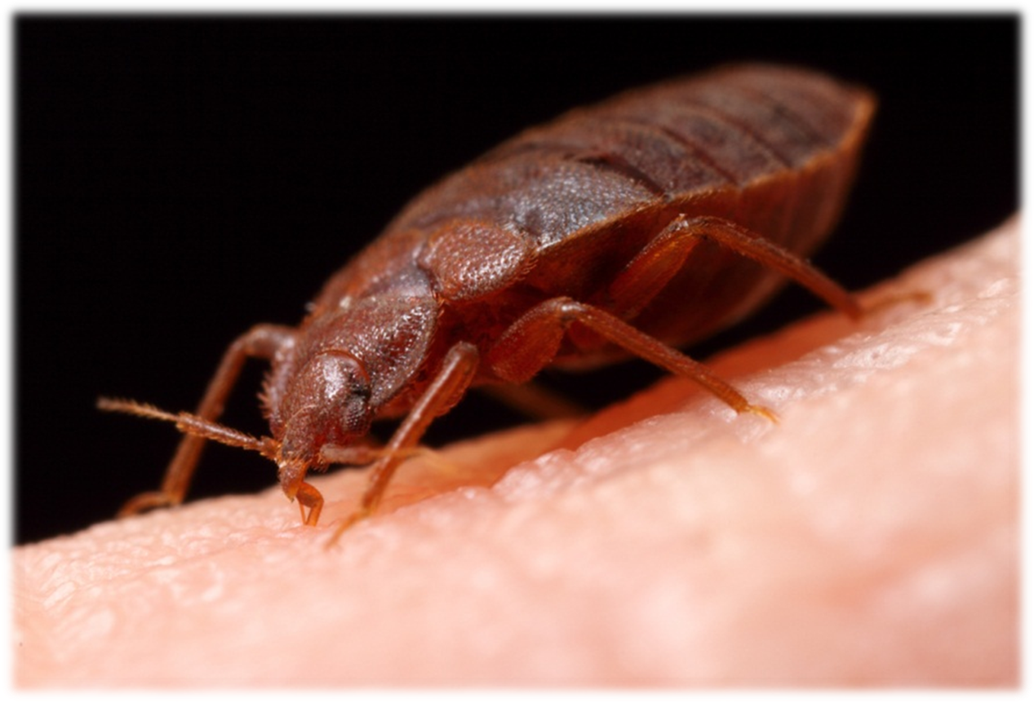
Bed Bugs: Biology, Behavior and Control
Dawn H Gouge
University of Arizona
Notes:
1

Slide 2
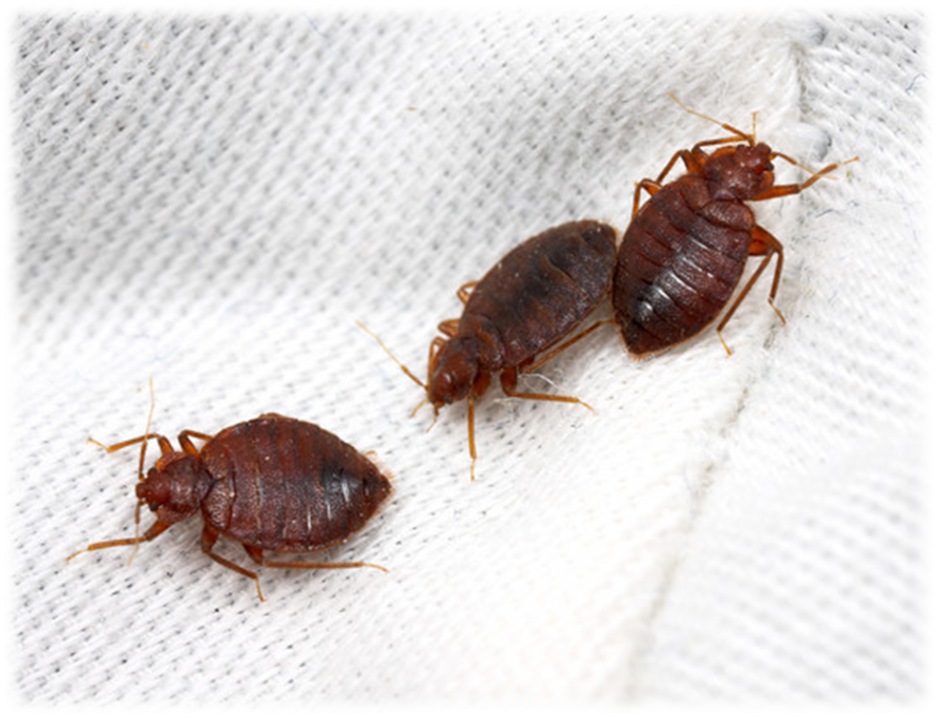
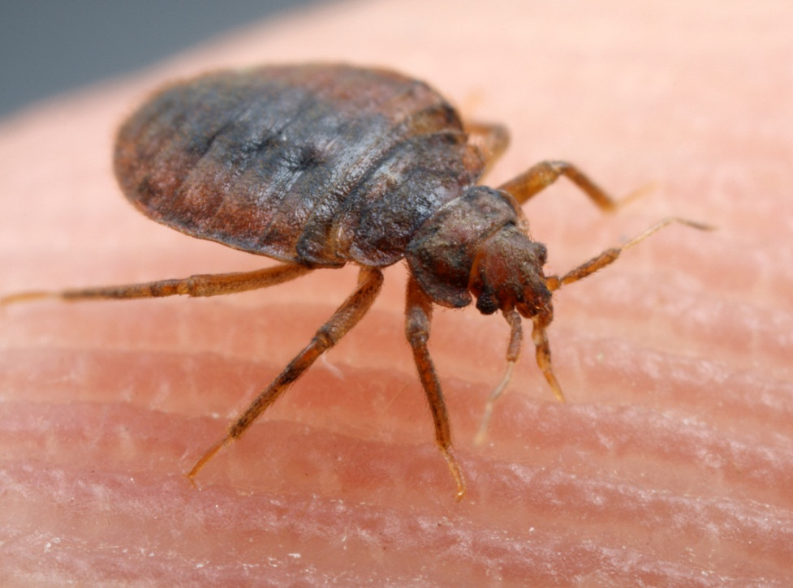
Anyone
can accidently
acquire bed
bugs

Slide 3
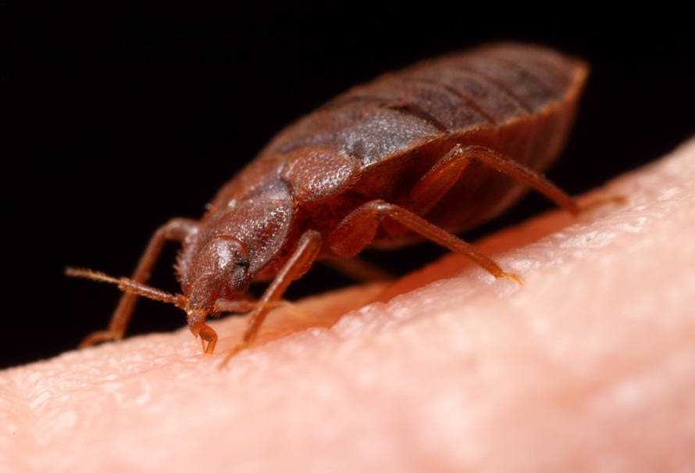
What are bed bugs?
Blood feeding true bugs - order Hemiptera
Eggs hatch and immatures
go through
5 nymph stages
before
becoming
adults
Notes:
Bed bugs are blood-feeding insects in the order Hemiptera (also called true bugs) they go through incomplete metamorphosis (gradual) and the life stages are best described as?
Baby bed bug, young immature bed bug, adult bed bug
Egg, five immature nymph stages, and a final sexually mature adult stage
Larva, adult
Egg, larva, pupa, adult

Slide 4
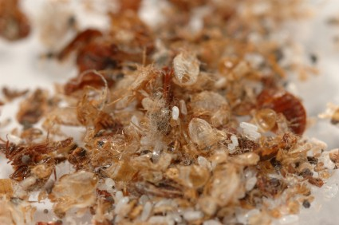
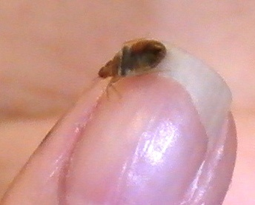
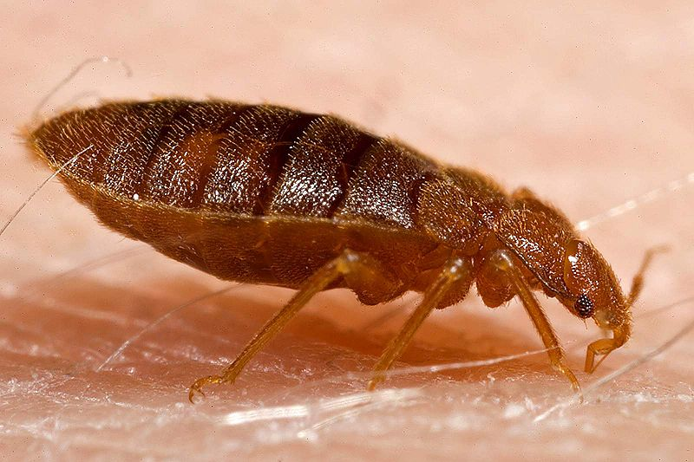
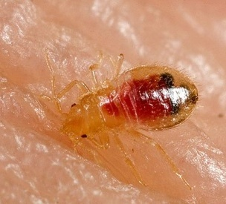
Adults are about the size of an apple seed

Slide 5
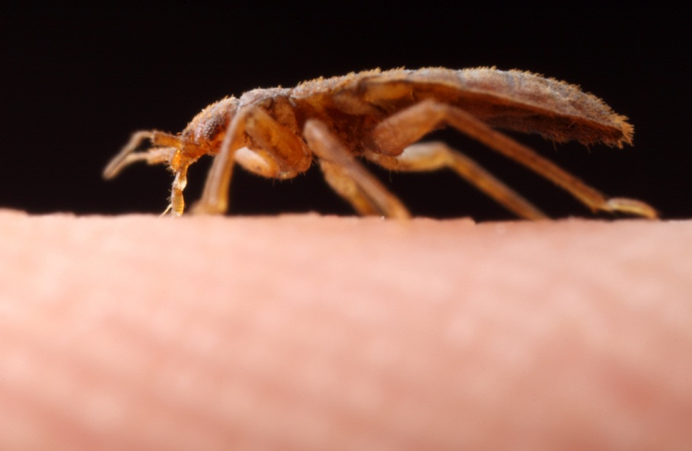

Slide 6
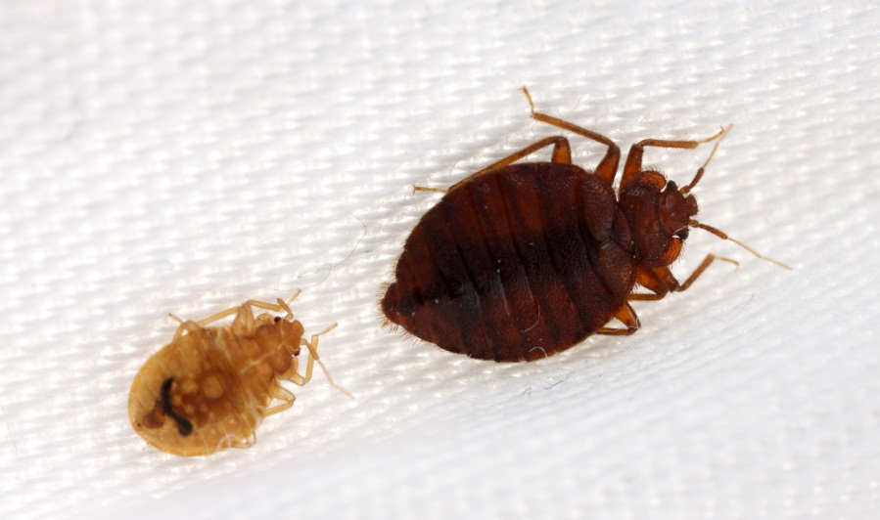
Bed bugs are not known to transmit disease organisms

Slide 7
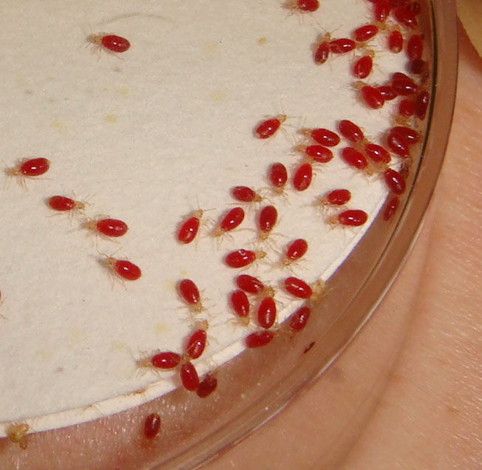
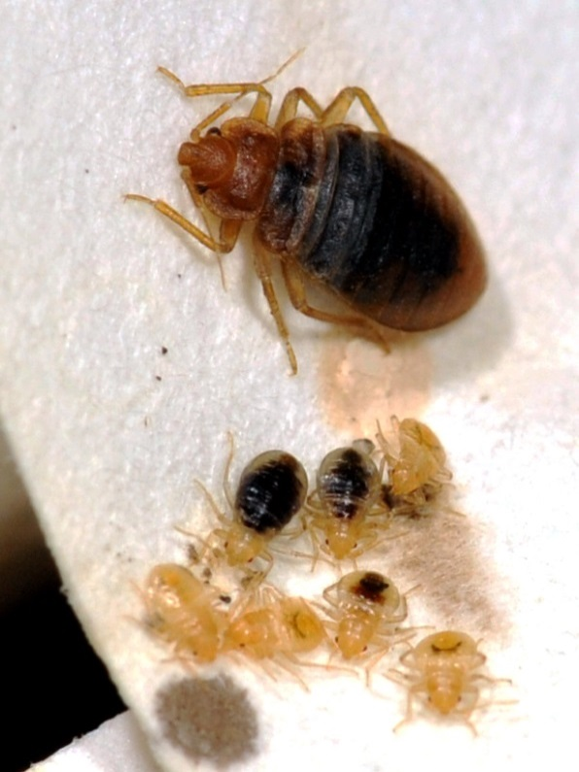
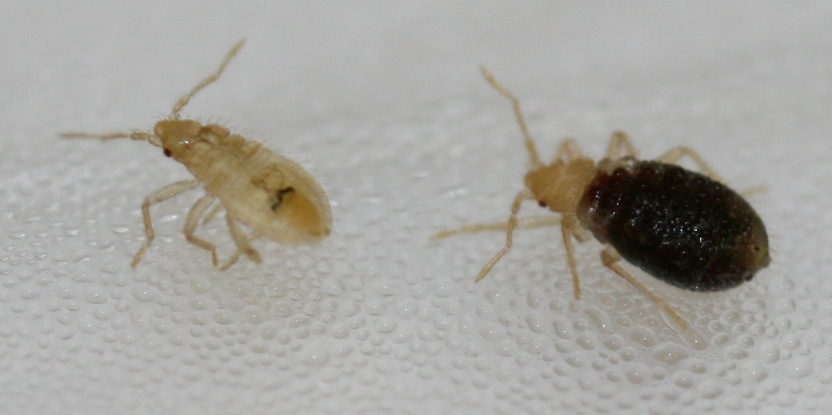
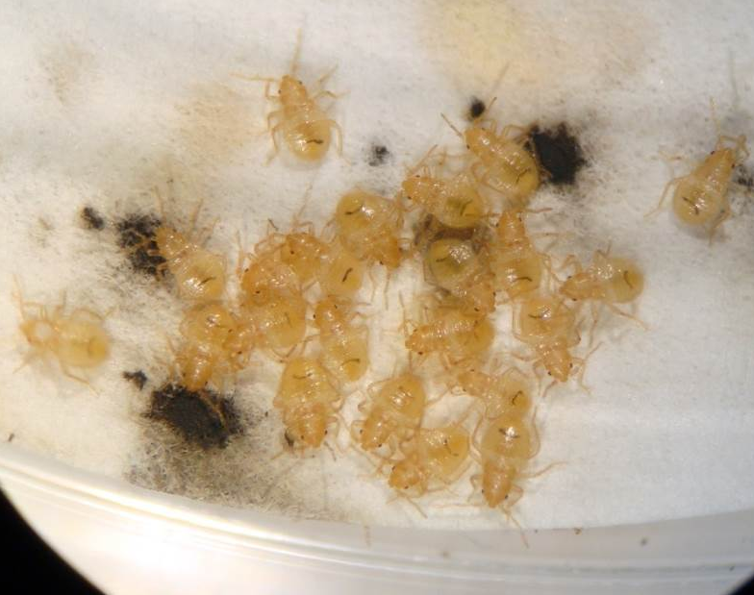

Slide 8
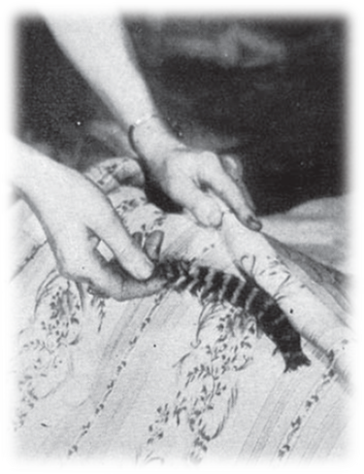
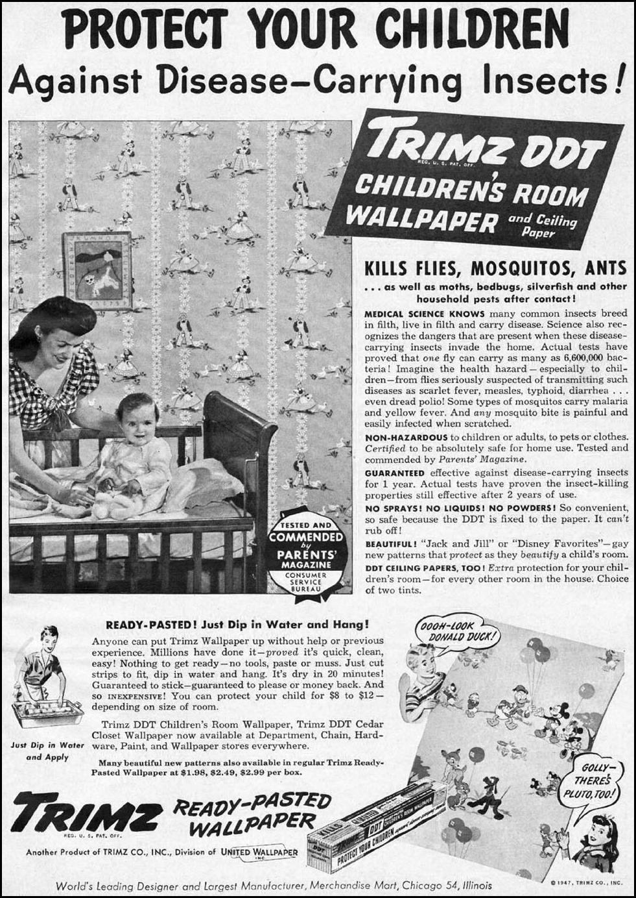
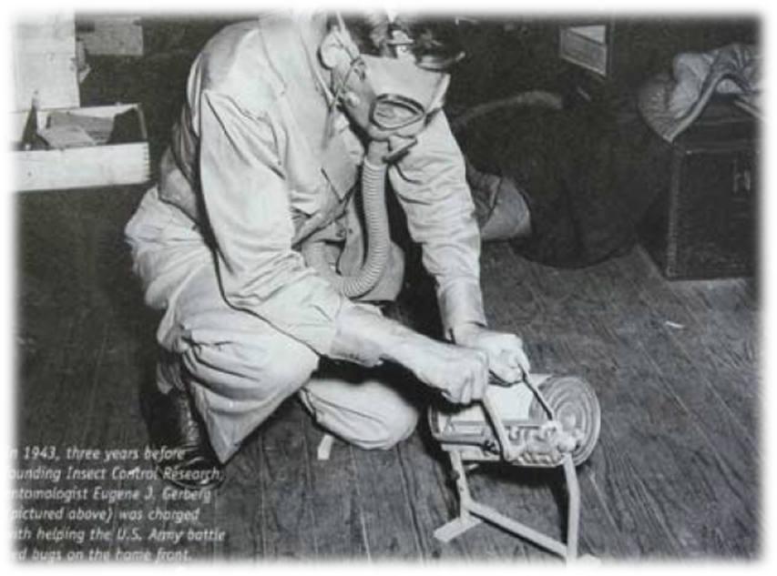
Mercury
chloride
Fumigation with hydrogen cyanide
Notes:
8

Slide 9
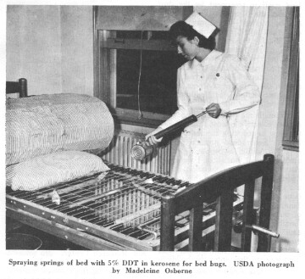
Common pest in the US at the turn of the century
Almost eradicated in 1940-50 due to DDT
Resistance
documented
to DDT,
malathion,
carbamates
and
pyrethroids

Slide 10
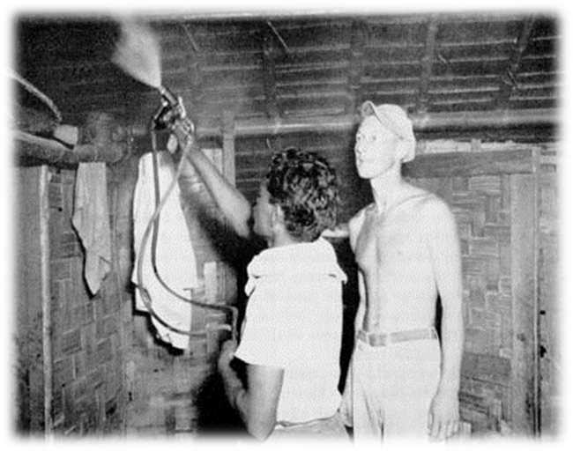
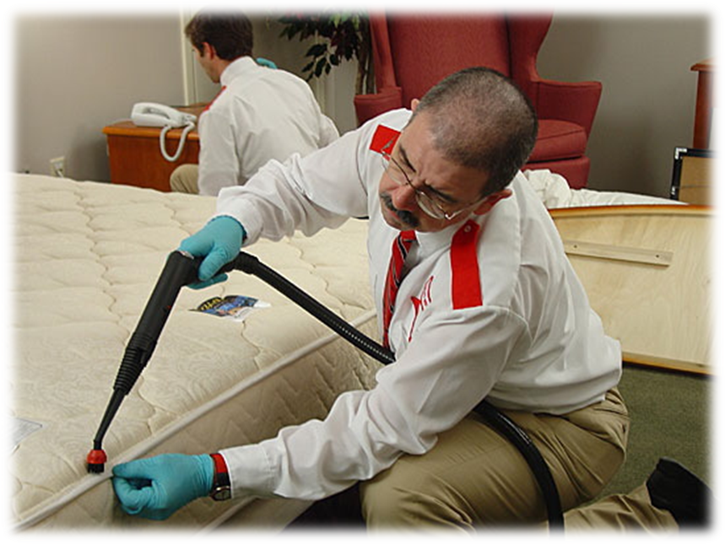
Management relied upon
Labor intensive
Detailed work
Constant monitoring
This is just as true today as it was then, despite technological advances

Slide 11
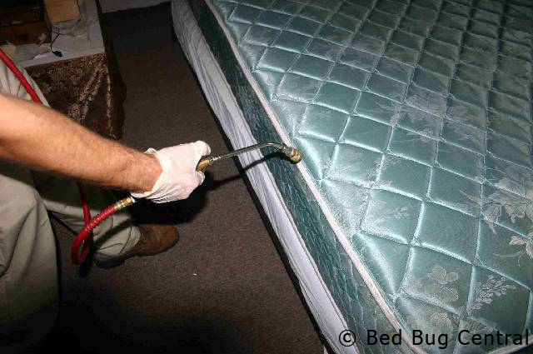
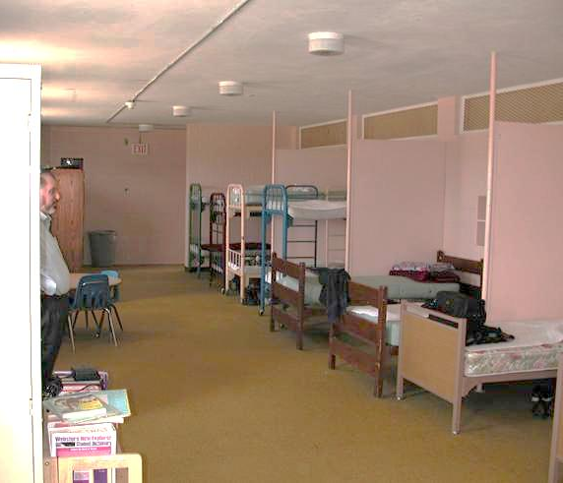
2001 Arizona
Some communities remain unaware of chemical exposure risks
Beds in school dorms were sprayed with diazinon weekly
EPA banned diazinon for in-home use in 2004
Notes:
Diazinon is derived from a World War II nerve gas developed by Nazi Germany

Slide 12

Why are Bed bugs back?
International travel?
Reduced indoor chemical use?
Increased pressure of resistant populations?
100-500% increase in bed bug jobs in US, Europe, and Singapore

Slide 13
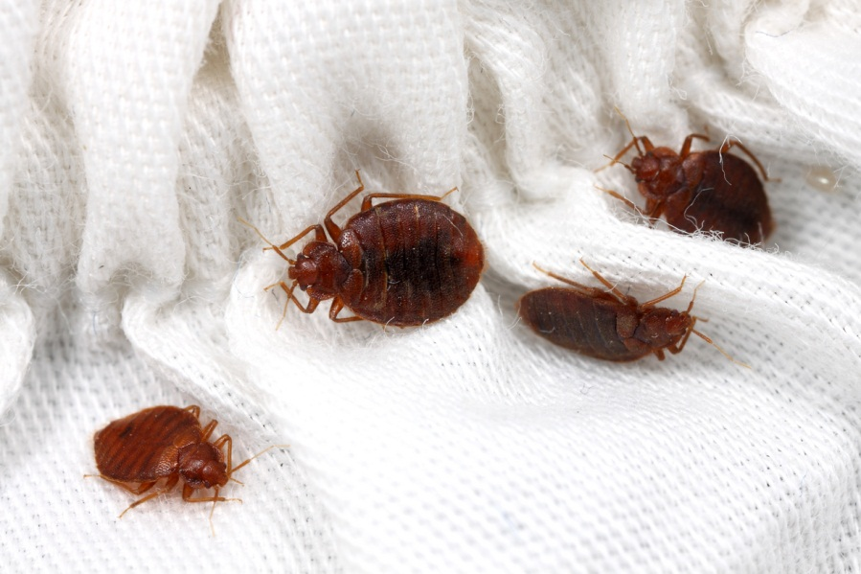

Maricopa County – 300% increase between 2008-2010

Slide 14
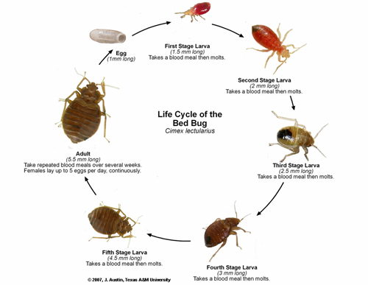
40 bed bugs are in a 70°F room on May 2. By Nov 2 how many are there?
First Stage
(1.5 mm long)
Egg
(1 mm)
Second Stage
(2 mm long)
Cimex
lectularius
Adult (5.5 mm long)
Third Stage
(2.5 mm long)
5,905!
Fifth Stage
(4.5 mm long)
Fourth Stage (3 mm long)

Slide 15
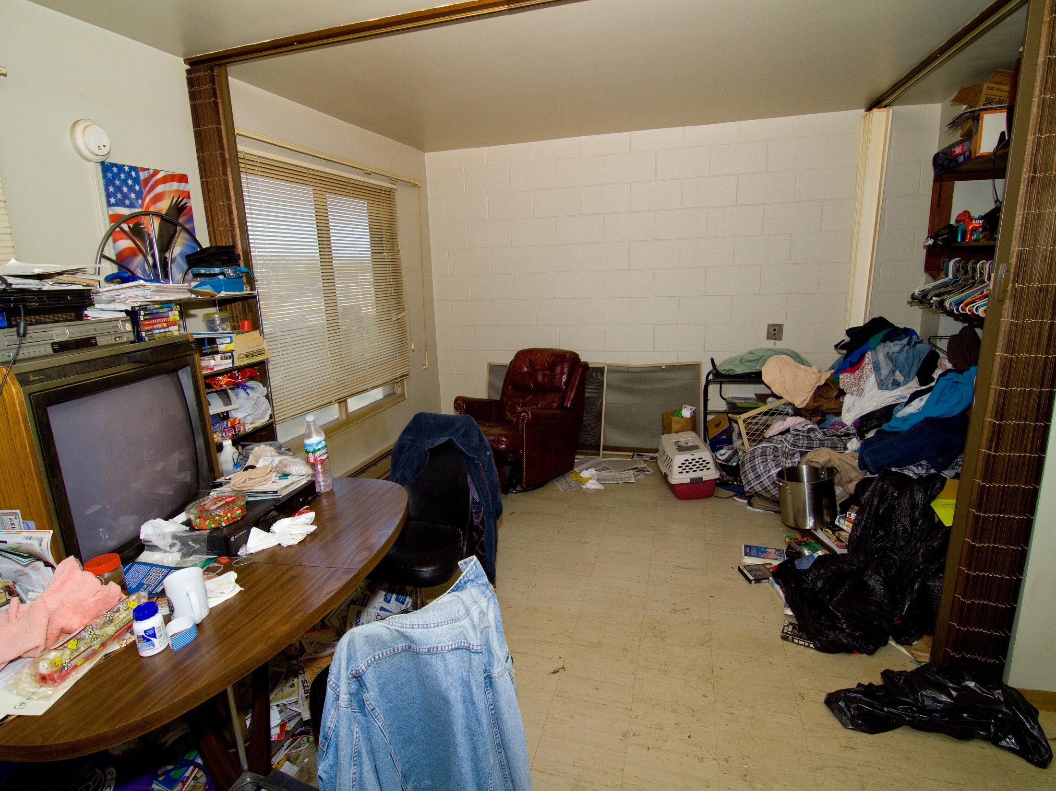

Slide 16
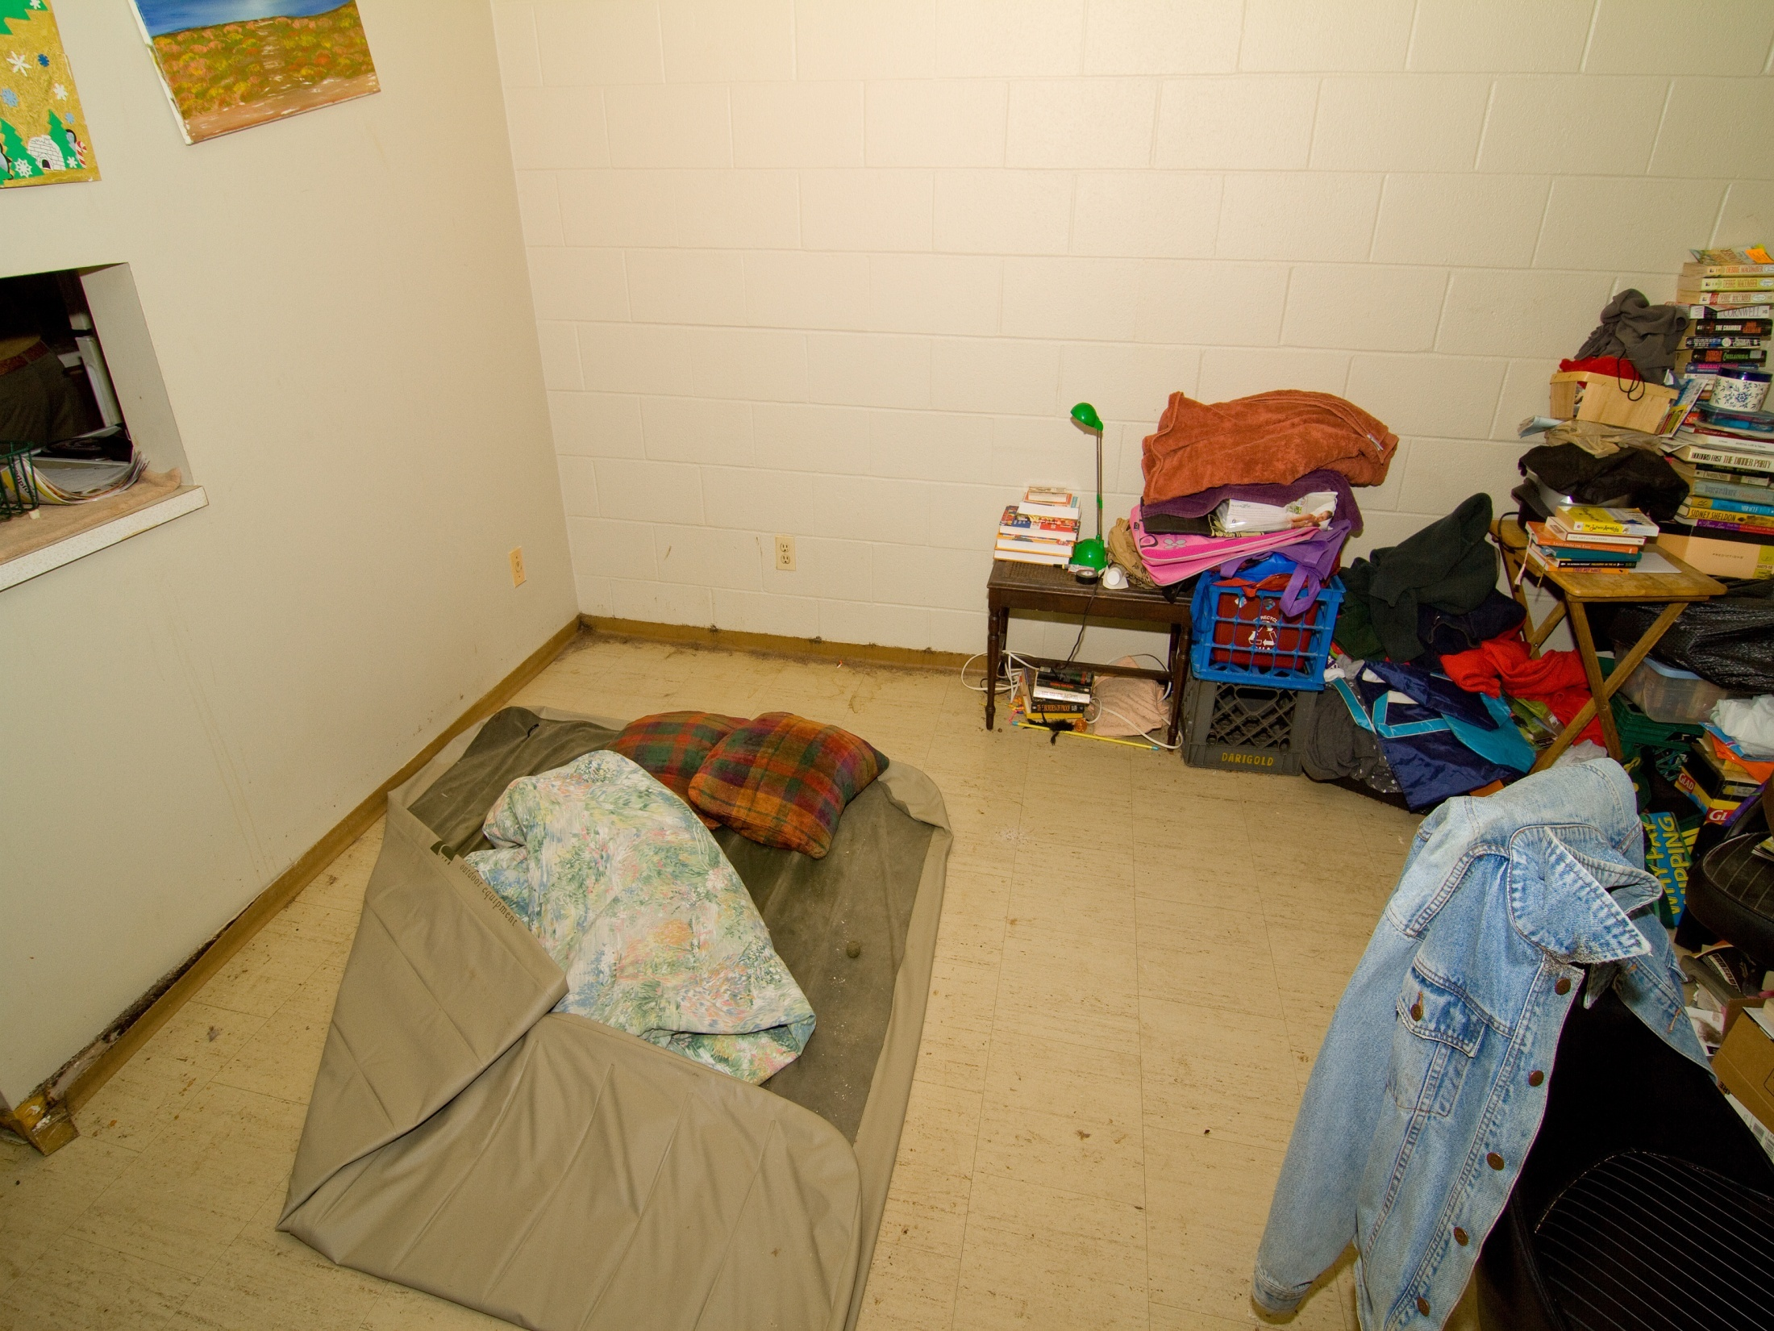
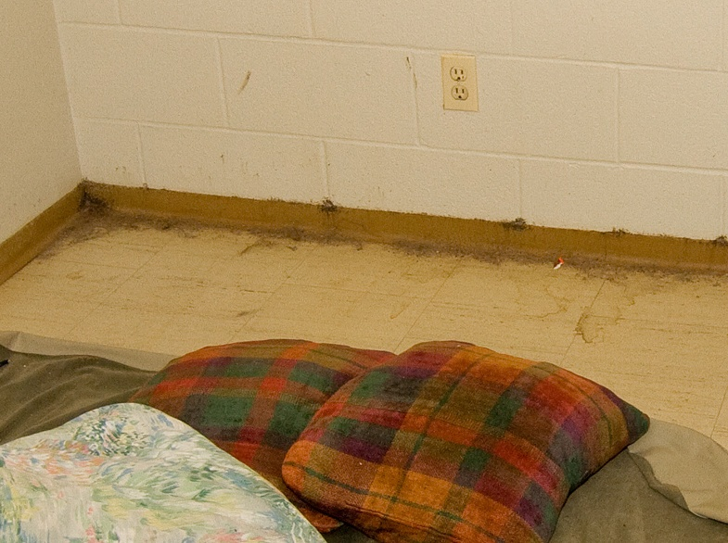

Slide 17
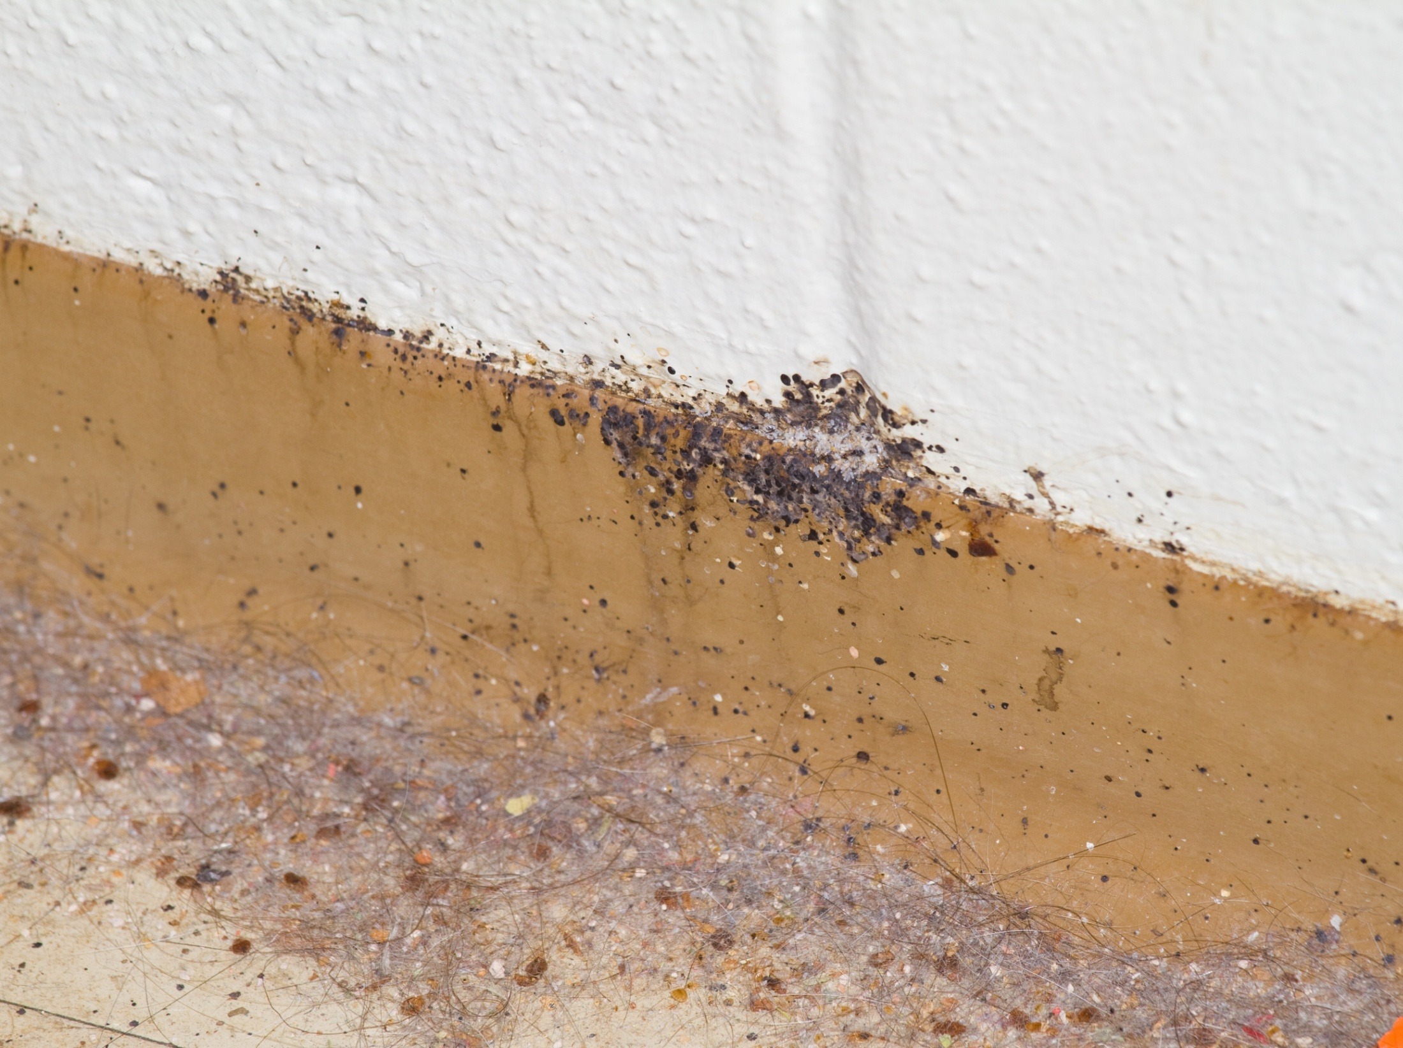

Slide 18
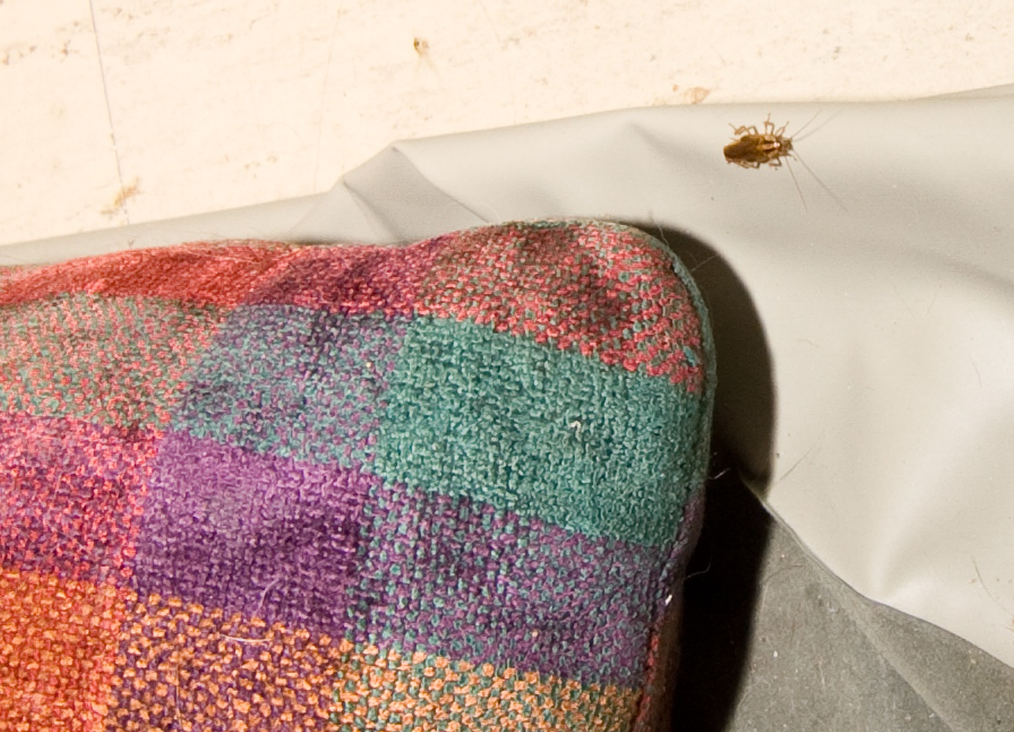

Slide 19
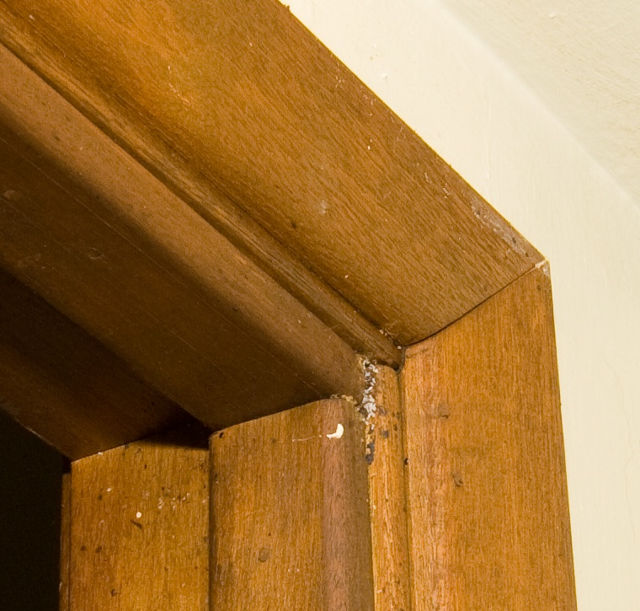
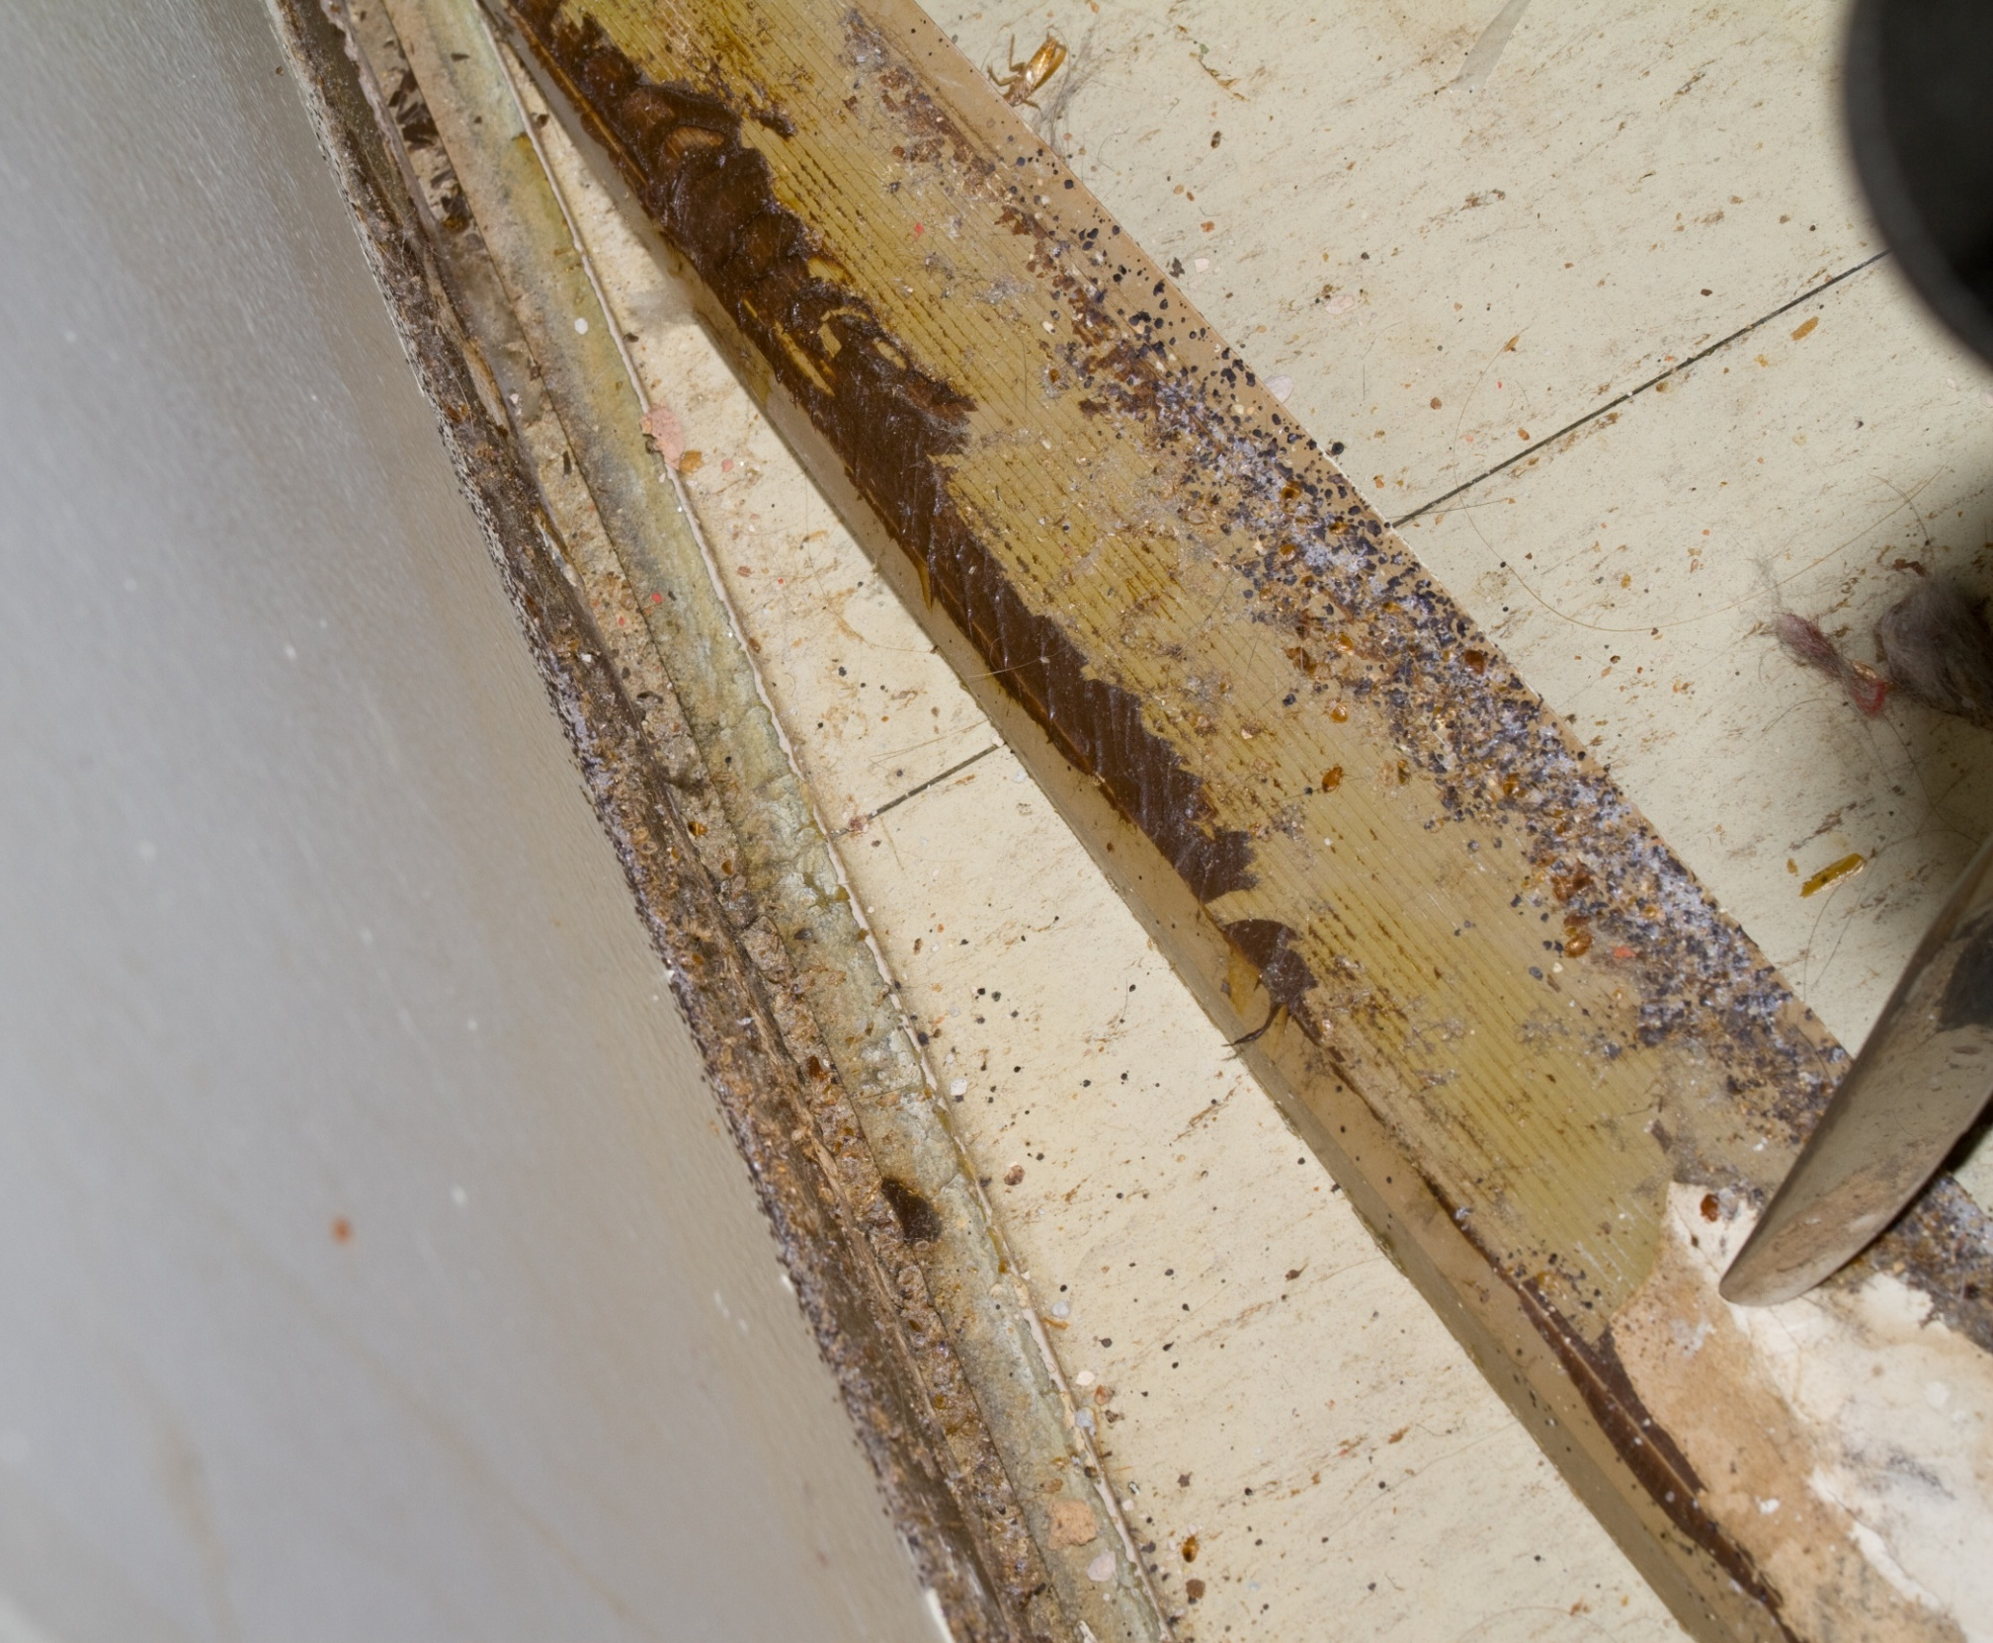
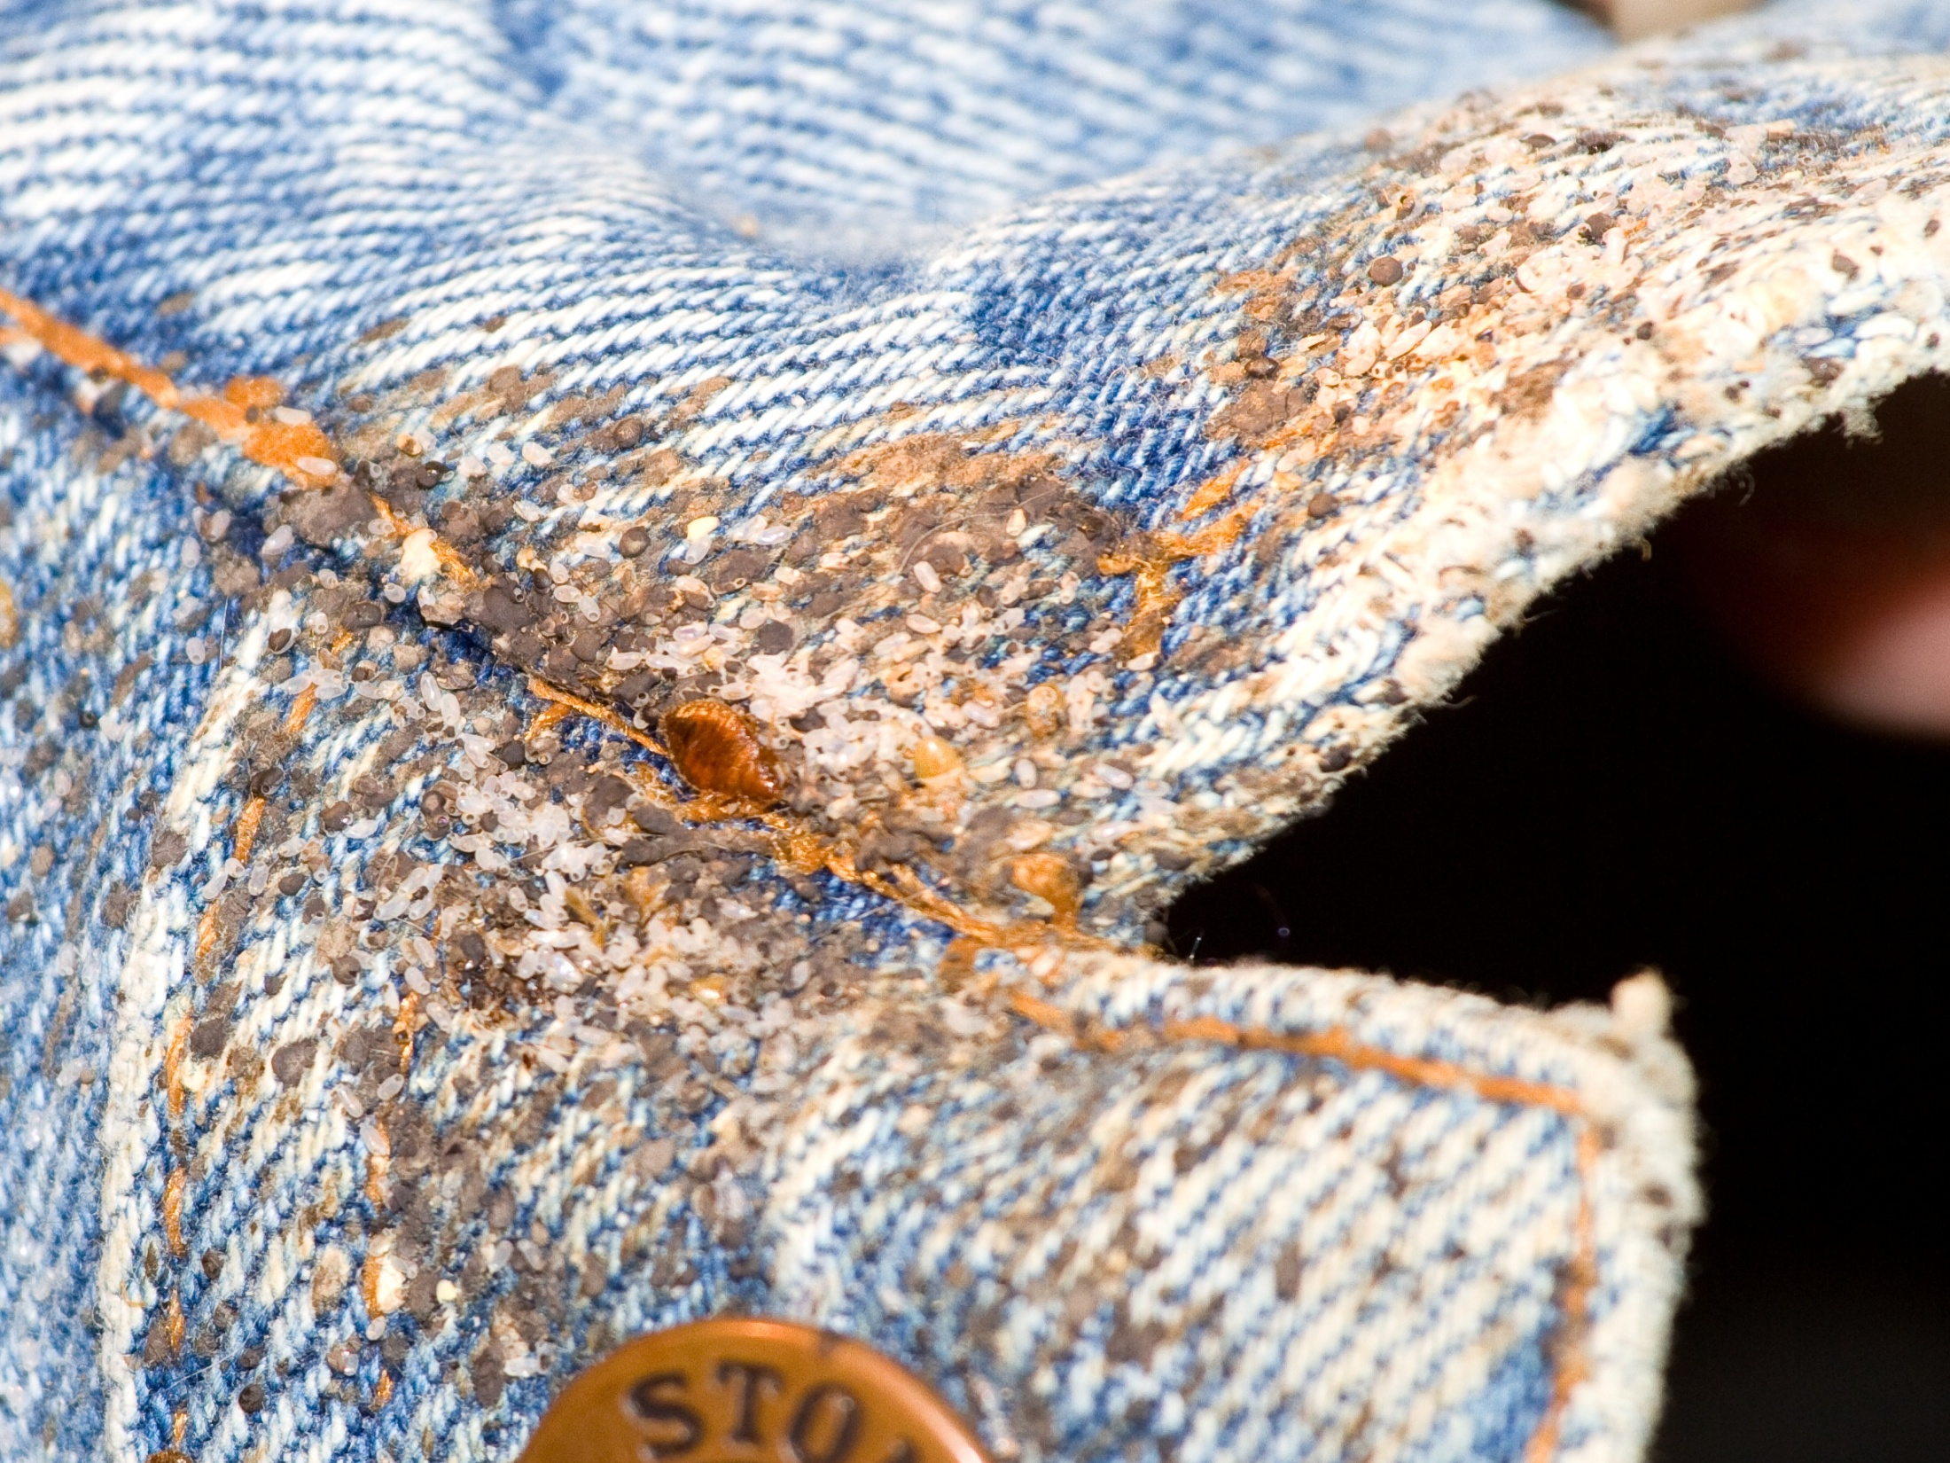
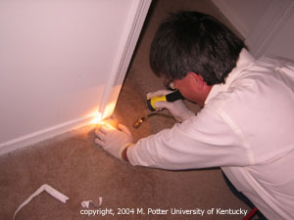
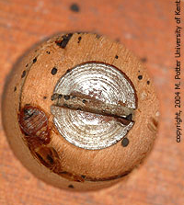
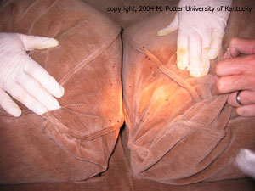
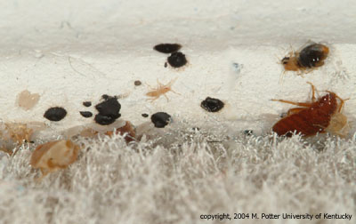
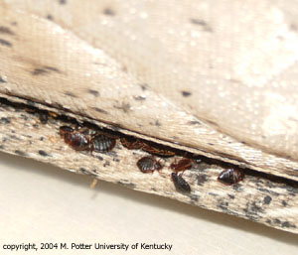
Combine inspection with vacuum cleaning
Use a brush, flash-light, canister vacuum
with a crevice
attachment

Slide 20
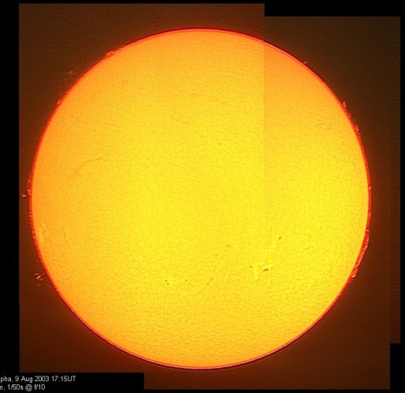
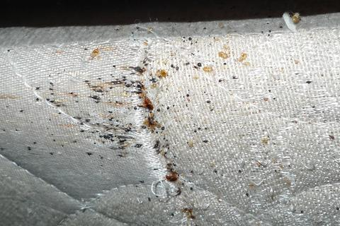
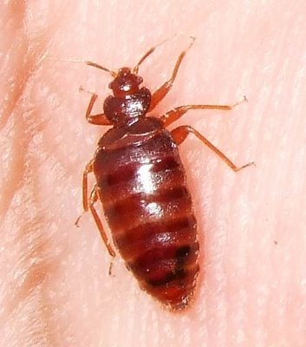
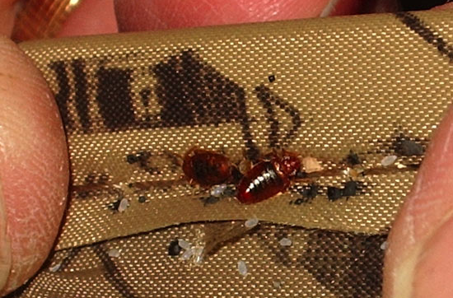
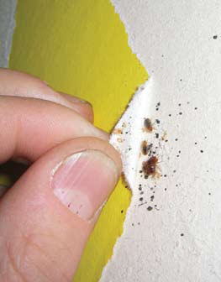
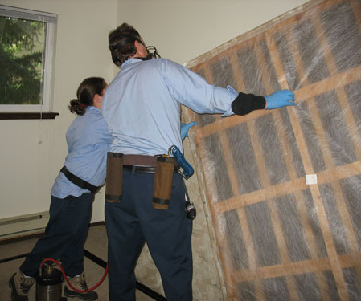

the Life of a Bed Bug
Feeding
Hiding

Slide 21
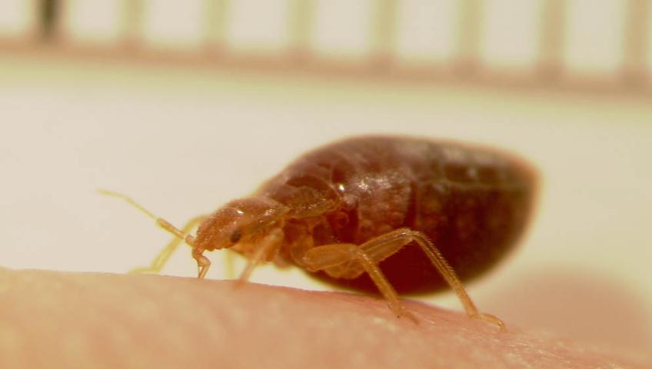

Slide 22
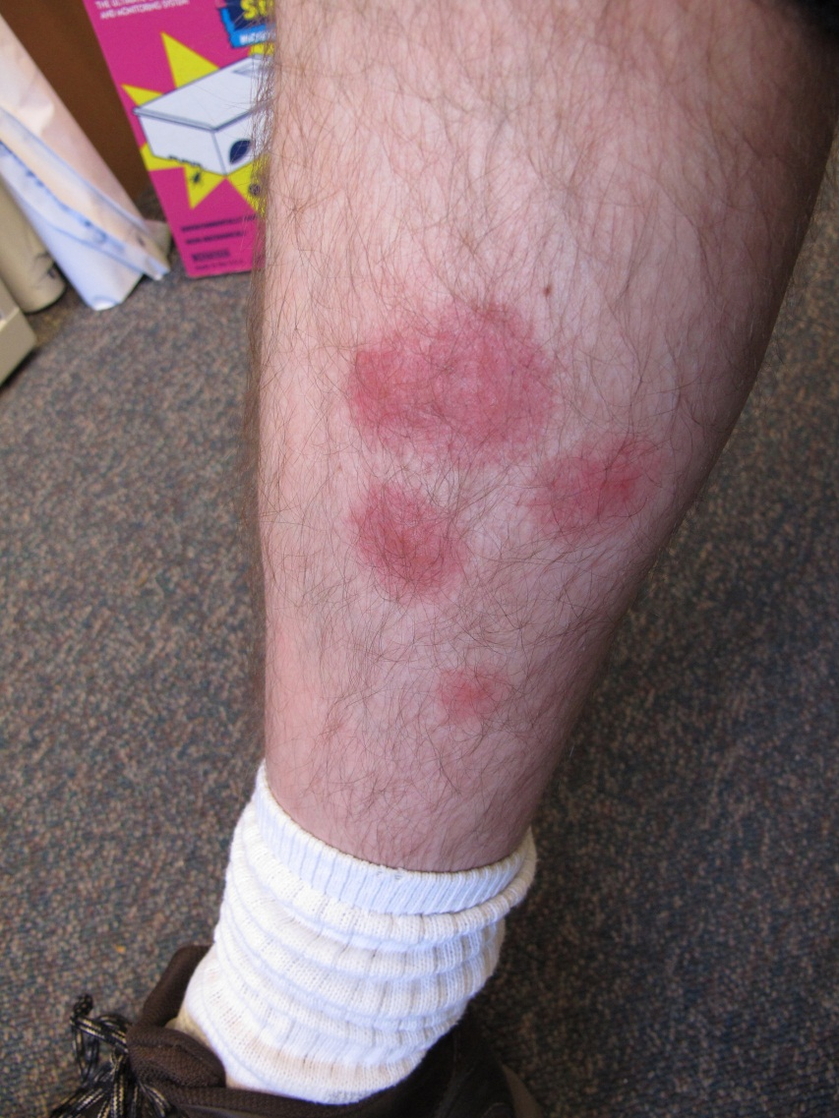
Bed bugs feed on the blood of humans, birds and mice.
Feed at night –
mainly
Saliva can cause a
person to itch
and cause swelling
Scratching can
lead to infected
sores

Slide 23
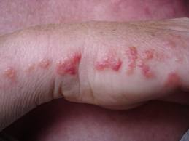
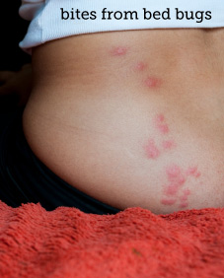
Bites may occur in lines
- usually on exposed skin

Slide 24
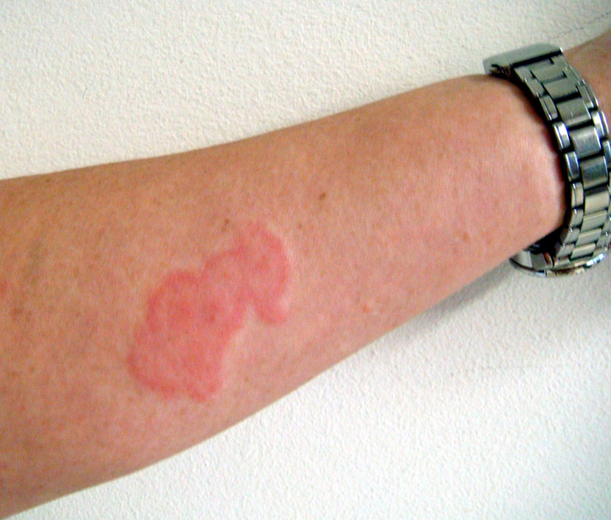
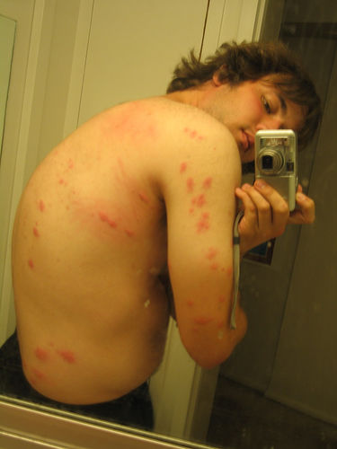
  One study 30% had a reaction
  One study 96%
  Reactions vary depending on your immune system and number of bites
  Bites do not confirm bed bug infestations

Slide 25
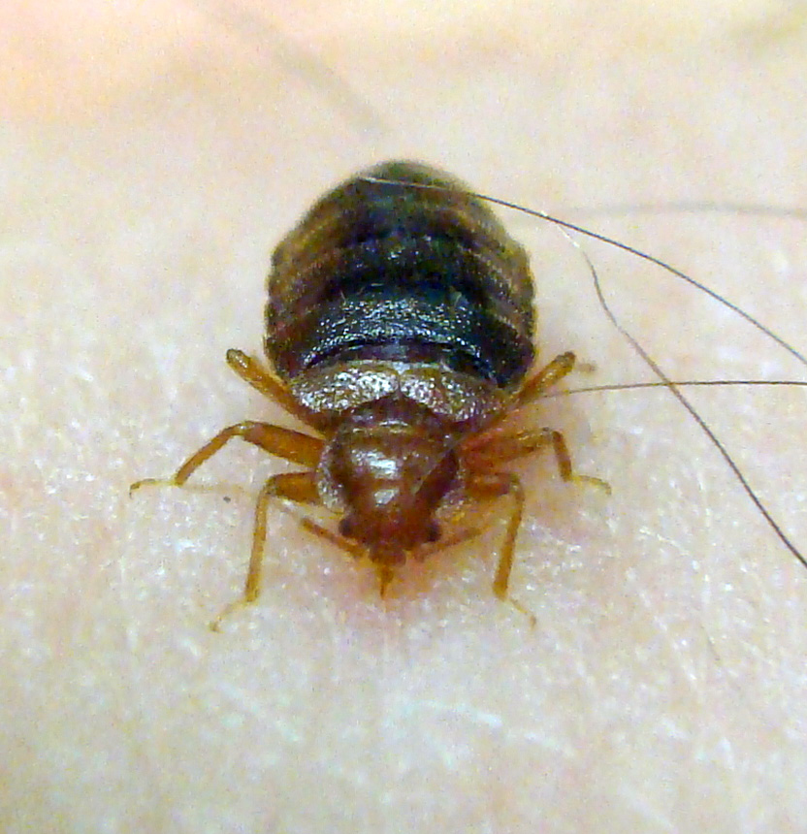
Bugs probe the skin to find a capillary space that allows the blood to flow rapidly
May probe several times before feeding
Feed for 5-10 min
After feeding, moves
to aggregate
Feed every 3-7 days

Slide 26


After feeding adults become interested in mating
They engage in
traumatic
insemination
Females may be
mated by many
different males
Females leave
aggregations after
being mated several times

Slide 27

Females that mate only once will produce 25% more eggs than multi-mated females
A single mated female can cause an infestation
After taking a blood meal the
females produce
5-20 eggs over
~12 days
Females produce
~143 eggs in a lifetime

Slide 28


Aggregate in cracks and crevices all day
If hungry they become active between midnight and 5:00 am
Stimulated by the
increase of CO₂ in
the room
Travel many yards
to get to host
Bed bugs detect
temperature, CO_{2,}
other chemicals

Slide 29

Frass spots (bed bug poop)
  Mattress seams and on the tag
  Wood frame of the box springs
  Behind the head board
  Along the tops of
  baseboards / the edge
  of carpeting
  Ceiling / wall junctions
  behind pictures
  Electrical outlets
  In curtain seams

Slide 30

Excreted digested blood
Looks like
cockroach
feces but feels
very different

Slide 31


Fecal Crust

Slide 32


Molted Skins

Slide 33


Less Obvious Unless You Know
Looks like mold
But is actually a bed bug aggregations
What are we looking at?

Slide 34



Blood
Smash and
Drag

Slide 35




Slide 36



Slide 37



Slide 38



Slide 39



Slide 40

Most products will kill some bed bugs
Consumers do not realize that killing bed bugs we can see is not the problem

Slide 41


Treatments
Multiple applications of
insecticides
Crack and crevice applications
Resistance to pyrethroid
products is very high
Not all populations are
resistant to the same
products
Two general types of
resistance occurring
Notes:
There are several products labeled for bed bug treatments, and they are seeing widespread use because the pest control industry is using everything they can to combat bed bugs. And, researchers are making reccomenedations whether to use repellent or non repellent products in combination with Sanitation, matress treatments, mattress covers, and scorched earth policy. But as far as products are concerned, we currently have no data to tell us if these products actually work. So there is a great need to evaluate some of these products. So we can make better recommendations on how to control bed bugs. ***Repellency****

Slide 42




Products
Novel pesticide formulations
  Temprid (B-cyfluthrin & imidacloprid
  Transport (Bifenthrin & acetamiprid)
  Tandam (ƛ-cyhalothrin & thiomethoxam
Chlorfenapyr
  pyrolle; “pro-insecticide”
Alpine Dust
  Dinotefuran and DE

Slide 43

DIY stores are not helping
Notes:
43

Slide 44

Non Chemical Methods
Becoming the primary methods used in combination with chemical methods
  Heat/Cold
  Vacuuming
  Mattress
  encasements
  Desiccant dusts
  Other
How do you treat libraries?

Slide 45


Treatment Preparations
Most companies provide preparation instructions
Difficult for the resident: laundry bill
New way of thinking!
Leave the infestation in place

Slide 46


Canine Detection
Excellent detectors
Can distinguish between live and dead bugs
Good for lawsuit defense
Expensive and require constant training
Are only as good as their handler
Notes:
46

Slide 47






Active Monitors
NightWatch
CDC 3000
Verifi
BuggyBed
2 Bed Bug First Response
Bed Bug Beacon

Slide 48





Passive Monitors/Traps
4 Climb Up Interceptors
4 Bed Moat
4 CVT BB Trap
BB Alert
6 BB Detection System
Notes:
The top tow monitors use the human as bait and intercept hungry bed bugs on the way to the host.
The bottom two are probably most attractive to fed bed bugs who have left the host and are looking for a place to harbor.
48

Slide 49

Vacuuming
The value of
vacuuming is it
makes inspections
easier
Large infestations,
harborage areas are
filled with live bed
bugs, dead bed bugs,
molted skins, hatched
egg shells, and feces

Slide 50


Heat kills bed bugs Best of All!
Items can be placed in a hot dryer dry for 40 minutes after items
are dry
Washing only,
does not kill
bed bugs
Heat box
for books,
etc.

Slide 51


Showering removes bugs from your person
Notes:
Reinforce this point that was made earlier in the course.

Slide 52

Steam Cleaning
Steam
temperature
(at the bed bug)
must be 130º F (54º C) or greater
The steam head
must be large
Steam power
will kill bed bugs
and their eggs
Steaming is slow
and labor intensive

Slide 53

Heat Chambers
Do it Yourself
Pack Tite ®

Slide 54


Whole Home Heat
Propane or electric
Temperature ~132°F, fans turned on to heat items in the room to 120°F
Notes:
54

Slide 55


Cryonite®
Bed bugs exposed
to CO₂ snow at
-42º C
The snow is
pressurized
through a nozzle
that forms vapors
Snow freezes the
cells of the bugs
This system will
not eliminate a bed
bug infestation if used alone

Slide 56

Mattress Covers
Encasements for both mattress and box springs!
Improved version has a zipper protector sewn in
Traps bed bugs and eggs, bite proof and escape proof
Protected Zipper

Slide 57


Not all covers protect
Where the zipper closes and the zipper teeth
are vulnerable to bed bug escape

Slide 58


Desiccant Dusts
Desiccant dusts are
ultimately more effective
than sprays
Resistant strain died
in ~36 hours
Diatomaceous Earth
  insecticide grade 2-3 days
Silica dust
  2-3 days
Lasts unchanged in wall voids for years in low humidity
Notes:
58

Slide 59


Fumigation with Vikane
Fumigation is
generally considered
the “last resort” due
to price
Effective for multi-
unit housing
Residents moving to
and from different
units
Sharing of belongings
Large communal areas

Slide 60

Why Bed bugs
IN School?
Bed bugs are excellent hitchhikers
  Clothing
  Backpacks
  Books
Bed bugs are good runners

Slide 61

Evidence
Univ. Minnesota – Dr. S. Kells

Slide 62

Unhappy Bed Bugs
Schools
usually lack
a food source at night
Boarding schools are the exception
Backpacks, books, clothing, wheelchairs from home provide harborage and transport
Schools can be transitional locations

Slide 63

In-school transfer
does occur

Slide 64

Accurately identify all specimens
Notify all parents of kids in the room
Provide basic information
Inspect room, monitor, careful cleaning and vacuuming
Reduce clutter
Isolate student
belongings in clear
plastic bags
Usually no need for
residual insecticides
Notes:
Take a piece of scotch tape and tape the bed bug between tape layers. Save for proper identification.

Slide 65

Locate the source,
(as with head lice)
without effective
communication,
reintroduction
occurs
Can we prevent new introductions?
It is possible but requires significant cooperation
between parents and school staff

Slide 66
Results:
Children missing school
Faculty and staff losing their jobs
Affected
families
move homes
and schools
Extreme
chemical use
A. Wild

Slide 67






Paradichlorobenzene
Dichlorvos
Naphthalene
Notes:
Naphthalene or Paradichlorobenzene

Slide 68

bed bug found on a student
Be sensitive to a child’s privacy and safety
Kids may come
to school tired
and anxious
with bites
Parents may
deny there is a
problem

Slide 69

Keep insects found for ID
Talk openly with the student
If bed bugs are confirmed - the principal should contact parents
The principal
must be
knowledgeable
and have good
information to
give to parents

Slide 70

Children of families dealing with bed bugs at home should not be barred from attending school
Unlike lice, bed
bugs can take months to
eradicate
Steps can be
taken to prevent
the spread within
school

Slide 71

Bed bug prevention in school
The school community should be notified about bed bug sightings and offered resources
Belongings of
students should be
separated as a
matter of policy
Use ziplock bags and
storage containers for belongings
This is not easy – but it is reality

Slide 72

parents
Inform parents how to send students to school free of bugs
  Launder clothes, dry heat for shoes, backpacks, etc.
  Clothing items
  stored separated
  from bed bug
  areas in
  airtight bags

Slide 73
If a bed bug is discovered in the school
Do not panic
or cause panic!
Often it’s a
stray, single bug
Collect it for proper ID
Do not evacuate the classroom or office
Thoroughly inspect the room

