Slide 1
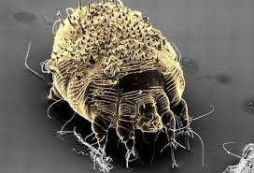
Scabies Sarcoptes scabiei

Slide 2
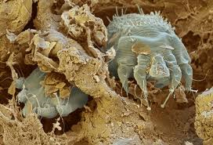
Scabies is an intensely itching (pruritic), contagious infestation of the skin.
Arachnid mite Sarcoptes scabiei variety hominis.
Adults are 1/3 millimeter long.
Historically the term scabies was used by the Romans for any pruritic skin disease.

Slide 3
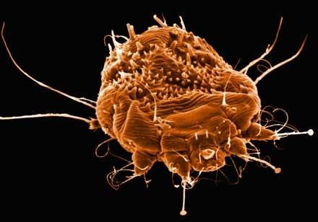
Scabies mites played an important role in world history, with epidemics partially coinciding with military activities and major social upheavals.
Scabies has been recognized as a disease for over 2500 years.
It was historically treated with topical sulfur, still used today.
Notes:
Crowding

Slide 4
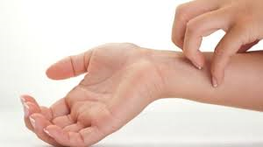
Mites are inactive below 20ºC (68ºF).
At 20ºC mites can persist for 2 weeks.
Itchy!
Notes:
Crowding

Slide 5
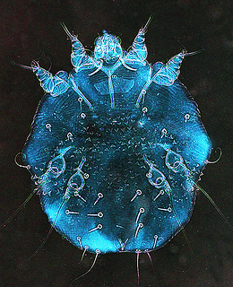
Incidence
Frequency In the US: In developed countries, scabies epidemics seem to occur in 15-year cycles; however, the most recent epidemic began in the late 1960s and for some unknown reason continues today.
300 million cases of scabies occur worldwide each year – about 1 million in the U.S.

Slide 6
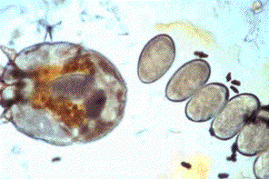
SPREAD
The mite, S. scabiei spreads through direct and prolonged contact between hosts.
The mite remains viable for 2-5 days on inanimate objects; transmission via articles such as clothing, towels, or bedding, is possible, but less likely.

Slide 7
Transmission of Sarcoptes scabiei is rapid under crowded conditions that facilitate frequent skin-to-skin contact.
Hospitals, childcare facilities, and schools are optimal locations for the spread of scabies.
Notes:
Also prisons, nursing homes, military barracks, and emergency shelters.

Slide 8
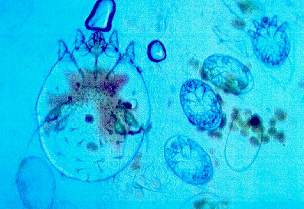
Infection occurs due to the direct transfer of a single fertilized female.
The entire life cycle of the mite occurs over 10-17 days.
Notes:
Once bound to their host, 10-15 mites mate on the surface of the skin.

Slide 10
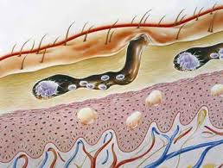
After mating, the male mite dies.
The female mite burrows into the epidermis of the host using her jaws and front legs, where she lays up to 3 eggs per day
(30 mins).

Slide 11
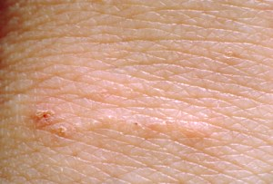
Burrows are often not seen but check in the webbing of fingers or on the inside of wrists.
Notes:
The typical distribution is arm pits/breast area, waist line, and crotch/buttock area. It tends to avoid the face and neck.

Slide 12
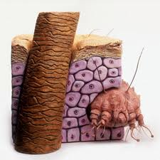
An affected host harbors 10-15 adult mites during a typical infestation.
The eggs hatch in 3-4 days.
The young leave the burrow to mature on the skin.
Fewer than 10% of the eggs laid result in mature mites.
Notes:
Once bound to their host, 10-15 mites mate on the surface of the skin.

Slide 13
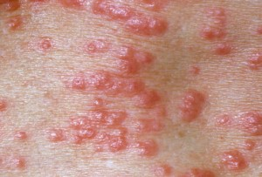
The young mites mature on the surface of the skin using hair follicles or shallow burrows as protection.
They feed on fluids provided by follicles.
The males remain on the skin surface wandering between burrows.
Mated females begin to make a permanent burrow 0.5-5mm per day.

Slide 14
Females feed on the skin and fluids that are released from the damaged tissues.
While in the burrows the females deposit fecal matter and lay eggs as they burrow.
Skin scrapes are the only way to positively ID.

Slide 15
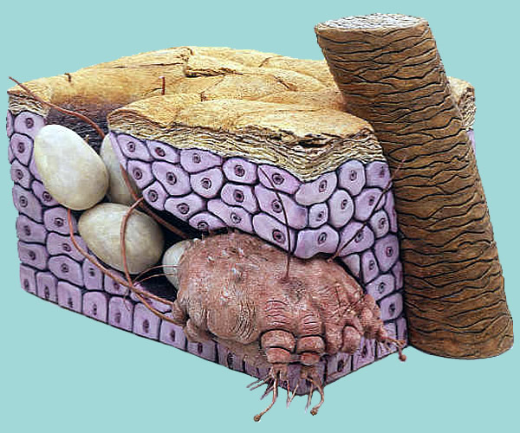
A delayed type IV hypersensitivity reaction to the mites, molts, eggs, or scybala (packets of frass) occurs approximately 30 days after initial infestation.

Slide 16
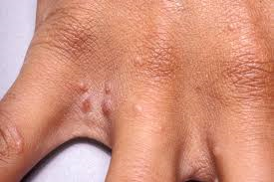
This reaction is responsible for the intense pruritis, which is the hallmark of the disease.
Individuals who already are sensitized from a prior infestation can develop symptoms within hours.

Slide 17
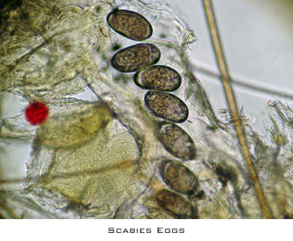
Diagnosis
Definitive diagnosis of scabies is made by direct visualization of the mite, eggs, or feces.
Mineral oil is placed on the end of a burrow, preferably where a black dot is visible.

Slide 18
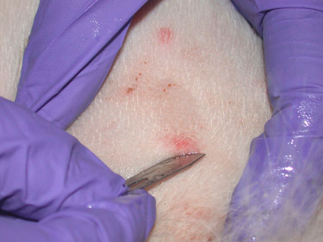
Diagnosis
The area should then be scraped with a number 5 scalpel blade and the scrapings shed onto a slide.

Slide 20
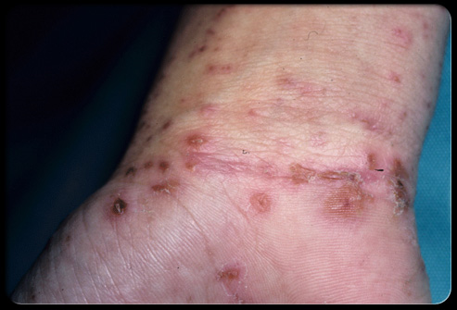
Main presenting features include rash and intense itching.
In young infants, pruritus may be difficult to detect. Irritability, especially during sleep, may be the only symptom.
History of involvement of other family members and contacts is often present.

Slide 21
Scabies disproportionately affects women and children.
Pruritus is most severe at night.
Secondary bacterial infection is most commonly.

Slide 22
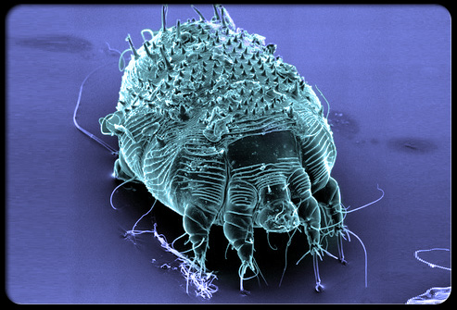
Scabies is unlikely to cause a long-term disease state in healthy individuals.
Lesions and associated pruritus may last for weeks to months without adequate treatment.
The immunocompromised are likely to develop crusted scabies, which may be impossible to fully eradicate.

Slide 23
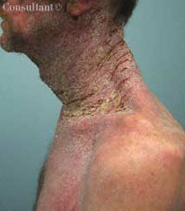
Norwegian (crusted) Scabies
In 1848, the Norwegians Danielssen and Boeck described a highly contagious variant of scabies that occurs in immunocompromised patients.
Crusted or hyperkeratotic scabies, is an overwhelming scabies infestation that can be difficult to control.

Slide 24
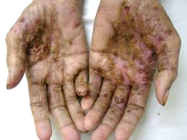
This rare form of scabies occurs in elderly or mentally incompetent patients.
Because of an impaired antibody response, these individuals can be infested with thousands to a couple million mites.

Slide 25
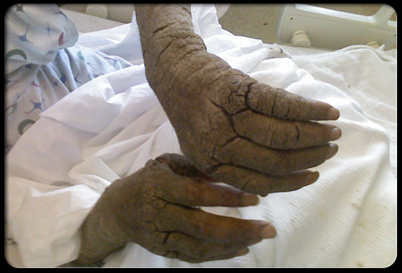
People with a compromised immune system (elderly, disabled, patients with AIDS, or lymphoma).
Lesions are extensive and may spread all over the body especially elbows, knees, palms, scalp, and soles of feet.
Fingernails can be thickened and discolored.
Itching may be minimal or absent.

Slide 26
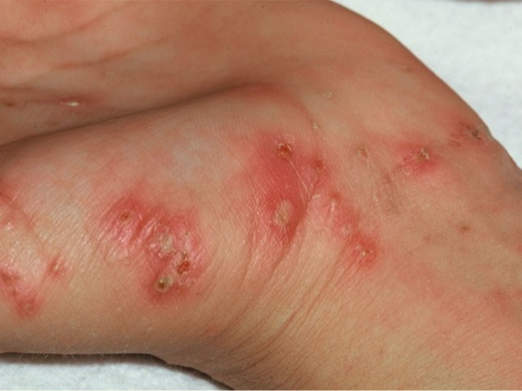
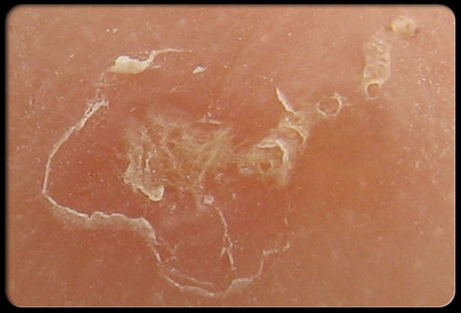
Physical Exam
The classic rash of scabies includes primary and secondary lesions.
The primary lesions include burrows, papules, vesicles, and pustules.
The secondary lesions occur from scratching and include excoriated papules and crusted areas.

Slide 27
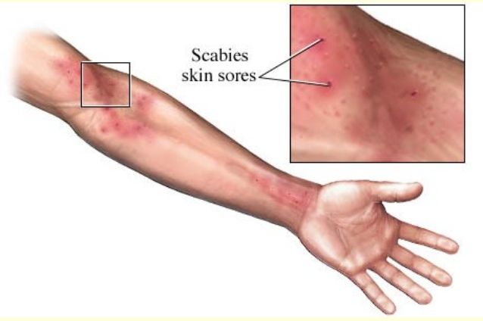
In infants, the most commonly affected areas are the palms, soles, axillae, and scalp.
Involvement of the face is uncommon in people older than 5 years.

Slide 28
In older children and adults, lesions are usually confined below the neck and involve the web spaces between the fingers, flexor surfaces of the arms, wrists, axillae, and the waistline.
The umbilicus, nipples, penis, and scrotum may also be affected.

Slide 29
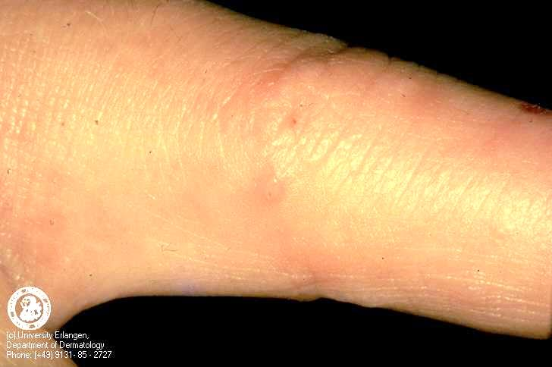

Slide 30
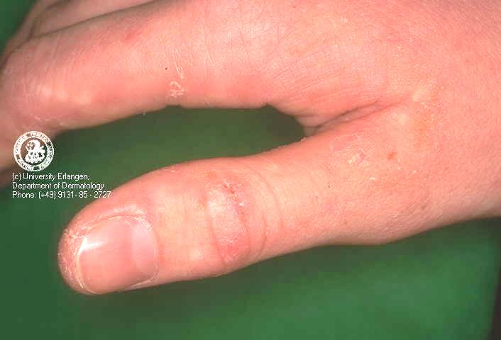

Slide 31
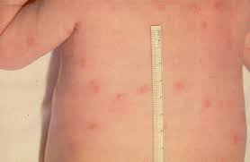
Nodular scabies
7% of infested individuals.
Most common in children.
Orange-red-brown puritic nodules located on the lower trunk, groin, and top of the legs.
Mites are rarely found, implying that this variety represents a delayed hypersensitivity reaction to the scabies mites.
Treated with steroids.

Slide 32
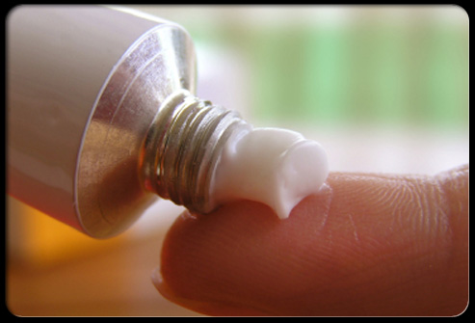
Treatments
Permethrin (e.g. Elimite) is a neurotoxin that causes paralysis and death in ectoparasites.
It is the most common treatment used today for scabies.
The lotion should be applied over the entire body from neck down.
It should be left on for 8-12 hours and then rinsed off.
Notes:
The following medications for the treatment of scabies are available only by prescription.
1.Permethrin cream 5%
Brand name product: Elimite*
Permethrin is approved by the US Food and Drug Administration (FDA) for the treatment of scabies in persons who are at least 2 months of age. Permethrin is a synthetic pyrethroid similar to naturally occurring pyrethrins which are extracts from the chrysanthemum flower. Permethrin is safe and effective when used as directed. Permethrin kills the scabies mite and eggs. Permethrin is the drug of choice for the treatment of scabies. Two (or more) applications, each about a week apart, may be necessary to eliminate all mites, particularly when treating crusted (Norwegian) scabies.
2.Crotamiton lotion 10% and Crotamiton cream 10%
Brand name products: Eurax*; Crotan*
Crotamiton is approved by the US Food and Drug Administration (FDA) for the treatment of scabies in adults; it is considered safe when used as directed. Crotamiton is not FDA-approved for use in children. Frequent treatment failure has been reported with crotamiton.
3.Lindane lotion 1%
Brand name products: None available
Lindane is an organochloride. Although FDA-approved for the treatment of scabies, lindane is not recommended as a first-line therapy. Overuse, misuse, or accidentally swallowing lindane can be toxic to the brain and other parts of the nervous system; its use should be restricted to patients who have failed treatment with or cannot tolerate other medications that pose less risk. Lindane should not be used to treat premature infants, persons with a seizure disorder, women who are pregnant or breast-feeding, persons who have very irritated skin or sores where the lindane will be applied, infants, children, the elderly, and persons who weigh less than 110 pounds.
4.Ivermectin
Brand name product: Stromectol*
Ivermectin is an oral antiparasitic agent approved for the treatment of worm infestations. Evidence suggests that oral ivermectin may be a safe and effective treatment for scabies; however, ivermectin is not FDA-approved for this use. Oral ivermectin has been reported effective in the treatment of crusted scabies; its use should be considered for patients who have failed treatment with or who cannot tolerate FDA-approved topical medications for the treatment of scabies. The dosage of ivermectin is 200 mcg/kg orally. It should be taken on an empty stomach with water. A total of two or more doses at least 7 days apart may be necessary to eliminate a scabies infestation. The safety of ivermectin in children weighing less than 15 kg and in pregnant women has not been established.

Slide 33
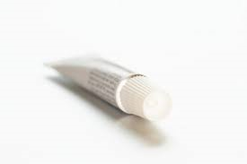
Reapplication of permethrin one week later is advised; however, no controlled studies exist that show that 2 applications are better than one.
No cases of scabies resistant to permethrin have been documented.
Infants >2 months: Apply as in adults and also on hairline, neck, scalp, temple, and forehead.
Children: Apply as in adults if hair is not infested.

Slide 34
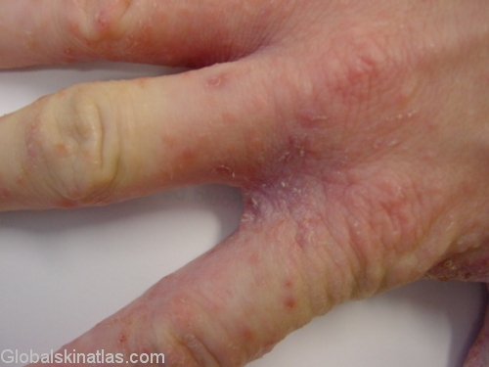
Crotamiton (e.g. Eurax; Crotan) frequent treatment failure has been reported with crotamiton.
Lindane lotion is NOT recommended, but not all doctors are aware of this.

Slide 35
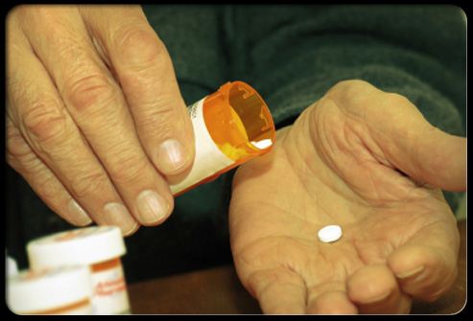
Ivermectin (e.g. Stromectol) is an oral antiparasitic medication that has also been shown to be an effective scabicide, although it is not FDA-approved for this use.
Permethrin has fewer side-effects and is considered safer.

Slide 36
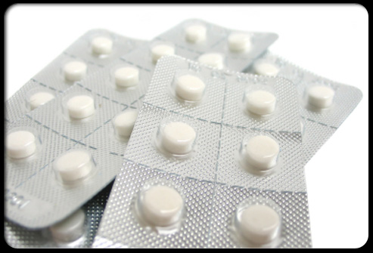
The antihistamine diphenhydramine (Benadryl), can be useful in helping provide relief from itching.
Itching often becomes worse after the mites are killed, itching can be intense for a few weeks before abating.
Notes:
Wash linens and bedclothes in hot water. Cut your nails, and clean under them thoroughly to remove any mites or eggs that may be present.
Thoroughly vacuum your rugs, furniture, bedding, and car interior and throw the vacuum-cleaner bag away when finished.
Try to avoid scratching. Keep any open sores clean.

Slide 37
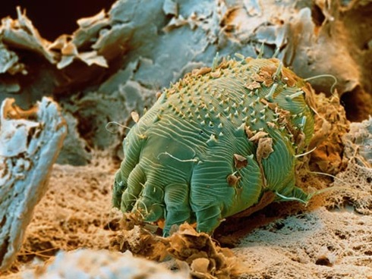
Inappropriate things
Pesticides applied to school buses.
Pesticides applied to classrooms.
Sterilants and high level disinfectants applied to classrooms incorrectly.

Slide 38
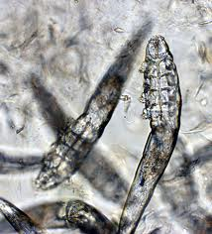
Animals do not spread human scabies.
Pets can become infested with demodetic mites that cause mange.
Mange causing mites do not survive or reproduce on humans usually.
The mange mites can get under the person’s skin and cause temporary itching and skin irritation.

Slide 39
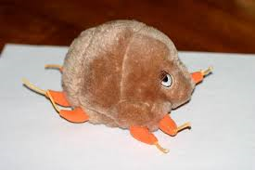
References
Pest Press http://ag.arizona.edu/apmc/docs/2013OctoberAZSchoolIPMNewsletter.pdf
Rick Lin, DO MPH (KCOM Dermatology)

