Slide 1
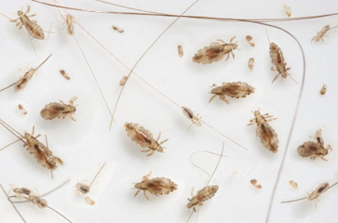
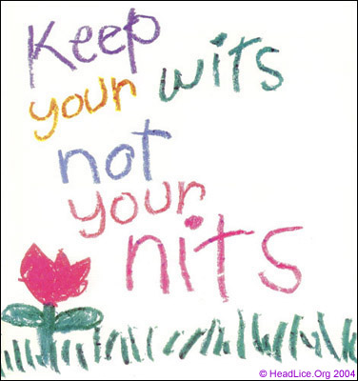
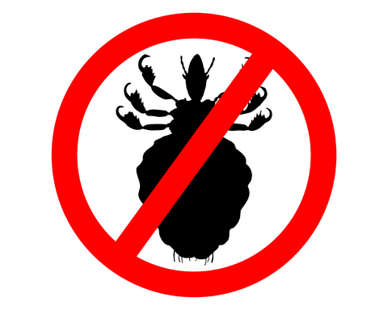
Keep your wits,
Lose the Nits!
Manage Head lice
Shujuan (Lucy) Li
Dawn Gouge
University of Arizona

Slide 2

A Problem of Society
More commonly found in children of preschool and early elementary age
(3-11 years old).
It can happen to anyone! Parents, siblings and caregivers sometimes acquire.
The most common symptoms are itching and sleeplessness.
Scratching leads to secondary bacterial skin infection.
Notes:
According to the Centers for Disease Control and Prevention (CDC), “an estimated 6 million to 12 million infestations occur each year in the United States among children 3 to 11 years of age.” Girls are infested more often than boys.
Head lice infestations are common in many parts of the world. Head lice can infest people of all ages, but children are prone to infestations due to their play activity and close contact. Getting head lice is not related to cleanliness of the person or his or her environment.
Head lice can cause discomfort, e.g. irritation, scratching, sleepless nights, and subsequent secondary infection.
In fact, the problem of head lice can be so rampant among preschool and school-aged children that often schools must work in conjunction with many families to control an infestation.

Slide 3

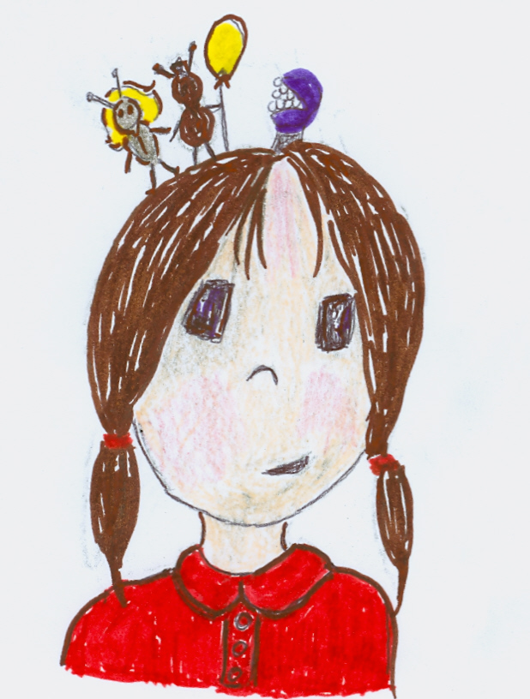
A Problem of Society Cont.
Head lice: embarrassment; unnecessary days lost from school; pesticide exposure; millions of dollars spent on remedies.
Know how to manage it!
You can ditch the itch!!!
Notes:
Head louse infection is more a societal than an infectious disease problem
Excessive public and professional reactions lead to an inflated perception of prevalence, to unnecessary, inappropriate or ineffective action, and to a great deal of unwarranted anxiety and distress. These actions and reactions in themselves cause problems, especially from the misuse and overuse of treatments.
American Pediatrics - Itching can develop in a sensitized individual.

Slide 4
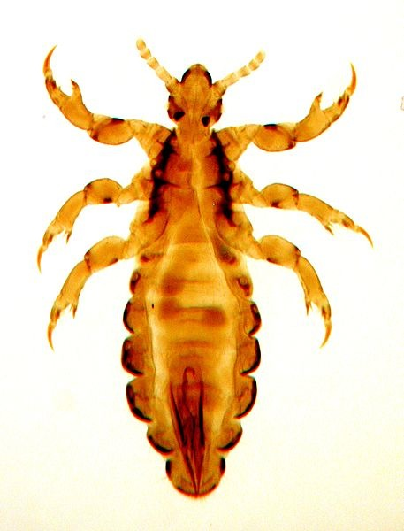
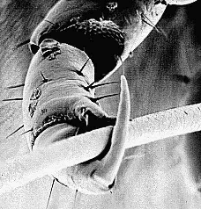
What are head lice?
Pediculosis humanus capitis
A small parasitic insect that lives on the scalp and neck hairs of a human host.
Six legs.
No wings. Cannot fly.
Cannot jump.
Move around using claw-like legs.
Notes:
They bite the scalp of the humans . Head lice prefer to live on the hair of the head, although they have been known to wander to other parts of the body.
Head lice don’t have wings or powerful jumping legs, so they move around by clinging to hairs with specially adapted claw-like legs

Slide 5
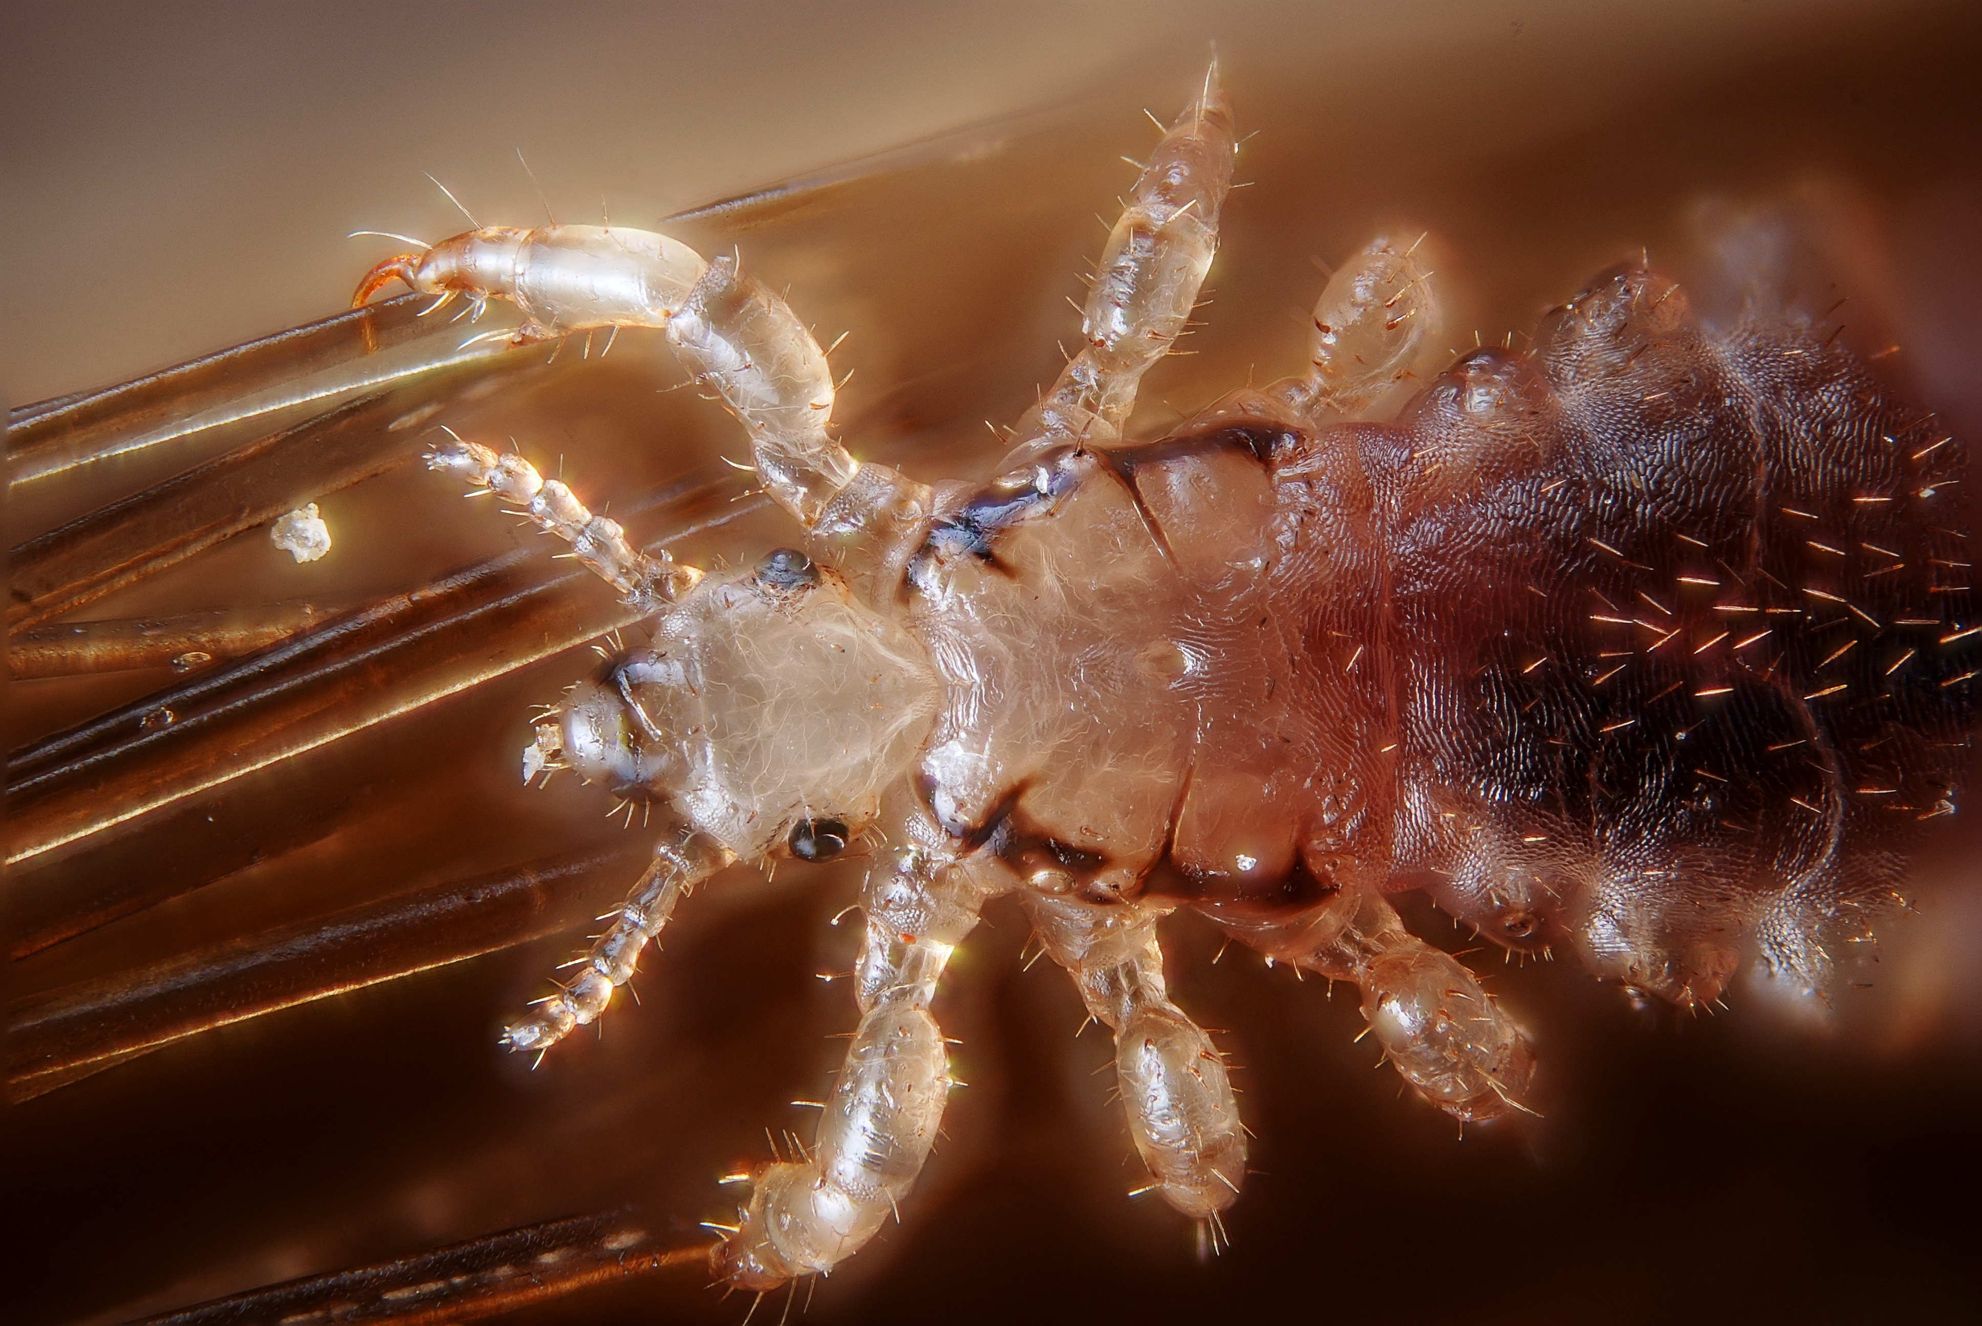
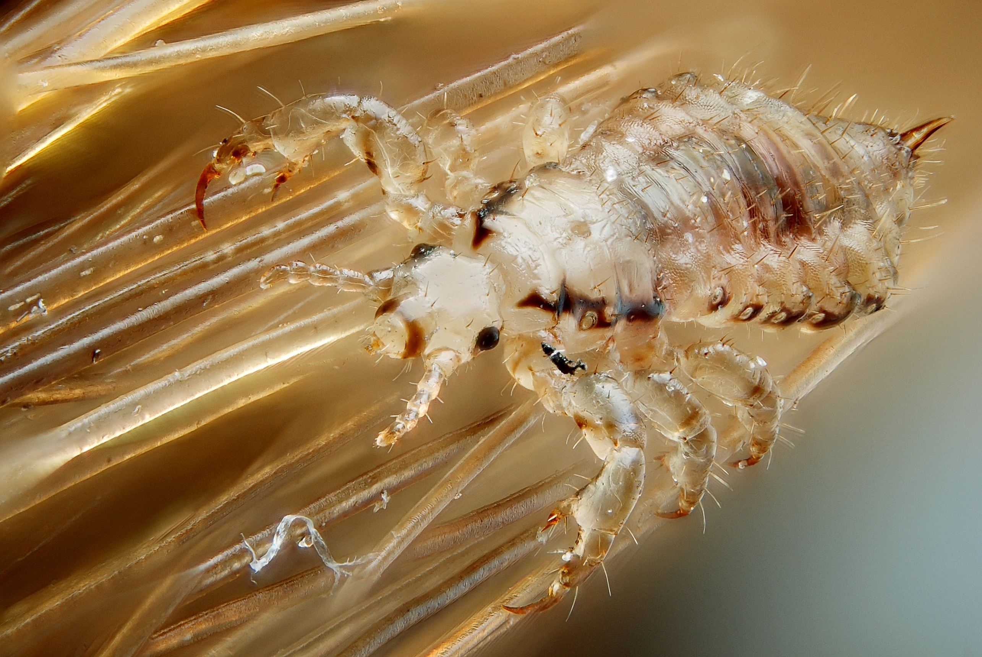
Requires human blood to grow, develop and lay eggs (nits).
Unable to survive more than 48 hours without a blood meal.
Cannot live within rugs, carpets, or school buses.
Not a sign of uncleanliness.
Female
Male
Notes:
Head lice feed every 4 – 6 hours so must remain in close contact with the host.
They are unable to survive away from a human host for more than about 48 hours (thus, they cannot live within rugs, carpets, or school buses).

Slide 6

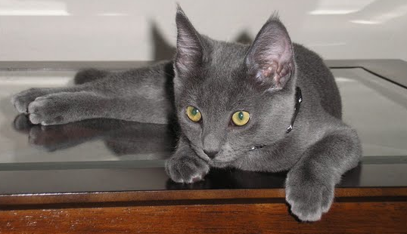
Found on animals or pets?
Transmitted from pets to humans?
Transmit infectious disease?
Discriminate among socioeconomic groups?
NO.
NO.
NO.
NO.
Notes:
Head lice are not found on animals or household pets, and are not transmitted from pets to humans.

Slide 7
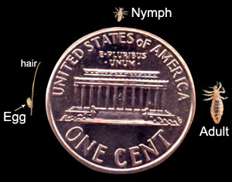
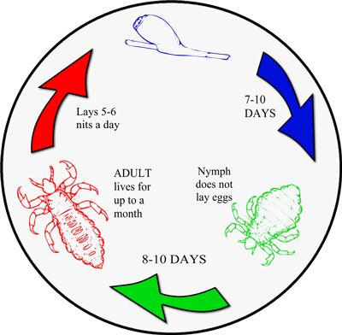
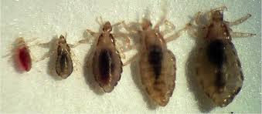
Life Stages of Head Lice
Lice have three different life stages: egg (or nit); nymph; adult.
Notes:
Egg (commonly known as nit)
Adult lice lay eggs (nits) that attach directly to individual strands of hair. Eggs stick to the hair shaft, close to the scalp (for warmth).
Nits are camouflaged with pigment to match the hair color of the infested person. Most easily seen at the posterior hairline.
Eggs hatch in approximately 7-10 days. Empty nit casings are easier to see.
Nits look similar to dandruff but are firmly attached to the hair strand. Empty nit casings are easier to see, white against darker hair.
Once the eggs hatch, nymphs leave the shell casing, grow for about 9 to 12 days, and mate, and then females lay
eggs. Immature stage of a louse (baby lice after hatching). Look similar to an adult, only smaller and are unable to reproduce. Mature into an adult about 10-12 days after hatching. Must feed on human blood to survive and grow.
Adult
Move quickly. Difficult to see. Size of a sesame seed (2-3 mm long). Tan in color. Feed several times a day. Nymphs feed more often.
Adult females live up to 30 days if untreated. Adult females lay about 6 eggs a day.
Cannot survive away from the scalp (will die within 2 days).
Adult lice have 6 legs and are approximately the size of a sesame seed (2 to 4mm) and are tan in color. Once hatched, lice are often difficult to see as they change their color to match the environment.
If untreated, adult lice can live for up to 30 days on a human head.
Fewer than a dozen active lice on the head at any time

Slide 8
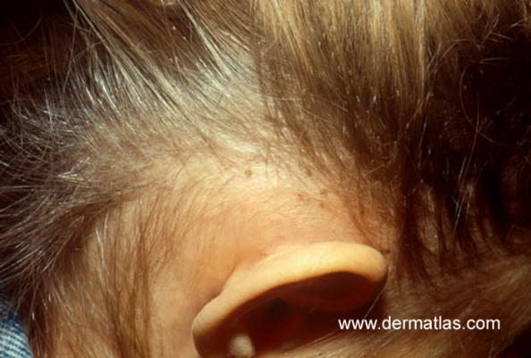
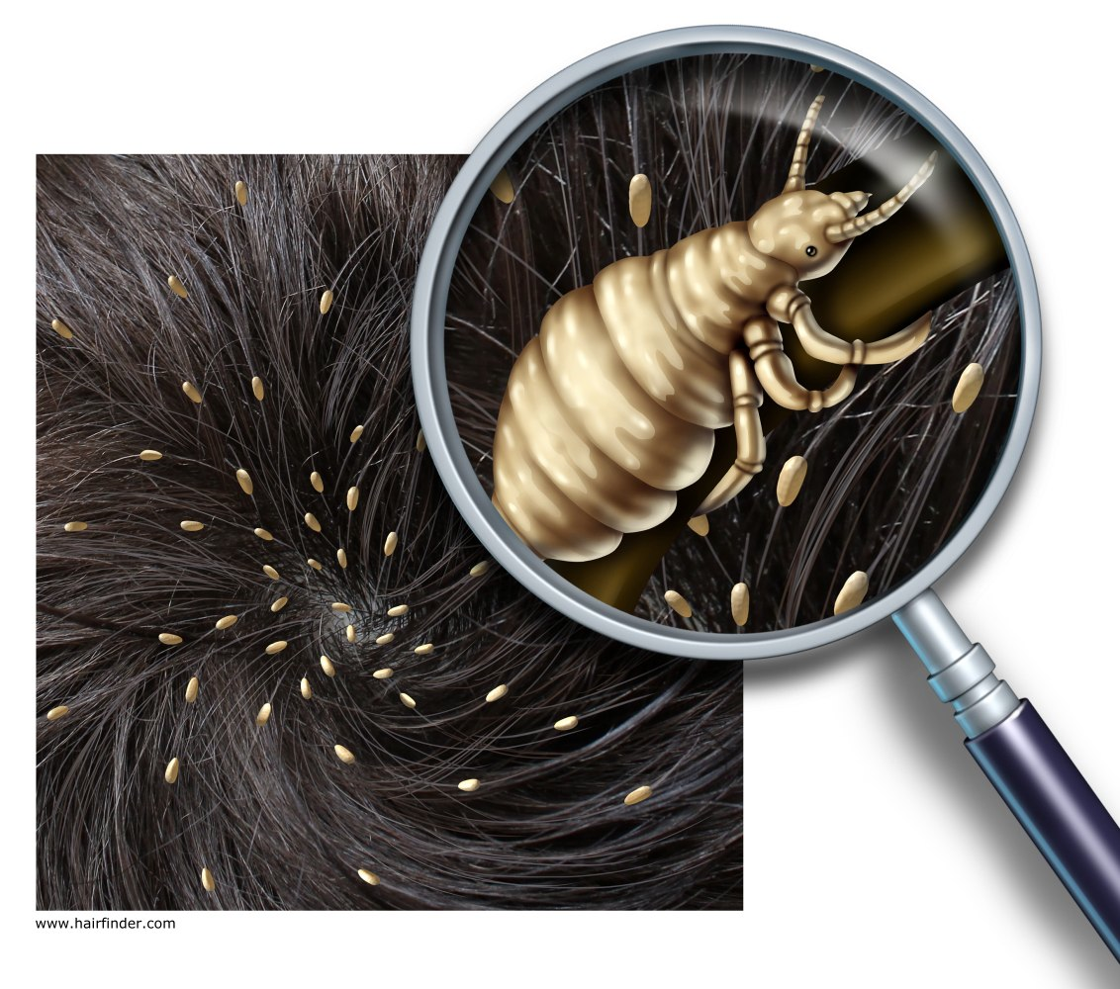
Head lice can be found anywhere in the hair.
Nits are easier to spot, at the nape of the neck or behind the ears, within 1 cm of the scalp.
Nits are deposited on the hair shaft about 1 mm from the scalp.
Eggs more than ½ inch (or 1 cm) away from the scalp are nearly always hatched and do not, by themselves indicate an active infestation.
Notes:
Head lice can be found anywhere in the hair

Slide 9
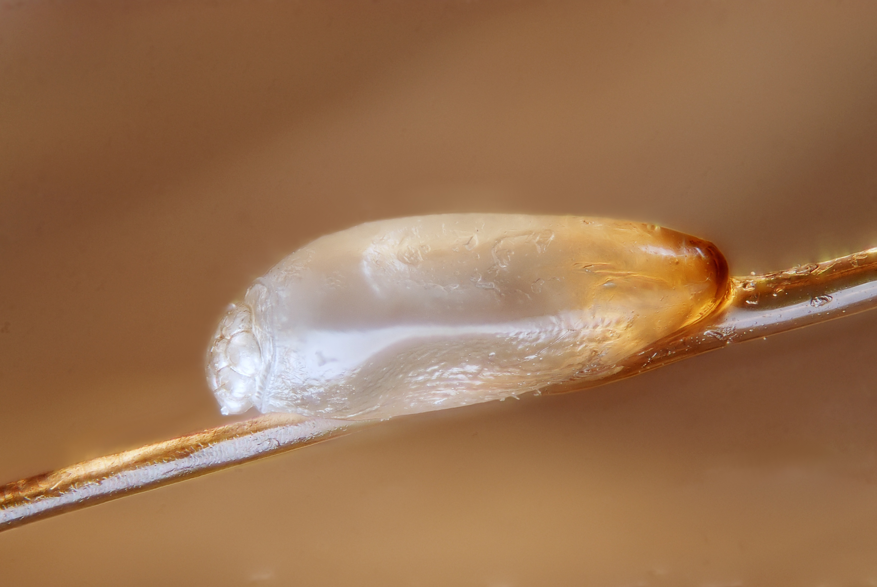
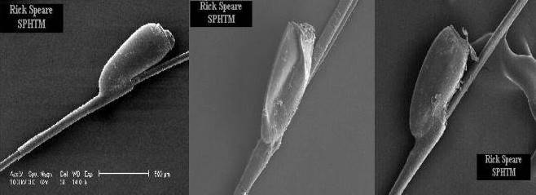
Eggs that have died or hatched, remain firmly attached to the hair; but will never again produce another louse.
Lice eggs have curved walls and will pop when squeezed
Dead eggs have collapsed sides
Hatched eggs have a flat top in profile
Notes:
Whitish/grey or tan in color. Oval in shape. About the size of a grain of sand. Nits are firmly attached to the hair strand.

Slide 10
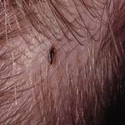
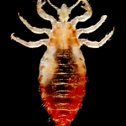
Lice feed by injecting small amounts of saliva and taking tiny amounts of blood from the scalp every few hours. This saliva may create an itchy irritation.
With a first case of head lice, itching may not develop for 4 to 6 weeks, because it takes time to develop a sensitivity to louse saliva.
If not treated, life cycle may repeat itself every 3 weeks.
Notes:
The eggs are incubated by body heat and hatch in 10 to 14 days.
Once the eggs hatch, nymphs leave the shell casing, grow for about 9 to 12 days, and mate, and then females lay
eggs.

Slide 11
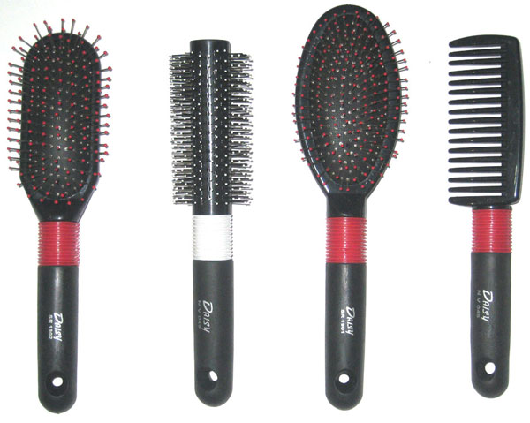
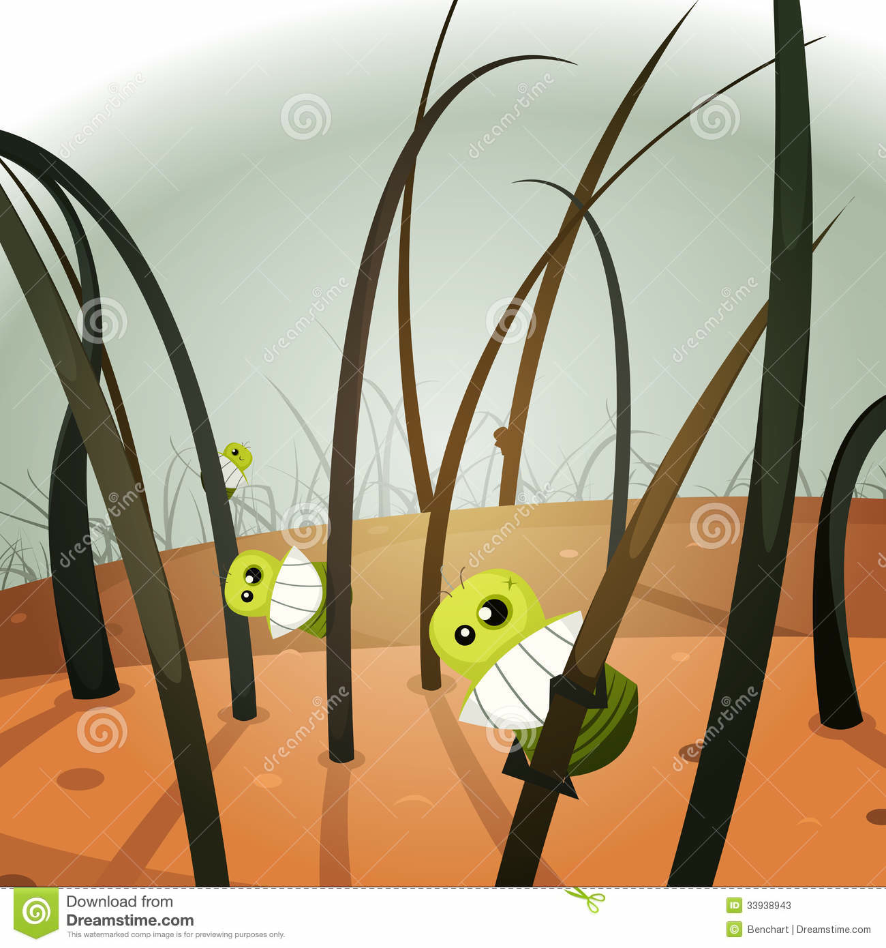

Transmission (Spread) of Head Lice
Head-to-head contact with an infested person and sleepovers are the BIG transfer risks.
Only LIVING LICE can transfer from one person to another.
The transmission from hats, combs, pillows, etc. is possible.
Nits cannot be passed onto someone else.
Notes:
How is lice transmitted from one person to another? The transmission from hats, combs, pillows, etc. is possible – but much less likely.
Lice are spread through direct hair to hair contact. Head lice is also commonly spread by indirect contact such as sharing things like hats, combs, hairbrushes, hair accessories, and headphones. Head lice are like trapeze artists - they swing from hair to hair using their strong claws. Head lice need close head-to-head contact to spread from one person to another. Electrostatic charge from combing dry hair can fling head lice up to 1 metre. Only the young lice and adult lice can move from one head to another.

Slide 12

According to CDC, most transmissions occurs in the home environment (friends, sleep-overs, camps, etc.).
Head lice are very communicable (spreads easily) in situations where people are in close contact with other people.
Head lice are most common
amongst school age children
or young children attending
child care services
(1 in 10 children).
Notes:
Research has shown that on average 1% of students are usually infested with head lice. If screeners indicate 10-30 of students in a class infested the chances are the screener is looking at something that is not head lice.

Slide 13

Checking for Head Lice
Periodic inspections for early detection of adult lice are far easier than dealing with advanced infestations.
During the early fall months (August to November) children should be inspected weekly by parents.
Prevention (home screening) is the best way to reduce the spread of lice infestation.

Slide 14
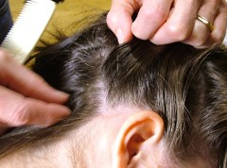
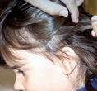
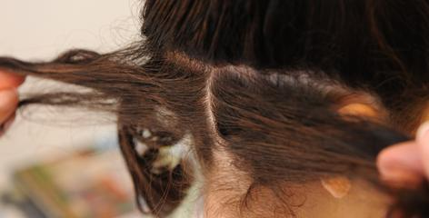
To confirm a case of head lice, you need to find live adult lice. Children can have a few nits without actually having a case of head lice.
Good lighting is important when you are checking.
Head lice move fast and are hard to see. They are usually found very close to the scalp, at the bottom of the neck and behind the ears.
To look for nits, part hair in small sections, moving from one side of the head to the other. Check carefully, looking close to the scalp.
Notes:
A louse can crawl quickly! Up to 30 cm per minute, which makes them difficult to catch. You can slow them down considerably, blowing dry hair with a blow dryer.
Usually children have no more than 10 to 20 live lice.

Slide 15
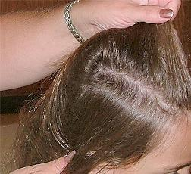
Look for nits near the scalp. Eggs more than ½ inch away from the scalp are nearly always hatched or dead and do not, by themselves, indicate an active infestation or a need for treatment.
If adults or lots of nits (more than 5 nits occurring in the area of a dime) are found, this is a call to action.
Also check everyone in the household, including adults.
Notes:
Shampoo hair first. Do not use a product with conditioners if you are going to use a lice treatment. Begin with good lighting for your inspection. A lamp or good natural light from a window works. Use a hand lens or magnifying glass to help detect nits and lice. Remove tangles with a comb or hairbrush. Divide the hair in sections and fasten the hair that is not being worked on.
Look for nits near the scalp. Eggs more than 1/2 inch away from the scalp are nearly always hatched or dead and do not, by themselves, indicate an active infestation or a need for treatment. If, however, adults or lots of nits (more than 5 nits occurring in the area of a dime) are found, this is a call to action. Also check everyone in the household, including adults.

Slide 16
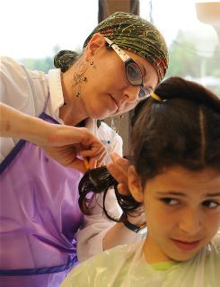
While screening children, if you think you may have found nits or lice contact your team leader or school health nurse for additional support.
Confidentiality!
Ensure sensitivity surrounding the child’s feelings. Anyone can get lice and no one is immune (children or adults). Lack of cleanliness does not cause head lice (stigma).

Slide 17
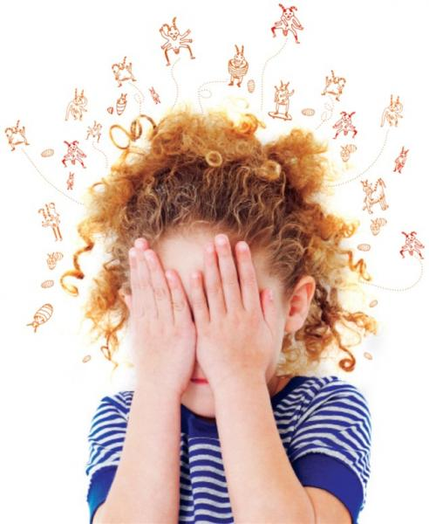
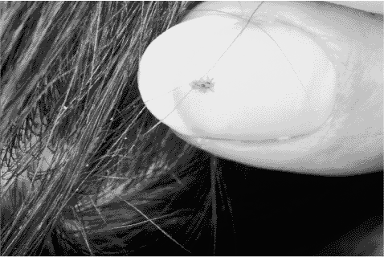
Found lice?
Treatment is recommended only for individuals found with live lice
Notes:
Nits further than ¼ inch from head, are probably hatched and no longer viable

Slide 18
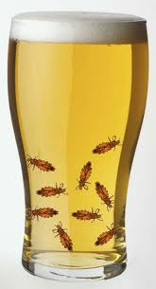
Pediculicides
Treatment of Head Lice
Chemical treatments
Natural products
  mayonnaise, petroleum jelly, vinegar, olive oil, tea tree oil, or aromatherapy
Alcohol
  benzyl alcohol
Never use gasoline or spray insecticides to treat lice.
Notes:
Today, insecticides used for the treatment of head lice include organochlorines (lindane), organophosphates (malathion), carbamates (carbaryl), pyrethrins (pyrethrum), and pyrethroids (permethrin, phenothrin, bio-allethrin).
The only agents approved by the FDA for treatment of pediculosis are lindane and malathion.[2]
Laboratory and clinical studies found that many of the pediculicides in the market are either not fully effective or are ineffective when they are used according to the instructions.[3][4][5][6]
Pediculicides may rapidly lose their efficacy because of the development of resistance. Resistance of head lice to insecticides such as lindane, malathion, phenothrin and permethrin has been reported.[7][8][9]
Home remedies such as mayonnaise, petroleum jelly, olive oil, tea tree oil, vinegar, or aromatherapy have been shown to make it hard for lice to breath. No evidence suggests it effectively kills all nits or lice.
Head lice shampoos contain insecticides and if they are not used properly they can be hazardous. When using a head louse shampoo, minimize body exposure by confining the insecticide to the head hair. Wash the infested person's hair in a basin or sink so insecticide residues do not reach other parts of the body. Never apply treatments to children in the bath or shower! The person applying the treatment should wear rubber gloves. Never apply an insecticide to anyone who has open cuts, scratches, or inflammations, and never use these materials on infants without consulting a doctor. In all cases, follow label directions completely and carefully.

Slide 19
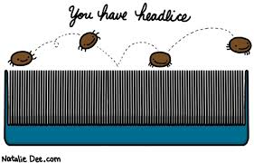
Treatment of Head Lice
Lice shampoos
  Contain insecticides (Pyrethrins, Permethrin, Lindane, Malathion, etc).
  Be cautious when applying treatments.
  Directions must be followed exactly.
  Susceptible lice should die within 10 to 30 min after treatment.
  A second treatment may be required in 10 to 14 days.
  Resistance may be occurring.
Notes:
Head lice shampoos contain insecticides and if they are not used properly they can be hazardous. When using a head louse shampoo, minimize body exposure by confining the insecticide to the head hair. Wash the infested person's hair in a basin or sink so insecticide residues do not reach other parts of the body. Never apply treatments to children in the bath or shower! The person applying the treatment should wear rubber gloves. Never apply an insecticide to anyone who has open cuts, scratches, or inflammations, and never use these materials on infants without consulting a doctor. In all cases, follow label directions completely and carefully.

Slide 20
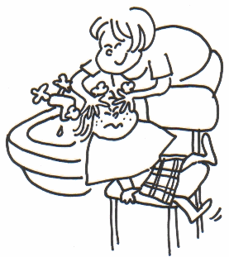
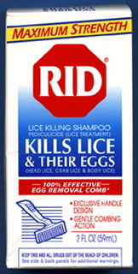
Pyrethrins Plus Piperonyl Butoxide OTC
Natural extracts from chrysanthemum, (e.g. RID).
Neurotoxic to lice.
Possible allergic reaction in patients who are sensitive to ragweed, or chrysanthemums.
Mostly shampoos that are applied to dry hair and left on for 10 minutes before rinsing out, over a sink rather than in the shower to limit exposure, and with cool rather than hot water to minimize absorption.

Slide 21
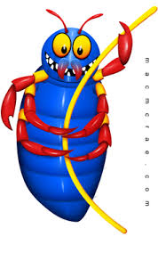
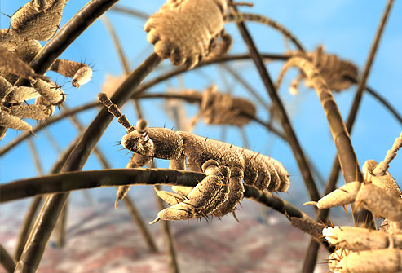
Not ovicidal (newly laid eggs do not have a nervous system for several days); 20% to 30% of the eggs remain viable after treatment. This necessitates a second treatment after 7 to 10 days.
Resistance of adult lice to these products has been reported as wide-spread.

Slide 22
Permethrin (1%) OTC
A synthetic pyrethroid, 1% permethrin (e.g. Nix) is currently the recommended treatment of choice for head lice by pediatricians.
It has a lower mammalian toxicity than pyrethrins.
Does not cause allergic reactions in individuals with plant allergies.
The product is a cream rinse applied to hair that is first shampooed with a non-conditioning shampoo and then towel dried. It is left on for 10 minutes and then rinsed off, and it leaves a residue on the hair that is designed to kill nymphs emerging.
20% to 30% of eggs are not killed with the first application. It is suggested that the application be repeated if live lice are seen 7 to 10 days later.
Wide-spread resistance to 1% permethrin has been reported.

Slide 23
Lindane (1%) Prescription
Lindane (e.g. Kwell) is an organochloride that has central nervous system toxicity in humans; several cases of severe seizures in children using lindane are reported each year.
Prescription shampoo that should be left on for no more than 10 minutes with repeated application in 7 to 10 days.
It has low ovicidal activity (30% to 50% of eggs are not killed), and resistance has been reported worldwide for many years.
Personally, I do not think it should ever be used.

Slide 24
Malathion (0.5%) Prescription
The organophosphate (cholinesterase inhibitor) 0.5% malathion (e.g. Ovide).
Prescription lotion that is applied to the hair, left to air dry, then washed off after 8 to 12 hours.
Malathion has a high ovicidal activity, but the product should be reapplied if live lice are seen in 7 to 10 days.
The major concerns are the high alcohol content of the product, making it highly flammable, and the risk of severe respiratory depression.
Personally, I do not think this should be used.

Slide 25
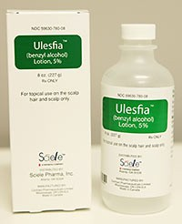
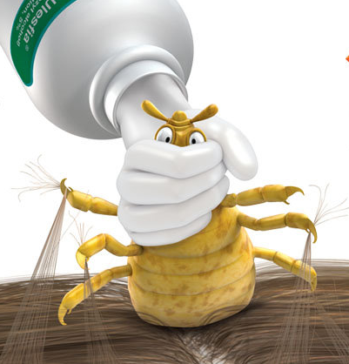
Alcohol based lice shampoo
  Resistant lice may need prescription treatment.
  Benzyl alcohol (Ulesfia, 5% solution): non-neurotoxic, highly effective lotion.
  Kills the live lice.
  Not ovicidal (doesn’t kill eggs).
  2 treatments are necessary.
  Consult your doctors before using it.
  No resistance reported.
Notes:
If live lice persist following treatment with over the counter products, parents should discuss with doctors.
Ulesfia® (benzyl alcohol)is a non-neurotoxic,highly effective lotion used for the topical treatment of head lice infestation in patients 6 months of age and older. Ulesfia® like most treatments is not ovicidal(does not kill the eggs), so 2 treatments are necessary. This product is a prescription only treatment but is currently one of the most effective products with fewer side-effects.
With pyrethrin and permethrin shampoos, lice should die within 10 to 30 minutes after treatment. If you find live lice after 30 minutes, resistance may be occurring and you should discontinue use of that product. Switch to a different kind of product e.g. benzyl alcohol Ulesvia prescription). Never resort to dangerous practices such as applying other insecticides, or materials such as kerosene!

Slide 26

Alternative treatments
  Soap shampoos containing coconut or olive oils.
  Begin with four shampoo applications, each about 3 days apart.
  Kills newly-hatched nymphs.
  Kill lice mechanically: Hair drying and brushing.
Home remedies such as mayonnaise, petroleum jelly, olive oil, tea tree oil, vinegar, or aromatherapy have been shown to make it hard for lice to breath. No evidence suggests it effectively kills all nits or lice.
Standard hair conditioner is as effective.
Notes:
If you want to avoid insecticides entirely, try using soap shampoos that contain coconut or olive oils. Begin with four shampoo applications, each about 3 days apart. Each successive shampooing kills newly- hatched nymphs. Hair drying and brushing is a very effective way of killing lice mechanically.

Slide 27
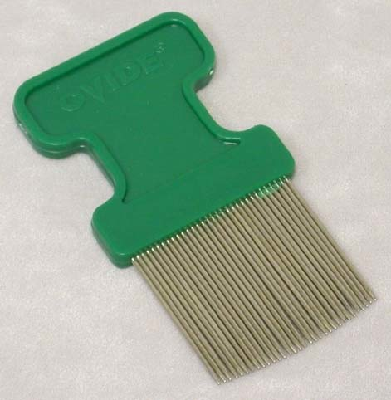
Manual Removal
None of the pediculicides are 100% ovicidal.
Manual removal of nits (especially the ones within 1 cm of the scalp) after treatment with any product is recommended.
Special, fine-toothed “nit combs” are needed (LiceMeisterTM combs).
Combing and brushing wet hair damages lice. Hair drying injures adults and nymphs.
Nit removal aids are designed to loosen the attachment of the nit to the hair shaft.
Notes:
Remove lice from the head by combing
Combing with a nit comb can sometimes be effective in removing viable nits and lice
Comb daily until no live lice are discovered ( 2 weeks)
Recheck in 2-3 weeks after you think they are gone
Combing is critical to controlling head lice because 20 to 30% of lice can still be alive after shampooing (especially with the pyrethrin or permethrin based products). Note: using a lice comb to remove the insects can take up to several hours a day, depending on the thickness and curliness of the hair. Time for a movie marathon or board game evening.

Slide 28
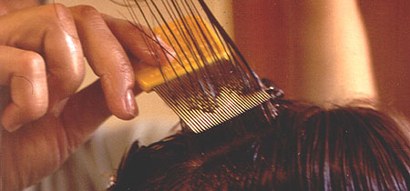
Vinegar or vinegar-based products (e.g. Clear Lice Egg Remover Gel) are applied to the hair for 3 minutes before combing out the nits. No clinical benefit has been demonstrated.
Combing is critical to control head lice.
Comb daily until no live lice are discovered (2 weeks).
Recheck in 2-3 weeks after you think they are gone.

Slide 29

Home disinfection
Wash items in hot soapy water and dry in a hot dryer for 15 minutes.
Launder and dry on a high heat, 130 degree F.
Store items in plastic bags for 2 weeks.
Vacuum the surfaces where heads may have rested
(sofas, helmets, car seats, etc).
Notes:
In addition to removal of lice and nits, environmental controls are important, too.
Home disinfection: remove lice and nits from the house household environment
Once an infestation is detected, all clothes should be washed in hot soapy water. Pillowcases, sheets, blankets and other bedding material should also be washed and placed in the clothes dryer on the "high heat" cycle to kill the lice and their eggs. Any non-washable items should be dry cleaned or sealed in plastic bags and placed in the freezer at 5 degreeF or lower for 10 hours or more (a good option for headphones). Vacuuming the home will remove shed hair that has nits attached. Remember if the lice are off the body for 48 hour they are all dead, so simply leaving things that cannot be laundered (very large stuffed animals, duvets, furniture etc.) in a bag or off-limits for 48 hours will do the trick.
Although head lice do not live long off the scalp; to avoid re-infection or transmission to other person it is recommended to clean all hats, combs/brushes, pillowcases, bed sheets, stuffed animals etc. Avoid the use of insecticide sprays.
Wash in hot water all bedding, towels and clothing that came into contact with the infected person's head, within 48 hours of starting treatment. Items such as combs, brushes, and head accessories may be treated by sealing in plastic bags for 2-4 weeks, boiling in water for 5 minutes or soaking in rubbing alcohol for 1 hour. Lice are a common childhood problem. Now you know how to tackle the treatment if it comes to your home.

Slide 30
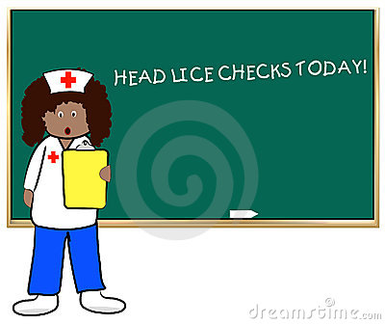
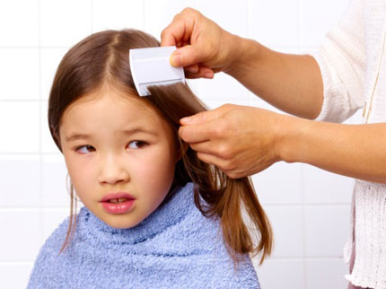
Check regularly
Daily head checks and nit removal until infestation is gone.
Followed by weekly head checks to detect re-infestation.
Continue weekly head checks of the whole family.
Notes:
Nits are easier to spot, especially at the nape of the neck or behind the ears, within 1 cm of the scalp.
Nits found more than 1 cm from the scalp are unlikely to be viable.

Slide 31
Managing Head Lice in Schools
When parents of elementary school aged children are surveyed as to what childhood health issues concern them most, head lice usually rank higher than much more serious conditions.

Slide 32

Managing Head Lice in Schools
School district policies on head lice vary throughout Arizona.
Majority of students involved.
1% of students are usually infested.
Some have “no nit policies”.
Notes:
Missouri Survey:
91% screen regularly
60% screen at beginning of school year
23% screen monthly
81% screen according to a “situation”
Students missing school due to identification of lice or nits,. 85% of districts removed students from class for the presence of nits.
A “no nit” policy is one that excludes students from school based on the presence of lice eggs whether or not live lice are present. The Department of State Health Services (DSHS) does not recommend a “no nit” policy. We do recognize, however, that school districts may adopt one as a local option.
DSHS does not have authority to impose a set policy regarding head lice on districts. DSHS does, however, urge school districts to ensure that its policy does not cause children to miss class unnecessarily or encourage the embarrassment and isolation of students who suffer from repeated head lice infestations.
Head lice infestation is a social issue not a health threat. “No nit” policies place a disproportionate amount of emphasis on head lice management than on real health concerns which should be a higher priority. This over-emphasis can lead to unproductive use of time by school staff and parents, missed classes, unnecessary absences, and parents missing work.
The American Academy of Pediatrics recommends that no healthy child be excluded from or allowed to miss school because of head lice, and that “no nit policies” for return to school be discouraged
Research has shown that on average 1% of students are usually infested with head lice. If screeners indicate 10-30 of students in a class infested the chances are the screener is looking at something that is not head lice.

Slide 33

Why Ban the No-Nit Policy?
  Not supported by research.
  Not recommended by experts.
  Misdiagnosis of nits is common.
  Encourage use of potentially dangerous pesticides.
  Causes children to miss school needlessly.
  Costs school large
Notes:
Such a policy has not been supported by research and is not recommended by experts.
Misdiagnosis of nits is common.
Encourages use of potentially dangerous pesticides for no reason.
Causes children to miss school needlessly.
Harvard’s School of Public Health obtained samples from health care professionals and the public of “lice and nits”.
Most samples came from schools.
Lice or eggs were present in less than two thirds.
Less than half had either a louse or potentially viable egg.
The researchers found that over-the-counter medications were used as much in those with active infestations as those without viable lice or eggs.
Misdiagnosis leads to the possibility of overuse of pediculocides and inappropriate exclusion from school.
The same researchers have found that the kids sitting next to kids with live lice are NOT more likely to get it than anyone else.
It is transmitted when there is direct head-to-head contact where LIVE lice are concerned.
Nits cannot be passed to another person.
According to the Center For Disease Control most transmission occurs in the home environment. (friends, sleep overs, camps, etc..)
The National Association of School Nurses state that nit free policies disrupt the education process and should not be viewed as an essential strategy in the management of head lice
Health and Health Care in Schools:
“ Children with nits do not pose an immediate risk to the health of others, therefore, excluding these children from school and requiring them to be treated with pesticidal product is probably excessive”.

Slide 34

School Management Plan
Screening for nits is not an accurate way of predicting which children will become infested.
Children having 5 nits or more within 1 cm² of the scalp are significantly more likely to develop an infestation, still only 1/3 of these higher-risk children convert.
Approximately 18% of kids with nits alone, will convert to an active infestation.
Generally, around 30% of school children with nits will have concomitant lice.

Slide 35
Should classroom or school-wide screening be discouraged?
Providing information to families on the diagnosis, treatment, and prevention of head lice is a good plan.
Parents and the school nurses should be encouraged to check their children’s heads for lice if the child is symptomatic.
Parents need to be educated. This is not a hygiene issue.
Children need to be educated about sharing hats, helmets, etc.

Slide 36
Classroom Management
No need to spray the classroom. Regular cleaning agents would work to control head lice.
Lice do not infest classrooms, carpets and chairs.
Space desks and chairs apart so that children are not sitting shoulder-to- shoulder.
Have children hang coats and hats separately.
Notes:
Do not pile them on top of each other.
During outbreaks, minimize use of shared headgear (such as earphones, helmets, etc.) and clothing (such as hats and costumes in drama classes). Always hand vacuum such headgear between users.

Slide 37
Space children apart when standing or walking in lines.
During head lice outbreaks, minimize close contact games and sports, such as wrestling.
During outbreaks, minimize use of shared headgear and clothing. Always hand vacuum such headgear between users.
Provide head louse prevention education to children, such as not sharing combs, brushes, hats, headbands, or clothing.
Notes:
Do not pile them on top of each other.
During outbreaks, minimize use of shared headgear (such as earphones, helmets, etc.) and clothing (such as hats and costumes in drama classes). Always hand vacuum such headgear between users.

Slide 38
Please Remember
Don’t panic! It can happen to anyone, and you can ditch the itch!
Only living lice transfer from person to person.
Head lice don’t fly or jump.
They don’t transmit infectious disease.
Head lice can’t survive more than 48 hours away from the host.
Head lice can’t live within rugs, carpets, or school buses.
No need to exclude infested kids from school.
Work with parents! Routine screening, early detection, accurate ID and thorough removal of lice and nits.

Slide 39
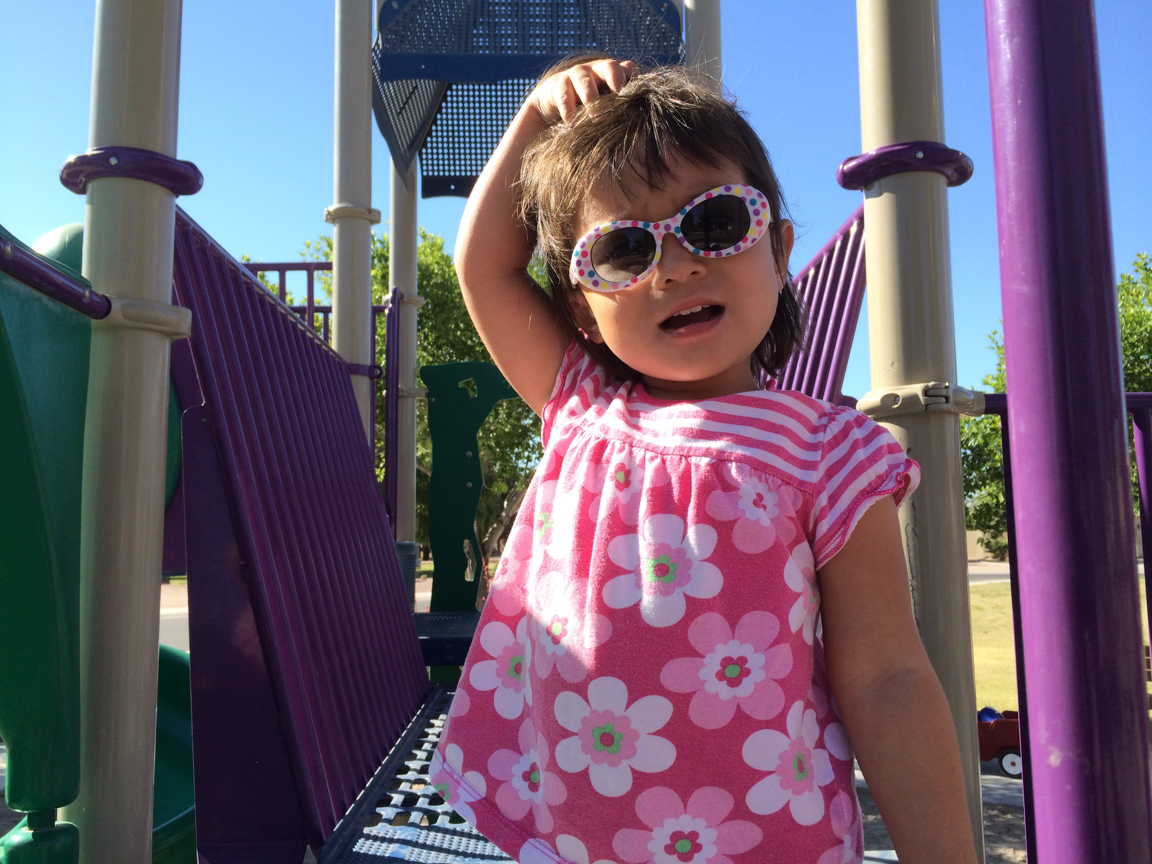
Questions?
Thank You

Slide 40
References
http://cals.arizona.edu/apmc/docs/2013SepAZSchoolIPMNewsletter.pdf
Managing head lice in the school setting, Department of Health and Senior Services. Marjorie Cole, health.mo.gov/living/families/schoolhealth/ppt/HEADLICE.ppt
Centers for Disease Control (2001). Fact sheet: treating head lice. Retrieved April 21, 2005 from: http://www.cdc.gov/ncidod/dpd/parasites/headlice/factsht_head_lice_treating.htm
The American Academy of Pediatrics and the National Association of School Nurses (www.nasn.org/po sitions/nitfree.htm)
National Association of school nurses (2004). Position statement: pediculosis in the school community. Retrieved October 20, 2004 from: http://www.nasn.org/positions/2004pediculosis.htm
National Pediculosis Association [n.d]. The no nit policy: A healthy standard for children and their families. Retrieved April 21, 2005 from: http://www.headlice.org/downloads/nonitpolicy.htm

