Slide 1
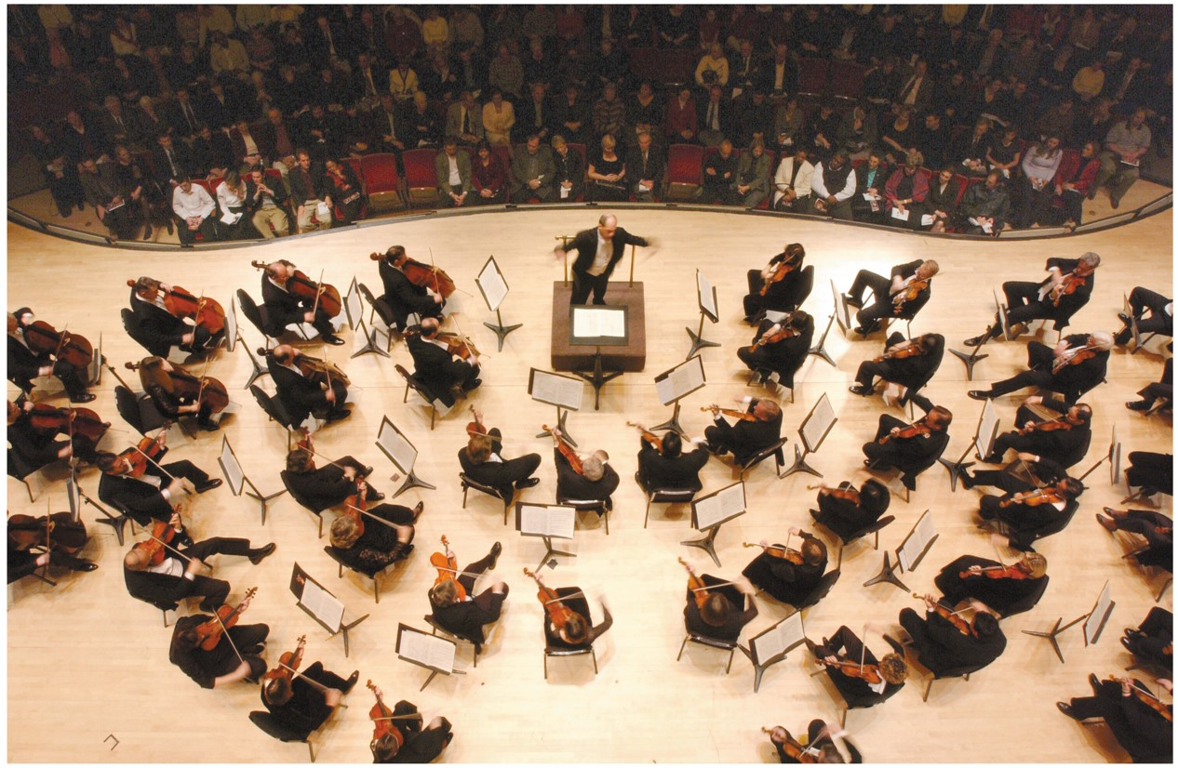
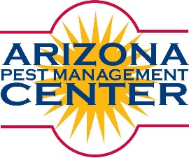

WHY and HOW
MAKES GOOD SENSE
http://www.yoursecretname.com/wp-content/uploads/2011/02/overhead.jpg
IPM
Shaku Nair and Dawn Gouge
University of Arizona
Maricopa Ag. Center
37860 W. Smith-Enke Road
Maricopa, AZ 85138
Notes:
1

Slide 2
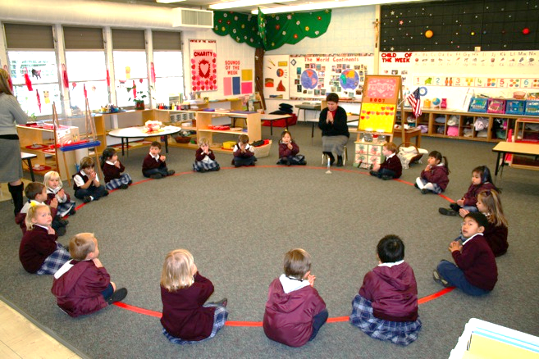
Community (“Sensitive”) Environment ??
Schools, child care centers, homes, hospitals, retirement/ nursing facilities, restaurants, hotels
Host diverse people in confined spaces
May have health problems such as asthma, allergies, or immune system compromising diseases
Challenging places for pest management
http://www.canyonheightsacademy.com/academics/pk_environment_files/page39_2.jpg

Slide 3
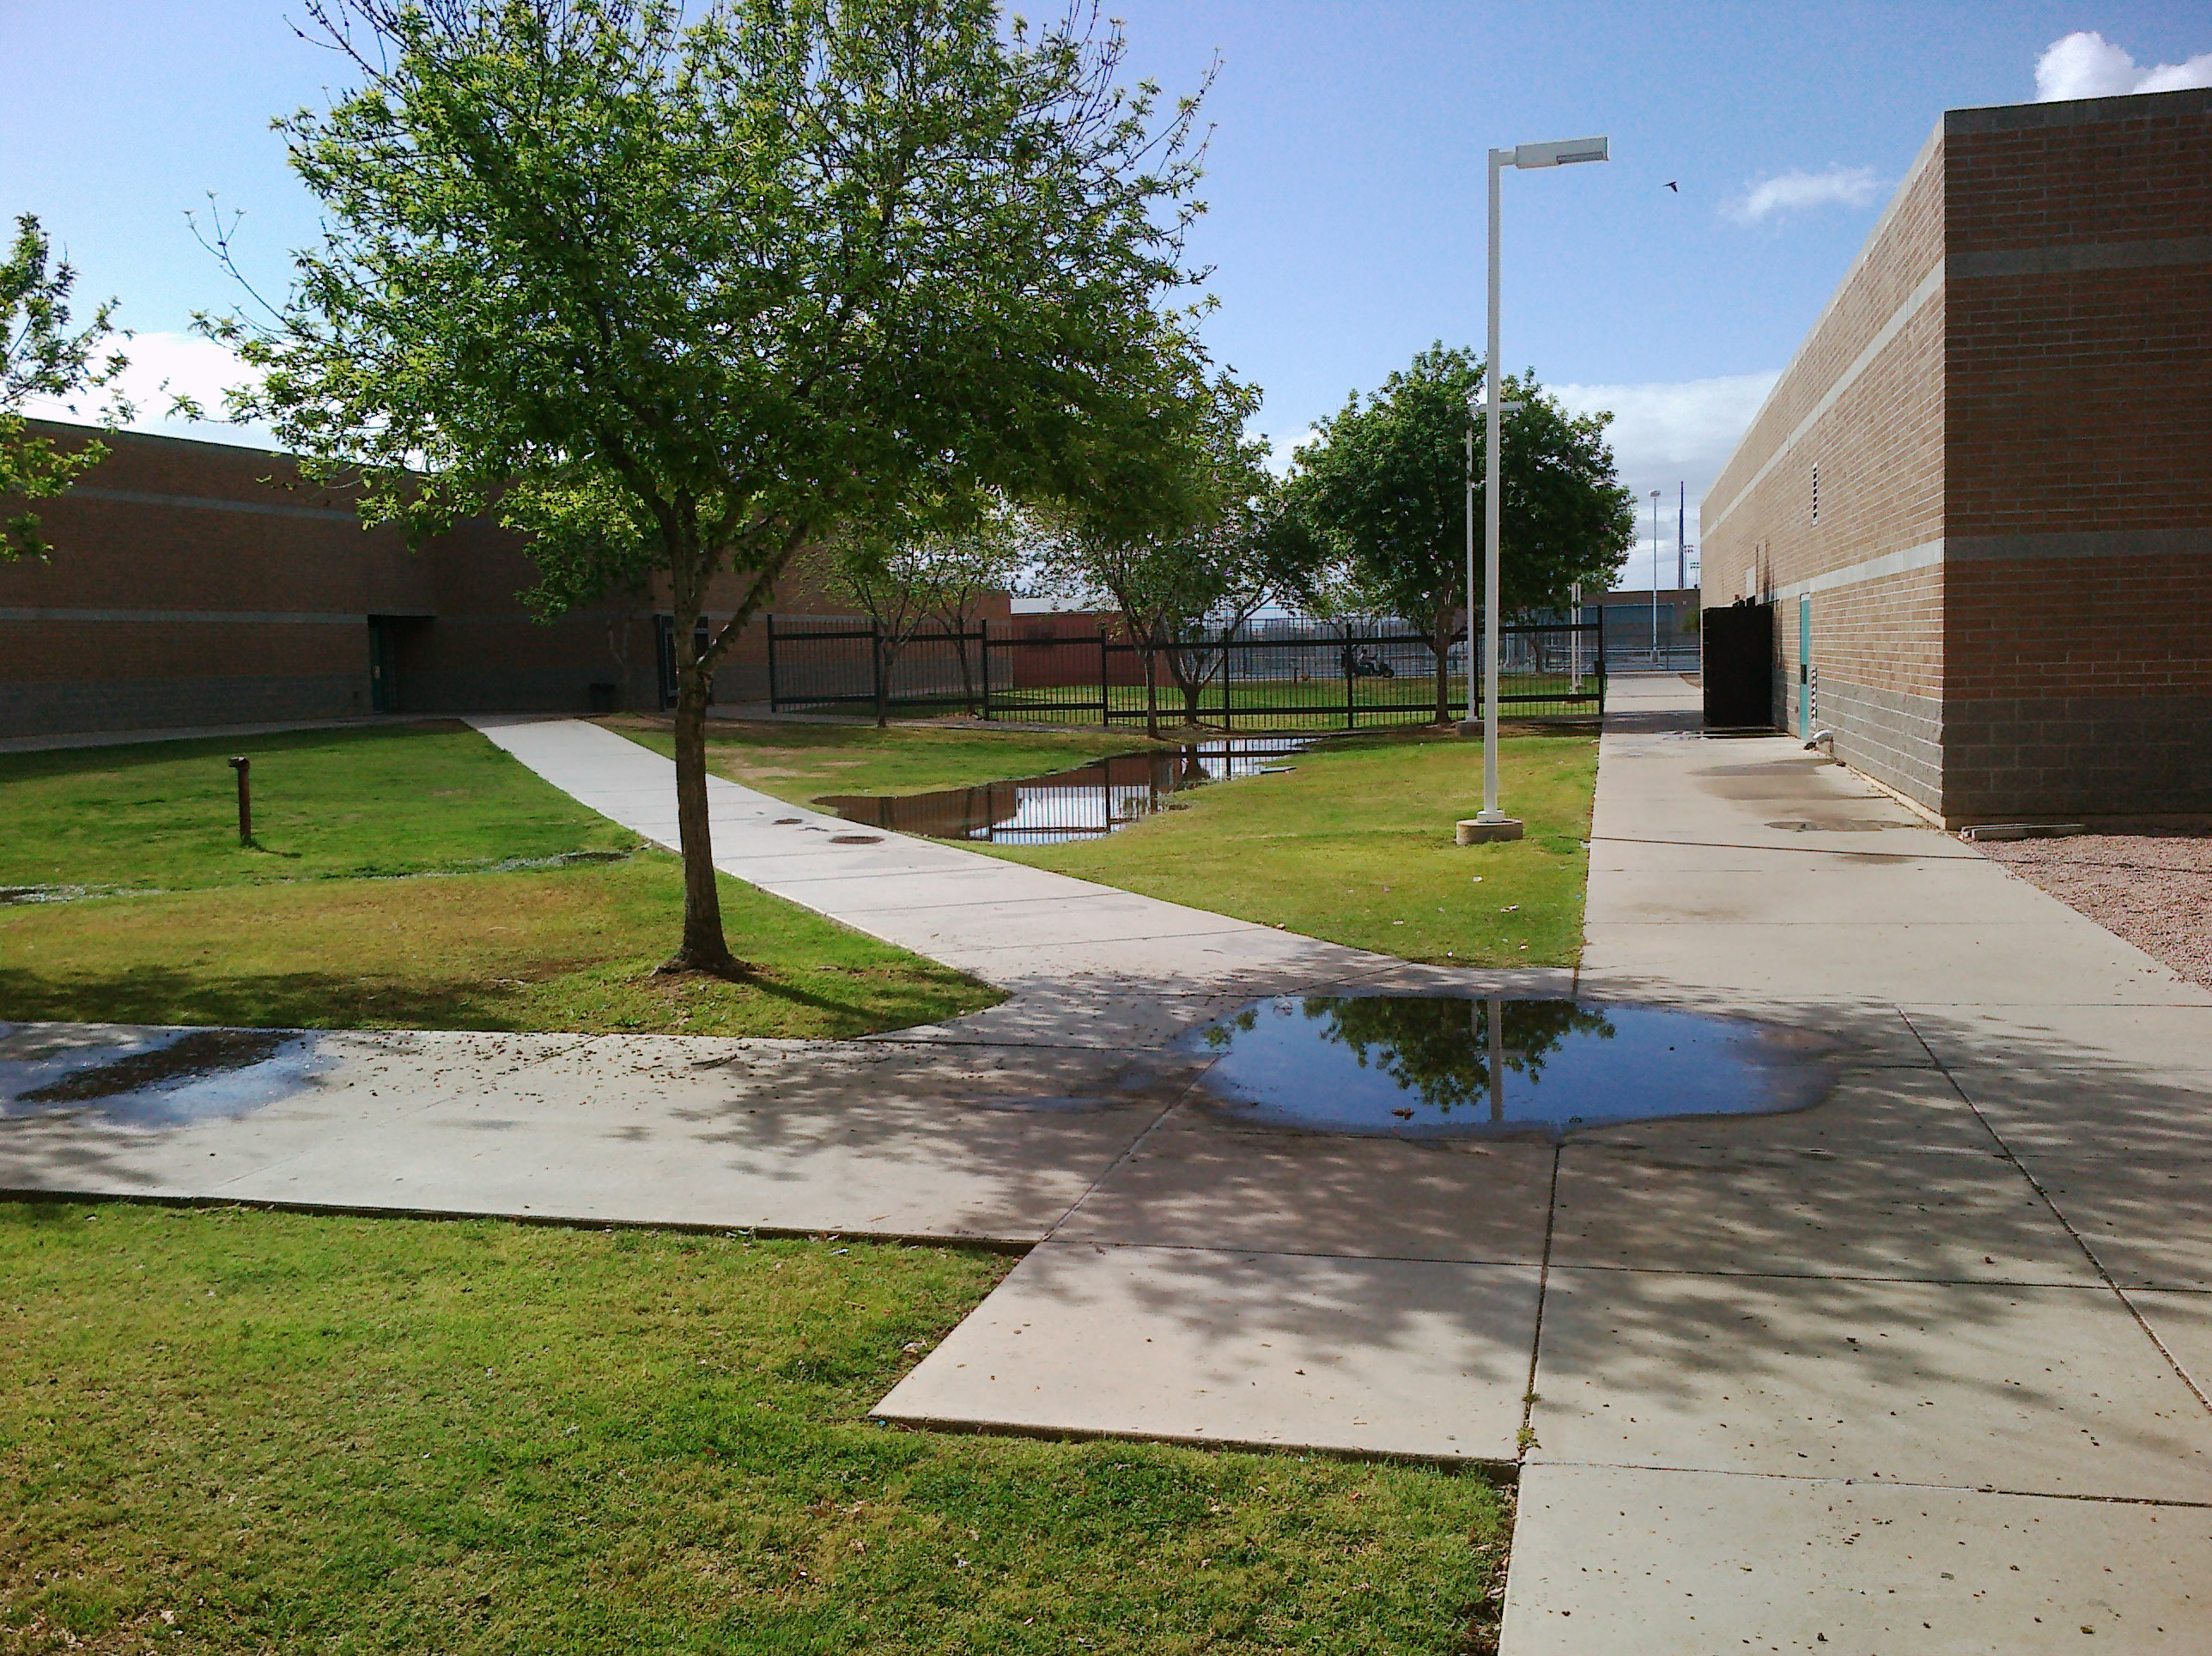
Community (“Sensitive”) Environment ??
Include diverse physical spaces, indoors and out, that require customized solutions to pest problems
Provide ideal entry points and harborages for pests
Diminishing budgets and deferred maintenance worsen these problems

Slide 4
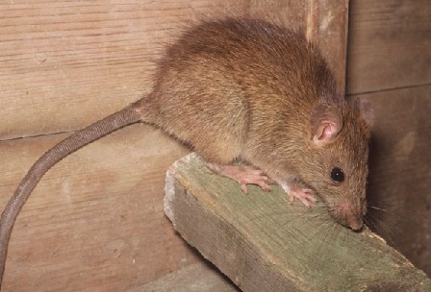
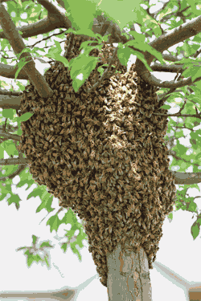
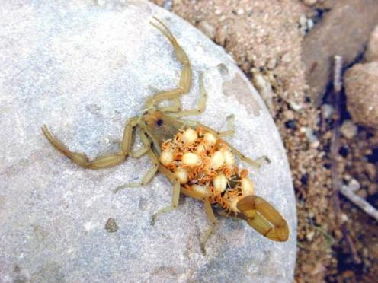
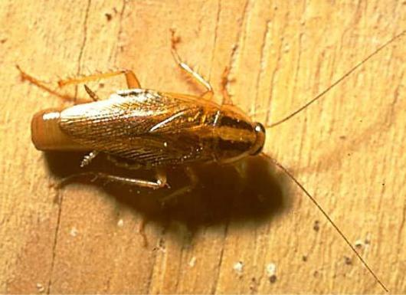
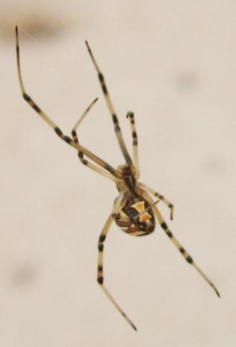
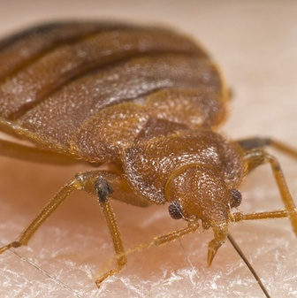
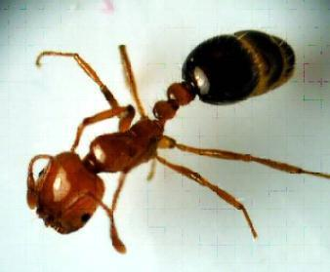
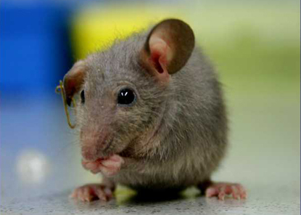

Slide 5
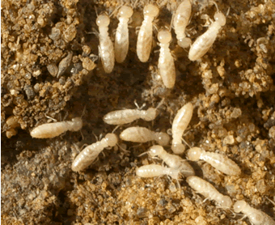
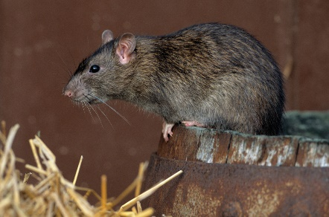
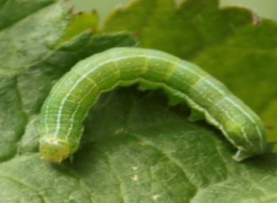
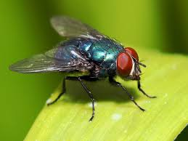
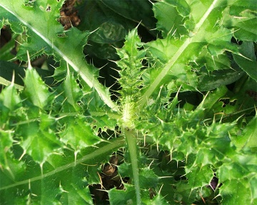
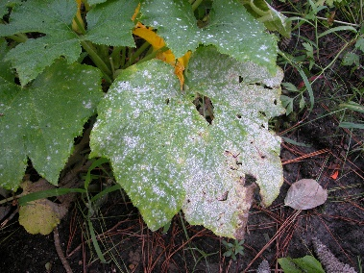
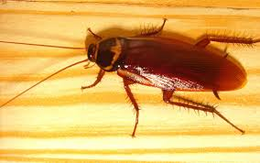
A Pest, Defined
Any organism that is detrimental to humans or their interests
  destroys crops & structures
  poses threats to human health and livestock
  reduces aesthetic and recreational value
Any organism that is out of place!
Pests include insects, mites, plant pathogens, weeds, mollusks, fish, birds, and mammals
Notes:
What is a PEST? A pest is any organism that is unwanted by humans. Pests may be unwanted due to their destructive nature, the health concerns they pose, or because they’re plain annoying. Insects are not the only kind of pest. Mites, plant pathogens, weeds, mollusks, fish, birds, and even some mammals can be pests. They can be found in waterways, agriculture, landscapes, roadsides, natural areas, stored food, schools, hospitals and even swimming pools.

Slide 6
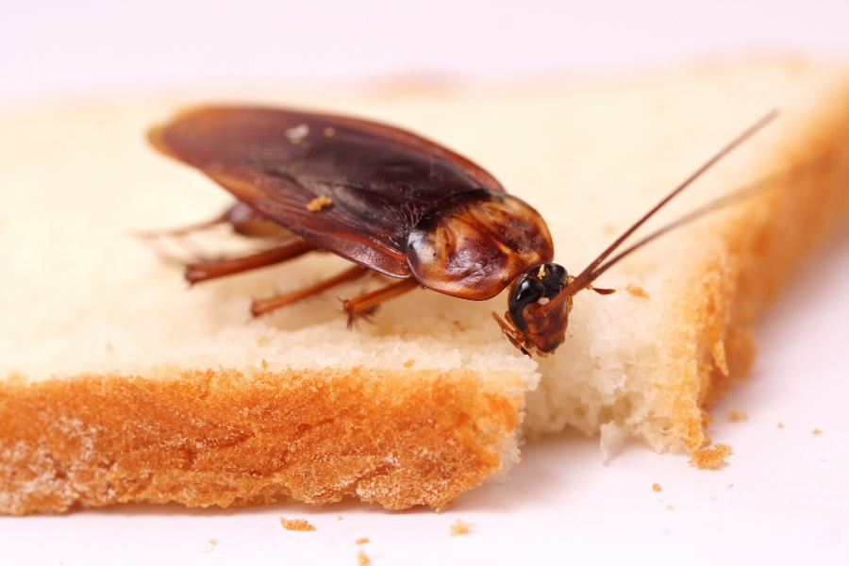
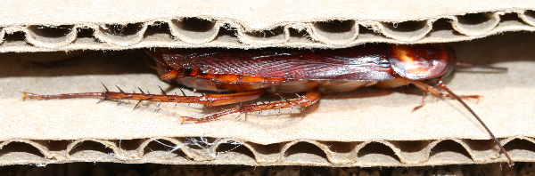
Why are there pests?
Pests need FOOD, WATER and SHELTER.
http://directpestsolutions.org/wp-content/uploads/2013/07/coackroach-eating.jpg
http://insectexpertphd.com/images/cockroaches/americancockroach.png
We provide them FOOD, WATER and SHELTER.

Slide 7
Problems due to pests
Can cause structural damage
Can bite / sting
Can damage food by entering and feeding
Can contaminate food and surfaces with microorganisms they carry
Nuisance when they invade buildings
AND…

Slide 8

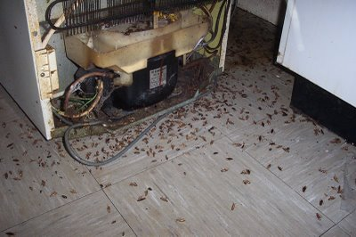
Allergies & asthma
Cockroaches are a leading cause of childhood asthma
http://www.epa.gov/ncer/images/inhaler.jpg
Notes:
8

Slide 9
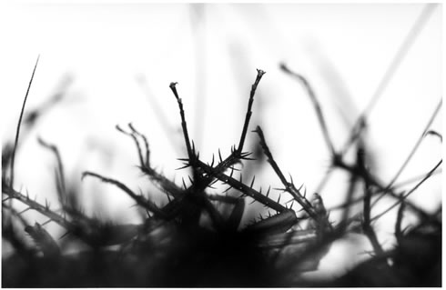
Cockroach allergens
Substances produced in cockroaches bodies
Spread into the environment through their feces, shed skins and other body parts, and dead bodies
The longer these materials persist in the environment, the higher the chances of them getting spread through the air and reaching sensitive people

Slide 10

Nationally almost 8.5% of students are asthmatic
Up to 25% of city students are asthmatic
Asthma triggers include allergens and aerosols
1 in 4 students have
learning disabilities
and tend to be
sensitive to
allergens and
chemicals

Slide 11
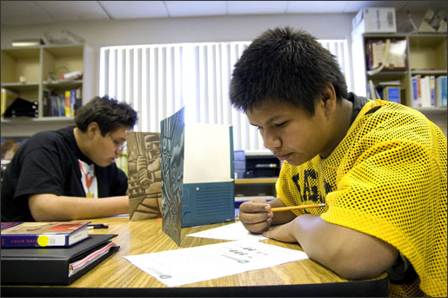
Asthma costs the US ~ $20 billion –
annually
56% of the overall cost of asthma comes in lost work time
Asthma adds about 50 cents to every health care dollar spent on children
12.8 million school days per year
Asthma reduces
student
achievement

Slide 12
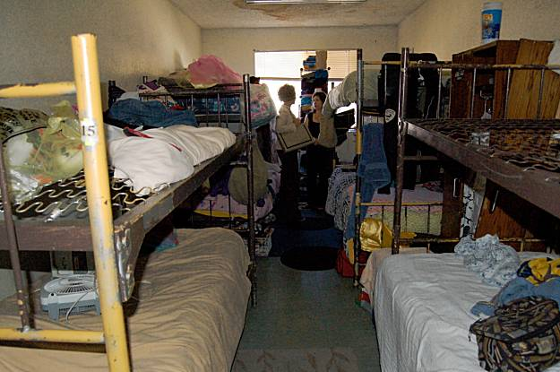
Housing residents have some of the highest rates of allergic asthma in the country
Some communities 60% of children are sensitive to cockroach allergens

Slide 13
Pest management methods
Physical
Mechanical
Natural
Cultural
Regulatory
Biological
Genetic
Chemical
Notes:
As mentioned earlier, it’s important to correctly identify the pest in order to develop an effective management plan. Determining the cause of the problem or identifying the pest may be difficult. Immature stages of weeds and insects may not look at all like the mature stages.
Once you have properly identified the pest, learn about its biology. Resources that can help you identify and learn more about pests and host plants include books, extension bulletins, and field guides that contain pictures and biological information. Search the Internet. Illustrations of immature pest stages are helpful. Remember, weed seedlings and rosettes often don’t resemble mature plants, and caterpillars don’t resemble adult moths. If you can’t identify the pest, take it to a specialist. When collecting specimens for identification, make sure you collect several specimens and store them in suitable containers. Don’t forget to record important specimen information like the host plant and location where the specimen was collected.

Slide 14
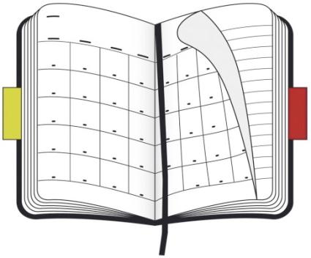

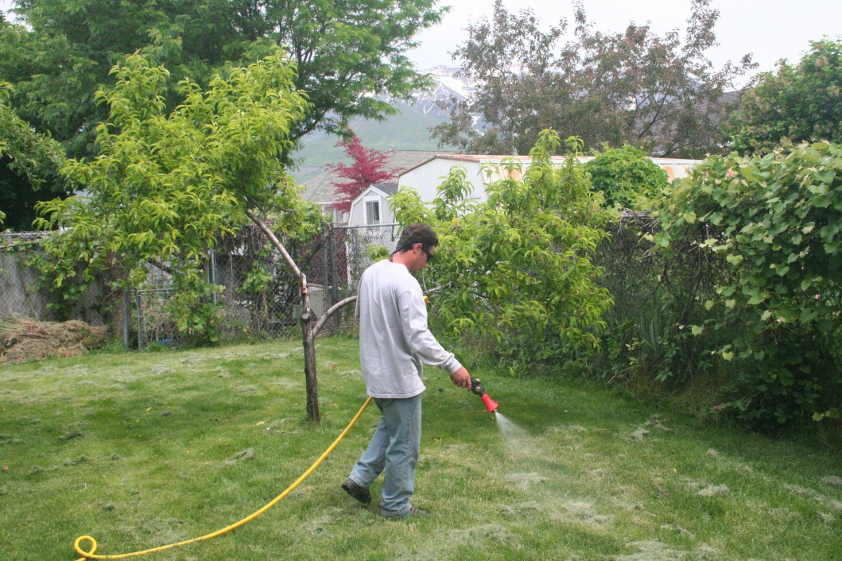

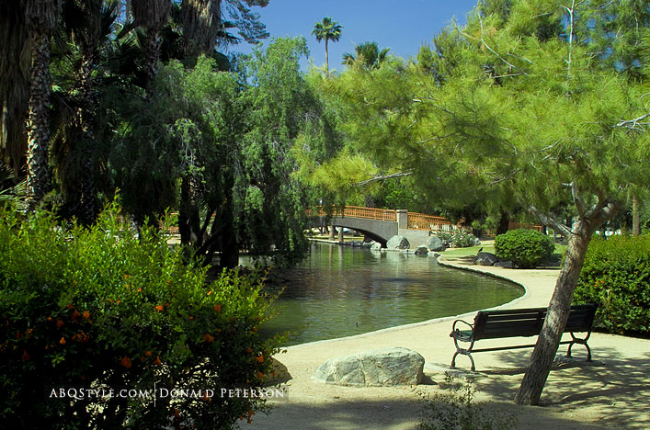

Calendar model
Which do you prefer?
Pesticides
=
Notes:
Most school districts have been using out-dated methods

Slide 15



IPM model
=
Educator & Diagnostician
Notes:
Most school districts have been using out-dated methods

Slide 16

Proactive
Scout /monitor
Education
Plant health
C
H
E
M
I
C
A
L
Multiple actions
Thresholds
A shift in pest management strategies

Slide 17

The IPM approach!
A sensible, environment-friendly, and effective way to solve pest problems.
Pests are managed by the most economical means and always with the least possible risk to people, property and the environment
http://groundreport.com/wp-content/uploads/2014/02/1_113417_1.jpg

Slide 18
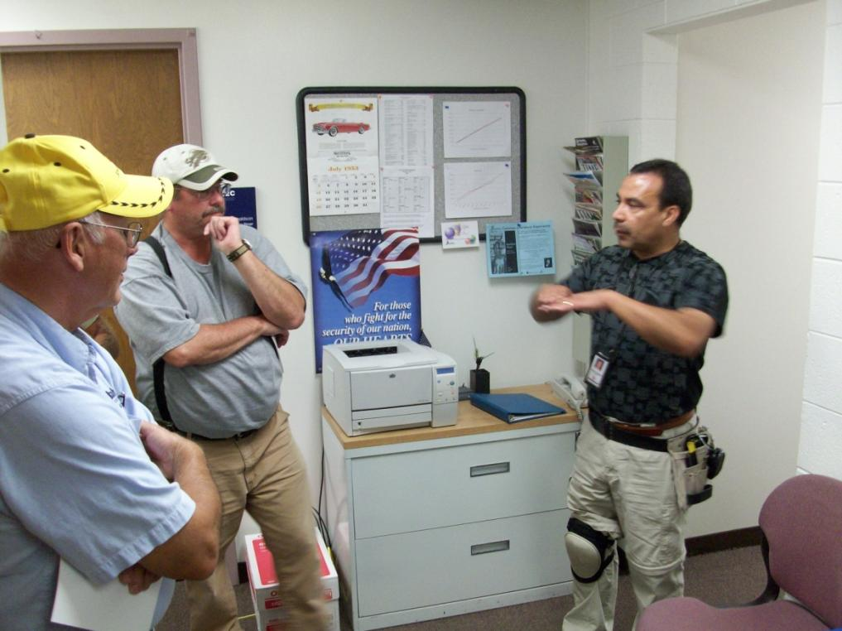
IPM Techniques
Improving sanitation
Habitat manipulation, eliminate pest conducive conditions.
Encouraging natural occurring biological control species
Select your pesticide
tools carefully
Pest proofing

Slide 19
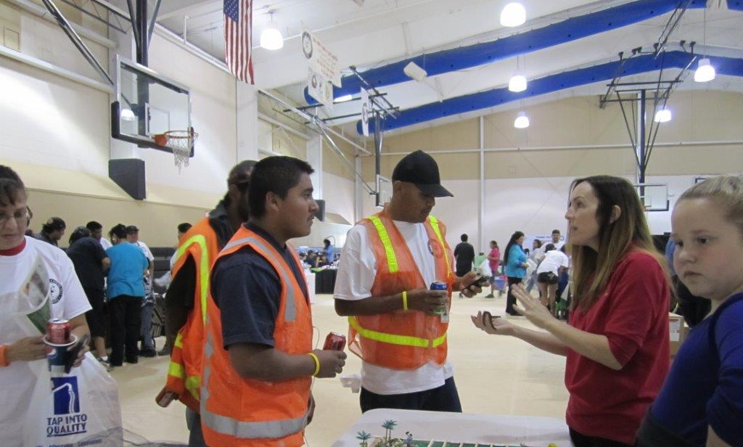
IPM Steps
Inspect for pests and pest conducive conditions
Monitor and engage community in reporting
Remediate problems in pest vulnerable areas
Be proactive and
discriminate between
options
Educate, communicate,
build partnerships.
Evaluate and reward

Slide 20
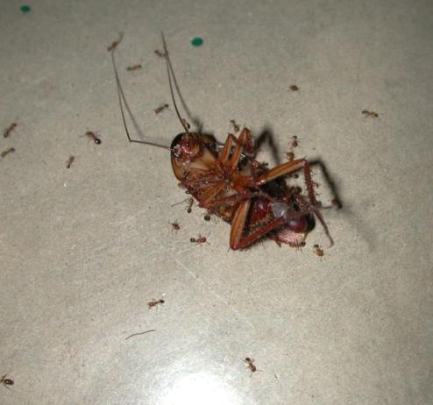
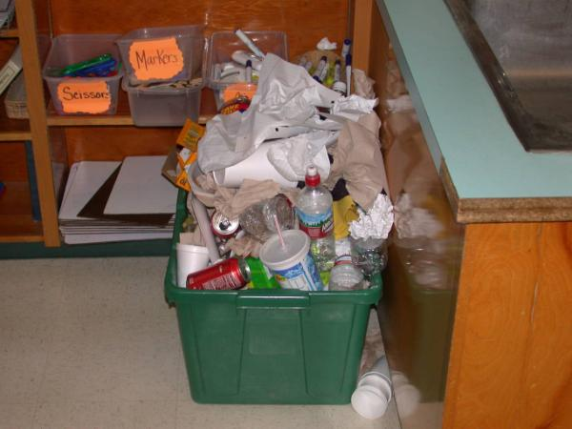
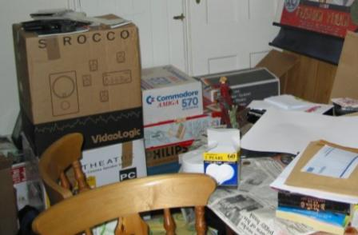
Basically,
Don’t attract pests
Keep them out
Get rid of them using the safest, most effective
methods
Notes:
Pest conducive conditions allow pests to thrive in our schools and homes

Slide 21
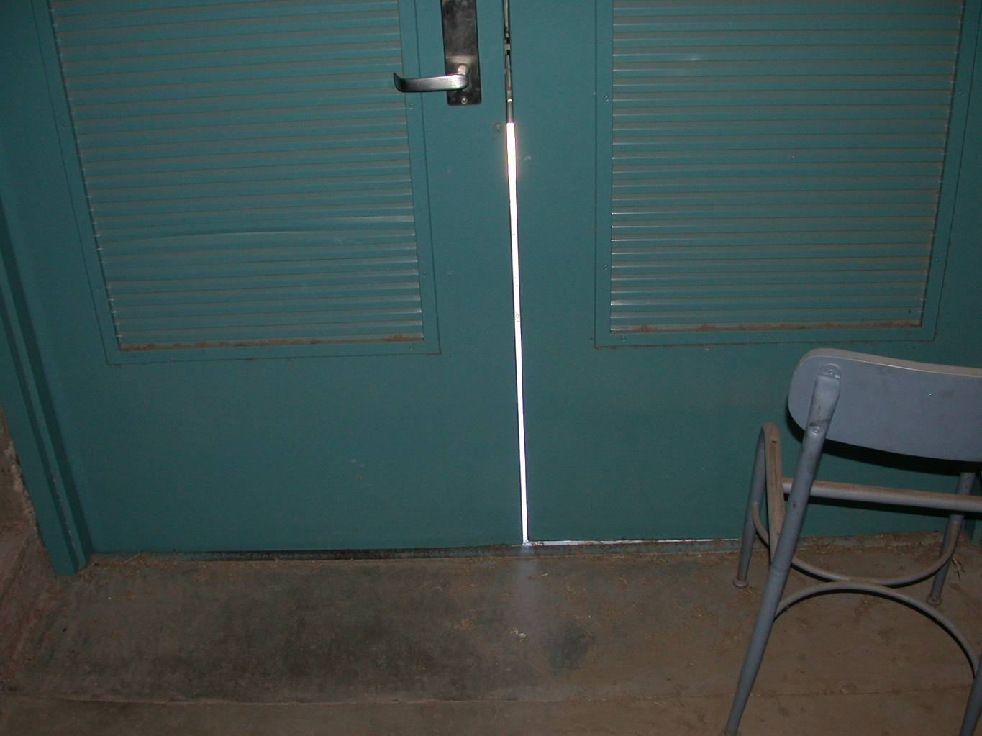
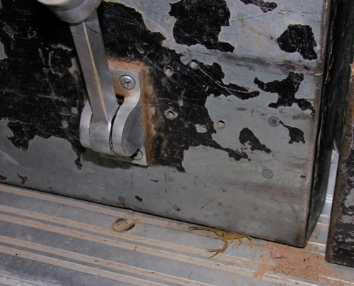
Pest Proofing Problems – this door is open to pests!

Slide 22

Waste Management – who has a party after the class party? …bugs!

Slide 23
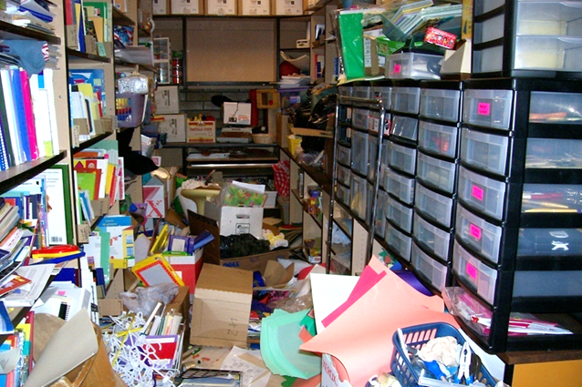
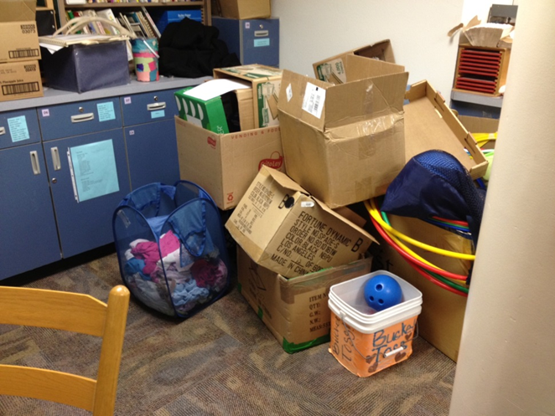
Evidence of Clutter Bugs – giving food and shelter to the enemy!

Slide 24
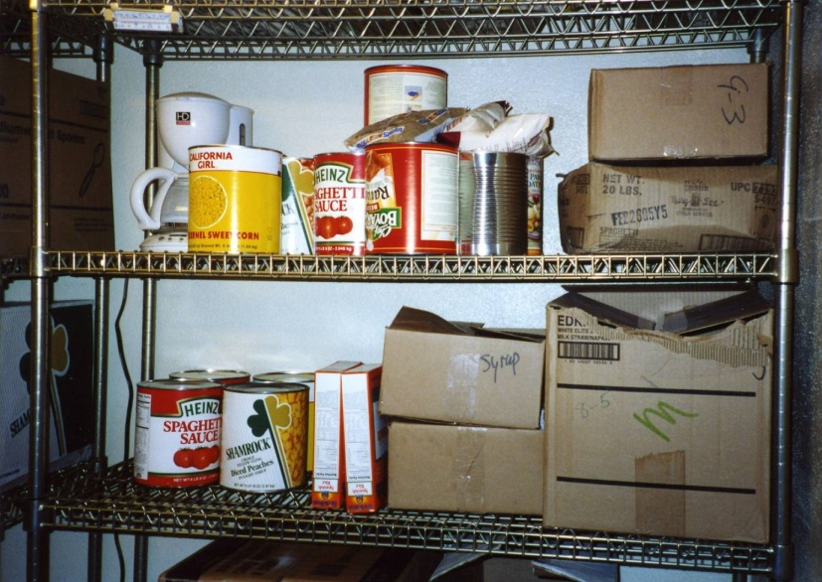
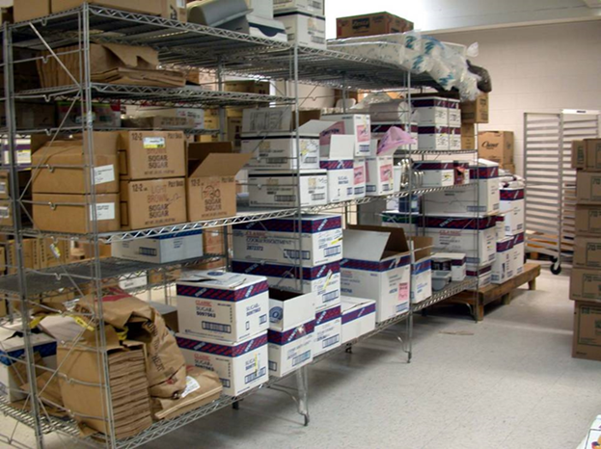
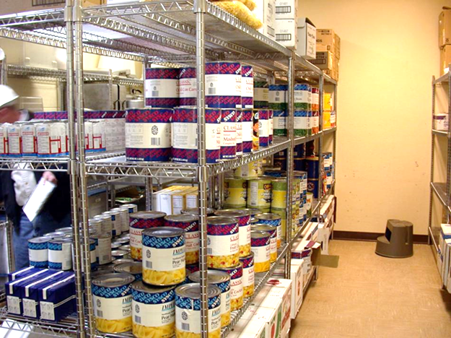
Food Storage: cardboard = cockroach condos

Slide 25
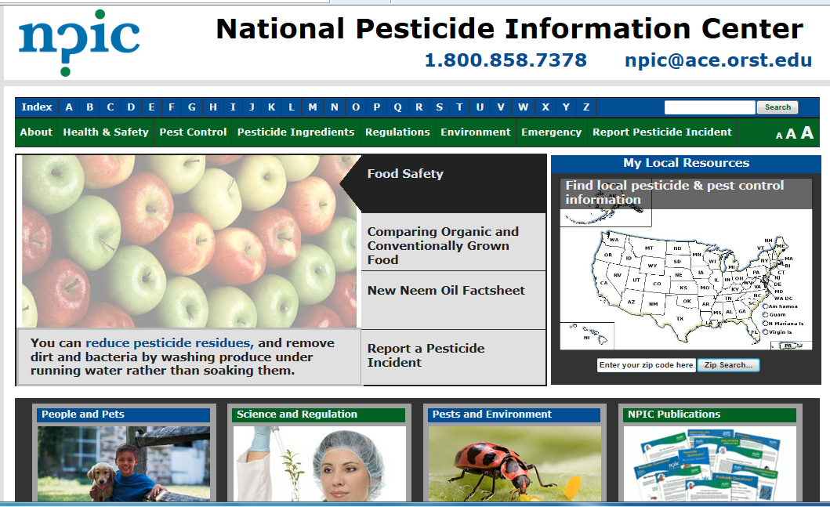
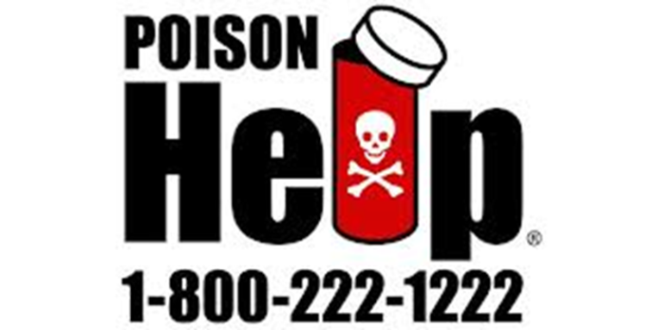
Pesticides are important tools, many can be used effectively and safely
http://npic.orst.edu/

Slide 26
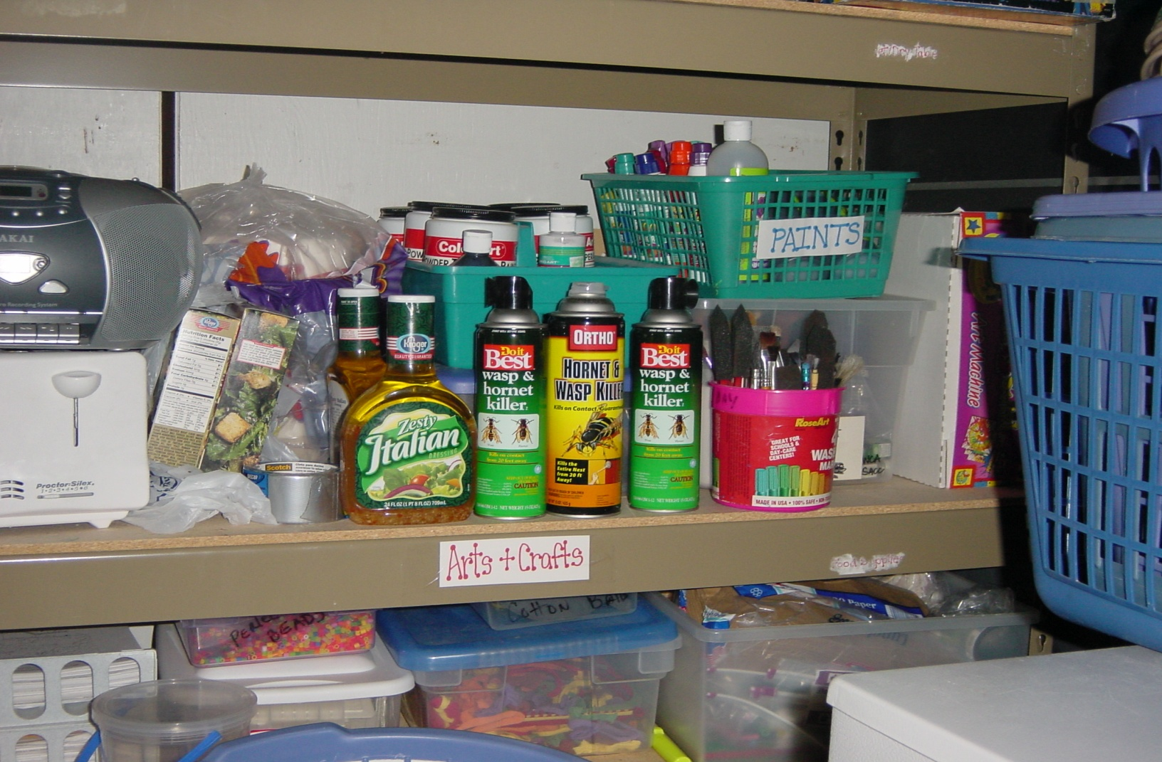
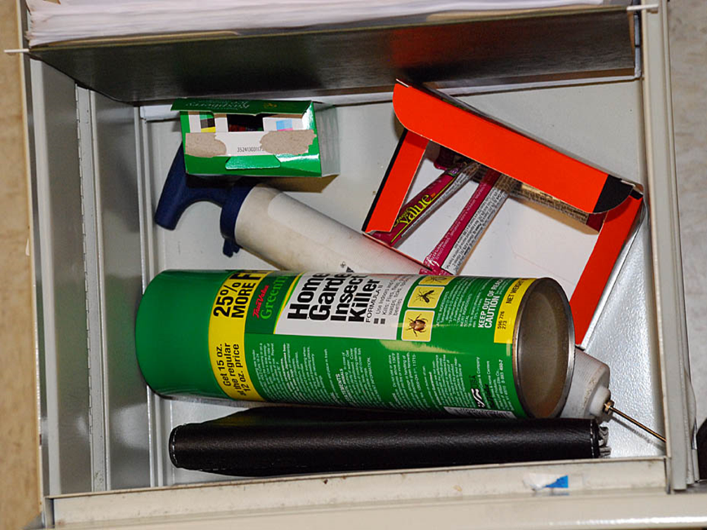
But Self Applied Pesticides are Completely Inappropriate!
Notes:
Make sure that the district does not feel defensive. We are not the pesticide police, facilitate compliance, don’t slap folk around. To become accepted community members we need to foster trust.
Mid-term and 1 year evals. You can take a tougher line but not on the initial inspection.
Suggest a pesticide amnesty opportunity, sending memos out for any and all pesticides to be turned in for appropriate disposal.

Slide 27

Teacher desk drawer

Slide 28
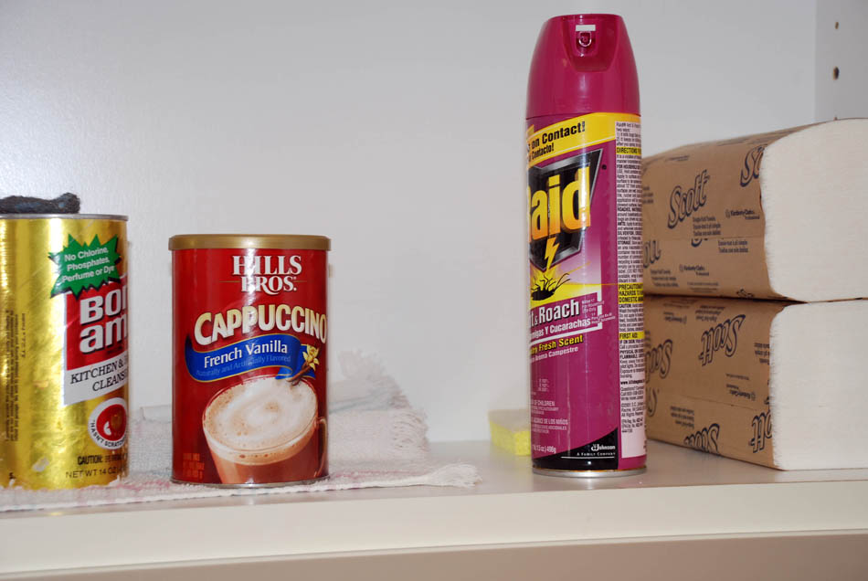
Kitchen cabinet

Slide 29
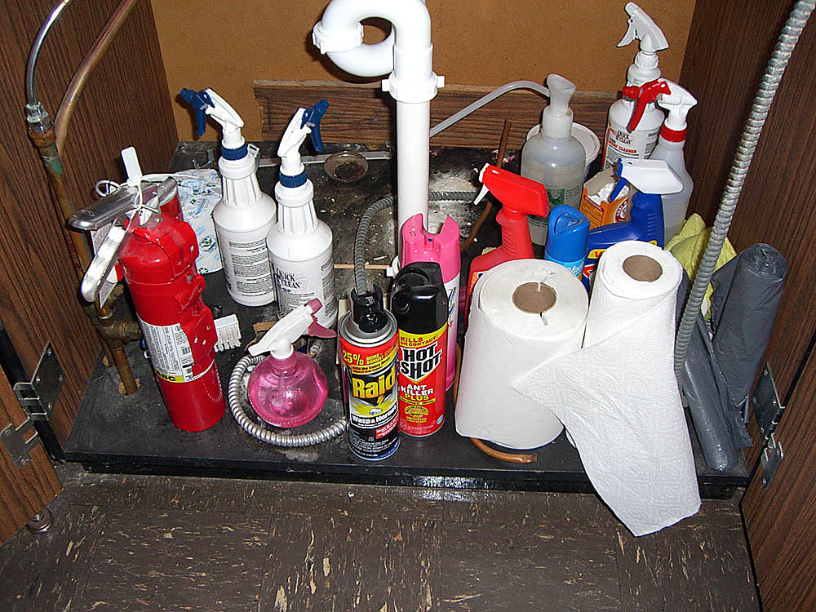
Child Accessible cabinet

Slide 30
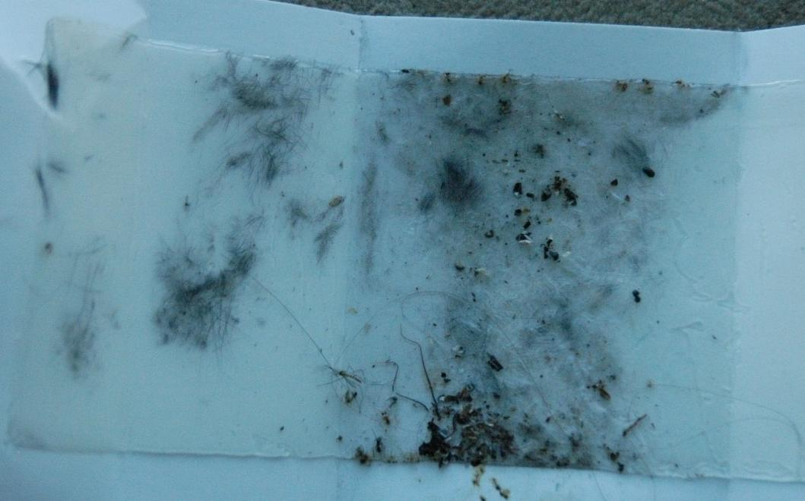
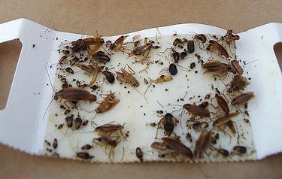
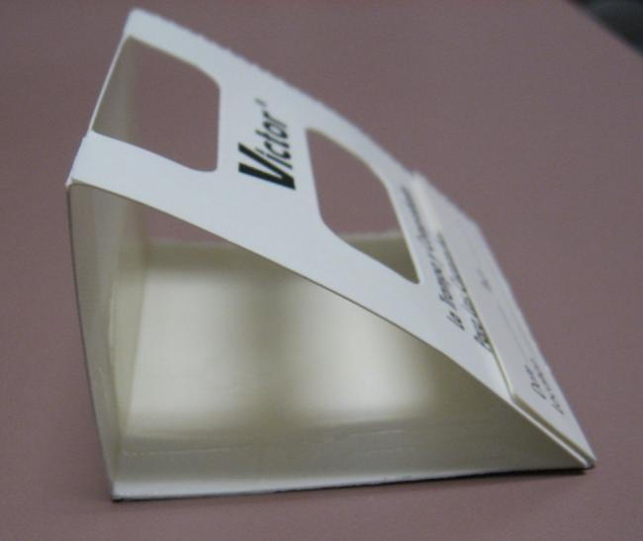
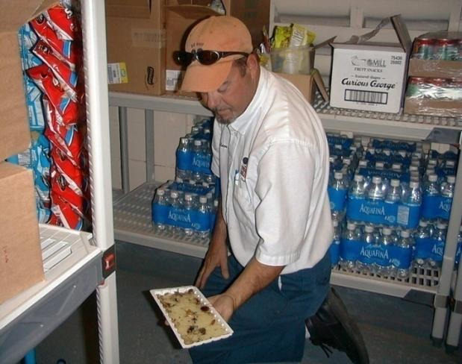
Don’t Look. Observe.
Monitor

Slide 31




Shock and Awe
Inspect

Slide 32



Sanitation

Slide 33


Identify

Slide 34



Slide 35

Couch retreats
Notes:
Several good housekeeping procedures help to reduce cockroach incidents in homes: Clean house regularly, remove pet foods from the floor at night, eliminate water sources and seal cracks around base boards.
Don’t give them anything to eat, they will go somewhere else to dine.

Slide 36


Weatherproofing
Notes:
Vents and air doors
Lights over door
Thresholds and poorly maintained weather stripping at the side of doors

Slide 37
Pest entryways

Slide 38

Dumpster placement

Slide 39

What is IPM?
Focuses on the fundamental reason why pests are a problem in the first place
IPM is proactive – monitoring and inspecting is constant
Pesticides are used only when necessary and not as a band aid

Slide 40

What IPM is NOT
An “out of sight, out of mind” contractual function
A no chemical pesticide option
A chemical pesticide program
A job description added to an unwilling or unqualified individual
A “low bid” process

Slide 41

Common Problems
No monitoring in PVAs.
No PMP hours with staff.
Excess pesticide use e.g. 143 applications for 3 schools in one year.
No ID e.g. “red ants” or “sugar ants”.
Poor knowledge e.g. mice have no bones.
OTC pesticides.
No communication with
or education of faculty
and staff.
Poor partnerships.
IPM costs more….

Slide 42
IPM must be compatible with current operations
Doing what you do now---just think pests!!!
  Security = monitoring
  Energy conservation = exclusion
  Sanitation = nothing to eat
  Clutter control = no place to live
Food Water Shelter
Notes:
Pests need the same things we need to survive, food, water and shelter.

Slide 43


Benefits of IPM
IPM is more effective and proactive
IPM is sustainable
IPM reduces risks
IPM is cost effective
Good environmental
health promotes
good health

Slide 44

Pest log

Slide 45



Fix It – Pest-proof It
Remediate

Slide 46




Prioritize PVAs

Slide 47

Monitor – early intervention = minimal chemical exposure, especially important in sensitive environments
Good sanitation
Eliminate harborage
Get rid of:
cockroaches, frass,
dead bodies,
allergens
Notes:
47

Slide 48





Look beyond and behind

Slide 49

Waste Management

Slide 50
HAZARD = Toxicity x Exposure
Use pesticides only when necessary & be selective when you choose a product
The risk of a pesticide contacting or entering the body
Risk; the potential for injury
The capacity of a pesticide to cause injury
Notes:
What’s the hazard or risk of a particular pesticide? In order to determine the hazard of any pesticide you must know two things – product toxicity and human exposure.
Toxicity is the capacity of a pesticide to cause injury either short- or long-term. Toxicity is a property of the pesticide itself.
Exposure is what happens when the pesticide comes in contact with the human body. How a pesticide is formulated can increase or decrease the risk of exposure which in turn changes the hazard.

Slide 51

The National Academy of Sciences 1993 landmark report
Pesticides in the Diets
of Infants and Children
estimates that
50%
of lifetime pesticide exposure occurs during the first five years of life…

Slide 52


Growing & Developing
Greater Metabolic Demands
Behavior Differences
Anatomic & Physiological Differences

Slide 53






CAUTION, WARNING, DANGER - Signal word
DE &
Pyrethrin
Abamectin
Strychnine
Alkaloid
Pyriproxyfen
Notes:
Signal words - The signal word for a pesticide is typically determined by the results of the six acute toxicity studies performed with the product formulation. The acute oral, dermal and inhalation studies evaluate systemic toxicity by those routes of entry. The primary eye and skin irritation studies measure irritation or corrosion, while the dermal sensitization study evaluates the potential for allergic contact dermatitis. With the exception of dermal sensitization, each acute study is assigned to a toxicity category based on the study results

Slide 54


Use pesticides with care!
http://homeinformationguru.com/wp-content/uploads/2012/10/poison_300_200.jpg
http://www.westernsafety.com/eaglemanufacturing/eaglepg3-pesticidecabinet.jpg
Notes:
Thank you very much for inviting us to your school district and giving us the opportunity to demonstrate IPM

Slide 55

Pest prevention is everyone’s job

Slide 56
IPM
Fact: the vast majority of pest management is achieved by food service, custodial, administrative and building maintenance professionals practicing IPM principles ….
NOT pesticide applications
SAFE
ENVIRONMENT
C
u
l
t
u
r
a
l
C
h
e
m
i
c
a
l
S
a
n
i
t
a
t
i
o
n
E
x
c
l
u
s
i
o
n
M
e
c
h
a
n
i
c
a
l
=
=
EDUCATION:
Inspection and monitoring, identification,
understanding pests, pest-proofing, etc.
Notes:
The Monroe IPM Model is a step-by- step program which facilitates the school district adopting IPM

Slide 57

Have a policy for each pest
  Response plan
  Thresholds
  Management protocols
  Communication protocols
Notes:
Pest vulnerable areas (PVAs)

Slide 58

When transitioning from a traditional monthly treatment service to an IPM program, costs usually decreased in the long-term.
Notes:
Which of the following statements is true?
Response
Pre test
Post test
Practicing good IPM standards typically increases liability issues for schools but the offset in pesticide use may ultimately reduce costs.
Training faculty and staff regarding IPM practices is the least important part of a school IPM program
Involving students and communicating IPM information to parents is not a benefit to the community because of the cost and time involved.
When transitioning from a traditional monthly treatment service to an IPM program, costs nearly always decrease
Which statement is true?
Response
Pre test
Post test
Practicing good IPM standards typically increases liability issues for schools but the offset in pesticide use may ultimately reduce costs.
Training faculty and staff regarding IPM practices is the least important part of a school IPM program
Involving students and communicating IPM information to parents is not a benefit to the community because of the cost and time involved.
When transitioning from a traditional monthly treatment service to an IPM program, costs nearly always decrease

Slide 59

IPM is a Process Not a Miracle
Don’t expect to have a perfect program overnight

Slide 60

Children are the most
vulnerable members of society, and
we are
the custodians of their world

